Slide 1
Why did the Governor announce new Covid restrictions yesterday?

Slide 2
On October 21st, we presented an update on the Covid spread
U.S Covid Hot Spot Map 10/21
U.S Covid Hot Spot Map 11/16

Slide 3
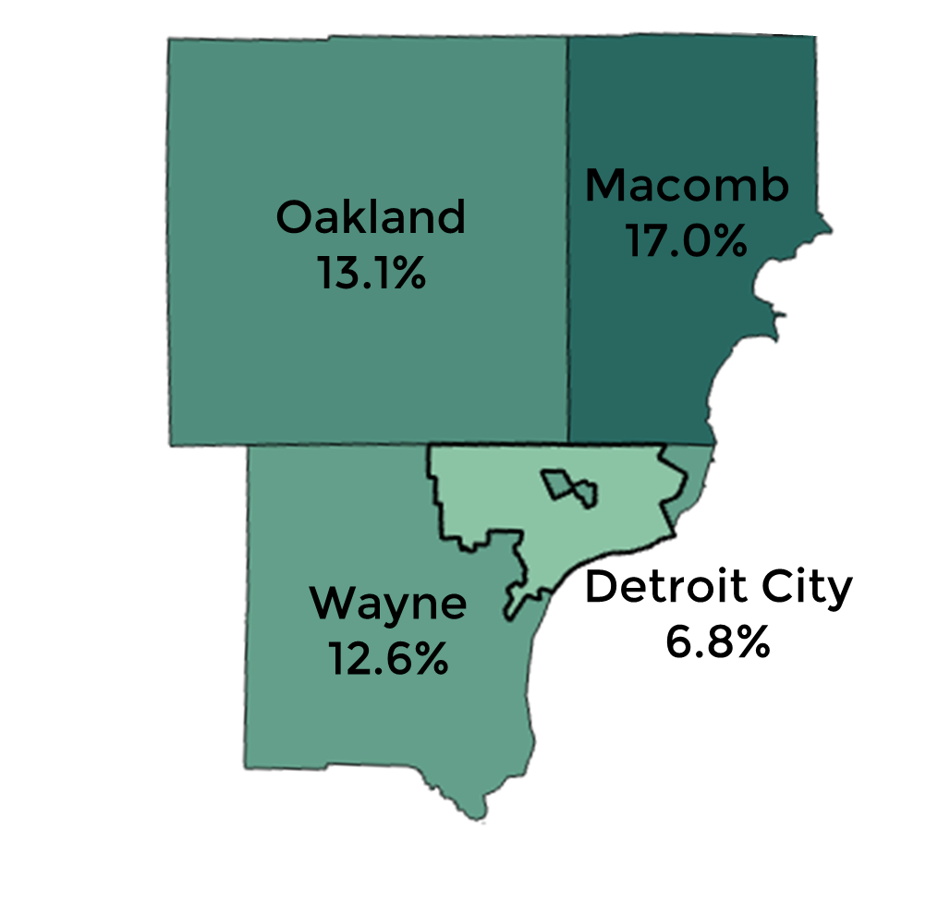
7 Day Positive Infection Rate in Southeast Michigan
City of Detroit businesses are being shut down because of irresponsible behavior in surrounding communities
Infection Rate 10/21
Infection Rate 11/16
Source: Mistartmap.info

Slide 4
On October 21st, we showed Detroit hospitalizations are increasing
Detroit Daily Covid Hospitalizations increased from 46 to 71 in two weeks

Slide 5
Today we have 145 patients hospitalized – doubling every 2-3 weeks
Very troubling trend since 1 out of 10 hospitalized die of Covid
11/15 - 146

Slide 6
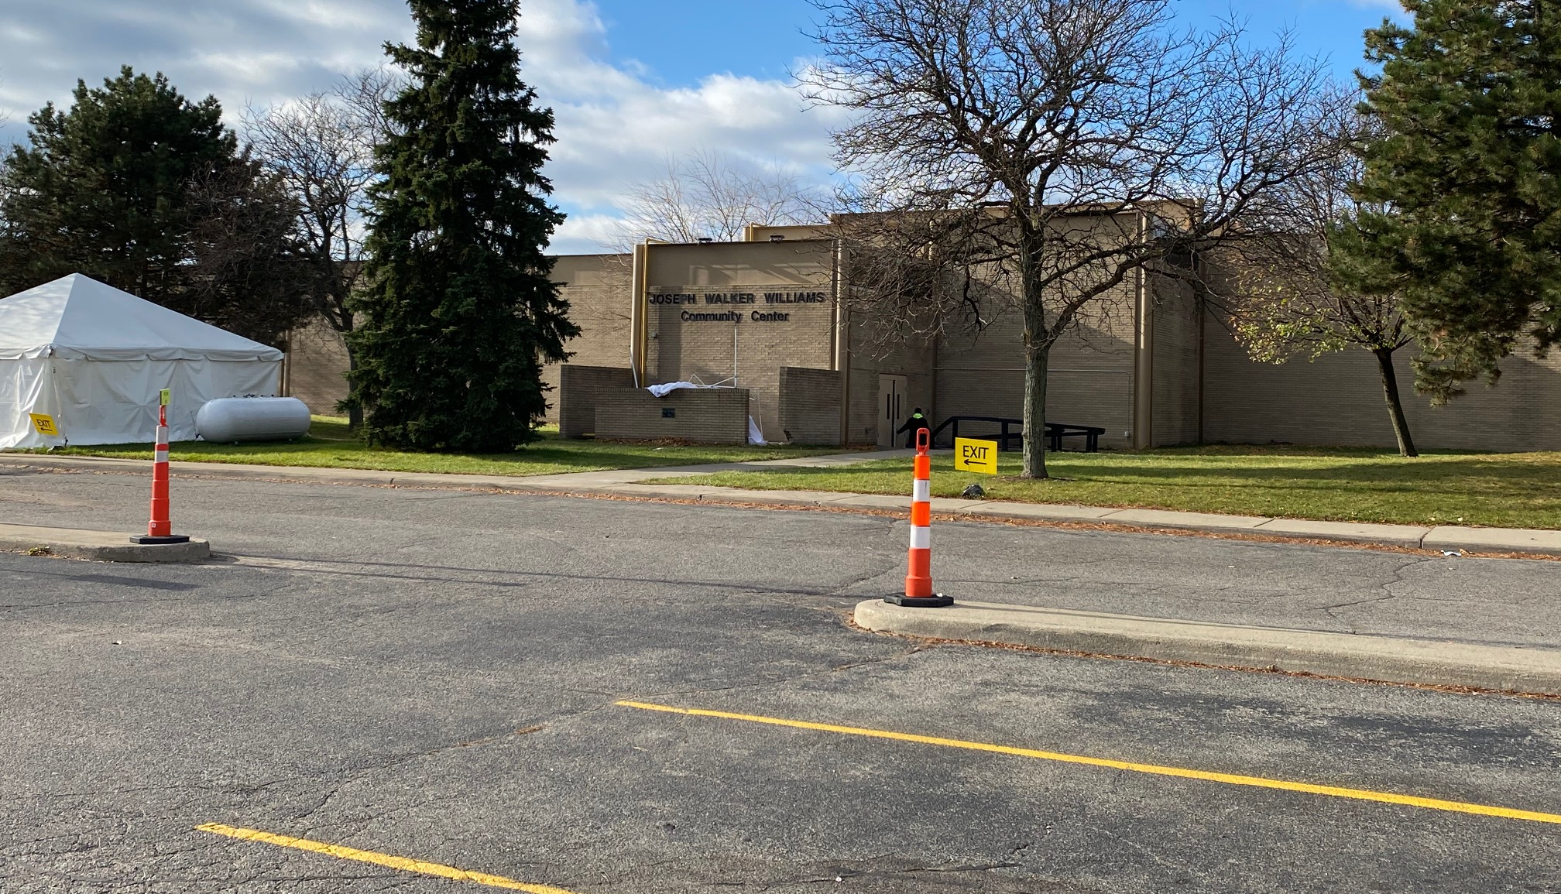
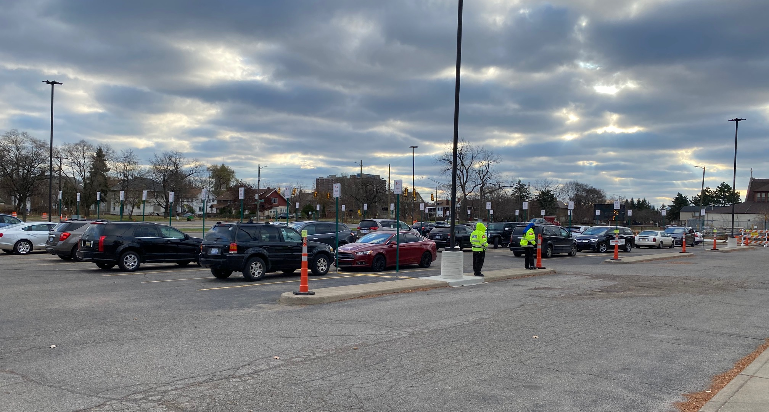
So what is the City going to do to continue to protect Detroiters?
Provide immediate testing to all Detroiters, regardless of insurance or prescriptions: 313-230-0505
Next day appointment
Results in 24-48 hours
Samples taken in car for those with symptoms or can’t make it inside
Testing done for others inside center
Williams Recreation Center
8431 Rosa Parks
Monday-Friday 9-5

Slide 7
Protecting Our Most Vulnerable
Detroit Health Department will test staff and residents at all Detroit nursing homes within next 2 weeks.
Detroit Health Department conducting frequent testing at all homeless shelters and warming centers. Those testing positive are transported to quarantine site for duration of their illness.
K-8 Schools will received unannounced Detroit Health Department visits - $200 fines assessed on staff found in non-compliance.

Slide 8
Safer at work – keeping our businesses safe
Business toolkit to help keep employees and customers safe can be found at detroitmeansbusiness.org
Health Department inspectors will issue $1,000 fines/ businesses risk possible shutdowns

Slide 9
You can help – report businesses not masking up
Report violations on our homepage

Slide 10
What if you’ve been in close contact with someone who tests positive?
Exposure risk normally means you’ve been
within 6 feet of someone for 15 minutes or more
If you have been exposed:
Stay Home for 14 days after exposure
Social distance from other in your home, wear mask
Getting a test:
If you have symptoms, get tested immediately
If you don’t have symptoms, get tested 5-7 days after exposure (30% of cases show no symptoms)

Slide 11
Re-Imagine the Holidays
No more than 10 family members from 2 separate homes
Celebrate virtually via ZOOM
Have fun with those living in your home – avoid large gatherings
Create new traditions

