Slide 1
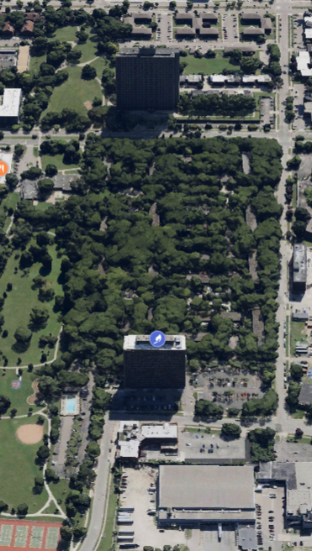
Lafayette Park Revised Plan for Energy System Improvement

Slide 2
Revised Plan to Provide Heat for 600 Lafayette Park Residents
First, the company spared no expense to make this project safe. Detroit Thermal could have simply reenergized the existing steam line but instead decided to insert new sleeved piping in some sections of the line and make other improvements in the interest of safety and reliability.
Second, as a neighbor of Lafayette Park, Detroit Thermal knows and respects the compelling history of the community and will do nothing to undermine it.
Finally, Detroit Thermal asks those concerned by this utility upgrade to respect the needs and wishes of their neighbors at 1300 Lafayette – some 600 people who want and need the affordable, clean energy that will be safely brought into their homes.

Slide 3
Lafayette Park Timeline Regarding the Project
Lafayette Park Timeline Regarding the Project
Jul 2024:
Feb 2025:
May 2025:
1300 Lafayette East Cooperative engages Detroit Thermal to explore the option of reconnecting to District Energy
MPSC issues order approving contract with a finding that it is in the public interest
On 5/7/25: City of Detroit scheduled and met with Detroit Thermal and all 5 Co-op Board Representatives
On 5/14/25: Detroit Thermal presents to the Detroit Historic Commission
Mar 2025:
Sep-Oct 2024:
June 2025:
Agreement signed with 1300 East Cooperative and Detroit Thermal to move forward.
Detroit Thermal requested another meeting with the Lafayette Park Co-ops to be coordinated by KC Properties
Detroit Thermal Initiates and Exploratory restoration
On 9/12/24: Detroit Thermal conducts a walk-through with KC Property Management and 20-30 residents
Three areas determined to be evaluated via annual permit:
2 authorizing work in the rights-of-way (Joliet parking lot and Nicolet parking lot)
1 authorizing work in an easement but not right-way (playground area)
6/12/25: Detroit Thermal submits supplemental information requested by HDC
6/24/25: Detroit Thermal scheduled meeting with meet with all 5 Co-op Board Representatives
Apr 2025:
June 2025:
Detroit Thermal initiates the permitting process with the City’s Legal and DPW
Detroit Thermal secures the DPW permit
Residential Concerns re safety and Historic District Commission permissions were expressed
The city issues a stop-work order
6/12/25: Detroit Thermal submits supplemental information requested by HDC
6/24/25: City of Detroit scheduled meeting with Detroit Thermal and all 5 Co-op Board Representatives
Jan 2025:
Detroit Thermal files application filed with the Michigan Public Service Commission (MPSC) for approval of contract

Slide 4
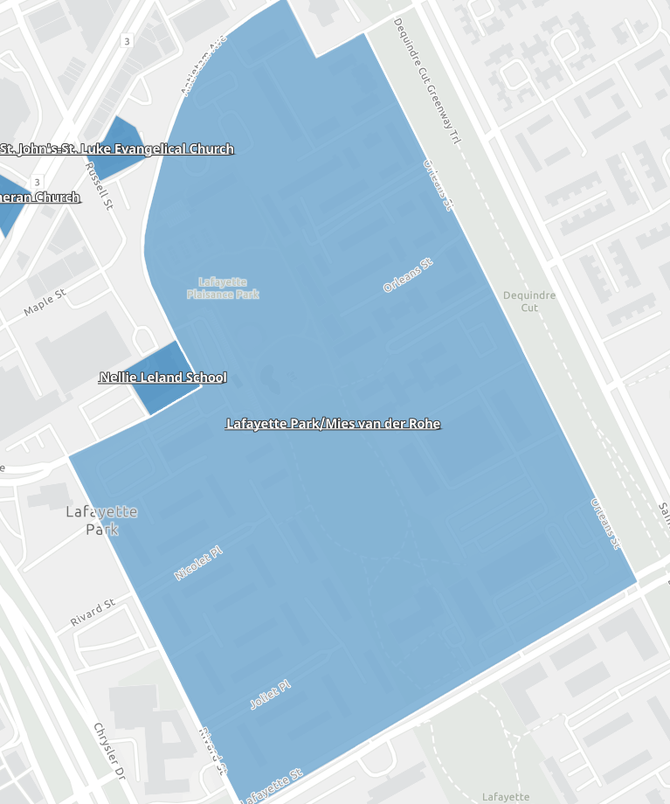
Impact in Lafayette Park Historic District
The Lafayette Park/Mies van der Rohe Historic District is 46 acres which encompass 13 acres of greenery which contain tens of thousands of plants.
The red arrows point to the areas of construction in the Lafayette Park Historic District to provide heat to 600 residents in 1300 East Lafayette.
The construction area will impact up to 7 wooded plants within the Lafayette Park/Mies van der Rohe Historic District.

Slide 5
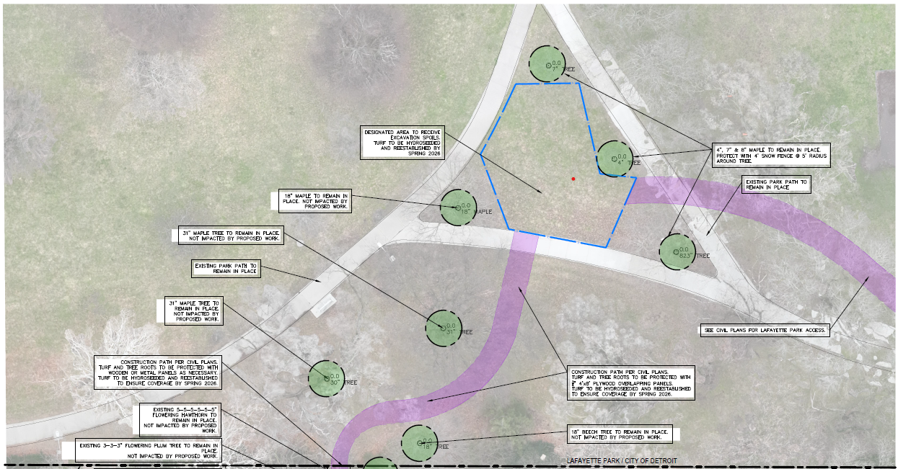
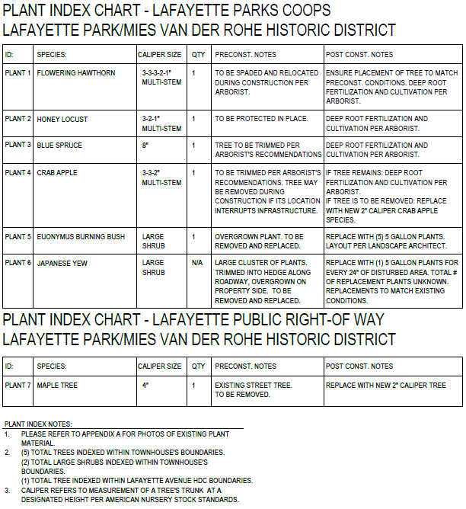
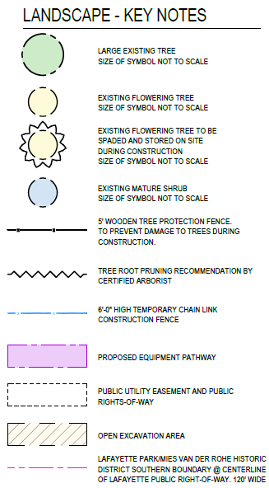
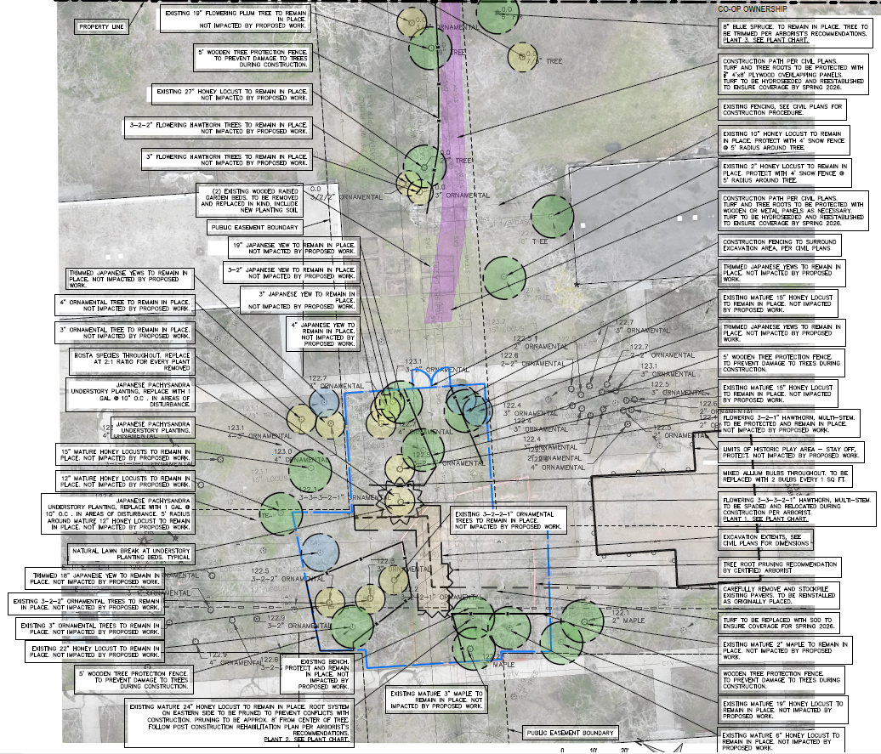
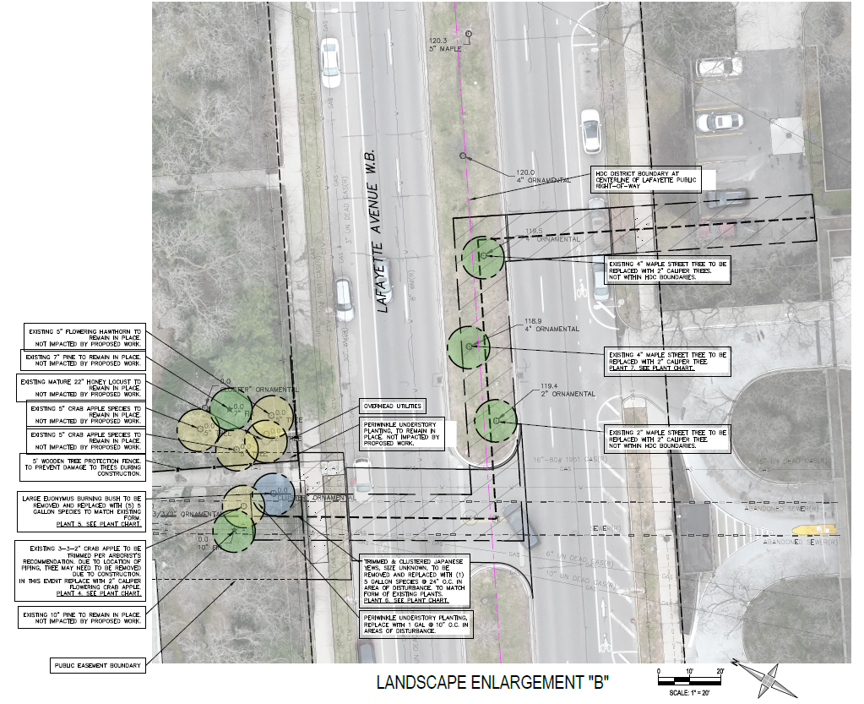
HDC Information Request
Finer detail about existing landscaping around the excavation sites and the access routes to those excavation locations, including identification of all locations of vegetation.
Detroit Thermal has surveyed the site with their professional land surveyor, landscape architect and certified arborist. All plant material adjacent to the proposed excavations, along the access routes and at the layout down area have been located and memorialized on the provided plan set.

Slide 6
Finer detail about existing landscaping around the excavation sites and the access routes to those excavation locations, including identification of all locations of vegetation.
HDC Information Request
2
3
1
4
Detroit Thermal has surveyed the site with their professional land surveyor, landscape architect and certified arborist. All plant material adjacent to the proposed excavations, along the access routes and at the layout down area have been located and memorialized on the provided plan set.

Slide 7
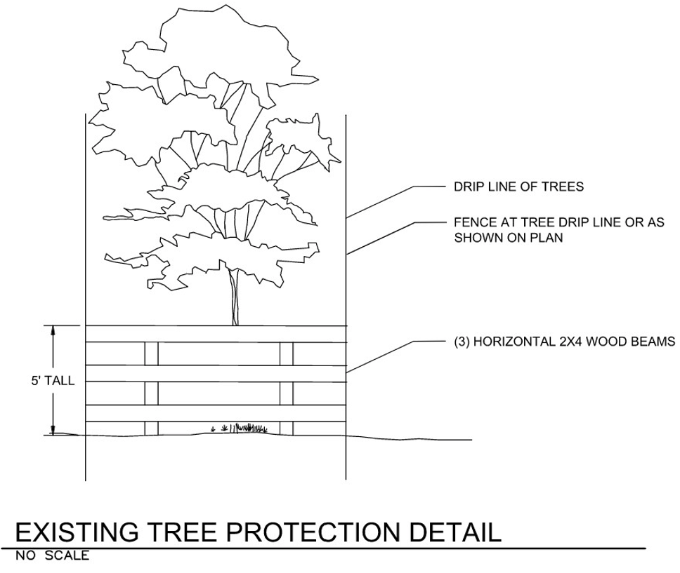
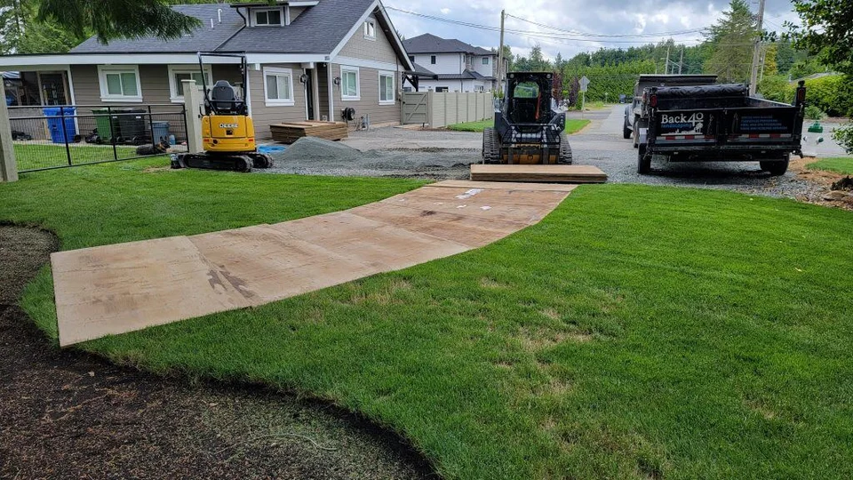
HDC Information Request
Information about possible steps that could be taken to protect the landscape.
Temporary 4’x8’ plywood ground protection will be installed a key locations of the access route adjacent to tree roots within their drip line. This is a light weight, low impact solution to disperse construction equipment loading on the soil and reduce compaction.
A combination of snow fence and wooden tree protection fencing will be installed to keep construction equipment away from plant material adjacent to the exaction sites. These specific locations are identified on the plans set.

Slide 8
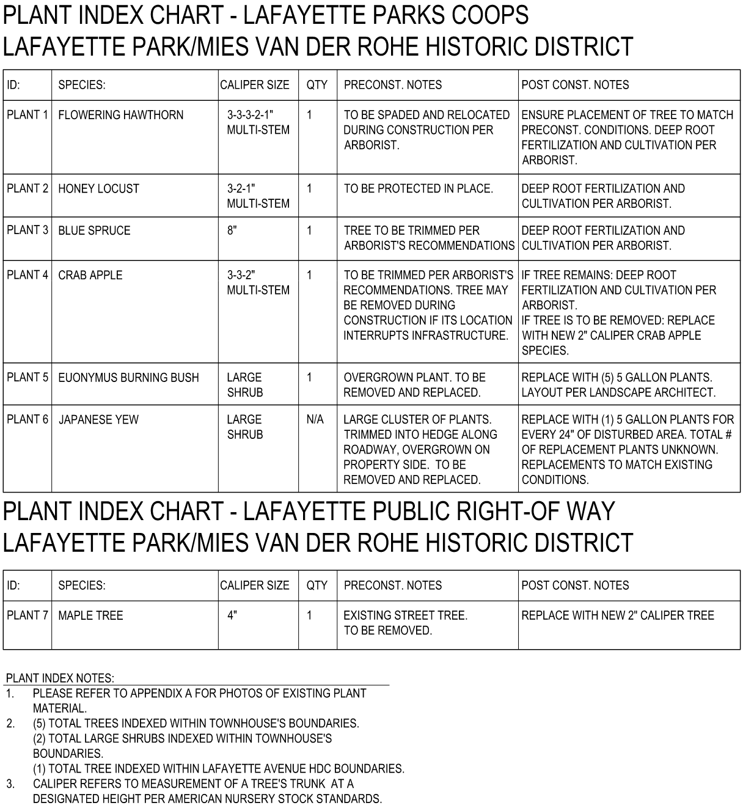
HDC Information Request
Clearer definition of what landscape might be impacted and steps to mitigate impact.
All seven (7) of the woody plants to be impacted is identified on the plan set, each is given a number designation. Each plant is then further described along with the landscape architect and arborist’s recommended preconstruction and post construction activities.
Impacted ground cover, other than standard turf grass, is identified on the plans and replacement direction is provided if impacted by the construction.

Slide 9
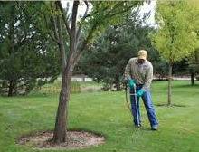
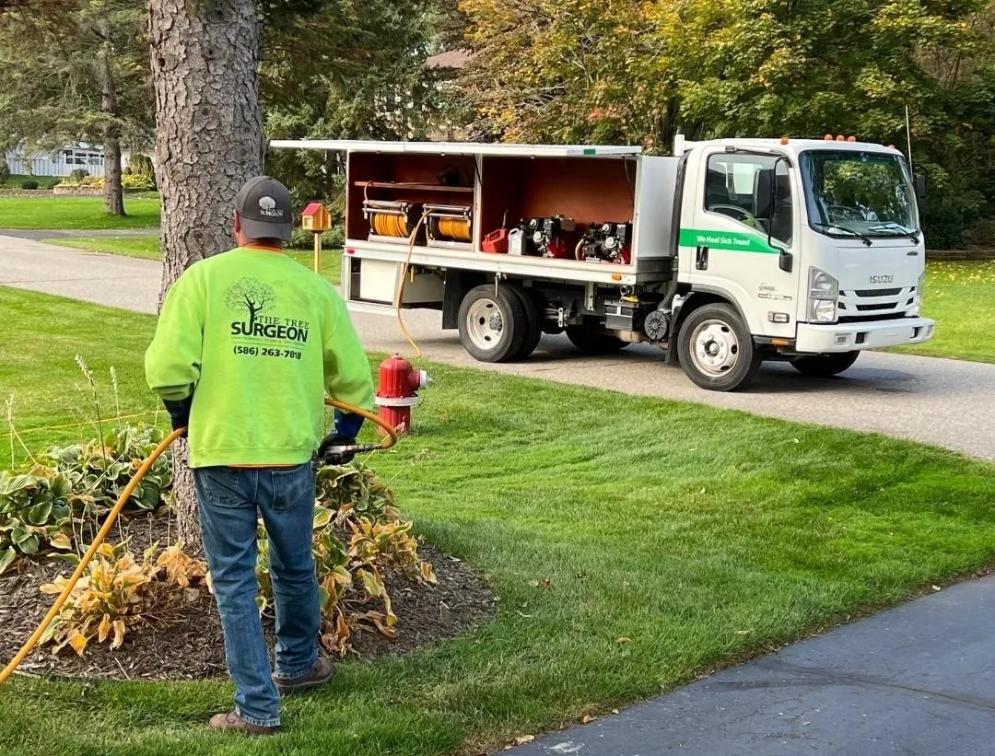
HDC Information Request
Steps about what can be done to remediate landscape damage.
The best way to reduce the impacts to the landscape material is to complete the protection measures and controlled preconstruction pruning from the previous sections.
Follow the construction and restoration, the certified arborist will inspect the relocated and pruned trees and perform deep root fertilization. This feeding will support recovery and promote healthy regrowth. This will occur this fall, post construction and next fall in 2026 to ensure continued recovery, health and long-term resilience.

Slide 10
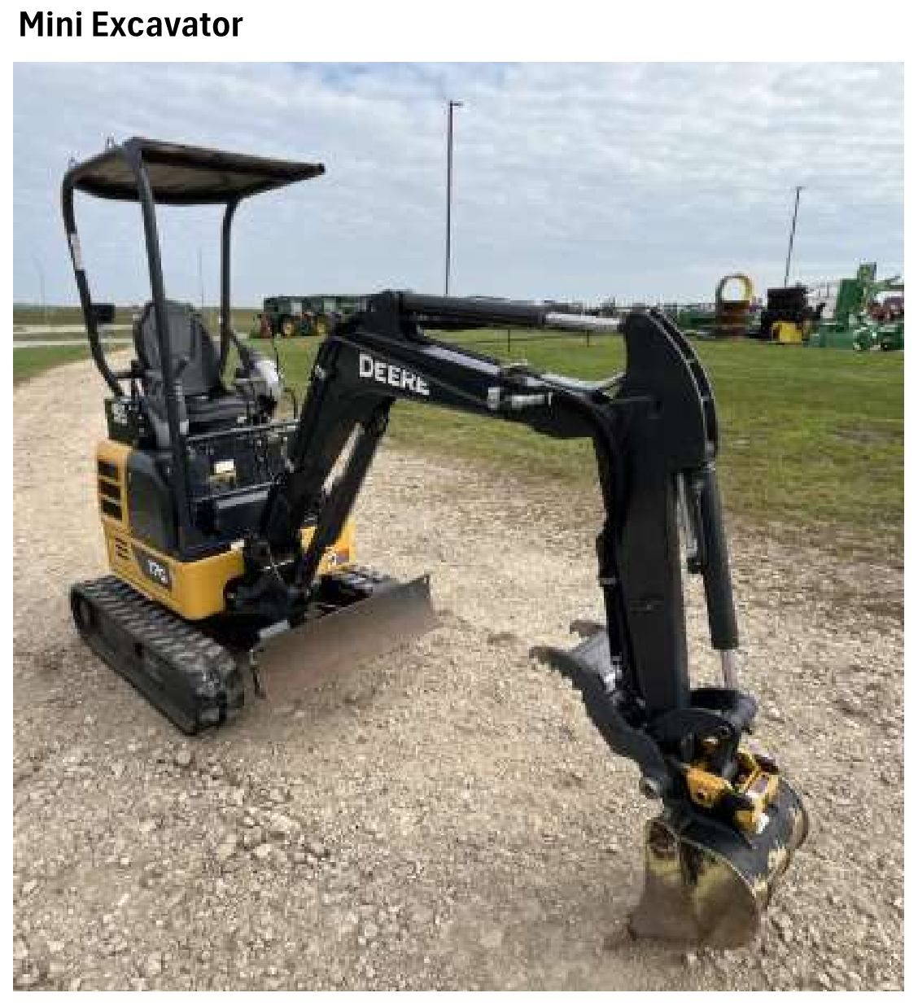
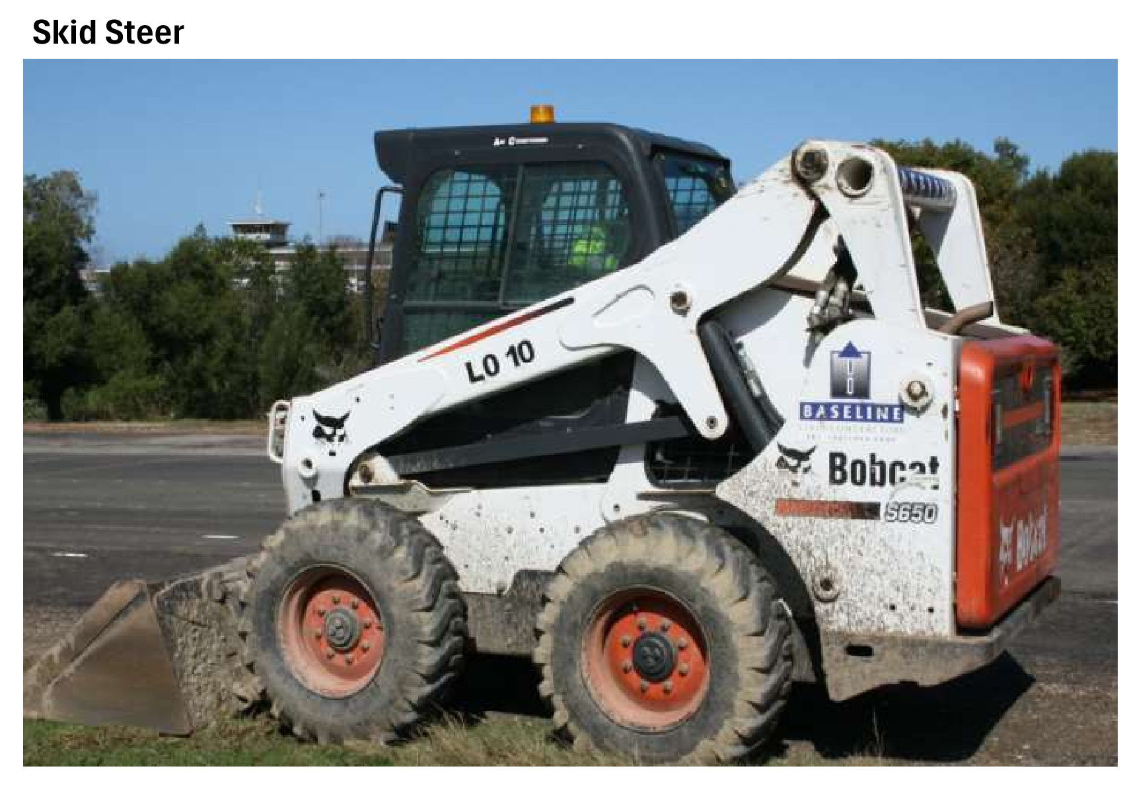
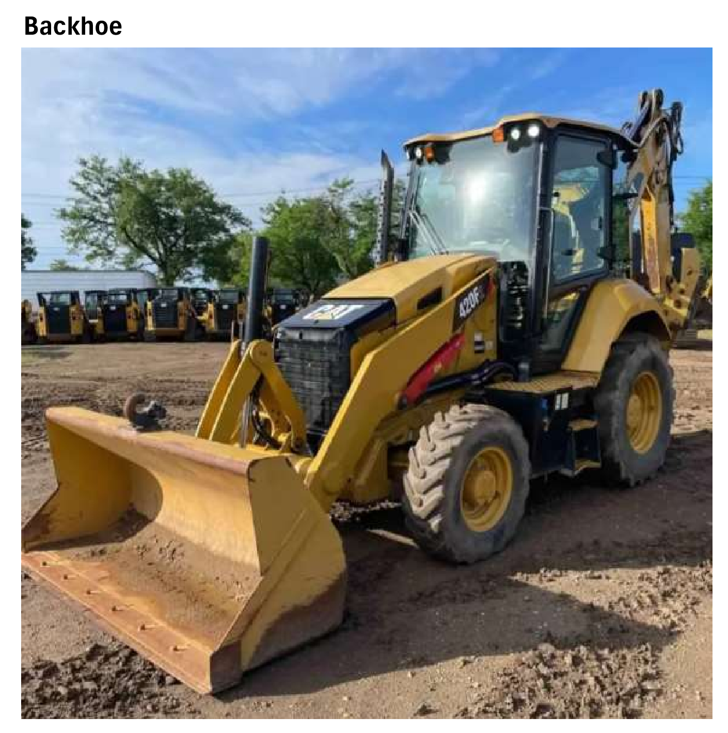
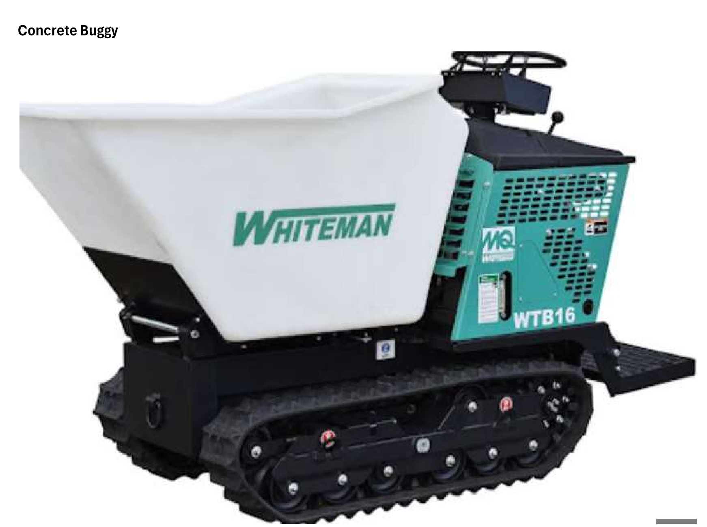
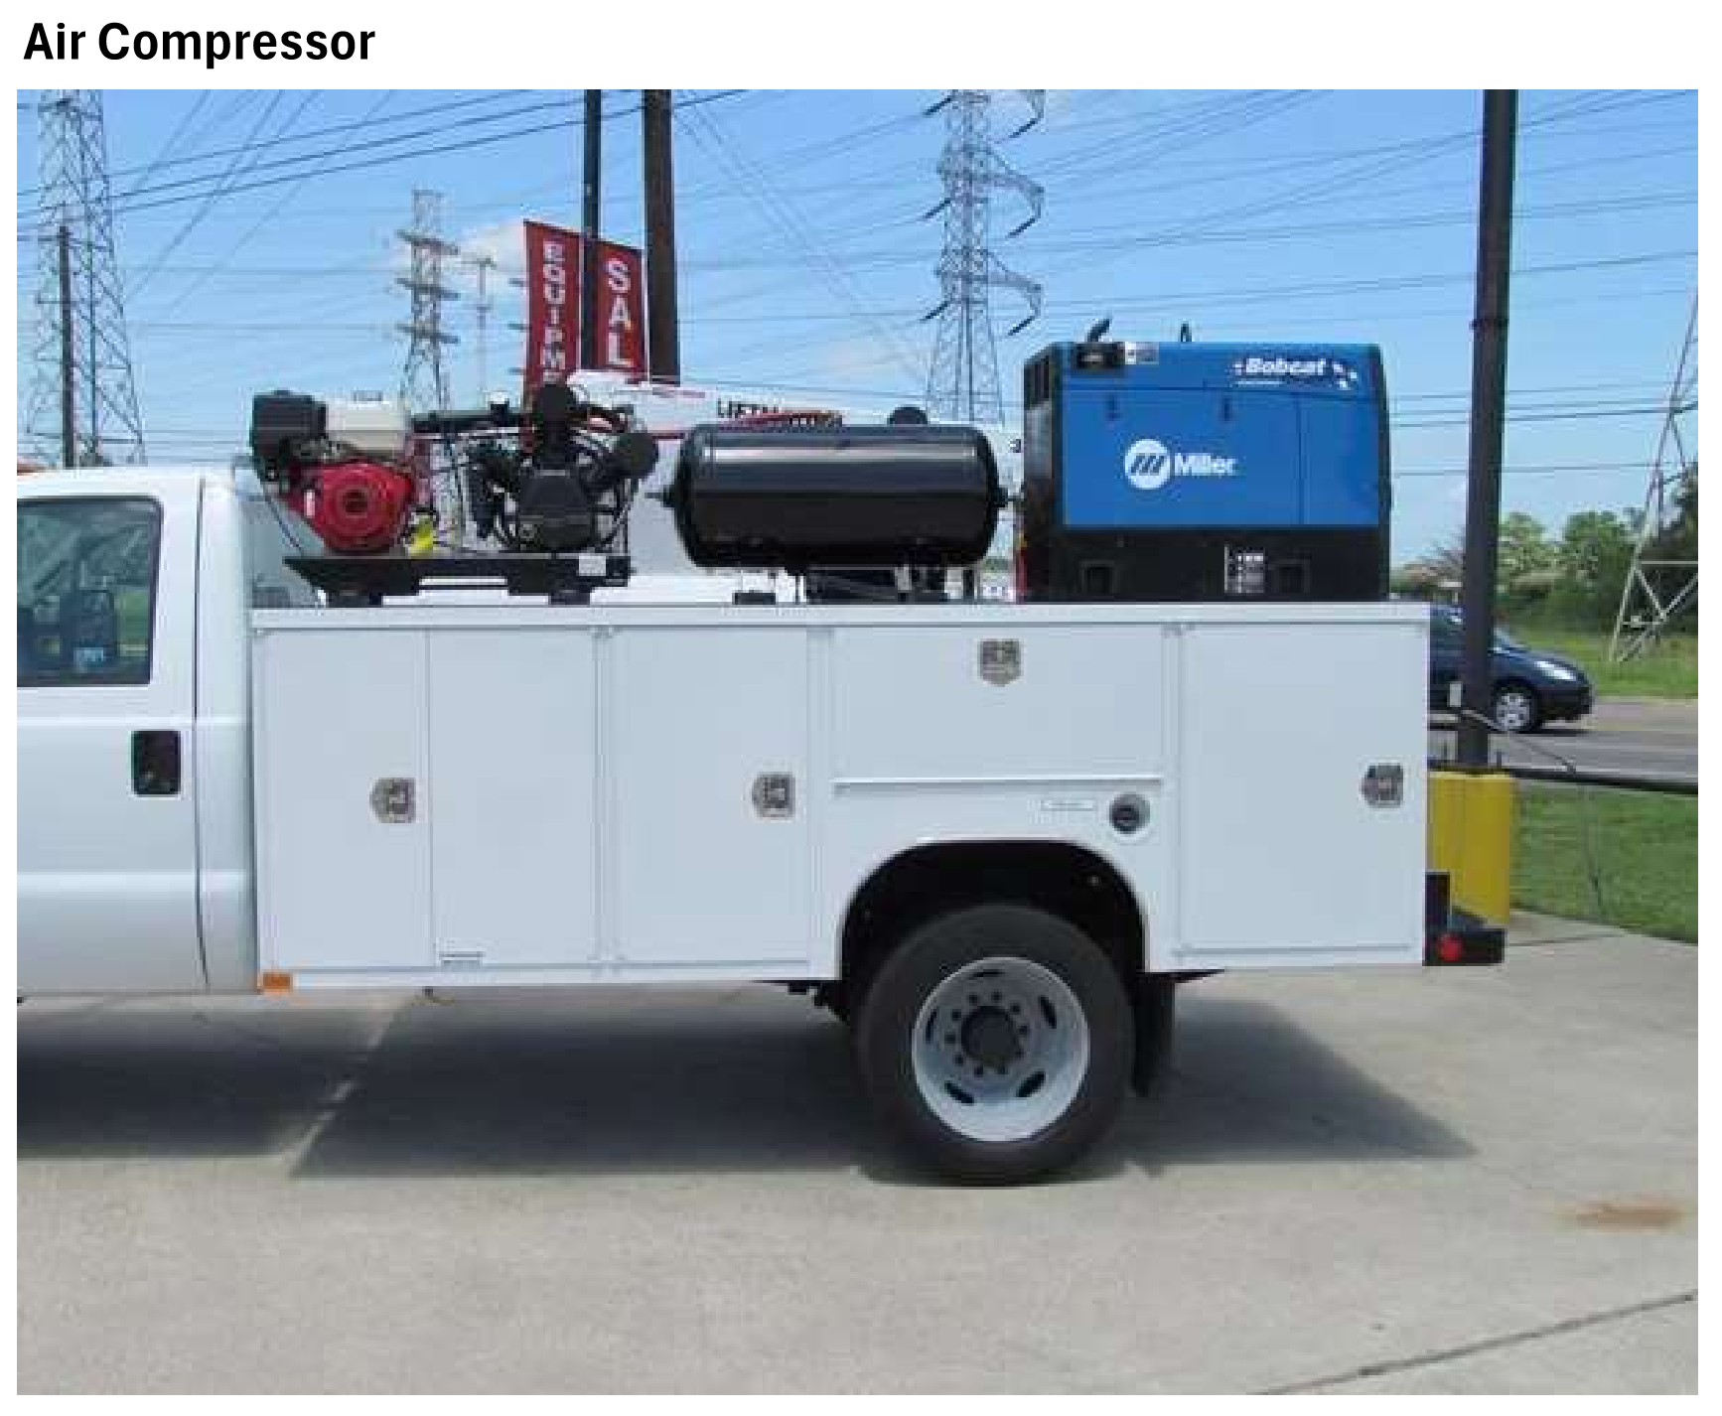
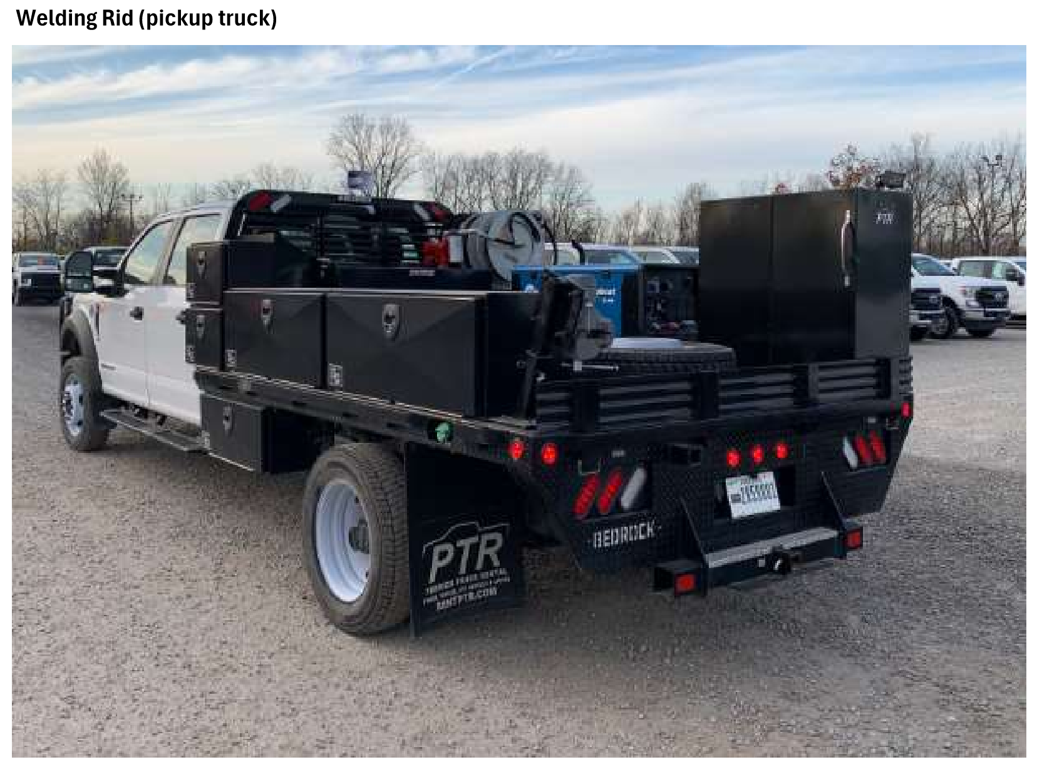
HDC Information Request
Excavation techniques.
The excavation within the landscaped easement area of the vacated Russel and Macomb will be completed with the small equipment, using a mini excavator, skid steer, backhoe, concrete buggy and pick-up trucks.
Welding Rig (pickup truck)

Slide 11
HDC Information Request
Details on how trees will be protected.
As described in Section II, Protection measures will be provided for the trees and the soil.
Plant material that is to remain but could be impacted by the excavation or access to sites will be pruned to provide controlled arborist led impacts to the trees. This includes above grade limb pruning and below grade root pruning both identified, specifically in the plans. Below are some advantages of root pruning.
Healthy Root System: Root pruning stimulates the development of a compact and robust root system. By trimming unnecessary or circling roots, the tree focuses on cultivating healthier roots that provide enhanced anchorage, water, and nutrient access.
Reduced Tree Stress: During transplantation or construction activities, root pruning alleviates stress on the tree, increasing its chances of survival and successful establishment.

Slide 12
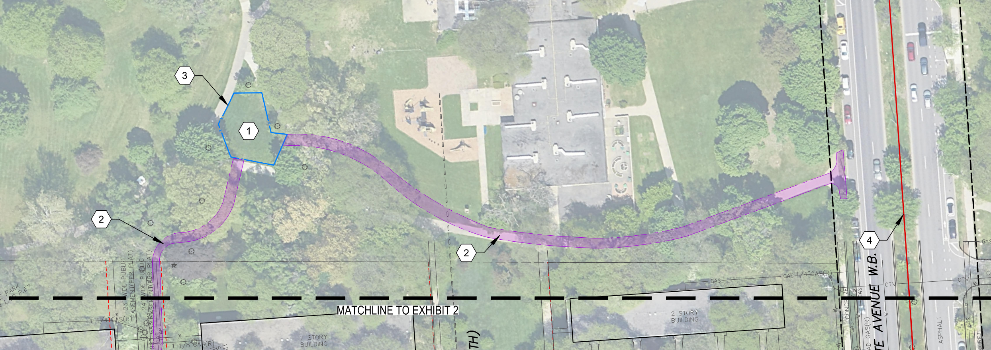
HDC Information Request
Proposed equipment staging locations and approach.
The area of the vacated Macomb and Russell Streets, north of the play area, will be accessed via the Lafayette Plaisance Park off Lafayette Ave., see callout 2.
The area for staging, laydown and the stockpiling of material will also be in the park, see call out 1, and will be secured with a 6ft. tall construction fence, see callout 3.

Slide 13
HDC Information Request
Proposed equipment staging locations and approach.
The area of the vacated Macomb and Russell Streets, north of the play area, will be accessed via the Lafayette Plaisance Park off Lafayette Ave., see callout 2.
The area for staging, laydown and the stockpiling of material will also be in the park, see call out 1, and will be secured with a 6ft. tall construction fence, see callout 3.

Slide 14
HDC Information Request
Environmental impacts of steam on tree canopy.
The Nicolet Public Right-of-Way parking area stack has been removed from the proposed plan in response to residents’ aesthetic concerns. A standard, on grade, Detroit Thermal cast iron manhole frame and cover are proposed for the existing manhole structure 1254.
The Joliet Public Right-of-Way parking area stack has been removed from the proposed plan in response to residents’ aesthetic concerns. A standard, on grade, Detroit Thermal cast iron manhole frame and cover are proposed for the existing manhole structure 1268.

Slide 15
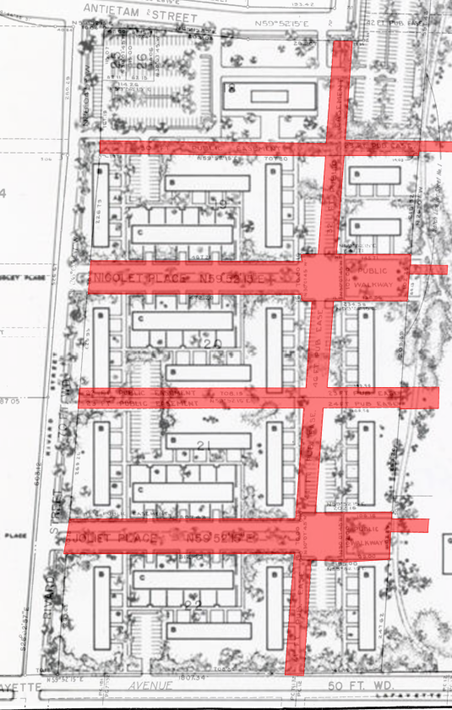
HDC Information Request
Potential landscape experts to help Commission better understand how roots and replanting and future work down the line could impact the landscape.
An ISA Certified Arborist, Dave Scherer, has been brought on for the project to support and provide the incorporated comprehensive tree protection and mitigation plan aimed to minimize impacts and promote the long-term health to the adjacent trees and woody plants. See the provided letter dated June 11, 2025.
There exists many utilities within the formerly vacated Rights-of-Way, now public utility easements. The original layout of the townhouses was coordinated very closely with the existing utilities and vacated Rights-of-Way, see adjacent plan. The existing utilities include Detroit Thermal, DTE electric and gas, DWSD combined sewer and water main, and data/communications. With this proposed construction completed, Detroit Thermal does not anticipate additional excavation within the easement in the foreseeable future.

Slide 16
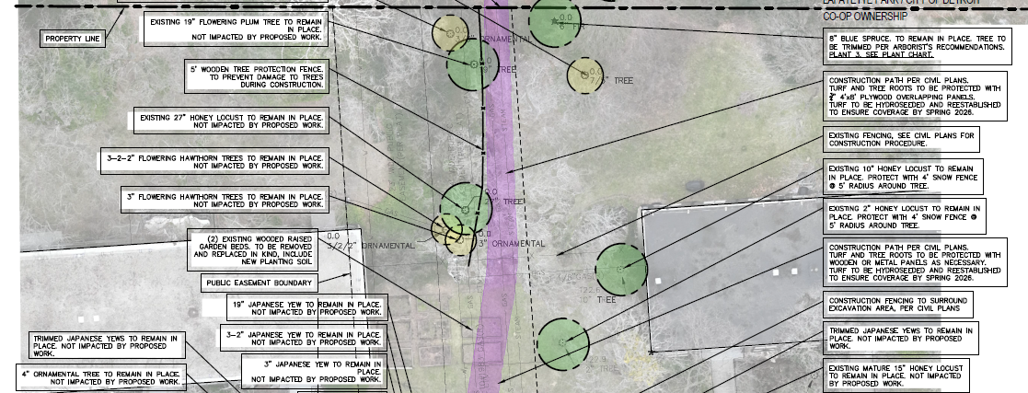
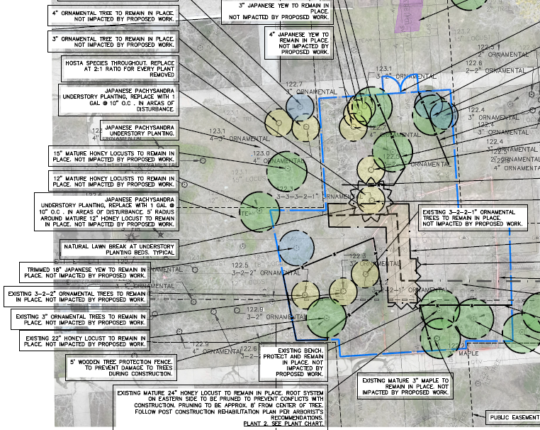
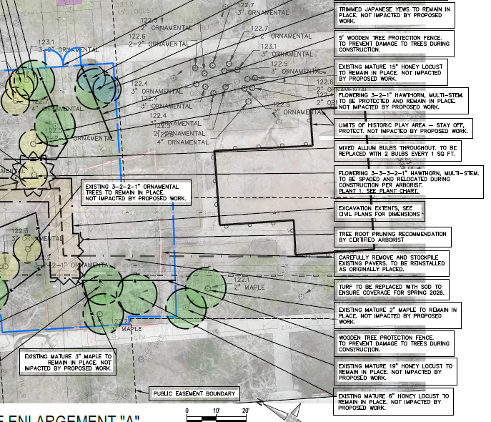
Excavation in Russell-Macomb Easement

Slide 17
Excavation in Russell-Macomb Easement

Slide 18
Excavation in Russell-Macomb Easement

Slide 19
Excavation in Russell-Macomb Easement
3
2
1

Slide 20
Excavation in Russell-Macomb Easement
3
2
1

Slide 21
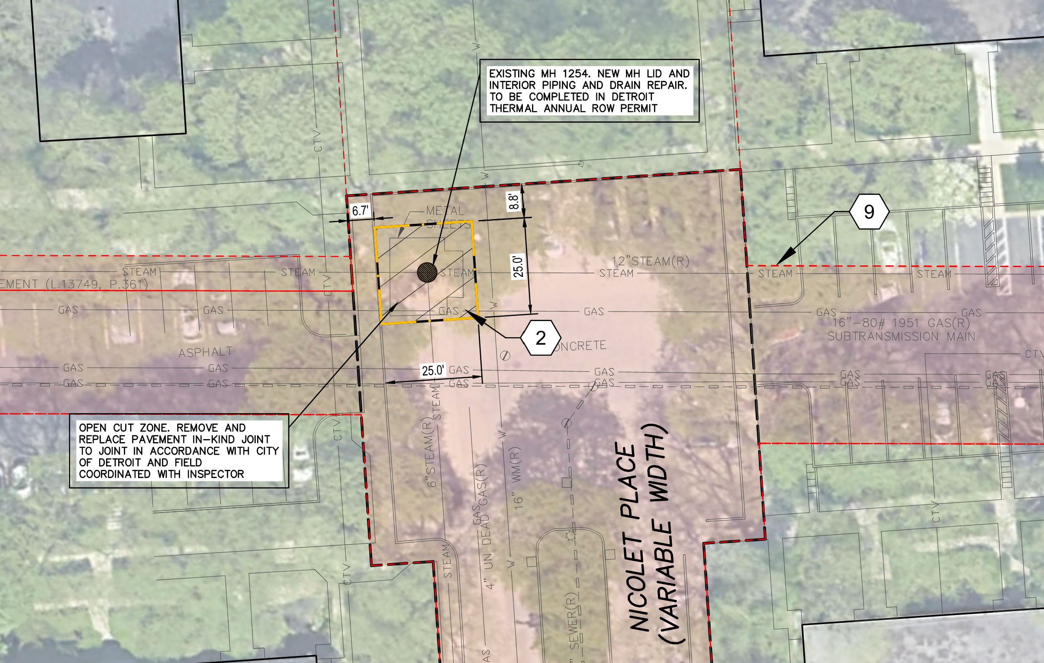
Lafayette Park Timeline Regarding the Project
Excavation in the Nicolet Right-of-Way

Slide 22
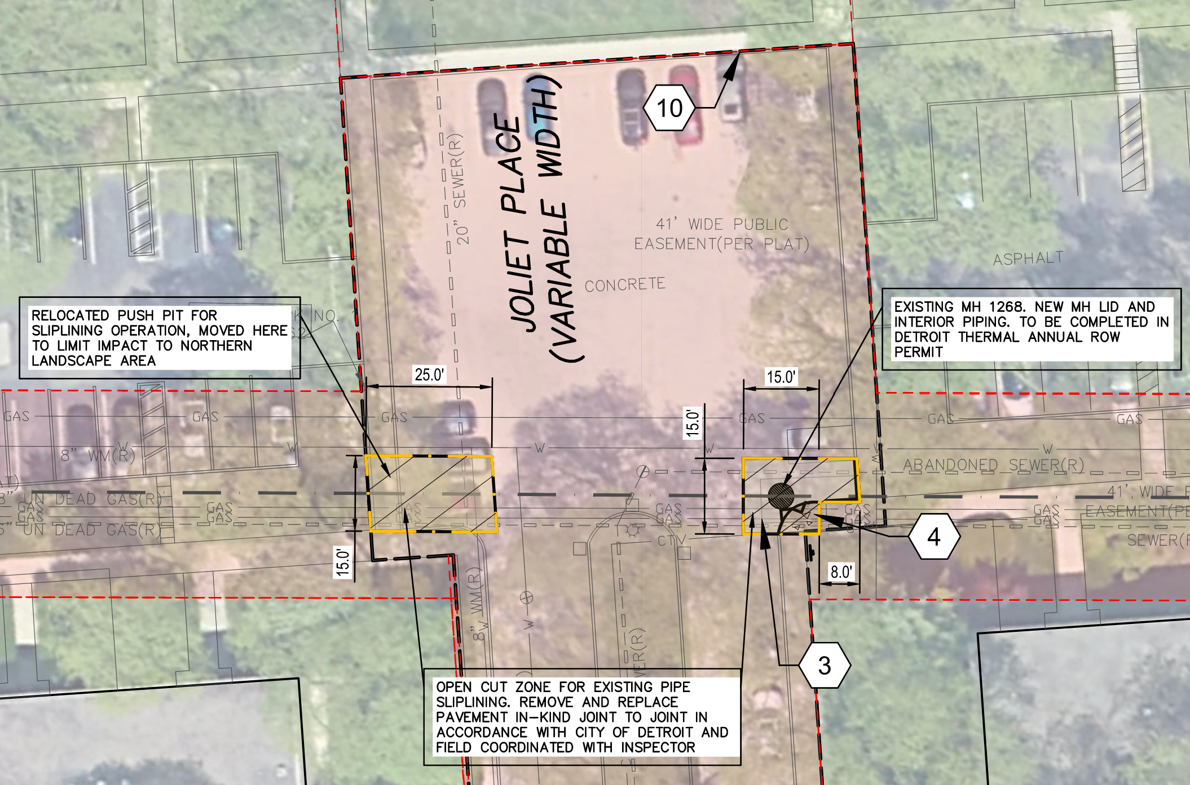
Excavation in the Joliet Right-of-Way

Slide 23
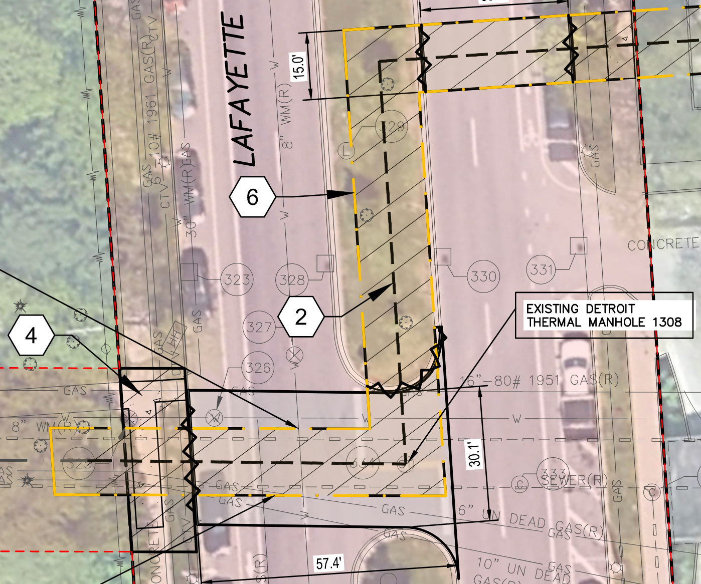
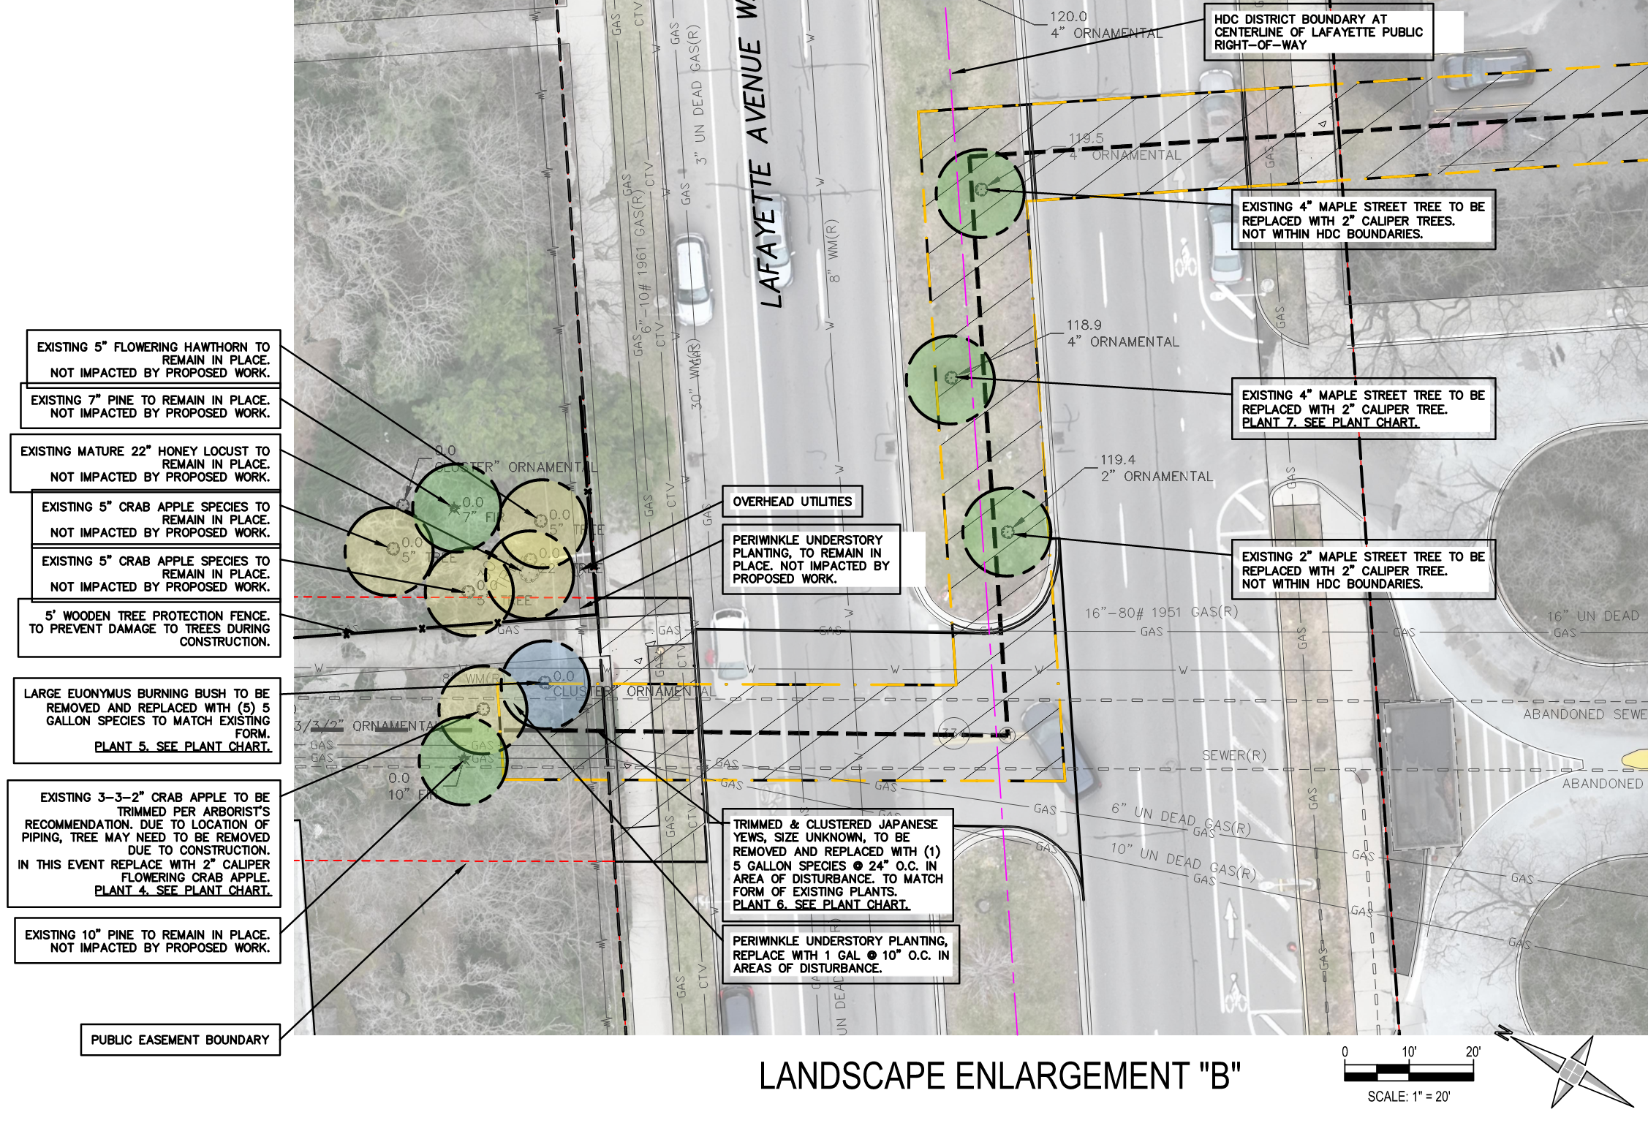
Excavation in the Russell Easement & Lafayette ROW

Slide 24
Excavation in the Russell Easement & Lafayette ROW
1
2
3

Slide 25
Excavation in the Russell Easement & Lafayette ROW

Slide 26
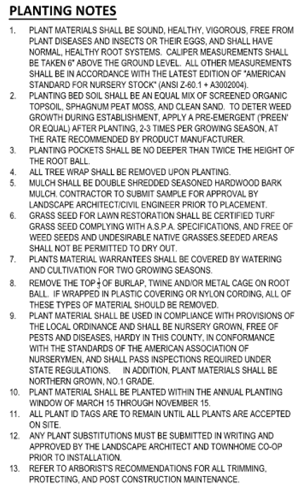
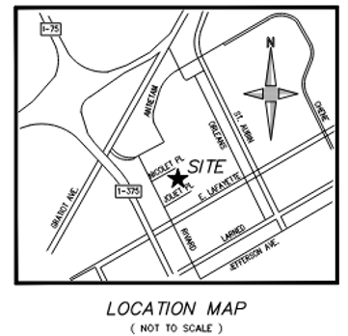
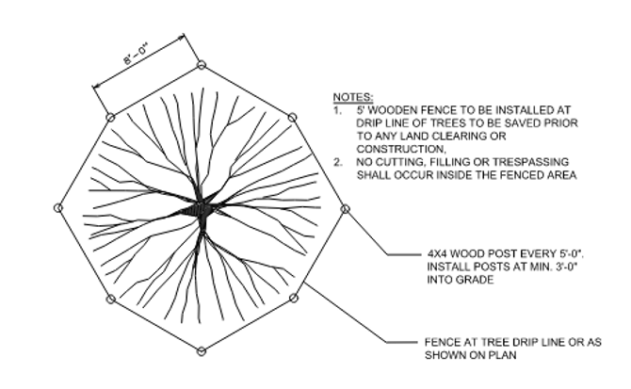
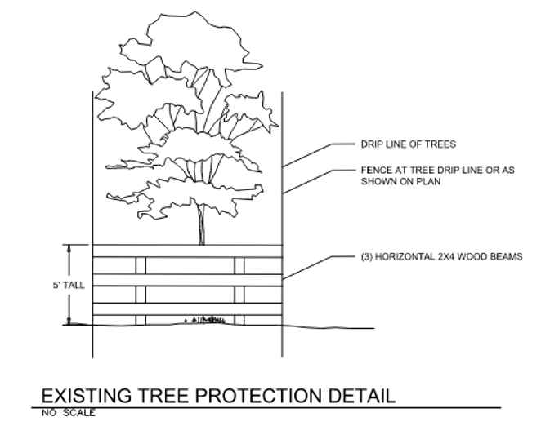
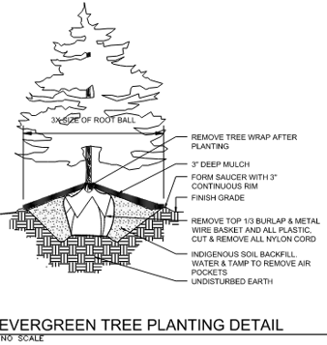
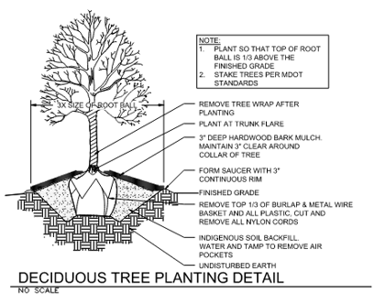
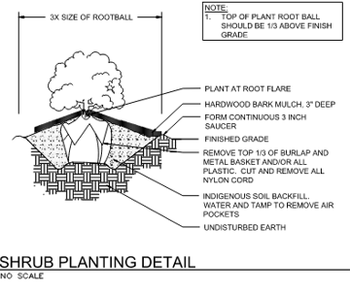
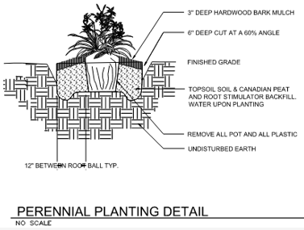
Planting Notes and Details

Slide 27
Planting Notes and Details

Slide 28
Planting Notes and Details

Slide 29
Planting Notes and Details

Slide 30
Planting Notes and Details

Slide 31
Planting Notes and Details

Slide 32
Planting Notes and Details

Slide 33
Revised Plan to Provide Heat for 600 Lafayette Park Residents
First, the company spared no expense to make this project safe. Detroit Thermal could have simply reenergized the existing steam line but instead decided to insert new sleeved piping in some sections of the line and make other improvements in the interest of safety and reliability.
Second, as a neighbor of Lafayette Park, Detroit Thermal knows and respects the compelling history of the community and will do nothing to undermine it.
Finally, Detroit Thermal asks those concerned by this utility upgrade to respect the needs and wishes of their neighbors at 1300 Lafayette – some 600 people who want and need the affordable, clean energy that will be safely brought into their homes.

Slide 34
END
PRESENTATION

Slide 35
HDC Information Request

Slide 36
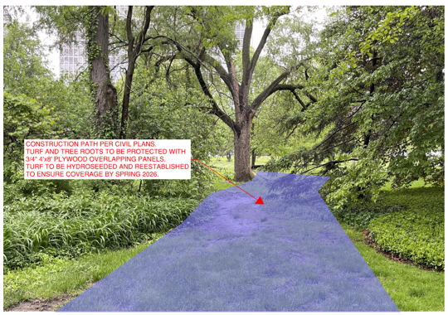
HDC Information Request

Slide 37
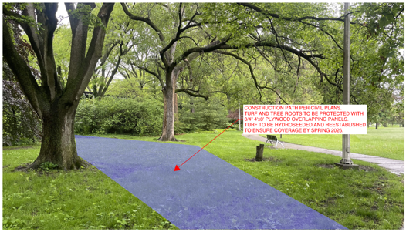
HDC Information Request

Slide 38
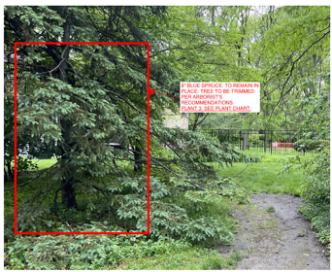
Excavation in Russell-Macomb Easement

Slide 39
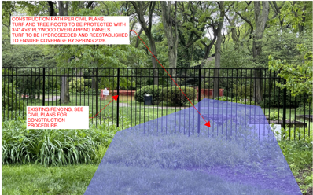
Excavation in Russell-Macomb Easement

Slide 40
HDC Information Request

Slide 41
Excavation in Russell-Macomb Easement

Slide 42
Excavation in Russell-Macomb Easement

Slide 43
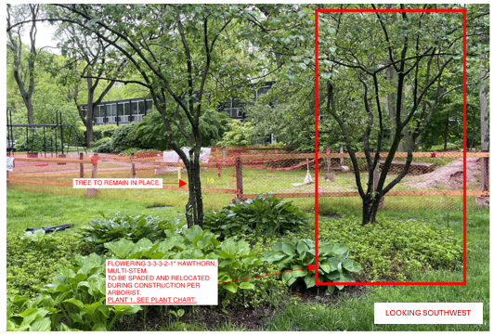
Excavation in Russell-Macomb Easement
Excavation in Russell-Macomb Easement
Excavation in Russell-Macomb Easement

Slide 44
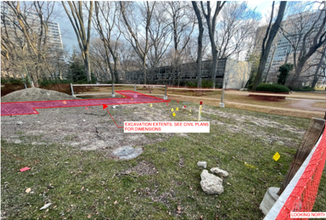
Excavation in Russell-Macomb Easement

Slide 45
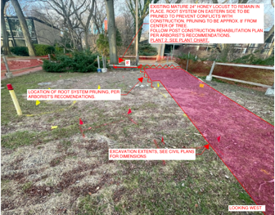
Excavation in Russell-Macomb Easement

Slide 46
Steam Pipes That Provides Heat
Manhole Cover
Detroit Thermal cast iron manhole frame and cover

Slide 47
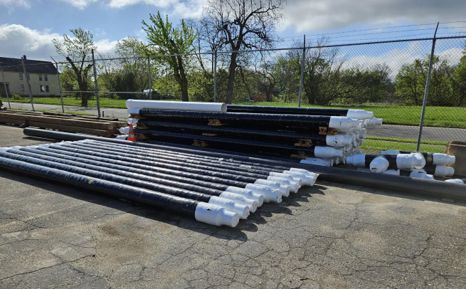
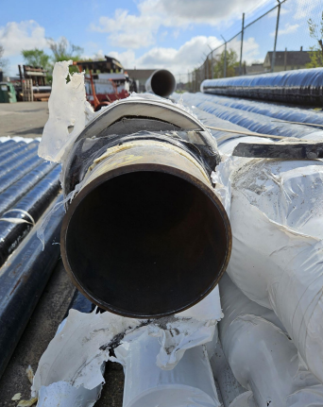
Steam Pipes That Provides Heat

Slide 48
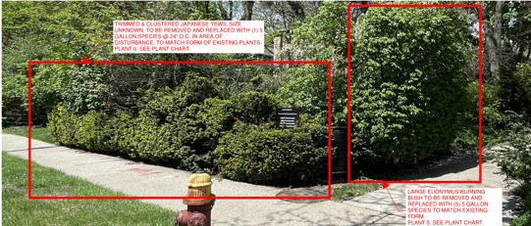
Photos Lafayette Avenue Area

Slide 49
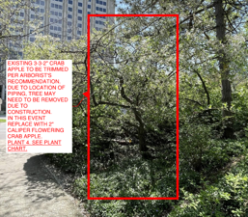
Photos Lafayette Avenue Area

Slide 50
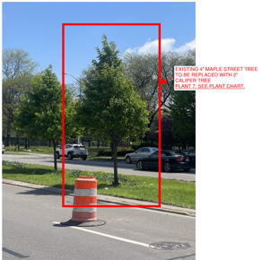
Photos Lafayette Avenue Area

