Slide 1
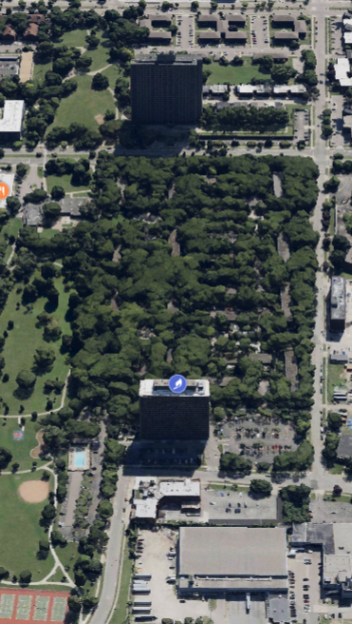
Lafayette Park Revised Plan for Energy System Improvement

Slide 2
Revised Plan to Provide Heat to for 600 Lafayette Park Residents
Revised plan will provide clean, affordable, reliable, and safe heat to the 600-plus residents at 1300 Lafayette East Cooperative, upgrading and reconnecting the Detroit Thermal line in a manner that serves the entire Lafayette Park Neighborhood.

Slide 3
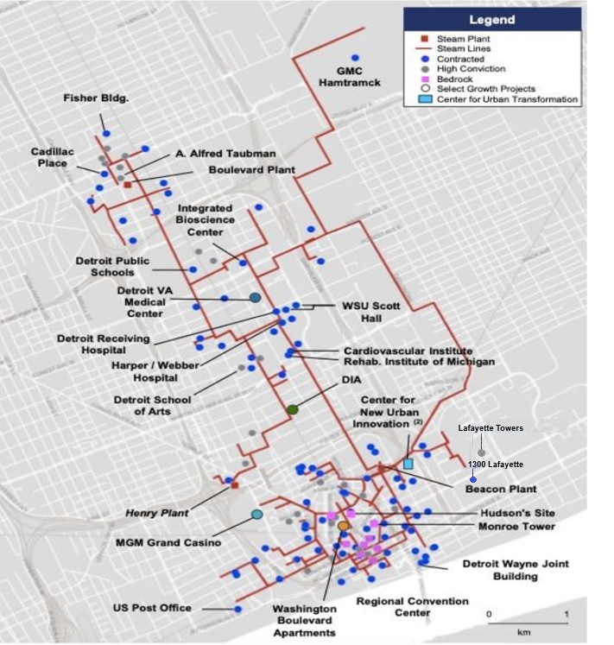
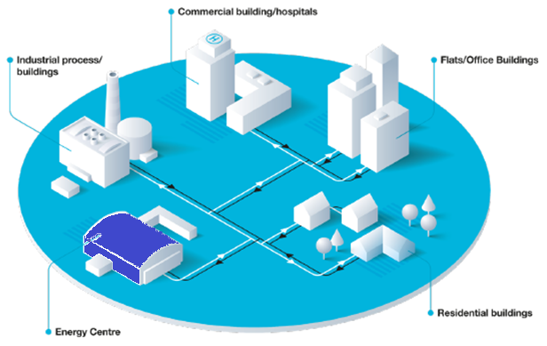
Detroit Thermal Is District Energy
District Energy is a superior solution for large energy users with distributed or centralized real estate footprints. A central plant makes steam, chilled water and hot water, while underground pipes distribute to buildings. It is cost effective, safe, reliable, and sustainable.
Benefits of district energy for the customers:
Energy cost reduction compared to utility bill and on-site systems
Lower carbon impact and sustainable system
Reliable energy sources benefiting from redundancy N+1 technology configurations, ensuring continuous customer operations
More efficient and resilient services than onsite energy options
Safer service, eliminating the risk of onsite combustion
100% off balance sheet funding and eliminating upfront capital cost to the customer
Reduction of operations and maintenance costs of complex energy infrastructure
No onsite boilers or chillers, freeing up space
Detroit Thermal’s District Energy System

Slide 4
Lafayette Park Timeline Regarding the Project
Jul 2024:
Jan 2025:
Apr 2025:
1300 Lafayette East Cooperative engages Detroit Thermal to explore the option of reconnecting to District Energy
Detroit Thermal files application filed with the Michigan Public Service Commission (MPSC) for approval of contract
Detroit Thermal initiates the permitting process with the City’s Legal and DPW
Detroit Thermal secures the DPW permit
Residential Concerns re safety and Historic District Commission permissions were expressed
The city issues a stop-work order
Detroit Thermal agrees to present a revised plan to the Historic District Commission on May 14
Sep-Oct 2024:
Feb 2025:
Detroit Thermal Initiates and Exploratory restoration
On 9/12/24: Detroit Thermal conducts a walk-through with KC Property Management and 20-30 residents
Three areas determined to be evaluated via annual permit:
2 authorizing work in the rights-of-way (Joliet parking lot and Nicolet parking lot)
1 authorizing work in an easement but not right-way (playground area)
MPSC issues order approving contract with a finding that it is in the public interest
Mar 2025:
Agreement signed with 1300 East Cooperative and Detroit Thermal to move forward.
Detroit Thermal requested another meeting with the Lafayette Park Co-ops to be coordinated by KC Properties

Slide 5
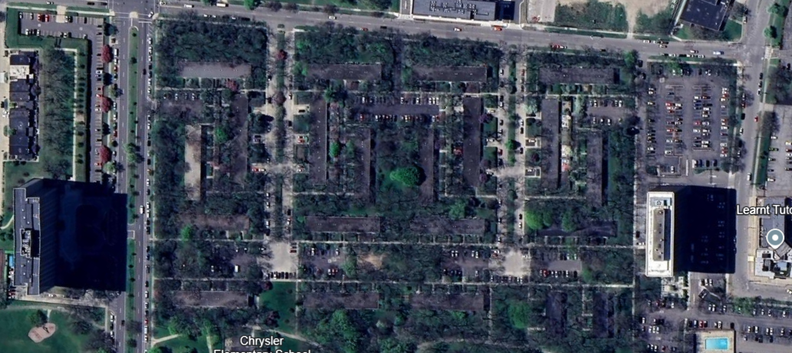
Detroit Thermal Revised Plan (to be approved)
Air Ventilation and Manhole
Slip Line
Air Ventilation and Manhole
1300
Inactive Line
New Piping
Active Line

Slide 6
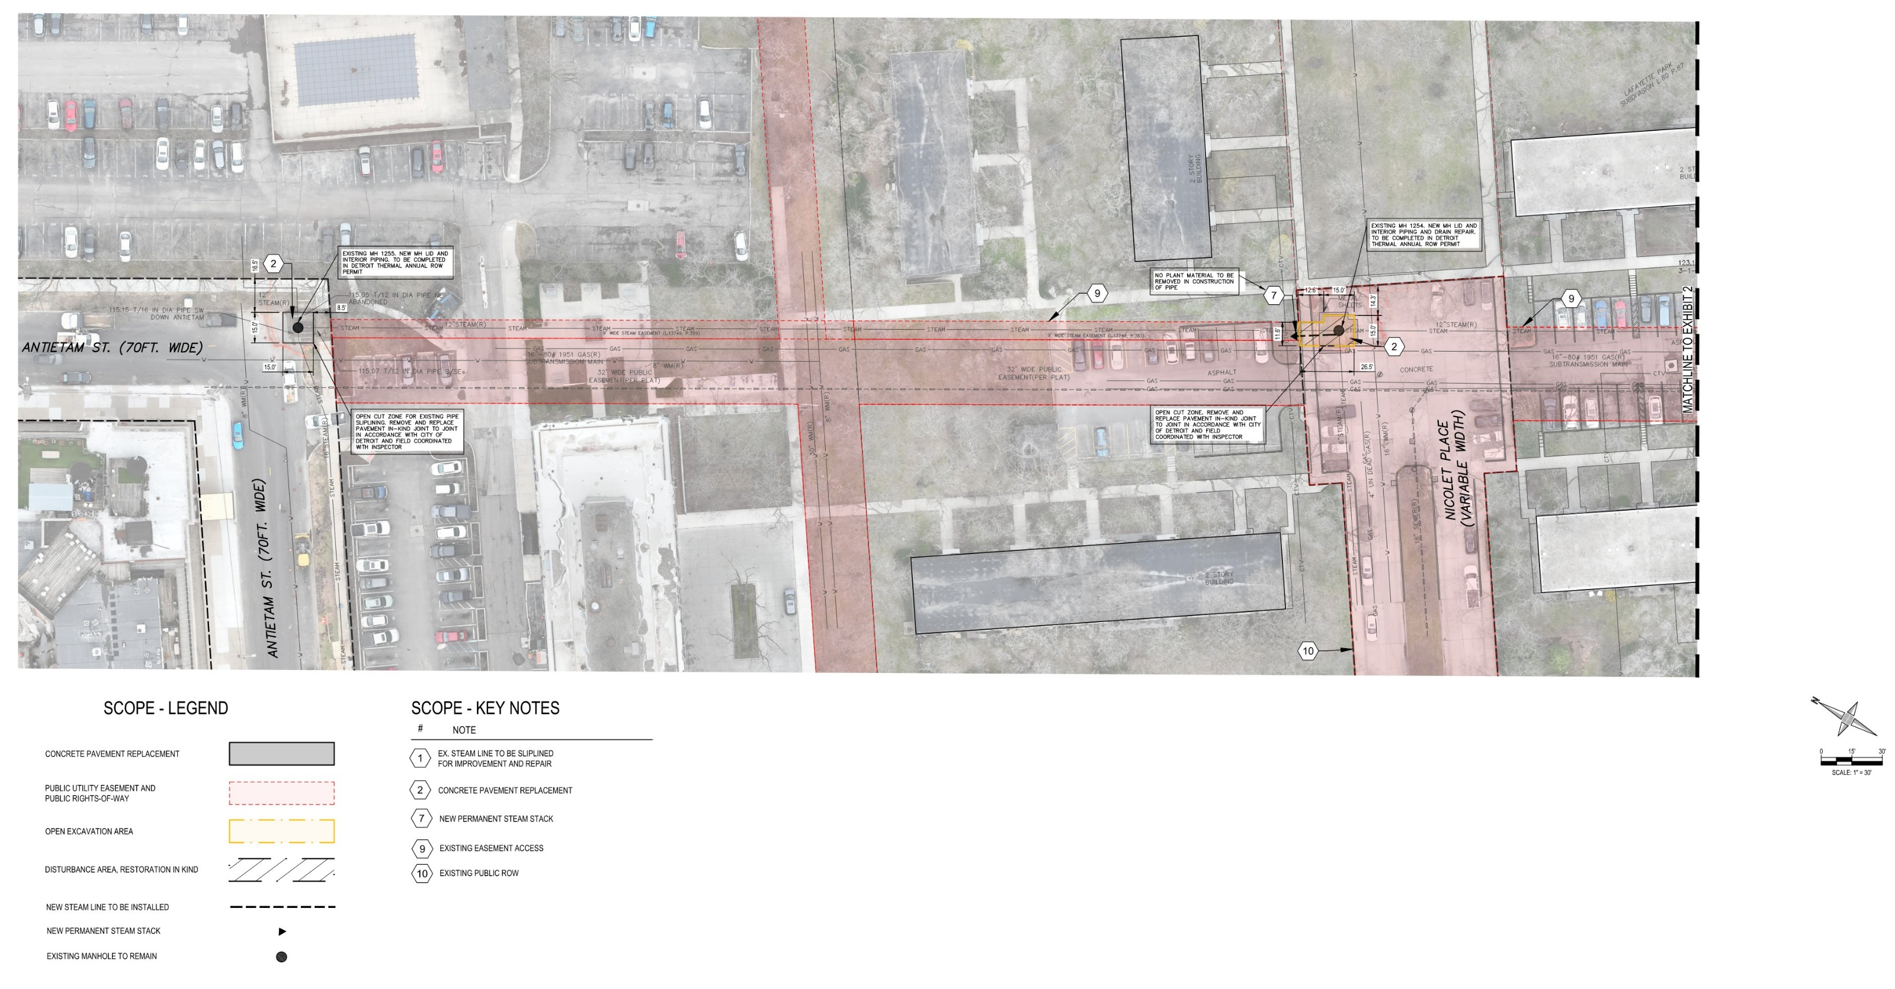
^{PLAN SET}

Slide 7
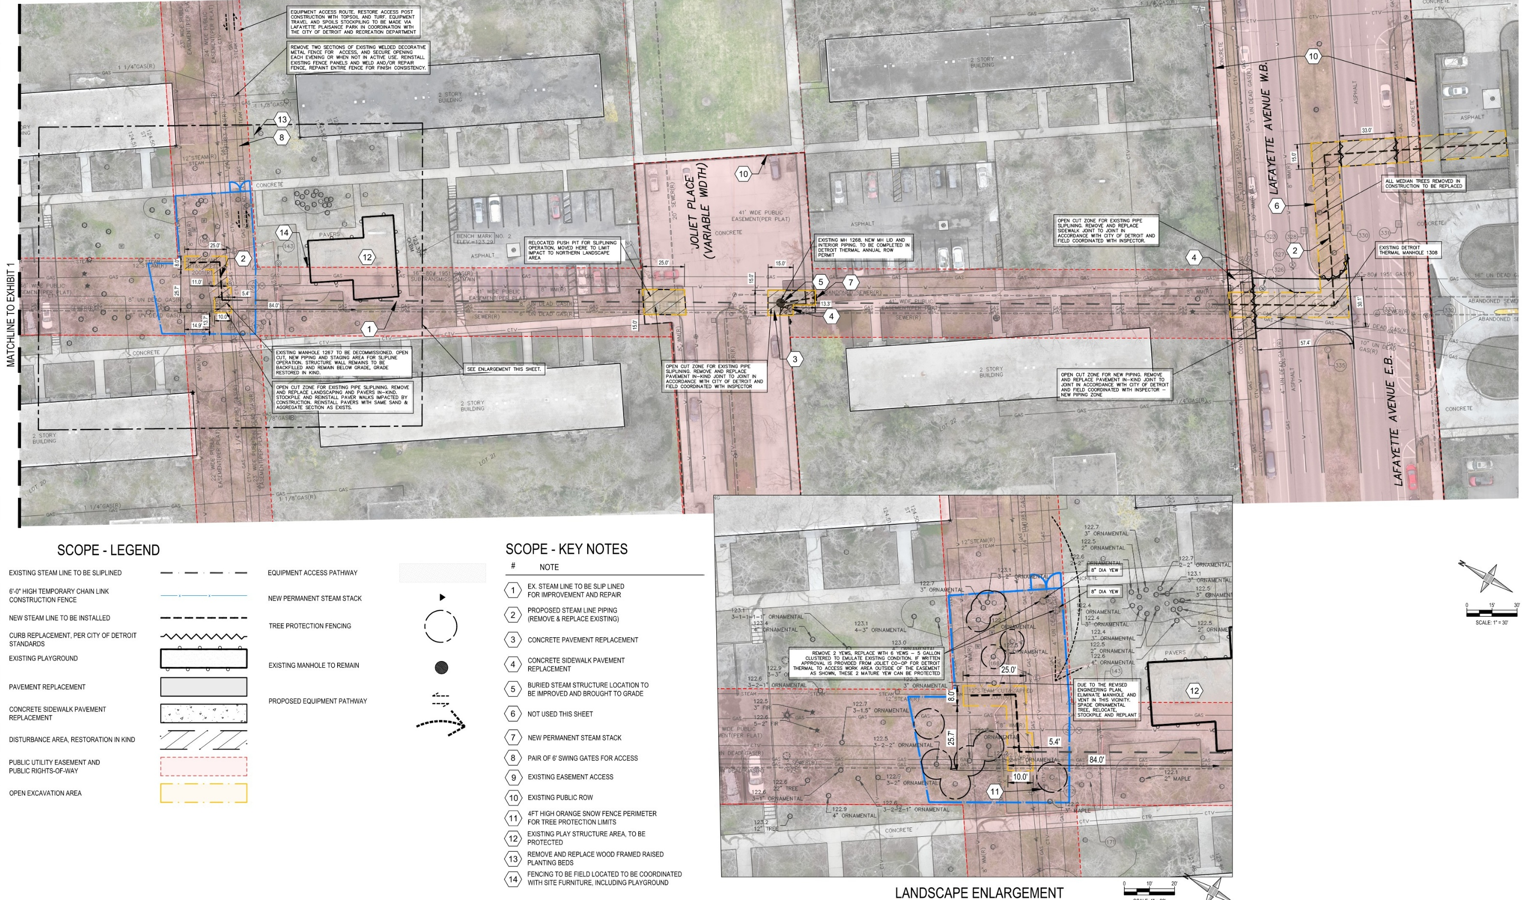
^{PLAN SET}

Slide 8
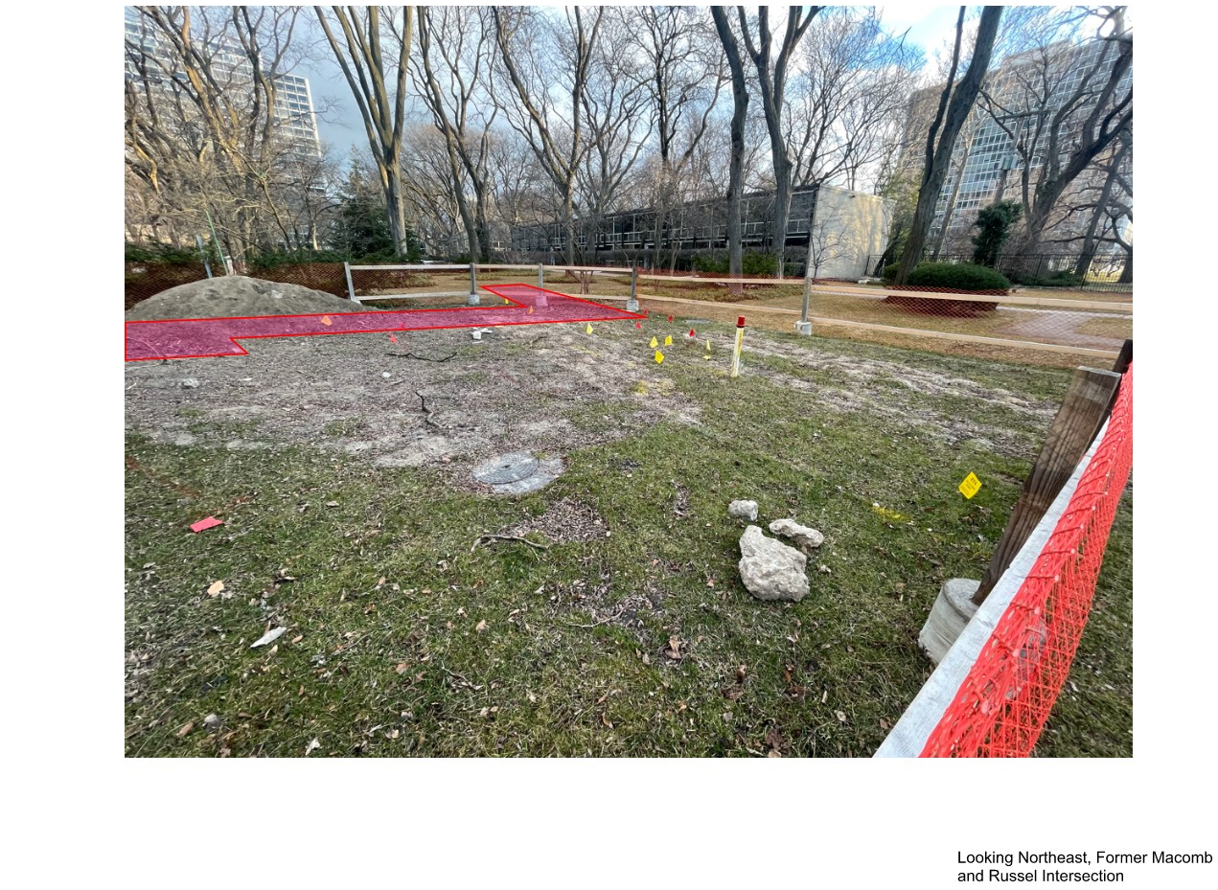
^{PHOTO OPEN CUT DIAGRAM}

Slide 9
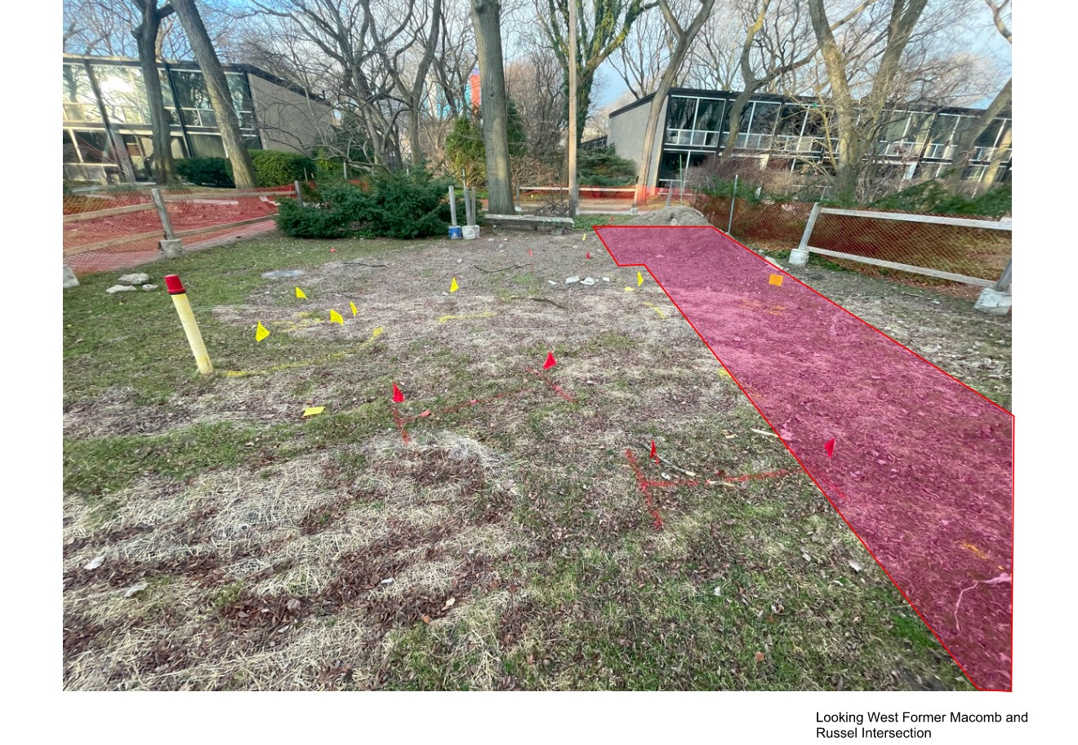
^{PHOTO OPEN CUT DIAGRAM}

Slide 10
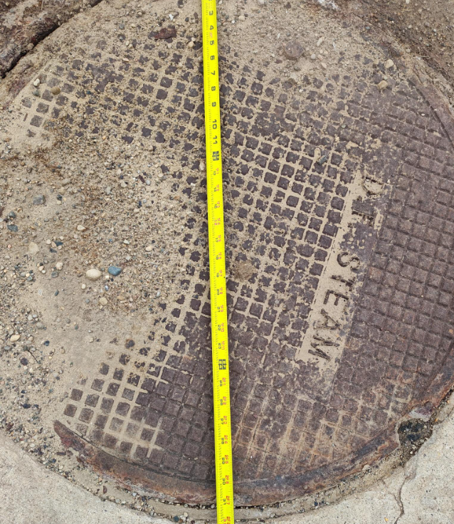
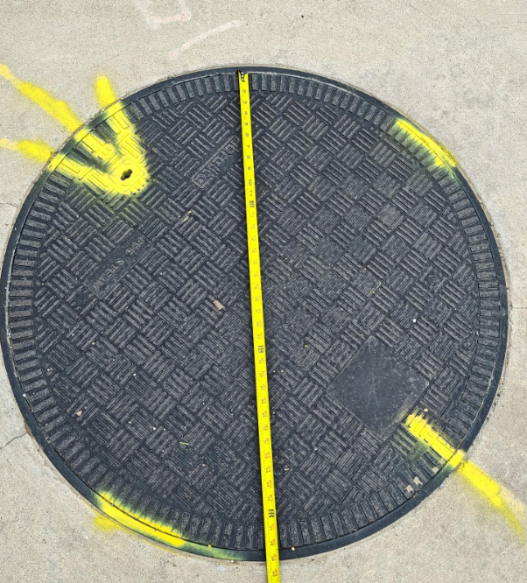
MANHOLE COVER SYSTEMS
Cast iron manhole cover
The Fiberlite manhole cover is safer because it is a composite material that does not transfer heat, and it has a gasket sealed lid

Slide 11
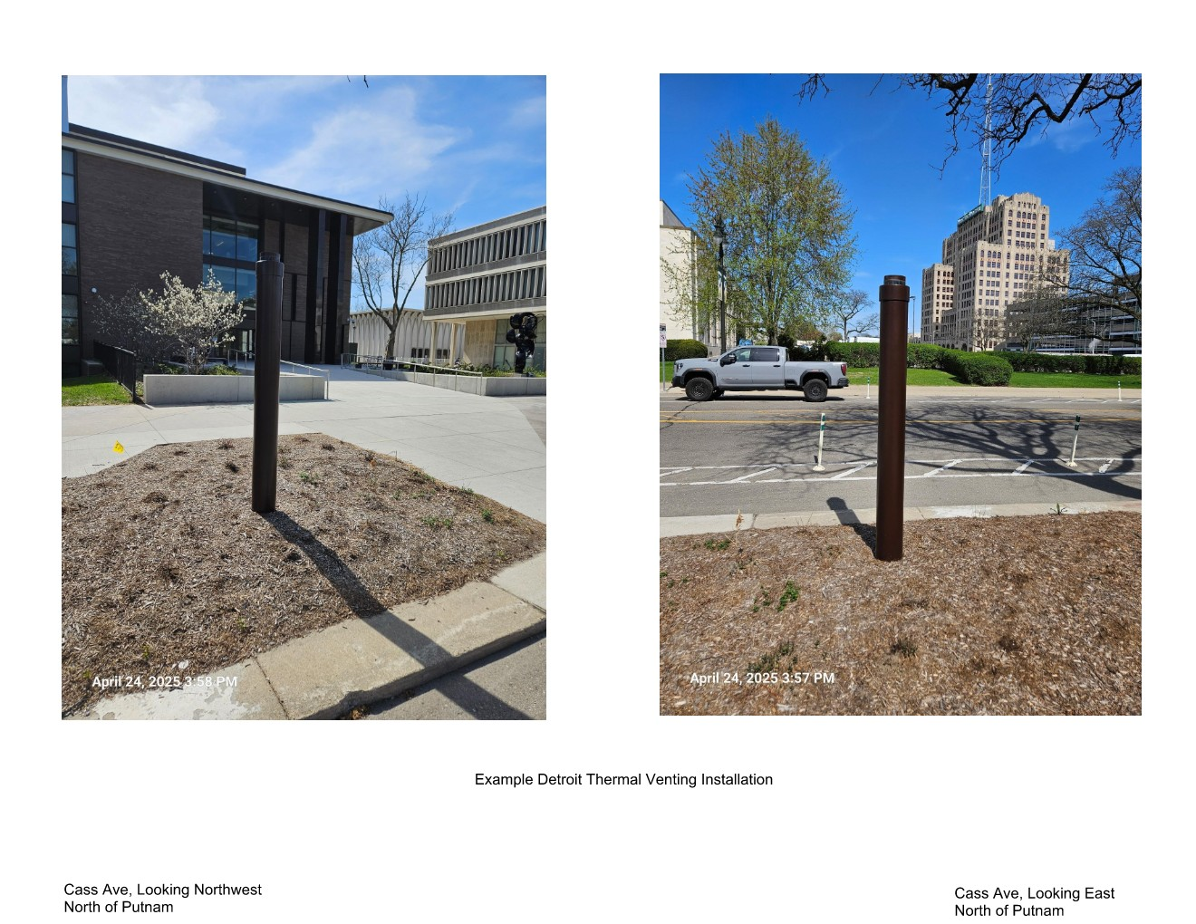
^{VENT EXAMPLE}

Slide 12
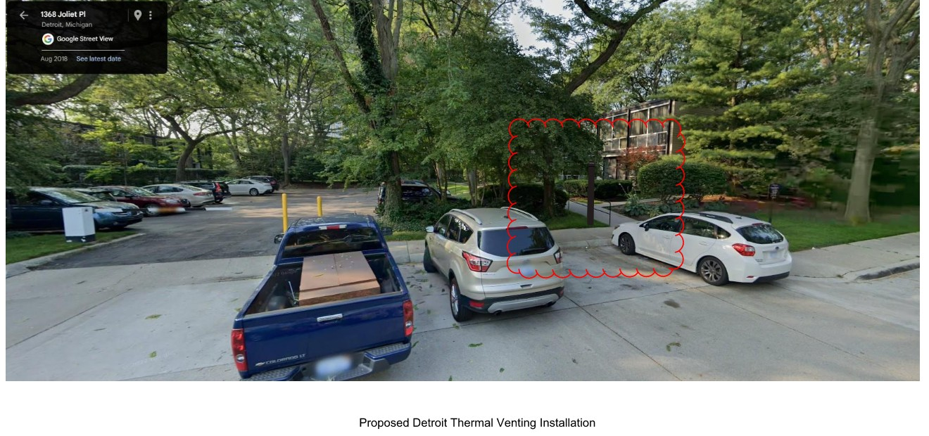
^{PHOTO OPEN CUT DIAGRAM}

Slide 13
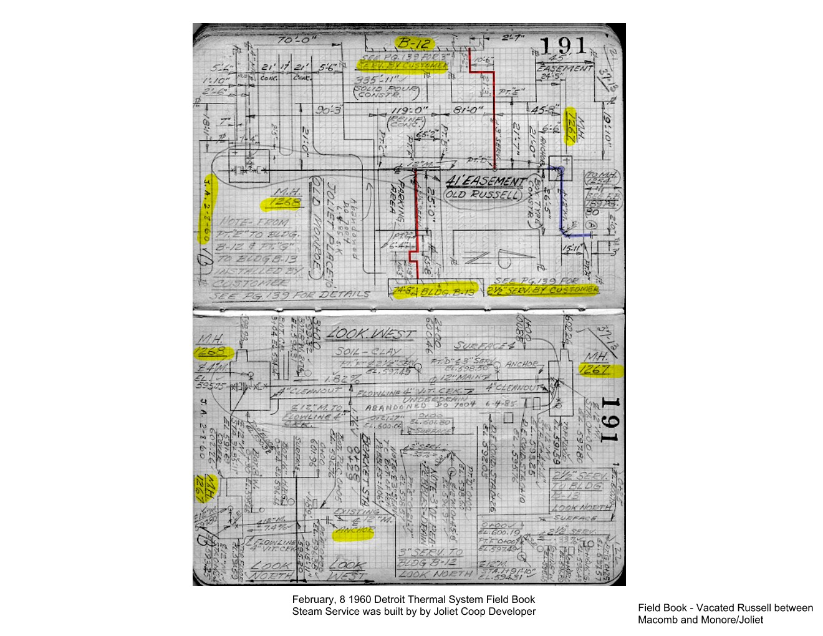
HISTORIC FIELD BOOK

Slide 14
^{APPENDIX}

Slide 15
EXISTING UTILITIES WITHIN EASEMENT

Slide 16
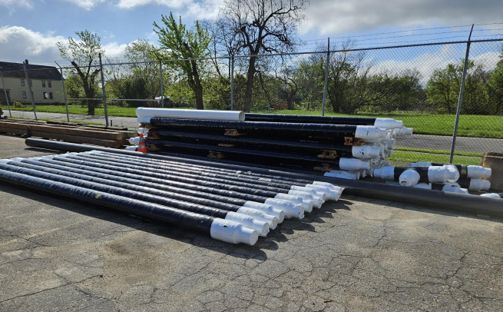
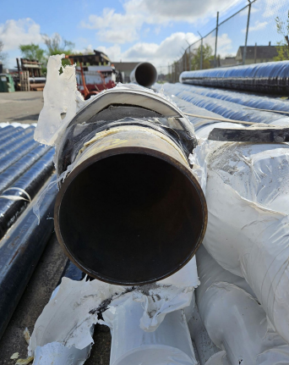
Steam Pipes That Provides Heat

Slide 17
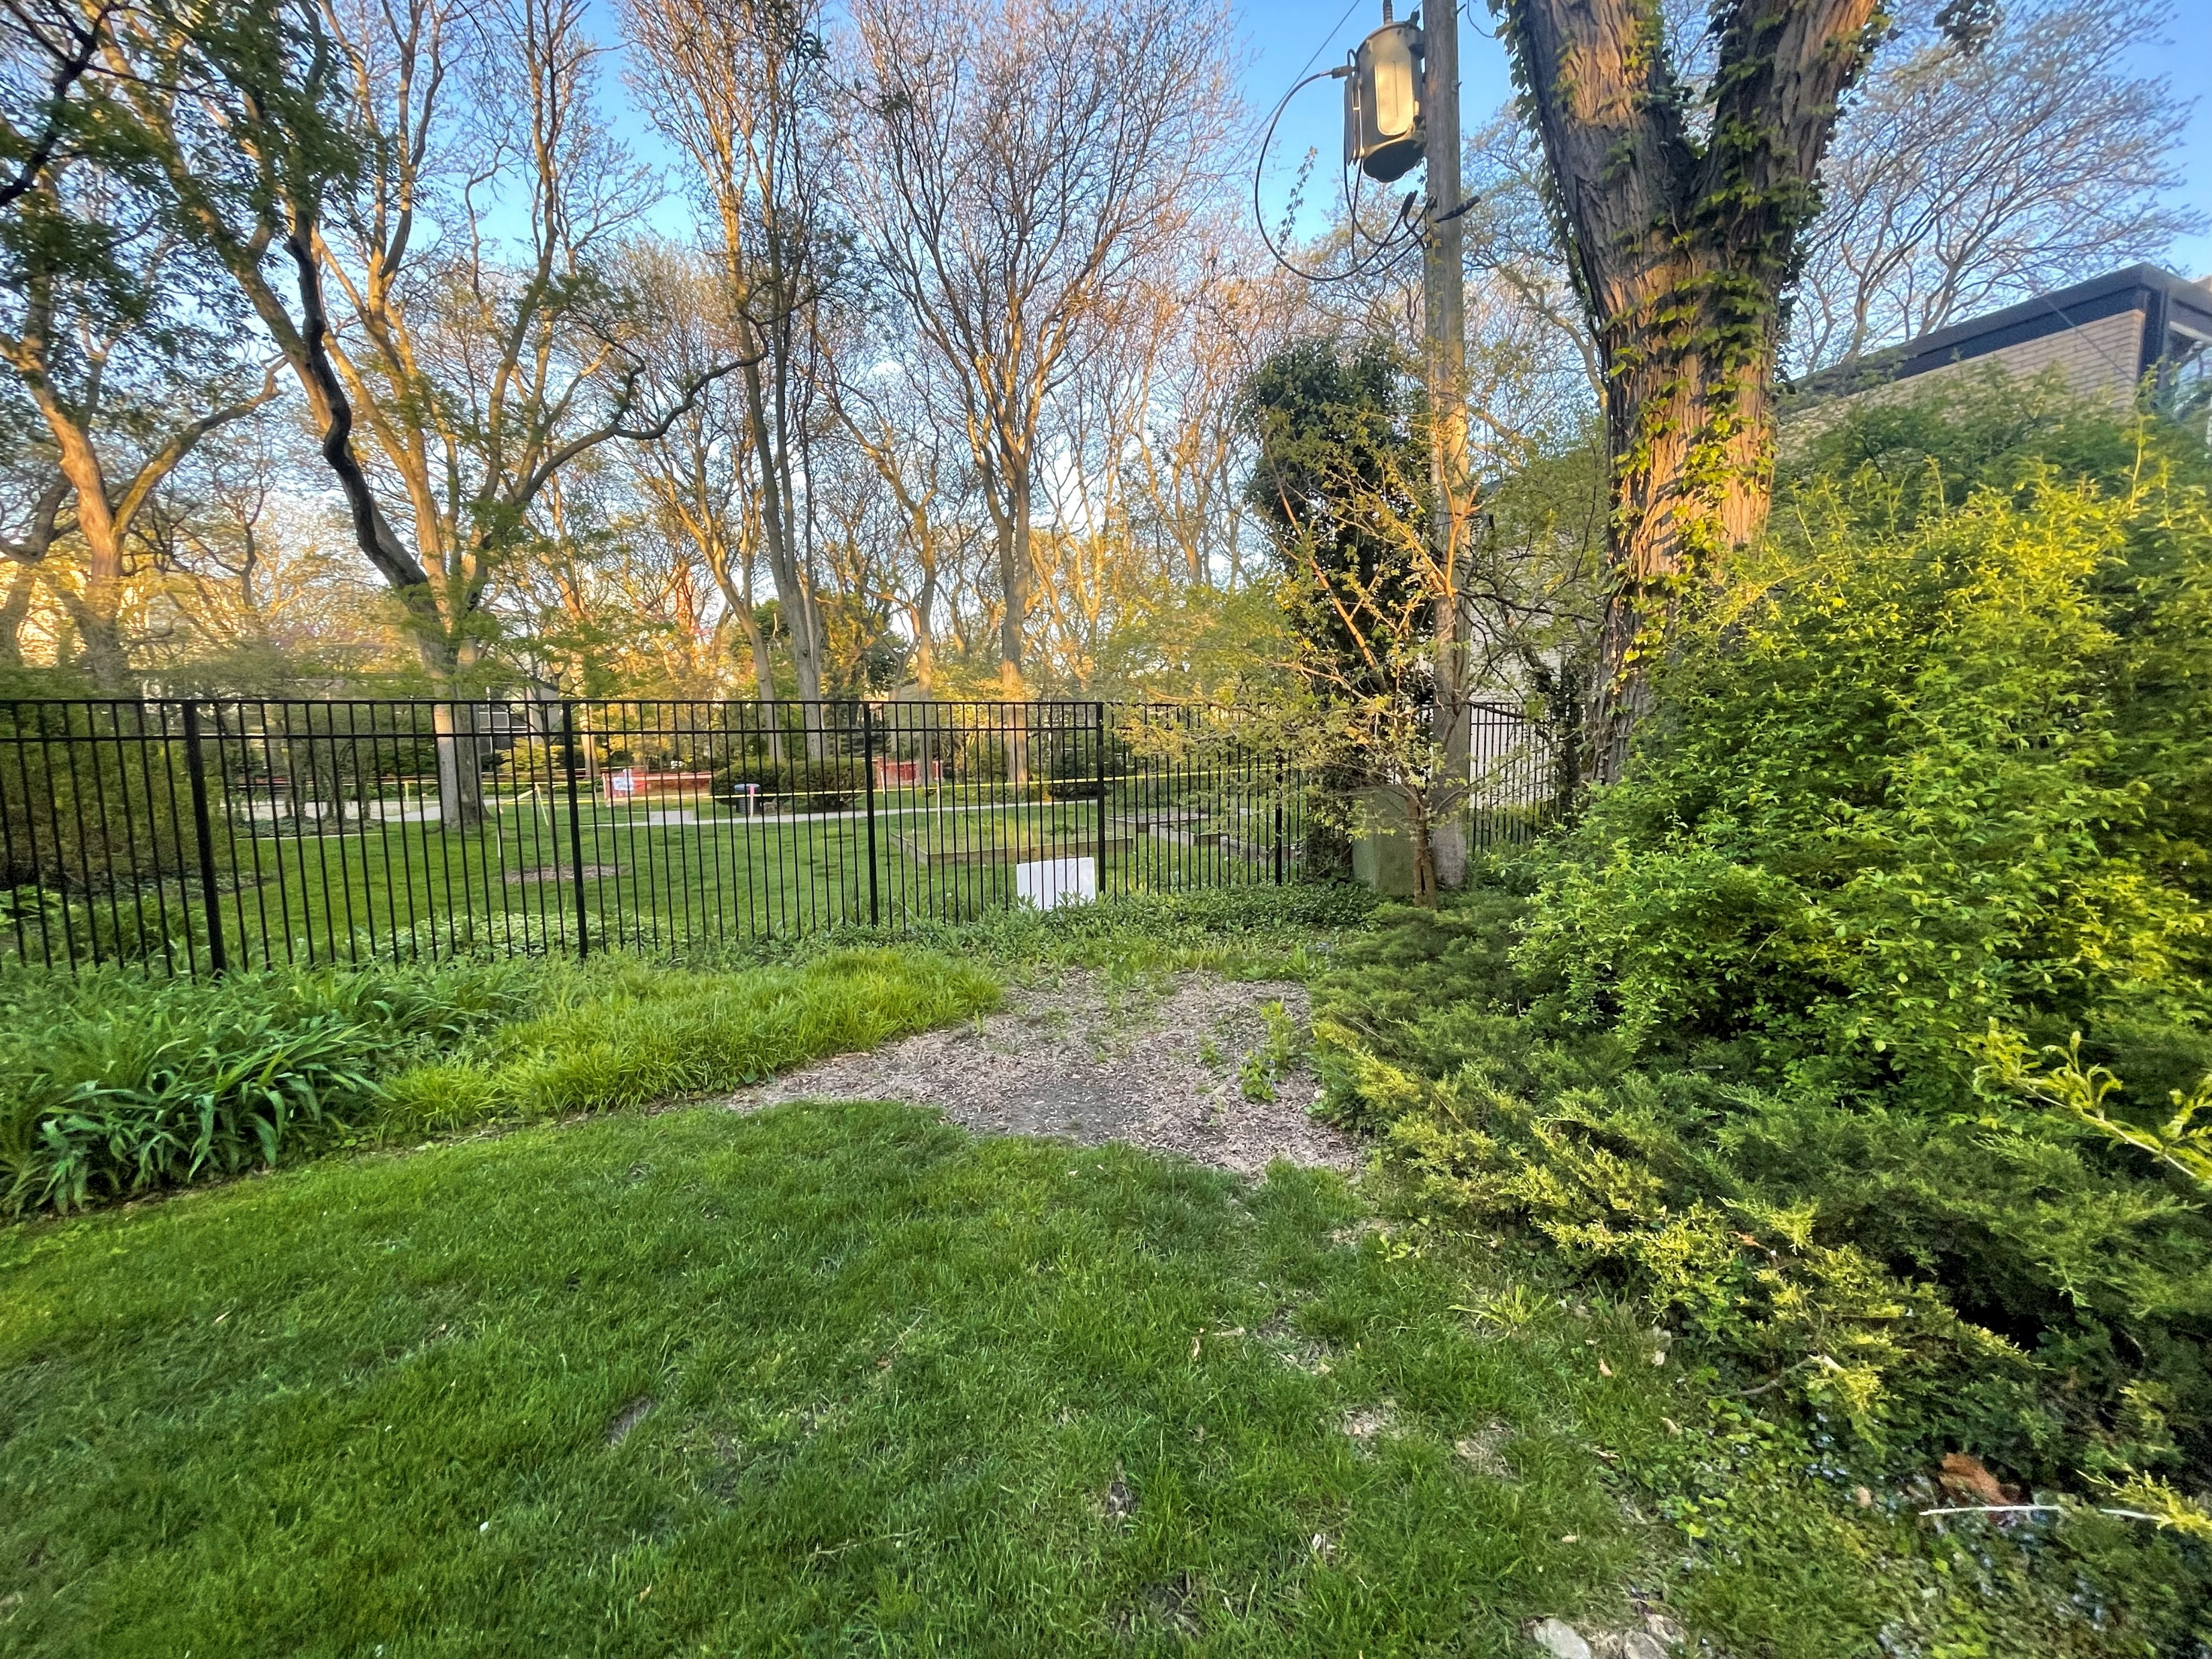
FENCING PHOTO

Slide 18
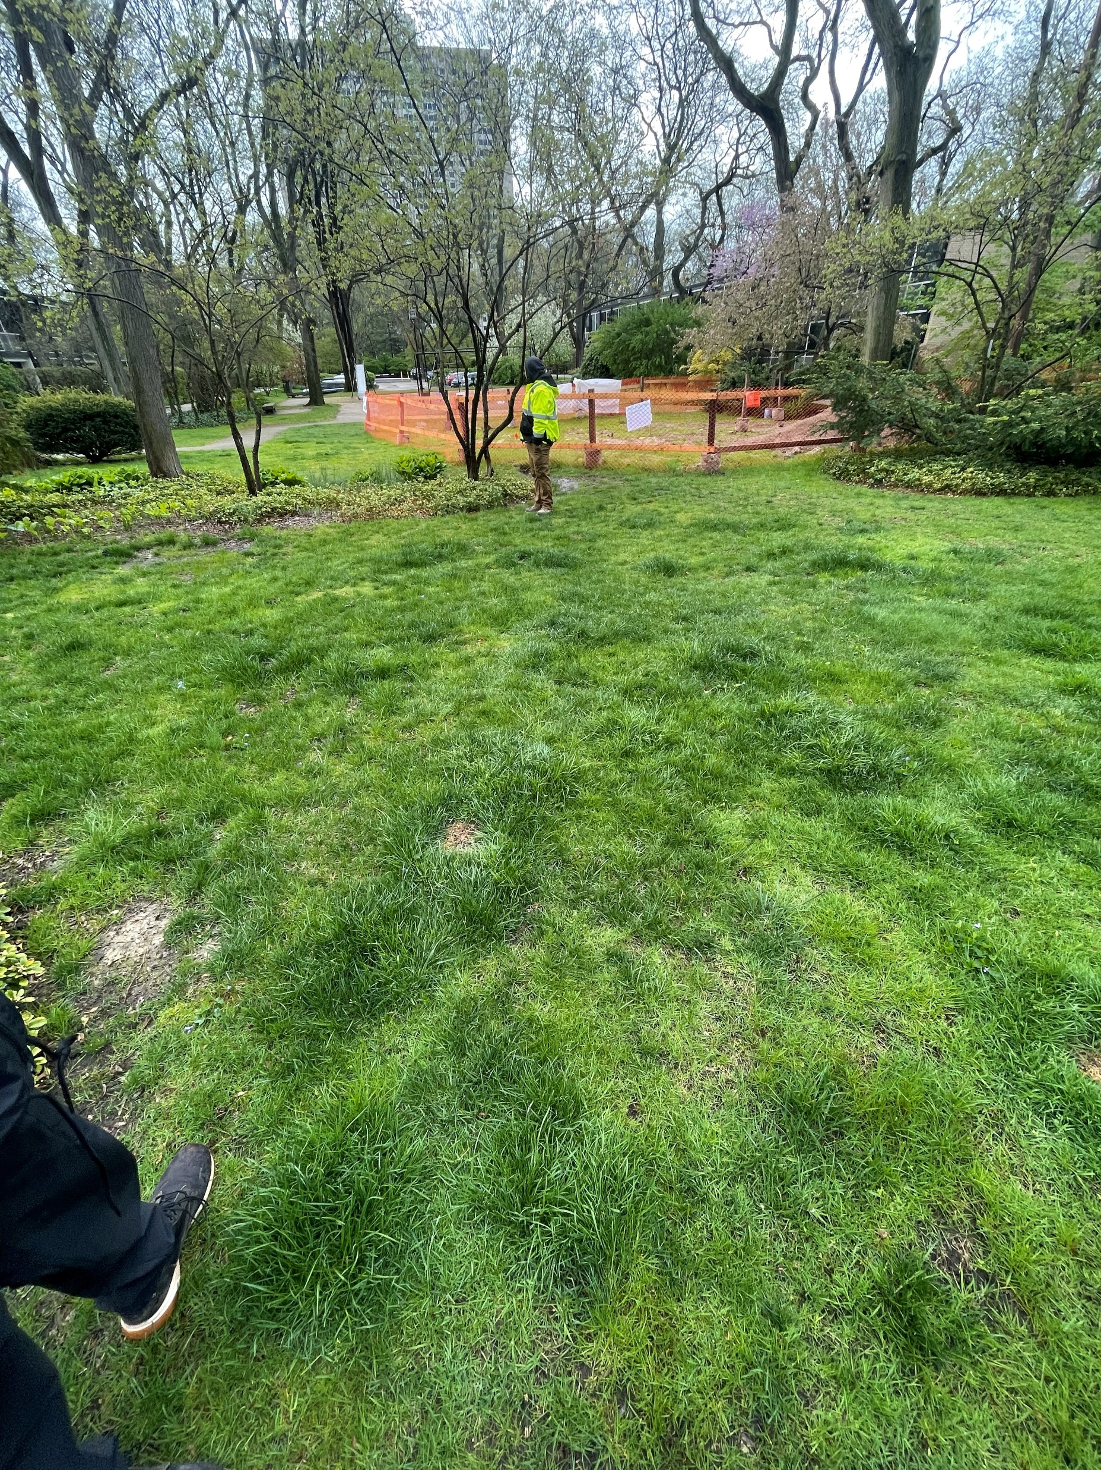
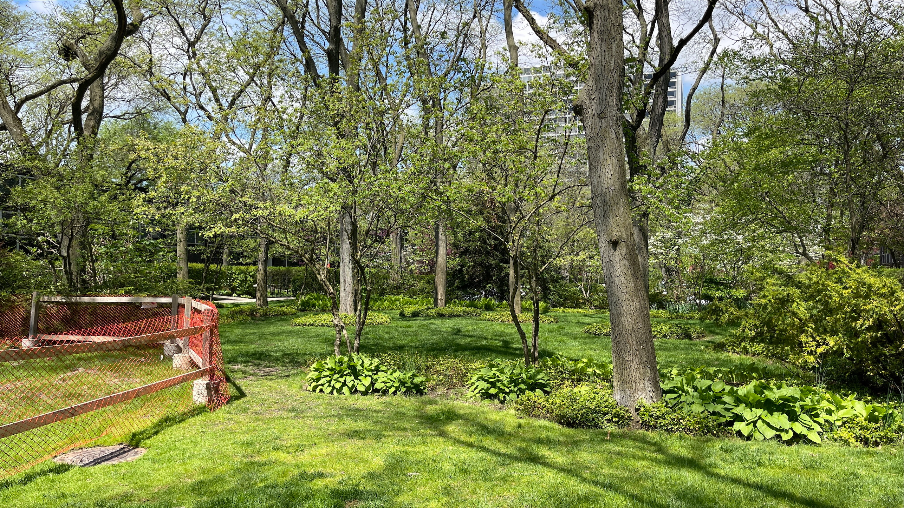
STOCKPILED/REPLANTED ORNAMENTAL

Slide 19
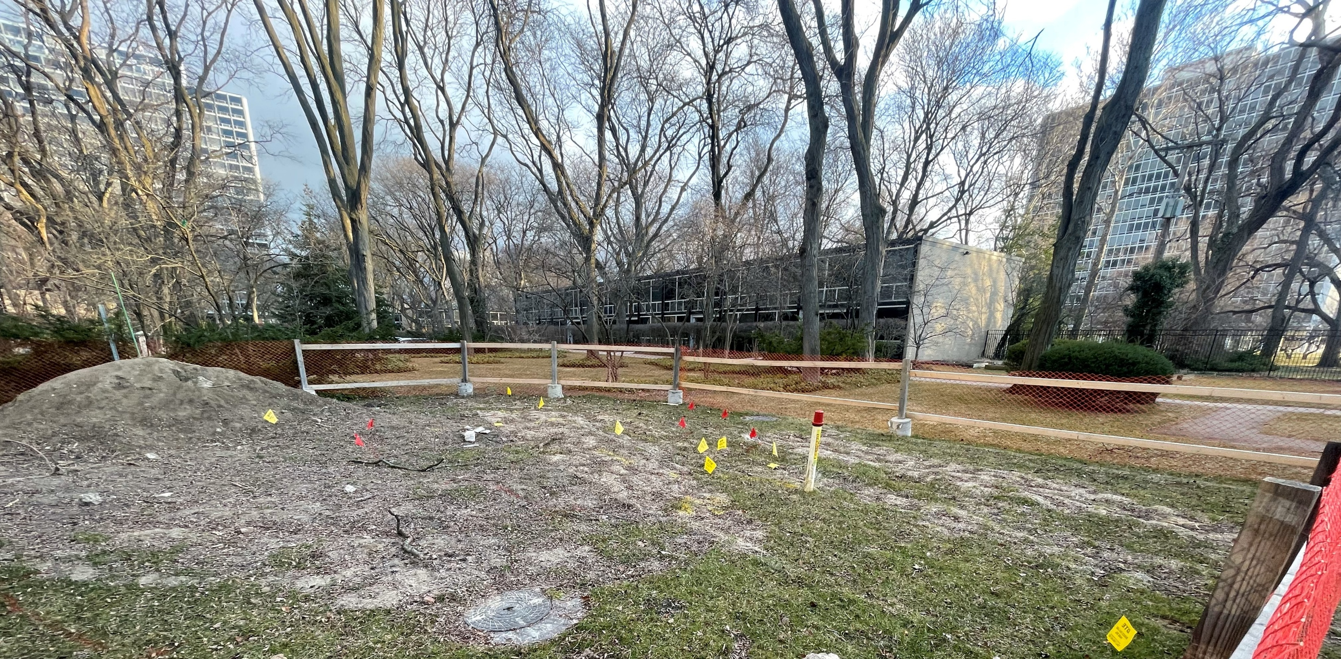
YEWS TO PROTECT IF APPROVAL FOR ACCESS OUTSIDE EASEMENT IS PROVIDED

