Slide 1
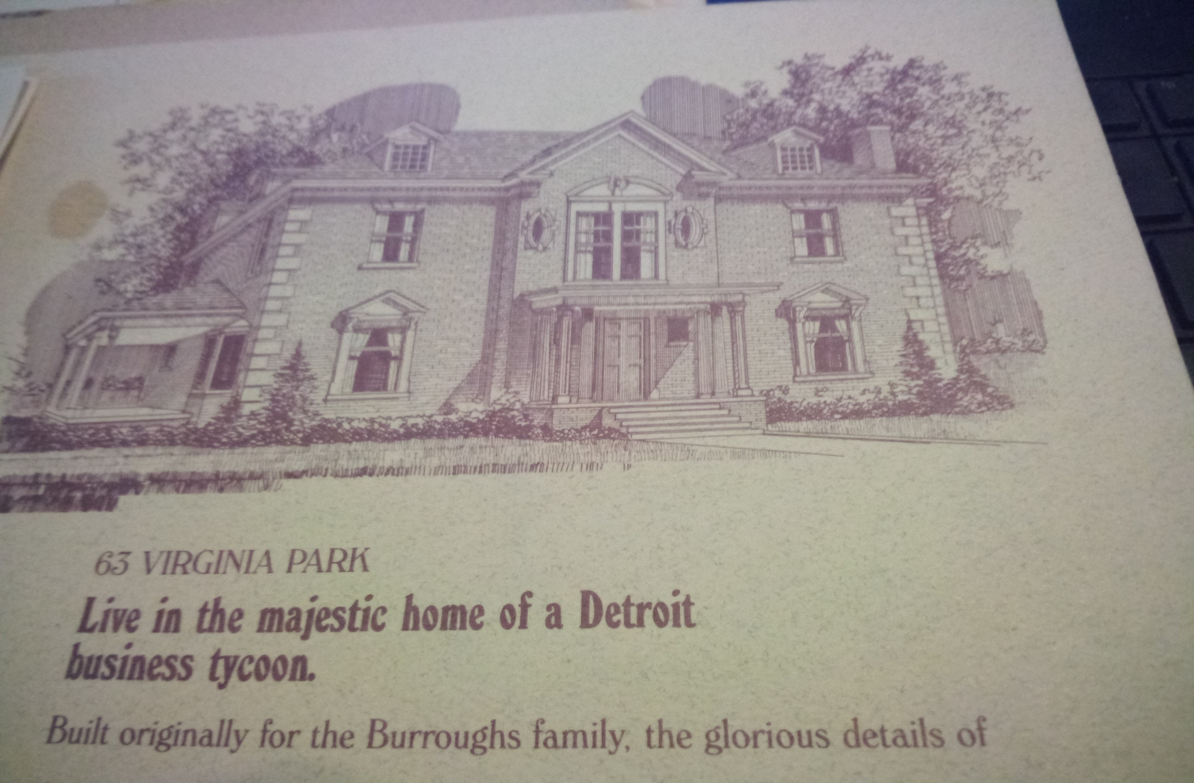
Historic Update of 63 Virginia Park –Dormers and Porches
Steve Waldrop/Zartek-Beta LLC
586-764-8386
waldropsteve@yahoo.com
Total GM Marketing BS

Slide 2
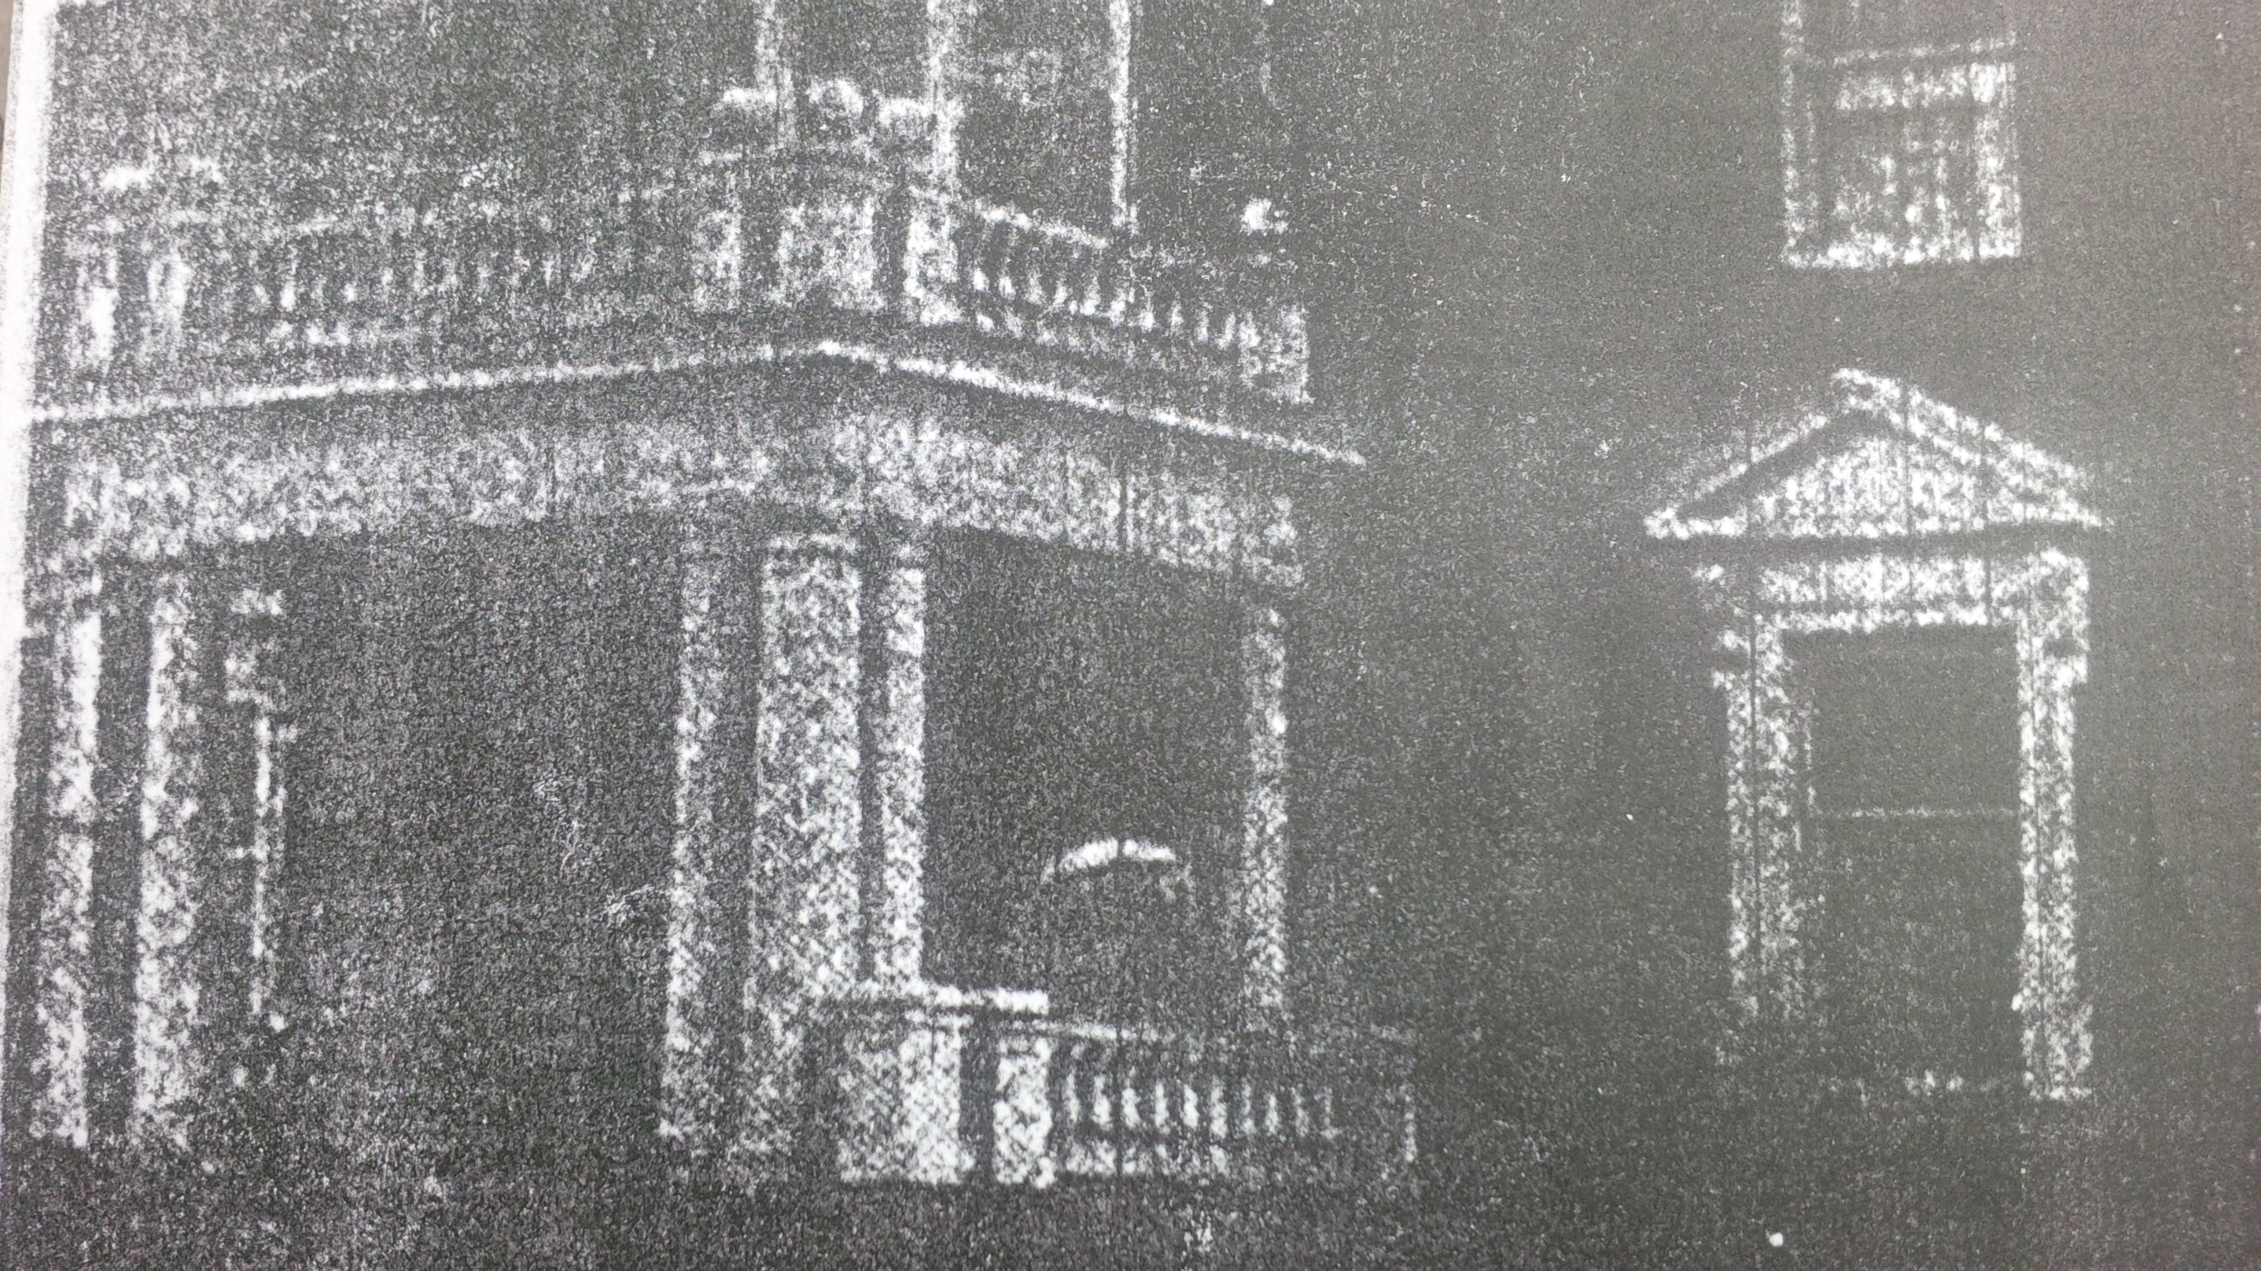
The way it should have been restored–
s
All Columns are 100”
Note: All Railings scale to about 24”

Slide 3
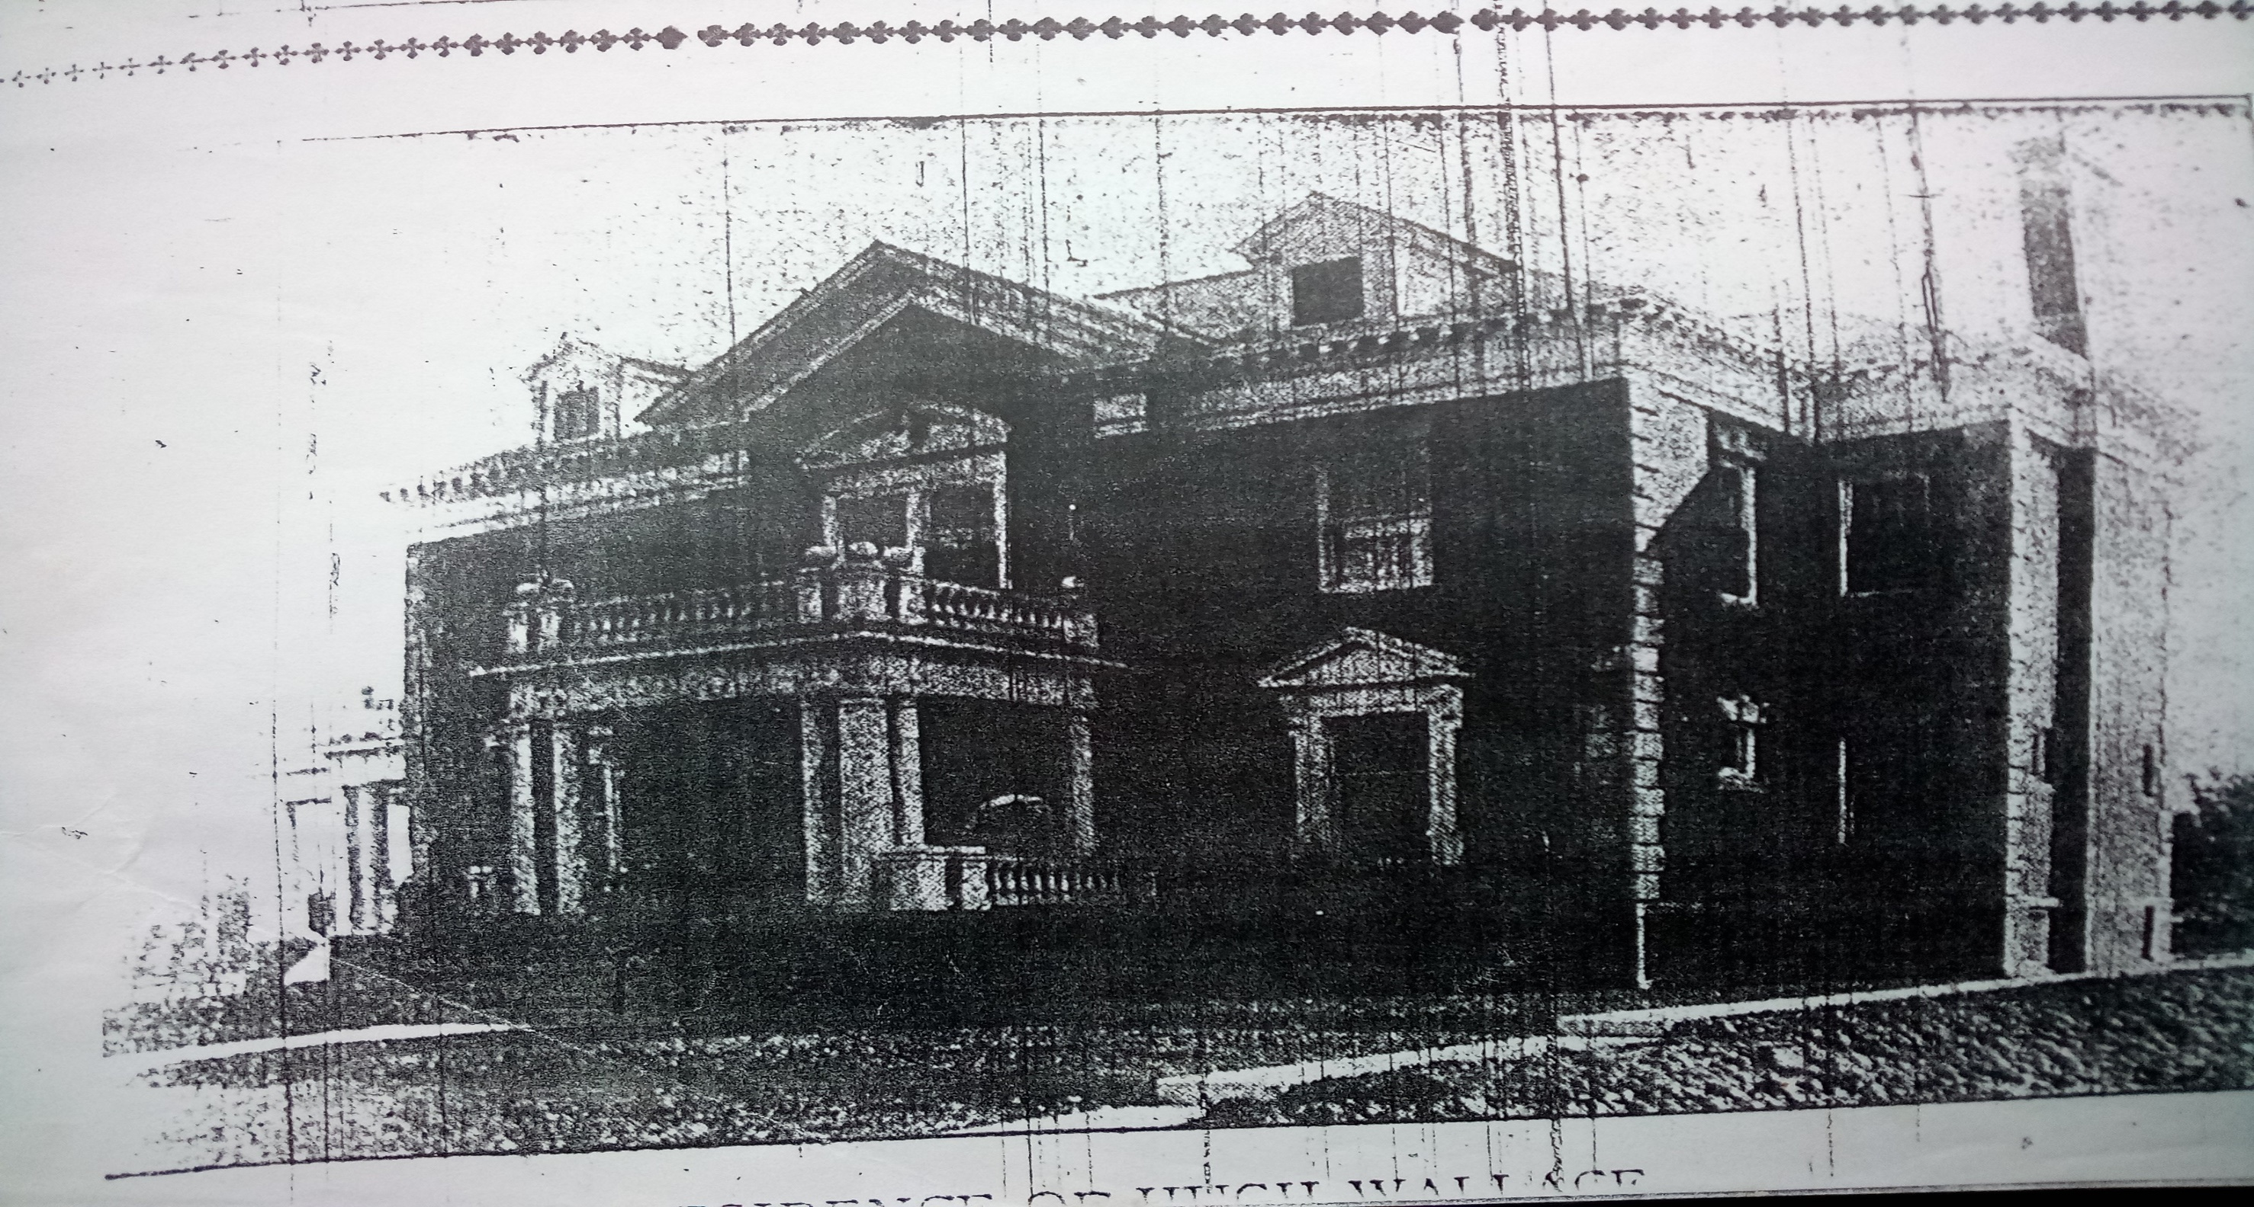
–
Appears to be slate

Slide 4
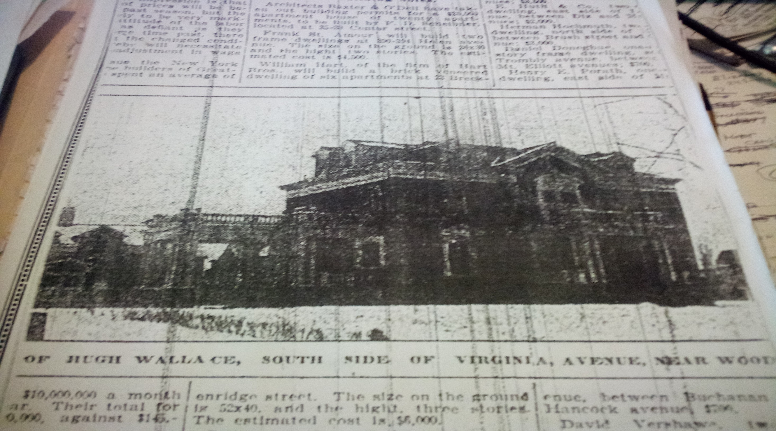
–
Note Railing is not “outside” of columns, but between Columns

Slide 5
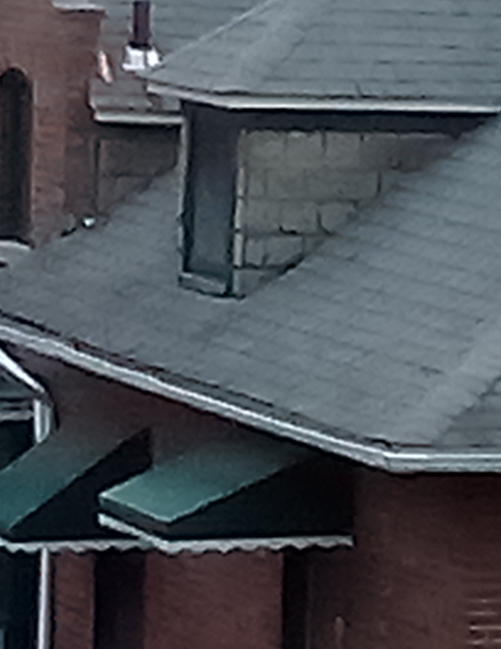
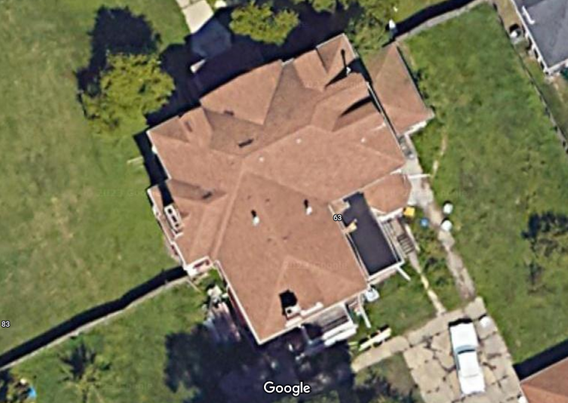
Request to replace
Failing shingles at 63 VP with original slate.
Such as shown at 97 VP.
Dormer C
Dormer D&E
97 VP
Dormer B
Dormer A

Slide 6
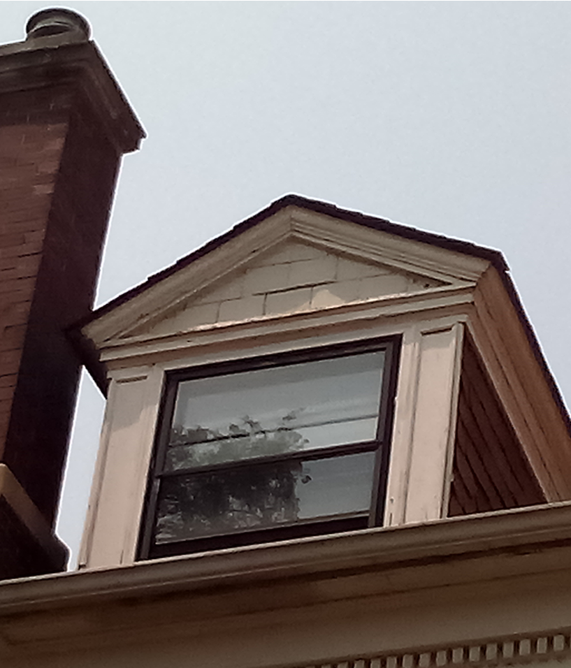
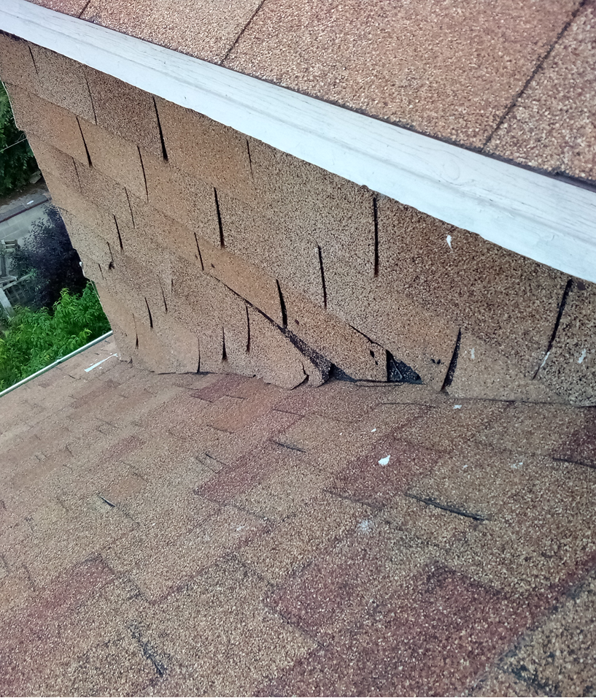
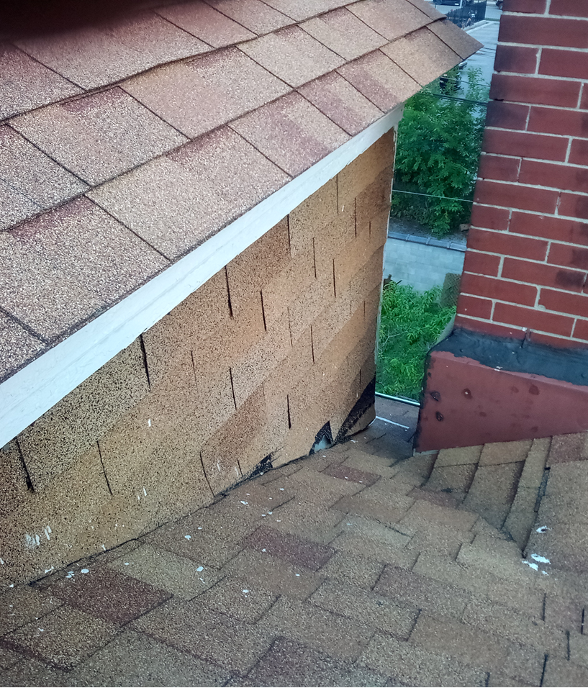
Pictures of Current Rear Dormer A at 63 VP
Original Slate

Slide 7
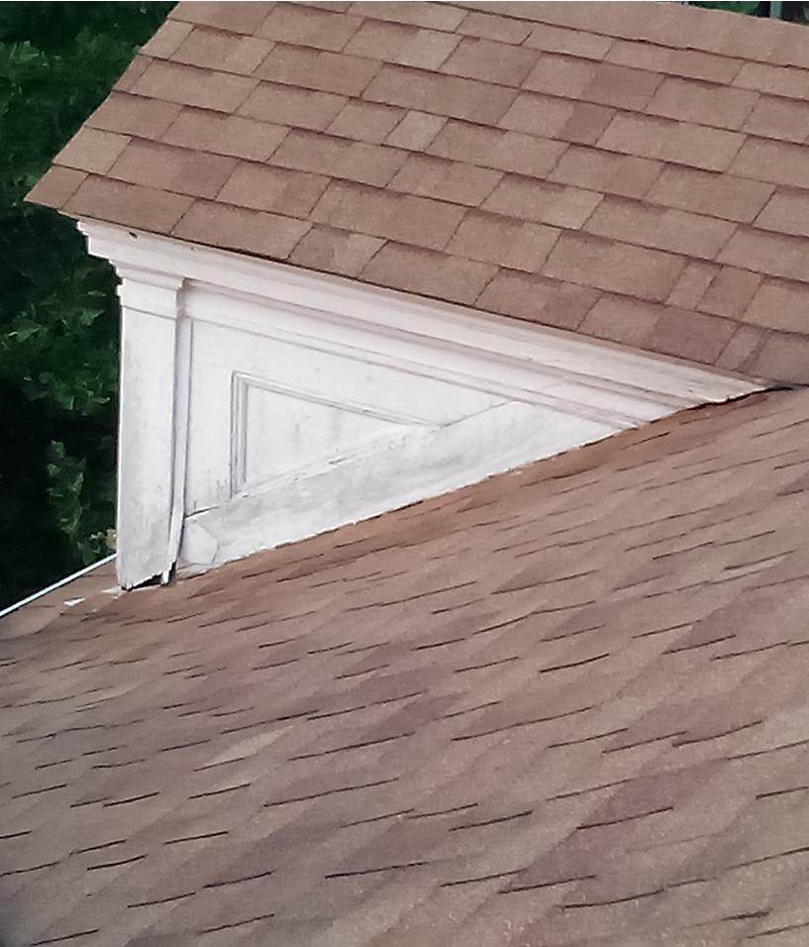
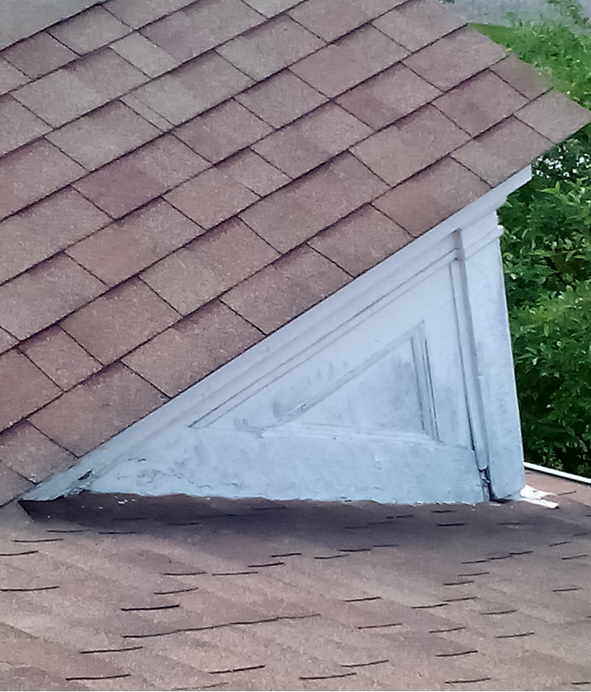
Pictures of Current Dormer B & C
Original Slate

Slide 8
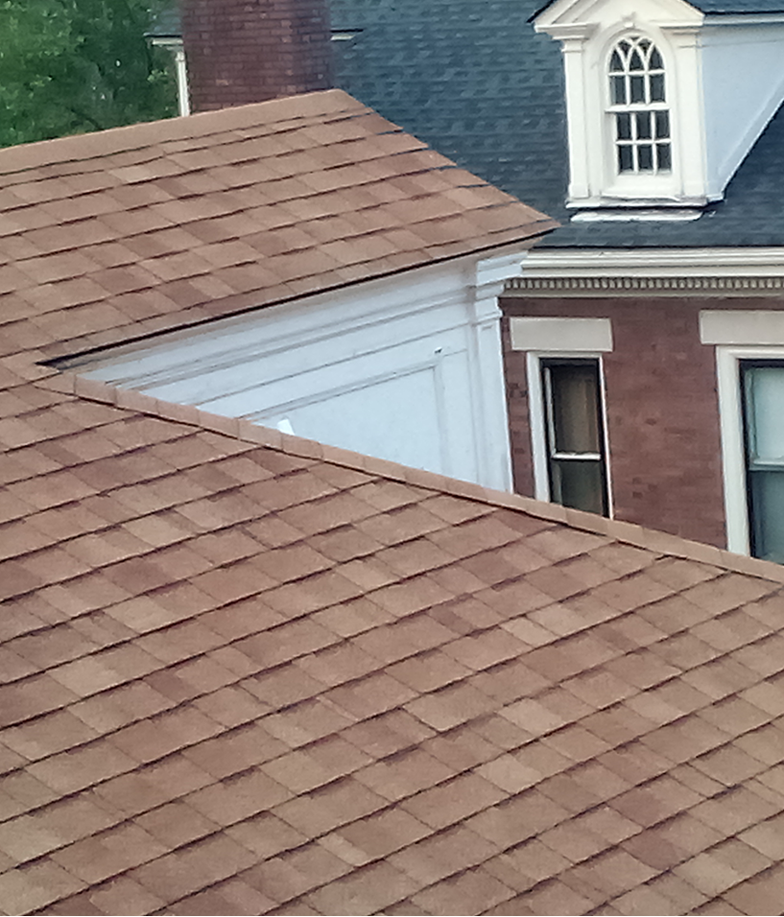
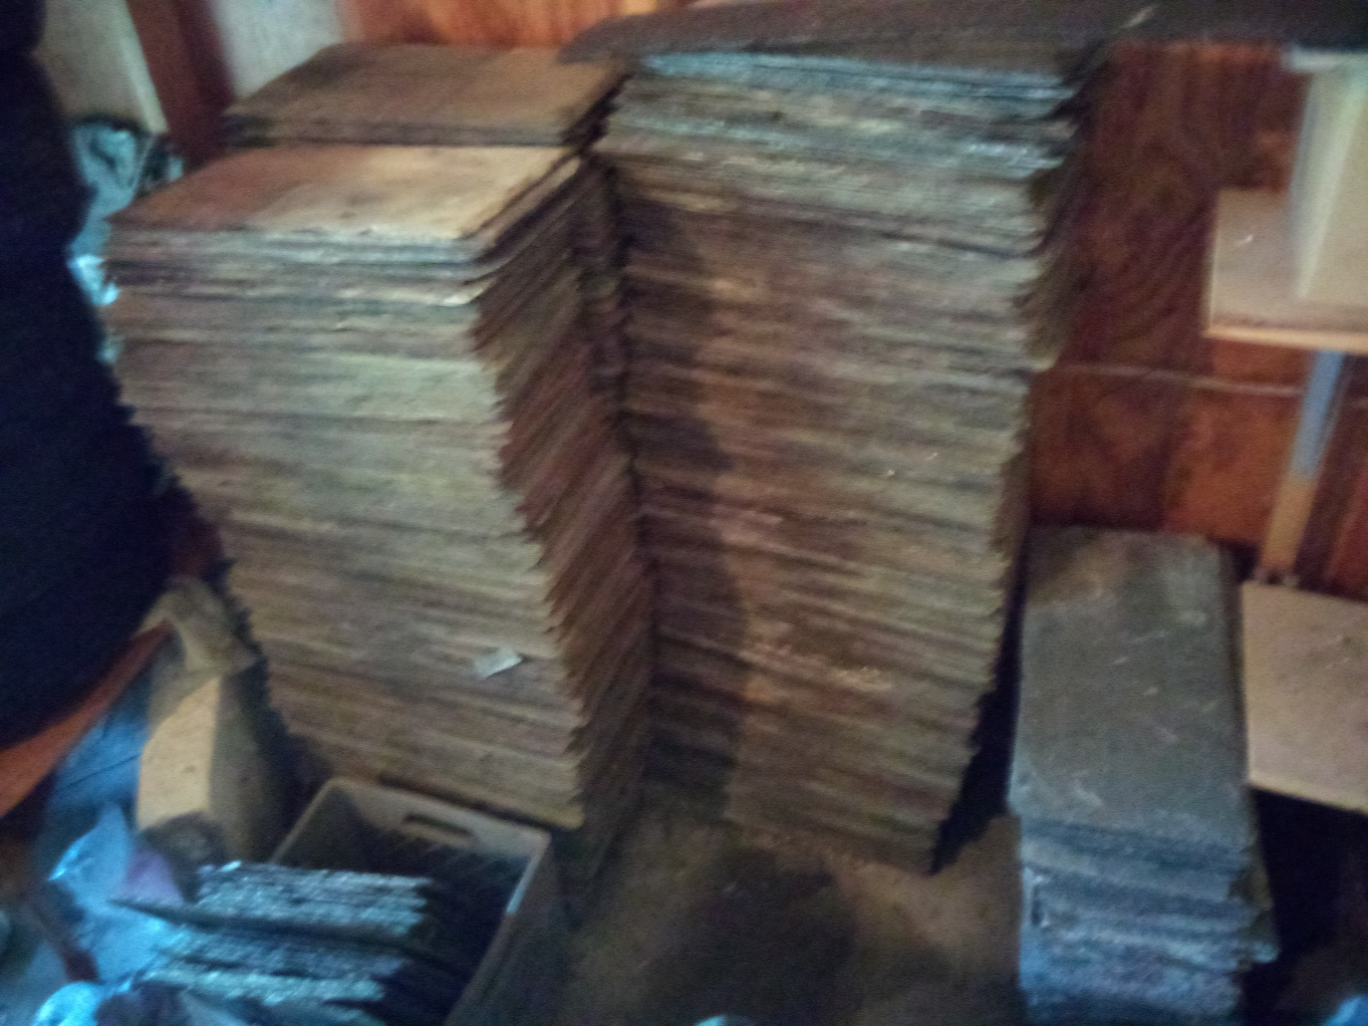
Pictures of Current Dormer E/D
Original Slate
Some of about 1100 slate shingles for reuse

Slide 9
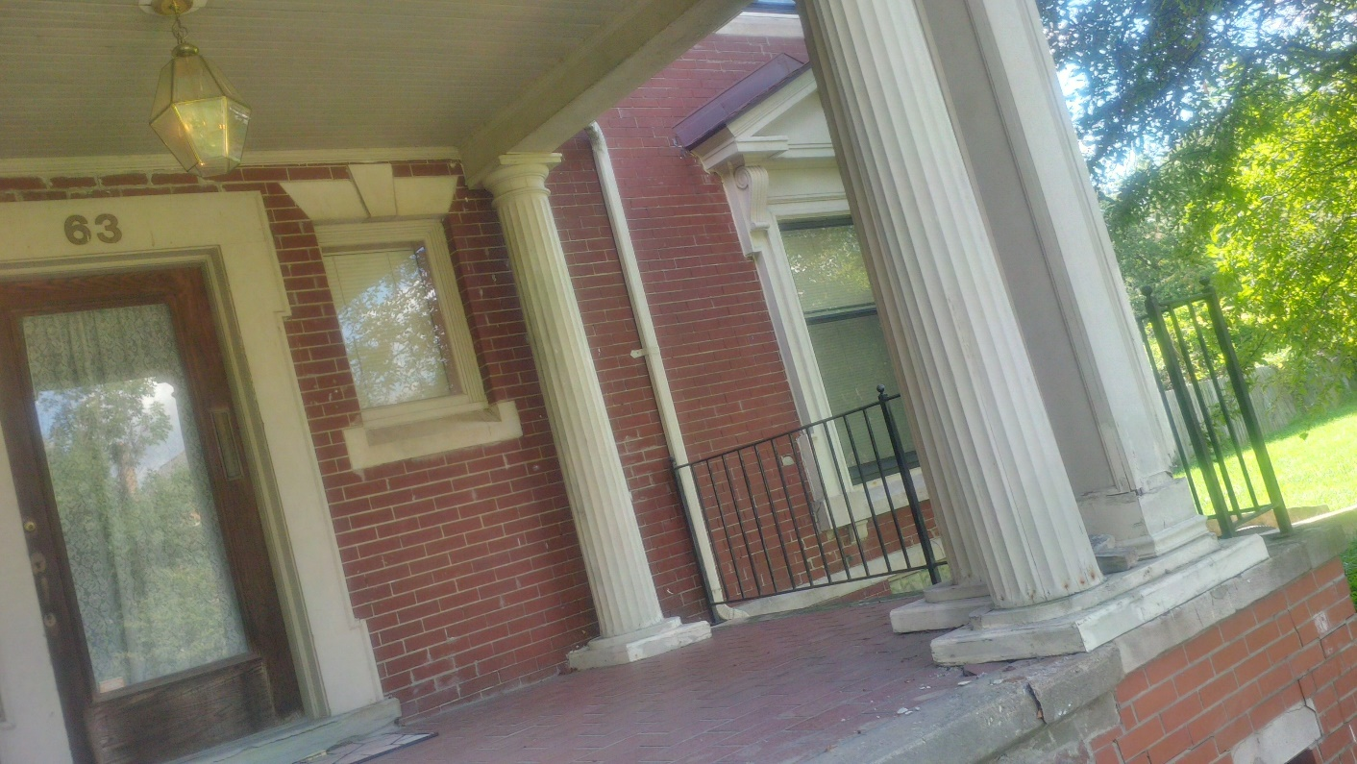
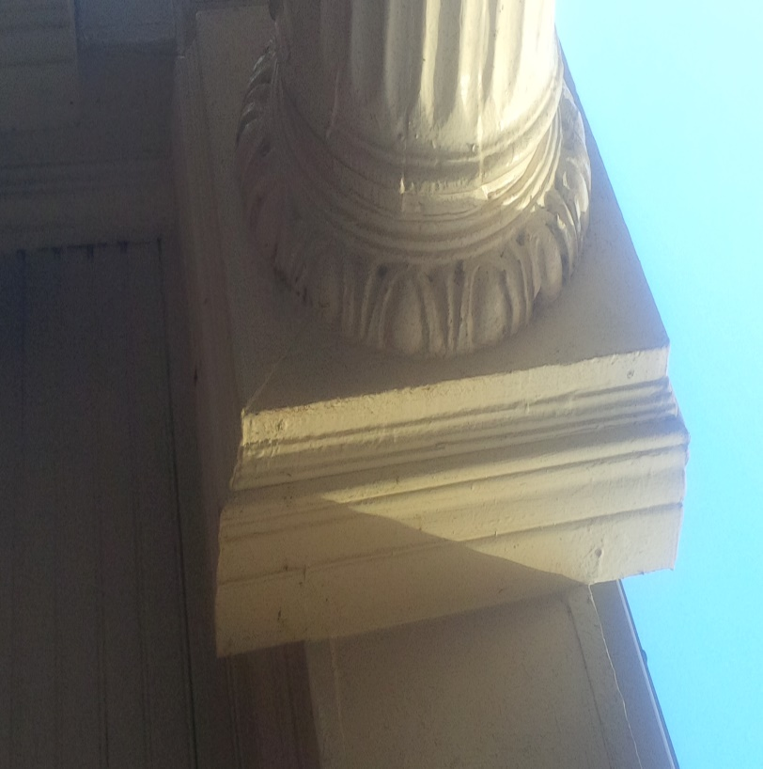
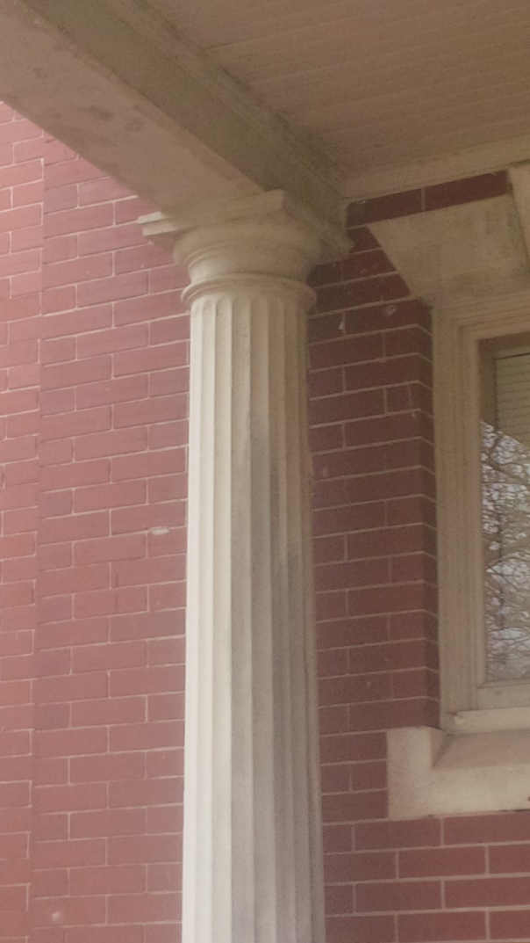
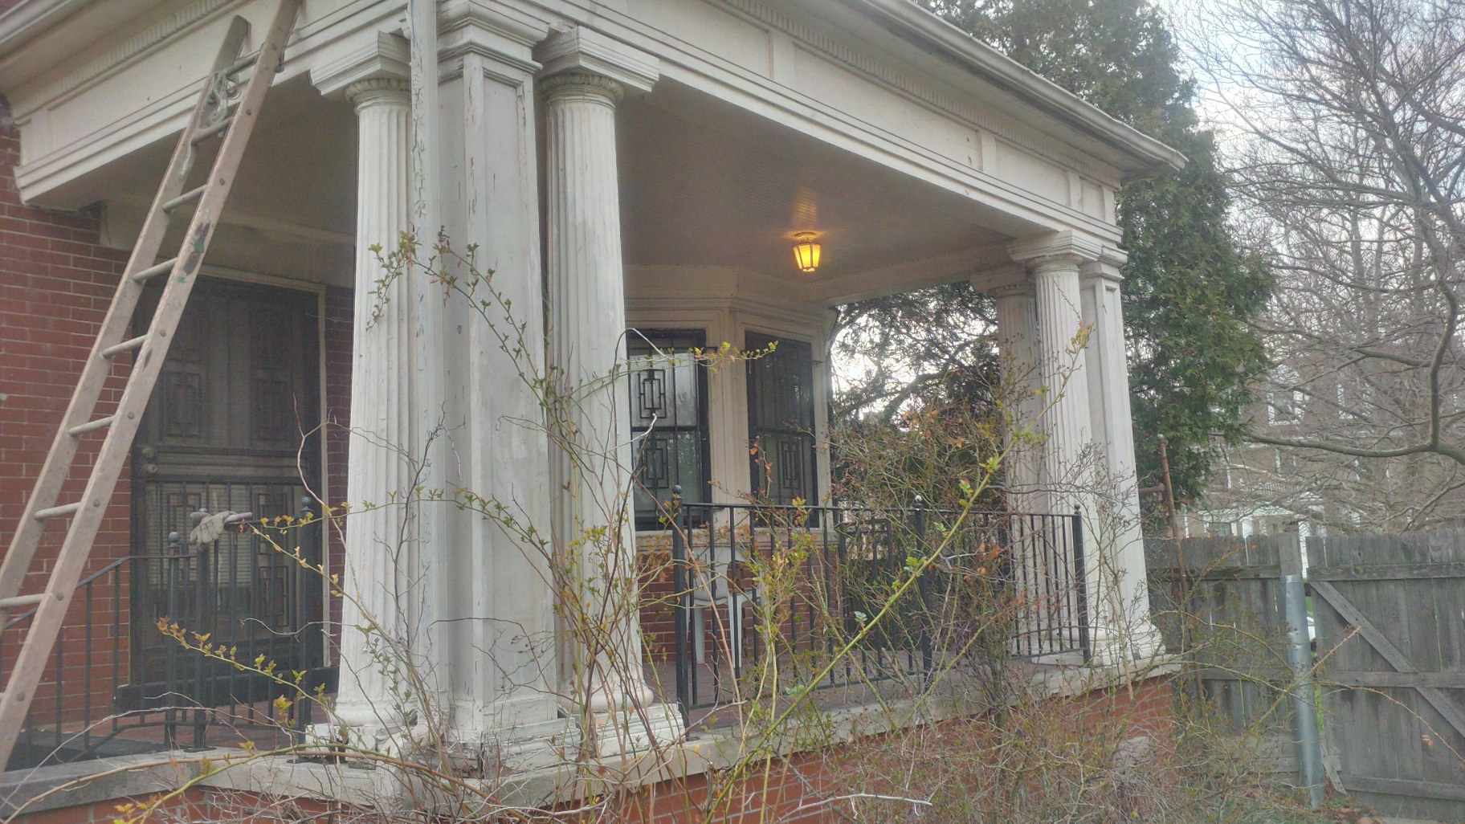
Front Porch vs Side Porch Columns
Messed up front porch Bases
from prior owner.
Side Porch
Side Porch
Front porch
I have not found any prefabricated Egg and Dart Capitals. To Match Historically, columns must be cast from the originals. This means a trip to Jacksonville FL with Columns in the van.

Slide 10
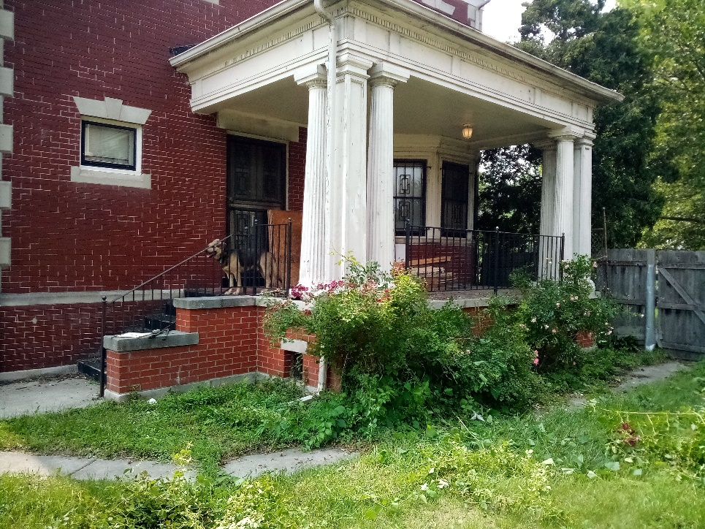
Front Porch/Side Porch Elements
Some Correspondance with Manufacturer is below
Side Porch
I request approval to
Add Slate Shingles to all Dormer sides and (if I have enough) dormer roofs.
This includes replacing asphalt shingles on rear Dormer.
2) Remove all modern iron railing.
3) Replace all columns with reproduced (most likely Royal Foam)
structural Columns. Mount a 4”x4” of treated lumber or yellow
pine in centers of columns.
4) Mount Historic sized railing approximately 24”. Pier/Caps are slightly
higher.
Front Porch, but elements to match on Side Porch

