Slide 1
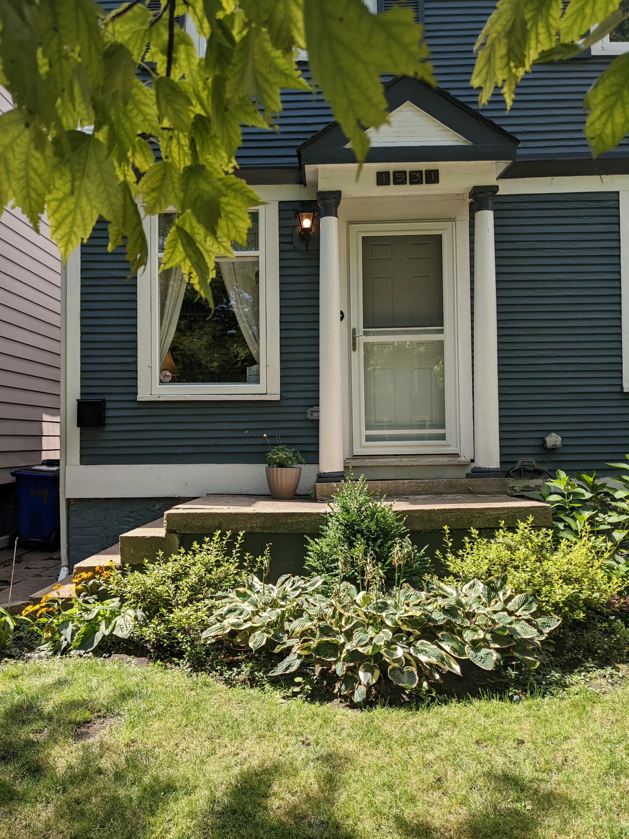
1531 Parker St
Current Front Porch

Slide 2
1531 Parker St Current cracked front porch viewed from stairs

Slide 3
1531 Parker Street Cracked patio viewed from above

Slide 4
Neighbor’s wooden porch

Slide 5
Another example of wooden porch on Parker Street

Slide 6
Another example of wooden porch on Parker Street

Slide 7
Sanborn Map ca. 1950 indicating original porch was likely made of wood

