Slide 1
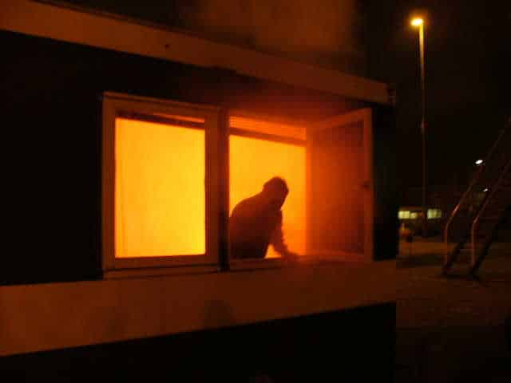
DFD Safety Series: Home and business fire escape plan
Welcome & Thank You for Joining us for the DFD Safety Series!
Edward Davis III, Captain –Fire Marshal Division - Public Instruction Unit
General Info: 313-596-2968
Emergencies: 9-1-1
https://detroitmi.gov/departments/detroit-fire-department
April 9, 2025

Slide 2
DFD Safety Series: Home and business fire escape plan
WHAT IS A FIRE ESCAPE PLAN?
A plan designed to help you safely exit a place in the event of a fire emergency.
It should explain how everyone will be notified of the incident taking place.
It should show all exit or egress points, i.e. how to get out.
It should show ways to shelter in place - what to do if you can not get out safely.
It should show the meeting area or rally point once you are outside of the building.

Slide 3
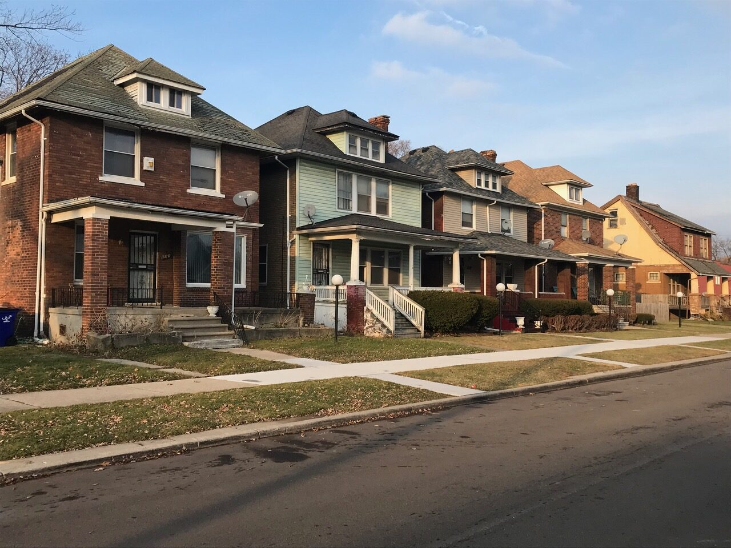
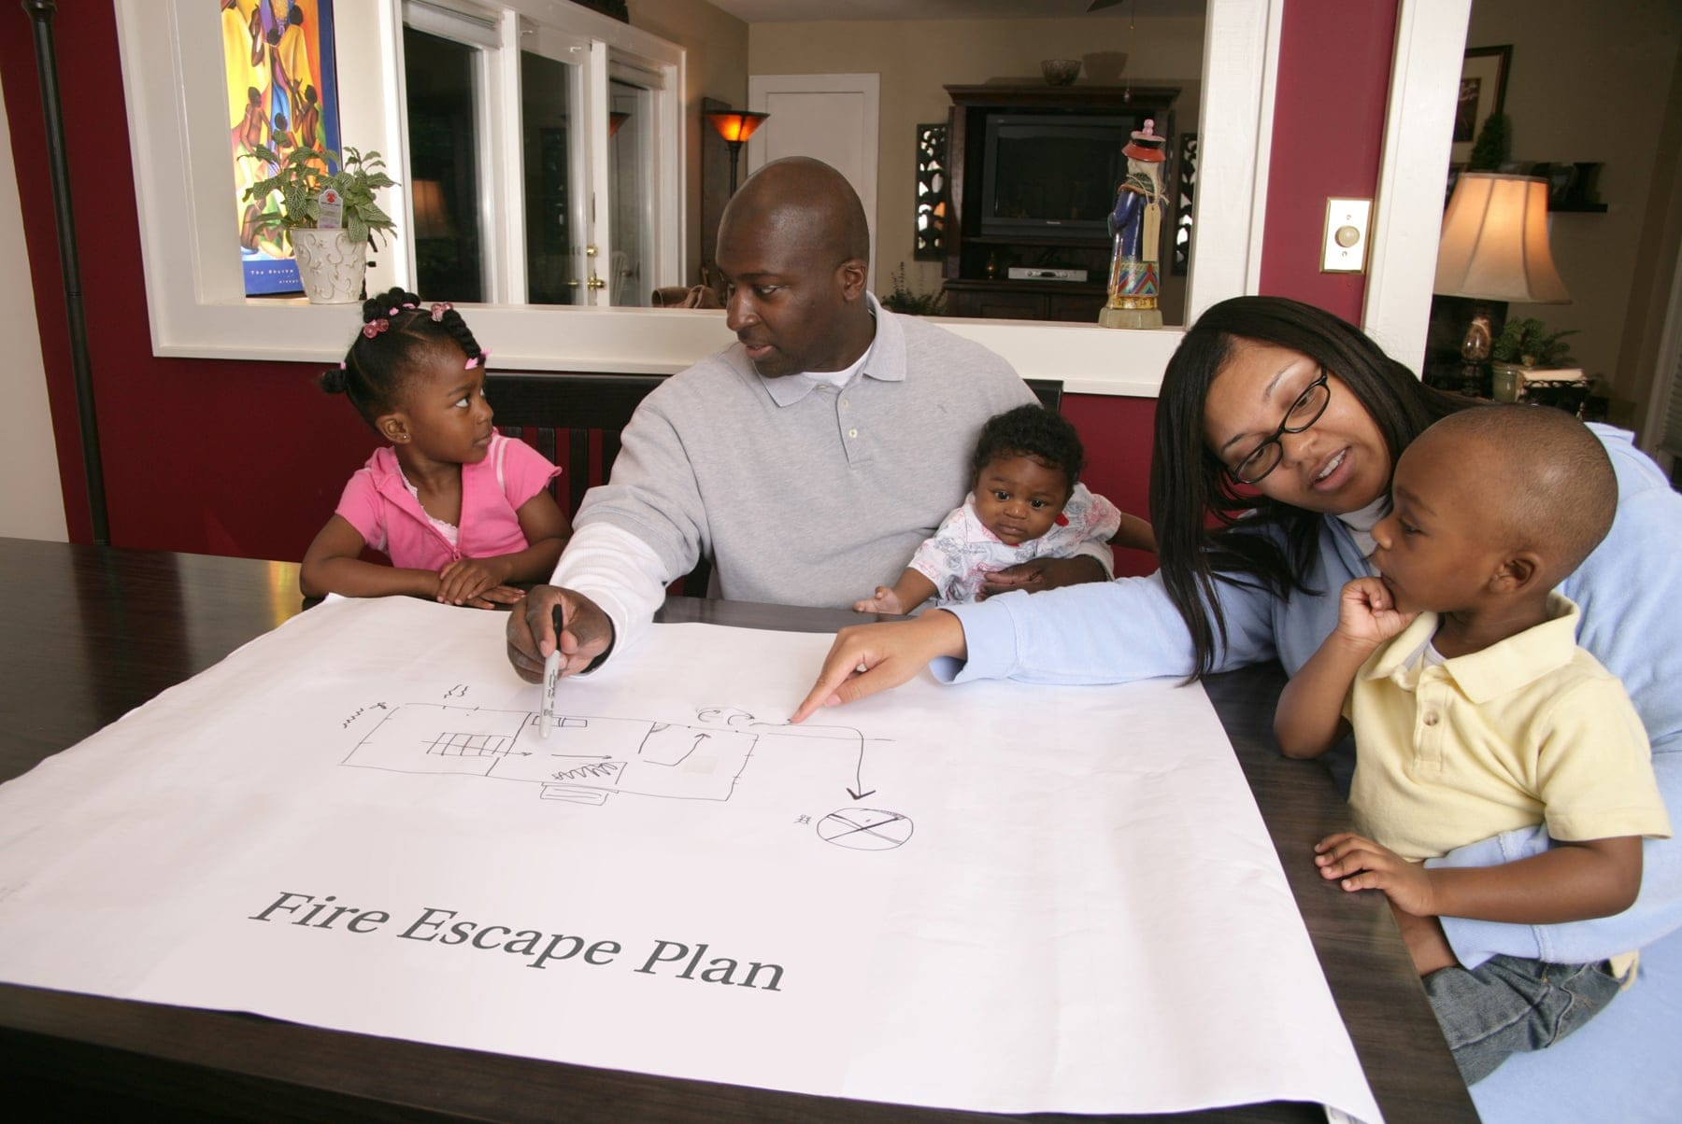
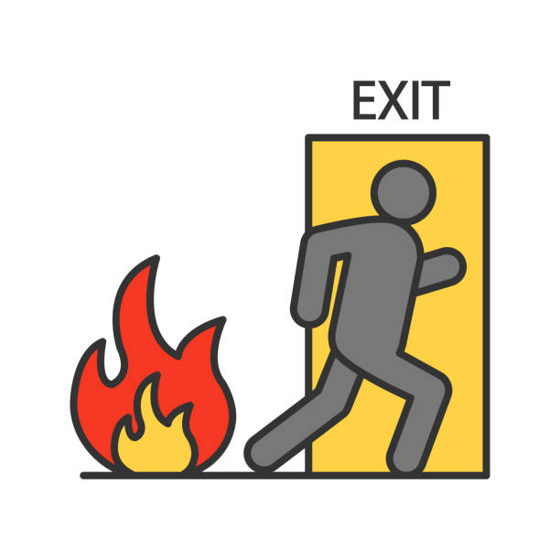
DFD Safety Series: Home and business fire escape plan
HOME ESCAPE PLAN

Slide 4
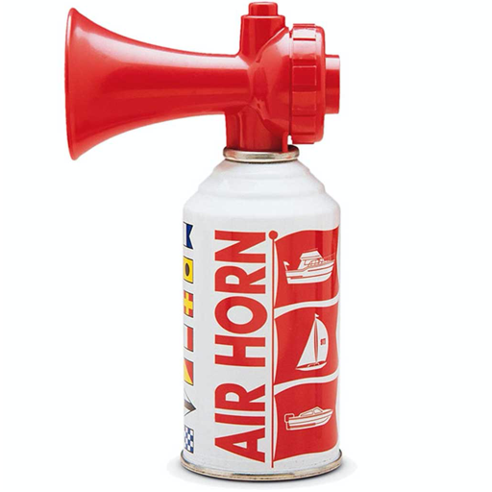
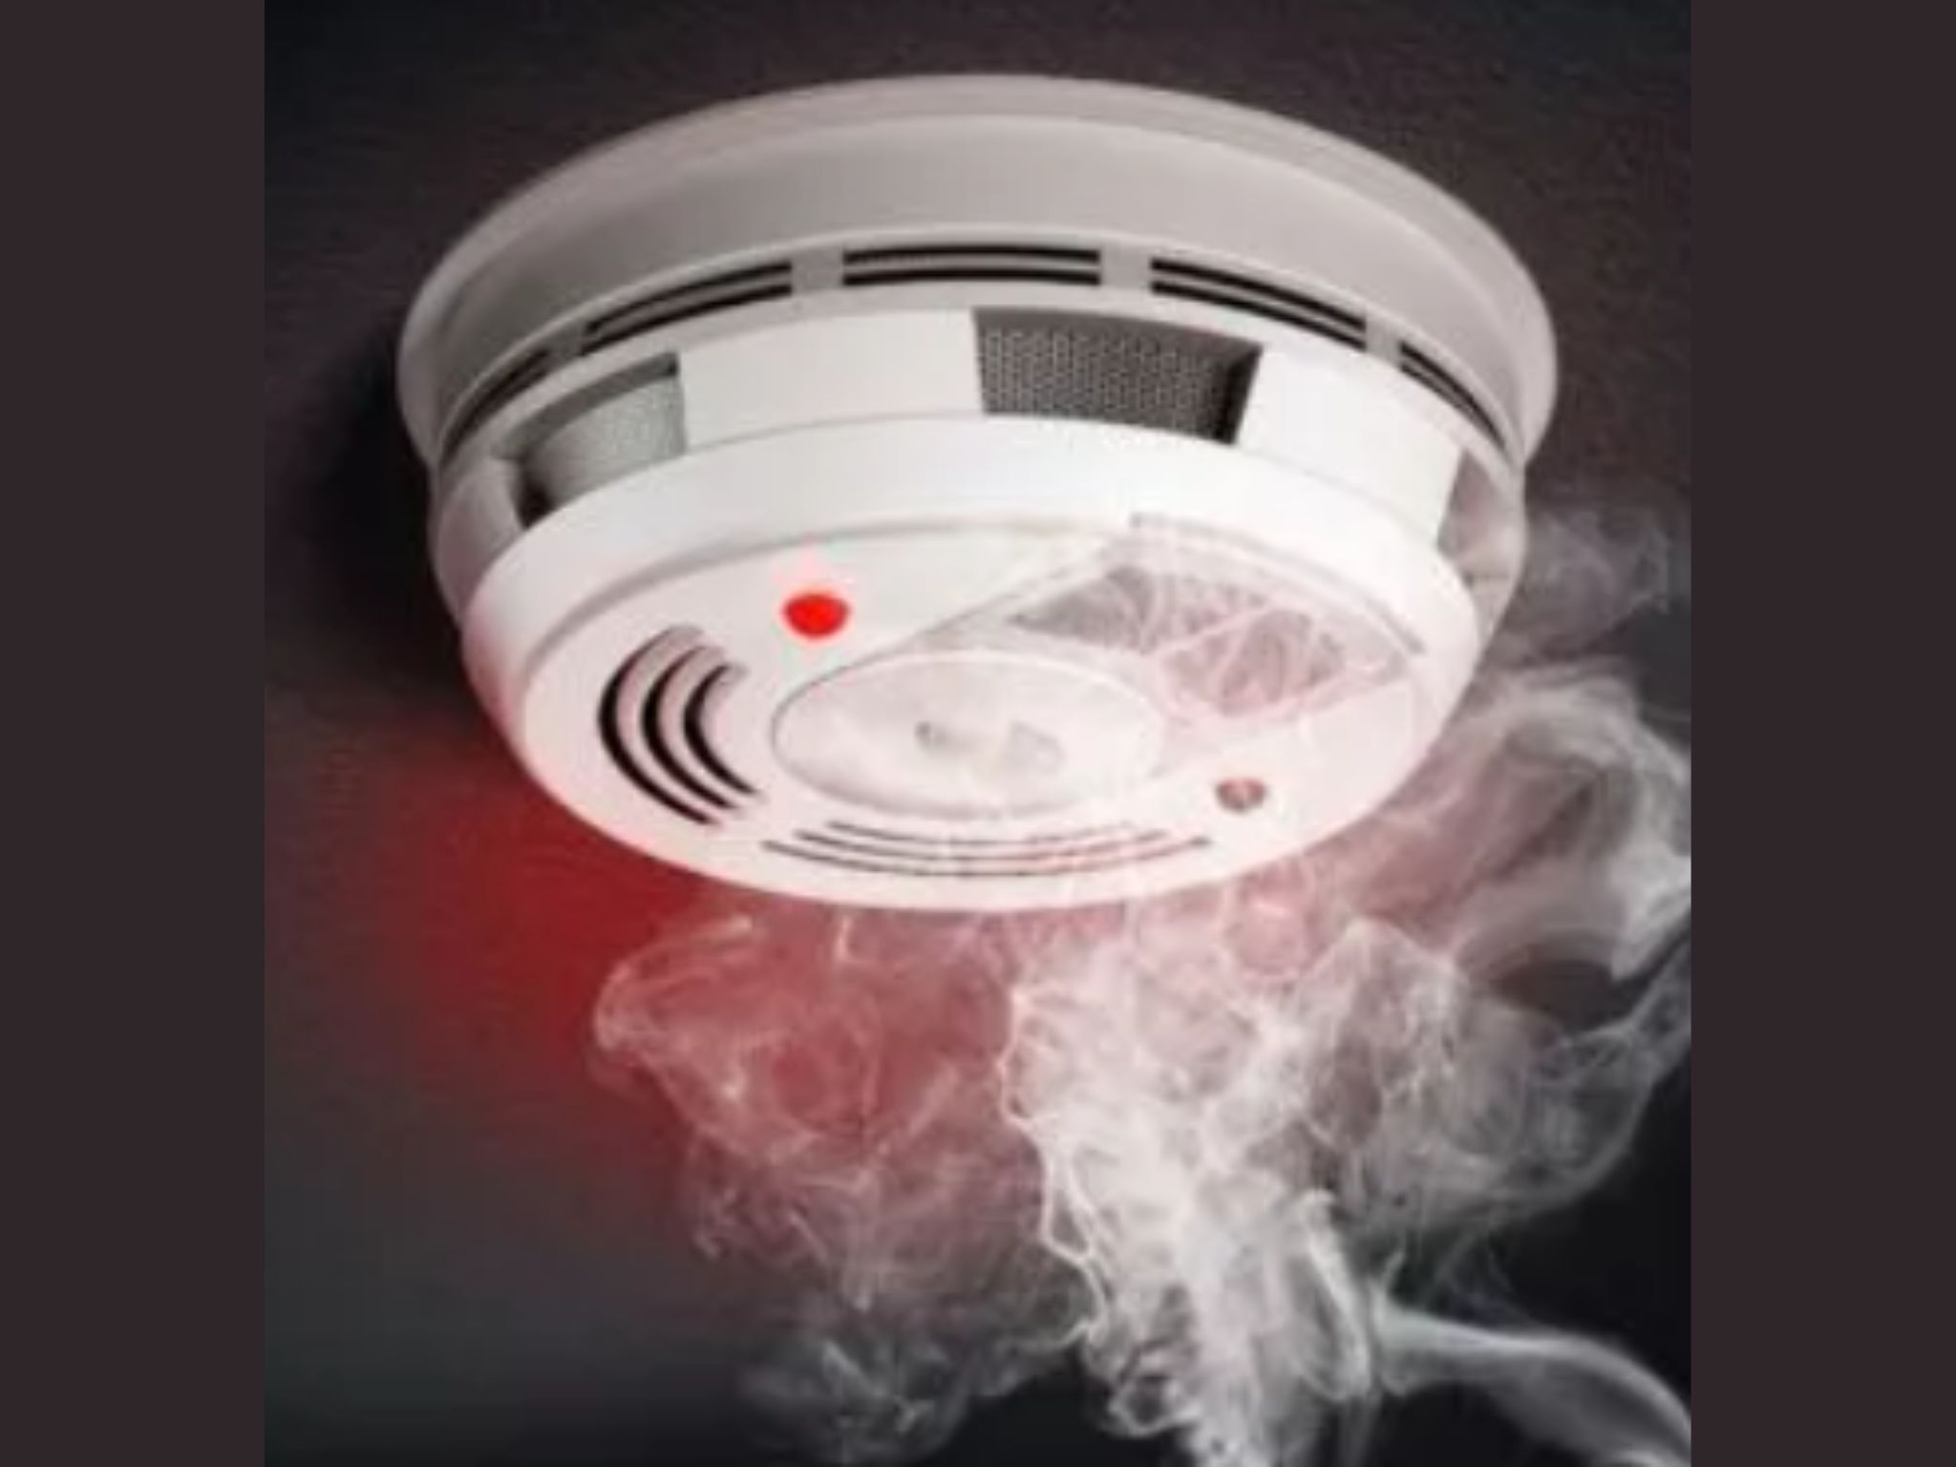
DFD Safety Series: Home and business fire escape plan
NOTIFY
YOUR
FAMILY!

Slide 5
DFD Safety Series: Home and business fire escape plan
R
E
D
EACT
VALUATE
ECIDE

Slide 6
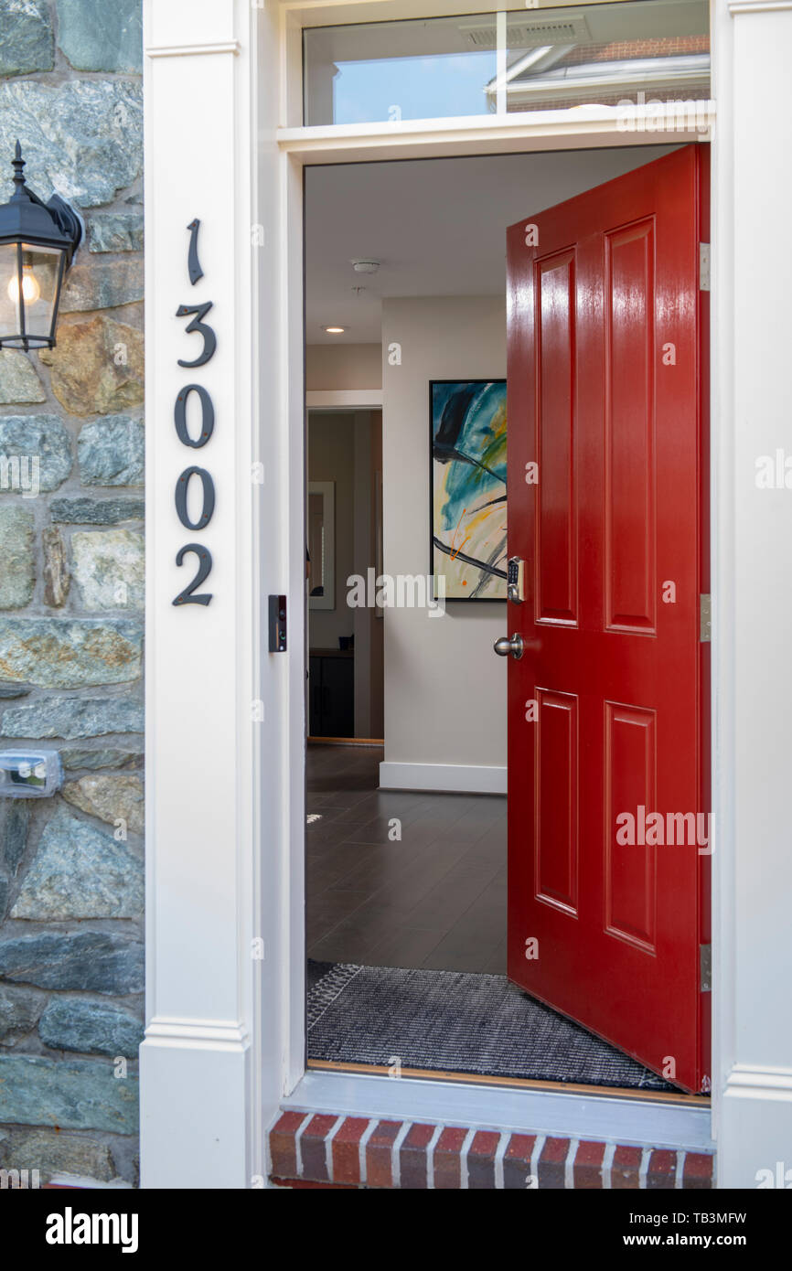
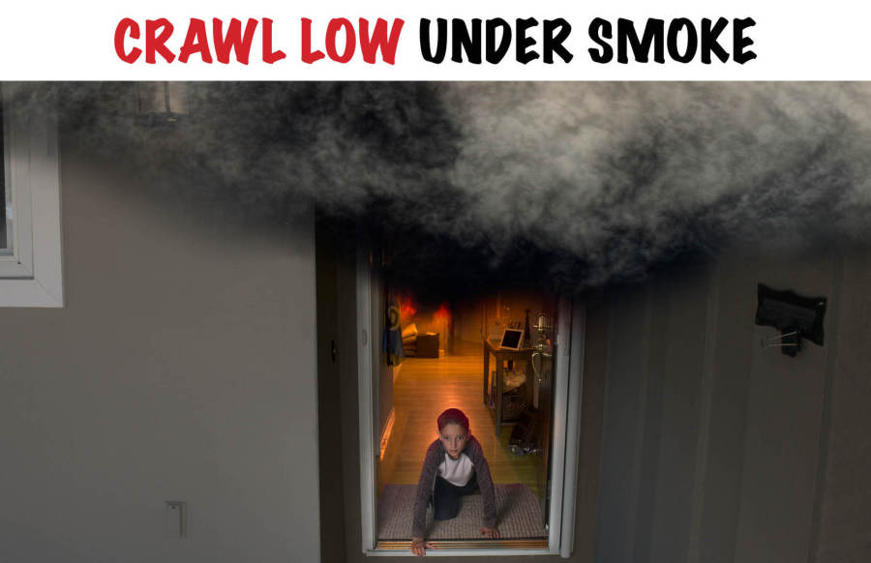
DFD Safety Series: Home and business fire escape plan
EXIT THE HOME!!!!!
Identify at least two (2) ways out of each room, if possible.
Keep exit paths clear of clutter and debris.
Do not block windows and doors with furniture.
GET LOW AND GO!!!

Slide 7
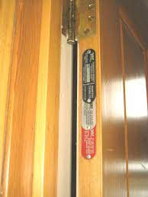
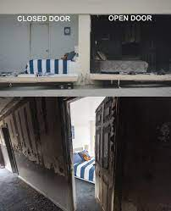
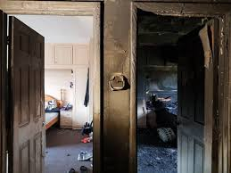
DFD Safety Series: Home and business fire escape plan
HOW TO SHELTER IN PLACE!
If you can not get out, call 9-1-1 and notify them of where you are in the home. (TEXT 9-1-1 option)
Close doors to limit the spread of fire and smoke.
All doors have a minimum fire rating of 20 minutes.
Place wet towels at the bottom of closed doors.

Slide 8
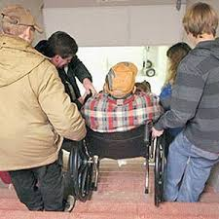
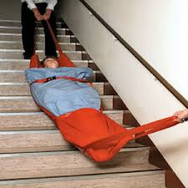
DFD Safety Series: Home and business fire escape plan
FOR RESIDENTS WITH PHYSICAL CHALLENGES
If a person has physical challenges that prevent them from walking down a flight of stairs, and they cannot shelter in place, there are other options to get them safely out of the home.
It’s possible to use bedsheets or large towels to assist in getting down the stairs. BE CAREFUL OF THEIR HEAD!!
If they are on the main level, use a wheeled office chair or wheelchair to get them to safety.

Slide 9
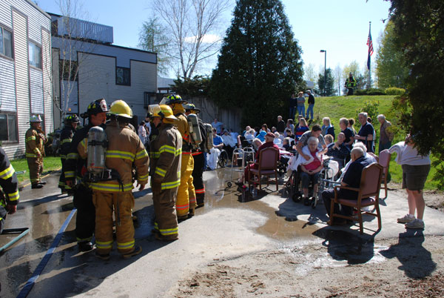
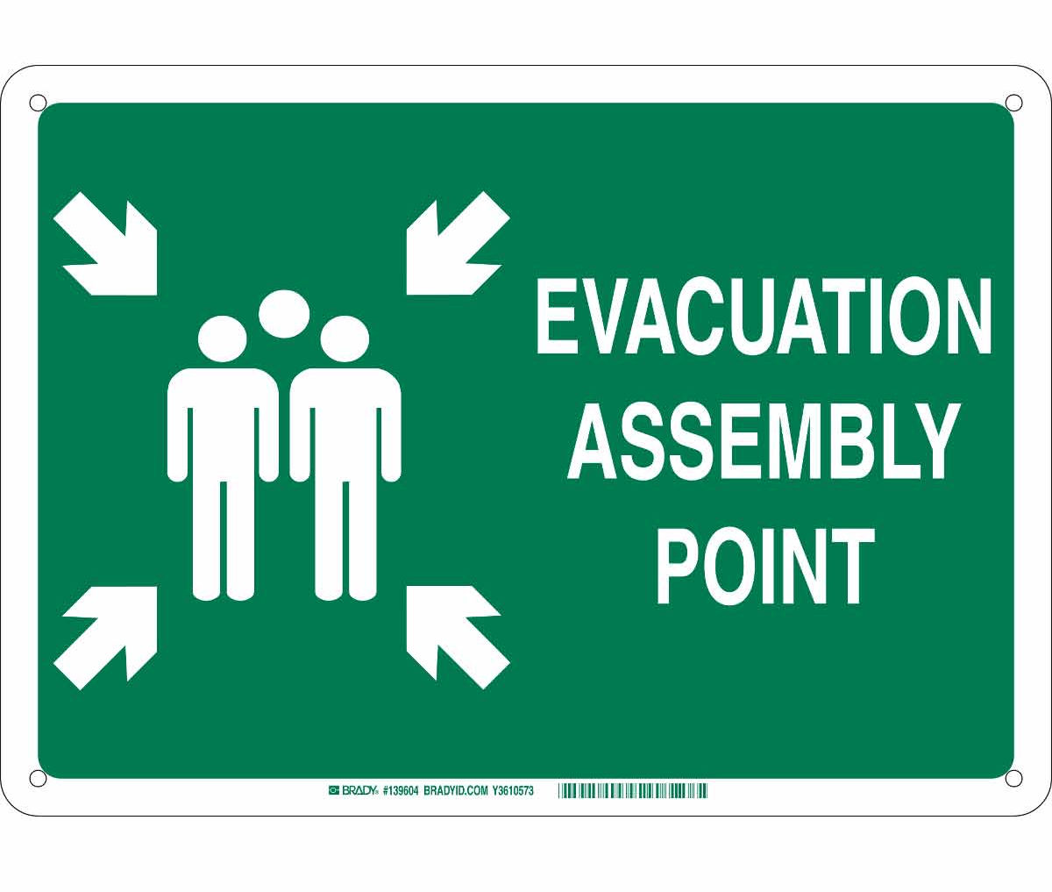
DFD Safety Series: Home and business fire escape plan
ASSEMBLY OR RALLY POINT
Determine a designated assembly point outside of the home.
Assembly area should be far enough from the home to prevent exposure to smoke, falling debris, and not in the path of responders working.
Everyone report to the same designated area.
Let responders on scene know if anyone is missing
Do not return to the home for any reason until it is deemed safe by first responders on scene to do so.

Slide 10
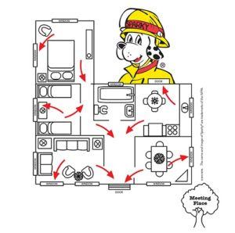
DFD Safety Series: Home and business fire escape plan
CREATING THE PLAN
Begin with creating a drawing of each floor of your home. **It does not have to be fancy**
Show all exit doors and windows.
Use arrows to show exit routes and paths.
Show where the meeting point is once you are out of the home.

Slide 11
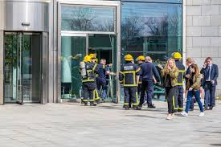
DFD Safety Series: Home and business fire escape plan
RESIDENTIAL APARTMENTS AND COMMERCIAL BUILDINGS
The Fire Marshal Division works directly with Owners and Property Management to establish a fire safety plan.
The type of occupancy, contents, and building’s fire protection systems (fire alarm, sprinkler system, fire doors, etc.), along with Fire Operations (firefighting) division’s response procedures are considered when creating the plan.
By NFPA Fire Code and the Detroit City Charter, all fire plans must be approved and filed with the Fire Marshal’s office.

Slide 12
DFD Safety Series: Home and business fire escape plan
Request a copy of your building’s fire escape plan.
Make yourself aware of the location of all exits, protected stairwells, fire extinguishers, and alarm pull stations.
Participate in all fire drills.
Become a floor/area captain.

Slide 13
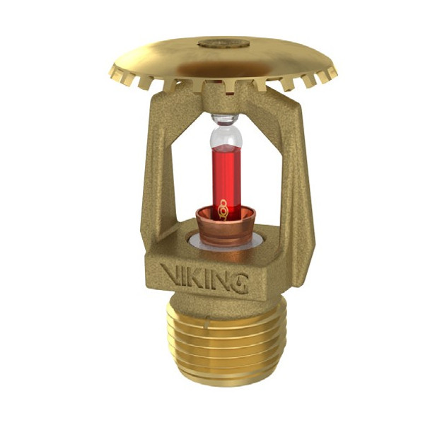
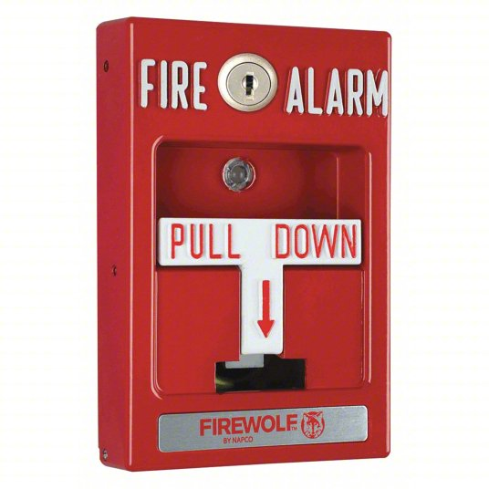
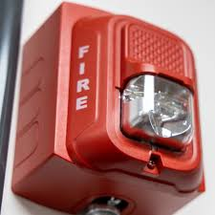
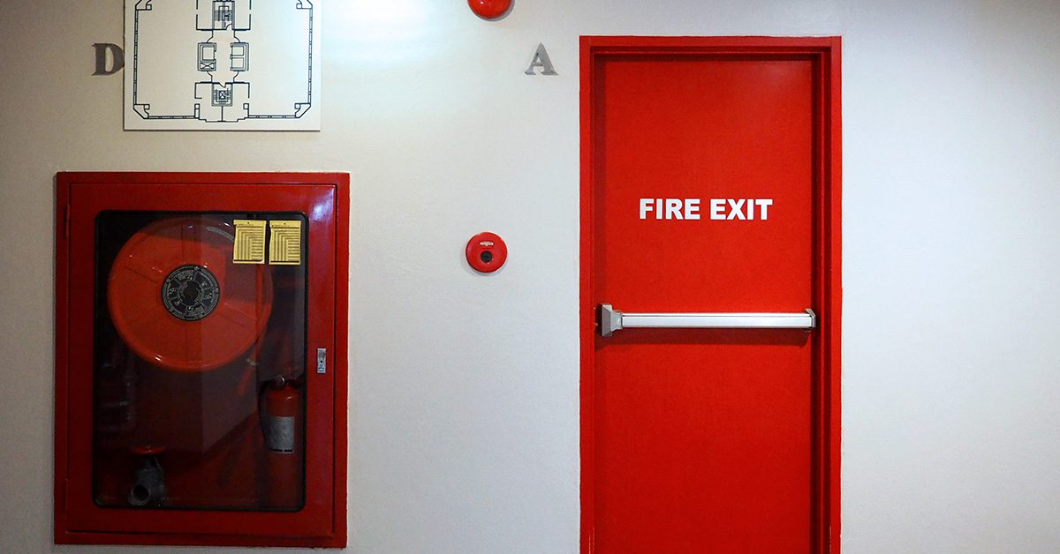
DFD Safety Series: Home and business fire escape plan
FIRE PROTECTION SYSTEMS

Slide 14
DFD Safety Series: Home and business fire escape plan
PRACTICE!!!!!
Constantly review plan and revise as needed.
Make all tenants and occupants aware of the plan.
Conduct at least two (2) drills a year, more often if children are in the home.
Treat every alarm as the real thing.
WE PLAY HOW WE PRACTICE!!

Slide 15
DFD Safety Series: Home and business fire escape plan
Thank you for joining us today for the DFD Safety Series.
Please reach out if you have any questions!
Edward Davis III, Captain, Fire Prevention
Contact Information:
Davise7002@detroitmi.gov
313-596-2968

Slide 16
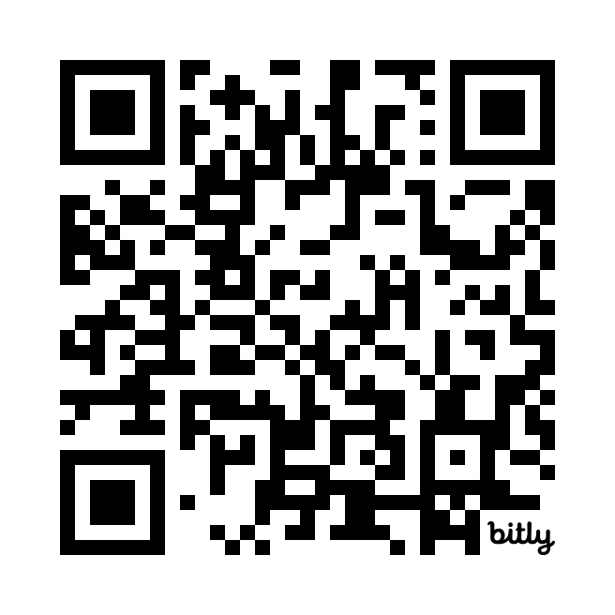
DFD Safety Series: Home and business fire escape plan
Q&A
To ask a question, use this link:
bit.ly/DFDQuestions
Or scan the QR Code:

