Slide 1
AGENDA III.C. 7:30 PM PRESENTATION
Solar Initiative

Slide 2
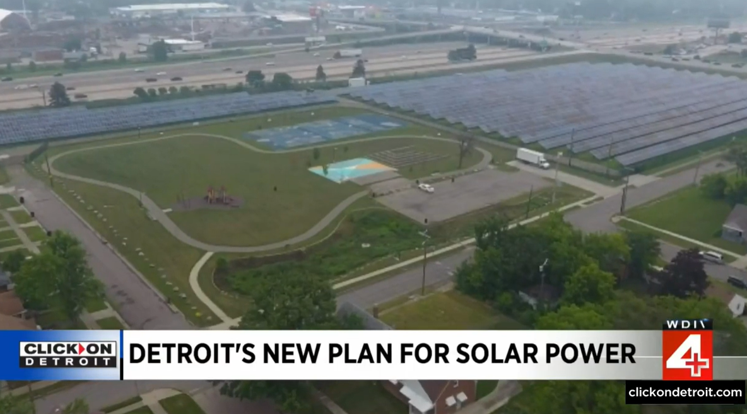
Solar Initiative – June Announcement
June 28, 2023 – District 3 Charter Mandated Meeting
Mayor’s Office: Goal to convert Detroit’s municipal buildings to solar power (~9m/yr)
Tertiary goal of blight remediation
Estimated 250 acres of solar panels needed
Multiple 20-60 acre sites (Option 1) or
One 250-acre site outside of the city (Option 2)
Community Driven: Neighborhoods/Block Clubs apply to host solar farms in their area
Would provide $25,000/acre to the neighborhood in Energy Efficiency upgrades
Applications due this past October

Slide 3
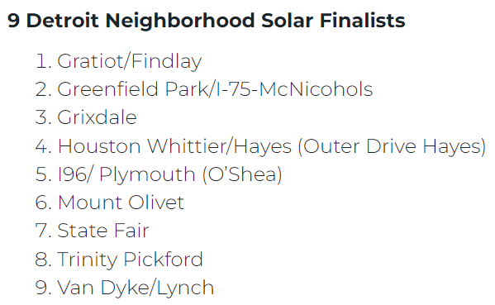
Solar Initiative – Nov. Announcement
City announces 9 finalists for Solar Field Host Neighborhoods
Update: Goal to offset electricity used currently by 127 city buildings:
City Hall
Police & Fire Stations
Recreation Centers
27 neighborhood groups held discussion meetings, 10 submitted formal proposals
6 winning sites, totaling 250 acres, expected to be selected by March 2024
250 acres would host 33 megawatts of solar arrays
January 31 deadline for 9 finalists to submit evidence of resident support

Slide 4
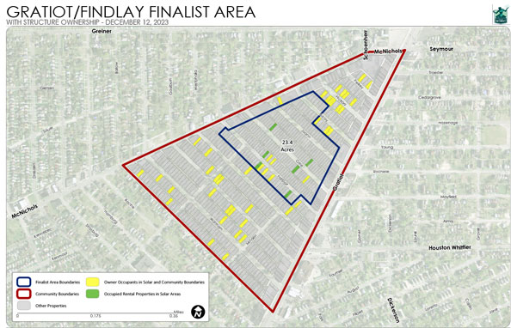
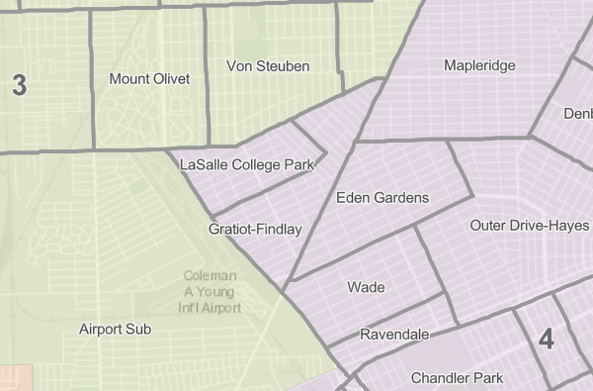
1. Gratiot/Findlay (D4)
Council Districts & Neighborhoods
Blue Outline: Finalist Area Boundaries – 23.4 acres
Red Outline: Community Boundaries
Yellow Lots: Owner Occupied
Green Lots: Occupied Rental Property

Slide 5
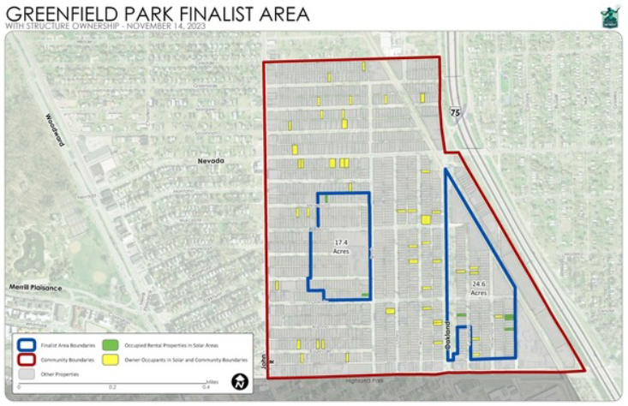
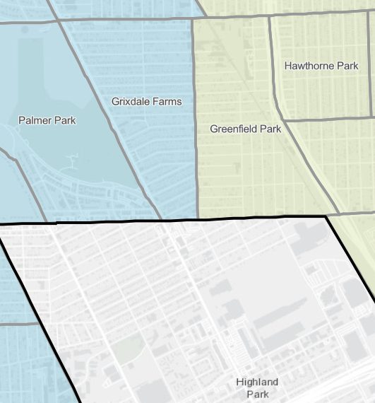
2. Greenfield Park/I-75-McNichols (D3)
Council Districts & Neighborhoods
Blue Outline: Finalist Area Boundaries – 42 acres
Red Outline: Community Boundaries
Yellow Lots: Owner Occupied
Green Lots: Occupied Rental Property

Slide 6
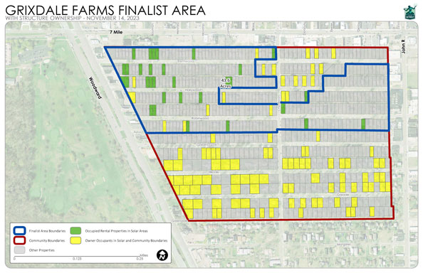
3. Grixdale (D2)
Council Districts & Neighborhoods
Blue Outline: Finalist Area Boundaries – 43.6 acres
Red Outline: Community Boundaries
Yellow Lots: Owner Occupied
Green Lots: Occupied Rental Property

Slide 7
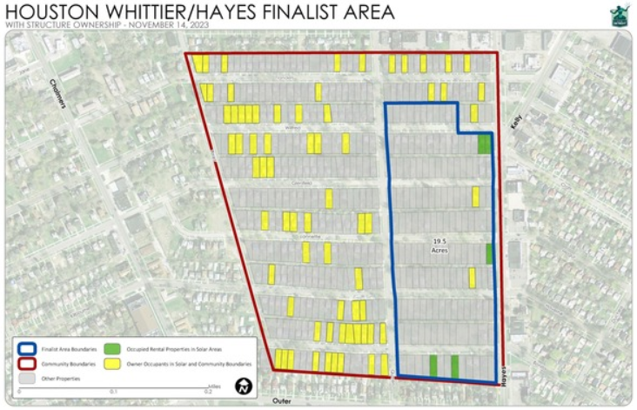
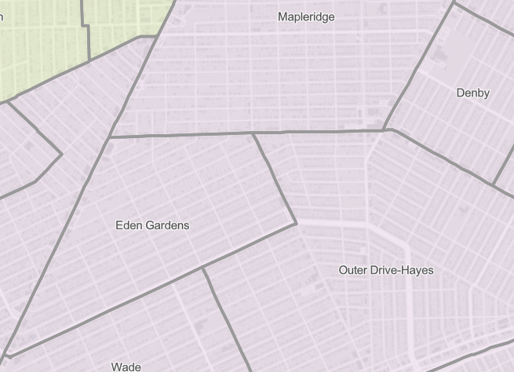
4. Houston Whittier/Hayes (D4)
Council Districts & Neighborhoods
Blue Outline: Finalist Area Boundaries –19.5 ac.
Red Outline: Community Boundaries
Yellow Lots: Owner Occupied
Green Lots: Occupied Rental Property

Slide 8
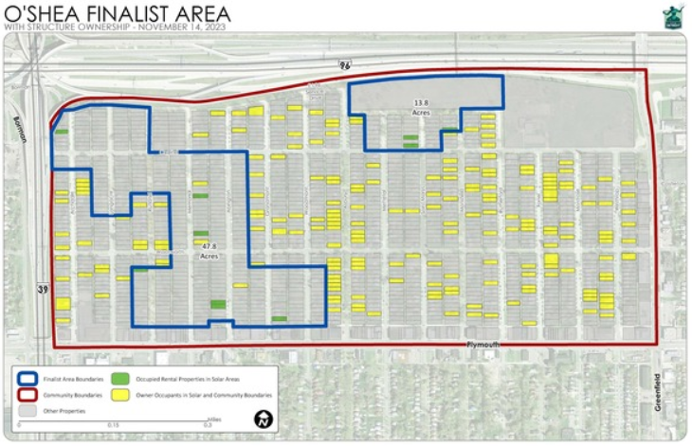
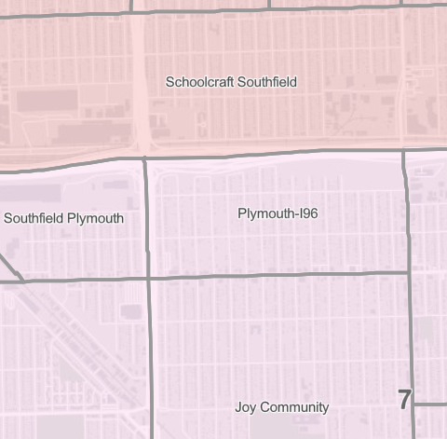
5. I-96/Plymouth-O’Shea (D7)
Council Districts & Neighborhoods
O’Shea Solar Park
Blue Outline: Finalist Area Boundaries – 61.6 acres
Red Outline: Community Boundaries
Yellow Lots: Owner Occupied
Green Lots: Occupied Rental Property

Slide 9
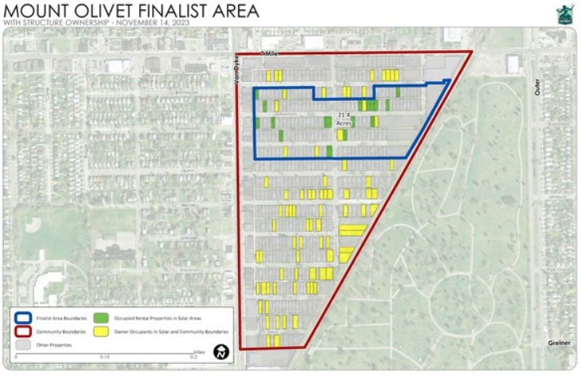
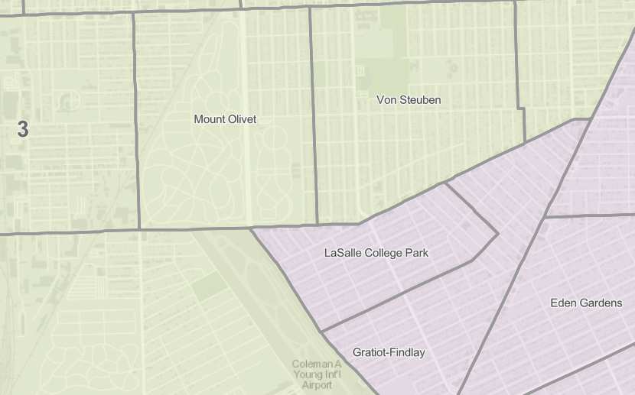
6. Mount Olivet (D3)
Council Districts & Neighborhoods
Blue Outline: Finalist Area Boundaries – 21.4 acres
Red Outline: Community Boundaries
Yellow Lots: Owner Occupied
Green Lots: Occupied Rental Property

Slide 10
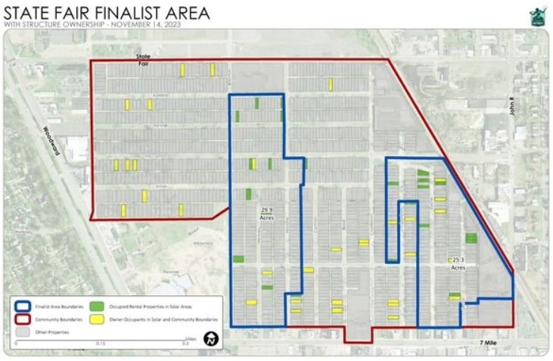
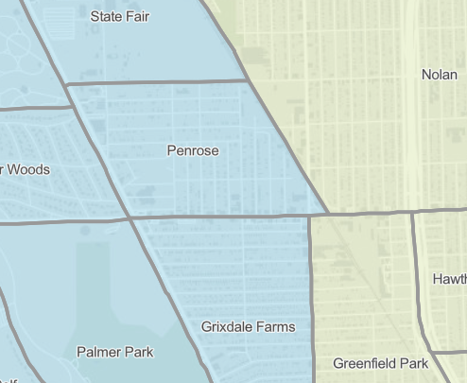
7. State Fair (D2)
Council Districts & Neighborhoods
Blue Outline: Finalist Area Boundaries – 55.2 acres
Red Outline: Community Boundaries
Yellow Lots: Owner Occupied
Green Lots: Occupied Rental Property

Slide 11
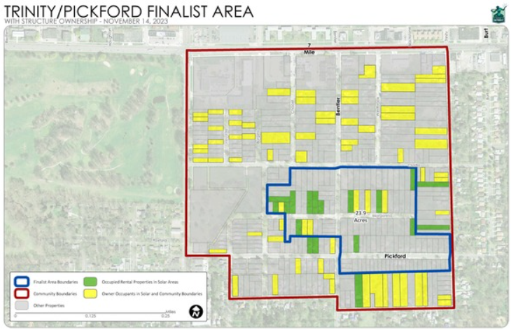
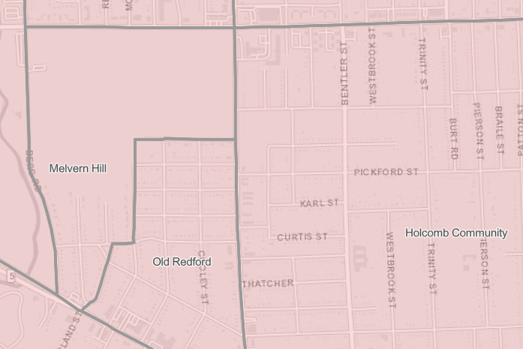
8. Trinity Pickford (D1)
Council Districts & Neighborhoods
Blue Outline: Finalist Area Boundaries – 23.9 acres
Red Outline: Community Boundaries
Yellow Lots: Owner Occupied
Green Lots: Occupied Rental Property

Slide 12
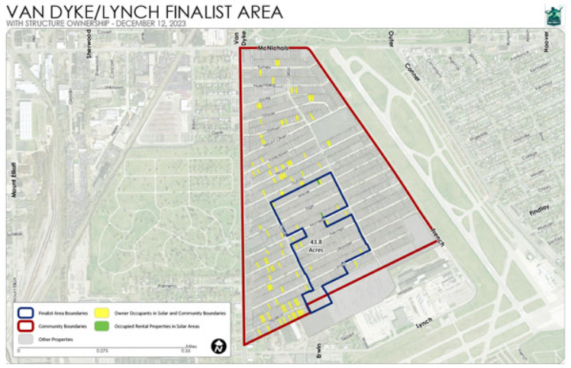
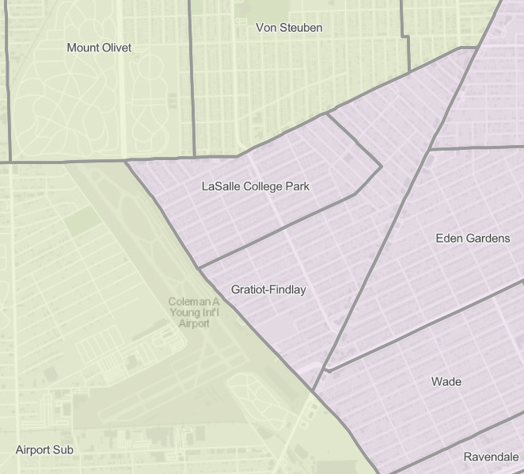
9. Van Dyke/Lynch (D3)
Council Districts & Neighborhoods
Blue Outline: Finalist Area Boundaries – 43.8 acres
Red Outline: Community Boundaries
Yellow Lots: Owner Occupied
Green Lots: Occupied Rental Property

