Slide 1
March 2023 HRD Pre-Submission Outreach Meeting March 14th, 2023
Master Rehabilitation Plan Assistance
Notes:
Kelly

Slide 2
INTRODUCTIONS
City of Detroit Housing and Revitalization Department
John Salvatore
Tracie Apatira
City of Detroit Office of Contracting and Procurement
Nancy Cepeda
Aaliyah Greenhouse
Ciarra Williams
Decima, LLC - Owner’s Representative
Alex Baloch
Noor Muhammad
Momal Khan
Notes:
Larry

Slide 3
PROJECT OBJECTIVE
The City of Detroit Housing and Revitalization Department (HRD) is pleased to request applications from qualified respondents (public serving facilities operated by nonprofits) to obtain assistance with creation of a Master Rehabilitation Plan (Master Rehab Plan) for their facility.
A master rehab plan will identify and prioritize capitalize needs of the nonprofit’s facilities. Applicant facilities in need of assistance must be located within the City of Detroit. If an organization has multiple locations, then they must submit a separate application.
Awarded organizations will receive assistance from Decima, LLC - a City of Detroit contracted Owner's representative - to create a Master Rehab Plan outlining their facility capital needs and for use in submitting future applications to HRD Notice of Funding Availability (NOFA) opportunities.
Notes:
Kelly

Slide 4
Application Release and Submission
Advertisement Date: March 17th, 2023 @ 2:00PM
Questions: All questions must be submitted via email to PFR@detroitmi.gov
Application Submission Date: Applications submitted prior to March 31, 2023 @ 4:00PM will be given priority for assistance. We will continue to accept applications on an ongoing basis until all available Master Rehab funds have been exhausted, no later than December 31, 2024.
Application Submission: The application package along with a link to complete the application on DocuSign will be published on the HRD website <<Link>> and will be distributed via email to interested parties.
Respondents must read the package in its entirety and complete the application via DocuSign.
Notes:
Kelly

Slide 5
Future Notice of Funding Availability
The Housing and Revitalization Department has received Coronavirus State and Local Recovery Funds (SLRF) as an Entitlement grantee from the U.S Department of Treasury. A portion of the SLRF is dedicated to ADA accessibility improvements for organizations that have faced increased construction barriers due to the Coronavirus pandemic.
The Housing and Revitalization Department will publish a Notice of Funding Availability (NOFA) in the coming months providing organizations the opportunity to apply for funding for rehabilitation projects that support ADA improvements to public serving nonprofit organizations with facilities located in the City of Detroit. Having a comprehensive Master Rehab Plan will be included as part of the scoring award criteria for the NOFA.
Notes:
Kelly

Slide 6
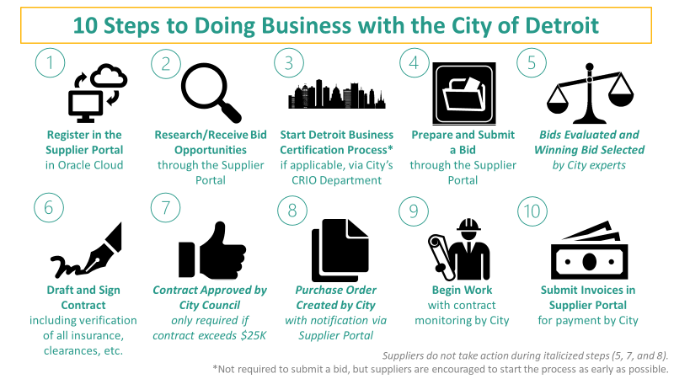
Get Bid Ready
Following the application submission, non-profit organizations must follow the bidding process if applying for future NOFA projects, if you have not already:
For a more detailed description of each step of the procurement bidding process, click here.
Notes:
Kelly

Slide 7
Oracle Tech Support
The City of Detroit’s Office of Contracting and Procurement (OCP) uses Oracle, an electronic purchasing tool for handling all bids. Oracle creates a one-stop shop for all available business opportunities.
• NEW SUPPLIERS: To complete your registration, you will need:
◦ Taxpayer ID
◦ Valid Email Address
◦ Business Classification Certification (e.g. DHB, DBB, MBE, WBE)
◦ Administration Contact with Valid Email Address
◦ Bank Routing Number
◦ Bank Account Number
◦ Voided Check
◦ ACH Authorization Form Registration is required to submit bids and to receive payments.
• New Suppliers click here to register: https://bit.ly/SUPREGIST
• Existing Suppliers, access your portal here: https://bit.ly/SUPPORTAL to access bid opportunities
• For technical issues with registration into Oracle Cloud or if changes and connections are needed once registration is complete, contact the e-Procurement team at procurementinthecloud@detroitmi.gov
or call (313) 670-8106.
Notes:
Kelly

Slide 8
Keeping Up with OCP
Supplier Portal Information and Instructions
detroitmi.gov/supplier
City of Detroit: Office of Contracting and Procurement
@cityofdetroitOCP
@cityofdetroitocp
@cityofdetocp
@cityofdetroitocp
bit.ly/GOVDELIVERY
*Create an account using email and scroll down to “Procurement Updates*
Notes:
Kelly

Slide 9
Questions
Please use the raise hand function or type your questions into the chat
Please submit additional questions to PFR@detroitmi.gov
Notes:
Kelly

