Slide 1
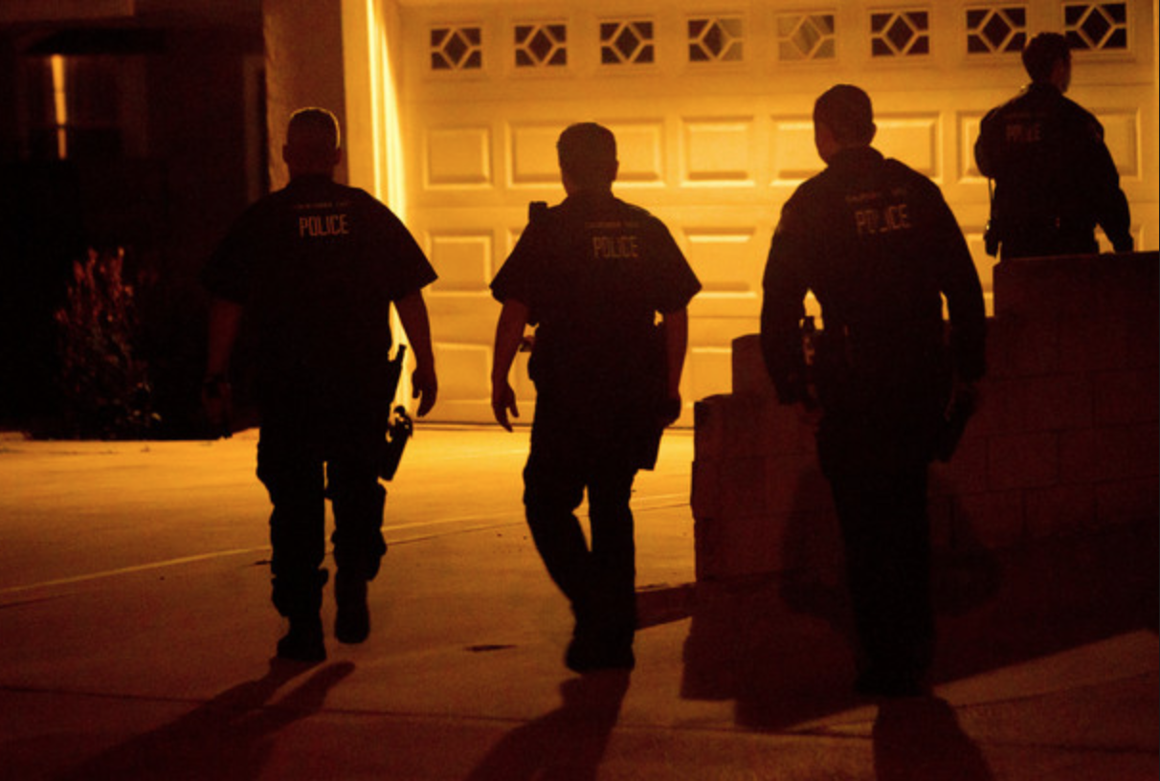

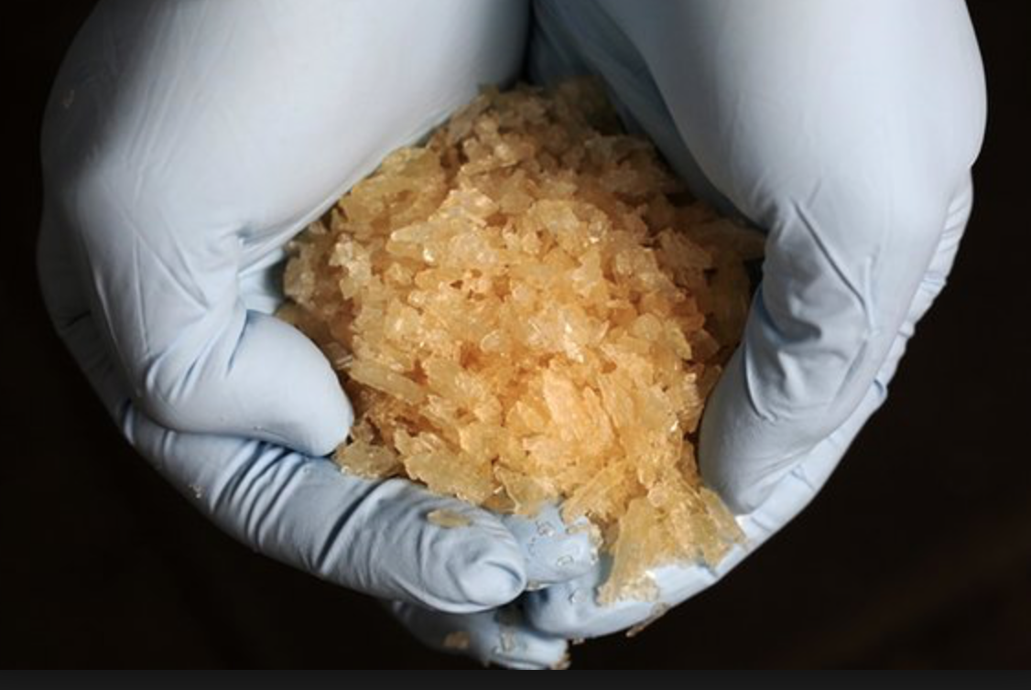
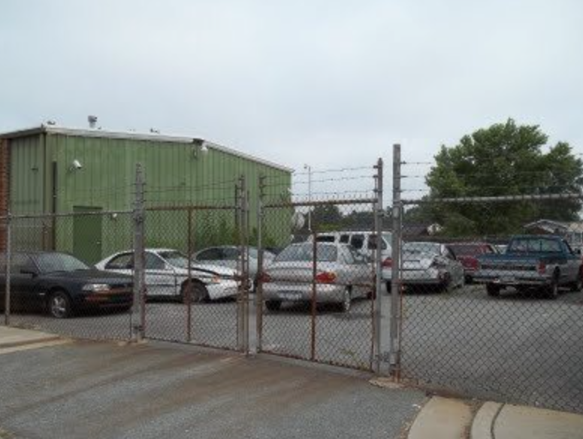
Detroit Police Department —Forfeiture Section
Chief of Police James E. Craig

Slide 2


A recognized method of combatting illegal drug trafficking and curbing lewd and other wanton behavior.

Slide 3
Introduction to the Forfeiture Section
Chief of Police
James E. Craig
Office of Support Operations
Assistant Chief David M. LeValley
Special Services
Commander Sonia J. Russell
Management Services
Captain Michael Parish
Forfeiture
Sgt. Darchell Brown

Slide 4
The Role of the Forfeiture Section
The Forfeiture Section is responsible for—
    Receiving and processing all forfeiture petitions;
    Serving as a liaison between the Detroit Police Department and the Wayne County Prosecutors Office or other prosecuting agency;
    Tracking the status of forfeiture cases;
    Maintaining statistics as required by law or department policy;
    Serving as a final repository of all forfeiture case files; and
    Providing information, guidance, and training in matters pertaining to civil asset forfeiture.

Slide 5
What is Civil Asset Forfeiture?
A legal process that involves a divestiture without compensation of property that was used in a manner contrary to local, state, or federal law.
Types of Civil Asset Forfeiture Actions:
    Drug Asset Forfeiture (MCL 333.7521)
    Nuisance Abatement (MCL 600.3801)
    OWI “Repeat Offender” (MCL 257.625)
    Drag Racing Forfeiture (MCL 257.626)
    Felony Identity Theft (MCL 445.79)
    Omnibus Forfeiture (MCL 600.4701)
Regardless of the action, the goal is DETERRENCE.

Slide 6
AMENDED COUNTY ORDINANCE
In November 2020, Wayne County Ordinance No. 2000-328 Chapter 207 Sec.6, under Nuisance Abatement, was amended to include drifting.
Racing means to (1) race a vehicle either against another vehicle or against a time- or speed-measuring device, WHETHER OR NOT THERE IS AN AGREEMENT TO RACE; OR (2) DRIVE A VEHICLE AT EXCESSIVELY HIGH RATES OF SPEED OR ACCELERATION OR IN ANOTHER RECKLESSLY DANGEROUS MANNER IN AN EXHIBITION OR CONTEST OF DRIVING PROWESS, SUCH AS DRIFTING, SLIDING, OR ‘DONUTS’ (INVOLVING LOSS OF TRACTION AND/OR REPEATEDLY DRIVING THE VEHICLE IN CIRCLES OR FIGURE EIGHTS OR IN A SIDEWAYS MOTION IN CIRCLES OR FIGURE EIGHTS) THAT IS RECKLESSLY DANGEROUS AND COULD CAUSE SERIOUS INJURY OR DEATH AND/OR IS AN IMPEDIMENT TO TRAFFIC.

Slide 7
Process in Forfeiting Property
Investigation
Probable Cause
Property seizure and Notice of Intent to Forfeit
Once the forfeiture office has received all paperwork, the Department will petition the Wayne County Prosecutor Office (WCPO) to bring the appropriate forfeiture action against the property.
If a person’s property is no longer subject to forfeiture the Department is put on notice and prompt action is taken to have the property released according to DPD protocols.
Forfeited cash assets are deposited into the Department's forfeiture account. These accounts are managed by the Office of Departmental Financial Services (ODFS). Tangible property will be sold at auction. The funds received from the auction are subsequently deposited into the DPD's forfeiture account.

Slide 8
What are “forfeiture dollars” used for?
As a general matter, forfeiture assets can be used for “any legitimate law enforcement purpose.”
Examples include—
        Training
        Equipment
        Facilities
        Supplies
        Other programs
Prohibited uses include—
        General government use
        Personal gain
        To replace law enforcement budget allowances.

Slide 9
How does Civil Asset Forfeiture help the community?
Civil Asset Forfeiture is a deterrence to criminals.
Civil Asset Forfeiture is helpful by removing property used to facilitate illegal conduct and placing the property back into a legitimate stream of commerce.

Slide 10
Significant Events
In 2019 there were changes in forfeiture laws, prohibiting forfeiting a person’s property unless the owner is convicted of a crime or a plea of guilt.
Marijuana laws have changed in Michigan, making it legal to possess no more that 2.5 ounces in public, 10 ounces or 12 plants in your home, for personal use.
These laws have had a significant effected our forfeiture program.
In November 2020, Wayne County Ordinance No. 2000-328 Chapter 207 Sec.6, under Nuisance Abatement, was amended to include drifting.

Slide 11
Forfeiture Statistics
In FY 2018-2019, the Detroit Police Department—
    Seized $1,679,853.21 in currency;
    Seized 1059 vehicles; and
    Filed 1,742 forfeiture petitions
        904 “F-Cases”
        838 “DET-Cases”
In FY 2019-2020, the Detroit Police Department—
    Seized $793,406.08 in currency;
    Seized 372 vehicles; and
    Filed 658 forfeiture petitions
        356“F-Cases”
        302 “DET-Cases”

Slide 12
Forfeiture Statistics
In FY 2020- current Detroit Police Department—
    Seized $724,536.03 in currency;
    Seized 301 vehicles; and
    Filed 768 forfeiture petitions
        414 “F-Cases”
        335 “DET-Cases”
        18 “Omni”
        1 “OWI”
    Note: The current Fiscal Year is not complete until July 31, 2021. These stats represent July 1, 2020 to current.

Slide 13
Questions

