Slide 1
Virginia Park
PRE-CONSTRUCTION MEETING
JULY 30, 2026
Phase 1: Virginia Park (2nd Ave. to 3rd Ave.)

Slide 2
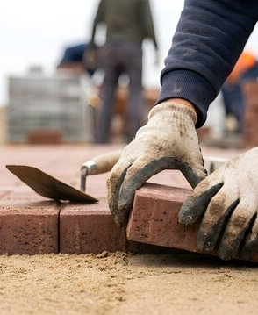
Construction Overview
The anticipated start date for the Streetscape will begin: 08/03/2026, and the anticipated completion for all 3 blocks will be 11/01/2027.
Prime Construction Contractor
Century Cement
The anticipated working hours are as follows:
(M-F: 7am to 5:30),(Sat:7am to 3:30pm)
*Due to noise ordinance, work cannot be done before 7am.

Slide 3
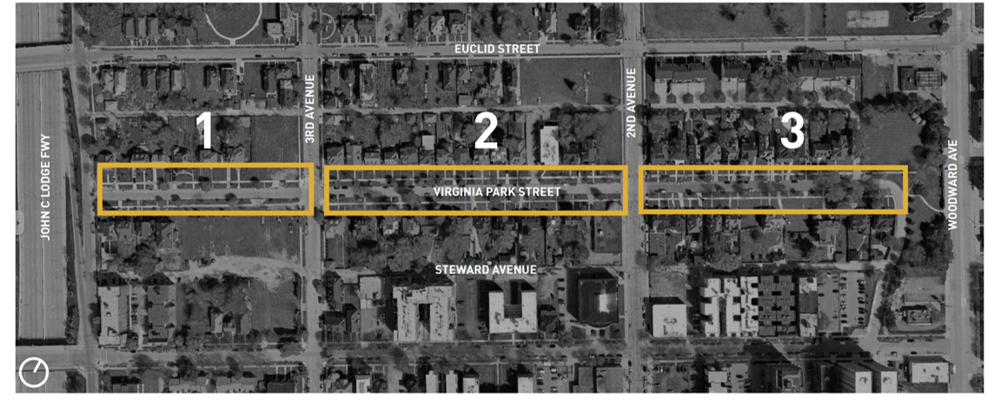
Project Timeline
Phase 2
Phase 1
Phase 2
Phase | Estimated Timeline
Phase 1 (2nd Ave. – 3rd Ave.) | Aug. 3, 2026 | Nov. 15, 2026
Phase 2 (Lodge – 3rd Ave. & 2nd Ave. – M-1), and tree planting | Apr. 15, 2027 | Sept. 3, 2027

Slide 4
PHASE 1: Timeline
Activity | Approx. Date
Sidewalk Removal/Replacement | Early Aug. 2026
Road Closure Begins | Mid Aug.
Brick Removal | Mid–Late Aug.
Concrete Paving | Sept.
Stage Switch | Early Oct.
South Side Brick Removal | Early Oct.
South Side Concrete | Mid Oct.
Brick Installation | Late Oct to Mid November

Slide 5
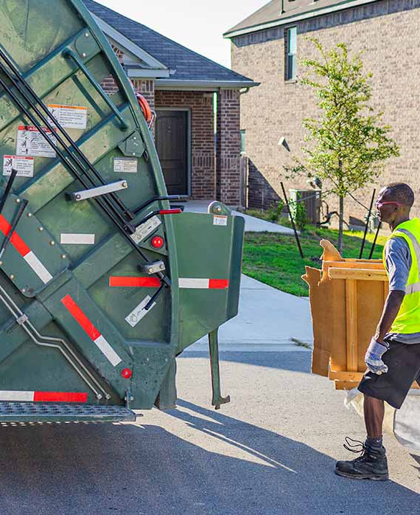
Starting Aug. 19:
Residents’ "last" chance for scheduled bulk waste pickup
"Last" normal waste collection
*Bulk Waste will continue to be scheduled after the completion of the block. Once the project is finished, regular collection schedules will return to normal.

Slide 6
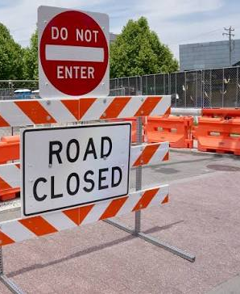
Starting Aug. 20:
Full road closures to vehicle traffic (emergency vehicles only)
Heavy equipment removing existing bricks and concrete base
Installation of a new concrete roadway base and subsurface drainage
Salvaging and reinstalling historic brick pavement
Construction crews and equipment throughout the work zone

Slide 7
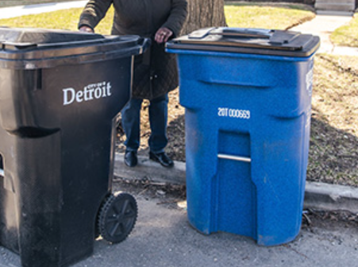
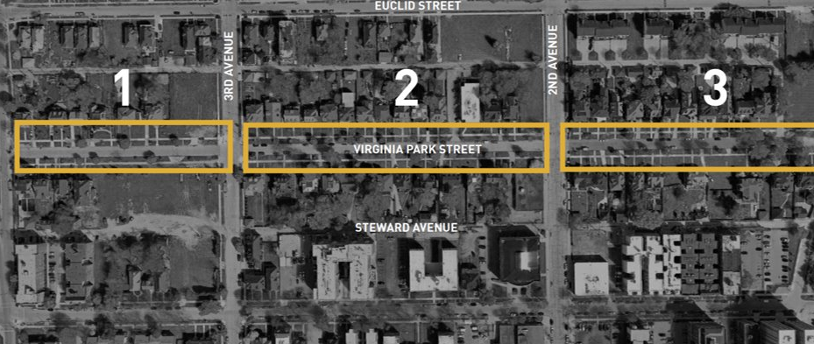
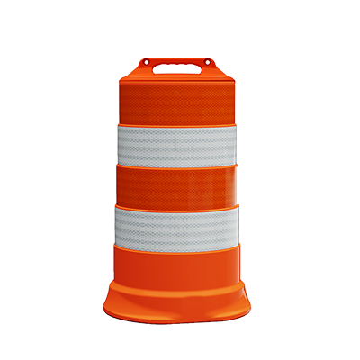
Starting Aug. 26:
Residents must move trash bins and recycling bins to the nearest intersection for pickup in collection zone. Items to be placed out by 7:00 a.m or risk of not being picked up.
Residents may continue to place bundled or bagged yard waste on the front curb by berm by 7:00 a.m
Collection Zone: will be identified by construction barrels and signage.
*Yard Waste to be moved by Contractor.
Suggestion: Add something to identify your trash/recycling bin

Slide 8
THANK YOU

