Slide 1
HOW TO USE THE SLIDES

Slide 2


  Here’s your title slide and end slide, all content is customizable.
  Note: the month and year are set to be automatic, it will aways change depending what month it is. In your slide you can always toggle them on or off under “Insert” from your file menu.

Slide 3
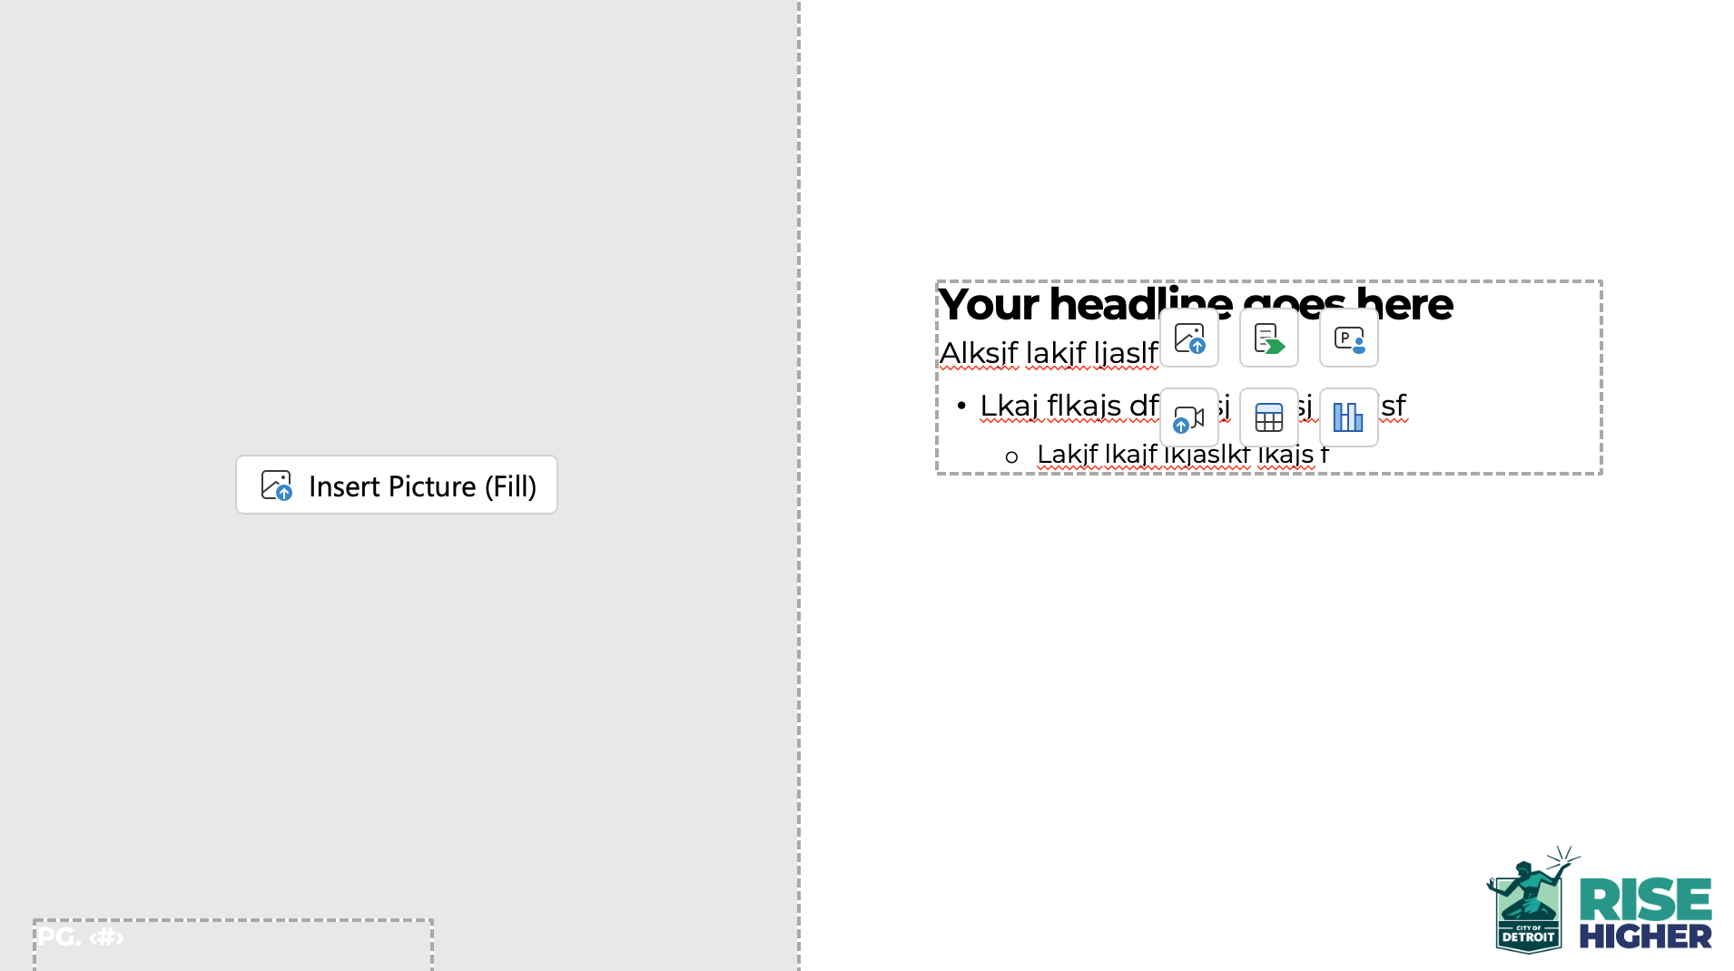
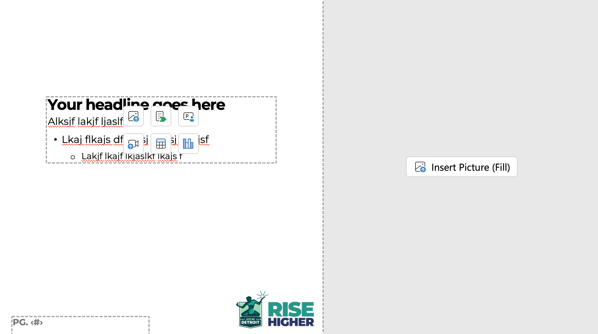
  We’ve produced a page template for just copy and a visual. Simply click the “Insert Picture” button to add a photo, it will crop it to the size it appears. You can always re-crop so the image is placed the way you like. Don’t change the size of the box. You’ll notice a left image option and a right image option. I looks best to alternate if you have multiple copy slides.
  Avoid covering the logo if possible.

Slide 4
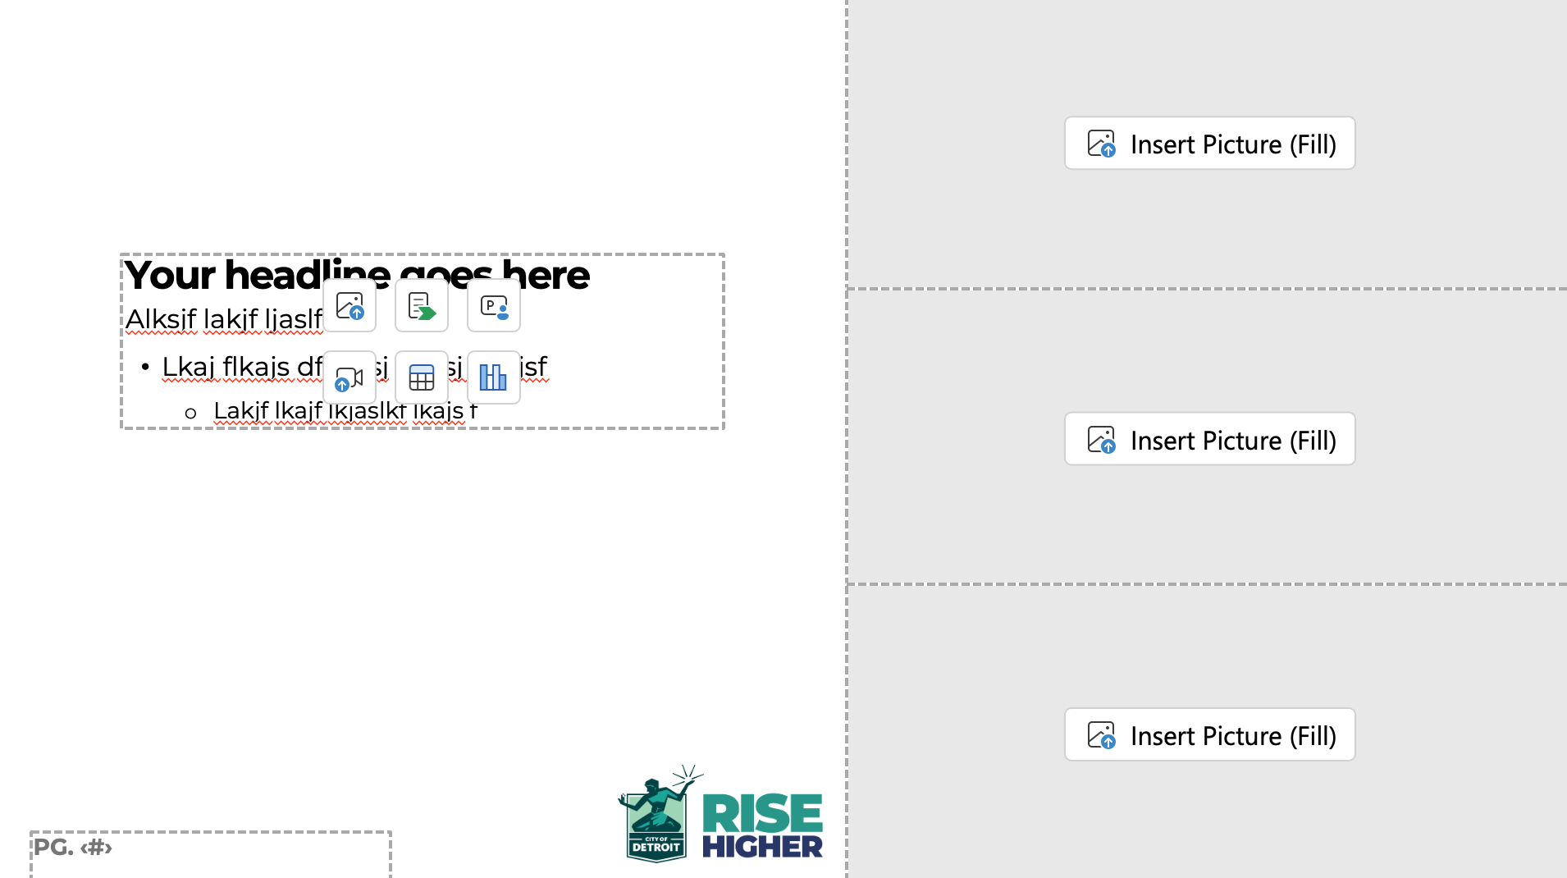
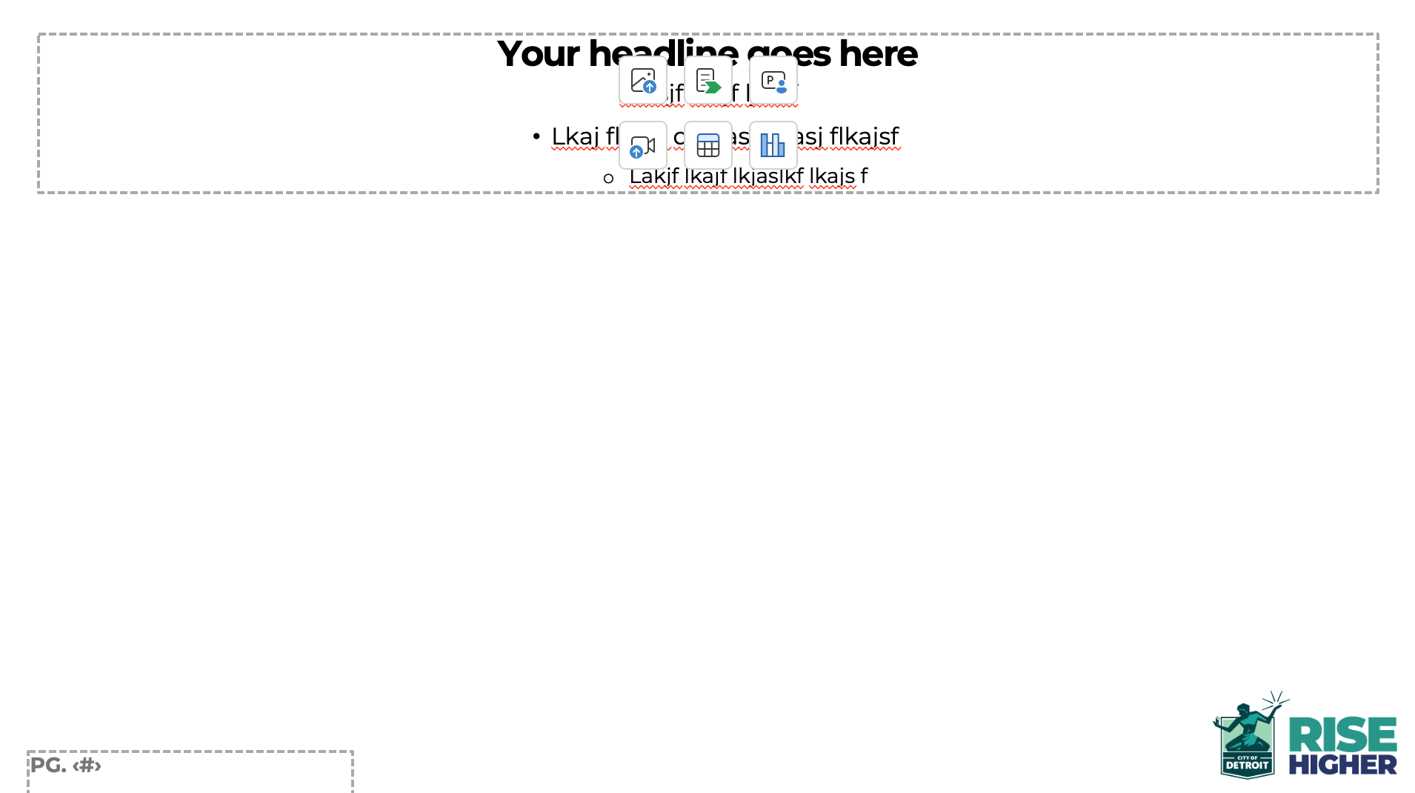
  Just like the left and right copy slides, these templates offer an alternative. The first allows for three images and the second template allows for charts, horizontal content.

Slide 5


  Use the image slide if you like to bring larger photos. This works the same as the previous templates, just click “Insert Picture” and select preferably landscape photo.
  Below is an example of how that would look. It has a black transparent rectangle to help with the legibility of the copy.

Slide 6

  To get this style of body copy you must click on the indent more button after you do a hard return. These buttons are located on your home menu. Once your copy is entered, center the type from top to bottom.
  To add a photo to the right, click the Insert Picture button
Indent More
Headline
  Your body copy
    First bullet indent
      Second bullet indent

Slide 7
Your title goes here
Sub Title Goes Here

Slide 8
First 100 Days:
Leading with People-Centered Investments
  A Mandate to:
    Focus on Quality-of-Life issues
    Prioritize Poverty Alleviation
    Ensure Neighborhood Development
    Lead Significant Reform Measures – Taxes, Zoning & Permitting, City Operations
    Reframe and diversify large-scale Economic Development projects

Slide 9
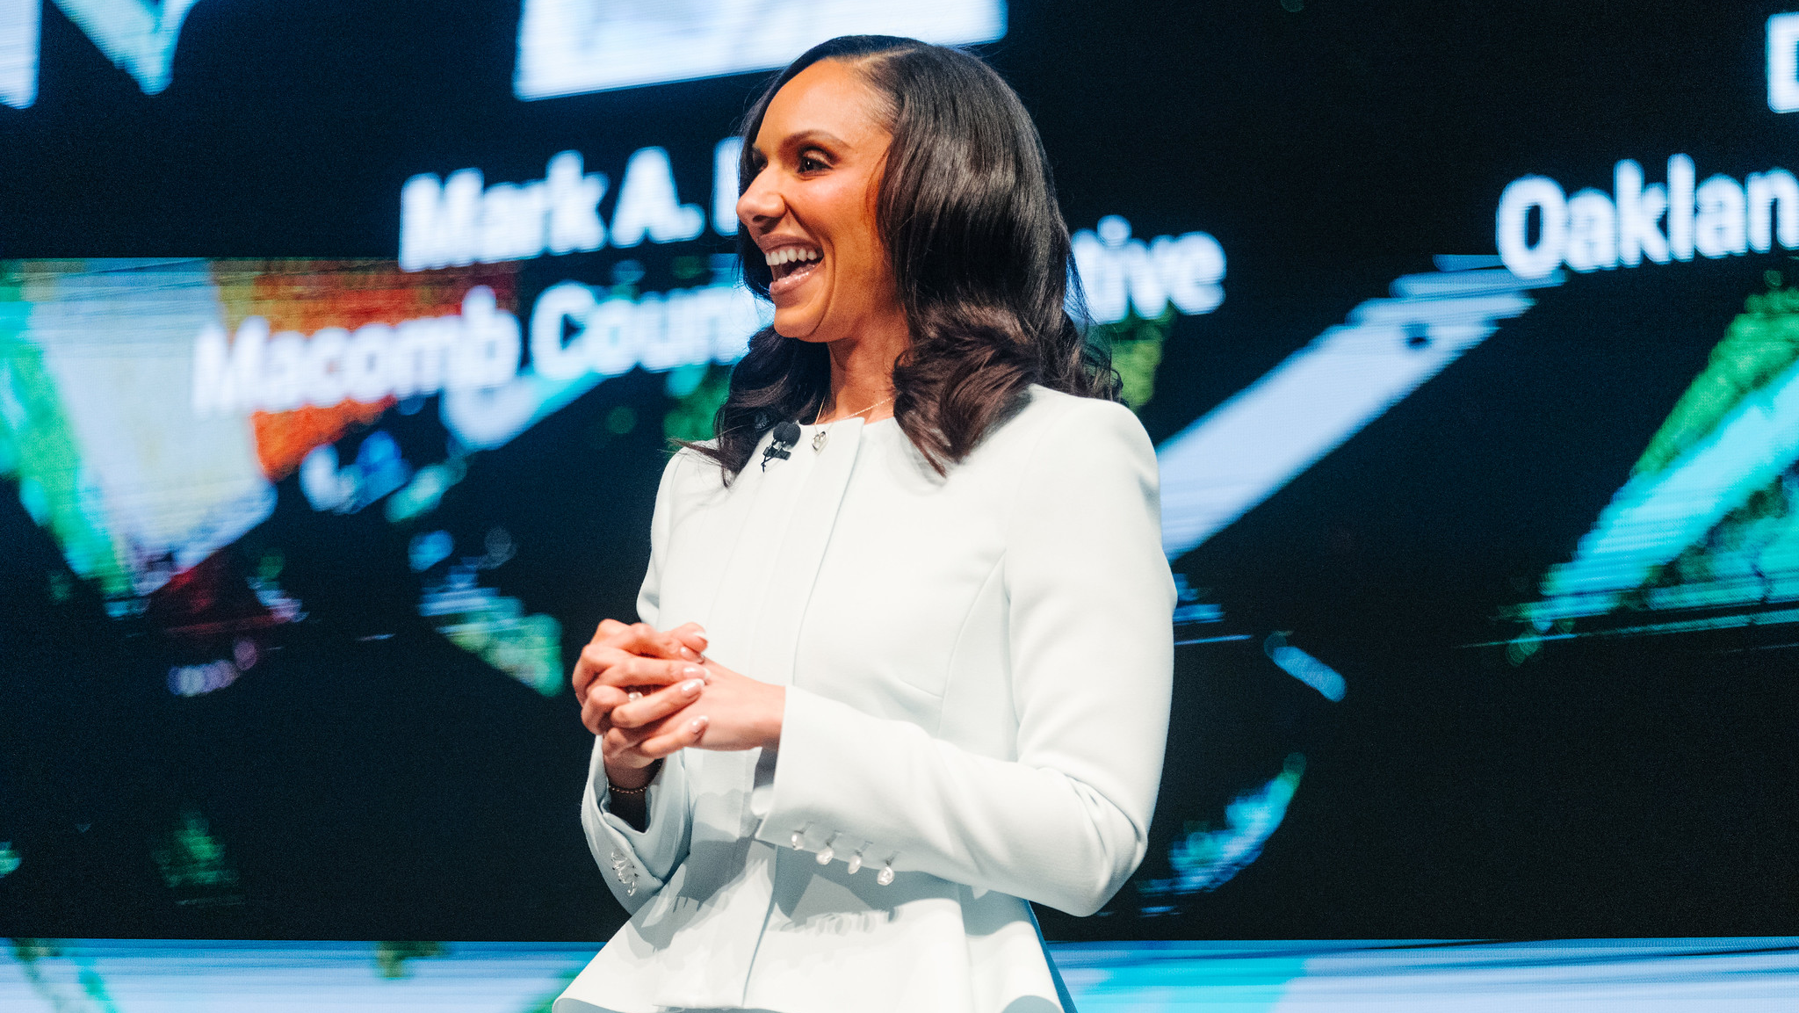
Image slide

Slide 10
The Rise Higher Agenda: Centering Growth
  Investments in People:
    Growing Detroit by Growing Detroiters first.
  Investments in Places:
    Growing Detroit by Growing Detroit's Neighborhoods.
  Investments in Infrastructure:
    Growing Detroit by Investing in Systems and Policies.

Slide 11
INFO GRAPHIC, CHART EXAMPLES

Slide 12

The Rise Higher Agenda:
Centering Growth
1
PEOPLE
Growing Detroiters
2
PLACES
Growing Neighborhoods
2
SYSTEMS
Growing Infrastructure and Policies

Slide 13


The Rise Higher Agenda:
A Business Case
1
Supported and Empowered Detroiters
2
A More Capable Workforce
3
Higher AMI's and Better Neighborhood Conditions for Development
4
Attraction of Jobs and Retail
5
More Economic Mobility
6
More Investment
The Rise Higher Virtuous Cycle

Slide 14
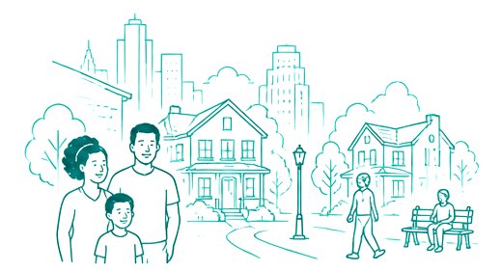



A Successful Strategy Leads to
Three Outcomes:
1
STAY
Detroiters Staying and Thriving
2
RETURN
Detroiters Moving Back to the City
3
MOVE
Individuals and Families Relocating to Detroit

Slide 15
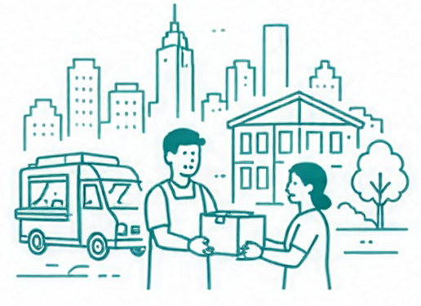



Our Rise Higher Detroit Strategy:
Four-Year Funding Progression
YEAR 1
Build the Foundation
YEAR 2
Expand Prevention
YEAR 3
Advance Systems Change
YEAR 4
Lead with Policy
As targeted investments are made, our philanthropic funding goals should progress as follows:
We should continuously be progressing away from intervention and more towards policies that create and drive needs on a City-wide scale and that originate in local, state and federal spaces
75%
20%
5%
Intervention & Safety Net Services
Prevention
Policy
60%
30%
10%
Intervention & Safety Net Services
Prevention
Policy
40%
40%
20%
Intervention & Safety Net Services
Prevention
Policy
20%
50%
30%
Intervention & Safety Net Services
Prevention
Policy

Slide 16
THANK YOU

