Slide 1
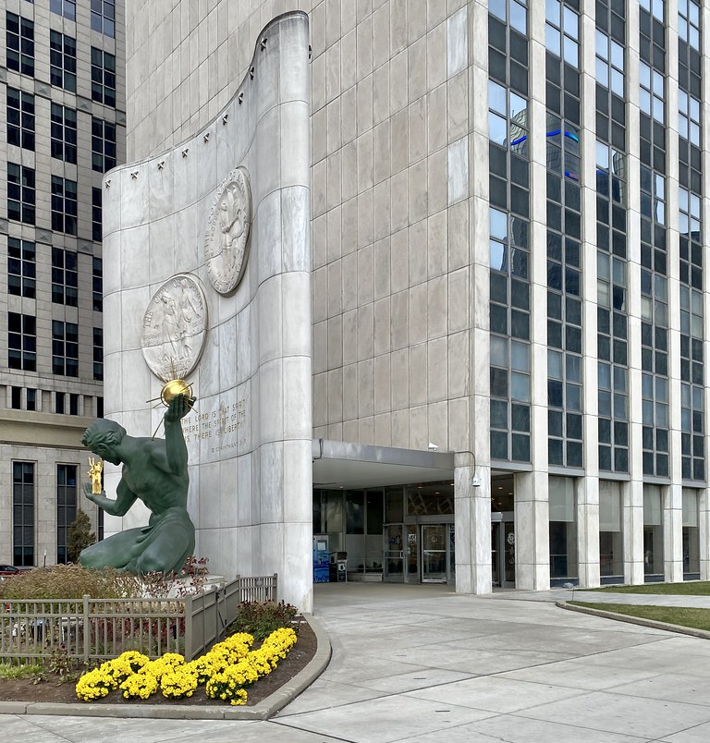

City council district 2 Community Townhall “Navigating the City Budget” Prepared by the Legislative Policy Division

Slide 2
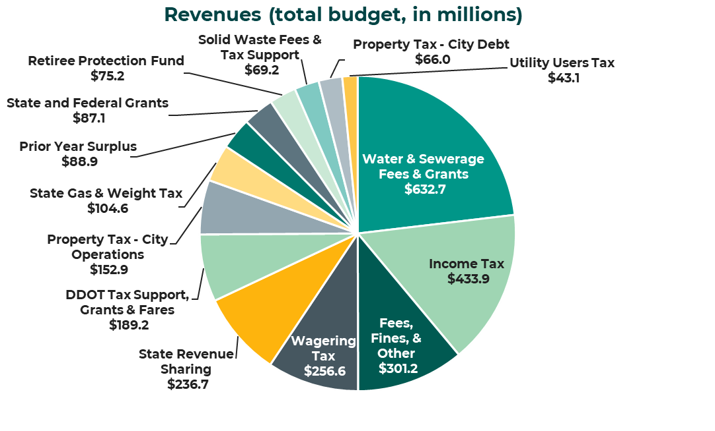
Where does the budget money come from?
Detroit’s FY25 city budget totals ~$2.7 billion
Revenue sources that support the General Fund include: Wagering Tax, Property Tax, Income Tax, Utility Users Tax, and State Revenue Sharing
Source: OCFO-Office of Budget

Slide 3
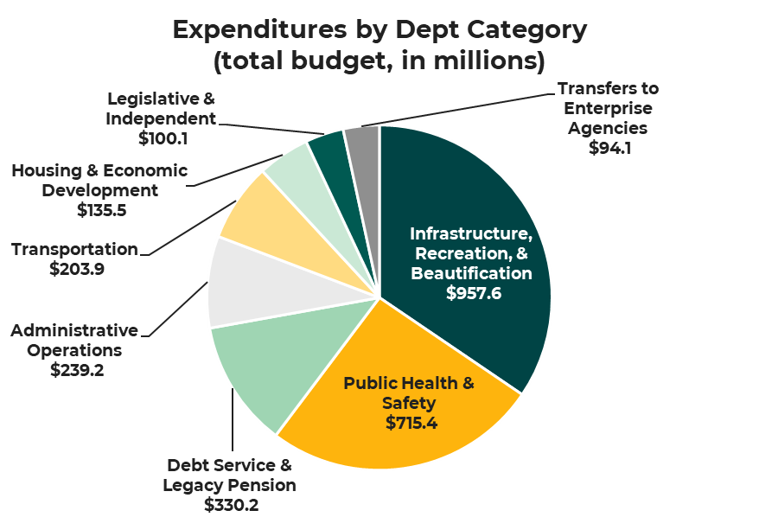
Where does the budget money go?
Detroit’s FY25 city budget totals ~$2.7 billion
The City’s expenditures exactly equal its revenues to maintain a balanced budget
The FY 25 budget has a total of 11,146 budgeted positions
In the FY25 budget , this represents an increase of 345 full-time equivalent (FTE) positions, supporting departments like health, general services, and water and sewer
Source: OCFO-Office of Budget

Slide 4
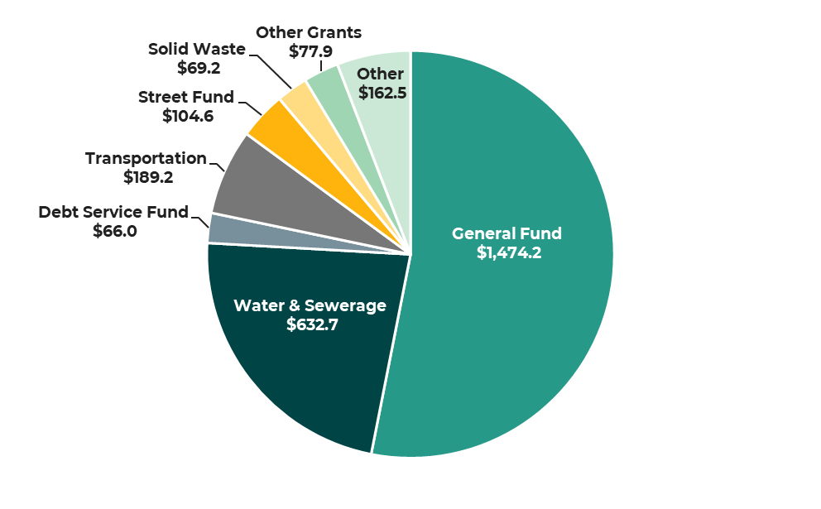

What portion of the budget can we influence?
The General Fund provides services most citizens are familiar with, such as police, fire, recreation, grass cutting, and Mayoral and City Council legislative activities.
Source: OCFO-Office of Budget

Slide 5
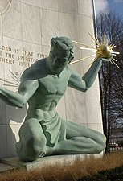
City of Detroit Budget Development Process
The City of Detroit operates on a fiscal year basis from July 1st to June 30th. The city’s budget process begins in September and runs to adoption of the budget by City Council in April and submission of the city’s Four-Year-Financial Plan to the Financial Review Commission (FRC) by April 30th.

Slide 6
City of Detroit Budget Calendar
September | Office of the Chief Financial Officer (OCFO)-Office of Budget sends Budget instructions to agencies and agency CFOs. The city’s holds the first of two Revenue Estimating Conferences as required by state law. The Office of Budget conducts two Annual Public Budget Meetings as required by the city charter.
October | The Administration conducts Budget Priorities Forums in each of the 7 Council Districts. Meetings monitored by the City Council Legislative Policy Division; issues a report per ordinance.

Slide 7
District 2 Budget Priorities from November 12, 2024, Community Meeting

Slide 8
District 2 Budget Priorities from November 12, 2024, Community Meeting, cont’d

Slide 9
City of Detroit Budget Calendar
November- January | The Office of Budget holds Budget Director meetings with departments, prepares budget documents and transmits recommendations to the Mayor for approval.
February | The city holds its 2nd annual Revenue Estimating Conference that sets the revenues for the upcoming budget year. The Mayor presents his proposed FY 2026 budget to City Council tomorrow on February 28th at 12:30 pm. It can be watched on Channel 10 Comcast, or on the City of Detroit, City Council website.
March | City Council holds 46 budget meetings with city departments- agencies City Council holds a final public hearing on the budget City Council begins deliberation on the budget in Executive Sessions (Will explain Council’s starting at next slide).
April | City Council continues deliberation on the budget in Executive Sessions City Council votes on the budget by April 7th City Council adopts the budget, approves related documents – (will explain later in the presentation). The City Clerk returns the budget to the Mayor for approval/veto action City Council votes to override the Mayor’s veto, if applicable. The Four-Year Financial Plan is submitted to the Financial Review Commission by April 30th.

Slide 10

City Council’s Review of the Budget
Council will conduct 46 budget hearings, about four a day, starting on Wednesday, March 12th and ending on Monday, March 31st.
The Budget Finance & Audit Committee expands into a Committee of the Whole and Council President Sheffield chairs the budget related meetings in accordance with Council’s rules.
After budget hearings are completed for a day, time is allocated for public comment on the respective budget hearings. A general public hearing will be conducted at 5 pm on Monday, March 31st, in accordance with Section 8-206 if the Detroit City Charter.
LPD’s prepares a budget analysis called “budget dailies” for the budget hearings per Council’s budget calendar. The Office of the Auditor General’s assists LPD with preparing the daily budget analyses.
In LPD’s budget analyses, we focus primarily on major appropriation amount changes from the current year’s budget to the proposed FY 2025 budget.

Slide 11
City Council’s Review of the Budget
Questions from Council Members can include questions on changes to appropriations and policy oriented based on their constituent needs.
The February 2025 Revenue Estimating Conference be held this year on Monday, February 10th, which will establish the revenues for the Mayor’s Proposed FY 2026 budget.
Therefore, if the majority of Council Members want to fund a Council priority, it must reduce an appropriation elsewhere in the budget to fund the priority. LPD Fiscal assists the Council in finding a place to find money for Council’s priorities.

Slide 12
City Council’s Review of the Budget- Executive Sessions
City Council convenes Executive Sessions to finalize its deliberations over the Mayor’s proposed budget.
During Executive Session, Council is discussing items Council members have put into Executive Session during the budget process. Council could technically put an item in Executive Session while being in Executive Session, or at anytime during the budget hearings.
LPD records Council’s items on a spreadsheet; Council discusses each entry and determines funding for the upcoming fiscal year.
If no funding is proposed, but Council would like further consideration, the item may be placed in Council’s Closing Resolution.

Slide 13
City Council’s Review of the Budget- Executive Sessions
Any monetary changes to the budget Council makes will appear on Schedule B for a vote on the budget. Council must “find” the money to make a monetary change (i.e., reduce an appropriation somewhere since revenues are set during the revenue consensus process).
Any non-monetary issues Council raised during Executive Session that they are urging the Administration to address in the upcoming fiscal year should go into Council’s Closing Resolution
Council will vote on a final version of Council’s Closing Resolution and Schedule B which represents the financial changes to the upcoming budget and other related budget documents from the Administration.

Slide 14
Other Documents City Council Approves during Budget Process
Schedule A voting schedule (contains Council’s changes to the proposed Community Development Block Grant (CDBG)/Neighborhood Opportunity Fund (NOF) budgets).
Schedule B voting schedule (contains Council’s changes to the proposed General Fund budget).
The Administration’s Errata Letter (contains the Administration’s non-substantive changes/corrections to the proposed budget)
The Administration’s Closing Resolution (contains the Administration’s establishment of revenues and appropriations/expenditures in the budget under the General Appropriation’s Home Rule City Act).
The Administration's Official Compensation Book- White Book
Tax Statement (establishes property taxation for property taxes and general obligation bonds supported by property taxes through property tax millage).
Page 14

Slide 15
What happened in the FY 2025 Budget Process?
Mayor Duggan’s total Proposed FY 2025 Budget was $2.76 billion.
The Mayor’s Proposed FY 2025 budget for the general fund was $1.46 billion. Again, the General Fund provides services most citizens are familiar with, such as police, fire, recreation, grass cutting, and Mayoral and City Council legislative activities.
Council’s total changes to Mayor Duggan’s Proposed FY 2025 General Fund budget was $37.3 million, about 2.6% of the Proposed FY 2025 General Fund Budget. Of the $37.3 million in Council’s changes, $33.9 million represents one-time changes to the Proposed FY 2025 General Fund budget and $3.4 million represents recurring changes to the proposed budget. The recurring changes will continue throughout FY 2028 of the City’s four-year financial plan.
Page 15

Slide 16
What happened in the FY 2025 Budget Process?
Mayor Duggan chose not to veto any of Council’s changes to the Proposed FY 2025 Budget.
The city forwards the Four-Year Financial Plan (inclusive of the FY 2025 Adopted Budget to the Financial Review Commission by April 30th.
Approval of the Budget and the related documents- the Tax Statement authorizes the city to levy property taxes for the upcoming fiscal year. Tax bills are normally mailed the first week in July (after July 1st).
Page 16

Slide 17
What happened in the FY 2025 Process? Council’s FY 2025 Closing Resolution
Not all of Council’s priorities were funded in the adopted budget. As the city’s financial circumstances changes, opportunities to fund Council’s priorities may become available.
Highlights areas of importance for the Administration to consider when favorable funding circumstances occur.
FY 2025 Council Closing Resolution include 112 issues of concerns for the Administration and 5 funding resolutions for additional future financial support.
LPD has committed to provide Council with periodic updates on the status of their Closing Resolution items.

Slide 18
Council member Whitfield-Calloway Sponsored Proposals in the FY 2025 Budget
Budget Appropriations
$250,000 to increase appropriation for the Eastern Market- Support for Black Owned Farms.
$500,000 to increase appropriation for Goal Line (after-school) Program.
$2.5 million to increase appropriation for Lead Based Paint Encapsulation Program.
$40,000 to increase appropriation for Banners for the Livernois Ave of Fashion.
$2.5 million for the restoration of Merrill Fountain at Palmer Park

Slide 19
Council member Whitfield-Calloway Co-Sponsored Proposals in the FY 2025 Budget
Budget Appropriations
$36,000 to increase appropriation for Zoo operations for Senior Transportation.
$500,0000 to increase appropriation for a Detroit Legacy Business Fund (at the Detroit Economic Growth Corp).

Slide 20
Council member Whitfield-Calloway Sponsored Proposals in the FY 2025 Budget
Closing Resolutions (Excerpt)
Assist small landlords with compliance, with registration and certification requirements for lead-based paint encapsulation.
Prepare a study evaluating the condition and status of all vacant school structures.
Develop strategies that would allow a 1 mil reduction to the operational property tax rate.
Fund and Conduct a Feasibility Study for the use of smaller buses on W McNichols and Livernois Routes and provide a report within 30 days.

Slide 21
Council member Whitfield-Calloway Sponsored Proposals in the FY 2025 Budget
Closing Resolutions (Excerpt- Cont’d)
Allow Council Members more decision-making power in the use of approximately $20 Million in unallocated ARPA funds by dividing the funds equally between the nine Council Members
Participate in the MI Tri-Share program where the State, the City and the employer equally share the cost of childcare.
Fund 4 additional vehicles for $100,000 each for the Detroit Employment Solutions Corp (DESC).
Advocate for an amusement tax, through appropriate enabling state legislation, to increase municipal revenues and diversify the sources of municipal revenue.

Slide 22
Council member Whitfield-Calloway Sponsored Proposals in the FY 2025 Budget
Closing Resolutions (Excerpt- Cont’d)
Engage in outreach to business and property owners on the Historic Avenue of Fashion and ensure façade improvements to commercial properties.
Expand the Citizens Radio Patrol Program throughout the city.
Request the Police Department to reallocate funding to establish a safety training program to help reduce or eliminate the instances and cost associated with motor vehicle collisions.
Fund a program designed to relieve the burdens of blight tickets on senior residents of the city.

Slide 23
Conclusion
The Administration will publish the Four-Year Financial Plan with the Adopted Fiscal Year Budget (inclusive of City Council changes and approved documents) on the Office of the Chief Financial Officer website at a later date.

Slide 24
Conclusion, cont’d
Monitoring of the City Budget after budget adoption and during the ensuing Fiscal Year starting July 1st:
Council's Budget, Finance and Audit (BF&A) Standing Committee, chaired by CM Durhal III, serves as the committee that primarily monitors the city's budget. The Legislative Policy Division prepares periodic reports to assist in the budget monitoring process, including reports on the status of Council’s Closing Resolution items.
The BF&A Committee receives the following reports from the Administration’s Office of the Chief Financial Officer (OCFO) to help monitor the City’s budget during the fiscal year:
Monthly fiscal year-to-date actuals to budget with annualized projections.
Monthly head count analysis.
Quarterly report on the current status of bond debt.
Quarterly report on payments made to the City’s pension plans and Retiree Protection Fund for its legacy pension obligations.
Annual report on legacy pension plans analysis, forecast and the City’s ability to pay its debt obligations, and a long-term general fund revenue and expenditure financial analysis.

Slide 25
Conclusion, cont’d
CONTACT INFORMATION
Irvin Corley, Jr.
Executive Policy Manager
Detroit City Council Legislative Policy Division
Coleman A. Young Municipal Center
2 Woodward Avenue, Suite 208
Detroit, Michigan 48226
(313) 224-1722 (office)
(313) 224-4336 (fax)
irvin@detroitmi.gov (email address)
QUESTIONS?

