Slide 1

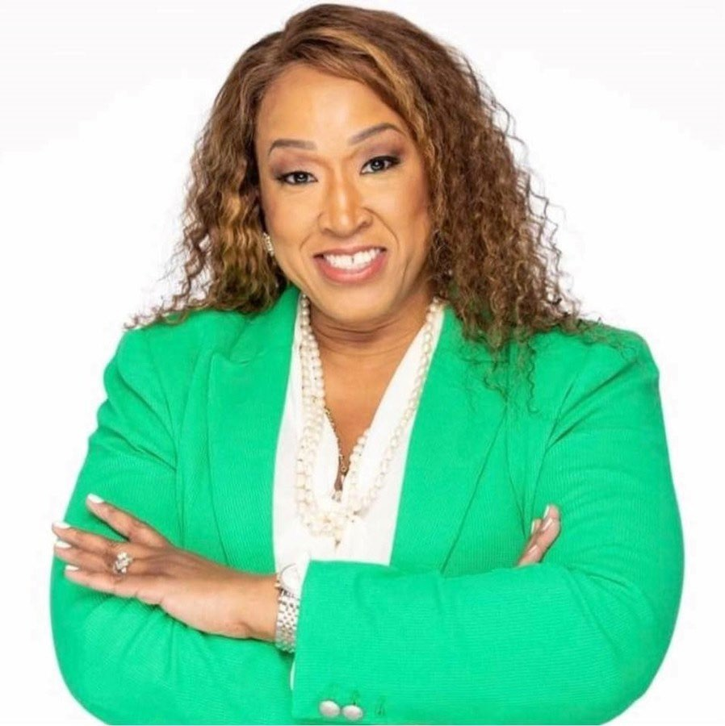
C I T Y O F D E T R O I T
O F F I C E O F T H E O M B U D S M A N
F Y 2 O 2 6 - 2 0 2 7 B U D G E T R E P O R T
Complaints Analysis & Budget Request
Issued: March 30, 2026
"Together we’re turning challenges into opportunities to improve the quality of life for Detroiters!"
Sherry Gay-Dagnogo, M.Ed.
City of Detroit Ombudsman
In Office Since: October 6, 2025
3,462 Total Complaints | 844 Web Submissions | 85% Closure Rate | 2,357 Legacy Reconciled
First Report · Detroit City Council · Coleman A. Young Municipal Center, Suite 114 · Detroit, MI 48226

Slide 2

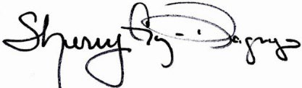
March 30, 2026
The Honorable Detroit City Council City of Detroit
1340 Coleman A. Young Municipal Center Detroit, MI 48226
RE: Ombudsman Budget Analysis for FY 2026-2027
Dear Honorable President, President Pro Tem, and Members of the Detroit City Council,
Thank you for the opportunity to present the Office of the Ombudsman’s FY 2025–2026 budget analysis and strategic direction as we work to strengthen service delivery for the residents of Detroit. Since assuming office on October 6, 2025, my administration initiated a comprehensive 90-day transition and assessment period, during which we engaged with 21 City of Detroit department directors and their teams to evaluate departmental effectiveness, accessibility, and responsiveness.
Our internal audit identified an approximate 80% complaint closure rate, alongside a significant backlog of cases dating back to 2021. In response, we partnered with department leadership to reestablish expectations for timely resolution, implemented shared tracking systems, and collaborated with our complaint management vendor to enhance system functionality and transparency.
Today, the Office of the Ombudsman is undergoing a critical transformation—from a reactive complaint-response model to a proactive, data-informed, and community-centered approach. This shift is grounded in five key strategic priorities outlined in this report. During this reporting period, our office processed 3,462 complaints and 844 web-based submissions. We hosted more than 50 community engagement events, reached over 4,150 seniors, conducted 12 targeted educational outreach sessions, and launched the Monthly Ombudsman Podcast Breakfast Series featuring city department leaders.
We have strengthened internal operations through strategic staff reorganization, led by Chief of Staff Linda Wesley and Deputy Chief and Education Assistant Ombudsman Allen Montgomery, M.Ed. Their leadership has improved accountability and efficiency internally, and each Assistant Ombudsmen is now aligned with a City Council District and partnering with the Department of Neighborhoods to enhance service awareness and deliver a more seamless, resident-centered experience.
Respectfully submitted,
Sherry Gay-Dagnogo, M. Ed.
City of Detroit Ombudsman
Page2
◆

Slide 3
TABLE OF CONTENTS
✦ C I T Y
O M B U D S M A N ' S
O F D E T R O I T ✦
O F F I C E — F Y 2 0 2 5 – 2 0 2 6
Section I | 90-Day Audit Findings, Analysis and Complaints Data
Section II | Complaints by City Council Districts (D1-D7) and Zip Codes
Section III | Transition, Recommendations, Community Engagement & Conclusion
SECTION I — 90-DAY AUDIT FINDINGS
October 2025 – January 2026
5,500* Open Cases Found | 2,357 Legacy Online Complaints | 844 Web Submissions | 21 Directors Met
Key Audit Findings
Approximately 5,500 open cases identified, requiring immediate triage and case management restructuring
Discovery of 2,357 legacy complaints submitted online dating as far back as 2021 — requiring full reconciliation with the Office's technology vendor
844 web-based submissions identified and logged for processing
Backlog traced to capacity gaps and lack of cross-departmental tracking infrastructure
Implemented shared Smartsheet tracking systems with BSEED, DPW, GSD, and DWSD
New intake protocols established to ensure no resident inquiry goes unaddressed
Page3
◆

Slide 4
CASES: OPEN VS. CLOSED – FEBRUARY 2025 – FEBRUARY 2026
85% — 2,951 Cases Closed | 15% — 511 Cases Open / Being Resolved
 | The Office significantly reduced the inherited backlog through Smartsheet tracking and coordinated departmental engagement across BSEED, DPW, GSD, and DWSD.
COMPLAINTS & RESOLUTION RATE BY DEPARTMENT
February 2025 – February 2026
Department |  | Complaints | % of Total | Closed | Rate %
BSEED (Buildings, Safety Eng. & Environmental) |  | 2,058 | 59.00% | 1,982 | 96%
General Services (GSD) |  | 200 | 5.78% | 171 | 86%
DWSD (Water & Sewerage) |  | 223 | 6.44% | 158 | 71%
DPD (Police Department) |  | 253 | 7.31% | 198 | 78%
DLBA (Detroit Land Bank Authority) |  | 123 | 3.55% | 96 | 78%
DPW (Public Works) |  | 238 | 6.87% | 179 | 75%
Finance |  | 88 | 2.54% | 69 | 78%
Administrative Hearings |  | 22 | 0.64% | 20 | 91%
Municipal Parking |  | 13 | 0.38% | 10 | 77%
Fire |  | 6 | 0.17% | 4 | 67%
Human Resources |  | 3 | 0.09% | 3 | 100%
CRIO |  | 4 | 0.12% | 4 | 100%
Law |  | 7 | 0.20% | 6 | 86%
DDOT (Transportation) |  | 14 | 0.40% | 9 | 64%
Health |  | 7 | 0.20% | 5 | 71%
PLD |  | 5 | 0.14% | 5 | 100%
P&DD |  | 1 | 0.03% | 1 | 100%
Elections |  | 5 | 0.14% | 3 | 60%
Recreation |  | 1 | 0.03% | 1 | 100%
Non Departmental & Non Jurisdictional |  | 23 | 0.66% | 23 | 100%
TOTAL / OVERALL RATE |  | 3,462 | 100% | 2,951 | 85%
 | Total of 3,462 complaints processed. Closed case counts reflect data through the current reporting period.
Page4
◆

Slide 5
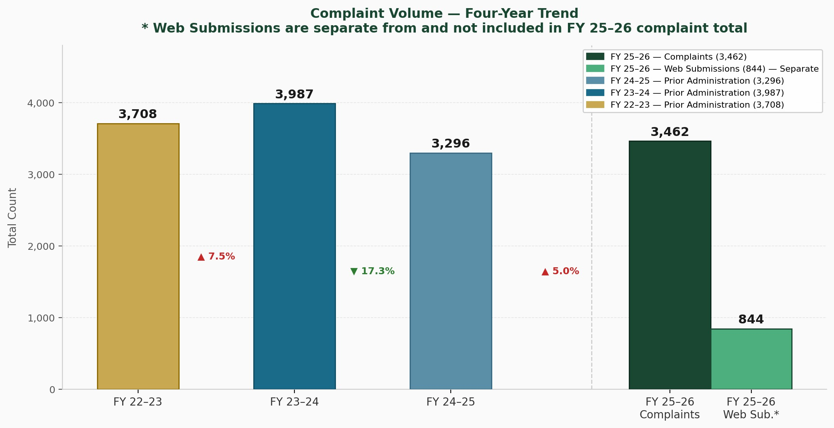
Trend Data — Complaint Volume | Four-Year Overview
February 2022 – February 2026 · Comparative complaint data across all reporting periods
Summary — Total Complaints by Reporting Period
 | Reporting Period | Total Complaints
 | FY 2022–2023 | 3,708
 | FY 2023–2024 | 3,987
 | FY 2024–2025 | 3,296
 | FY 2025–2026 | 3,462
 | FY 2025–2026 — Web Submissions * | 844
* Web Submissions (844) are NOT included in the FY 2025–2026 complaint total of 3,462. They are in addition to the 3,462
complaints that were identified by our vendor and are currently being logged and reconciled by staff to determine the appropriate complaint category
Page5
◆

Slide 6
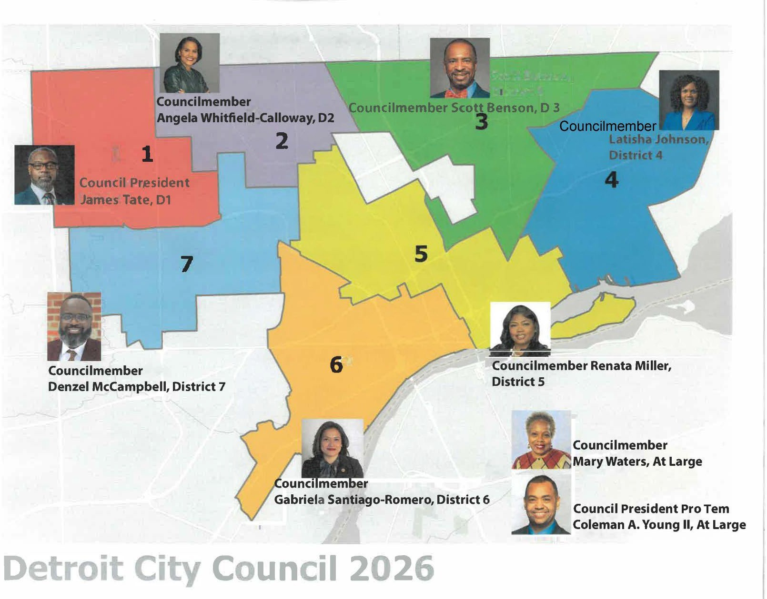
SECTION II — Complaints by City Council Districts (D1-D7) and Zip Codes
COMPLAINTS BY COUNCIL DISTRICT February 2025 – February 2026
City Council District | Complaints Received
District 1 | 477
District 2 | 540
District 3 | 793
District 4 | 444
District 5 | 438
District 6 | 324
District 7 | 400
Other | 47
TOTAL | 3,462
Page6
◆

Slide 7
SECTION II — (D1-D7) Highest Complaint Volume by Department
District 1 | Council President James Tate
Total Complaints 477 | BSEED | GSD | DWSD 345 | DPW | DPD 30 | 33
Top Complaint Type | Count
Illegal Dumping | 109
High Grass/Weeds | 37
Debris | 27
Abandoned Vehicles | 16
District 2 | Councilmember Angela Whitfield-Calloway
Total Complaints 540 | BSEED | GSD | DWSD 381 | DPW | DPD 49 | 50
Top Complaint Type | Count
Illegal Dumping | 109
High Grass/Weeds | 37
Abandoned Vehicles | 18
Debris | 27
District 3 | Councilmember Scott Benson
Total Complaints 793 | BSEED | GSD | DWSD 604 | DPW | DPD 34 | 71
Top Complaint Type | Count
Illegal Dumping | 109
Abandoned Vehicles | 39
High Grass/Weeds | 37
Debris | 27
District 4 | Councilmember Latisha Johnson
Total Complaints 444 | BSEED | GSD | DWSD 337 | DPW | DPD 33 | 31
Top Complaint Type | Count
Illegal Dumping | 109
High Grass/Weeds | 37
Debris | 27
Squatters | 4
Page7
◆

Slide 8
SECTION II — (D1-D7) Highest Complaint Volume by Department pg.2
District 5 | Councilmember Renata Miller
Total Complaints 438 | BSEED | GSD | DWSD 310 | DPW | DPD 42 | 22
Top Complaint Type | Count
Illegal Dumping | 109
High Grass/Weeds | 37
Sidewalks | 14
Abandoned Vehicles | 13
District 6 | Councilmember Gabriela Santiago-Romero
Total Complaints 324 | BSEED | GSD | DWSD 211 | DPW | DPD 20 | 15
Top Complaint Type | Count
Illegal Dumping | 109
High Grass/Weeds | 37
Debris | 27
Sidewalks | 8
District 7 | Councilmember Denzel McCampbell
Total Complaints 400 | BSEED | GSD | DWSD 288 | DPW | DPD 30 | 29
Top Complaint Type | Count
Illegal Dumping | 109
High Grass/Weeds | 37
Abandoned Vehicles | 12
Debris | 27
Page8
◆

Slide 9
SECTION II — Complaints by Zip Code & Maps
COMPLAINTS BY ZIP CODE
February 2025 – February 2026
Zip Code | Complaints | % of Total
48201 | 15 | 0.43%
48202 | 57 | 1.65%
48203 | 144 | 4.16%
48204 | 173 | 5.00%
48205 | 246 | 7.11%
48206 | 104 | 3.01%
48207 | 56 | 1.62%
48208 | 34 | 0.98%
48209 | 54 | 1.56%
48210 | 61 | 1.76%
48211 | 45 | 1.30%
48212 | 102 | 2.95%
48213 | 281 | 8.17%
48214 | 87 | 2.15%
48215 | 36 | 1.04%
48216 | 17 | 0.49%
48217 | 29 | 0.84%
48218 | 1 | 0.03%
48219 | 201 | 5.81%
48221 | 184 | 5.32%
48223 | 86 | 2.49%
48224 | 176 | 5.08%
48225 | 4 | 0.11%
48226 | 74 | 2.14%
48227 | 228 | 6.59%
48228 | 190 | 5.49%
48234 | 294 | 8.49%
48235 | 215 | 6.21%
48236 | 16 | 0.46%
48238 | 208 | 6.01%
48239 | 7 | 0.20%
Other | 37 | 1.07%
TOTAL | 3,462 | 100%
Page9
◆

Slide 10
Zip Code | Complaints | % of Total
SECTION II — Complaints by Zip Code — Geographic Distribution February 2025 – February 2026 · 3,462 Total Complaints · 31 Zip Codes
250+ Critical | 200–249 Very High | 150–199 High | 100–149 Elevated | 50–99 Moderate | 1–49 Low
Complete Zip Code Complaint Data — Ranked by Volume
ZIP | Neighborhood | # | % | Volume
48234 | N of 7 Mile / NE | 294 | 8.49% | ████████████████████
48213 | Far NE / East Warren | 281 | 8.17% | ███████████████████
48205 | NE Detroit / Osborn | 246 | 7.11% | █████████████████
48227 | Grandmont / Rosedale | 228 | 6.59% | ████████████████
48235 | Greenfield / McNichols | 215 | 6.21% | ███████████████
48238 | Dexter / Livernois | 208 | 6.01% | ██████████████
48219 | Brightmoor / Fenkell | 201 | 5.81% | ██████████████
48228 | Warrendale / W Side | 190 | 5.49% | █████████████
48221 | Bagley / Sherwood Forest | 184 | 5.32% | █████████████
48224 | East English Village | 176 | 5.08% | ████████████
48204 | Dexter / Woodbridge | 173 | 5.00% | ████████████
48203 | Highland Park / Palmer Pk | 144 | 4.16% | ██████████
48206 | Boston-Edison | 104 | 3.01% | ███████
48212 | NE Detroit / Banglatown | 102 | 2.95% | ███████
48214 | E Jefferson / Chalmers | 87 | 2.15% | ██████
48223 | Rosedale Park / NW | 86 | 2.49% | ██████
48226 | Downtown Detroit | 74 | 2.14% | █████
48210 | Mexicantown / Springwells | 61 | 1.76% | ████
48202 | New Center / TechTown | 57 | 1.65% | ████
48207 | East Jefferson | 56 | 1.62% | ████
48209 | SW Detroit / Junction | 54 | 1.56% | ████
48211 | E Grand Blvd | 45 | 1.30% | ███
48215 | Grosse Pointe Pk border | 36 | 1.04% | ██
48208 | Corktown | 34 | 0.98% | ██
48217 | River Rouge border | 29 | 0.84% | ██
48216 | Southwest / Hubbard Farms | 17 | 0.49% | █
48236 | Grosse Pointe border | 16 | 0.46% | █
48201 | Midtown / Wayne State | 15 | 0.43% | █
48239 | Redford border | 7 | 0.20%
48225 | Harper Woods border | 4 | 0.11%
48218 | River Rouge (partial) | 1 | 0.03%
Page10
Source: City of Detroit Office of the Ombudsman · FY 2025–2026 Complaints Report color reflect complaint volume per zip code tabulation area. Zip codes with fewer than 5 complaints shown in blue.
◆

Slide 11
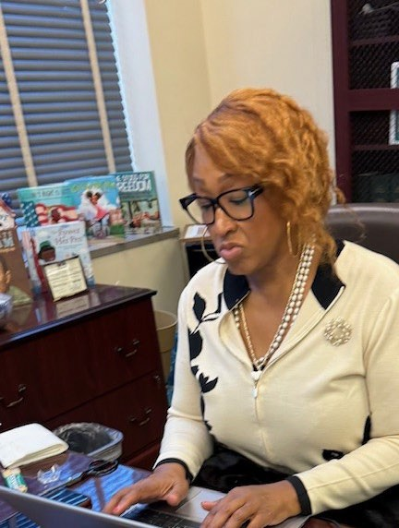
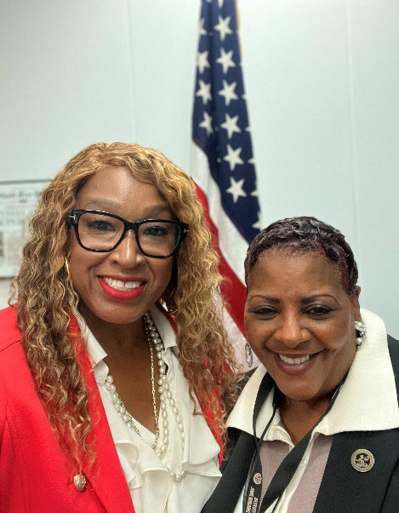
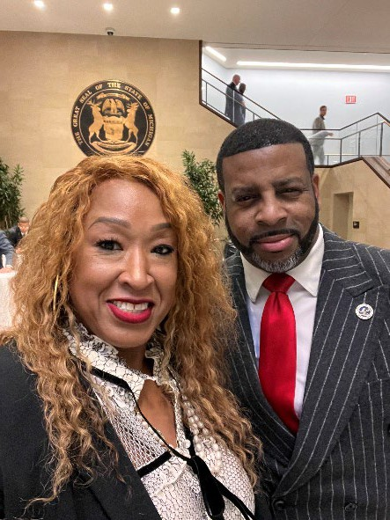
SECTION III — 90-Day Plan Findings, Recommendations & Conclusion
90-DAY TRANSITION PLAN SUMMARY
October 2025 – January 2026
Upon taking office on October 6, 2025, Ombudsman Gay-Dagnogo launched a structured 90-day transition plan to assess Office capacity, identify systemic challenges, and establish a clear path toward greater efficiency.
Conducted comprehensive Office needs assessment
Met with legacy staff to assess internal operations and complaint intake.
Met with CMTS Complaint Management Vendor
Met with 21 City of Detroit Department Directors
Performed full audit — revealing 5,500 open cases
Met with City of Detroit DoIT leadership
Established Smartsheet cross-departmental tracking
Identified 2,357 legacy online submissions Wingswept
Staff Restructuring, Community Engagement, Education, and Integration
Linda Wesley, Chief of Staff
Deputy Chief of Staff & Assistant Education Ombudsman Allen Montgomery, M.Ed.
Restructured complaint intake and assignment workflows Staff assigned to each Council District Staff CRIO: Civil Rights Lunch & Learn Staff Training: Ethics & Communication Detroit Office of Neighborhood Partnership | Interdepartmental Cross training to improve constituent services Interdepartmental Shadowing: Tax Center Interdepartmental: HRD Ride Along CRIO & The Office of Disability Affairs Project Partnership
Page11
◆

Slide 12
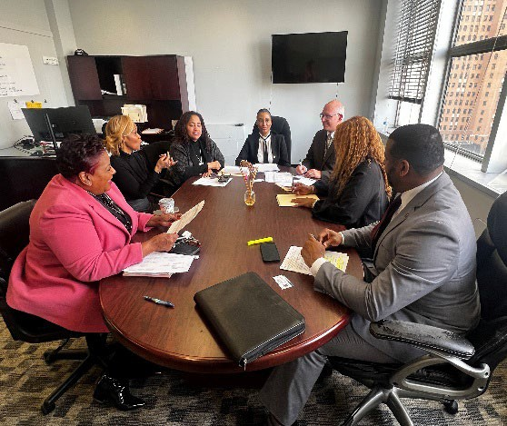
OMBUDSMAN RECOMMENDATIONS
FY 2025–2026 Strategic Priorities
The following recommendations are informed by the Office's 90-day needs assessment, complaint data analysis, departmental engagement, and community feedback.
I. Accessibility & Equity in City Services
A | ASL Accessibility Notification Requirement
Implement a standardized accessibility notification policy across all departments to require notice on:
Event flyers and promotional materials
Special Event applications and permits
Licensing applications
Public meeting notices
Departmental websites and digital communications
 | Rationale: Approximately 25,000–45,000 Detroit residents may be deaf or hard of hearing.
II. Strengthening Accountability & Compliance
A | Enhanced Enforcement for BSEED Violations
Establish direct referral pathway for unresolved BSEED and code violation
Escalate Penalties for repeat offenders i.e. lien on properties to prevent the transfer or sale of property.
Work with State Legislature and LARA to advance transparency policy and to identify property owners.
 | Rationale: BSEED inspectors report difficulties in identifying LLC property owners. Persistent non-compliance creates unsafe living conditions disproportionately impacting vulnerable residents.
B | Legislative Fix for LLCs & Co-op Property Managers
Pursue legislative remedies addressing the accountability gap for LLCs and co-op management entities:
Advocate for stricter LLC property ownership disclosure requirements
Support legislation requiring co-op boards to meet minimum code compliance standards
Partner with City Law Dept. and state legislators to close enforcement loopholes
 | Rationale: Current legal structures allow LLCs and co-ops to evade accountability. Legislative reform is essential.
Page12
◆

Slide 13
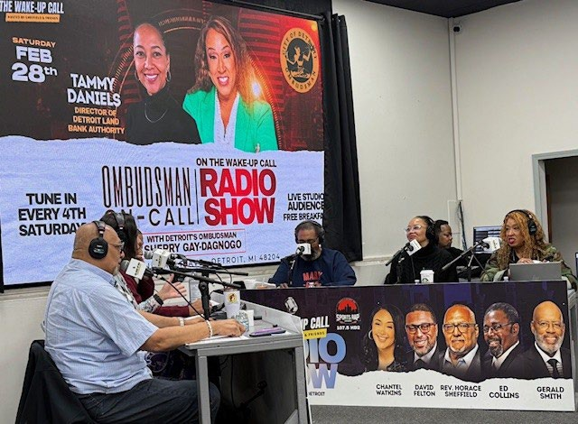
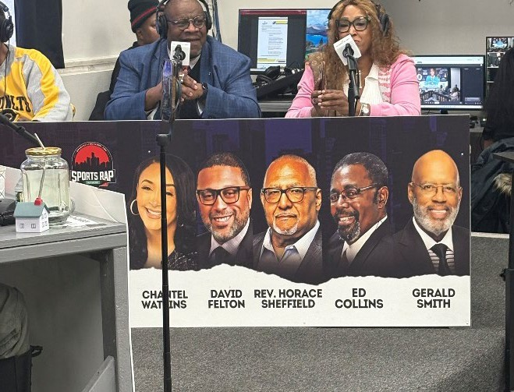
III. Internal Operations and Government Transparency
A | Standard Operating Procedures (SOPs) with AI Access
Require all departments to develop publicly accessible SOPs:
Publish SOPs on City of Detroit website
Integrate AI tools for applications, processes, and FAQs
Ensure real-time, accurate information access for all residents
 | Rationale: Accessible SOPs empower residents with real-time information, reducing confusion and delays.
B | 24-Hour AI Complaint Receptionist “Try our Demo: Dial (313) 771-xxxx”
Implement AI-powered 24-hour complaint intake ensuring no resident goes unheard:
Round-the-clock complaint intake and auto-acknowledgement
Intelligent routing to appropriate departments
Real-time case status updates for residents
 | Rationale: A 24-hour AI receptionist dramatically improves accessibility and eliminates backlog risk.
C | City of Detroit Podcast & Media Studio
Establish a centralized Podcast Studio and Communications Hub producing:
Program explainers and policy updates
Service navigation guides
Multilingual and accessible community content
 | Rationale: A shared platform reduces misinformation and prevents avoidable complaints.
DABO Podcast: Featuring Director Tammy Daniels, DLBA
DABO Podcast: Featuring Director Willie Donwell, BOR
Page13
◆

Slide 14
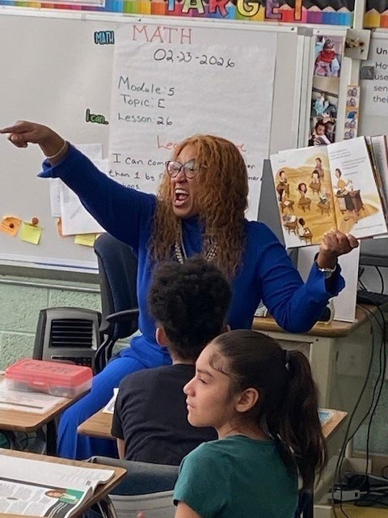
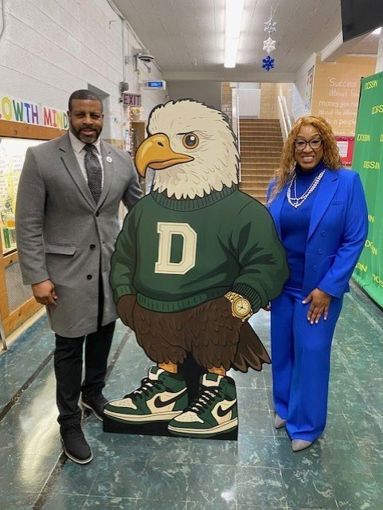
IV. External Education & Community-Based Solutions
A | After-School Programming in Recreation Centers
Expand after-school programming in all City recreation centers near DPSCD schools:
Align programming with school dismissal times
Provide academic, recreational, and enrichment opportunities
Partner with DPSCD and community organizations
 | Rationale: Existing recreation centers create cost efficiency while providing safe environments for youth.
B | Detroit Reads Literacy Partnership Pilot
Launch a citywide Detroit Reads initiative:
After-school literacy programs in libraries and recreation centers
Partner with educators and literacy organizations
Engage parents alongside students on weekends and after school
 | Rationale: Literacy is foundational to long-term success.
C | Mental Health & Family Support Services
Establish after-school mental health and family counseling at recreation centers:
Community-based mental health support
Licensed provider and community organization partnerships
Focus on youth, families, and vulnerable populations
 | Rationale: Addressing mental health needs at the community level improves well-being and reduces long-term challenges.
D | Collaborative Transportation Strategy for Families
Develop a City of Detroit–DPSCD collaborative transportation model:
Develop city ordinance to address surging prices of transportation during school hours
Address rising transportation costs during school hours
Improve access to after-school programming
Coordinate city and school district resources
 | Rationale: A coordinated system improves access while reducing service duplication.
Page14
◆

Slide 15
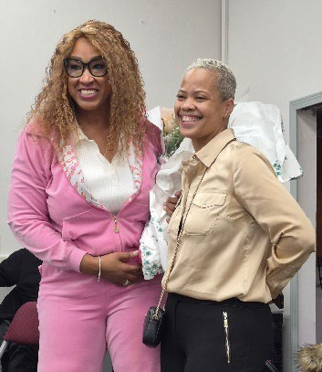
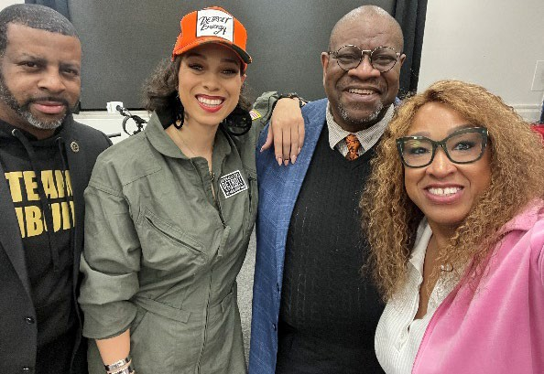
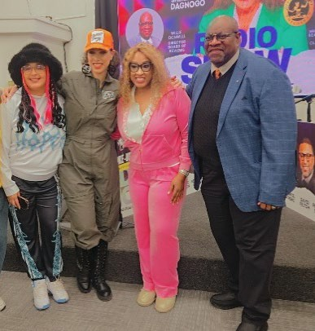
FEBRUARY 2025 – SEPTEMBER 2025 PRE-TRANSITION COMMUNITY ENGAGEMENT
25 Outreach Events | 25 Satellite Offices | 12 Schools Reached | 5 Events Volunteered
OMBUDSMAN SHERRY GAY-DAGNOGO, M.ED. COMMUNITY ENGAGEMENT October 2025 – February 2026
22 Community Engagement Events | 12 Interdepartmental Resource Tables | 5 Strategic Media Events | 4,150 Seniors Reached
Community & Legislative Outreach 3 Holiday Turkey Giveaway Events: Detroit PAL, Former NFL Players, 8th Precinct PD Senior Outreach — Detroit Area Agency on Aging, Holiday Senior Building Outreach 'Bridging the Gap from Detroit to Lansing' Lawmakers, Lobbyists, and City Leadership 12 Interdepartmental Resource Tables: City Council, Healthy Homes, Board of Review, DLBA, Tax Dept., Wayne County Treasurer 12 Education Outreach Events: African American History Month, March is Reading Month, State of the Schools, SER Metro | Media & Podcast Podcast Community Outreach Breakfast Series launched Partner: Director Willie Donwell, Board of Review Partner: Director Ebony L. Whitelow, Treasury Partner: Director Tammy Daniels, Detroit Land Bank Authority Detroit Is Different community platform feature
Page15
◆

Slide 16
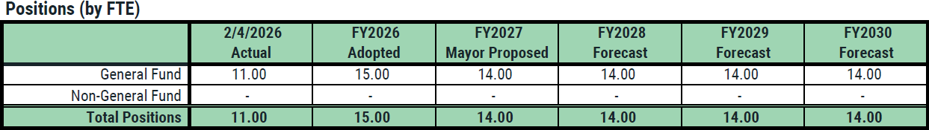
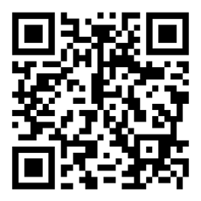
PROPORTIONAL FUNDING VS. PROPOSED 2026-2027 BUDGET
 | FY2025 Actual |  | FY2026 Adopted |  | FY2027 Mayor Proposed
 | General Fund | All Funds | General Fund | All Funds | General Fund | All Funds
Total Revenues | - | 12,000 | - | 12,000 | - | -
Total Expenditures | 1,487,886 | 1,488,058 | 2,021,229 | 2,033,229 | 1,954,312 | 1,954,312
Net Tax Cost | 1,487,886 | 1,476,058 | 2,021,229 | 2,021,229 | 1,954,312 | 1,954,312
3 Year Ramp Up: Proportional Funding
Budget Cycle | Allocation | FTEs
FY 2024 | $1,457, 595 | 14
FY 2025 | $1,666.595 | 14
FY 2026 | $1.718,477 | 15
FY 2027 Budget Request | $2,334,064.54 | 15
Proposed FY 2027 | $1,954,312 | 14
Request to be Restored: Annual Ramp Up $314,752 + $65K (FTE)
CONCLUSION & BUDGET REQUEST
These recommendations reflect a strategic shift toward a more proactive, integrated, and resident-centered government. By prioritizing accessibility, accountability, education, and collaboration, the City of Detroit can improve service delivery while ensuring greater efficiency, transparency, and equity for all residents. Our office is committed to building on this foundation and delivering measurable results for every Detroiter.
We humbly ask your honorable body to restore the funding with the appropriate annual ramp up as outlined by the adopted proportional funding ordinance to ensure that our office can continue the citizen focused trajectory outlined in this report.
Sherry Gay-Dagnogo, M.Ed.
City of Detroit Ombudsman
"Together we’re turning challenges into opportunities
to improve the quality of life for Detroiters!"
2 Woodward Ave, Suite 114 · Detroit, MI 48226 · OMBUDSMAN@DETROITMI.GOV
Scan to Visit Website
Page16
📷📷 Instagram | 👤👤 Facebook | ▶ YouTube | 💋💋 GovDelivery
◆
◆

