Slide 1
Fugitive Dust Ordinance
Buildings, Safety Engineering & Environmental Department
1

Slide 2
More than Bulk Solids
Who: Any community establishment that causes fugitive dust to be produced. Including; but not limited to:
Weed abatement
Freight/Trucking
Concrete Crushing/Batching Plant *
Scrapyard *
Outdoor Storage (>5 acres)
Farming / composting
Construction/Demolition Sites
High-impact manufacturing and processing facilities
Why: The Bulk Solid Material Storage ordinance does not apply to many dust generators. Only those starred above are covered under Bulk Solid Material Storage ordinance
Notes:
Community Establishment means all businesses, non-profit organizations, churches, governmental agencies, and other such institutions and residential structures containing five or more household units

Slide 3
What is required
Owner/operator must submit a fugitive dust (FD) plan not to generate an opacity greater > 5% onsite or greater than > 0% offsite.
Revise/update that plan when operations change or as requested by BSEED-EA.
BSEED-EA can require more effective fugitive dust mitigation measures to ensure compliance.
The plan must include a detailed site plan; includes what piles are stored where, truck routes and speed signage, emission points, entrance and exits on the property along with truck routes ¼ mile out.

Slide 4
Fugitive Dust Plan Example
Name and address of the
community establishment
owner of the property on which the premises of the community establishment resides
Dates and periods of time during which dust is expected to be generated
community establishment designee
person responsible for implementing the plan and their contact information
Notes:
Just an example of how a FD plan might look

Slide 5
Fugitive Dust Plan
Site map drawn to scales depicting the following:
community establishment boundaries
all buildings, internal roadways, and utilities
All roadways and transportation corridors within ¼ mile of the perimeter
All potential emission points
A detailed description of
operations which are expected to generate dust
dust control measures, devices, and technologies.
how all control measures, devices, and technologies will be maintained and calibrated to ensure their continued effectiveness
the training provided to staff regarding the proper application and operation of the control measures, devices, and technologies

Slide 6
Fugitive Dust Plan continued
A monitoring plan that includes the schedule and plan for testing to ensure compliance with the prohibition of FD. Such testing must be conducted by a certified professional trained and certified to opacity in accordance with EPA measurement method 9D and conducted during a range of weather conditions to ensure that representative conditions are covered.
The contingency plan describing the proposed response when FD exceeds action levels. The response activities should consist of a range of increasingly aggressive measures
Other information as deemed necessary by BSEED
A fact sheet or executive summary of the FD plan designed to inform the public

Slide 7
Implementation Enforcement
Inform & educate:
Inspectors to determine if a property may need a fugitive dust plan.
City departments
Business owners on how the ordinance may affect them
General public on how to report concerns
Require a FD plan as a part of annual C of C requirements.
EA has authority/responsibility to monitor and inspect to ensure compliance.
Process
Complaint received
EA Inspection substantiates complaint
14-day Correction Order Issued requiring implementation of an updated FD plan
If issue isn’t corrected EA may issue tickets and require community establishment to submit and get approval of a new FD plan before resuming any dust generating activities.

Slide 8
Enforcement
Tickets will be heard at the Department of Appeals and Hearings
Fines associated with violations are listed here
 | First Offense | Second Repeat Offense | Third & Subsequent Repeat Offense
XVIII. Failure to cease operations creating fugitive dust, in violation of Section 8-15-587 | $1,000 | $1,500 | $2,000
XVII. Failure to submit a timely fugitive dust plan in violation of Sections 8-15-582, 8-15-584, 8-15-585, 8-15-586, 8-15-587 | $500 | $750 | $1,000
XVI. Failure to timely implement adequate control measures, in violation of Section 8-15-586 | $500 | $750 | $1,000
XVII. Failure to comply with the terms of Sec 8-15-593 | $500 | $750 | $1,000

Slide 9
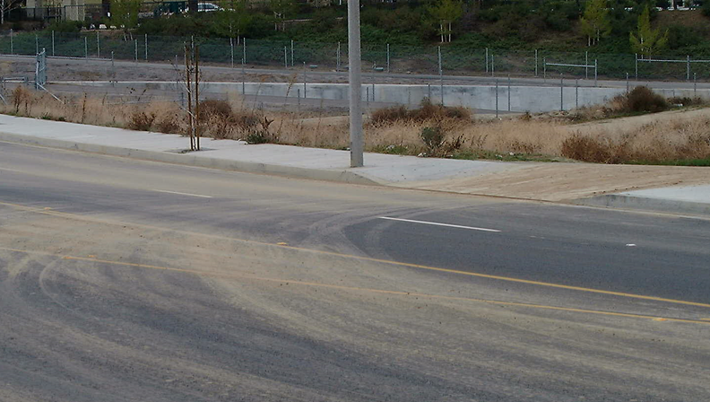
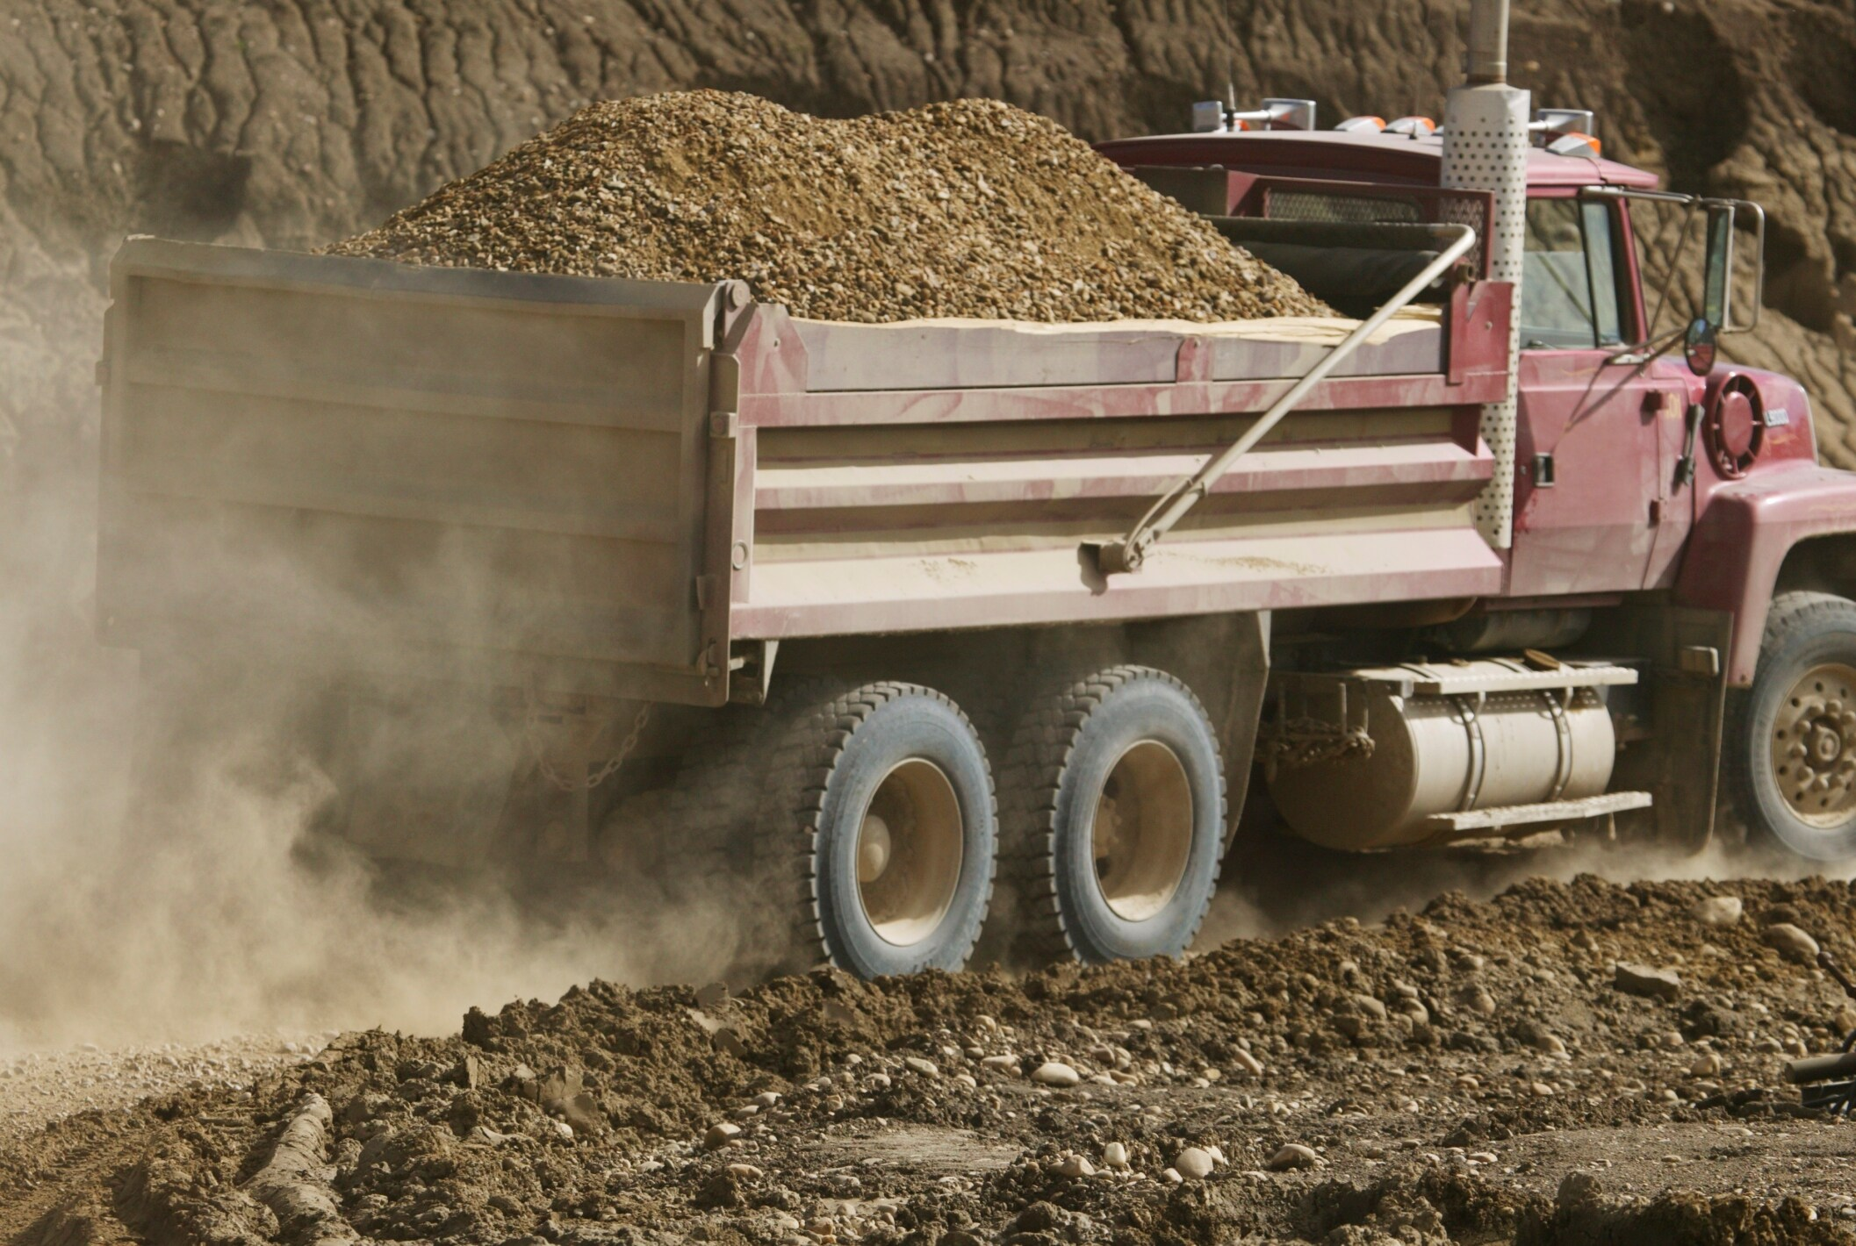
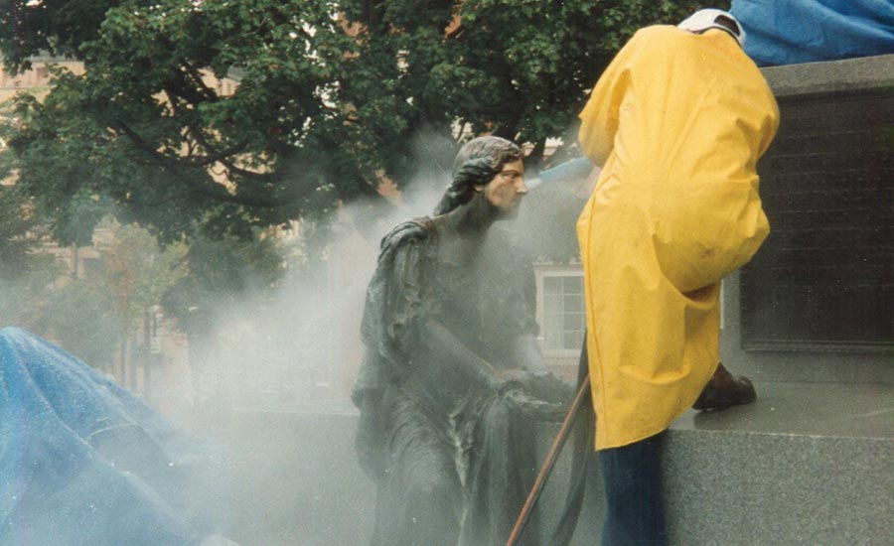
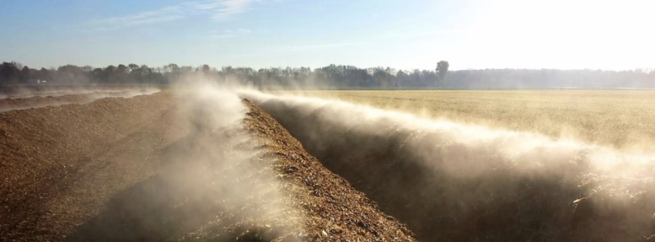
Examples
Bulk Piles
Driving on unpaved surfaces
Grass cutting
Road Milling
Notes:
Track out, trucking and composting all are covered under the FDO but simple cutting your property lawn is not.

Slide 10
Fugitive Dust Links (313) 628-9994 Email: Dust@detroitmi.gov https://tinyurl.com/COD-FDO-text https://tinyurl.com/FD-plan-Large-business https://tinyurl.com/FD-plan-Small-Business

Slide 11
QUESTIONS? THANK YOU!

