Slide 1
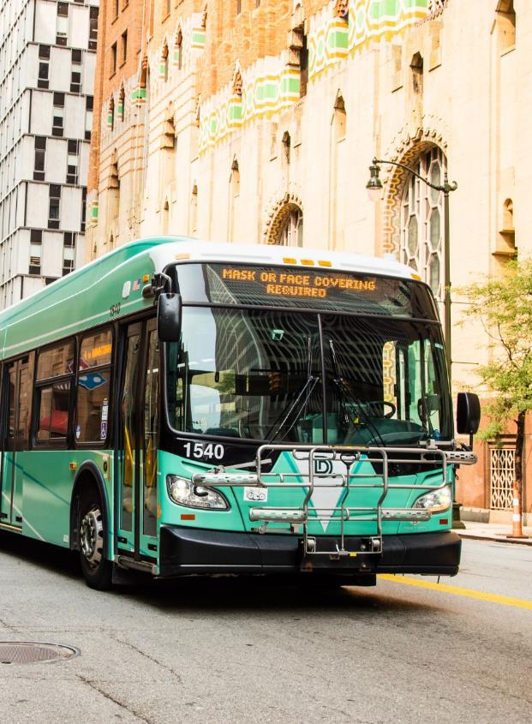
Proposed June 23, 2025 Service Changes
Public Hearing
March 20, 2025

Slide 2
A FEW REMINDERS
PERMISSION TO RECORD
By participating in this Zoom meeting, you are granting permission for your name, image, likeness, as well as audio and video recordings to be used by DDOT.
RAISE HAND FEATURE
Request to comment.
DIAL *9
If you are using the “Dial-in Only” phone option, enter *9 to serve as the “RAISE HAND” feature to Request to Speak or Ask a Question.
CHAT
Submit questions/comments to DDOT staff.

Slide 3
A FEW REMINDERS
BEFORE ASKING A QUESTION OR COMMENTING, BE SURE TO:
Unmute your audio
State your name and organization
Following your comments, mute your audio

Slide 4
Agenda
DDOT is proposing a set of frequency improvements and route realignments for implementation on June 23, 2025. This represents a significant step toward implementing the Final Plan resulting from the DDOT Reimagined process during 2022-2024. Note that some street segments would lose service or be served by a different route.
As a reminder, with this public hearing all your public comments will be recorded, and we will not be able to make an immediate response to any concerns or questions.
If time allows following the official public comment period, DDOT staff may be able to address some of your comments.
We will not allow for comments or questions that are not pertaining to tonight’s public hearing.
In tonight’s public hearing we will:
Provide details on the proposed June changes.
Ask for feedback during the public comments section.

Slide 5
Proposed June 2025 Service Enhancements
Routes with proposed changes:
3
12
Conant
40
Russell
Grand River
9
Jefferson
16
Dexter
52
Chene
10
Greenfield
32
McNichols
67
Cadillac/Harper

Slide 6
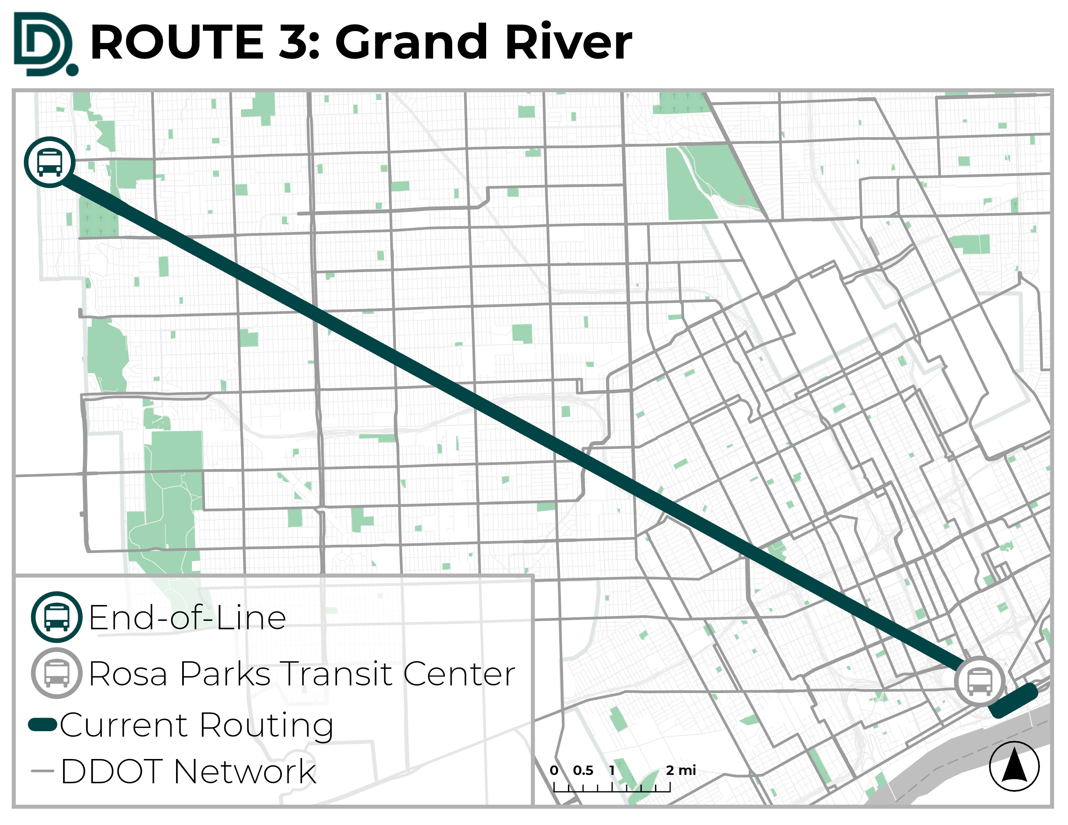
Proposed June 2025 Service Enhancements
Grand River is a designated corridor for “enhanced” service.
DDOT proposes improving daytime frequency to:
Weekdays
Every 10 Minutes
Weekends
Every 15 Minutes

Slide 7
Proposed June 2025 Service Enhancements
9
Jefferson
Extension to ALDI Supermarket at Mack & Alter via Alter, Charlevoix, Chalmers, and Mack.
Will no longer serve the SMART transfer point at Jefferson & Lakepointe.
Construction on the East Jefferson Enhanced Corridor project to begin this spring.

Slide 8
Proposed June 2025 Service Enhancements
16
Dexter
Extended via Outer Drive to Old Redford Meijer, removing service on Greenfield to Northland.
Realigned to the front of University of Detroit Mercy campus via Puritan and Livernois.
Daytime frequency improvements:
Weekdays
Every 15-minutes
Weekends
Every 20-minutes

Slide 9
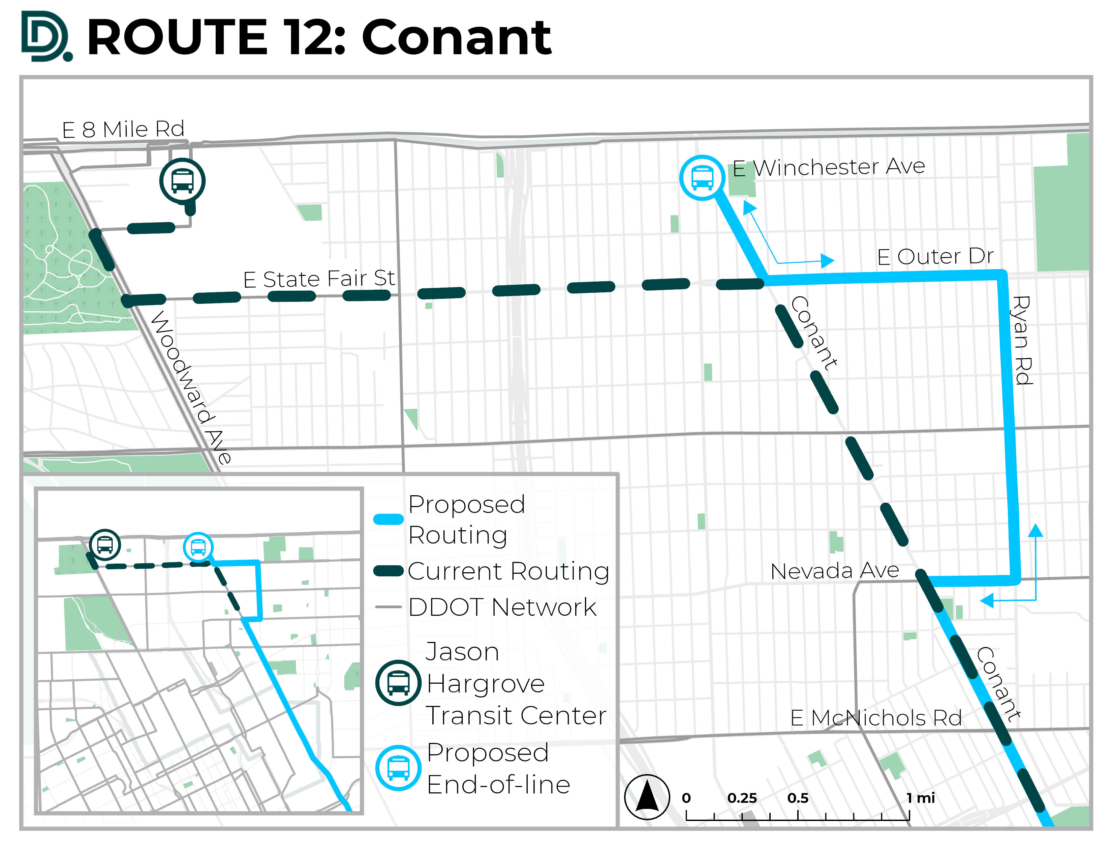
Proposed June 2025 Service Enhancements
12
Conant
Will be replaced by 52-Chene at Jason Hargrove Transit Center.
The northern
end-of-line will be relocated to Conant & E Winchester Ave via Nevada Ave, Ryan Rd, and E Outer Drive.
*12 Conant was considered for elimination during the DDOT Reimagined process but is now recommended to continue limited (lifeline) operations.

Slide 10
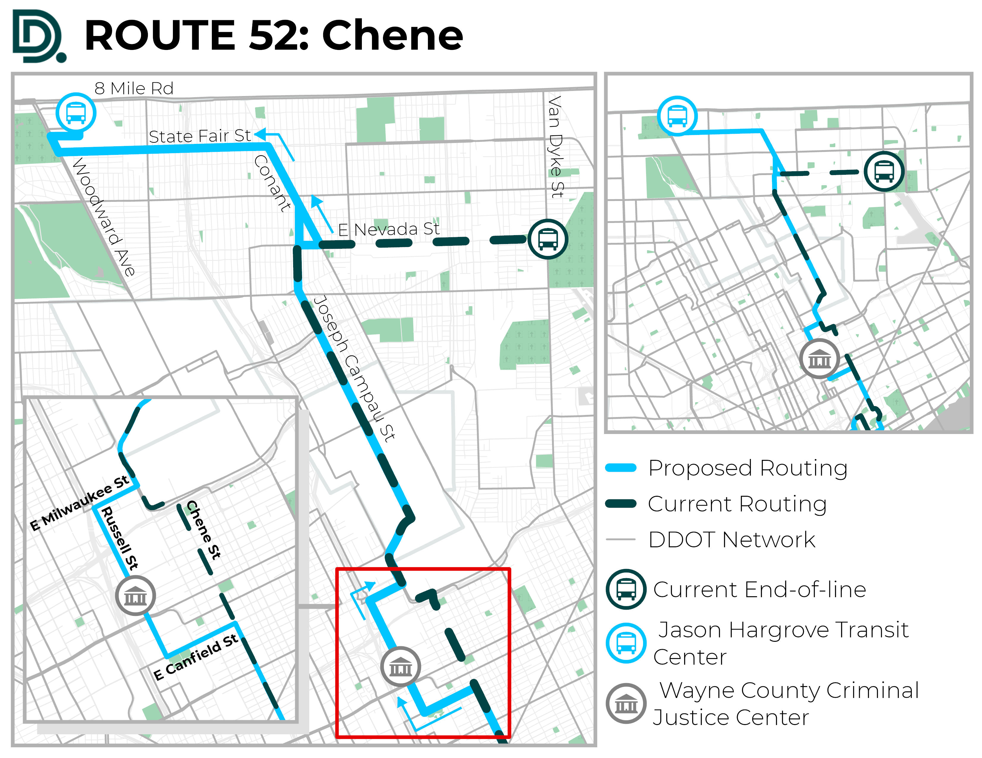
Proposed June 2025 Service Enhancements
52
Chene
Realigned to serve Jason Hargrove Transit Center via Conant, State Fair Avenue, and Woodward. This will remove service from Nevada & Van Dyke.
Realigned between Milwaukee and Canfield to operate on Russell and serve the new Justice Center.
Weekday Frequency Improvements:
Every 35-minutes during peak periods
Every 45-minutes during midday base

Slide 11
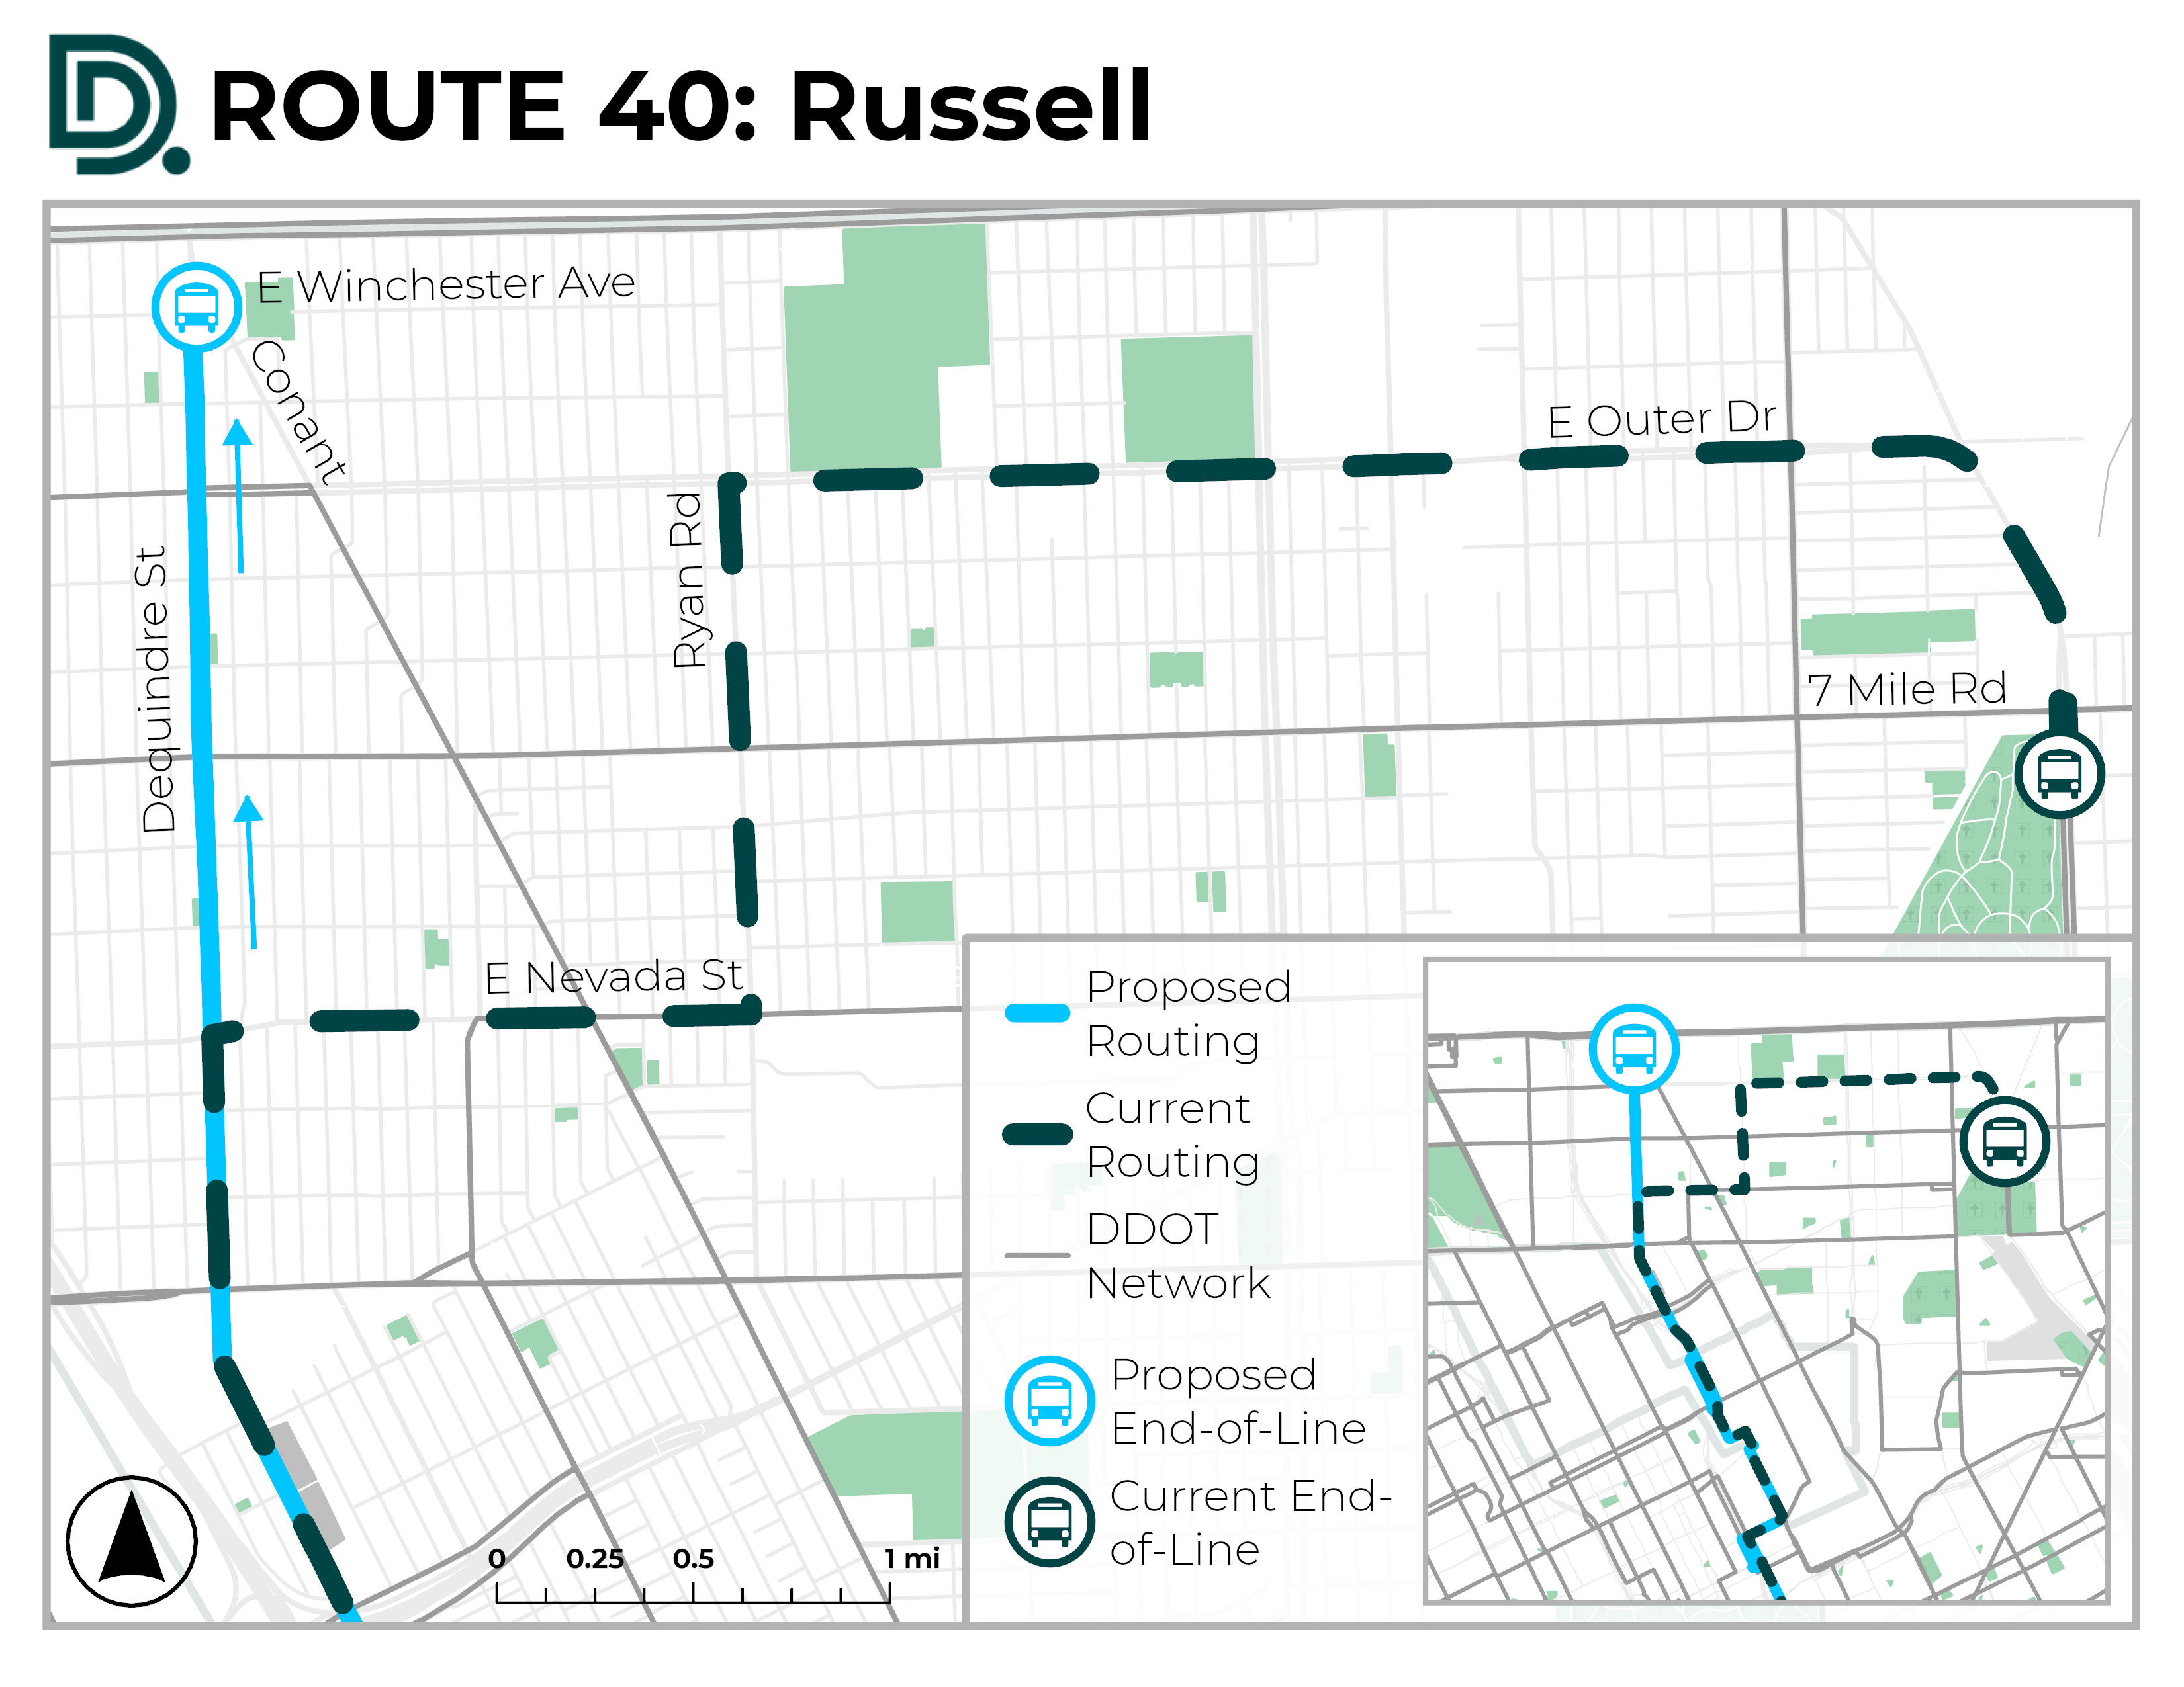
Proposed June 2025 Service Enhancements
40
Russell
The northern
end-of-line will be relocated to Conant & E Winchester Ave, discontinuing service on Outer Drive east of Ryan Rd.
*40 Russell was considered for elimination during the DDOT Reimagined process but is now recommended to continue limited (lifeline) operations.

Slide 12
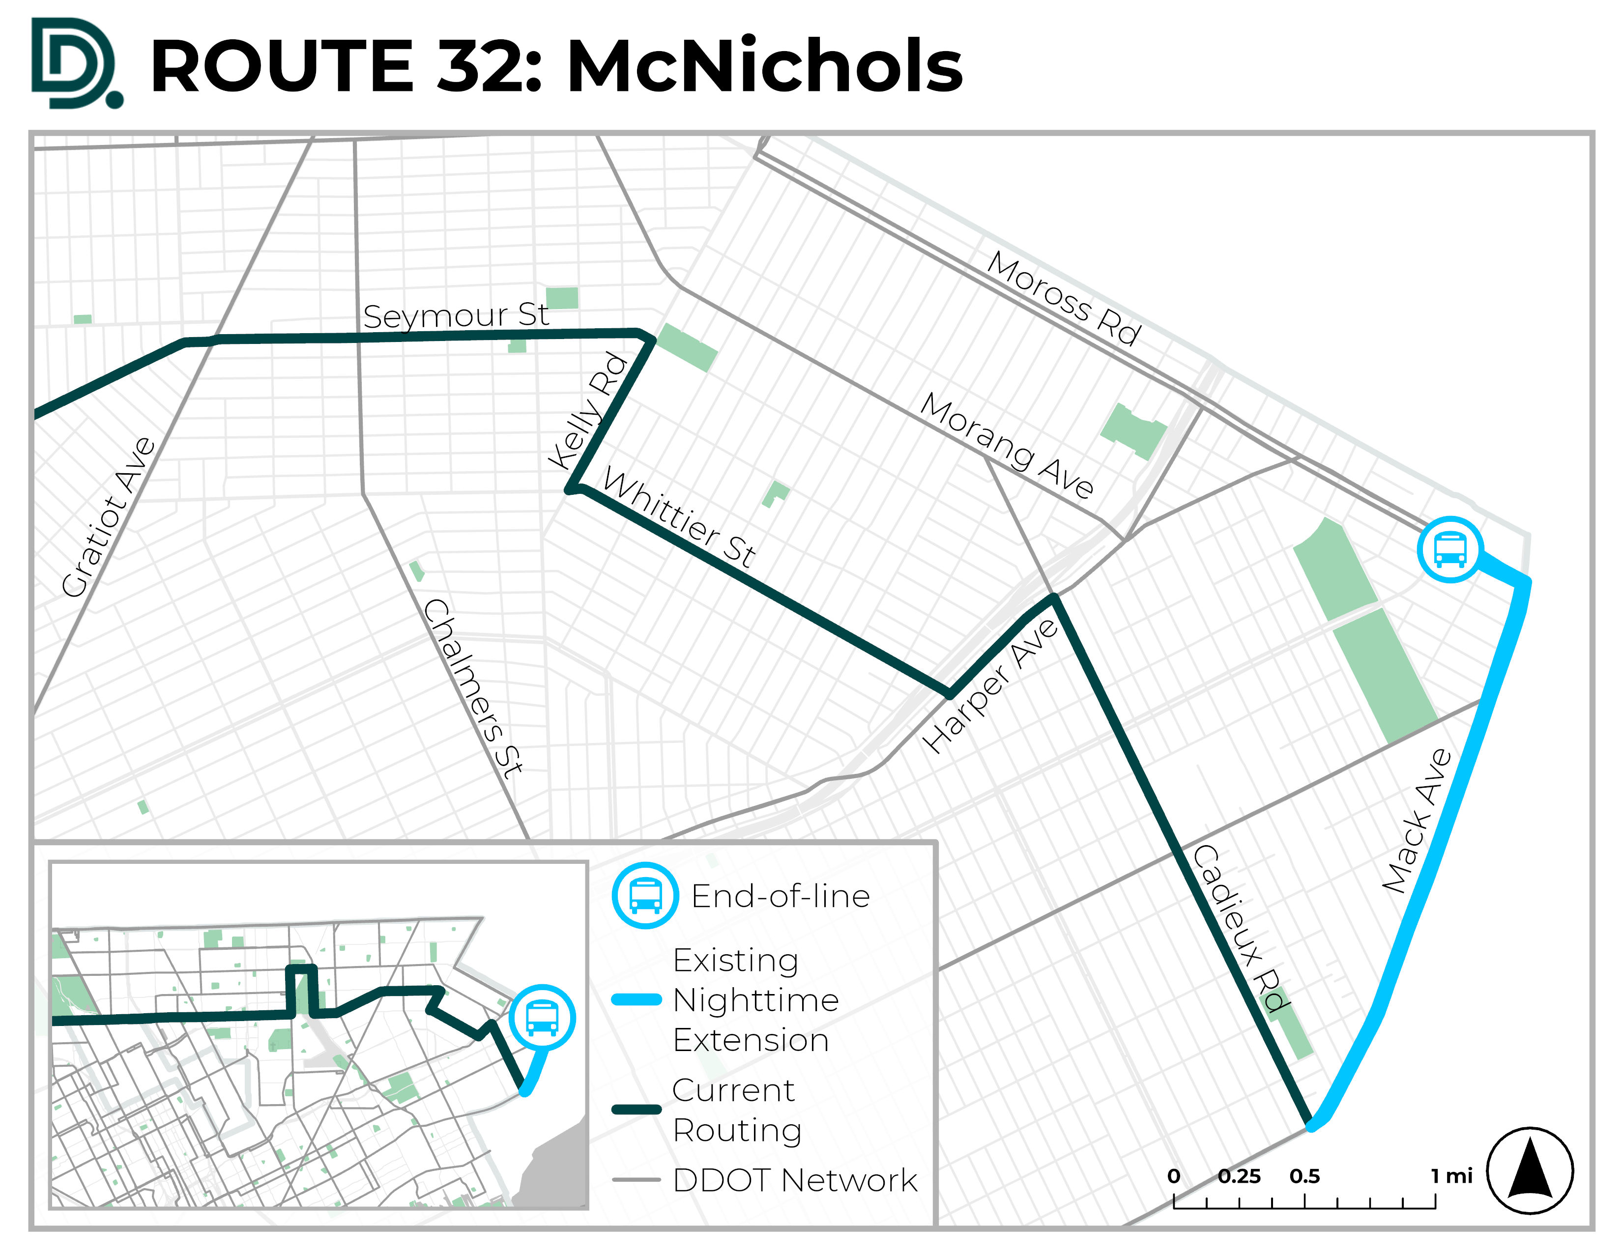
Proposed June 2025 Service Enhancements
32
McNichols
Will serve Mack & Moross transfer point at all times via the existing nighttime extension.
Daytime frequency improvements:
Weekday
Consistent 30-minute service

Slide 13
Proposed June 2025 Service Enhancements
Additional routes with proposed schedule changes…
67
Cadillac/Harper
Daytime frequency improvements:
Weekdays
Every 15-minutes
Weekends
Every 20-minutes
Weekday frequency improvements:
Peak Period
Every 35-minutes
Midday Base Period
Every 45-minutes

Slide 14
Public Comments
You can provide your public comment verbally tonight so that it will be recorded into public record.
You must state and spell your name for the record before providing your comment.
You will be given 2 minutes.
If you would like to make a comment after today, you have until April 19, 2025.
Provide comments by:
Email to DDOTComments@detroitmi.gov
By US Postal Service to: ATTN: June 2025 Hearing Detroit Department of Transportation 100 Mack Avenue Detroit MI, 48201
If you have questions, please call 313-933-1300
March
20
Changes will go into effect on June 23, 2025.
14

Slide 15
Thank You
detroitmi.gov/ddot
@RideDDOT

