Slide 1
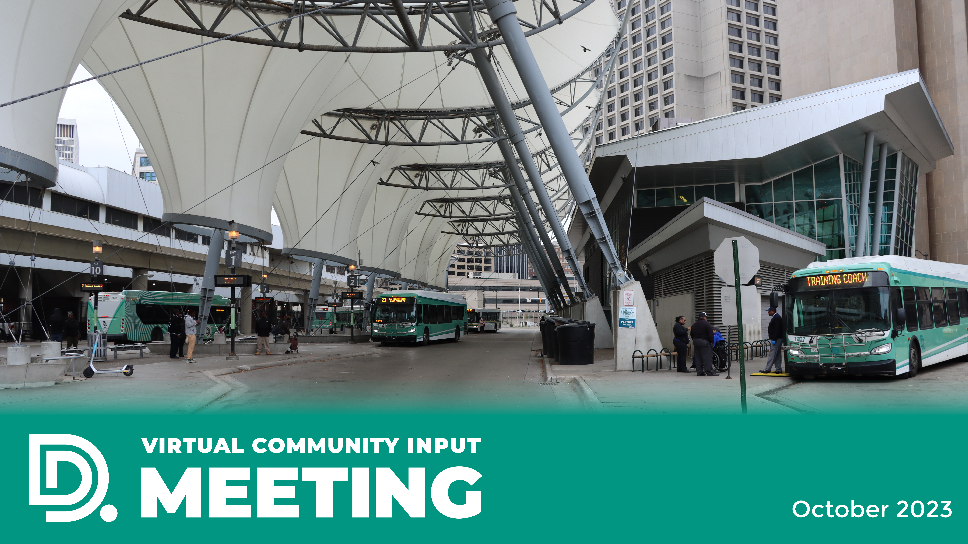

DDOT WEBSITE
UPDATES
Virtual Community
Input Meeting
May 15, 2025

Slide 2
A FEW REMINDERS
PERMISSION TO RECORD
By participating in this meeting, you are granting permission for your name, image, likeness, as well as audio and video recordings to be used by DDOT.
RAISE HANDS
During the public comments period, use the “Raise Hand” feature to be called upon
to speak.
DIAL *9
If you are using the “Dial-in Only” phone option, enter *9 to serve as the “RAISE HAND” feature to Request to Speak or Ask a Question.
VIRTUAL CHAT
Submit questions/comments to DDOT staff.

Slide 3



A FEW REMINDERS
BEFORE ASKING A QUESTION
OR COMMENTING, BE SURE TO:
Unmute your audio
State your name
and organization
Following your comments, mute
your audio

Slide 4


June Service Changes

Slide 5
June Service Changes
Thank you for your input on the service changes.
As a result of the public hearing and public comments, the following changes will be effective June 23, 2025:
16 Dexter and 10 Greenfield proposals
Daytime frequency improvements:
Weekdays
Every 15-minutes
Weekends
Every 20-minutes
All Dexter trips to Old Redford Meijer and UD Mercy reroute via Puritan and Livernois
5

Slide 6
June Service Changes
32 McNichols
3 Grand River
Will serve Mack & Moross transfer point at all times via the existing
nighttime extension.
BRT frequencies to improve daytime service
Weekdays
Every 10 Minutes
Weekends
Every 15 Minutes
6

Slide 7
June Service Changes
9 Jefferson
40 Russell
Extension to ALDI Supermarket at Mack & Alter via Alter, Charlevoix, Chalmers,
and Mack.
No routing changes.
50-minute peak service frequency and 70-minute midday (with more time for recovery and reliability)
7

Slide 8
June Service Changes
12 Conant
52 Chene
No routing changes.
45 - minute peak service frequency
No routing changes.
8

Slide 9
Looking Ahead to Proposed
September Changes

Slide 10
Proposed September Service Changes
DDOT proposes improving weekday frequencies on the following routes:
15-Chicago/Davison: Improve weekday base frequency from 60 to 45 minutes, and weekday peak frequency from 45 to 30 minutes.
19-Fort: Improve weekday base frequency from 50 to 40 minutes, and weekday peak frequency from 45 to 30 minutes. Improve Saturday daytime frequency to every 40 minutes.
23-Hamilton: Improve weekday base frequency from 60 to 40 minutes, and weekday peak frequency from 40 to 30 minutes.
27-Joy: Improve weekday peak frequency from 50 to 35 minutes.

Slide 11
Proposed September Service Changes
DDOT proposes improving weekday frequencies on the following routes:
30-Livernois: Improve weekday base frequency from 60 to 45 minutes, and weekday peak frequency from 45 to 35 minutes.
38-Plymouth: Improve weekday base frequency from 60 to 45 minutes, and weekday peak frequency from 45 to 35 minutes.
41-Schaefer: Improve weekday base frequency from 60 to 45 minutes, and weekday peak frequency from 45 to 35 minutes.
43-Schoolcraft: Improve weekday base frequency from 60 to 45 minutes, and weekday peak frequency from 45 to 30 minutes.

Slide 12
Proposed September Service Changes
DDOT proposes improving weekday frequencies on the following routes:
54-Wyoming: Improve weekday base frequency from 60 to 45 minutes, and weekday peak frequency from 45 to 35 minutes.
These proposed changes are expected to be effective September 1.
You can review and comment on these proposed changes on our website at detroitmi.gov/ddot. The information is under the News and Events section.
A full presentation on the changes will take place during the public hearing in July.

Slide 13
Coolidge Facility Update

Slide 14
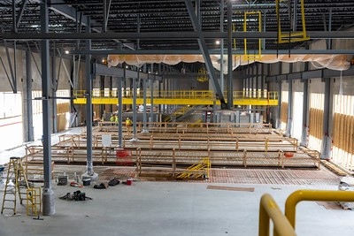
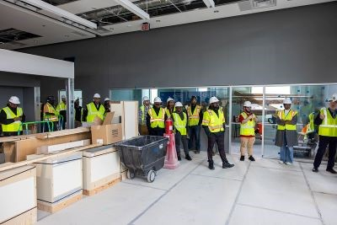
Coolidge Terminal
About two-thirds of the work is now complete at the new Coolidge Terminal, which is expected to open sometime
next year.
The new facility will replace DDOT’s Gilbert terminal. Key features of the new terminal include:
Employee locker rooms
Administrative and training space
Maintenance facility with heated floors
Storage building that can hold up to 150 buses, with the option to expand to 250 buses in the future.

Slide 15
DDOT TEO Status

Slide 16
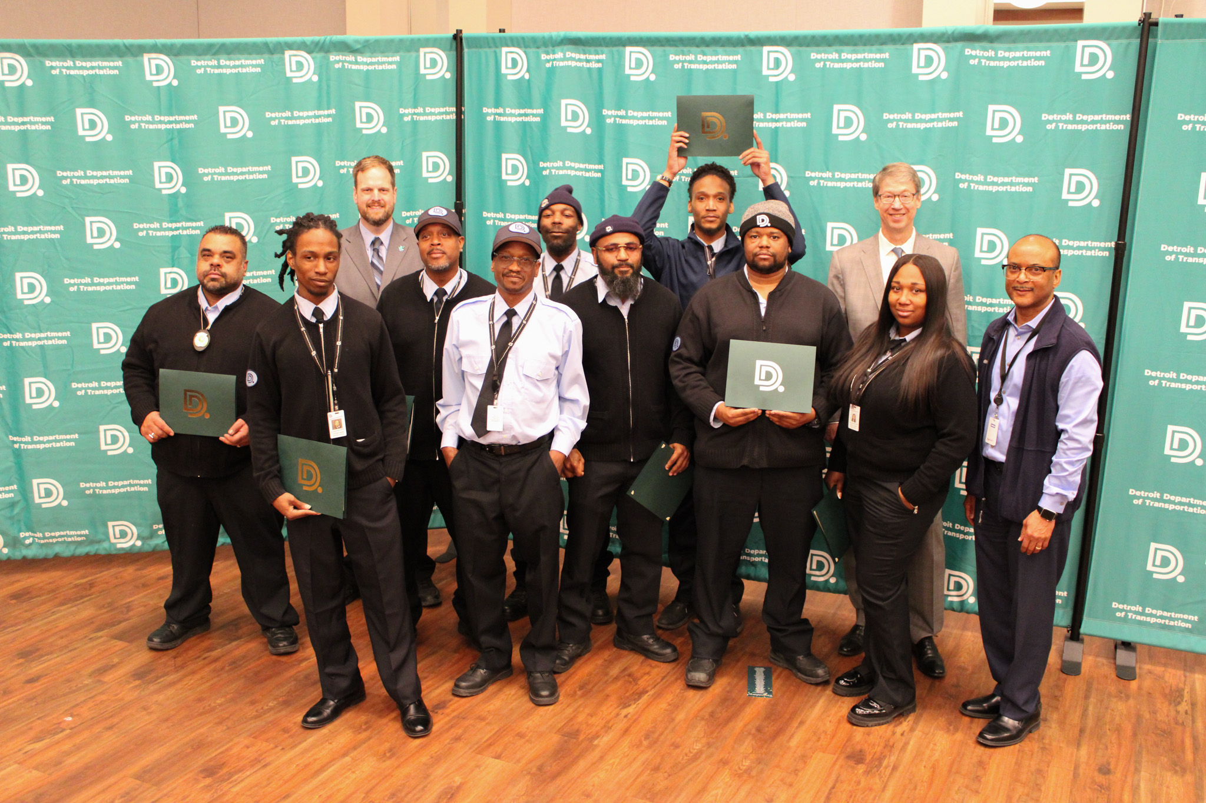
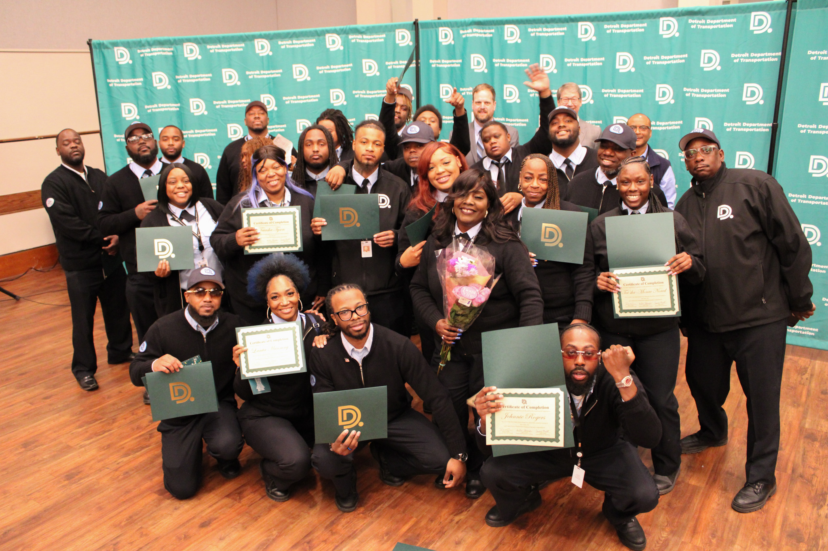
DDOT RECRUITMENT
TEO Status
DDOT currently has 499 active operators.
25 inactive operators

Slide 17
Paratransit Update

Slide 18
DDOT Now
Paratransit’s same day service, DDOT Now is expected to launch soon.
DDOT is awaiting essential equipment to begin the service.
DDOT NOW will be available to Paratransit's current and future eligible client base and will allow them to book a trip in as little as one (1) hour in advance.
The service area and fare ($2.50) will mirror DDOT Paratransit.
It will operate Monday through Saturday from 6a to 7p as a non-dedicated, supplemental service, trips and availability will be limited.

Slide 19
DDOT Safety

Slide 20
Your Safety Matters!!
We have an update about DDOT’s new initiative at the Rosa Parks and Jason Hargrove Transit Centers.
The use of the metal detectors will go live starting Thursday, May 22.
The metal detectors are installed at designated entry points to ensure prohibited items are not brought onto the property.
If you are using a medical device that may be affected by a metal detector, let our staff know. Alternative screening methods will be made available.

Slide 21
UPCOMING
MEETINGS
Virtual Local Advisory Council (LAC)
Tuesday, May 20 @ 10 a.m.
Public Hearing for Proposed September Changes
Thursday, July 17 @ 5 p.m.

Slide 22
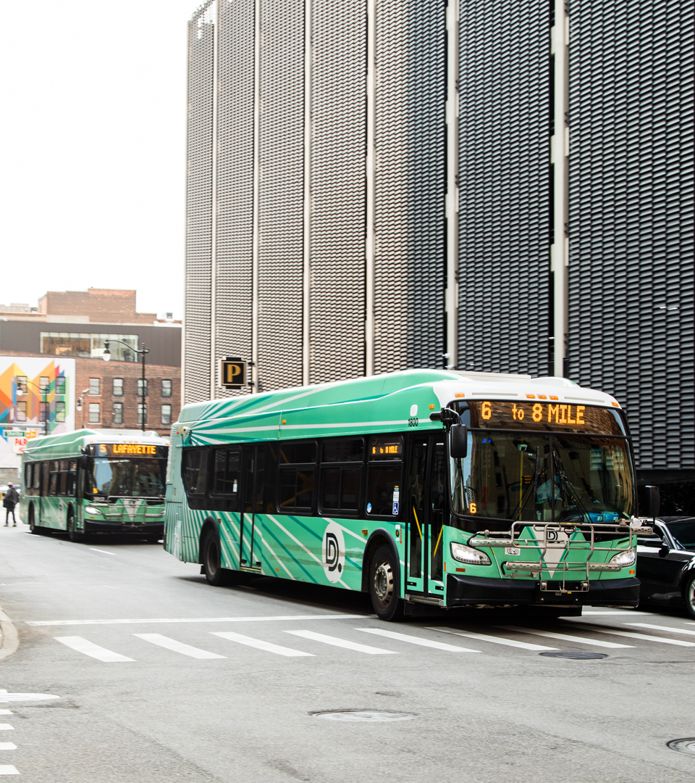

Thank You
Website
detroitmi.gov/ddot
Social Media
@RideDDOT

