Slide 1
Property Assessed Clean Energy (PACE)
Mary Freeman, Lean & Green Michigan
Doing Development in Detroit District 4
April 22, 2025

Slide 2
Lean & Green Michigan created and runs Michigan’s PACE market
We pioneered the idea of a uniform statewide PACE market that is privately run, efficient and open to all
Lean & Green Michigan:
Creates and administers the program for each participating local government
Connects commercial property owners, private lenders and local contractors
Sees projects through from beginning to end
There is no cost to local governments
Earns money only on successfully closed projects - and our fee is rolled into the loan

Slide 3
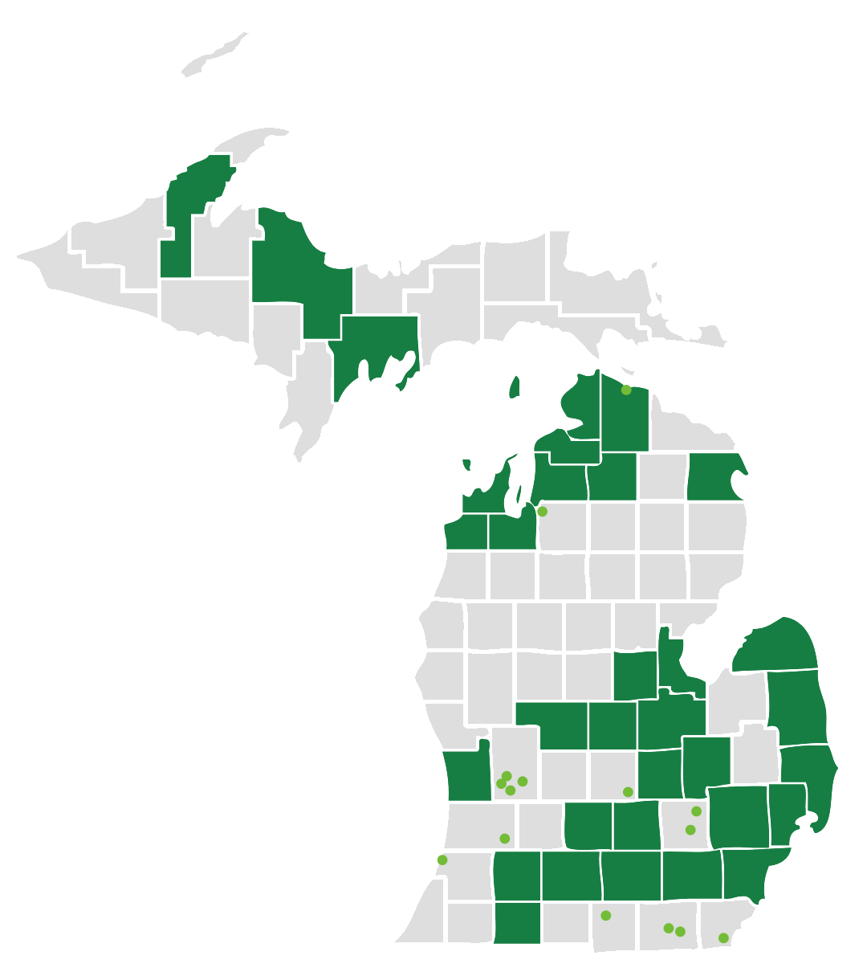
81% of Michiganders live in a Lean & Green Michigan PACE district.
61 Michigan municipalities have joined Lean & Green Michigan’s statewide market
Notes:
Wayne County was the 4th county and 6th jurisdiction overall to join our program by a 15-0 vote on December 5, 2013 - just under 11 years ago. (After Ingham, Macomb and Saginaw Counties and the cities of Southfield and Rochester Hills.)

Slide 4
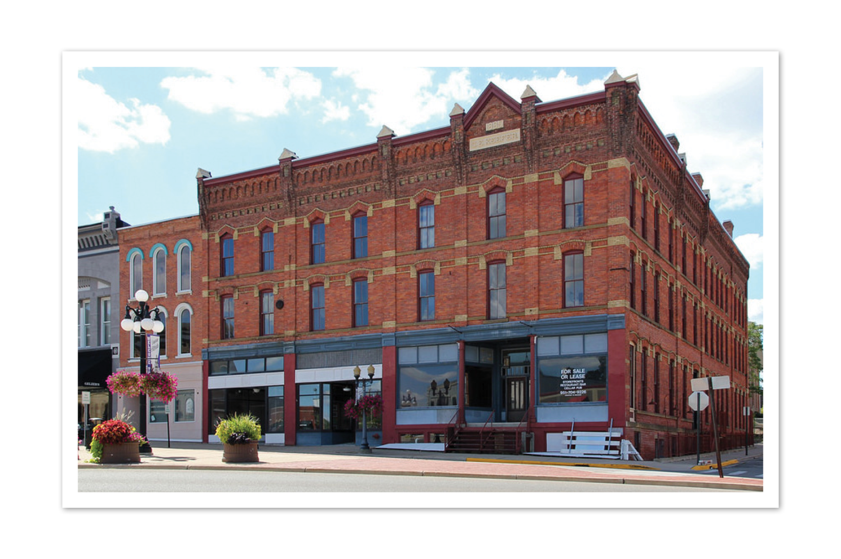
Eligible Properties
PACE financing in Michigan is limited to privately owned industrial, agricultural, or commercial properties.
Retail
Office
Hospitality
Nonprofits
Multi-family housing with four or more units
Senior living facilities
Mixed-use

Slide 5
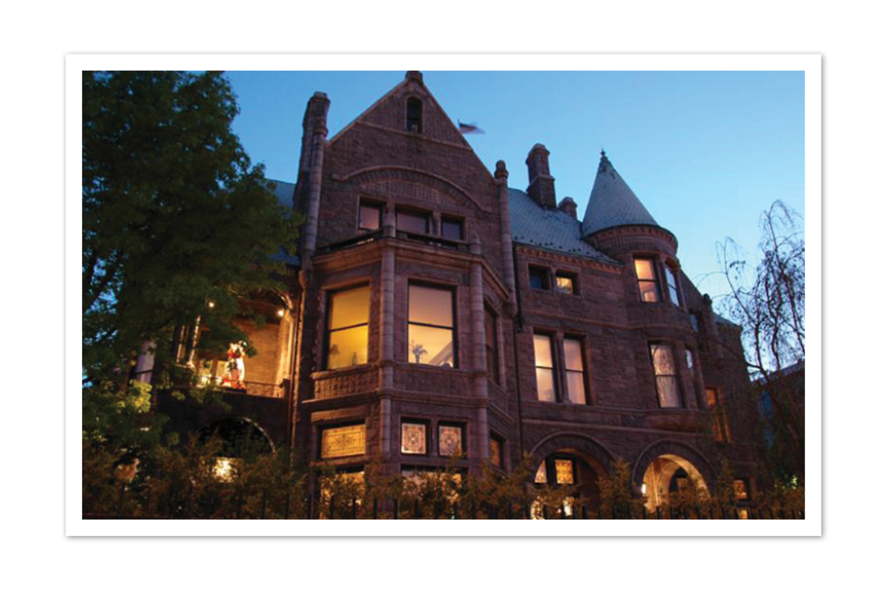
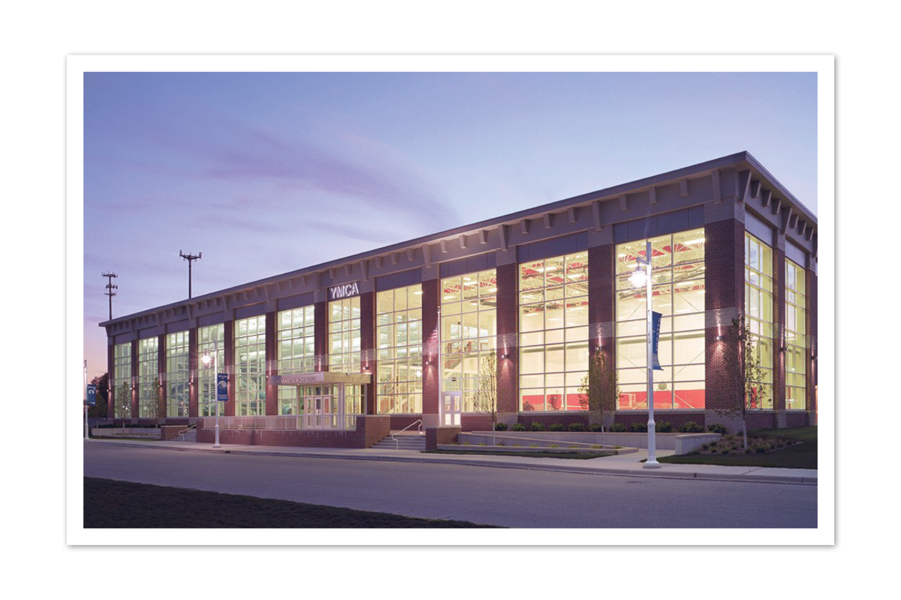
Benefits of PACE (a true win-win-win!)
Funding Brings in private capital for energy & water efficiency, renewable energy and enviro. hazard mitigation
Fixed Interest Rates Property owners get 100% up-front financing and long-term fixed interest rates (up to 25 yrs)
Lending Security PACE lenders get the security of a property lien created by the special assessment
Property Improvement Helps make property efficient and cost-effective for all situations: retrofits, gut rehabs & new construction
Increased Property Value Results in increased business profitability and property values, as well as improved sustainability of the real estate asset
New High Quality Jobs created for local workers

Slide 6
Eligible Improvements
Energy Efficiency: lighting, HVAC, windows, insulation, roofing, caulking, EV charging
Water Efficiency: stormwater recapture, low-flow toilets / sinks / shower heads, greywater systems
Renewable Energy: biomass, solar or solar thermal systems, wind energy, geothermal, CHP
Environmental Hazards: mitigation of lead, PFAS and other harmful substances in drinking water and protection against effects of severe weather such as drought and flood
Anaerobic Digester Energy Systems: systems to capture methane gas

Slide 7
PACE as Part of a Capital Stack
PACE works in almost any complex capital stack with:
Utility Rebates
Traditional Bank Finance
Historic Tax Credits
Brownfield TIF
Solar Tax Credits
USDA-Backed Loans
HUD-Backed Housing
Economic Development Incentives

Slide 8
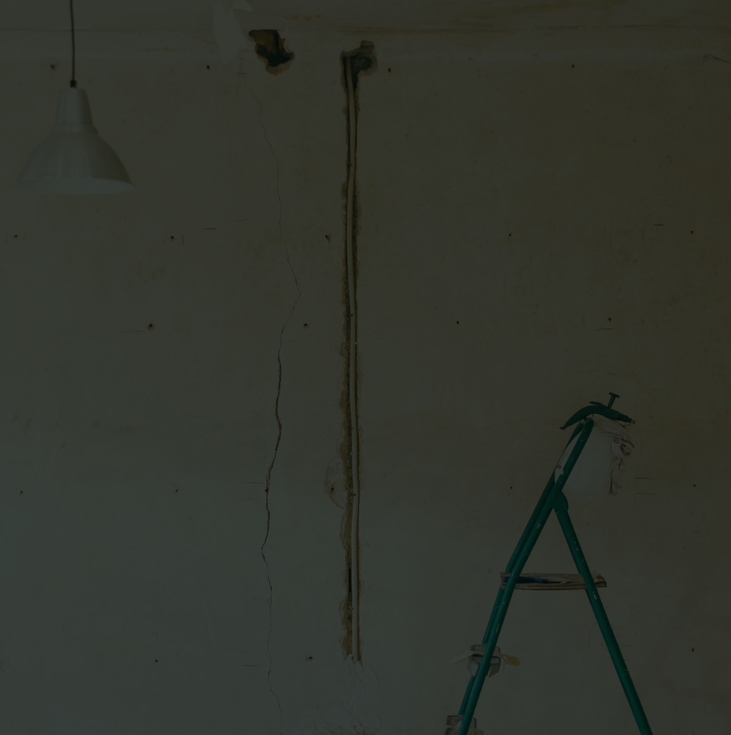
STATEWIDE MARKET DATA
LEAN & GREEN’S IMPACT
kWh of Electricity Savings | 423,452,219
Tons of CO2 Savings | 429,713
Gallons of Water Saved | 296,244,079
Money Saved | $234 million
Jobs Created | 1299
LEAN & GREEN IMPACT
kWh of Electricity Savings | 716,809,691
Metric Tons of CO2 Savings | 1,220,148
Gallons of Water Saved | 857,530,252
Money Saved | $342,000,000
Jobs Created | 3,549
LEAN & GREEN'S IMPACT
87
PACE projects financed since 2015
$308 million
Private investment

Slide 9
511 Woodward
Wayne County
$2,720,090 Financed in PACE
Notes:
Net Savings: $4,229,475
Energy Conservation Measures:
Building Envelope
Windows
Lighting Systems and Controls
Project Term: 25 years

Slide 10
AC Detroit at the Bonstelle
Wayne County
$8,163,587 Financed in PACE
Notes:
Net Savings: $ 11,259,222
Energy Conservation Measures:
LED Lighting
Windows
HVAC
Electrical Controls
Plumbing
Project Term: 25 years

Slide 11
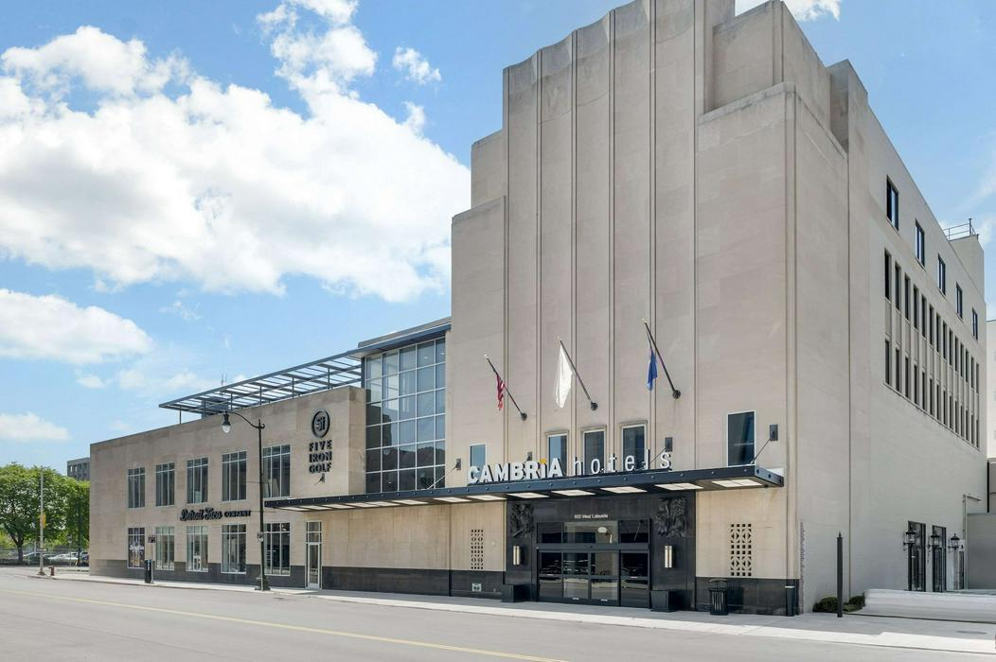
The Cambria Hotel Detroit
Wayne County
$20,038,760 Financed in PACE
Notes:
Net Savings: $9,734,953
Energy Conservation Measures:
Condensing domestic hot water
New HVAC system and lighting
Building envelope
Air barriers
EnergyStar kitchen / laundry appliances
Project Term: 25 years

Slide 12
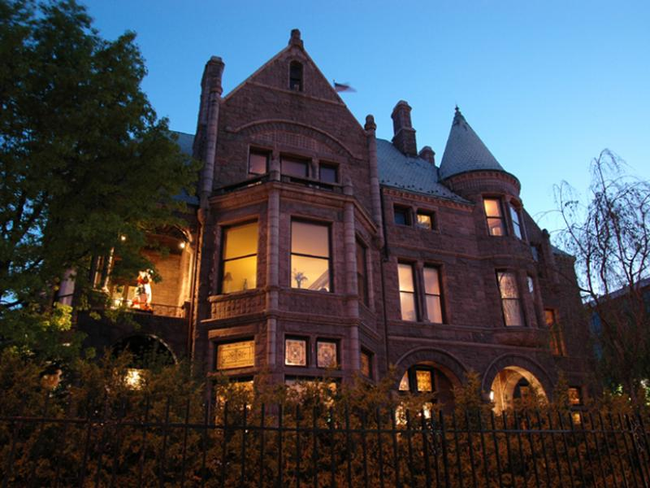
The Whitney
Wayne County
$863,130 Financed in PACE
Notes:
Net Savings: $2,097,327
Energy Conservation Measures:
Efficient HVAC
LED lighting
Building controls
Storm windows
Efficient kitchen ranges
Project Term: 20 years

Slide 13
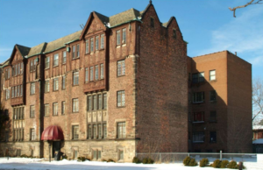
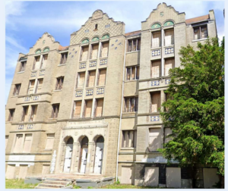
The Hazelwood Apartments
Wayne County
$2,110,000 Financed in PACE
Notes:
Net Savings: $4,950,575
Energy Conservation Measures:
LED Lighting
HVAC
Low flow fixture
Roof upgrade
Window upgrade
Project Term: 25 years

Slide 14
The Exchange
Wayne County
$13,000,000 Financed in PACE
Notes:
Net Savings: $39,863,448
Energy Conservation Measures:
Roofing
Windows
HVAC
Low flow fixtures
Low flow fixtures
Project Term: 25 years

Slide 15
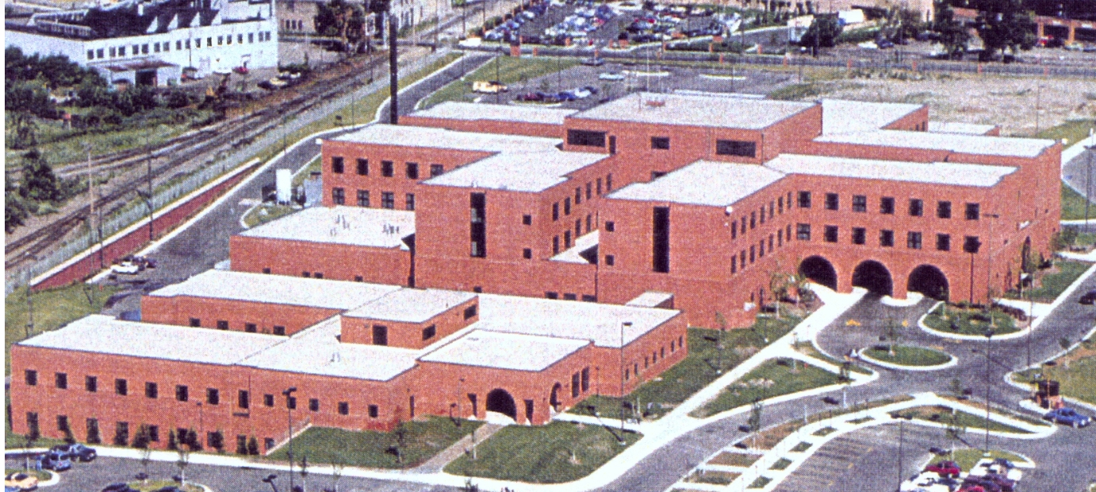
The Samaritan Center, Wayne County
Total Savings: $8,209,250
Energy Conservation Measures:
HVAC
LED Lighting
Water Systems
Chillers and Boilers
Elevators
Project Term: 25 years
$3,268,000 Financed in PACE

Slide 16
Stellar Residence Inn
Grand Traverse County
$5,307,803 Financed in PACE
Notes:
Net Savings: $6,000,000
Energy Conservation Measures:
LED Lighting
HVAC
Windows
Low flow water fixtures
High efficiency water heater
Project Term: 25 years

Slide 17
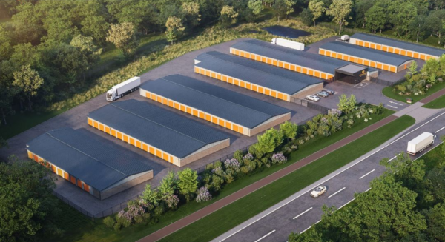
Romulus Self Storage Wayne County
District 11, Commissioner Al Haidous
Total Savings: $1,440,400
Energy Conservation Measures:
HVAC
Building Envelope
Windows
LED Lighting
Plumbing
Project Term: 25 years
$1,500,000 Financed in PACE
Notes:
Net Savings: $9,734,953
Energy Conservation Measures:
Condensing domestic hot water
New HVAC system and lighting
Building envelope
Air barriers
EnergyStar kitchen / laundry appliances
Project Term: 25 years

Slide 18
Thank You!
www.leanandgreenmi.com
Mary Freeman
CEO
mary@leanandgreenmi.com

