Slide 1
Messmer Park Improvement Project
Community Meeting at
East Warren Farmers Market
July 27, 2023

Slide 2
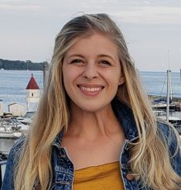

Slide 3
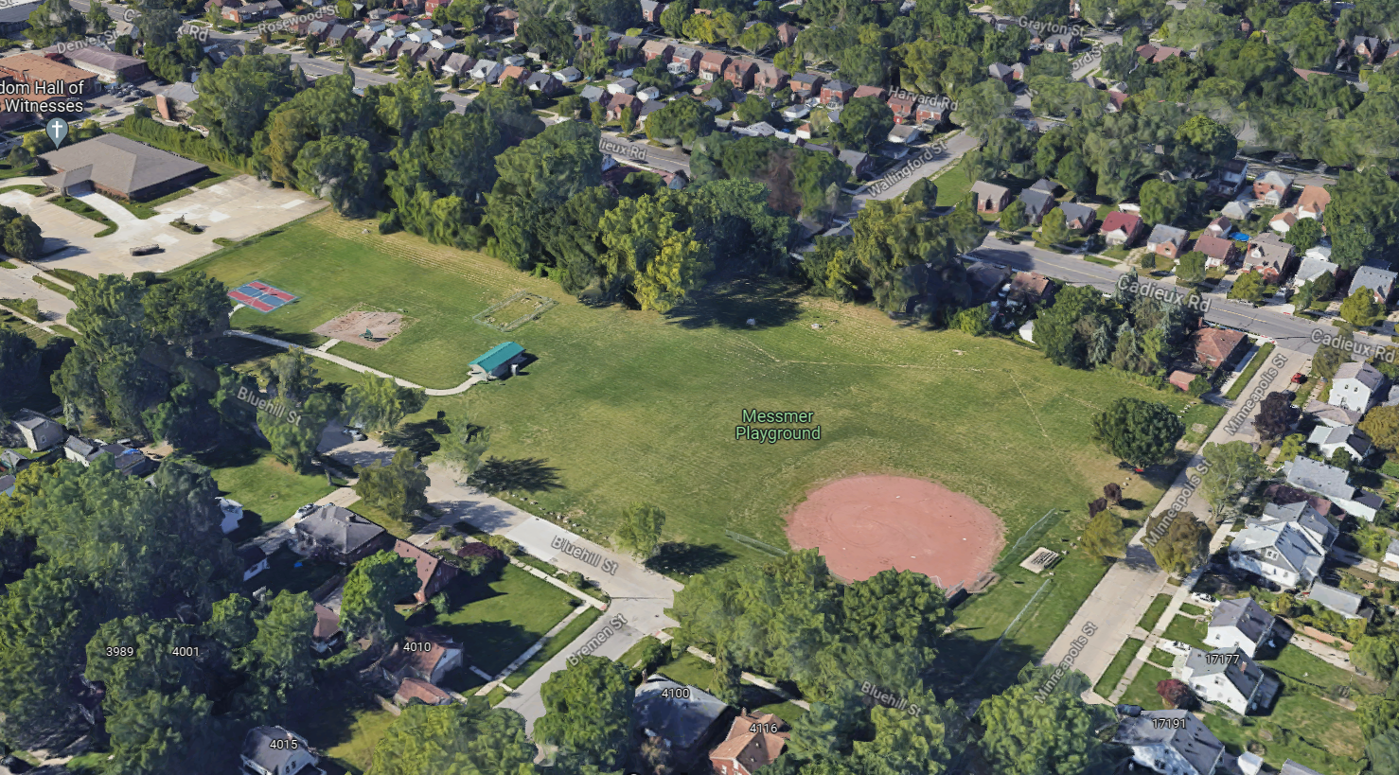
Messmer Park- 4135 Bluehill St
Cadieux Rd
Bluehill St.
Minneapolis St.
N

Slide 4
Project Overview & Timeline
Project Budget: <$500,000 (minor renovation)
Source: City of Detroit General Fund
Phase 2 implementation of Parks & Rec Strategic Plan

Slide 5
Community Outreach

Slide 6
External Stakeholder Meeting- May 25th
Zoom Meeting
Invited key stakeholders from East Warren/Cadieux Framework Planning Process
Staff from DON & PDD
Representation from Cornerstone Village & East Warren Development Corporation
Reviewed Survey
Help set date for Design Kickoff
Liked the idea of an on-site meeting

Slide 7
Online Survey
Open for the month of June
33 Responses
68% of respondents live within a ¼ mile from Messmer Park
36% use the park almost every day or several times per week

Slide 8
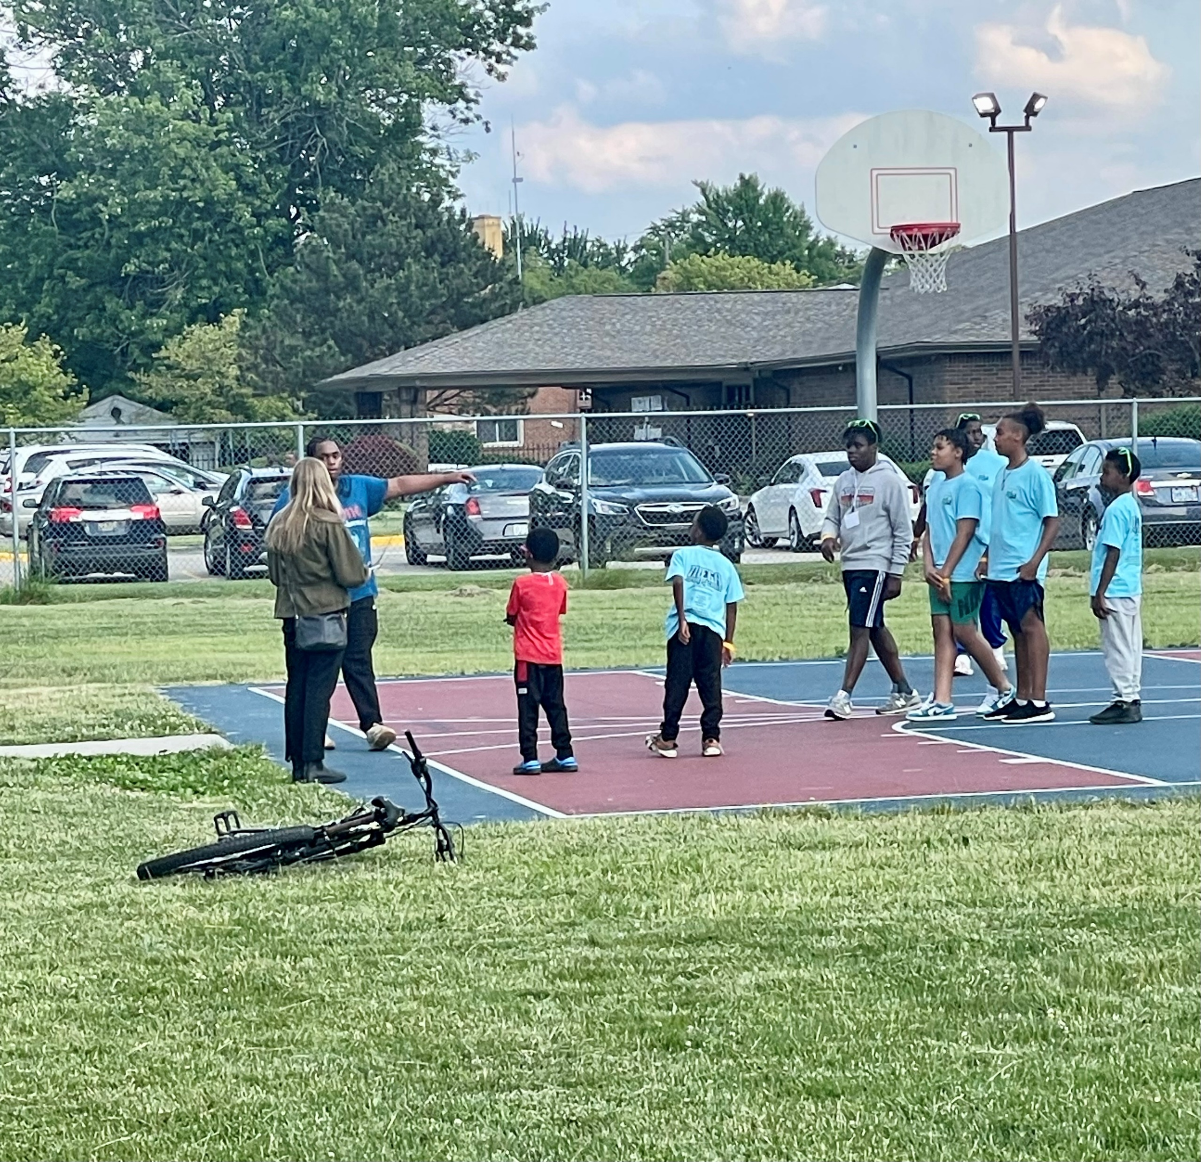
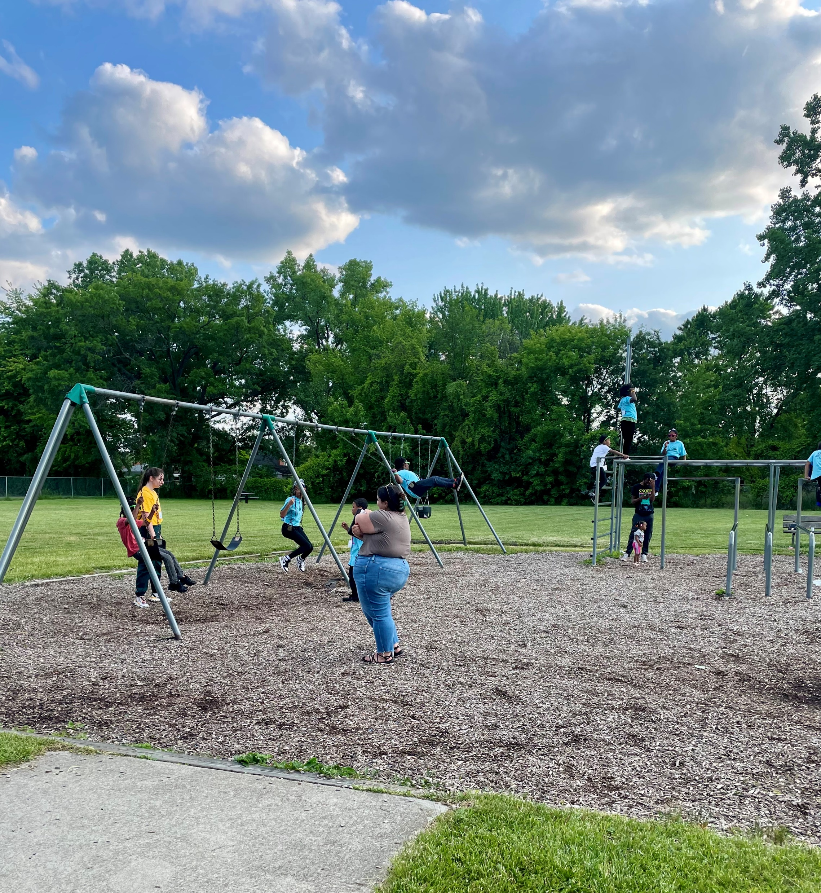
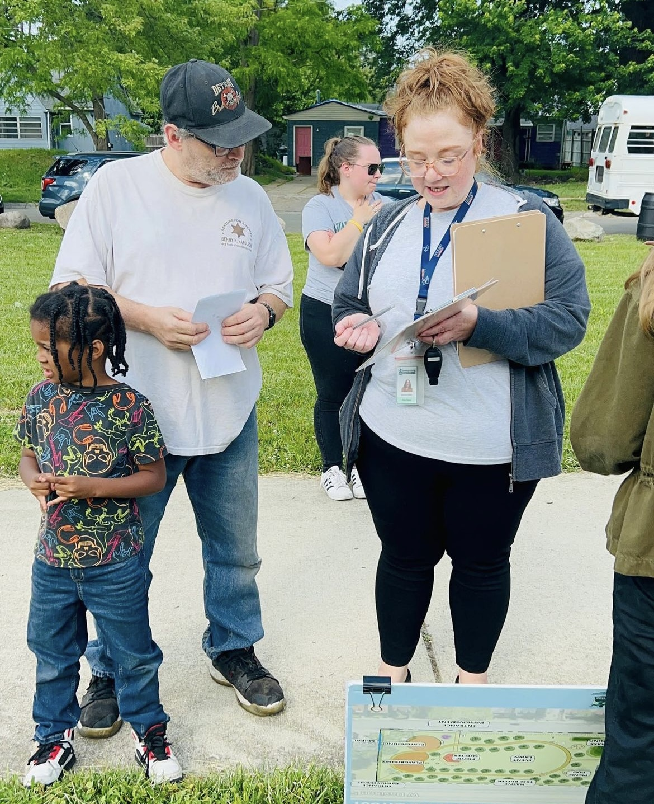
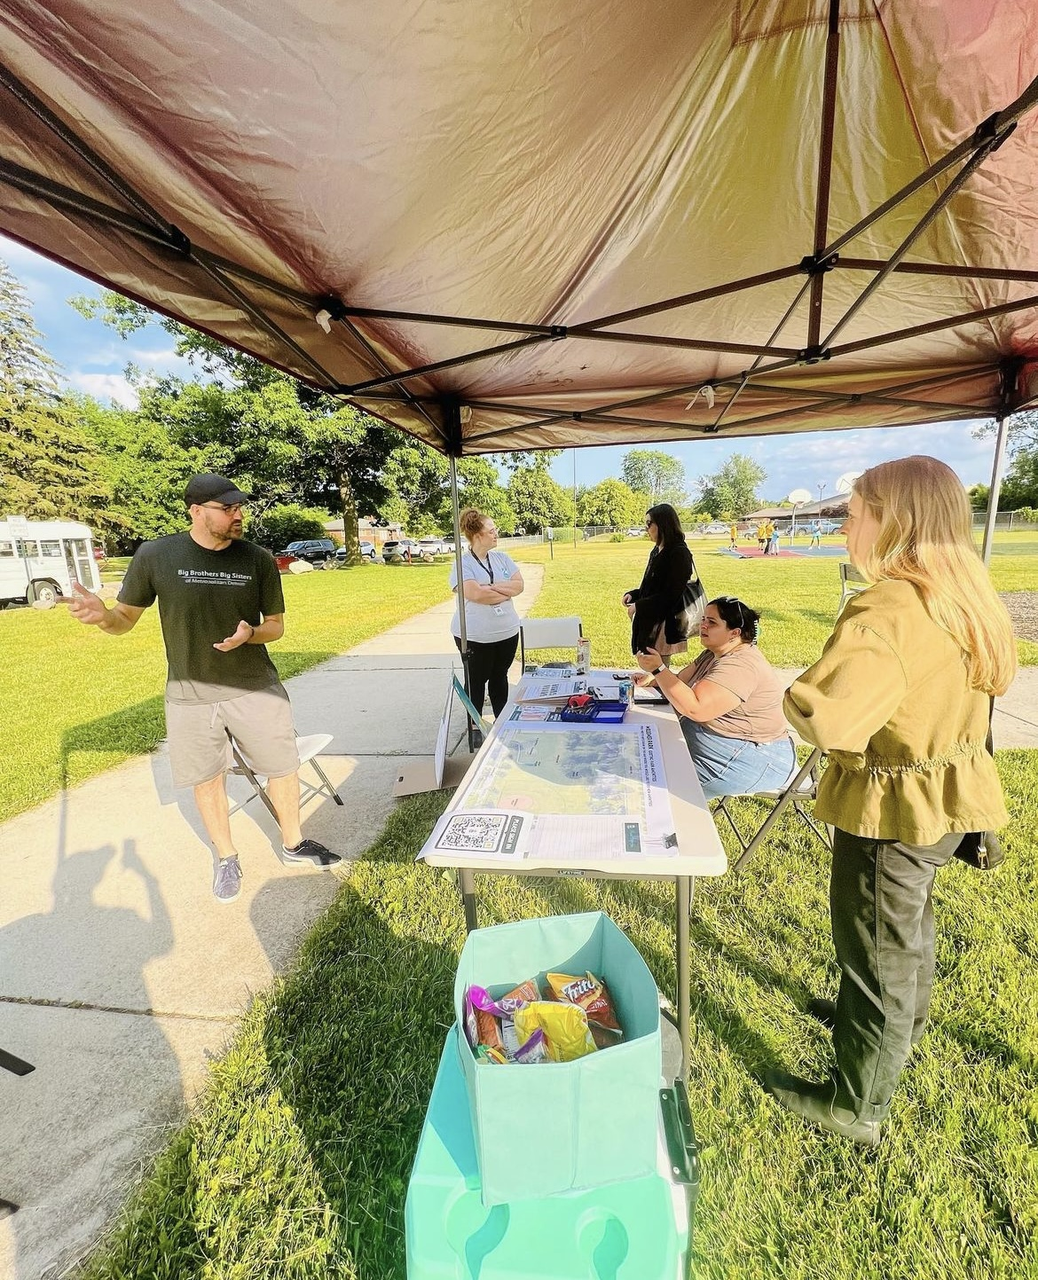
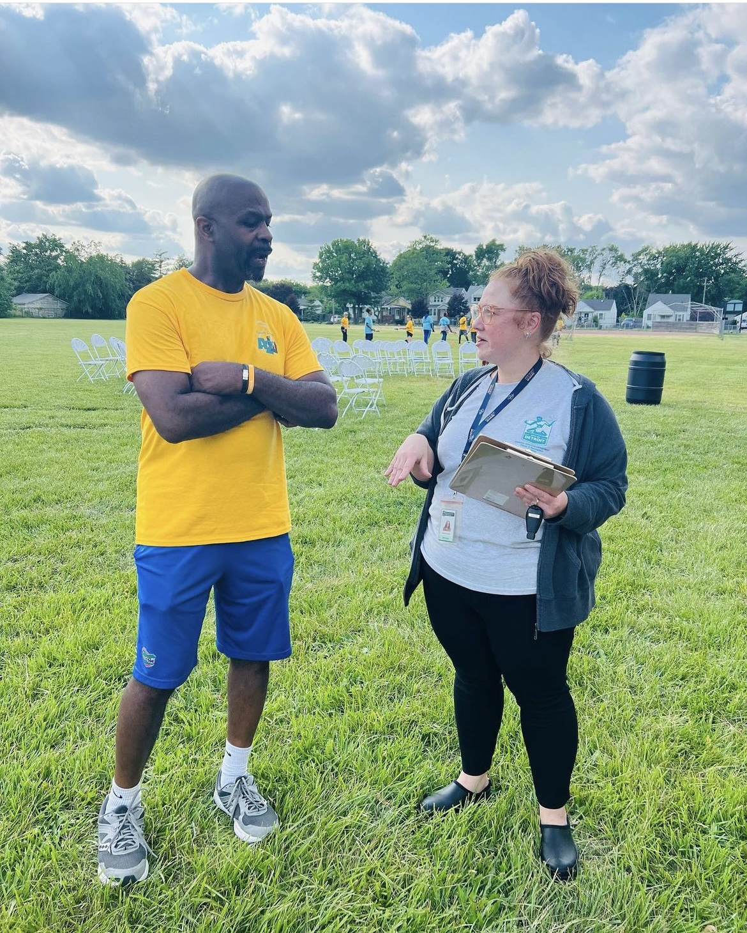
Collaborative Design Kickoff- June 24th
About a dozen responded to our flyer
Approx 70 kids & volunteers from
Church Camp
20 to 30 people stopped by

Slide 9
What activities do you currently do in the park?
Top 5 Activities
Walking/running (26%)
Walk/Run Dog (16%)
Passive Activities (15%)
Playtime for Kids (14%)
Open lawn use (10%)

Slide 10
Why don’t go you to the park more often? (Park Issues)
Why don’t you go to the park more often?
Top 5 Reasons/Issues
Condition of Amenities (17%)
Go other places for recreation (13%)
Loud destructive parties (11%)*
Nothing for me to do (10%)
Park doesn’t feel safe/welcoming (9%)*

Slide 11
How high of a priority is this improvement for the park?
1
2
3
4
5
Top 5 Priorities
Tot Lot
Walking Loop
Expand Tree Canopy
Landscaped Beds
Replace the current playground

Slide 12
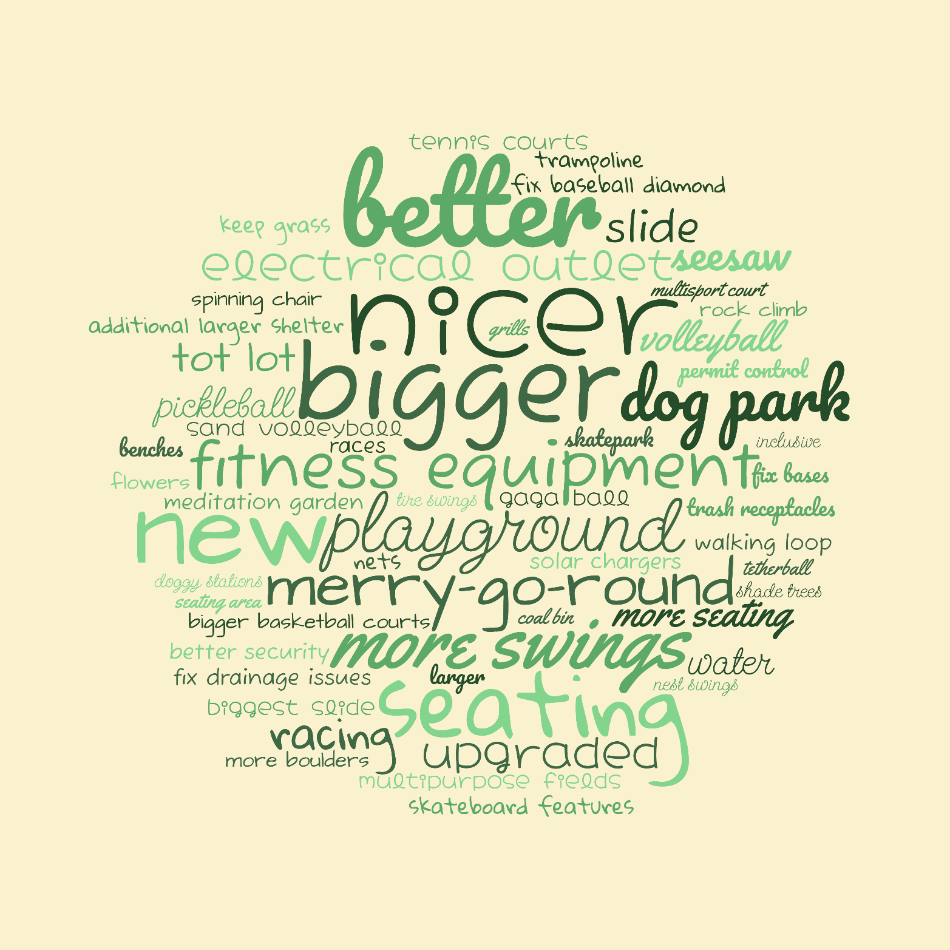
Input from Kids & Volunteers
What’s missing from this park?

Slide 13
Park Concepts

Slide 16
Tonight’s Activity
Divide into 3 groups around Table 1, 2 & 3

Slide 17
TABLE 1: Concept A (10 minutes)
How much do you like the concept?
Place dot around the number that shows how much you like the project.
What do you like about the concept?
Write on posterboard
3) What would make the concept better?
Write on posterboard
TABLE 2: Concept B (10 minutes)
How much do you like the concept?
Place dot around the number that shows how much you like the project.
What do you like about the concept?
Write on posterboard
3) What would make the concept better?
Write on posterboard

Slide 18
TABLE 3: Playground Typology (10 minutes)
Place dots on each of the playground types you think would be good for Messmer Park
OTHER INDEPENDENT ACTIVITIES:
Talk to Security and PD
Leave a Comment Card

Slide 19
Next Steps
✓ Collaborative Design Kickoff- June 14th
✓ Survey ended June 30th
✓ Community Meeting #2 - July 27th
Community Meeting #3
(late August)
We Are Here

Slide 20
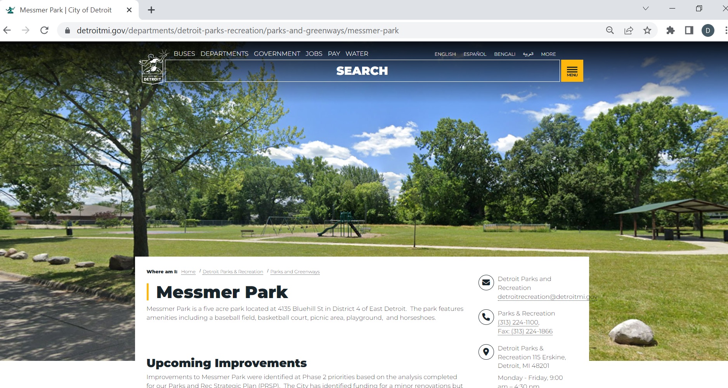
Go to website for updates: detroitmi.gov/messmer

Slide 21
THANK YOU!
Questions or Comments at any time in the process:
Shamori Whitt (PLANNING)
shamori.whitt@detroitmi.gov
(313) 268-1860
Arianna Zannetti (DESIGN)
zannettia@detroitmi.gov
(313) 236-8805
Notes:
Project Team Slide

