Slide 1
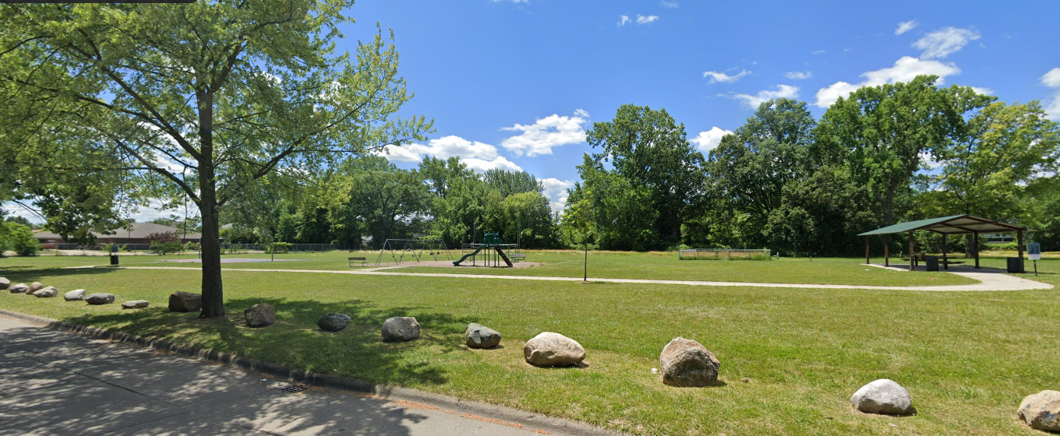
Messmer Park Improvement Project
General Services Division
June 2023

Slide 2
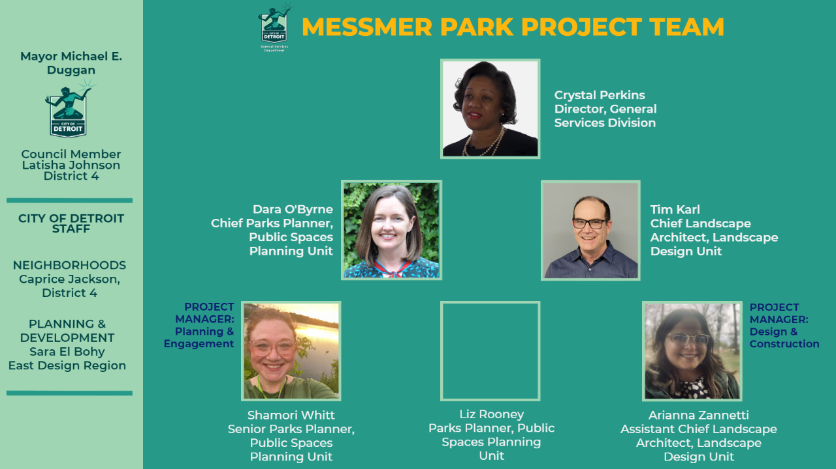


Slide 3
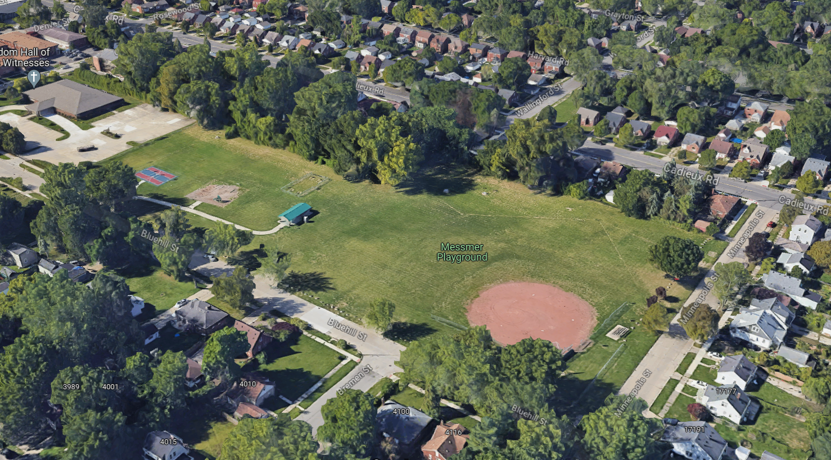
Messmer Park- 4135 Bluehill St
Cadieux Rd
Bluehill St.
Minneapolis St.
N

Slide 4
CURRENT CONDITIONS
Park type: neighborhood (5 acres)
Built in 1948
Most recent renovations:
2018 Boulders
2013 Trees, sidewalks and boulders
2011 Baseball field and other improvements by the Lear Corporation
  Matt Simoncini former CEO Lear Corp grew up in this neighborhood and the baseball field is likely named for his father.
Most recent engagement: East Warren Cadieux Neighborhood Framework Plan 2019-2021 (no specific recommendations)
Current park users: no reoccurring rentals
Current amenities: baseball field, basketball court, picnic shelter, playground, horseshoes

Slide 5
PRSP Phasing & Park Gap
Messmer Park is identified in Phase 2 in the Parks & Rec Strategic Plan (PRSP) in terms of statement of need and priority park gap.
Map is from Trust for Public Land and shows the park gap for the neighborhood.

Slide 6
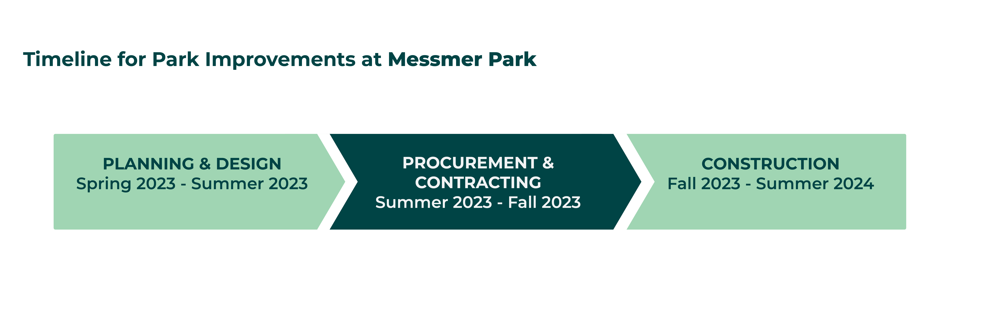
Project Overview & Timeline
Project Budget: <$500,000 (minor renovation)
Condition of existing amenities? Improvements?
Any site issues or immediate concerns?

Slide 7
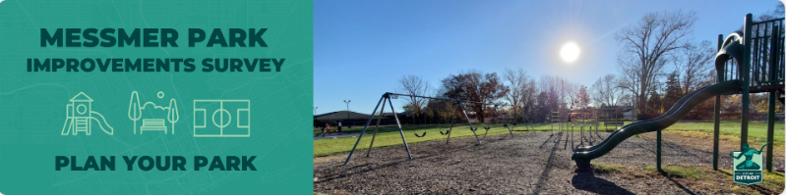
Survey & Community Outreach
Go to: https://forms.gle/Q7hszL8BQG5mtPBT9
Open until June 30th
E-blasts
Neighborhood Canvassing

Slide 8
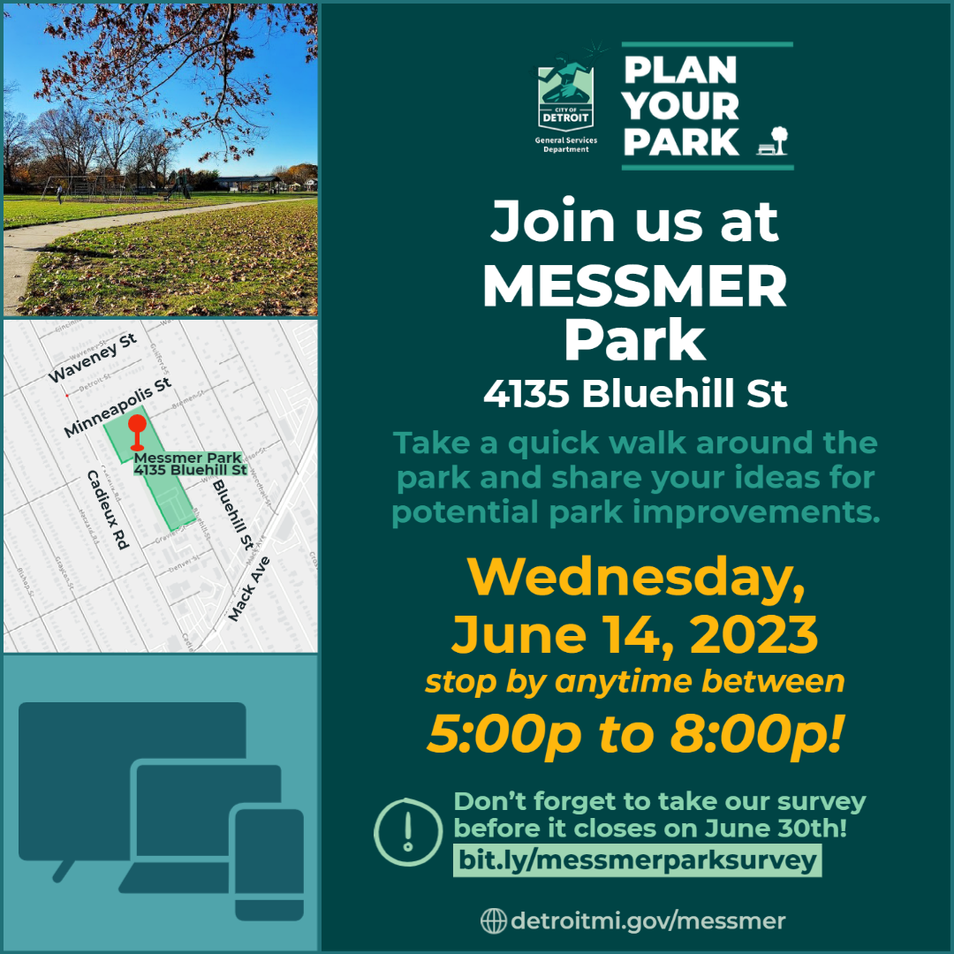
Collaborative Design Kickoff (Meeting #1)
Interactive planning activity
Go at your own pace
Anytime between 5:00 pm to 8:00 pm
Bring your pets & kids!

Slide 9

Next Steps
Collaborative Design Kickoff- June 14th
Survey ends June 30th
Community Meeting #2
(mid-late July)
Community Meeting #3
(mid-late August)

Slide 10
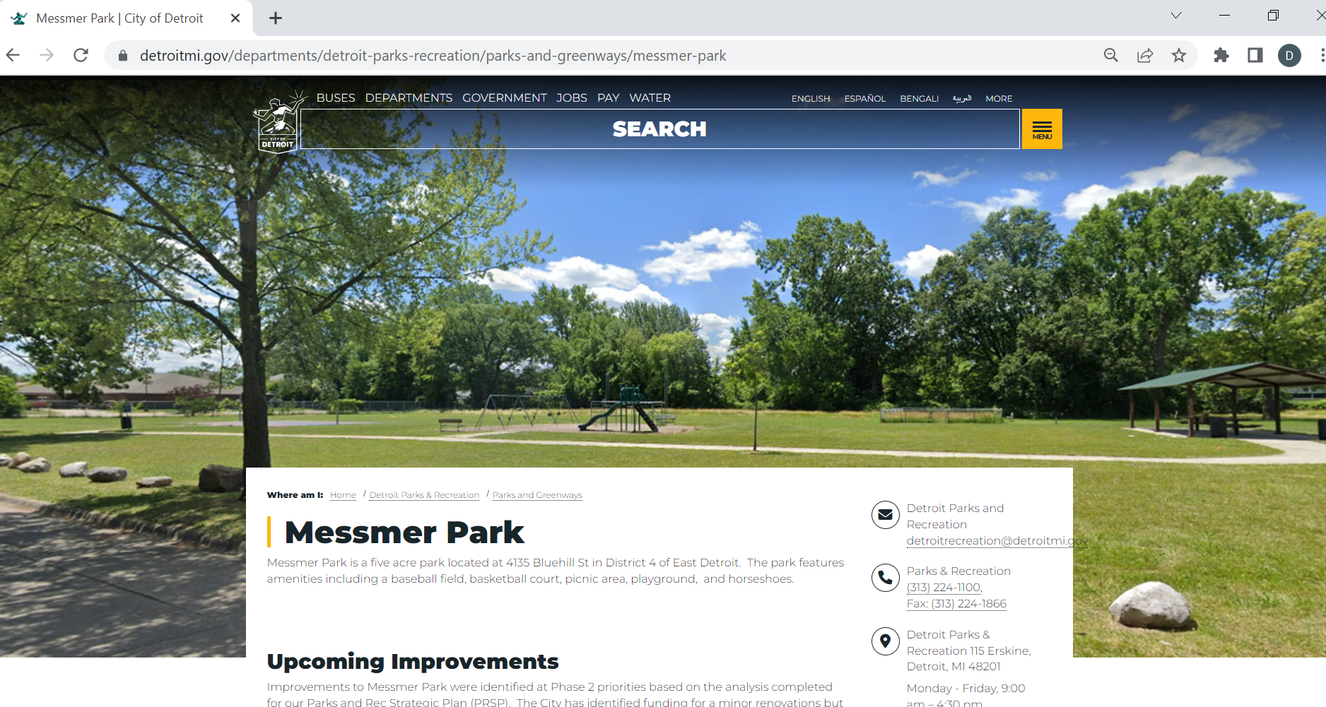
Go to website for updates: detroitmi.gov/messmer

Slide 11
THANK YOU!
Questions or Comments at any time in the process:
Shamori Whitt (PLANNING)
shamori.whitt@detroitmi.gov
(313) 268-1860
Arianna Zannetti (DESIGN)
zannettia@detroitmi.gov
(313) 236-8805
Notes:
Project Team Slide

