Slide 1
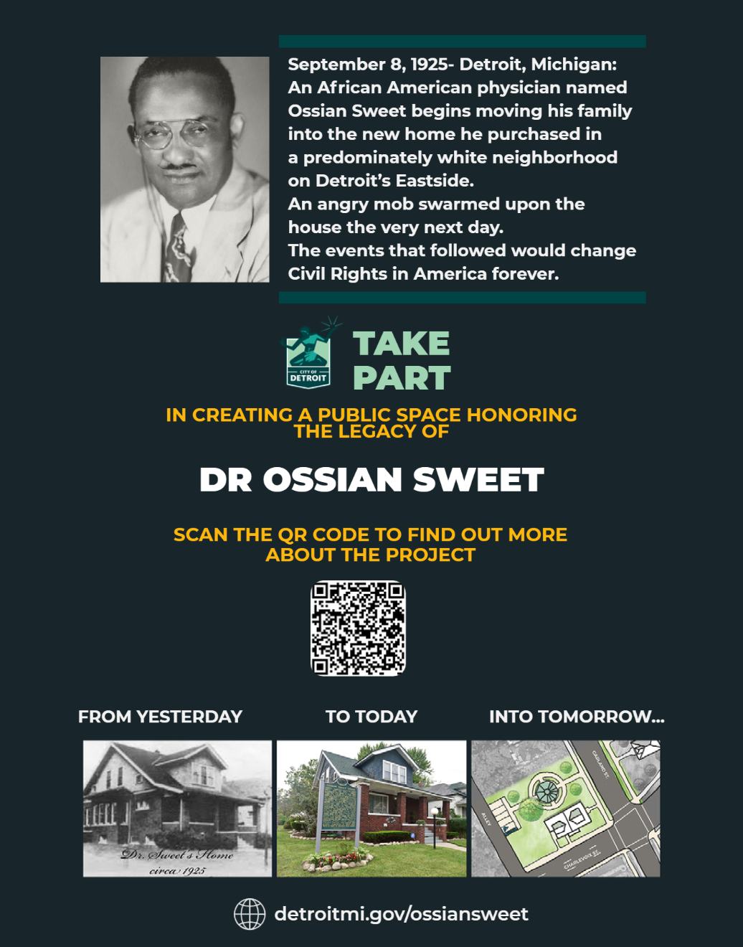
Ossian Sweet
Project
Community Meeting #1
Thursday, April 27, 2023

Slide 2
WELCOME
Joshua Roberson, District 5 DON
Butch Hollowell, Esq.

Slide 3
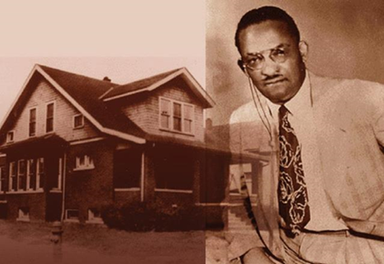
WXYZ Story from September 29, 2021

Slide 4
Tonight’s meeting is your opportunity to TAKE PART!
AGENDA
I. Update on the Dr. Ossian Sweet House
Learn the status of the House
II. Ossian Sweet Project Overview
Get Informed, Ask Questions, Provide Feedback
III. Dr. Ossian Sweet Story
Hear more about the Sweet Story & tell us what you think matters most
IV. Educational Plaza Design
Help us make key choices about the design

Slide 5
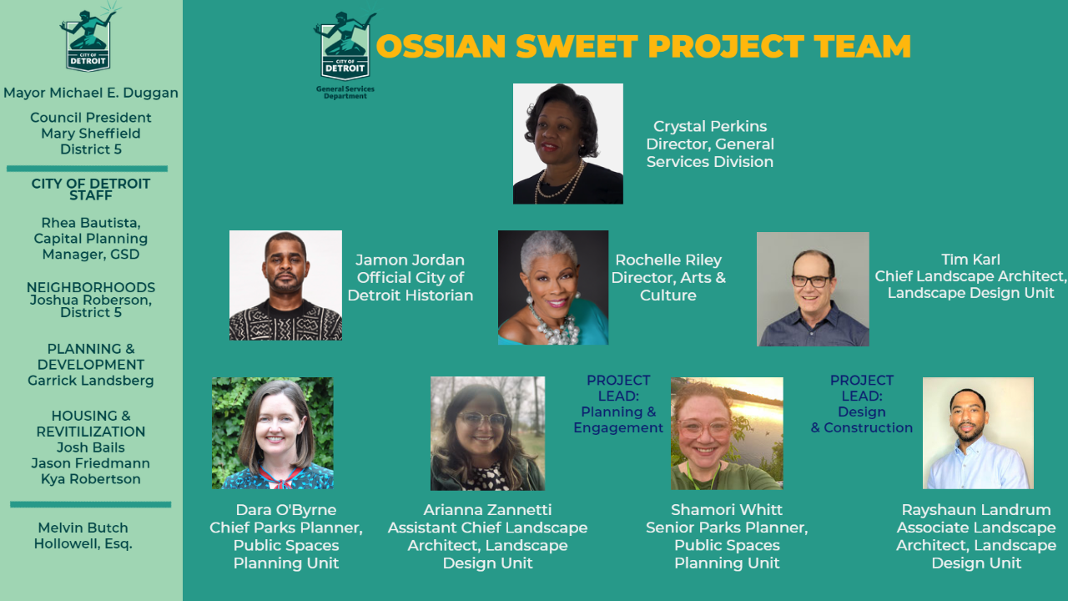

Slide 6
External Stakeholder Committee
Meets 1st Monday of every month at 12 noon
Meetings to Date:
March 1, 2023
April 3, 2023
Project Advisors
Daniel Baxter
Kevin Boyle
Seeking Participation From
Detroit Medical Society
Kappa Alpha Psi

Slide 7

Dr. Ossian Sweet House
Dr. Kya Robertson, PhD
Housing and Redevelopment Department

Slide 8
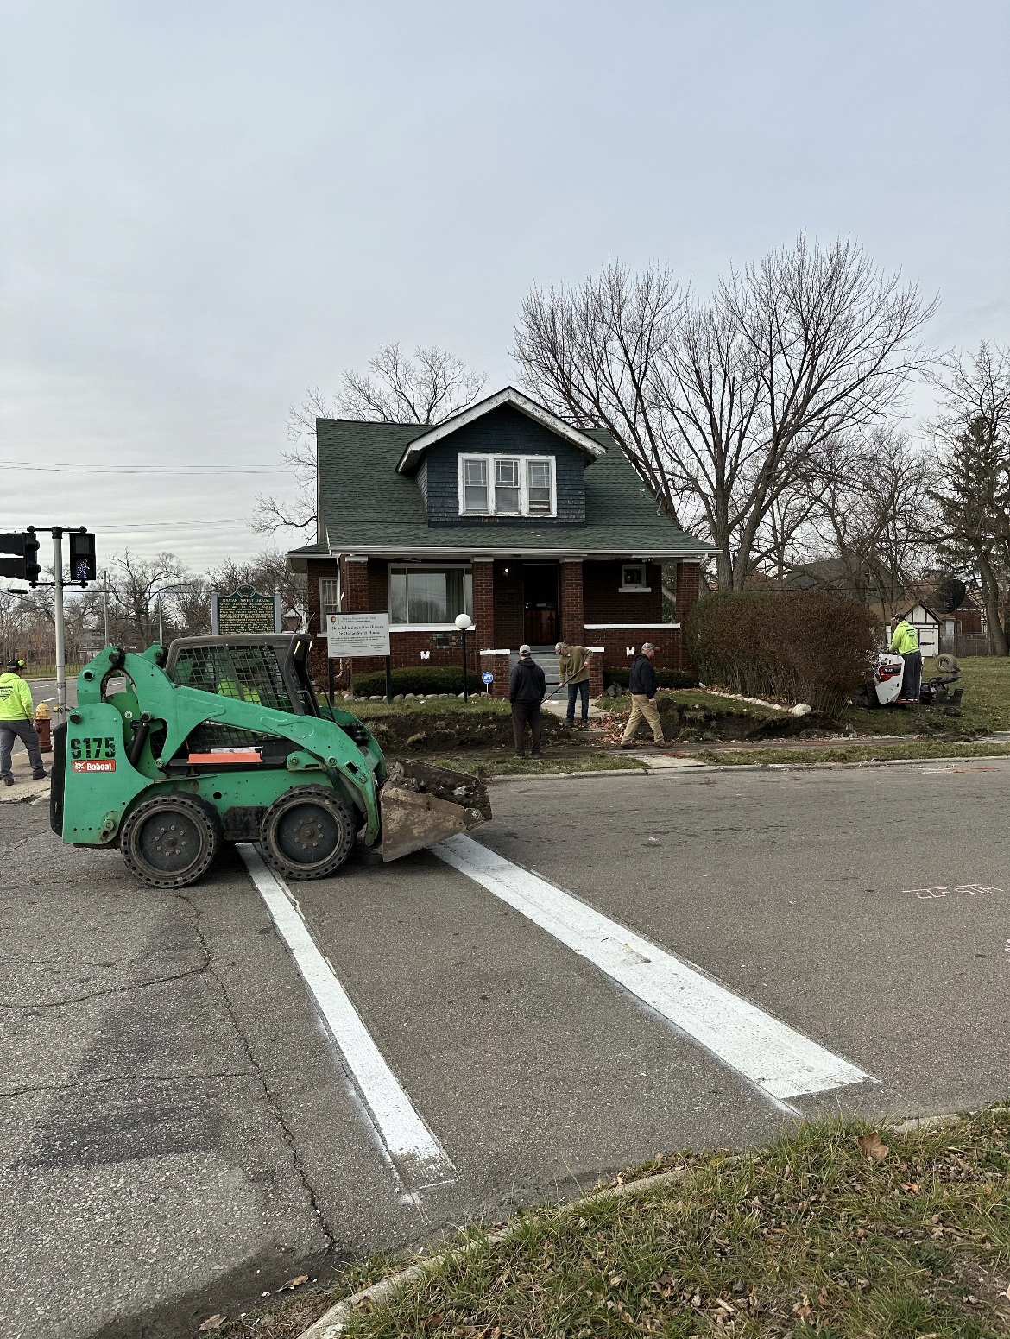

African American Civil Rights Grant
The City received a $500,000 African American Civil Rights Grant from National Park Service.
Purpose of this grant was to:
Update historical nomination for the neighborhood
Create a historical report
Construction of the house back to its original state in 1925
Developer selected is Blue Gate Michigan LLC
Construction started Fall of 2022 with an estimated completion of end of summer 2023
Questions

Slide 9

PROJECT OVERVIEW
Shamori Whitt, AICP
Parks & Recreation Division, Public Spaces Planning Unit

Slide 10
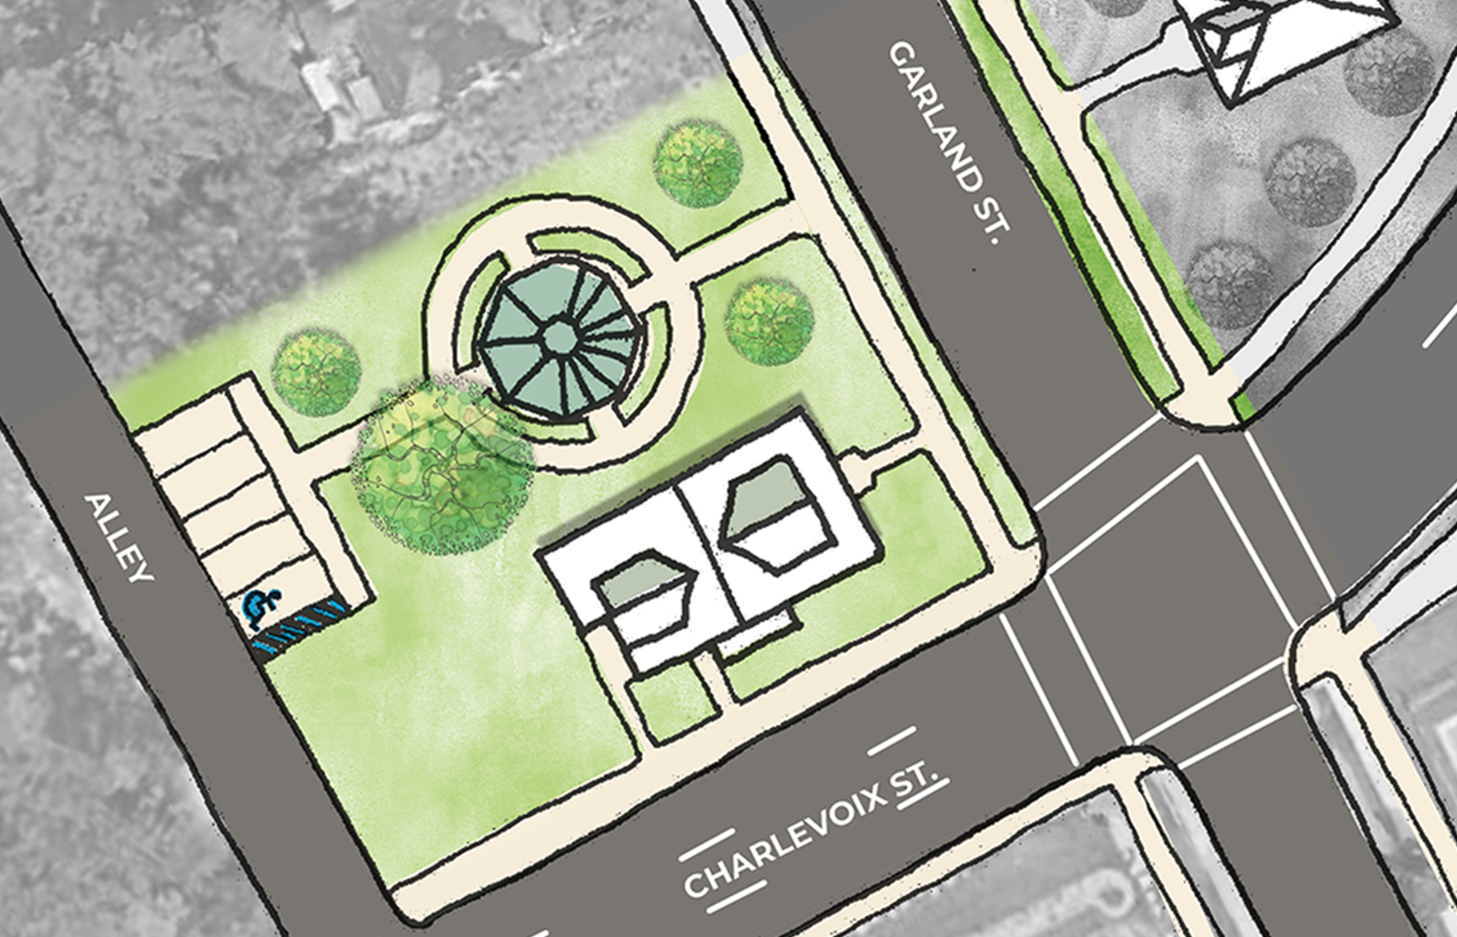

Ossian Sweet Project Background
OSSIAN SWEET HISTORIC INTERPRETIVE SITE
City of Detroit (Parks) awarded funding from American Rescue Plan Act (ARPA) funding in 2022
  Outdoor Educational Plaza
  Historic Interpretive Plan
Priority project of the Administration
Conceptual Drawing, NTS
Vision: To create a public space that commemorates and memorializes the history and legacy of Dr. Ossian Sweet and the influence of the events that unfolded in 1925 on the American Civil Rights movement.

Slide 11
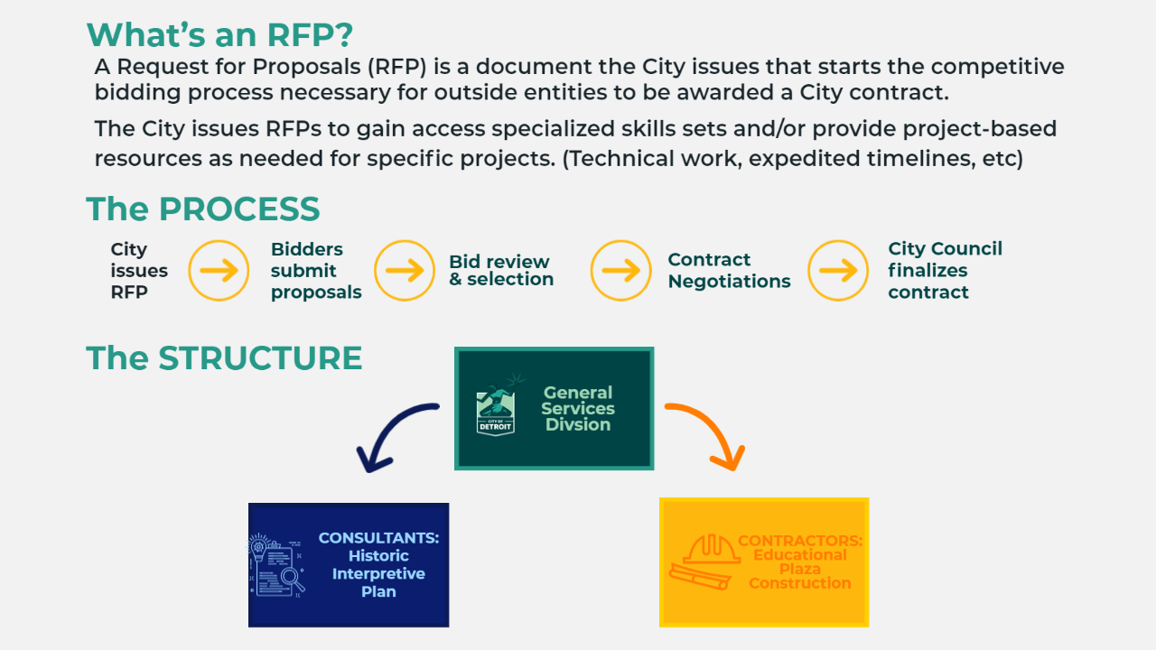

Slide 12
Role of the Historic Interpretive Plan
Organizational structure & financial sustainability
Further develop the Historic Narrative (content)
Create Design Standards & Branding
Site Circulation Plan
  Parking/Loading
  Traffic Calming/Pedestrian Safety
  Wayfinding
Maintenance
Interpretation, Exhibition, and Programming
(Public Education)
Potential future expansion

Slide 13
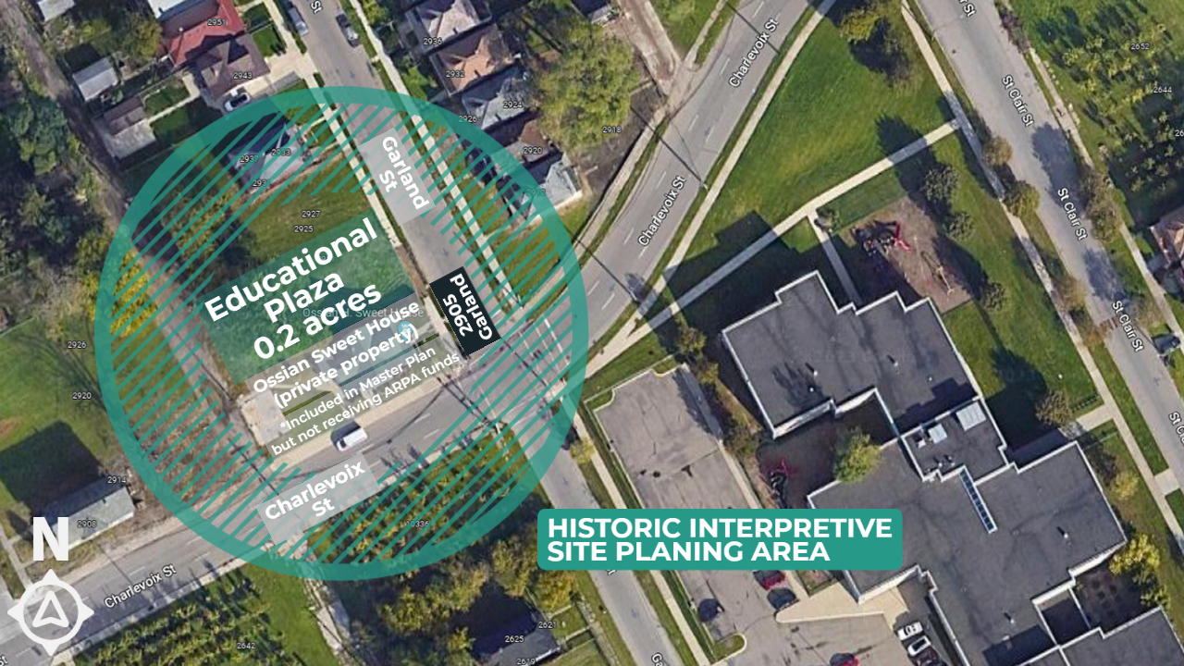

Slide 14
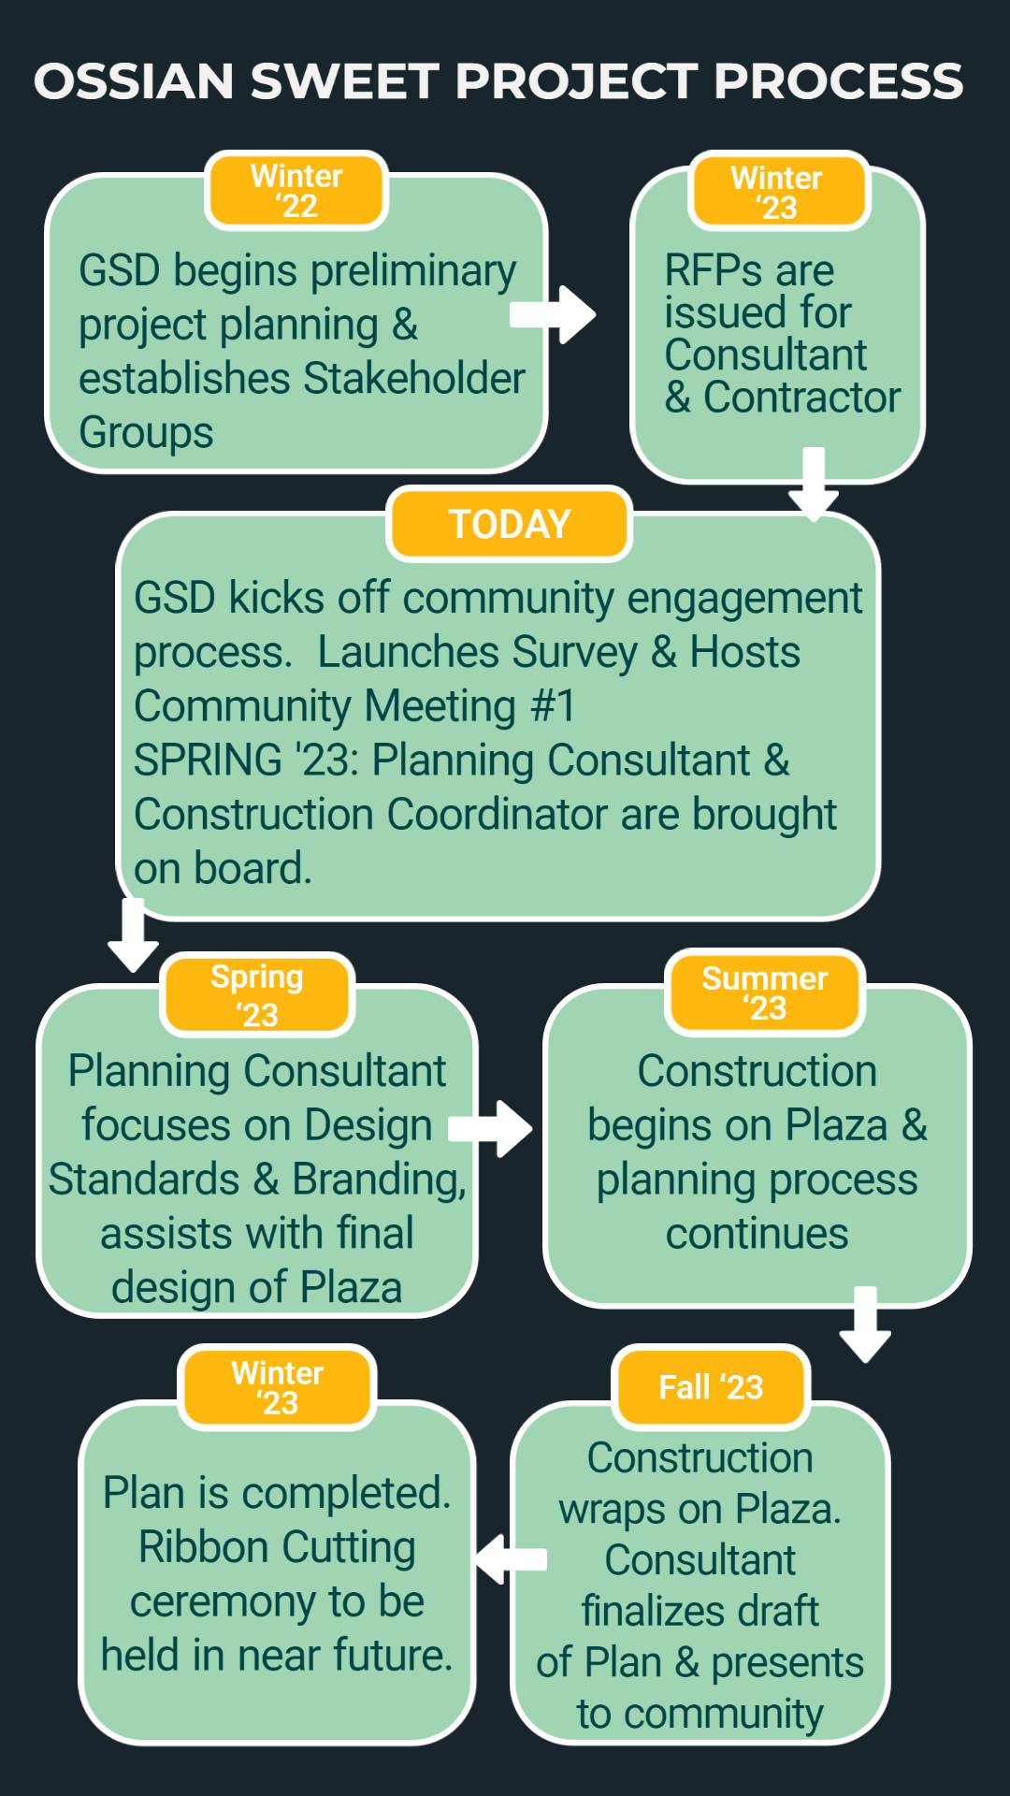
Multiple Opportunities for Public Participation
Online Survey
Community Meeting #2: Summer ‘23
Focus Group Sessions: Summer – Fall ’23
Community Meeting #3: Fall ‘23
Request us at YOUR meeting!

Slide 15
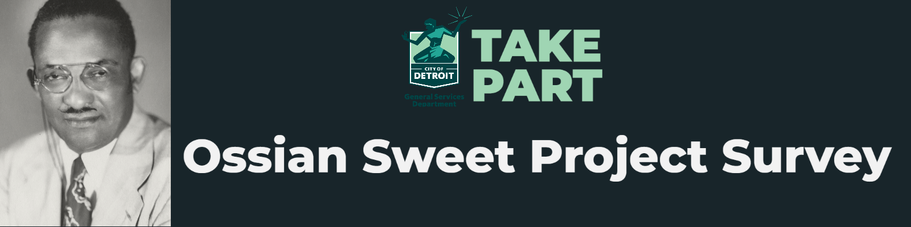

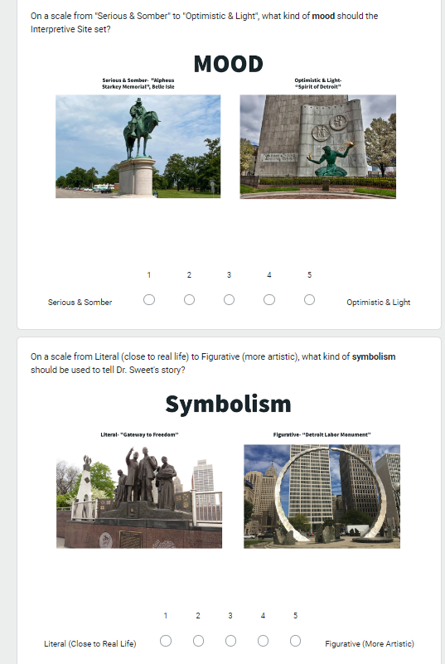
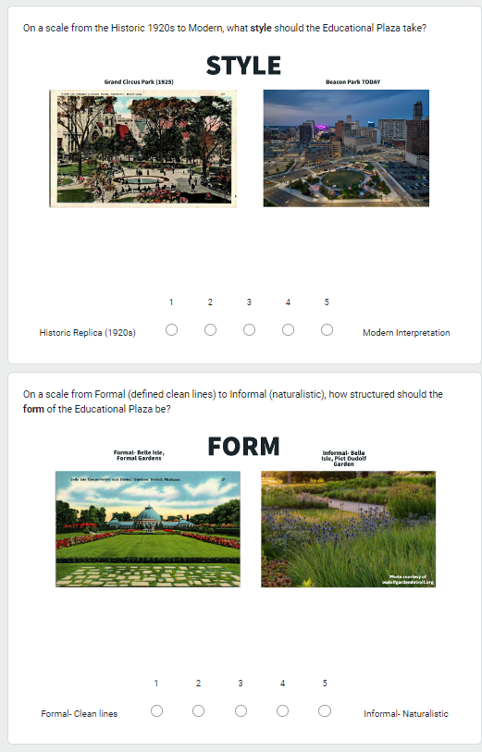
PROJECT SURVEY
NOW OPEN!
Go to:
bit.ly/ossiansweetsurvey
Closes May 15th
Notes:
Custom to Ossian Sweet Project
Establish baseline level of public awareness on the Ossian Sweet Story
Provide direction on overall Historic Interpretive Center
Get specific direction on Educational Plaza
Distributed in paper, upon request.

Slide 16

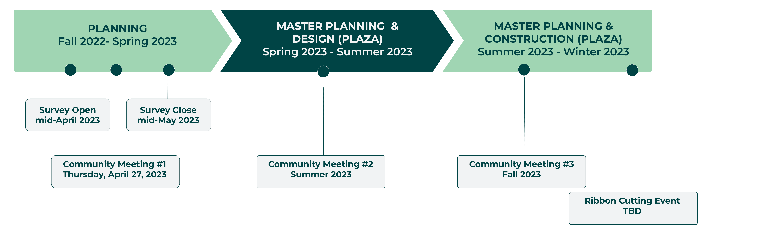

PROJECT TIMELINE
IDEAS FOR THE
100 YEAR ANNIVERSARY:
September 9, 2025???
2025
Notes:
In-Person Outreach
East Village Association- 4/11/23
Community Meeting #1: 4/27/23
Get important project information
Hear Official Account from Jamon Jordan & gather reactions from the public
Provide interactive feedback on Educational Plaza
Print Flyers
East Village Association to canvas neighborhood with 200 flyers
11x17 Posters
To be posted in select locations for the duration of the project
Developing on-site signage

Slide 17
QUESTIONS & FEEDBACK
5 minutes

Slide 18

Dr. Ossian Sweet Story
Jamon Jordan
Official Historian for City of Detroit

Slide 19
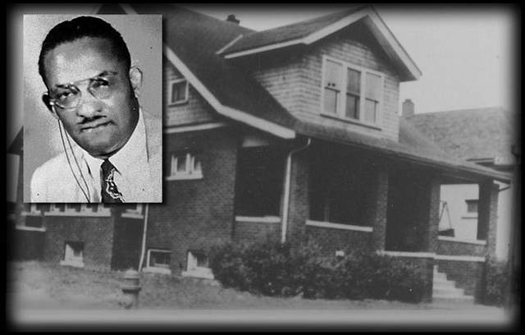
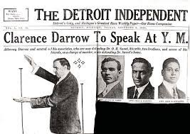
The Sweet Trials
Six policeman (who had been present at the house at the time of the shooting) entered the Sweet home, flung up all the shades, turned on all the lights, and arrested the eleven occupants. Thirty-five-year-old Judge Frank Murphy, the presiding judge of Recorder's Court, assigned himself to the trial of the Sweet case. After learning of the mass arrest in Detroit, the NAACP had sent Walter White, its assistant secretary, to Michigan on a fact-finding mission. After completing his assignment, White returned to New York where he met with Arthur Garfield Hays, a noted civil rights attorney, and Clarence Darrow, the most famous defense attorney of the time, and urged them to take the Sweet case. It didn't take much urging.

Slide 20
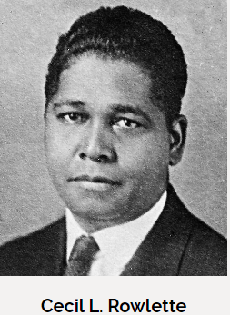
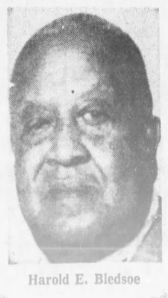
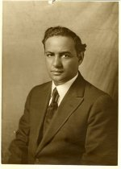
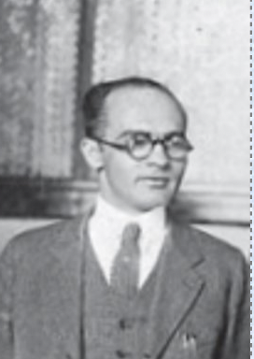
The Attorneys - Detroit
Cecil Rowlette
  Served as attorney for Fleta & Aldine Mathis & Dr. Alexander & Leota Turner
  Rowlette was the most adamant about leading the defense, instead of the NAACP choosing white attorneys to take over
Julian Perry
  Attorney & Friend of Dr. Ossian Sweet
Charles Mahoney
  1st African American on the Detroit Planning Commission
  Very politically connected
W. Hayes McKinney
  Served as attorney for Fleta & Aldine Mathis
  Former President of Detroit Branch of NAACP
  Detroit NAACP attorney
Harold Bledsoe
  Just graduated from UofD Law School
  Was working at Rowlette’s firm, and assisted during the Sweet case
  Would go on to become the 1st Black Asst. Attorney Gen. of Michigan
Charles Mahoney
Julian Perry

Slide 21
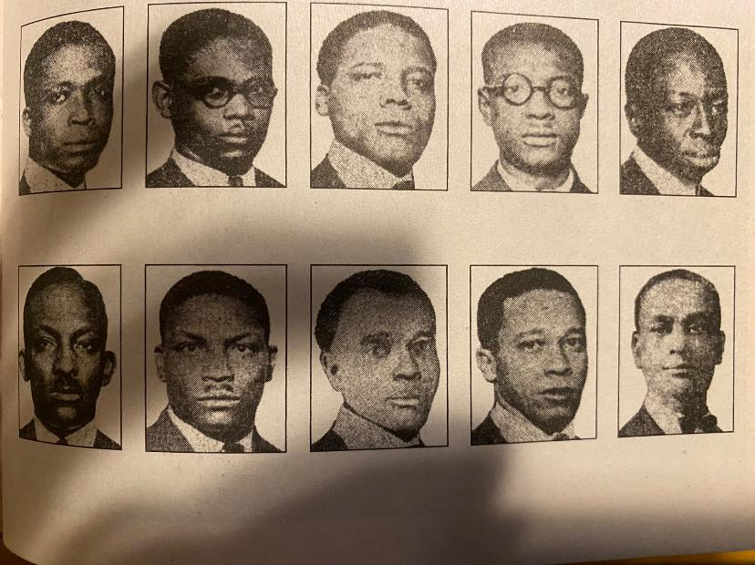
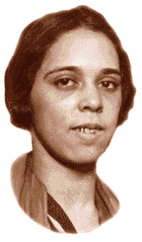
The Defendants
Dr. Otis Sweet
John Latting
Norris Murray, handyman
Joe Mack, chauffeur
Charles Washington
Gladys Mitchell
Sweet
Dr. Ossian Sweet
Hewitt Watson
William Davis
Leonard Morse
Henry Sweet

Slide 22
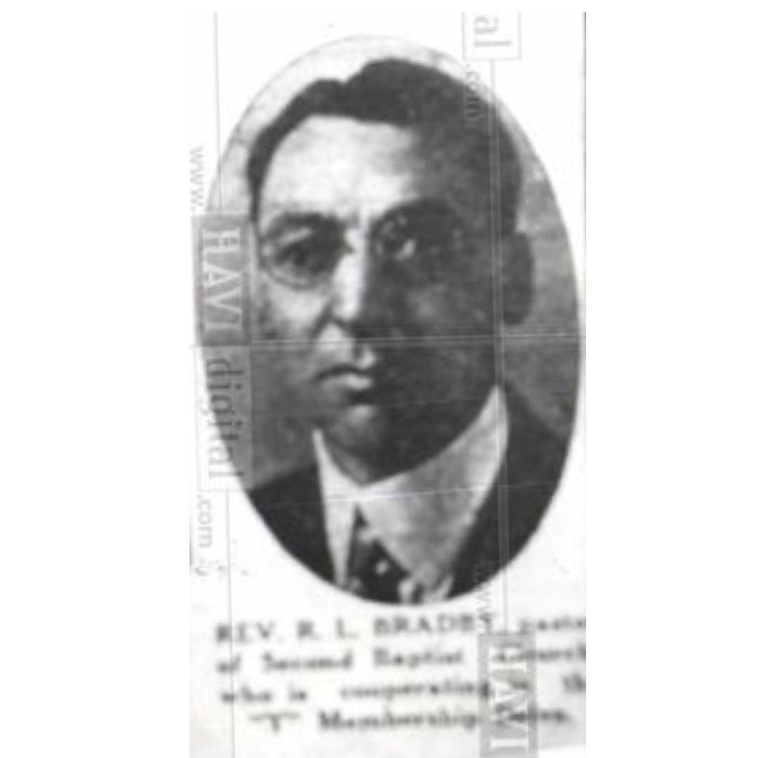
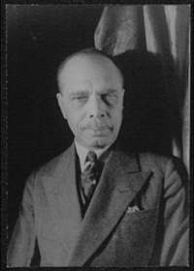
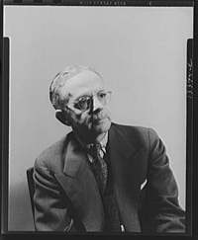
The NAACP
Pastor Robert Bradby, of Second Baptist Church, and president of the Detroit NAACP
James Weldon Johnson, General Secretary of the NAACP
Walter White, NAACP field secretary

Slide 23
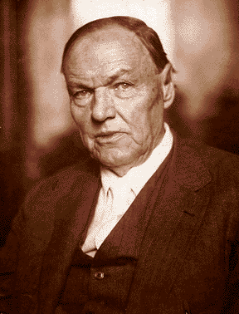
Clarence Darrow
Clarence Darrow was the most famous and respected defense attorney in the nation.
  Leading attorney for the ACLU
  Attorney for Leopold & Loeb
  Attorney for John Scopes in the “Scopes Monkey Trial”

Slide 24
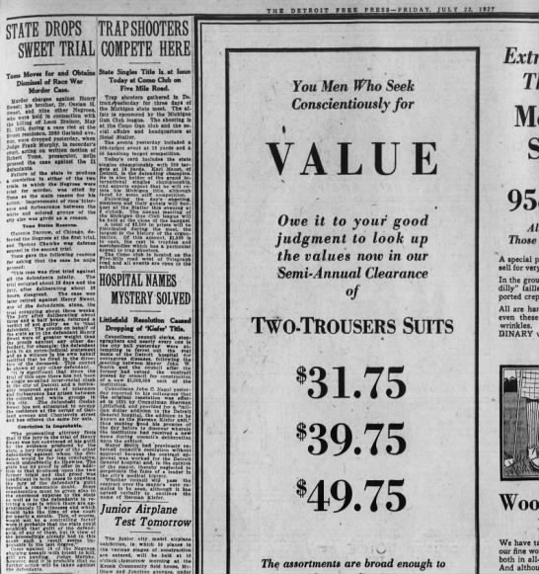
The Trials
In the first trial of the 11 defendants, there was a hung jury.
Clarence Darrow argued to have the defendants’ cases separated. They were. Henry was re-tried first and acquitted.
The Wayne County Prosecutor dropped charges on the rest.

Slide 25
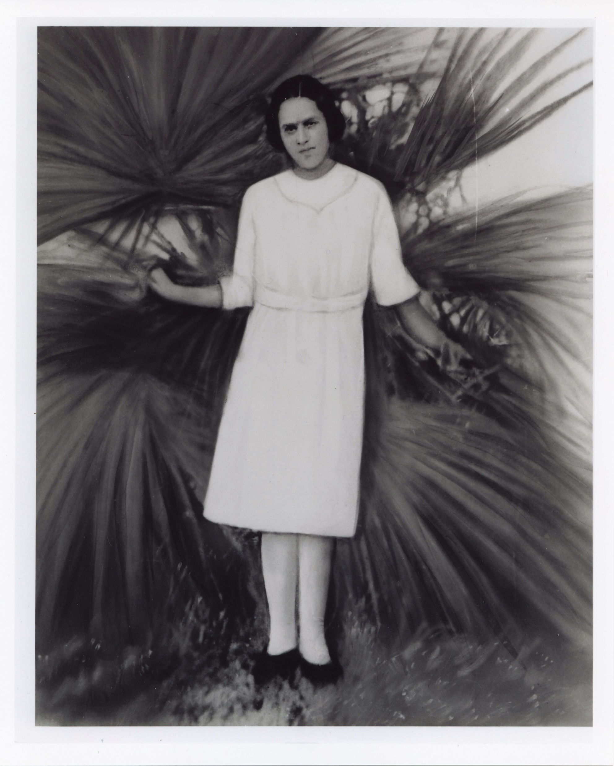
The Tragedies
While in the Wayne County Jail, Gladys Sweet contracted tuberculosis.
She brought it home to her 2-year old daughter, Iva, who got sick and died in 1926.
In 1928, Gladys Mitchell Sweet died from tuberculosis at the age of 27.
Henry Sweet died of tuberculosis in 1939.

Slide 26
The Aftermath
During the trial, the Michigan Chapter of the Ku Klux Klan campaigned and helped put the majority of City Council members in office. The KKK also lobbied the state of Michigan to pass a firearms law.
The US Supreme Court ruled in Corrigan v. Buckley-1926, that racial restrictive covenants were legal.
In 1927, the state of Michigan passed a firearms law stating that gun owners must be licensed and registered by a county board made up of the sheriff, the prosecutor and a state police representative. The law was meant to keep Black people from owning guns and using them against racist mobs.

Slide 27
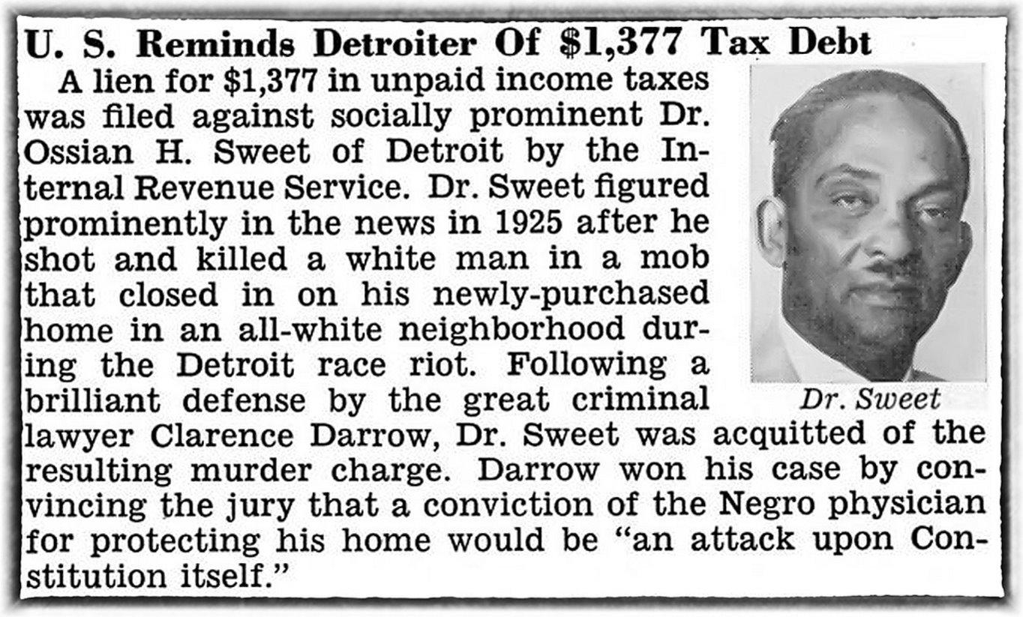
The Aftermath
Dr. Sweet moved back in the house in 1928.
Dr. Sweet left Dunbar Hospital.
He remarried and his second wife helped him open two private hospitals, including a tuberculosis hospital.
His second and third marriages ended in divorce.
He finally paid off the home in 1950.
Insurance premiums on his medical practice soared.
The IRS audited Dr. Sweet for back taxes.
In 1958, he sold the home and moved into the apartment above his pharmacy.
By then, he had all but abandoned medicine and was doing a string of odd jobs.
In 1960, Dr. Sweet committed suicide.

Slide 28
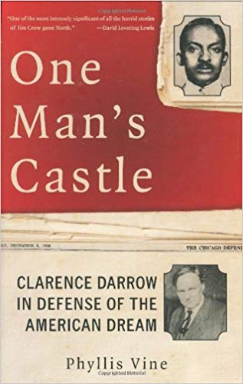



Slide 29
Small Group Discussion
15 Minutes

Slide 30
Report Out:
What’s the main thing you think people should know about the Ossian Sweet Story? (on card)
5 Minutes

Slide 31
Educational Plaza Design
Rayshaun Landrum
Parks & Recreation Division, Landscape Design Unit

Slide 32
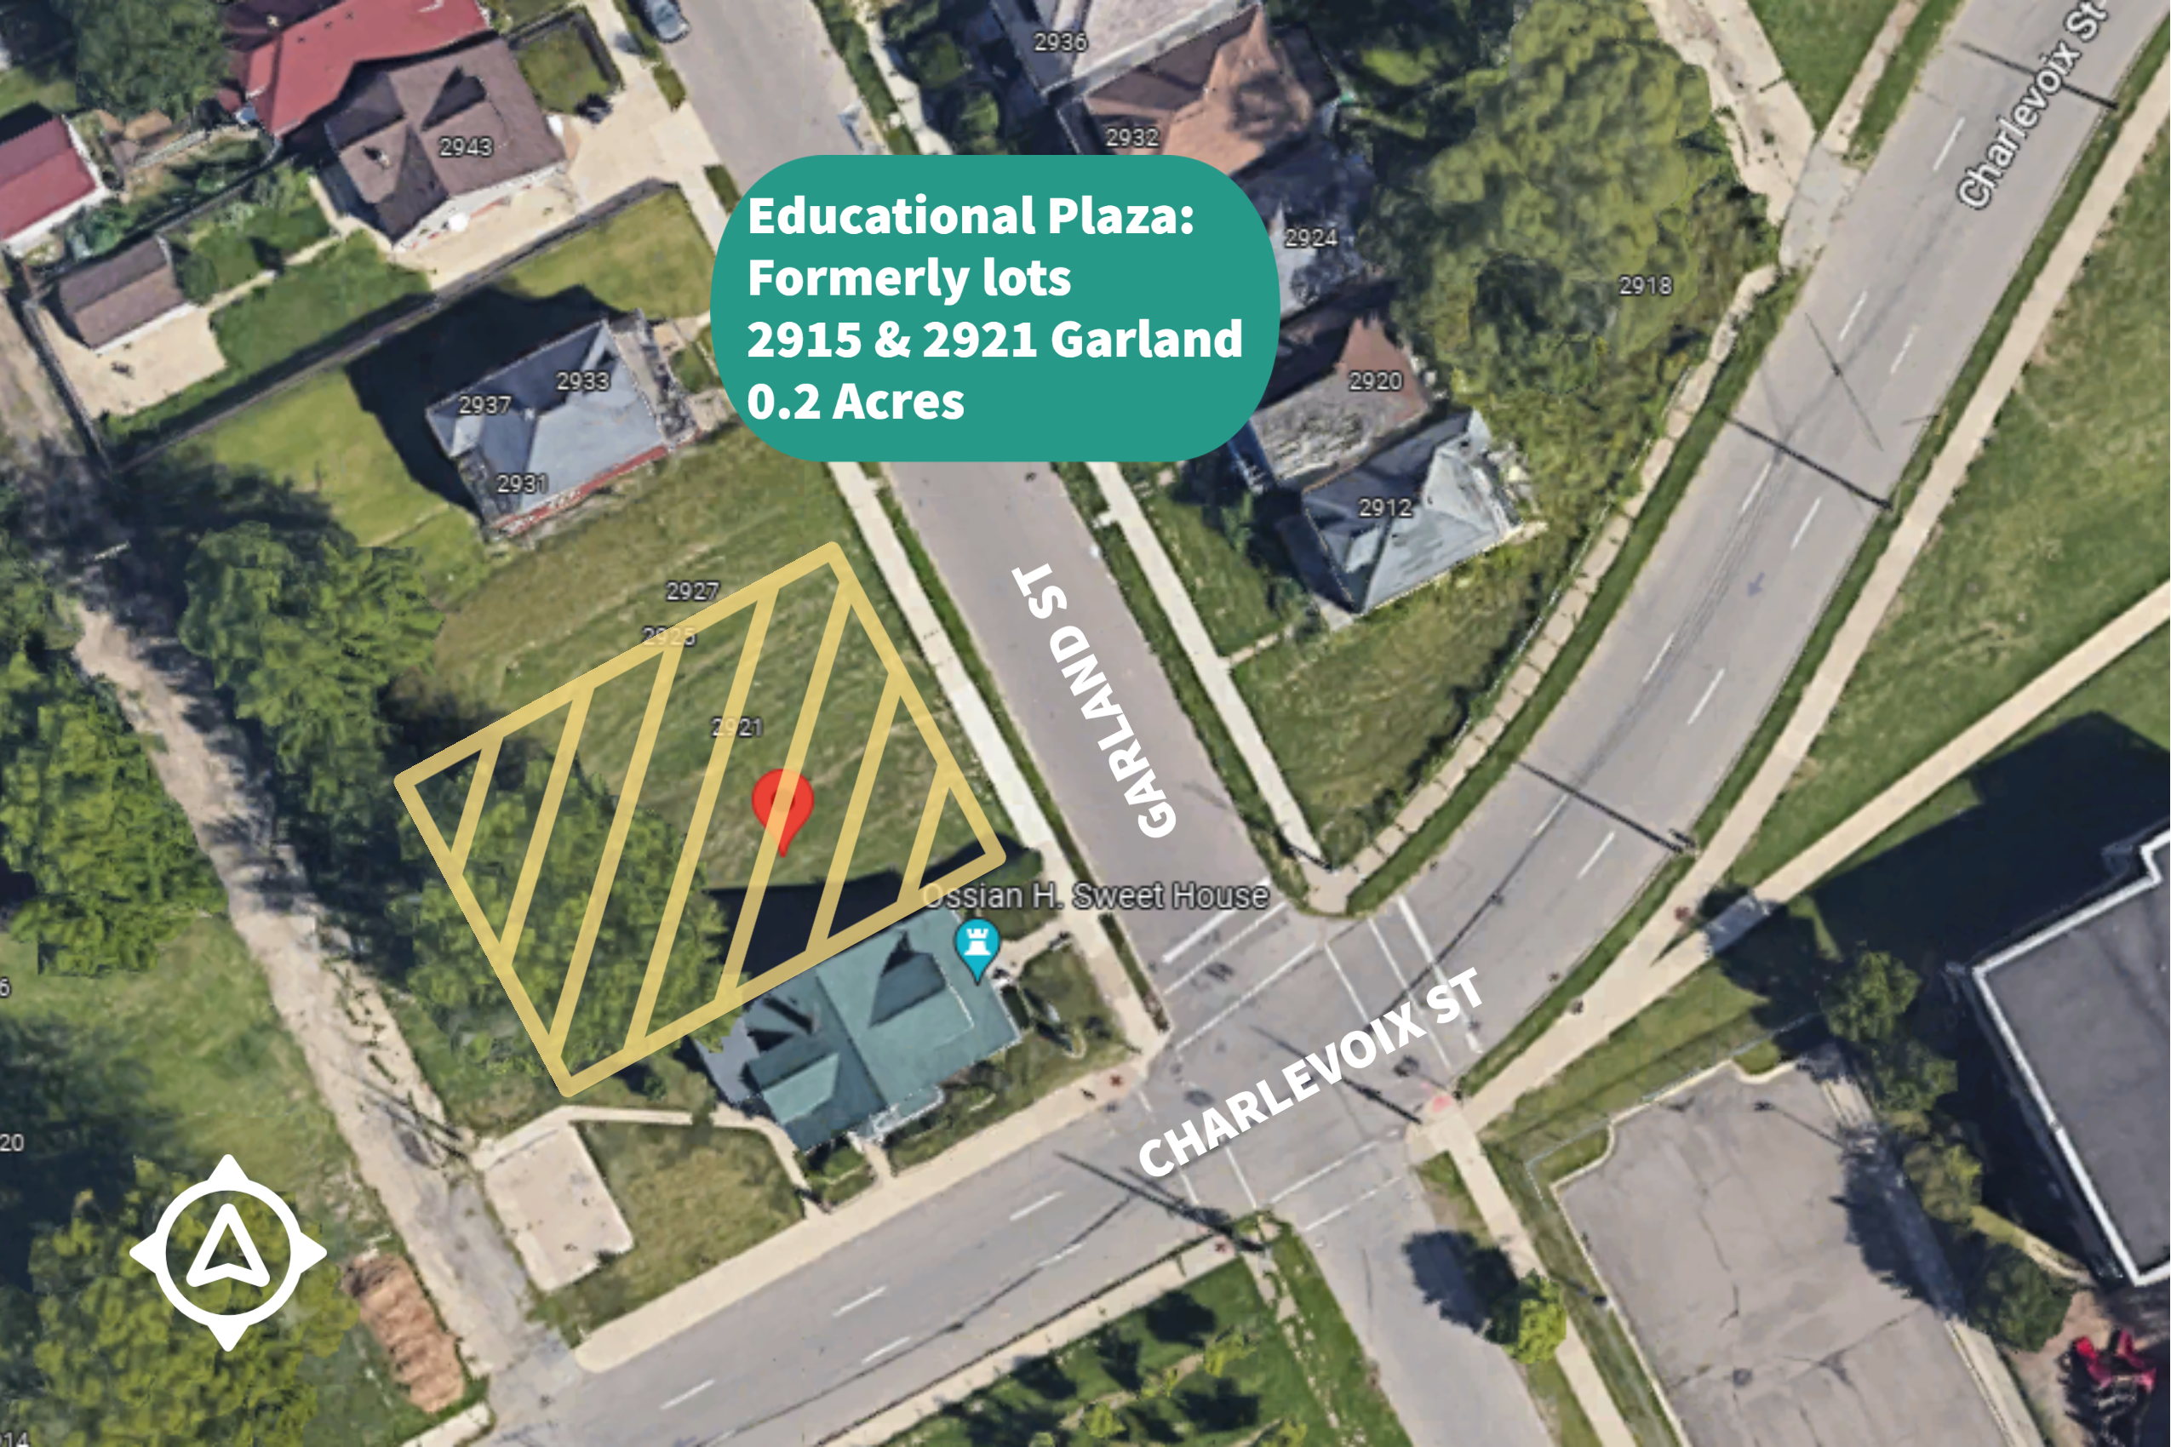
Educational Plaza
0.2 ac (approx.), adjacent to Dr. Ossian Sweet House
Accessible outdoor Interpretive space to learn the history of Dr. Ossian Sweet & engage about Civil Rights
Things to consider:
  The look and feel of the space
  Desired uses/functions
  Opportunities or needs of surrounding neighborhood

Slide 33
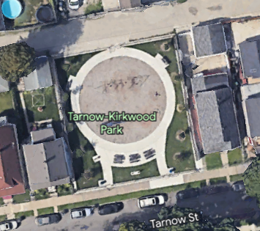
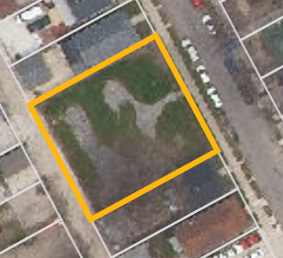
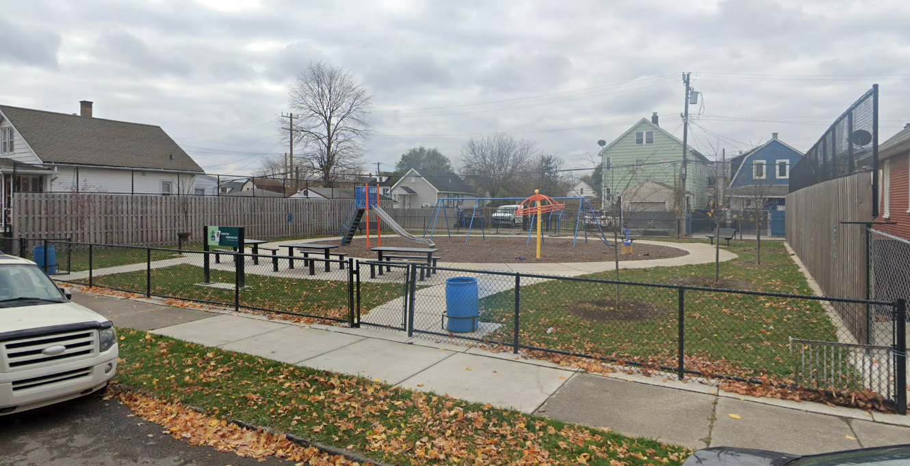
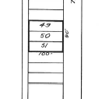
Tarnow-Kirkwood Park - Comparison #1
5837 Tarnow, Detroit, MI
District 6
.21 Acres
Zoning: Single Family Residential Zoning
Modern Feel
Amenities:
          Benches
          Plantings
A slightly larger, but very similar site to the educational plaza
Notes:
Tarnow-Kirkwood Park​
R2- Single Family Residential Zoning​
3 Parcels - 100’ x 30’ lots
Ossian Sweet Educational Plaza​
R2- Single Family Residential Zoning​
2 Parcels - 120 x 30 lots

Slide 34
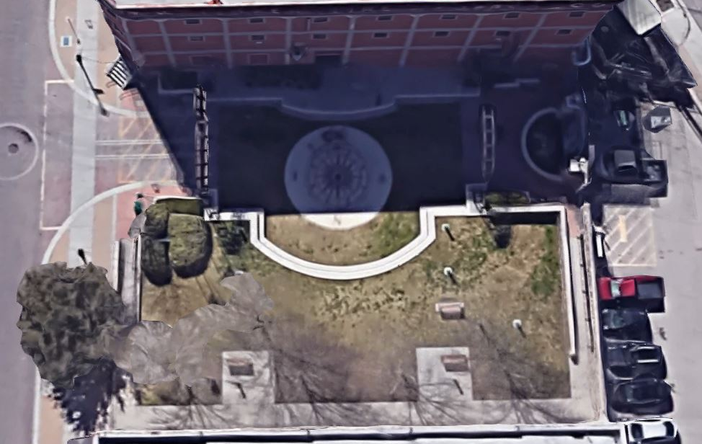
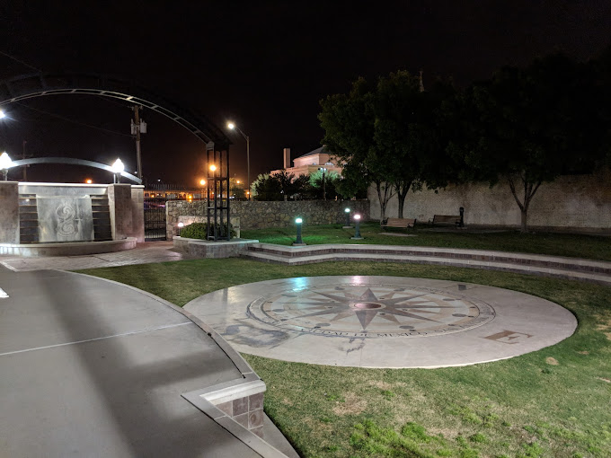
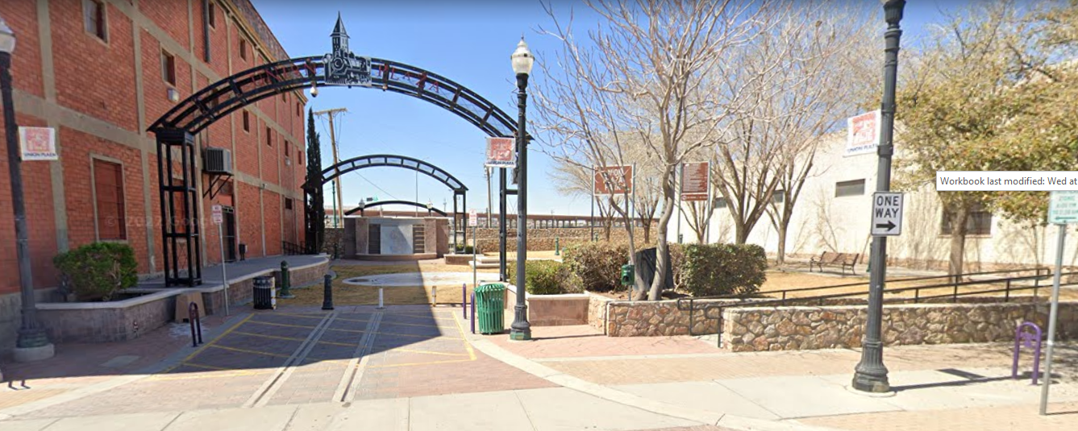
Union Plaza - Comparison #2
117 Anthony, EL Paso TX
.1433 acres
Zoning: Union Plaza District
Historic Feel
Amenities:
          Gateway Entrance
          Seating and Stage
          Water Feature
          Plantings
A slightly smaller, but very similar site to the educational plaza

Slide 35
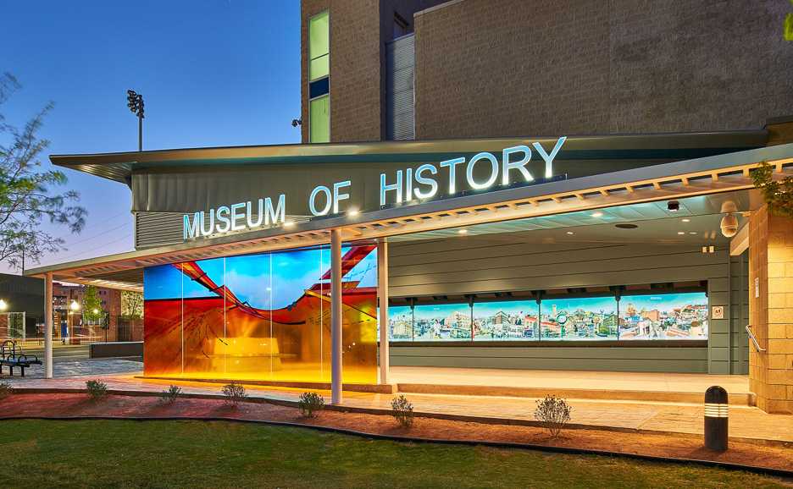
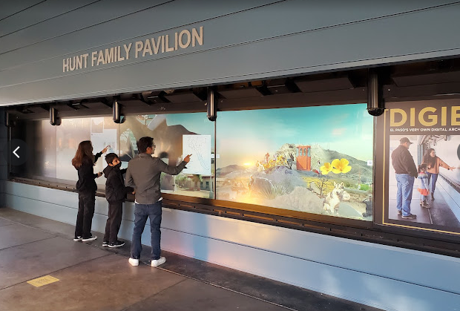
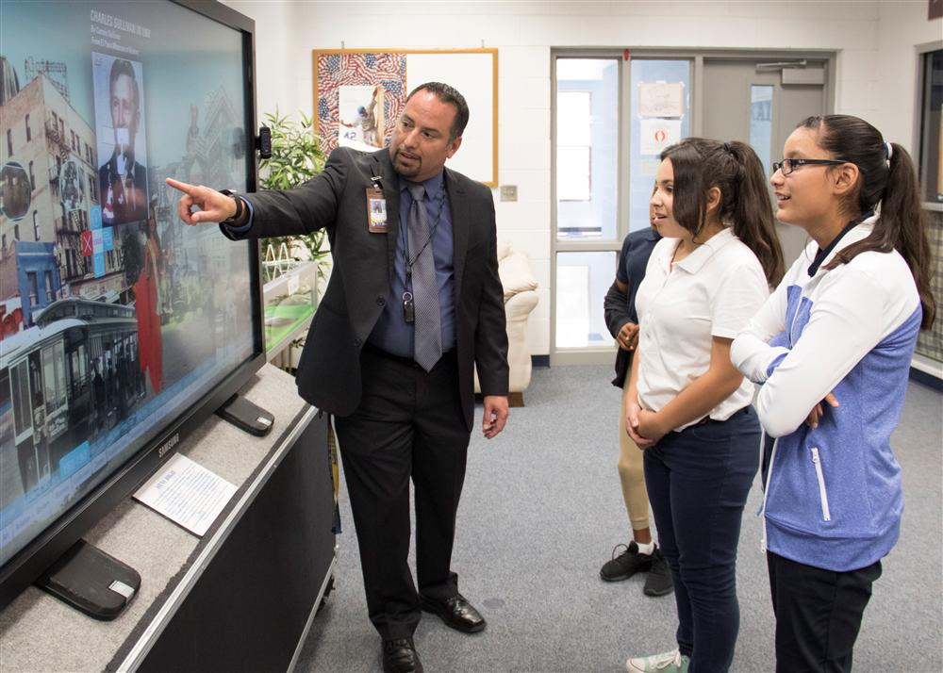
Digital Information Gateway in El Paso - Comparison #3
510 N Santa Fe St, El Paso, TX
First and only of its kind in the U.S., 1 of 4 in the world!
Modern Feel, all digital with simple site
Amenities:
          Touchscreens
          Interactive community archives
          Community image & video uploads
          Signage
A larger site vs the educational plaza
Notes:
A technological wonder at the entrance of the El Paso Museum of History in Cleveland Square

Slide 36
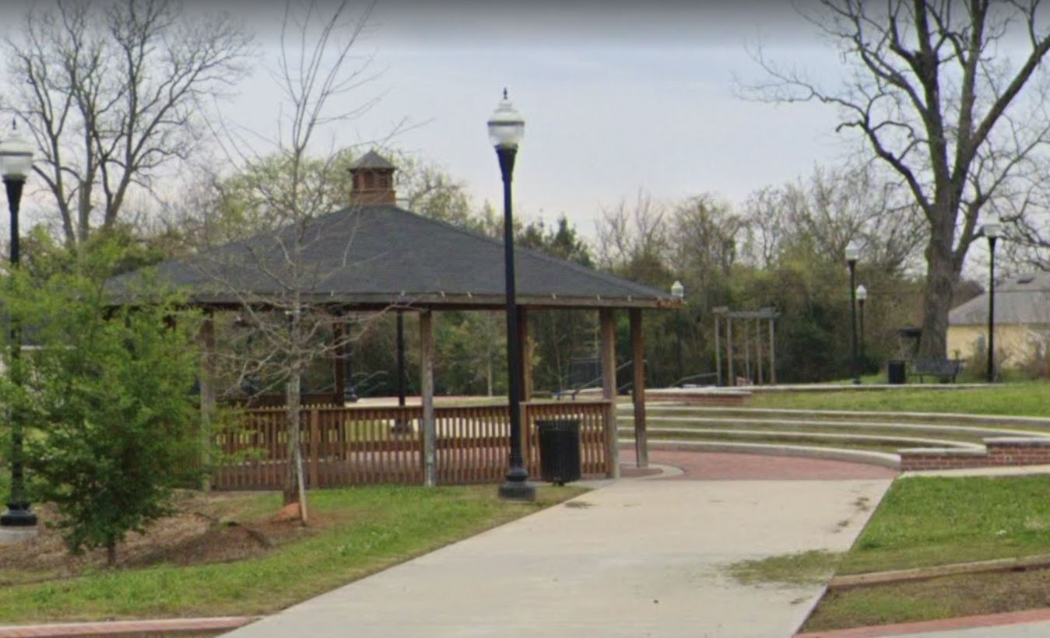
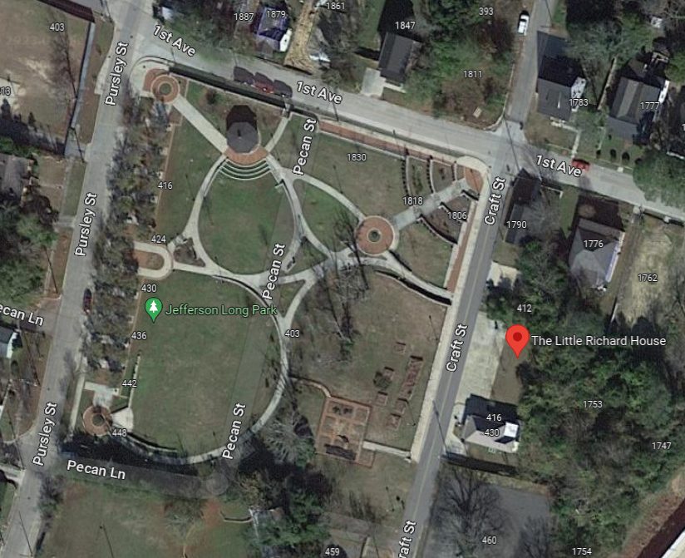
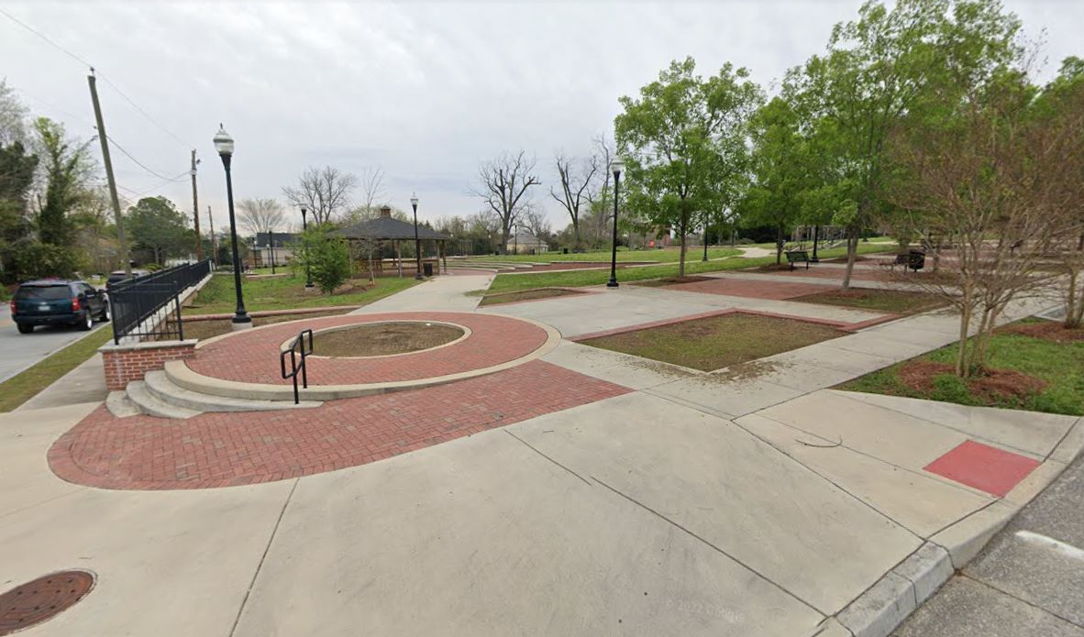
Jefferson Long Park (Little Richard)- Comparison #4
436 Pursely St, Macon, GA
2.5 acres
Traditional Feel
Amenities:
          Grand Entrance
          Seating/Stage
          Gardens
          Shelter
          Lighting
          Plantings
A much larger site vs the educational plaza
Notes:
Community park and asset for the community
Adjacency to The Little Richard Resource Center; honoring and educating people about the life of Little Richard.
Hosts tours and events

Slide 37
Let’s Discuss!
15 minutes

Slide 38
Report Out
5 minutes

Slide 39

TIMELINE
We Are Here!
Notes:
In-Person Outreach
East Village Association- 4/11/23
Community Meeting #1: 4/27/23
Get important project information
Hear Official Account from Jamon Jordan & gather reactions from the public
Provide interactive feedback on Educational Plaza
Print Flyers
East Village Association to canvas neighborhood with 200 flyers
11x17 Posters
To be posted in select locations for the duration of the project
Developing on-site signage

Slide 40
NEXT STEPS
Master Plan & Construction RFPs close on May 8th
  Selection Process, Contracting & City Council Approval (approximately 30-60 days)
Online Survey open until May 15th!
Next Community Meeting in Summer 2023!

Slide 41
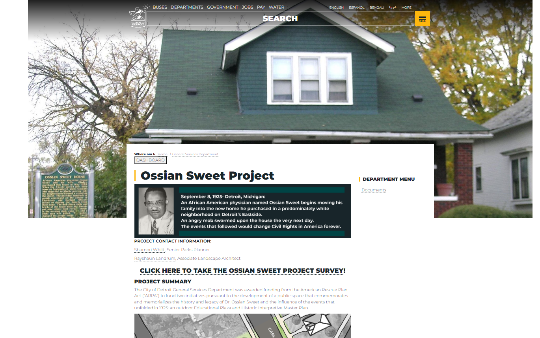
Check our webpage for updates: detroitmi.gov/ossiansweet
Enter “Ossian Sweet” in Search Bar

Slide 42

THANK YOU
QUESTIONS
COMMENTS
CONCERNS

