Slide 1
CITY OF DETROIT UPDATE
Thursday, March 16, 2023

Slide 2
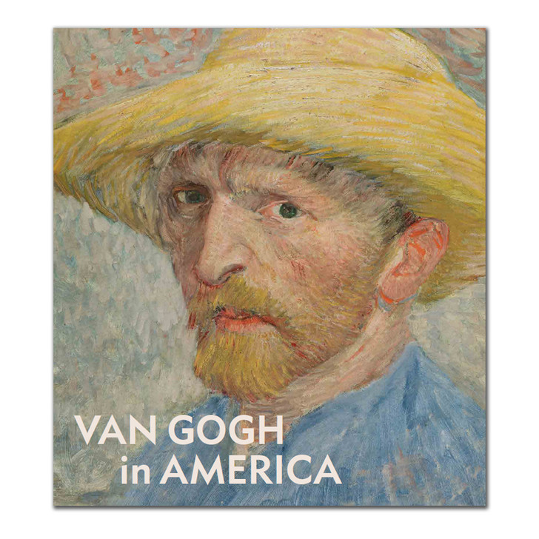
232,193 Visitors
Van Gogh in America

Slide 3
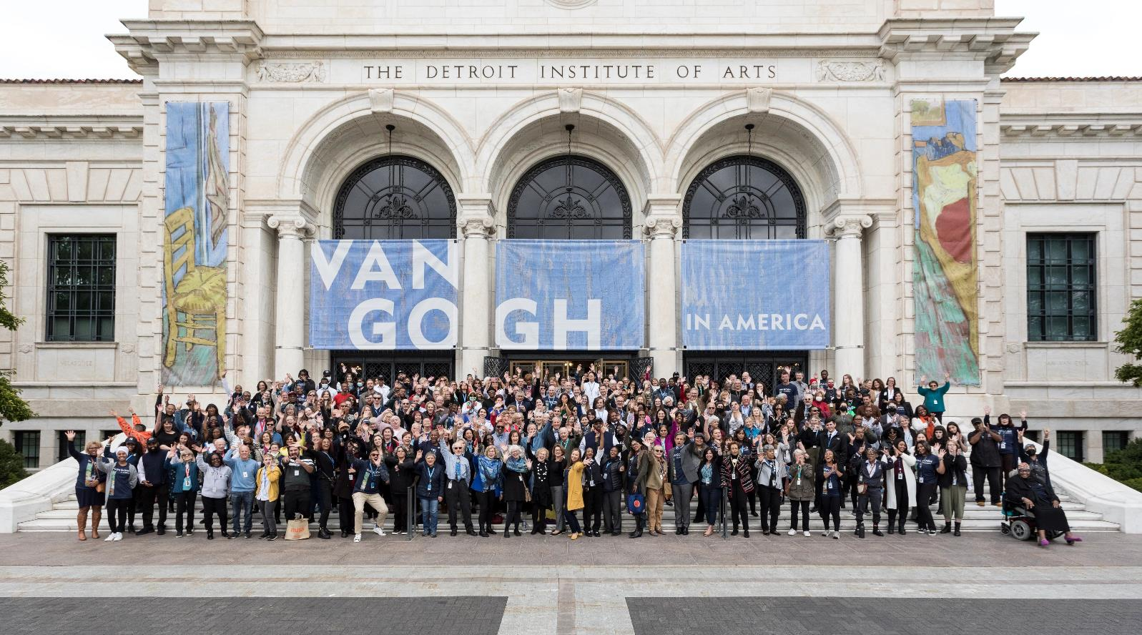
In total, 30 employees throughout the exhibition went from Temporary to Regular team member.
50% of these team members are Detroit residents.

Slide 4

USA TODAY’S BEST ART MUSEUM

Slide 5
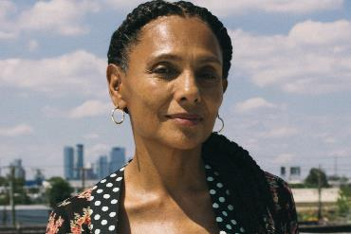
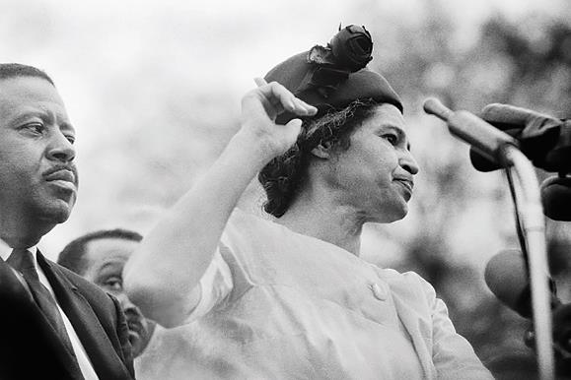
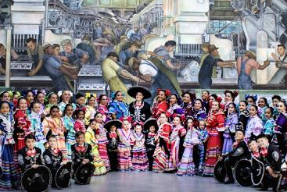

30th Annual Alain Locke Awards
The Rebellious Life of Mrs. Rosa Parks
Friday Night Live! Ballet Folklorico de Detroit
Hinamatsuri – Japanese Girls Day

Slide 6

DIA STRATEGIC PLAN
  Create an extraordinary experience for every DIA visitor, onsite, online, and in the community
  Continue to foster a sense of belonging for our team, visitors and Tri-County communities based on inclusion, diversity, equity, and access in all museum activities
  Cultivate a collaborative, inclusive, and equitable workplace culture to attract, develop and retain a high-performing team
  Develop education, exhibition and public programs and steward our art collection to uplift and reflect the diversity of cultures and human experiences, raising the world-class profile of the DIA
  Secure financial stability and support creativity for current and future generations by growing the DIA’s endowment
  Build digital capabilities that enable efficient teamwork and inspire our onsite and online audiences

Slide 7
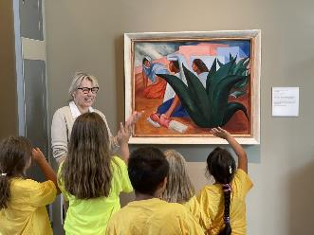
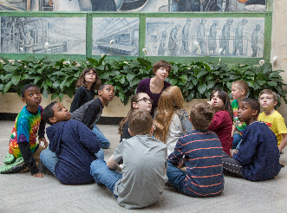
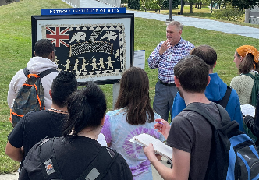
BENEFITS FOR DETROIT RESIDENTS
Free General Admission
Detroit residents receive Free General Admission
School Program
K-12 Field Trips with Bus Transportation
Community Partnerships
Art-based Programming with Cities, Townships, Villages, & Arts Organizations
Educator Professional Development
Senior Program
Senior Group Visits
Free Group Transportation
Docent-led Tours

Slide 8
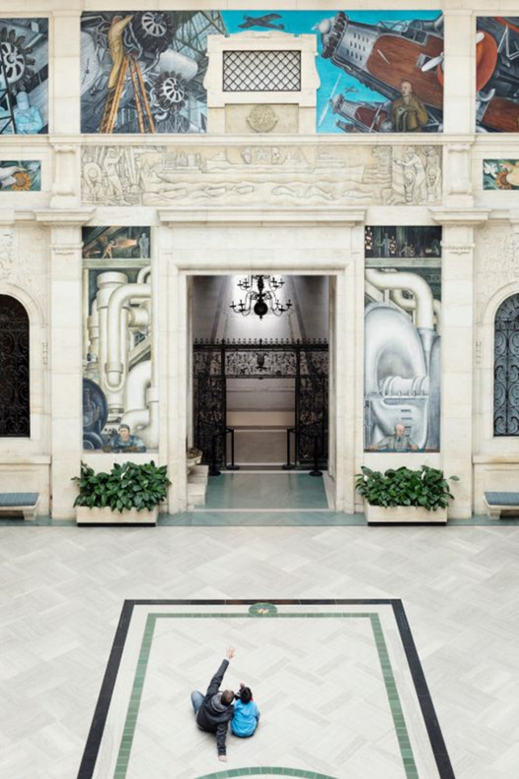
FREE ADMISSION
Museum Hours
Mon Closed
Tues – Thurs 9 AM – 4 PM
Fri 9 AM – 9 PM
Sat – Sun 10 AM – 5 PM

Slide 9
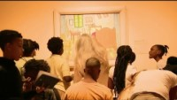
SCHOOL PROGRAM
Free K-12 Field Trips
9,061 Detroit students participated in 2022
Teacher Professional Development
Virtual & In-Museum Events
Custom Educator Professional Development Opportunities
Educator & Student Resources
Exhibition Resources
Lesson Plans
DIA Delivered
Art Byte Video Series

Slide 10
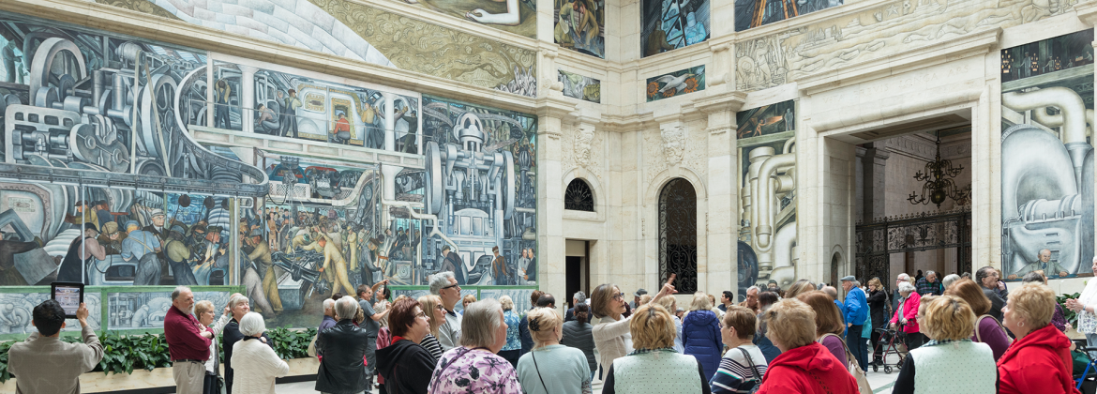
SENIOR PROGRAM
Museum Visits with Free Group Transportation & Tours
Behind the Seen Art Talks in the Community

Slide 11
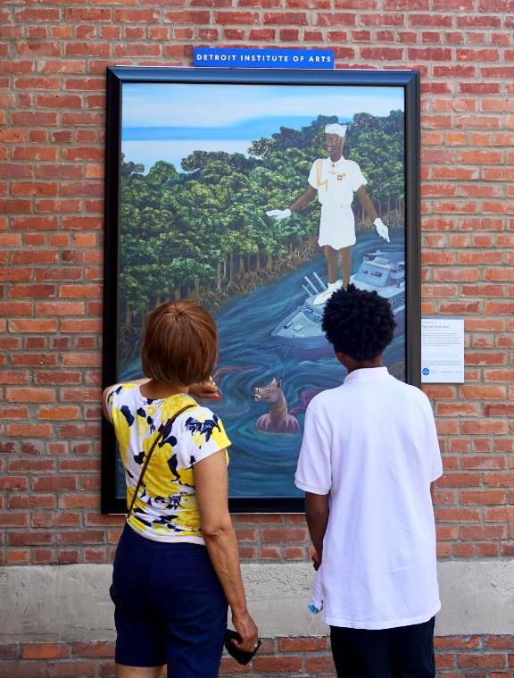
COMMUNITY PARTNERSHIP PROGRAMS
Concert of Colors
Community Group Studio Program
InsideOut Literary Arts
Wayne County High School Art Exhibition
86th Annual DPSCD Student Art Exhibition
Drop-in Art Making at Fairs & Festivals
INSIDE|OUT
2022
Greektown, Rouge Park &
Osborne Neighborhood Alliance
2023
San Bernardo Community,
Highland Park’s Avalon Village, & Southwest Detroit
Long-Term Partners
Wayne County Community College District
Warren C. Evans Terminal at Detroit Metro Airport
Brigitte Harris Cancer Pavilion at Henry Ford Hospital

Slide 12
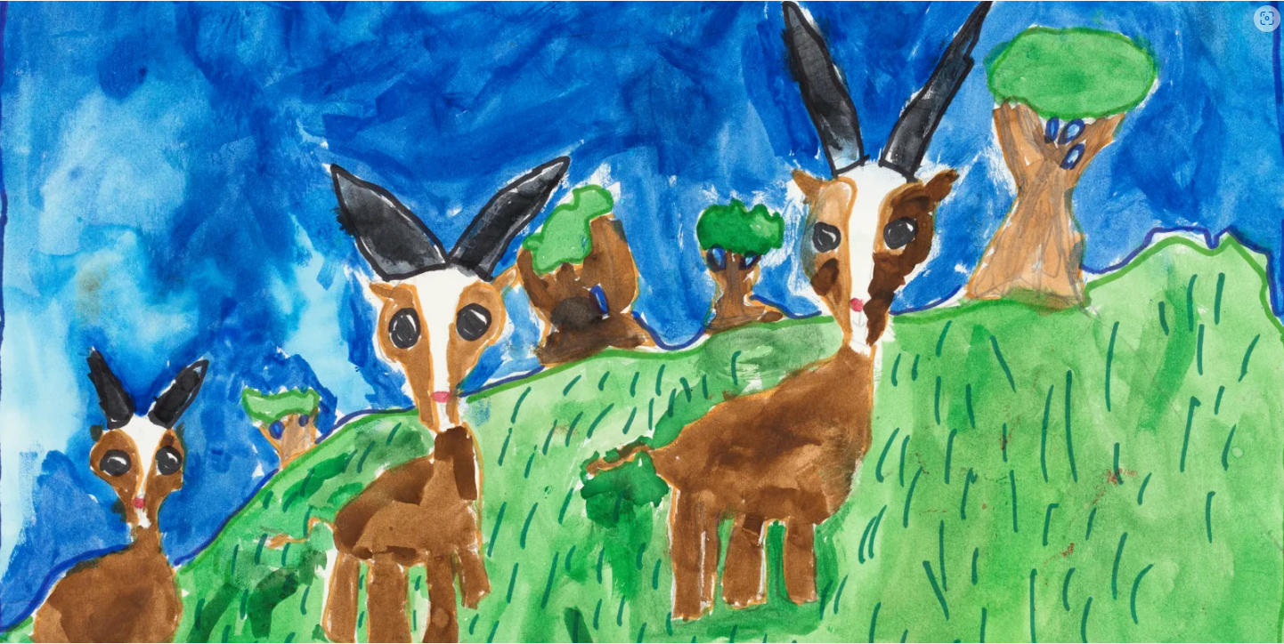
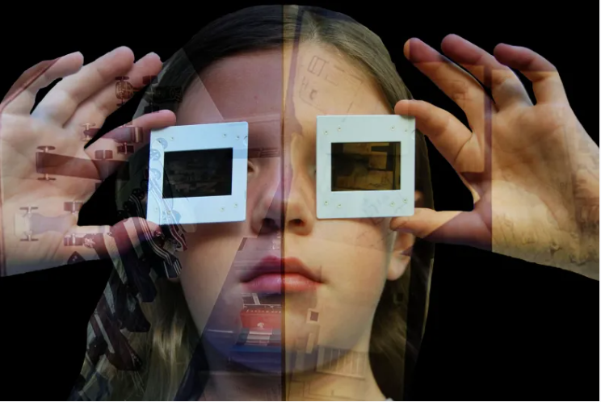
STUDENT ART EXHIBITIONS
86th Annual Detroit Public Schools Community District Art Exhibition
April 22 – May 28, 2023
Wayne County High School Art Exhibition
June 16 – July 16, 2023

Slide 13

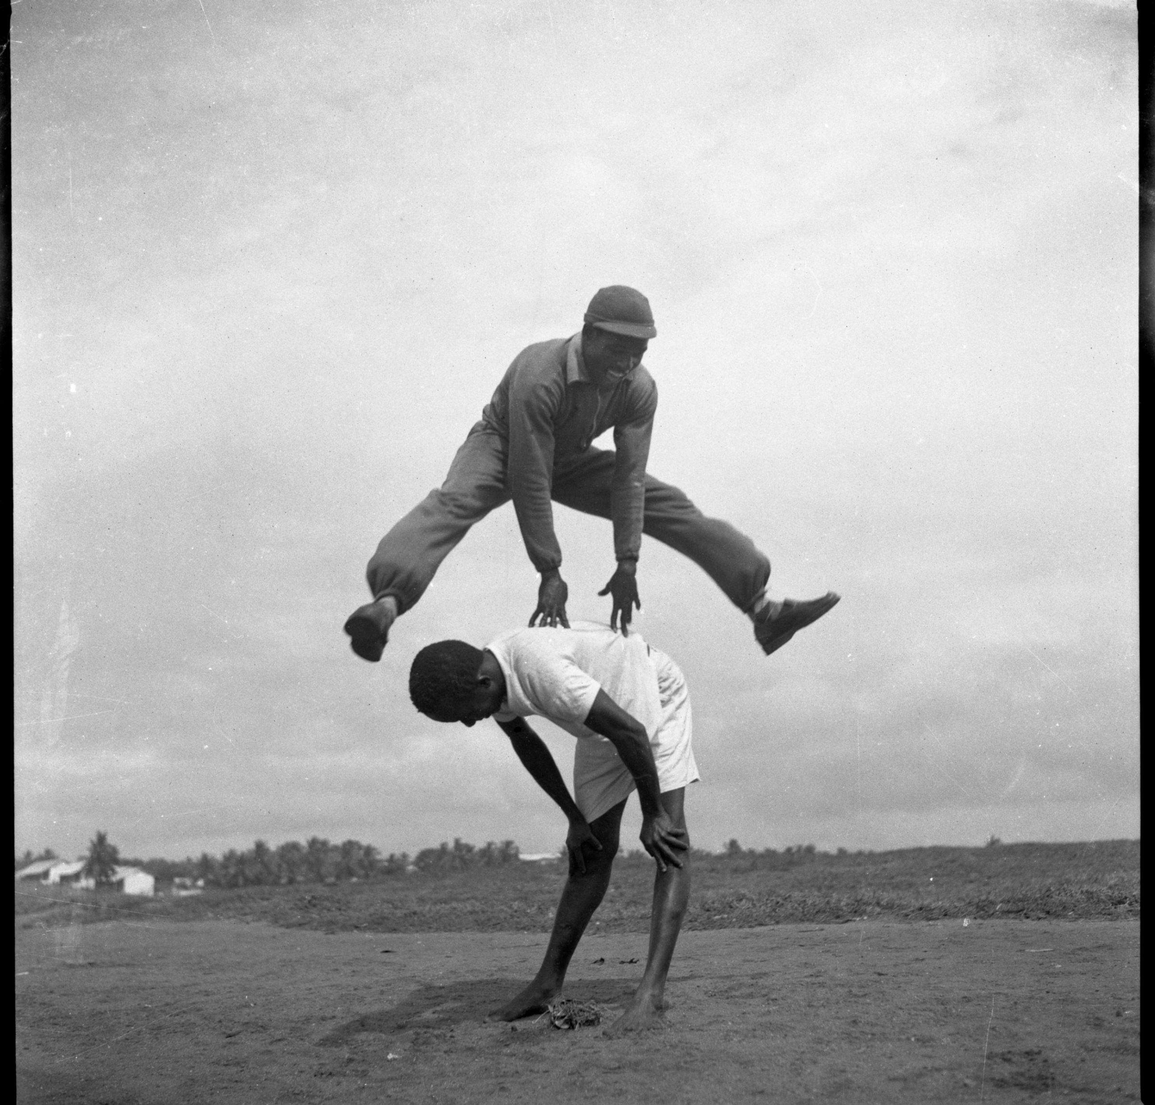
CURRENT & UPCOMING EXHIBITIONS
Printmaking in the Twenty-First Century
October 21, 2022 – April 9, 2023
James Barnor: Accra/London
May 28 – October 15, 2023
Mon on Seneca, 2021, Judy McReynolds Bowman
Pigment on Paper
Roy Ankrah During Road Work Training, Accra, 1951. Gelatin silver print.
Galerie Clémentine de la Féronnière, Paris.

Slide 14

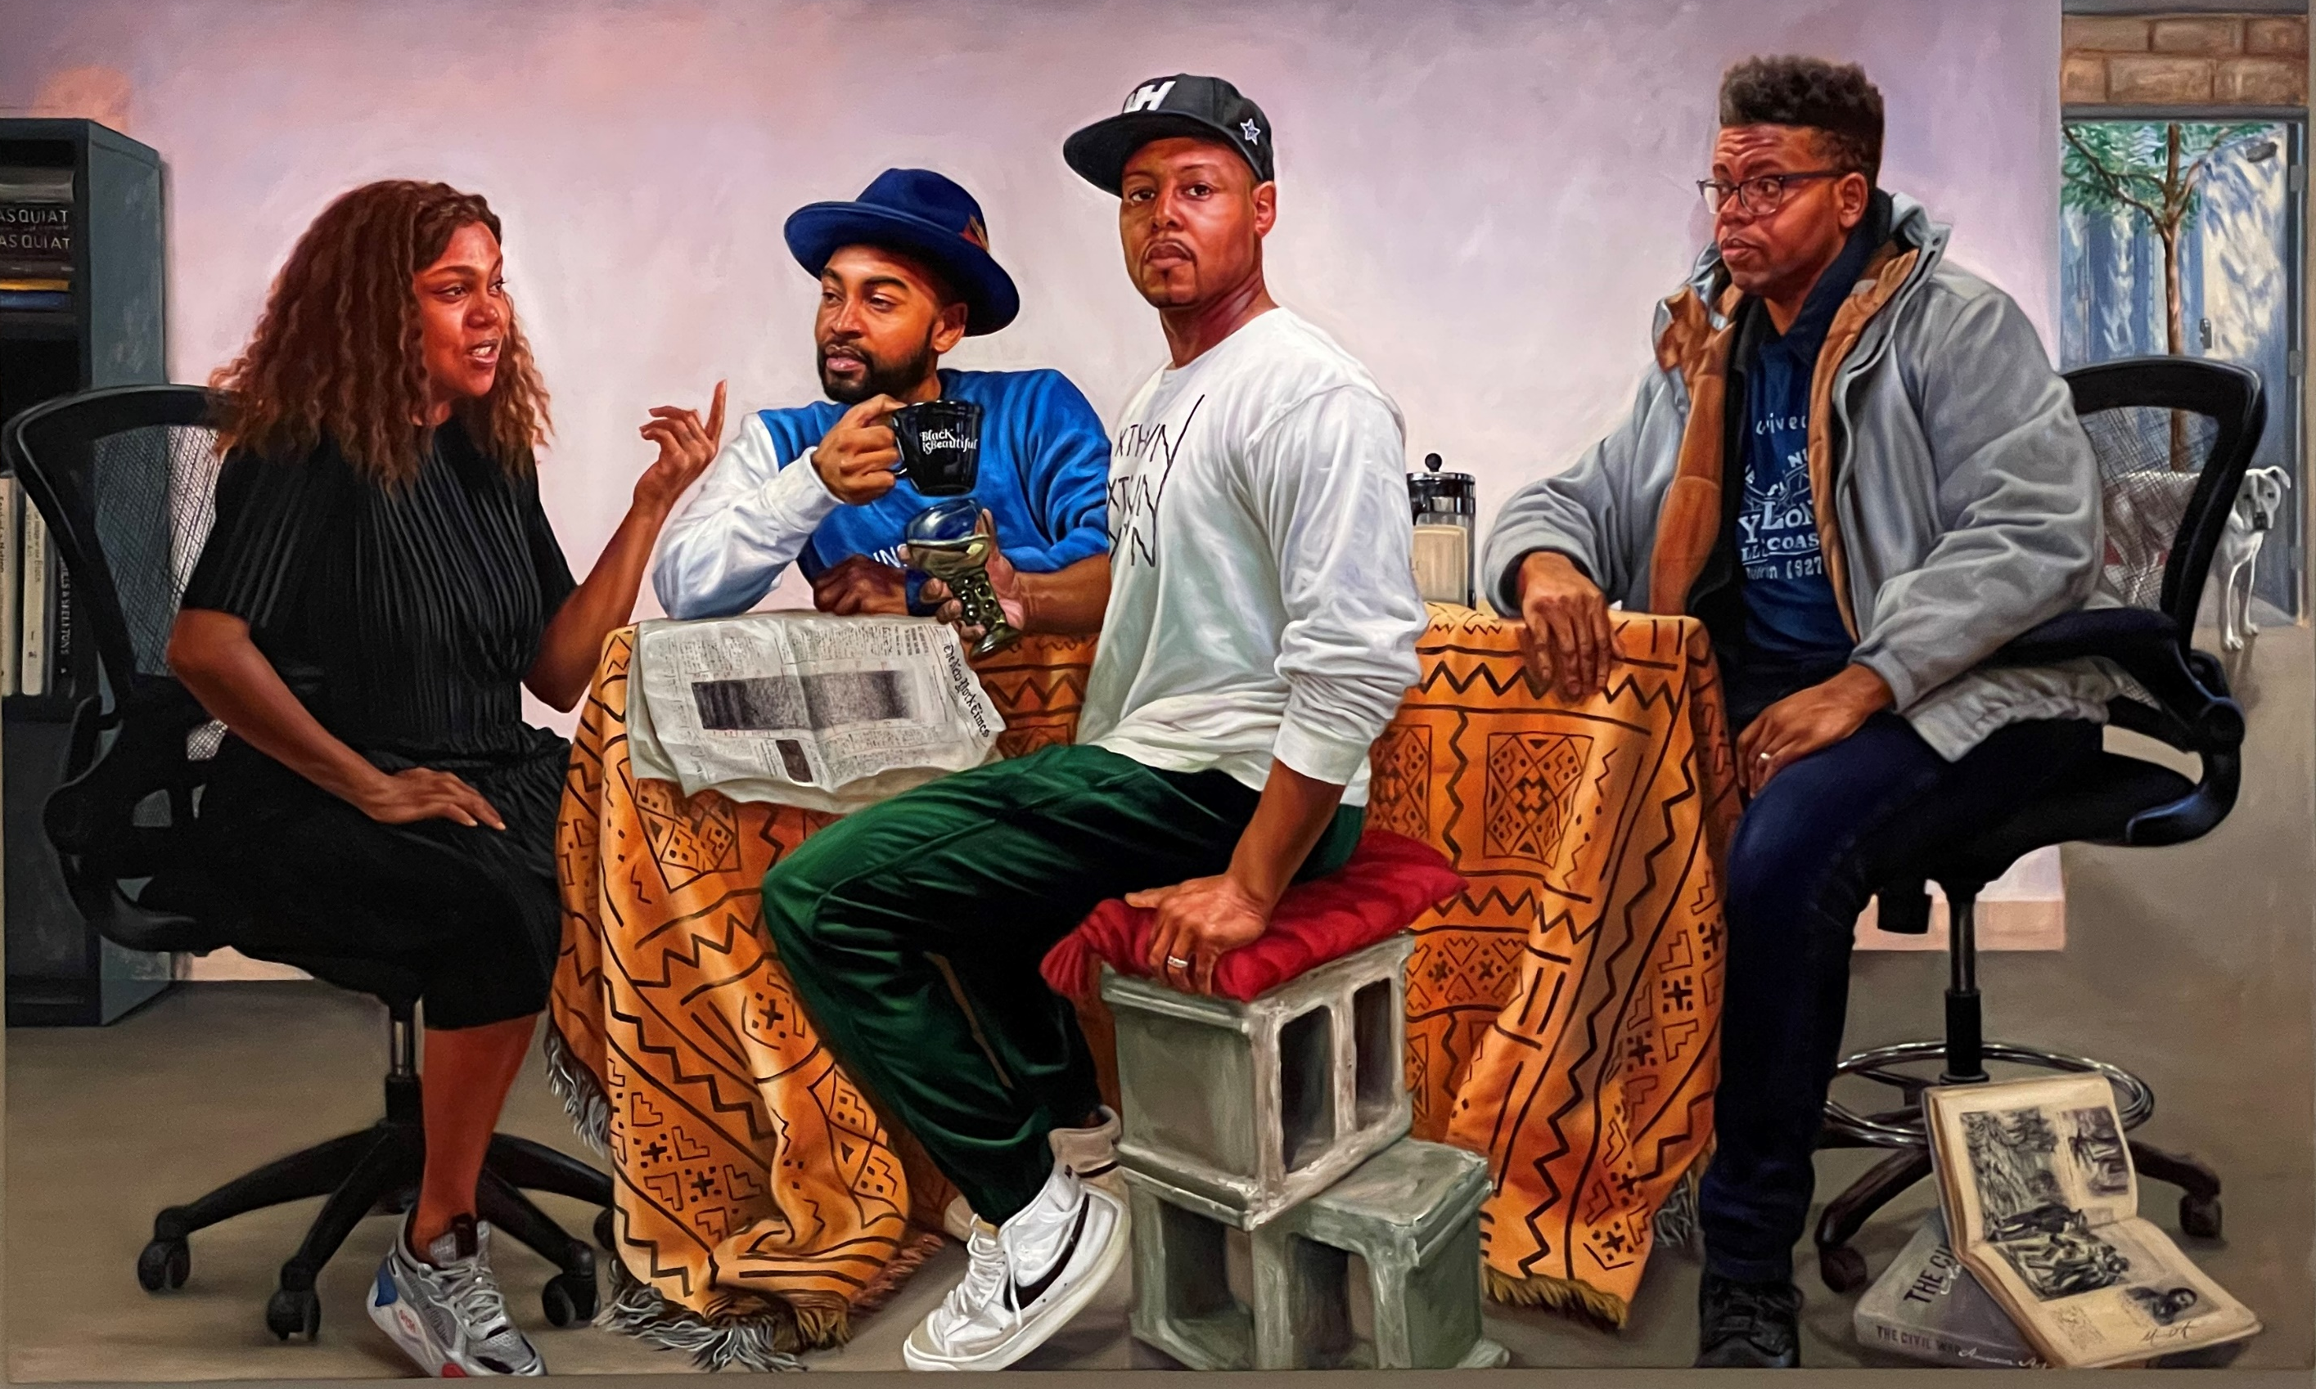
NEW AQUISITIONS
The Council, 2020
Mario Moore, American, born 1987
Oil on canvas
Golga, 2021
Cara Romero, Chemehuevi , born 1977
Pigment Print

Slide 15
CONTACT INFORMATION
THANK YOU!
Julie McFarland
Executive Director, Public Affairs
& Community Engagement
Jmcfarland@dia.org | (313) 833-8626

