Slide 1
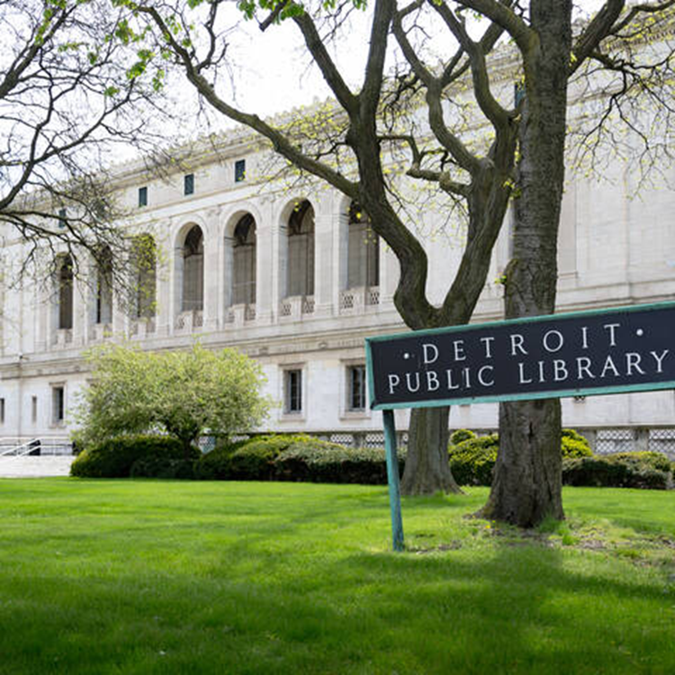
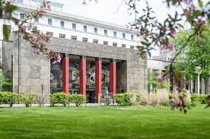
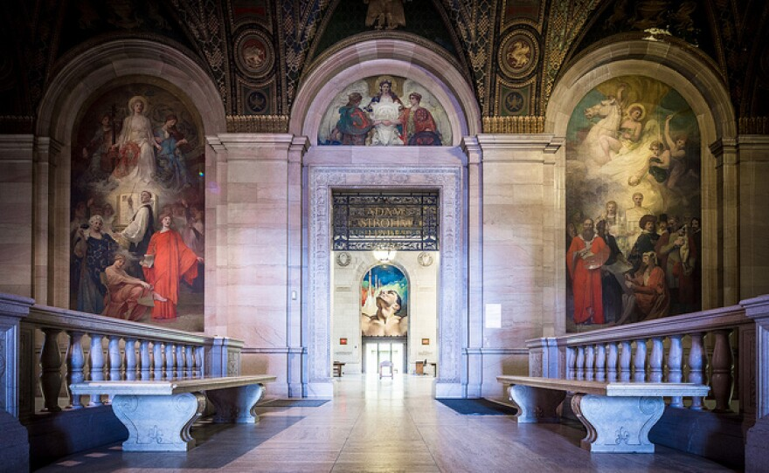
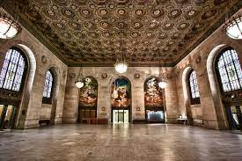
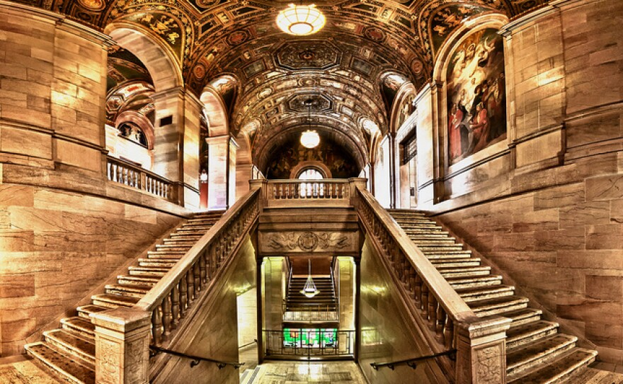

DETROIT PUBLIC LIBRARY
Ten-Year Financial Review and Projections/Outlook
Legislative Policy Division
January 2023
Notes:
We designed this template so that each member of the project team has a set of slides with its own theme. Members, here’s how you add a new slide to just your set:
Mark where you want to add the slide: Select an existing one in the Thumbnails pane, click the New Slide button, then choose a layout. The new slide gets the same theme as the other slides in your set.
Careful! Don’t annoy your fellow presenters by accidentally changing their themes. That can happen if you choose a different theme from the Design tab, which changes all of the slides in the presentation to that look.

Slide 2
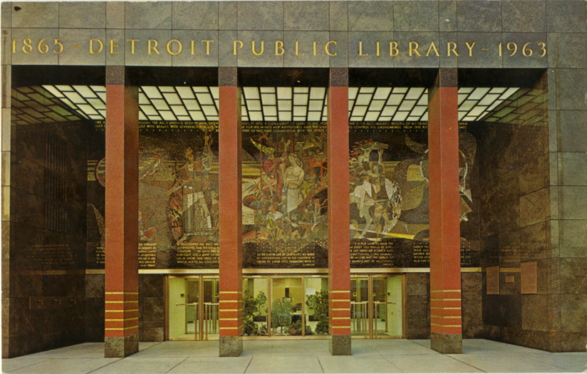
Executive Summary
The Detroit Public Library (DPL) an important educational and social institution to the City of Detroit for almost 160 years has provided essential library services to library patrons and citizens to the best of its ability with limited resources.
Like public libraries throughout the U.S., DPL faces financial challenges, as our 10-year financial review will show. A four-year outlook shows improved DPL finances in the near-term.
DPL needs financial help. Passing a renewal of the Library millage in 2026 is one key step to assisting DPL financially.

Slide 3
Executive Summary
Today, funding for public libraries is stressed in the face of all levels of government and non-government agencies competing for scare public dollars. But another key question arises: “Are Public Libraries Still Relevant?”
The answer is a resounding “Yes!” Today’s public libraries are a place for people of all ages and backgrounds to seek help, connect with others, and get access to the information and services they need.

Slide 4
Executive Summary
Moreover, public libraries help boost local economies: 1) they are free for patrons, 2) they provide a workspace for telecommuters, 3) supply free internet access for people looking for employment opportunities, and 4) offer job and interview training for those in need.
However, the role of libraries has changed. The number of in-person visits has declined, and libraries increasingly offer more diverse kinds of programs for all ages, such as story time for toddlers, afterschool programs for teens, and computer classes for adults and seniors. No longer are they just book-lending centers, and with the number of print materials declining, libraries have been expanding their electronic book collections significantly, with per capita e-book collections growing by more than 3,000 percent between 2010 and 2019.

Slide 5
Executive Summary
The funding sources for public libraries in the State of Michigan are primarily from three funding sources authorized by state law: millages, state aid and penal fines. Unfortunately, diminishing property values reduce property tax revenues based on a library millage. In addition, Downtown Development Authorities (DDAs) and Tax Increment Finance Authorities (TIFAs) often capture dedicated millages for public libraries, which impacts the library’s ability to sustain all its operations. Public Libraries also receive funds from miscellaneous sources: philanthropic donations, sales/charges for services (fees), interest earnings, and to a lesser extent, municipal General Fund contributions.
The main challenge facing libraries both locally and nationally is stable revenue sources. Local, national, and global economic conditions are significant factors in the availability of funding sources for public libraries. The decline in the sources of funds contribute to library reduced service hours and/or closures, resulting in poor and limited services to library users. In an economic recession, public libraries may be forced to reduce their budgets and operate in deficits.

Slide 6
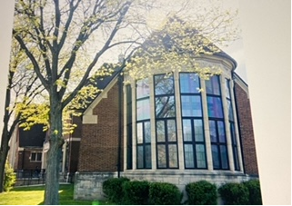
Executive Summary
Prior to the COVID-19 pandemic, the level of library services provided by DPL with limited resources is remarkable. DPL’s Main Library is a center for literacy support, library services, cultural programming, technology access, computer classes, and special historical collections such as the Burton Historical Collection. DPL’s Mobile Library offers checking out books, audio visual materials, access digital collections, connect with free Wi-Fi or participate in programs. And DPL’s library branches in Detroit’s neighborhoods serve as community centers connecting citizens to information and technology. Each branch is different, offering a range of services and programs tailored to fit the specific community served including: 1) technological online access; 2) literacy and tutoring; 3) technology training and lifelong learning opportunities; 4) summer reading program and other reading programs; and 5) many branches serve as warming centers during winter and cooling centers during the summer months.
DPL Executive Director Jo Anne G. Mondowney recently stated “We (DPL) are the community’s living room. We provide opportunities for lifelong learning and access to information. We’re always able to provide varying formats including print and on-line to access information, education, and recreation.”
“Dumas: Detroit Public Library is ‘here to stay’”, Detroit News, by Karen Dumas editorial writer, dated December 5, 2022.

Slide 7
Executive Summary
Prior to the COVID-19 pandemic, DPL operated the Main Library, 21 branches, and one mobile library. But like public libraries throughout the nation, the COVID-19 pandemic forced DPL to close its library system on March 13, 2020. In July 2020, DPL’s courageous frontline staff boarded the Mobile Library to visit parks, schools, food distribution sites, and recreation and community centers. On September 28, 2020, DPL reopened the Main Library and six branches based on geographic locations and the ability to accommodate social distancing. DPL also reopened the one mobile library.
In the face of the COVID-19 pandemic, DPL planned to reopen 11 additional library branches in Fiscal Year (FY) 2023, beginning July 1, 2022. DPL determined it would need to use $3.1 million of its unassigned general fund balance, which had a $26 million balance as of June 30, 2021, to reopen the 11 library branches. As of this report date, DPL has reopened nine of the 11 library branches.

Slide 8
Executive Summary: Ten-Year Financial Review and Projections/Outlook
LPD conducted a ten-year performance review of DPL’s financial condition per Council Member Benson’s request. Using a review of DPL’s annual financial statements, DPL’s financial records, and financial information from the City’s Office of the Chief Financial Officer (OCFO) Office of Budget, LPD reviewed: 1) makeup of DPL’s general fund total revenues for 1975, 1985, and from 2012 through 2021; 2) DPL’s general fund property tax captures from 2012 through 2022, and projections of property tax captures from 2023 through 2027; and DPL’s general fund revenues, expenses, net income (loss), and fund balance from 2012 through 2022. Key findings from this financial performance review are as follows:

Slide 9
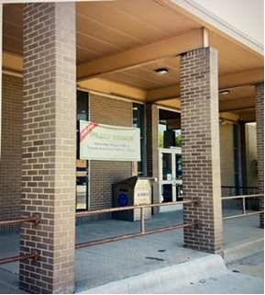
Executive Summary: Ten-Year Financial Review and Projections/Outlook - Key Findings
The history of the city’s General Fund support of DPL revenues have evolved over the years from over 50% primary support to zero upon implementation of a dedicated library property tax millage.
DPL’s approximate library millage of 4 mills currently generates approximately $26 million in gross property tax revenue, which constitutes about 89% of DPL’s FY 2021 total revenue sources. DPL’s library millage expires on June 30, 2025. If the library millage is not renewed by Detroit’s registered voters by FY 2026, DPL’s library system would eventually be forced to shut down.

Slide 10
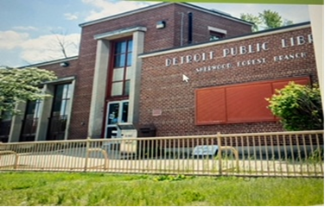
Executive Summary: Ten-Year Financial Review and Projections/Outlook - Key Findings
DPL’s net property tax revenue ranging from $27 to $33 million makes up about 92 to 96% of total revenues over the ten-year period, further emphasizing DPL’s dependency on property tax revenue generated by the library mills to operate at a level of providing the best library services it can offer.
Net Property Tax revenues include current property taxes based on total library millage of 4.63 mills (.64 mill per State law in perpetuity: Public Act 62 of 1933 plus 3.9943 mills approved by Detroit voters in August 2014), prior year taxes, special act property taxes from Neighborhood Enterprise Zones, Industrial Facilities Tax districts, and Obsolete Property Rehabilitation Act areas, personal property taxes, interest and penalties, less property tax captures (“property tax captures” represent property taxes captured by Tax Increment Financing Authorities for economic development purposes).

Slide 11
Executive Summary: Ten-Year Financial Review and Projections/Outlook - Key Findings
Unfortunately, DPL’s gross property tax revenue over the ten-year period did not grow but was rather stagnant hovering around $31 million annually. Meanwhile, property tax captures grew from $1 million to $3.5 million over the ten-year period, thereby creating lower net property tax revenue for DPL to operate. And DPL’s property tax captures are expected to reach approximately $4.1 million by FY 2027.

Slide 12
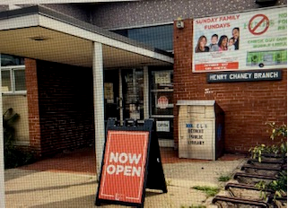
Executive Summary: Ten-Year Financial Review and Projections/Outlook - Key Findings
DPL general fund property tax capture is a product of tax increment financing, which is a mechanism that allows communities to “capture” property tax revenue from incremental increases in value in a determined area and spend the "tax increment revenue" on economic development projects. In the State of Michigan there are 10 different acts that provide for the use of tax increment financing, but three of these acts, Public Act (PA) 197 of 1975 Downtown Development Authority Act, PA 281 of 1986 Local Development Financing Act, and PA 381 of 1996 Brownfield Redevelopment Financing Act, primarily negatively impact DPL’s property tax revenues in the form of property tax captures.
Given that TIF authorities (some decades old now) under State law can capture property tax revenue for economic development purposes, DPL has no rights to the TIF captures according to State law, and the amount captured is not DPL’s property tax revenue; or stated simply, the amount captured is not DPL’s money. This is the reason for the accounting change made in 2019 by the City to show only net property tax revenue (gross property tax revenue minus property tax captures) in the financial statements.

Slide 13
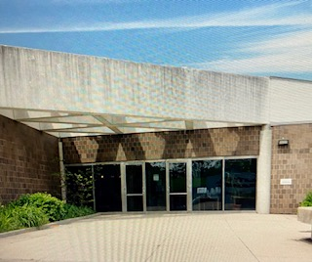
Executive Summary: Ten-Year Financial Review and Projections/Outlook - Key Findings
As a result, it would require a change in State law to eliminate the TIF authorities’ ability to tax capture. However, some TIF legislation allow for libraries in Michigan to opt-out of tax capture, but unfortunately, do not apply to DPL at the present time. In 2013, under an amended DDA, DPL had the opportunity to “opt out” from property tax capture from an expansion area for the Little Caesars Arena (LCA) project but failed to do so within a certain timeframe. However, as accommodation to DPL, the DDA entered into a tax sharing agreement allowing all tax increment revenue generated in the LCA expansion area be kept by DPL. DPL collects about $184,000 in property tax revenue annually from this expansion area.
In addition, Section 3(3) of the DDA Act was further amended to exempt library taxes levied before January 1, 2017, from capture when the applicable downtown development authority has no outstanding obligations. According to DDA’s annual financial statements as of June 30, 2021, the DDA issued in December 2018 $287.4 million in Series 2018A bonds to refund the Series 2014 bonds (for the LCA construction project) and Series 2017 bonds (for the Detroit Pistons relocation construction project). These bonds will be repaid primarily through Catalyst Development Project tax revenue captured by the DDA, and they mature in 2049.

Slide 14
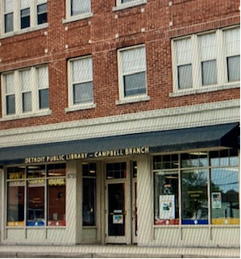
Executive Summary: Ten-Year Financial Review and Projections/Outlook - Key Findings
Of the DPL general fund property tax captures from 2012 through 2027, up to 87% of these tax captures represent DDA property tax captures, which help to support the repayment of outstanding DDA bonds, and therefore, cannot be eliminated if there are outstanding DDA bonds.
One key point is that there is no decrease in DPL’s property tax revenue that existed prior to a TIF. For instance, with many TIFs, it is quite the contrary since in many cases (outside of DDA capture districts), the properties are City owned, or owned by another government entity such as Detroit Public School, thereby generating zero taxes, until the ownership changes hands.

Slide 15
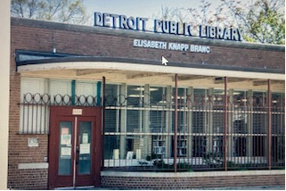
Executive Summary: Ten-Year Financial Review and Projections/Outlook - Key Findings
11.In addition, there are several tax incentives or tax abatements offered by the State of Michigan that reduces DPL’s property tax revenue. A tax abatement is designed to incentivize investment by reducing tax payments for a company. The types of tax abatements, also called “special act property tax legislation”, that can reduce DPL’s property tax revenue are as follows:
Obsolete Property Rehabilitation Act, PA 146 0f 2000, as amended; abatement term up to 12 years
Commercial Rehabilitation Act, PA 210 of 205, as amended; abatement term up to 10 years
Neighborhood Enterprise Zone Act, PA 147 of 1992, amended; abatement term up to 15 years
Industrial Facilities Exemption, PA 198 of 1974, as amended; abatement term up to 12 years
New Personal Property Exemption, PA 328 of 1998, as amended; abatement term up to unlimited term (however, terms have been limited to 12 years under the Mayor Duggan administration)
Commercial Facilities Exemption, PA 255 of 1078, as amended; abatement term up to 12 years
Michigan Renaissance Zone Act (Michigan Strategic Fund Designated Zone), PA 376 of 1996; abatement term up to 15 years
Next Michigan Development Act, PA 275 of 2010/Renaissance Zones PA 376 of 1996; abatement term up to 10 years

Slide 16
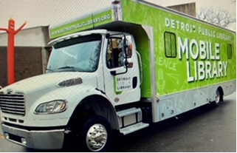
Executive Summary: Ten-Year Financial Review and Projections/Outlook - Key Findings
12. Fortunately, DPL can receive the same level of property tax revenue or more during the term of a tax abatement, and substantially more property tax revenue after the tax abatement expires. Based on information from the Detroit Economic Growth Corporation (DEGC), FY 2022 estimated library millage collections from 73 tax abatement projects amounted to $269,000 but grow to $873,000 when the respective tax abatements expire during the period 2021 through 2027.
13. City Council painstakingly deliberate over the cost/benefits of the TIF and tax abatement projects that come before them for approval to ensure the benefits outweigh the costs, which benefits include the retention and creation of more jobs, redevelopment of vacant and obsolete properties, creation of mixed-use projects including new housing units and commercial development, creation of affordable housing, etc. All projects must demonstrate that “but for” this incentive the project will not occur, and that the City will receive a net benefit from the investment.
"Costs to the City" associated with TIF economic projects are costs of any city services (police, fire, public works, general services, etc.) provided by the City on behalf of the TIF project.

Slide 17

Executive Summary: Ten-Year Financial Review and Projections/Outlook - Key Findings
14. Over the ten-year period, DPL’s total revenues averaged $32.6 million annually for the first five years, reaching a high of $35.3 million in FY 2016. But in the last five years, DPL’s total revenues average dropped to $29.5 million annually, reaching a low of $28.4 million in FY 2020, primarily due to the stagnant growth in gross property tax revenue and rising property tax captures. This means that DPL had limited resources to operate 22 branches (the Main Library and 21 neighborhood branches) with around 300 Full Time Equivalents (FTEs).
15. DPL experienced net losses in FY 2012 and FY 2013 when it operated 24 branches (the Main Library and 23 neighborhood branches) with limited resources. Therefore, DPL was forced to close two neighborhood branches in 2014 and reduce the number of FTEs to right-size the library system. This led to a string of net income results for four years from FY 2014 through FY 2017, and DPL basically broke even in FY 2018 when the number of FTEs increased by 32.

Slide 18
Executive Summary: Ten-Year Financial Review and Projections/Outlook - Key Findings
16. During the ten-year period, pre-COVID-19, it appears that DPL felt compelled to operate 22 branches with around 300 FTEs with limited resources and high costs to provide the best library services it could for its library patrons, including residents of the City of Detroit, even if it meant dipping into its general fund balance to do so. However, to operate 22 branches with limited resources and growing property tax captures, DPL is compelled to deficit spend and use fund balance at times, to maintain operations. This mode of operation is unsustainable for DPL to survive operationally in the long run. If total revenues do not grow substantially in the future, DPL would have to seriously examine providing library services with fewer branches.
17. For FY 2022, DPL ended up with a net income of $5.8 million, consisting of $2.9 million from operations and $2.9 million from an insurance recovery due to significant storm event on June 25, 2021. The positive operational results are from again just operating the Main Library and six library branches post-COVID.

Slide 19
Executive Summary: Ten-Year Financial Review and Projections/Outlook - Key Findings
18. DPL spent a total of approximately $19 million from fund balance on print and non-print material and capital improvements during eight years of the ten-year period under review. Meanwhile, DPL operated the Main Library, 21 library branches, and one mobile library with limited resources to provide the best library services it could for its library patrons, which consisted primarily of Detroit residents. Even though in February 2009 the registered voters of the City of Detroit approved a bond authorization up to $97 million for museums, libraries, recreation, and other cultural institutions (voters at the time were told up to $25 million would be used for the libraries), no general obligation bonds have been sold for DPL since 2009. If DPL had general obligation bond dollars from the City to fund these capital improvements, and possibly to fund the print and non-print material which may be classified as capital assets during this ten-year period, DPL would have been in a much better position financially to provide even more robust library services at the Main Library and library branches and avoid deficit spending.
The last General Obligation Bonds sold for DPL was in August 2001 for $3.5 million, over 20 years ago. This sale was from a 1997 voter authorization of $7.5 million (the library received $4 million of bond proceeds from a 1999 bond sale).

Slide 20
Executive Summary: Ten-Year Financial Review and Projections/Outlook - Key Findings
LPD reviewed DPL’s five-year capital improvement plan. Key findings from this review are as follows:
Some of DPL buildings are over 100 years old, with the average age being 57. Most buildings require extensive repairs and/or upgrades. Regular and timely maintenance will allow DPL to utilize its facilities to its fullest extend and to meet its mission to provide quality services to the community.
DPL’s FY 2022-2026 five-year capital plan totals $9.1 million in projects that will maintain the current infrastructure and does not include any new construction or expansion plans. These projects are anticipated to be paid for with funding from operations (millage/fund balance) denoting there is no anticipated or scheduled General Obligation Bond sale from the Capital Agenda on behalf of DPL.
In FY 2022, City Council approved $2 million in General Fund surplus dollars to replace the chillers at the Main Library; this amount was later amended to $4 million for total project costs. According to the OCFO, the City’s General Services Department is in the process of transferring the $4 million to DPL for this capital improvement project.

Slide 21
Ten-Year Financial Review and Projections/Outlook
Future Projections/Outlook for the Detroit Public Library
LPD conducted a four-year future projections/outlook for DPL per Council Member Benson’s request using three scenarios, which are as follows:
Scenario 1 is a four-year future projection/outlook for DPL based on the City of Detroit’s FY 2023-2026 Four-Year Financial Plan. Scenario 1 assumes that for FY 2023-2026, DPL will reopen 11 library branches in FY 2023 to operate 18 branches (Main Library and 17 library branches).

Slide 22

Ten-Year Financial Review and Projections/Outlook
Future Projections/Outlook for the Detroit Public Library
Estimated Detroit Public Library Revenues-Scenario 1 (in millions)

Slide 23
Ten-Year Financial Review and Projections/Outlook
Future Projections/Outlook for the Detroit Public Library
Key findings from Scenario 1 (reported by LPD in May 2022):
1. DPL projects it will need to spend $3.1 million from its unassigned general fund balance to provide a balanced budget in FY 2023 because of the reopened branches. As of June 30, 2021, DPL’s unassigned general fund balance (surplus) is at approximately $26 million.
2. In addition, with the reopening of the 11 Library branches, DPL’s administration anticipates funding shortfalls of $3.0 million in FY 2024, $3.0 million in FY 2025, and $3.5 million in FY 2026. If future funding shortfalls at this rate are covered by DPL’s unassigned general fund balance to maintain balanced budgets, the unassigned general fund balance (i.e., rainy-day fund) of $26 million will be depleted in almost nine years.
3. It is quite clear that the DPL needs an additional dedicated funding source to sustain operations in the future, or face cutting services to do so.

Slide 24
Ten-Year Financial Review and Projections/Outlook
Future Projections/Outlook for the Detroit Public Library
Scenario 2 is a four-year future projection/outlook for DPL based on the City of Detroit’s FY 2023-2026 Four-Year Financial Plan with updated financial information from DPL. Scenario 2 assumes that for FY 2023-2026, DPL will operate 18 branches (Main Library and 17 library branches). In addition, Scenario 2 assumes some increases in DPL’s net property taxes based on net property tax assumptions from the September 2022 Revenue Estimating Conference conducted by the OCFO. Also, Scenario 2 assumes a huge reduction in DPL pension expenses based on the latest actuarial report for the City of Detroit’s General Retirement System.

Slide 25
Ten-Year Financial Review and Projections/Outlook
Future Projections/Outlook for the Detroit Public Library
Estimated Detroit Public Library Revenues-Scenario 2 (in millions)

Slide 26
Ten-Year Financial Review and Projections/Outlook
Future Projections/Outlook for the Detroit Public Library
Key findings from Scenario 2:
With Estimated Property Tax-Net revenue increases and Estimated Other Revenues increase (which increase by $400,000 starting in FY 2024 per DPL’s estimates), coupled with the huge reduction in DPL pension contribution expense since DPL’s ten-year General Retirement System (GRS) legacy pension expense of $2.5 million ends in FY 2023 and reduces to $100,000 starting in FY 2024, it appears that DPL will only need to use $2.3 million from unassigned general fund balance for just FY 2023. For FY 2024-2026, DPL could end up with surpluses, with almost a $1 million surplus in FY 2026.
If DPL’s unassigned general fund balance of $31.6 million as of June 30, 2022 is only reduced by $2.3 million in FY 2023, leaving a balance of $29.3 million, this fund balance could be used solely to pay for $9.1 million in necessary capital improvements at the Main Library and library branches based on DPL’s five-year capital improvement plan mentioned previously. If fund balance is reduced by $9.1 million, then the remaining amount in fund balance further reduces to $20.2 million, which is still a healthy fund balance total. If the City of Detroit were to issue General Obligation Bonds in the future on behalf of DPL for necessary capital improvements, the fund balance would not be reduced as much and could last even longer for DPL and help ensure a stronger financial footing for DPL operations.
3. Based on this analysis, it appears that DPL should strongly consider continuing just operating 18 branches (Main Library and 17 library branches) to minimize the usage of DPL’s fund balance and strengthen its financial condition to become a more viable library system for its library patrons, especially for the citizens of Detroit who rely on DPL’s library services.

Slide 27
Ten-Year Financial Review and Projections/Outlook
Future Projections/Outlook for the Detroit Public Library
Scenario 3 is a four-year future projection/outlook for DPL based on the City of Detroit’s FY 2023-2026 Four-Year Financial Plan with updated financial information from DPL. Scenario 3 assumes that for FY 2023, DPL will operate 18 branches, and for FY 2024-2026, DPL will operate 20 branches (Main Library and 19 library branches) based on DPL’s proposed FY 2024 budget that was approved by the Library Commissioners on October 22, 2022. In addition, Scenario 3 assumes some increases in DPL’s net property taxes based on net property tax assumptions from the September 2022 Revenue Estimating Conference conducted by the OCFO. Also, Scenario 3 assumes a huge reduction in DPL pension expenses based on the latest actuarial report for the City of Detroit’s General Retirement System.

Slide 28
Ten-Year Financial Review and Projections/Outlook
Future Projections/Outlook for the Detroit Public Library
Estimated Detroit Public Library Revenues-Scenario 3 (in millions)

Slide 29
Ten-Year Financial Review and Projections/Outlook
Future Projections/Outlook for the Detroit Public Library
Key findings from Scenario 3:
It will cost DPL additionally about $3.5 million a year starting in FY 2024 to operate 20 branches to pay for higher operational expenses, such as salaries and benefits, contractual services, maintenance, utilities, etc., and possibly for more capital improvements.
Even with higher Estimated Property Taxes-Net revenue, and with a huge reduction in pension contribution expense, DPL would still need to use unassigned general fund balance ranging from $2.5 million to $3 million a year from FY 2024-2026 to maintain balanced operations. This equates to deficit spending.
$2.7 million is the average usage of DPL’s fund balance over the FY 2023-2026 four-year period. If DPL had to contribute $2.7 million annually from its fund balance totaling $31.6 million as of June 30, 2022 to maintain balanced operations, it would fully deplete its fund balance in about 12 years. The fund balance could be depleted even sooner if it had to be used to cover necessary capital improvements as depicted in DPL’s five-year capital improvement plan on top of being used to balance operations.
Scenario 3 would put DPL’s future financial condition in jeopardy, and at some point over the next decade would require DPL to reduce cost by operating a lower number of branches and reduce operating expenses, such as salaries and benefits, contractual services, utilities, etc.

Slide 30
Ten-Year Financial Review and Projections/Outlook
Future Projections/Outlook for the Detroit Public Library
Key findings from Scenario 3, continued:
If it is deemed important for DPL to operate 20 branches to provide more accessible citywide library services, it would need a new dedicated revenue stream of approximately $3.5 million a year, with a cost multiplier of about 2 to 4 percent annually to keep up with inflation.
If the City agrees to provide a $3.5 million annual subsidy, plus a multiplier, to DPL, then DPL’s unassigned general fund balance of $31.6 million as of June 30, 2022 is only reduced by $2.3 million in FY 2023, leaving a balance of $29.3 million, and this fund balance could be used solely for necessary capital improvements at the Main Library and library branches as depicted in DPL’s five-year capital improvement plan. If the City of Detroit were to issue General Obligation Bonds in the future on behalf of DPL for necessary capital improvements, the fund balance could last even longer for DPL and help ensure a stronger financial footing for DPL operations.

Slide 31
Recommendations
This report provides recommendations that seek more collaboration between the City of Detroit and DPL to make DPL stronger financially and become a more viable library system for its library patrons, especially for the citizens of Detroit who rely on DPL's library and social services. Key recommendations include:
City of Detroit should strongly consider affirming its commitment to DPL's participation in the city's General Obligation Bond Program to minimize DPL's usage of its unassigned general fund balance for needed capital improvements at the Main Library and library branches.
The City should strongly consider selling General Obligation Bonds on behalf of DPL that have been authorized by the electorate but unissued to date, up to an amount previously agreed to by City officials. If the amount of eligible authorization has been utilized for other city purposes, then the City should strongly consider placing before the electorate a separate ballot proposal for the Library's capital improvement program in amount mutually agreed upon by DPL and City officials.
All future voter authorization for General Obligation Bonds for DPL should be placed on the ballot as a separate proposal, dedicated for DPL use only.
DPL should strongly consider providing a comprehensive Capital Needs Assessment (CAN) for all DPL property (Main Library, branches, resource center, etc.) that addresses capital improvements and deferred maintenance needs to ascertain the full and true costs of these needs to better plan for DPL's future capital improvement projects. A CNA could also help the City and DPL determine what it would take financially to bring the library system's Main Library and library branch infrastructure to become a 21 ^{st} century library system, based on suggestions provided in Attachment Il. A CNA should further make the case why the City should use future General Obligation Bond proceeds to help with DPL's capital improvement needs to enable the library system to provide viable and sustainable library services to its library patrons, especially the citizens of the City of Detroit.

Slide 32
Recommendations
Key recommendations, continued:
DPL's Library Commission should strongly reconsider its approval of DPL's proposed FY 2024 budget so that it operates only up to 18 branches (Main Library and 17 library branches) to maintain balanced operations and to minimize the usage of DPL's fund balance and strengthen its financial condition to become a more viable library system for its library patrons, especially for the citizens of Detroit who rely on DPL's library services.
If it is deemed important for DPL to operate 20 branches to provide more accessible citywide library services, it would need a new dedicated revenue stream of approximately $3.5 million a year, with a cost multiplier of about 2 to 4 percent annually to keep up with inflation. The City should consider making it a priority to subsidize DPL to help enable the library system to provide valuable services to improve the quality of life of the citizens of Detroit. The City should also consider subsidizing DPL so it can minimize its usage of fund balance.

Slide 33
Recommendations
Key recommendations, continued:
City Council should consider passing a resolution supporting the renewal of the library millage in 2026 so that DPL can continue to operate the library system to the best of its ability to provide viable and important library services for its library patrons, including the citizens of the City of Detroit. The resolution should also include if Detroit's registered voters approve a library millage renewal by 2026, any tax sharing agreement entered by DPL and DDA would have to ensure that the repayment of outstanding DDA bonds is not hindered.
If City Council approves a transformational Brownfield for the estimated $1.5 billion District Detroit project, this economic development could significantly increase the property values in the downtown area. City Council should then consider passing a resolution urging the DDA to enter into a property tax revenue sharing agreement with DPL to improve the financial condition of DPL. Before entering into this agreement, the DDA should conduct an analysis to ensure that the level of property taxes captured even with this agreement in place will continue to properly support the repayment of any outstanding DDA bonds.

Slide 34
Recommendations
Key recommendations, continued:
The OCFO- Office of Grants should collaborate with DPL on grant and philanthropic opportunities available to the library.
DPL should work with Housing and Revitalization Department (HRD) and City Council staff to explore the use of Community Block Grant funds for eligible community centered projects.
The City should connect DPL with the Communication and Media Services Department to develop a multi-platform media campaign- cable, print, digital and social media to educate the public about DPL services.
The Duggan Administration and City Council need to collectively determine if a restructuring of the governance structure of DPL, such as providing City appointment authority on the Library Commission, would give the Mayor and City Council greater comfort in providing a City subsidy to DPL and in providing significant public capital investment in the library system's property. As stated previously, any change in the governance structure of DPL would require State legislative action.

Slide 35
Conclusion
DPL has provided a myriad of necessary library services and social programs, especially for the most vulnerable in the City of Detroit with limited funds. Over the last ten years, DPL has used limited resources to provide the best library services possible for its library patrons, but at minimal levels. This was exacerbated by the COVID-19 pandemic.
Additionally, DPL has felt compelled to deficit spend and use fund balance (“rainy day fund”) to make necessary capital improvements and address deferred maintenance to keep library branches open and accessible to the public. But this mode of operation is unsustainable for DPL to survive operationally in the long run. If total revenues do not grow substantially in the future, DPL will have to seriously examine providing library services with fewer branches.

Slide 36
Conclusion
It is imperative for DPL’s library millage of approximately 4 mills be renewed in 2026 so that DPL can continue to operate as a much-needed library system in Detroit. The City of Detroit should be supportive in this effort.
The City of Detroit can become a stronger partner with DPL to provide viable library and social services. Ideally, DPL needs another steady revenue source and future general obligation bond dollars to truly run a functional and viable library system for its library patrons, especially for the citizens of Detroit who rely heavily on the library for educational and social services.
Lastly, the City and the philanthropic community should make DPL a high priority that it deserves to become a strong library system for decades to come.

Slide 37
Conclusion
Questions

