Slide 1
March 26, 2022
District 1 Monthly Meeting
Detroit Housing Counseling and Homeownership Project

Slide 2
DHCHP
Center for Equitable Family & Community Well-being
Trina Shanks trwilli@umich.edu
DC Palmer LLC
David Palmer david@dcpalmer.com
Southwest Economic Solutions
Hector Hernandez hhernandez@swsol.org
Alex Makohn amakohn@swsol.org

Slide 3
DHCHP
Demand Overview
HUD data: 2014 to 2019
14 homebuyer education agencies in Detroit
7458 participants pre-purchase homebuyer education
1445 participants report purchasing a home (<20%)
78% of program participants <80% AMI
78% of program participants people of color

Slide 4
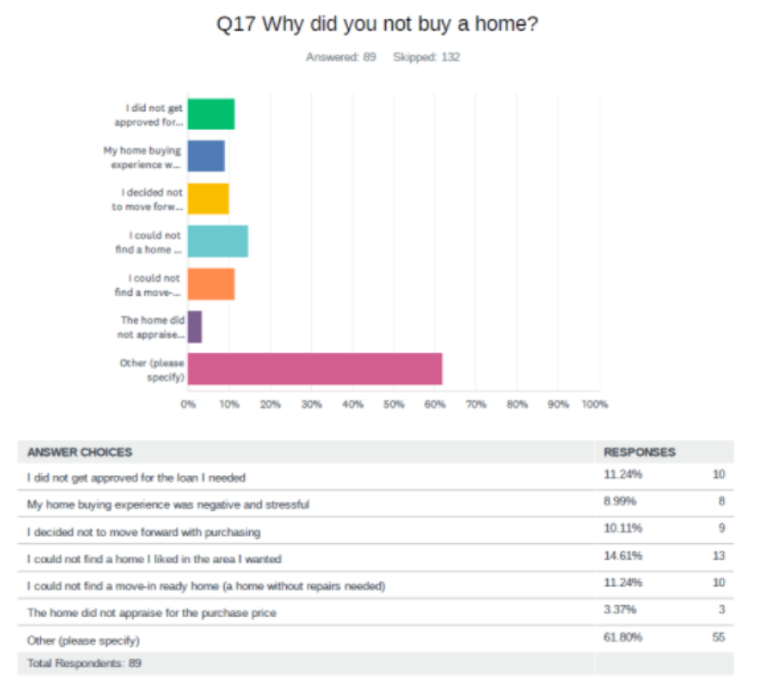
DHCHP
Demand context
SWES Survey
214 homebuyer ed participants
142 had not yet purchased a home
Home condition a consistent barrier to entry
56% of those purchased with mortgage <$800/month
Detroiters can afford $773/month

Slide 5
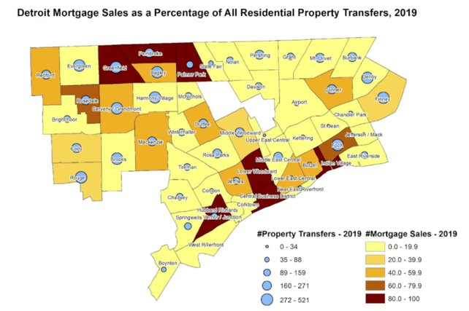
DHCHP
Detroit overview
City of Detroit​
2019 population: 670,000​
​
Median household income: $30,894​
​
Neighborhoods represented by clusters​
​
Mortgage sales 2019: 22.2% of all property transfers​
​
MSHDA DPA loans 2019: 212​
​
Prop N ”stabilization” homes total: 1491

Slide 6
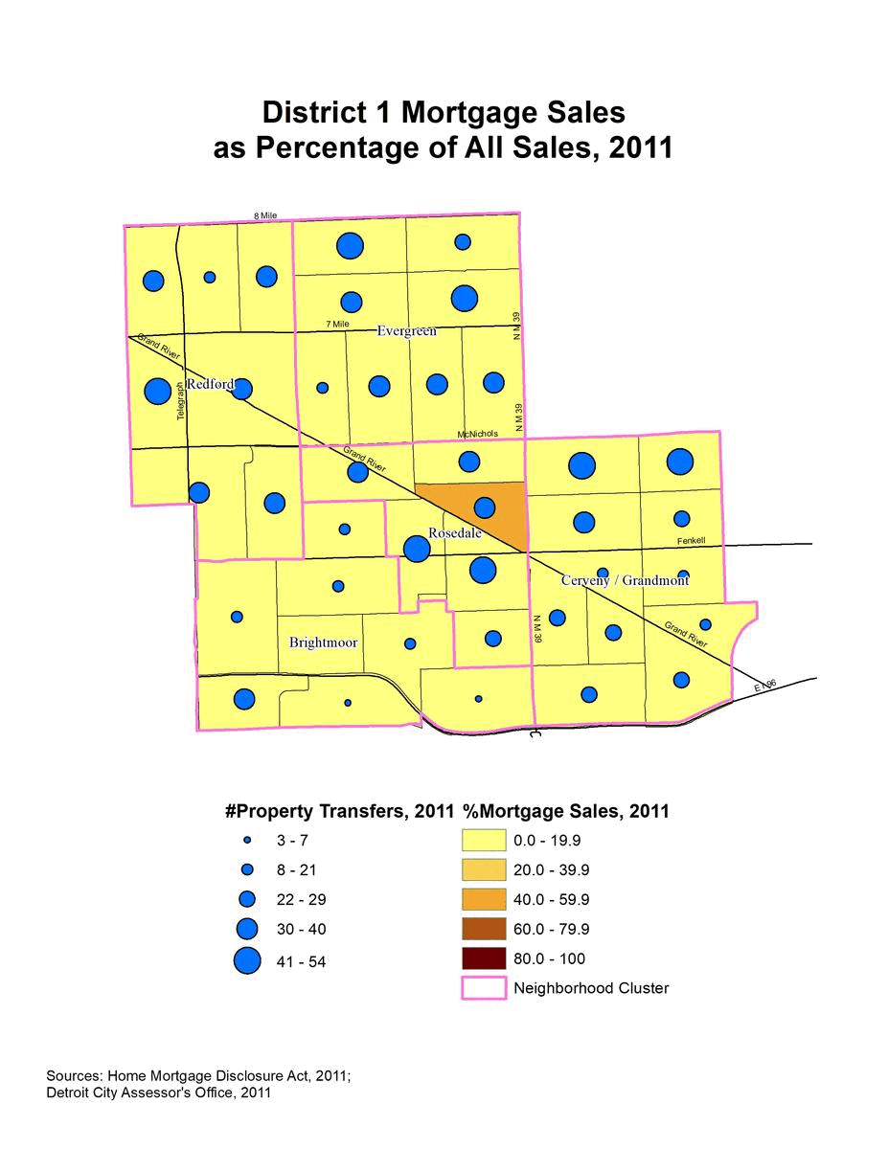
DHCHP
District 1 overview
2019 population: 96,093
Median household income: $37,156
Neighborhoods represented by clusters
Mortgage sales 2019: 26.9% of all property transfers
MSHDA DPA loans 2019: 65
Prop N ”stabilization” homes total: 87

Slide 7
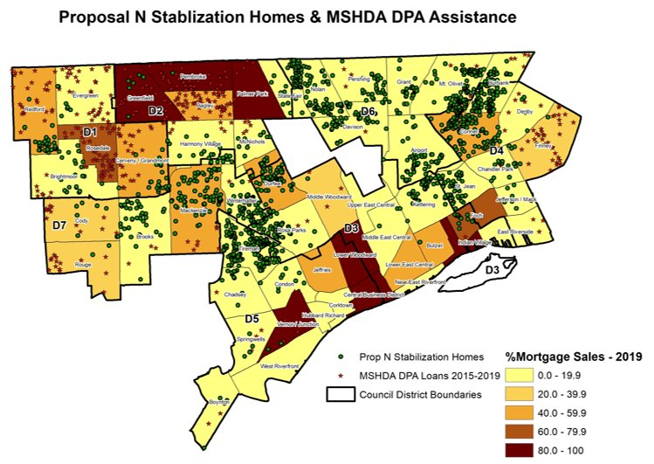

Slide 8
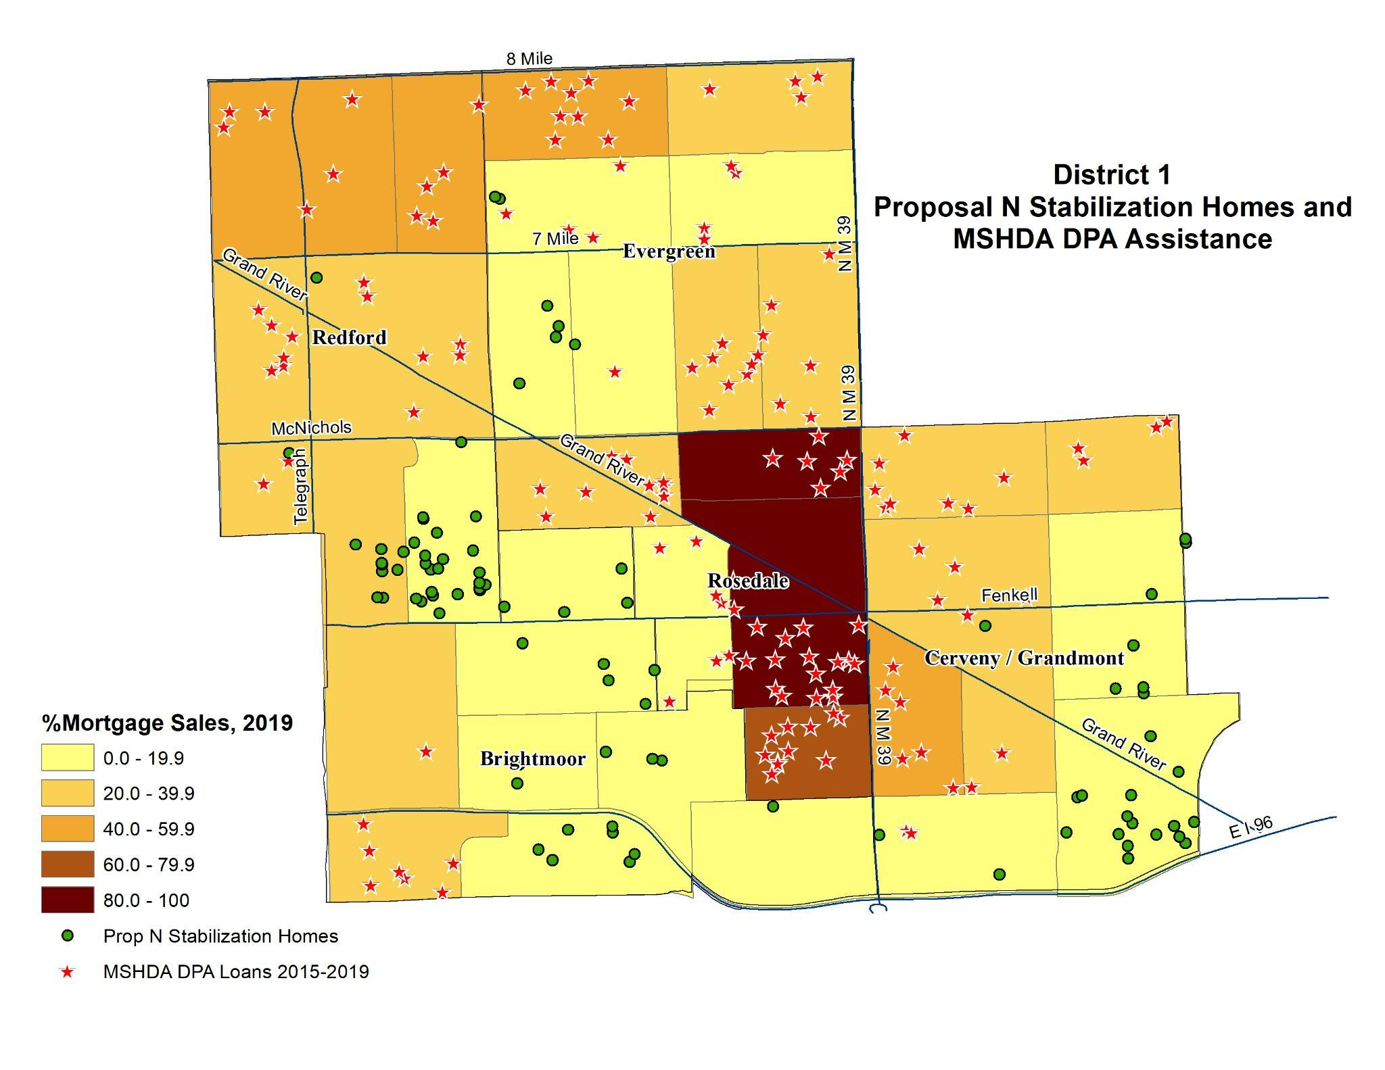

Slide 9
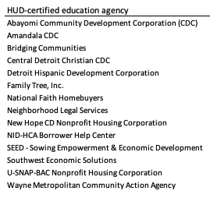
DHCHP
Leadership Opportunity
Convening:
Purposefully braid city resources with demand & education
Link to ongoing efforts like the Detroit Housing Compact
(2) new funds likely needed
Single-family reno
Portfolio mortgage product

Slide 10
DHCHP
Resources
Report & district profiles
https://ssw.umich.edu/offices/family-community-wellbeing/projects/dhch
Free Press Op-Ed
https://www.freep.com/story/opinion/contributors/2022/01/13/home-ownership-detroit-mortgages-low-income-housing/9095057002/
Lending dashboard
https://datastudio.google.com/u/0/reporting/38a55cdc-9f7f-496c-a84f-1455c9a73286/page/w91lC?s=tFG87Kt8MF8

Slide 11
Homebuyer Education Course ​
Second Friday of every month
Next Course is on April 8, 2022
8 Hour HUD_Approved Course that covers the ENTIRE home buying process
Certificate of Completion issued at the end that is required for most DPA.
Sign up for classes or counseling here: HTTPS://SWSOL.FORCE.COM/SWSOLCFT

Slide 12
Other SWES Services
One on One financial coaching and counseling
Homeowners Property Tax Exemption (HOPE) application assistance and counseling
Michigan Homeowner Assistance Fund (MIHAF) application assistance and counseling

Slide 13
Contact us for more info!
Email: homeownershipadmin@swsol.org
Phone: 313-841-9641

