Slide 1
DIRECTOR’S REPORT
November 14, 2018
detroitmi.gov/dwsd

Slide 2
CONTENTS*
Director’s Message for November 2018 3
Metrics by Function:
• Customer Care 4
• Field Services 7
• Finance 12
• Investigations 15
• Human Resources 17
• Public Affairs 21
• Information Technology 24

Slide 3
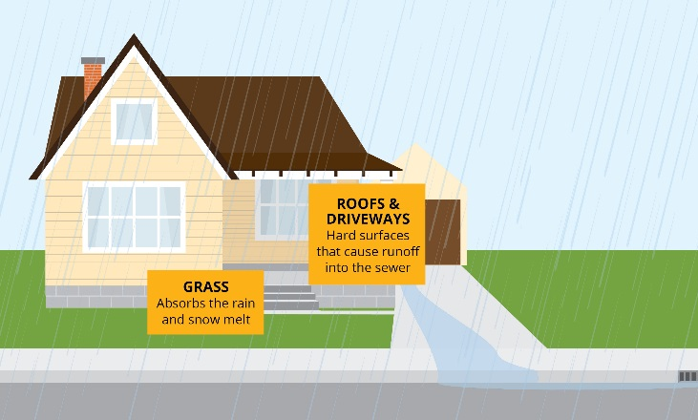
DIRECTOR’S MESSAGE TO THE BOARD
The Michigan Court of Appeals unanimously upheld the Detroit Water & Sewerage Department's (DWSD) practice of collecting a monthly drainage fee from customers to pay for the treatment of stormwater that runs off their property into the city's combined sewer system.
Staff pulling together the documents and studies to support DWSD’s case was critical to this outcome.
The first completed project to receive funding from the DWSD Capital Partnership Program is the shared green stormwater infrastructure practice at the Michigan Science Center (MiSci) done in partnership with the Charles H. Wright Museum of African American History.
The bioswale is between John R. and the parking lot in front of MiSci.
The Detroit Water and Sewerage Department (DWSD) and our contractors are moving more rapidly with lead service line replacements, including both planned and unplanned work.
The planned work is in conjunction with scheduled water main replacement projects, such as on Robson and Lasher.
The unplanned work is being funded by a State of Michigan $1 million grant and based on individual requests that meet specific criteria and houses DWSD identified that need a lead service line replacement.
DWSD will have our third round of coffee (cider) and conversation meetings with employees at all sites that offer them the opportunity to share freely their ideas and concerns.
We began this conversation series one year ago.
The meetings will be the last week of this month.

Slide 4
Customer Care

Slide 5
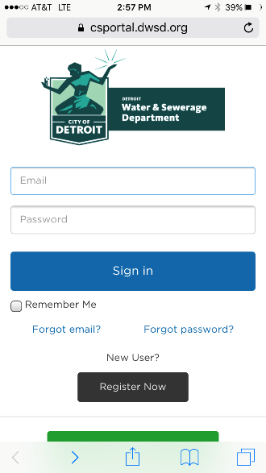
CUSTOMER CARE: Account Status
All Customers
Residential Only
Non-Residential Only
n Active customer accounts in good standing n Delinquent accounts
DWSD launched the mobile-friendly Customer Care Web Portal more than one year ago and is in the process of completing the transition of all web-based customers to the new portal from the previous web providers, including customers who were on autopay under the former system. Transactions via the web and the kiosks continue to increase monthly. Visit the portal at detroitmi.gov/paymywaterbill and see the map for the kiosks at dwsdkiosk.com.

Slide 6
CUSTOMER CARE: Transactions
Number of Transactions
Millions of Dollars
Payment Transactions by Type
Revenue Collected by Type

Slide 7
Field Services

Slide 8
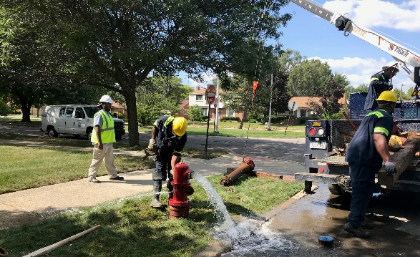
FIELD SERVICES: Fire Hydrant Maintenance
n Operating Fire Hydrants n Operating Hydrants with Issues n Non-Operating Hydrants
The Detroit Fire Department uses a mobile collector app where firefighters report on the status of each hydrant. This data integrates into DWSD’s work order system. In turn, DWSD maintenance and repair staff update the hydrant mobile app to indicate when a repair is completed.

Slide 9
FIELD SERVICES: Running Water
n Reported by Customers n Resolved within Two Days
Running water reports include water flowing on a street, issues at vacant properties, and calls by residents who see gushing or flowing water that is out of the ordinary.

Slide 10
FIELD SERVICES: Water Main Breaks
n Reported by Customers n Resolved within Four Days
DWSD has a service level agreement with contractors to have reported water main breaks repaired within four days.

Slide 11
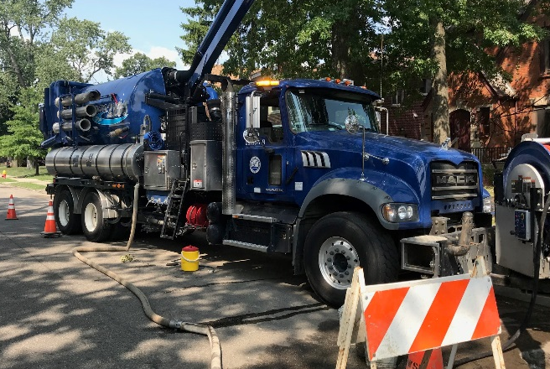
FIELD SERVICES: Catch Basin Inspection & Cleaning
The catch basin inspections and cleaning had a late start in 2018 due to weather, equipment maintenance and two large rainstorms which had DWSD crews re-assigned to water-in-the-basement complaints for two weeks on two separate occasions in the Spring.

Slide 12
Finance

Slide 13
FINANCE: Bill Collection Rate
12-Month Rolling Average Collection Rate
Every percentage increase in the collection rate above 80 percent is an additional $4-$7 million which can be applied to the maintenance and rehabilitation of the water and sewer infrastructure.

Slide 14
FINANCE: Cash Balance
$111,506,784
Water cash balance as of September 30, 2018
$81,669,178
Sewer cash balance as of September 30, 2018
As of September 30, 2018, DWSD had 235 days of cash on hand. The target is 120 days.

Slide 15
Investigations

Slide 16
INVESTIGATIONS: Results
930
[62 per month, on average]
Property addresses investigated for delinquency, possible meter tampering and no meter.
$5,616,727
Money owed to DWSD
Water theft
Unauthorized fire hydrant usage
The DWSD Revenue Recovery Unit, in collaboration with customer service/billing, has identified nearly $6 million in services owed by primarily commercial customers. They uncovered severe delinquencies, non-working meters, unauthorized use of fire hydrants, tampering with the meters, or connected to the city’s water main without a meter and/or permit. The team works closely with the DWSD collections and legal staff.

Slide 17
Human Resources

Slide 18
HUMAN RESOURCES: Detroit Residents and Hiring
Fifty-seven percent of the DWSD workforce lives in Detroit. Twelve new hires in October 2018 (nine in September).
Forty-three contract employees to augment staffing.

Slide 19
HUMAN RESOURCES: Retirement Eligible

Slide 20
HUMAN RESOURCES: Family Medical Leave Act

Slide 21
Public Affairs

Slide 22
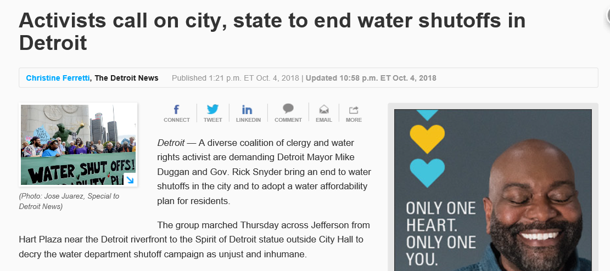
PUBLIC AFFAIRS: Positive vs. Negative News Stories
DWSD News Coverage: October 1 – October 31, 2018
This month the DWSD Public Affairs Group saw a total of 122 media stories. The majority of the coverage was on the DivDat Kiosk Network welcoming the 36th District Court. All these articles mentioned that customers may also pay their water bill at the kiosks. The second top story was workers rescued from a manhole. Many of the stories mistakenly reported the workers at a DWSD facility; the stories were later updated. The third top story was the water protest on October 4, of which DWSD coordinated a proactive response. Of the 122 stories, 5 were broadcast, 90 were print/online and 27 were radio.
PLEASE NOTE: For this metric, each story/interview published or aired is counted.

Slide 23
PUBLIC AFFAIRS: Social Media Activity
43
New Facebook Followers
7,456
Total Followers on Facebook
3,304
Engagement on Facebook
28
New Twitter Followers
1,368
Total Followers on Twitter
374
Engagement on Twitter
15
New Instagram Followers
1,025
Total Followers on Instagram
56
Engagement on Instagram
The DWSD Public Affairs Group gained 86 new followers on social media in October 2018, bringing the total number of followers to 9,849. In addition to the metrics above, Facebook saw a total of 860,400 impressions and 3,006 link clicks. The top performing post on Facebook was on October 3 about water saving tips. The post suggested using a pitcher or jug to store water in the refrigerator instead of letting the faucet run to get a cold glass of water. On this post alone, there were 15,600 impressions, 109 comments and 590 reactions. This water tip was also the top performing Twitter post (19,600 impressions, 8 responses and 7 retweets).

Slide 24
Information Technology

Slide 25
Information Technology: Application Availability
In the Informational Technology (IT) Group, the major projects underway are the transition from Great Lakes Water Authority (GLWA) IT shared services which includes new network, active director, BOX.com, print/fax services, IVR upgrade to the cloud, and GIS (Geographic Information System) to City of Detroit migration; launch of fleet management programs AssetWorks, FleetFocus and FuelFocus; CityWorks to replace WAM work order system; and Customer Care Web Portal phase two.

