Slide 1



DIRECTOR’S REPORT
October 21, 2020
detroitmi.gov/dwsd

Slide 2
CONTENTS*
Metrics by Function:
• Director’s Message 3
• Customer Care 4
• Field Services 7
• Finance 12
• Legal Services 15
• Investigations 17
• Human Resources 19
• Public Affairs 21
• Information Technology 25

Slide 3
DIRECTOR’S MESSAGE TO THE BOARD
The Michigan Supreme Court ruling on October 2 revoking Governor Gretchen Whitmer’s COVID-19 emergency orders has caused many to question whether water utilities and municipalities in Michigan will resume residential water shutoffs – the court ruling does not change the current direction of the Detroit Water and Sewerage Department (DWSD) as this official statement outlines:
In compliance with Governor Gretchen Whitmer’s Executive Order 2020-28, DWSD has restored water to every Detroiter who contacted us or Wayne Metropolitan Community Action Agency and was living in a household without water service. In cases where private plumbing and/or sewer defects prevented restoration, DWSD either utilized CARES Act funds, other funds in response to the COVID-19 Pandemic or other grant dollars to make the necessary repairs or worked with the Detroit Health Department, Detroit Housing and Revitalization Department and Detroit Land Bank Authority to find alternative housing for the family. Water service will be maintained for the duration of the state of emergency or the duration of any and all COVID-19 funding programs, whichever is later. After that time, no resident should be without water service for inability to pay their bill—all they need to do is ask for assistance. There are a multitude of programs for our residents, including the 10/30/50 Payment Plan, the Water Residential Assistance Program (WRAP), WRAP-finity (discounted bill for income-qualifying senior and permanently disabled residents), State Emergency Relief Funds, and the Detroit Community Health Corps. DWSD remains vigilant in its efforts to secure additional funding sources and programs for our residents. The recent court rulings regarding Governor Whitmer's executive powers do not affect DWSD’s actions.

Slide 4


Customer Care

Slide 5
CUSTOMER CARE: Number of Active Accounts
Active Residential Accounts Active Non-Residential Accounts
Vacant parcels, parking lots and other properties with no need for water service, receive stormwater charges only (drainage).

Slide 6
CUSTOMER CARE: Transactions
Number of Transactions
Millions of Dollars
DWSD continues to adapt during the COVID-19 Pandemic and is offering more services remotely, including contact via email at mydwsd@detroitmi.gov. DWSD is also communicating the convenient, safe ways to pay and how customers can access their account(s).

Slide 7
Field Services

Slide 8
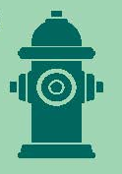
FIELD SERVICES: Fire Hydrant Maintenance
n Operating Fire Hydrants n Operating Hydrants with Issues n Non-Operating Hydrants
DWSD prioritizes fire hydrant maintenance as a key component of providing essential and exceptional service delivery led by the Maintenance & Repair Service Line in our Operations Group.

Slide 9
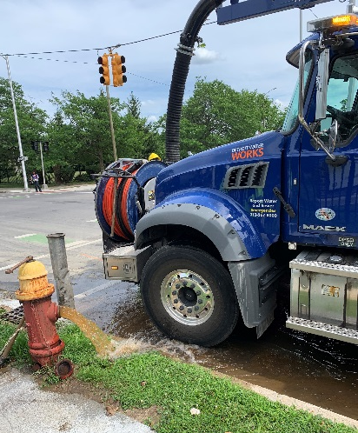
FIELD SERVICES: Running Water
n Reported by Customers n Resolved within Two Days
Complaint volume in this category has decreased over the summer. DWSD Operations continues to prioritize work orders based on level of impact, with water main repairs, street flooding and
water-in-basement complaints taking priority.

Slide 10
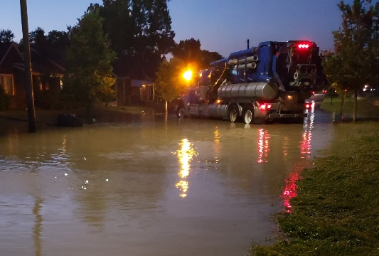
FIELD SERVICES: Water Main Breaks
n Reported by Customers n Resolved within Four Days
The number of water main breaks significantly rose in June and July and began to decline in August and into September. The early to mid-summer weeks had several days of above 90-degree weather. When there is dramatic change in temperature --- hot or cold --- the ground can shift and cause tension on the pipes potentially resulting in water main breaks.

Slide 11
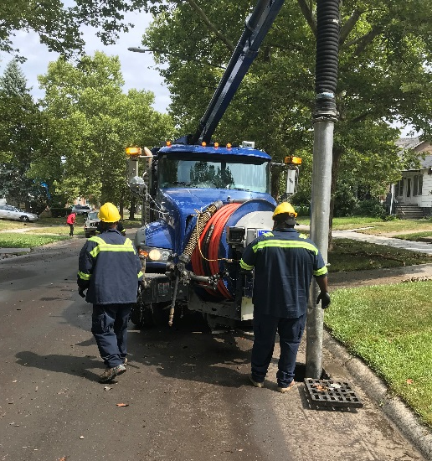
FIELD SERVICES: Catch Basin Inspection & Cleaning
The catch basin inspection and cleaning program launched in 2017. DWSD crews have touched more than 29,500 of the estimated 90,000 catch basins. The goal was 30,000
by August 2020, which is expected to be achieved before winter (delayed due to pandemic stay-at-home orders in March-May and the pandemic furloughs).

Slide 12
Finance

Slide 13
FINANCE: Bill Collection Rate
3-Month Rolling Average Collection Rate
n Water Revenue n Sewer Revenue
The Finance data is provided based on the most recent month reported to the Finance Committee of the
Board of Water Commissioners.

Slide 14
FINANCE: Cash Balance
$176,845,724
Water cash balance as of
June 30, 2020
$120,089,202
Sewer cash balance as of
June 30, 2020
The Finance data is provided based on the most recent month reported to the Finance Committee of the
Board of Water Commissioners.

Slide 15

Legal Services

Slide 16
LEGAL: Claims, Hearings and Cases
24
Cases handled by
in-house staff
10
Cases handled by
outside counsel
0
Lawsuits dismissed
5
Lawsuits dismissed in FY2020
Postponed
Dispute hearings
Postponed
Number of cases
DWSD prevailed
0
Property damage claims
$0
Amount in property
damage claims
$0
Amount of total claims recommended to be paid
Postponed
Amount in dispute
Postponed
Credited to customers based on hearing outcomes
Postponed
Owed to DWSD after hearings
DWSD uses a mix of in-house and contracted legal counsel to handle damage claims, civil action for commercial delinquencies and lawsuits filed against the department.
Due to the COVID-19 Pandemic and Governor Gretchen Whitmer’s emergency orders, the legal proceedings have been postponed.

Slide 17
Investigations

Slide 18
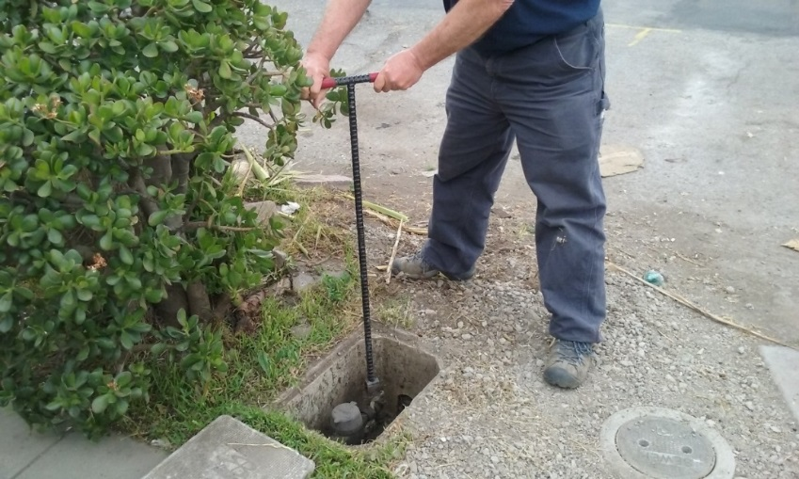
INVESTIGATIONS: Results
Money Owed to DWSD identified by Investigators
$1,037,334
Total since July 1, 2020
$118,096
Back billed
$491,620
Future owed in 12 months
$427,618
Water loss
124
Parcels investigated for delinquency, possible meter tampering and no meter since July 1, 2020
Revenue Identified Since Investigation Unit Began
$14,170,353
Total since August 14, 2017
Since August 2017, the unit, in collaboration with customer service/billing, has identified more than $14 million in services owed by primarily commercial customers. They uncover severe delinquencies, non-working meters, unauthorized use of fire hydrants, meter tampering, or connected to the city’s water main without a meter and/or permit. The unit works closely with the Finance/Collections and Legal Groups.

Slide 19
Human Resources

Slide 20
HUMAN RESOURCES: Detroit Residents and Hiring
Fifty-five percent of the DWSD workforce lives in Detroit.*
*DWSD and the City of Detroit do not require residency to be employed, per Michigan law.

Slide 21
Public Affairs

Slide 22

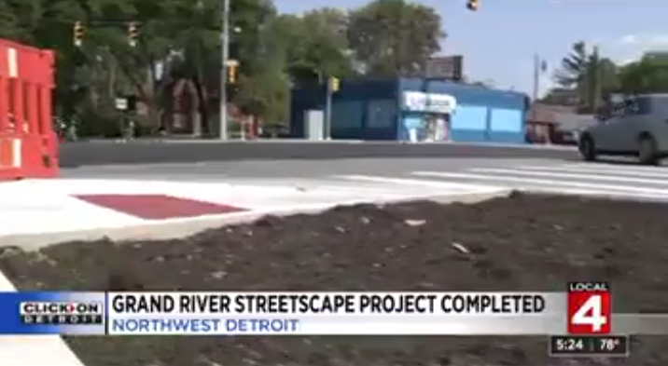
PUBLIC AFFAIRS: Good News
This month, the team garnered 1 positive pitched news story. The story was about the combined streetscape project with MDOT on Grand River being completed. The DWSD portion included 5.2 miles of water main replacement and 55 lead service lines were replaced.
PLEASE NOTE: For this metric, news stories are only counted once per topic, not by the number of media outlets picking up the story.

Slide 23
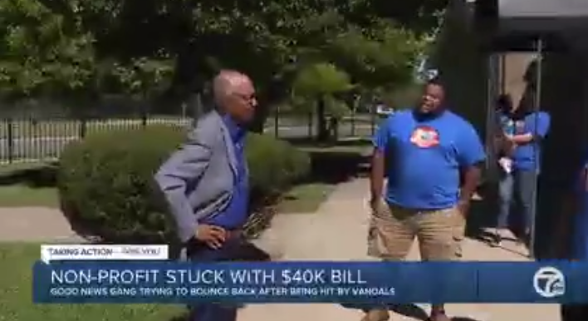
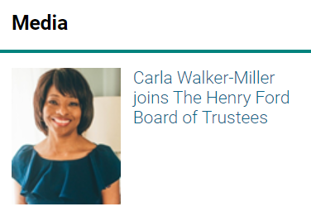
PUBLIC AFFAIRS: Positive vs. Negative News Stories
DWSD News Coverage: September 1 – September 30, 2020
In September, the DWSD Public Affairs team saw a total of 127 media stories. The positive stories featured Director Brown providing guidance on how non-profits (like the Good News Gang) can apply for CARES Act funding and DWSD & MDOT’s Grand River streetscape project. All the neutral stories were about Carla Walker-Miller, Founder & CEO of
Walker-Miller Energy Services being elected to serve a three-year term as a member of the Board of Trustees at The Henry Ford. Walker-Miller founded the Water Access Volunteer Effort (WAVE) Fund in 2003, while serving as a Commissioner for DWSD.
PLEASE NOTE: For this metric, each story/interview published or aired is counted.

Slide 24



PUBLIC AFFAIRS: Social Media Activity
8
New Facebook Followers
8,573
Total Followers on Facebook
3,201
Engagement on Facebook
-8
New Twitter Followers
1,690
Total Followers on Twitter
147
Engagement on Twitter
3
New Instagram Followers
1,476
Total Followers on Instagram
46
Engagement on Instagram
The DWSD Public Affairs team gained 11 new followers (also lost 8 followers) on social media in September 2020, bringing the total number of followers to 11,739. In addition to the metrics above, Facebook saw a total of 299K impressions and 1,895 link clicks for the month. The top performing post on Facebook (Sept. 24) and Instagram (Sept. 25) was the post congratulating Director Brown being named dBusiness’ Top 500 most powerful business leaders in Metro Detroit. The Facebook post had 89 total engagements, 20 reactions, 17 comments and 8 shares. The top Twitter post was on Sept. 21 about the easy and convenient ways to pay.

Slide 25
Information Technology

Slide 26
TECHNOLOGY: Top Ten Projects Scorecard
A+

Slide 27
TECHNOLOGY: Application Availability
100% SYSTEMS AVAILABILITY
99.9% = TARGET
Systems Availability
Last 90 Days
Systems Availability
Last 90 Days

