Slide 1
DIRECTOR’S REPORT
October 17, 2018
detroitmi.gov/dwsd

Slide 2
CONTENTS*
Director’s Message for September 2018 3
Metrics by Function:
• Customer Care 4
• Field Services 7
• Finance 12
• Legal Services 15
• Investigations 17
• Human Resources 19
• Public Affairs 23
• Information Technology 27

Slide 3
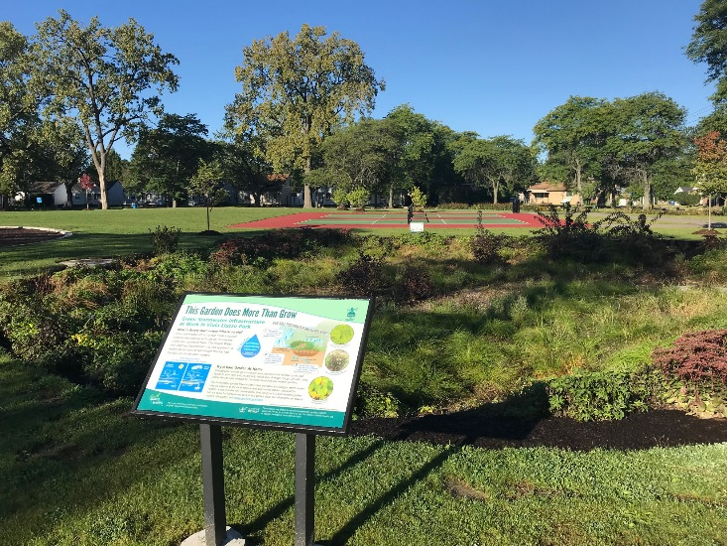
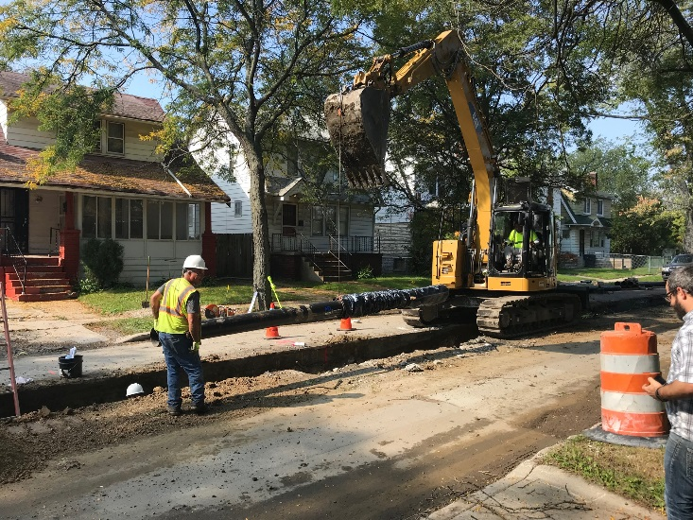
DIRECTOR’S MESSAGE TO THE BOARD
In the past five years, the Detroit Water and Sewerage Department (DWSD) has completed or is constructing 16 Green Stormwater Infrastructure (GSI) projects to manage 61 million gallons of stormwater annually on 118 acres, investing $23.47 million.
Many of the projects are at city parks and Detroit Land Bank Authority property.
On September 29, the City of Detroit Parks and Recreation Department, DWSD and the Viola Liuzzo Park Association cut the ribbon on the revitalized Liuzzo Park that included a $1 million investment in park improvements, including new equipment and a walking path, and three bioretention gardens.
The year 2005, leading up to Super Bowl XL in Detroit, was the last time there were nearly 30 miles of water main replaced – this year DWSD is on track to replace nearly 30 miles of water main at 26 projects.
The effort includes robust customer notifications and updates, including community meetings right on the block where the work is being done.
The water main replacement includes the option for residents to give DWSD the authority to replace their lead service line, if they have one, with a new copper pipe (more than 150 agreements have been signed).
Eleven non-profit organizations are currently engaged in outreach activities on behalf of DWSD and received nearly $20,000 in bill credits to date based on their efforts.
Organizations are hosting water assistance fairs with DWSD Customer Assurance Specialist Team (CAST) members, and passing out DWSD literature on customer assistance programs during their community events, such as the food program at Historic Little Rock Baptist Church.

Slide 4
Customer Care

Slide 5
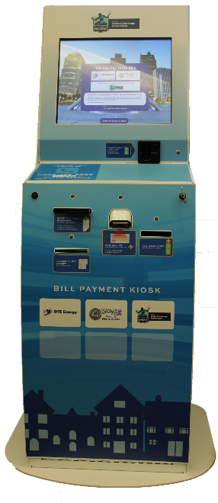
CUSTOMER CARE: Account Status
All Customers
Residential Only
Non-Residential Only
n Active customer accounts in good standing n Delinquent accounts
DWSD customers may conveniently pay their bill with cash, personal check, and credit/debit card at 38 locations. The online map at www.detroitmi.gov/dwsdkiosk is updated by DivDat as kiosks are added or moved to different locations. Customers may also pay, schedule a payment, enroll in autopay and enter a payment arrangement on the Customer Care Portal at www.detroitmi.gov/paymywaterbill.

Slide 6
CUSTOMER CARE: Transactions
Number of Transactions
Millions of Dollars
Payment Transactions by Type
Revenue Collected by Type

Slide 7
Field Services

Slide 8
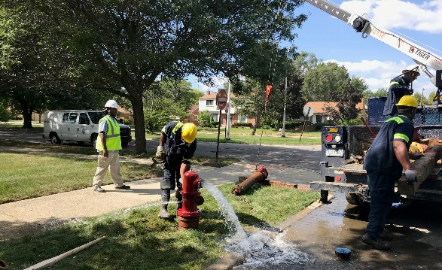
FIELD SERVICES: Fire Hydrant Maintenance
n Operating Fire Hydrants n Operating Hydrants with Issues n Non-Operating Hydrants
The Detroit Fire Department uses a mobile collector app where firefighters report on the status of each hydrant. This data integrates into DWSD’s work order system. In turn, DWSD maintenance and repair staff update the hydrant mobile app to indicate when a repair is completed.

Slide 9
FIELD SERVICES: Running Water
n Reported by Customers n Resolved within Two Days
Running water reports include water flowing on a street, issues at vacant properties, and calls by residents who see gushing or flowing water that is out of the ordinary.

Slide 10
FIELD SERVICES: Water Main Breaks
n Reported by Customers n Resolved within Four Days
DWSD has a service level agreement with contractors to have reported water main breaks repaired within four days.

Slide 11
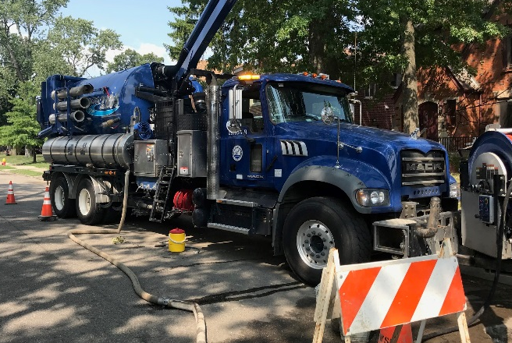
FIELD SERVICES: Catch Basin Inspection & Cleaning
The catch basin inspections and cleaning had a late start in 2018 due to weather, equipment maintenance and two large rainstorms which had DWSD crews re-assigned to water-in-the-basement complaints for two weeks on two separate occasions in the Spring.

Slide 12
Finance

Slide 13
FINANCE: Bill Collection Rate
Water Service Collection Rate Sewer Service Collection Rate
Every percentage increase in the collection rate above 80 percent is an additional $4-$7 million which can be applied to the maintenance and rehabilitation of the water and sewer infrastructure.
The data in the chart is based upon the 330-360 day collection rate.

Slide 14
FINANCE: Cash Balance
$112,167,921
Water cash balance as of August 31, 2018
$82,032,996
Sewer cash balance as of August 31, 2018
As of July 31, 2018, DWSD had 188 days of cash on hand. The target is 100 days.

Slide 15
Legal Services

Slide 16
LEGAL: Claims, Hearings and Cases
21
Property damage claims
7
Basement backup damage claims appeals
8
Dispute hearings
2
Number of cases DWSD prevailed
17
Cases handled by in-house staff
9
Cases handled by outside counsel
$129,505
Amount in property damage claims
$44,621
Basement backup damage claim appeals
$174,126 Total claims in September 2018
$17,210
Amount in dispute
$2,208
Credited to customers based on hearing outcomes
$15,002
Owed to DWSD after hearings
DWSD uses a mix of in-house and contracted legal counsel to handle damage claims, civil action for commercial delinquencies and lawsuits filed against the department.
Customers who have bill disputes may request a hearing at the City of Detroit Department of Appeals and Hearings. The cases are heard by an administrative hearing officer, which will restart in October after a recently vacated position is filled.

Slide 17
Investigations

Slide 18
INVESTIGATIONS: Results
873
[62 per month, on average]
Property addresses investigated for delinquency, possible meter tampering and no meter.
$5,169,687
Money owed to DWSD
Water theft
Unauthorized fire hydrant usage
The DWSD Revenue Recovery Unit, in collaboration with customer service/billing, has identified more than $5 million in services owed by primarily commercial customers. They uncovered severe delinquencies, non-working meters, unauthorized use of fire hydrants, tampering with the meters, or connected to the city’s water main without a meter or permit. The team works closely with the DWSD collections and legal staff.

Slide 19
Human Resources

Slide 20
HUMAN RESOURCES: Detroit Residents and Hiring
Fifty-seven percent of the DWSD workforce lives in Detroit. Nine new hires in September 2018 (two in August).
Forty-three contract employees to augment staffing, plus six returning citizens working on the hydrant painting project.

Slide 21
HUMAN RESOURCES: Retirement Eligible

Slide 22
HUMAN RESOURCES: Family Medical Leave Act

Slide 23
Public Affairs

Slide 24
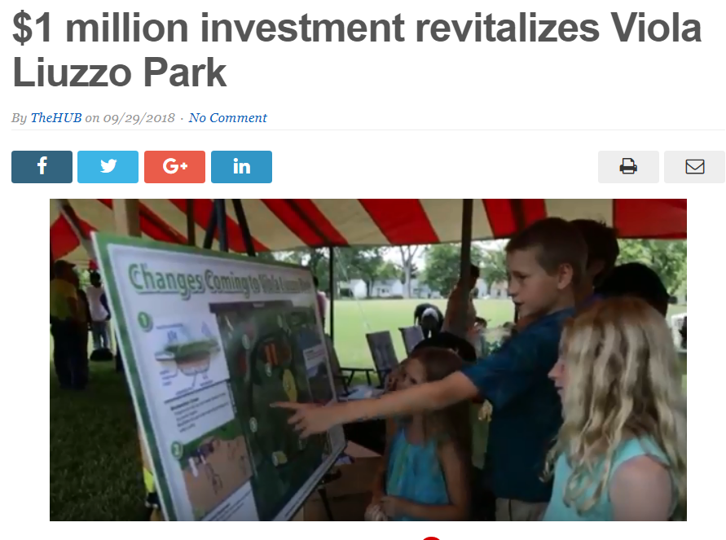
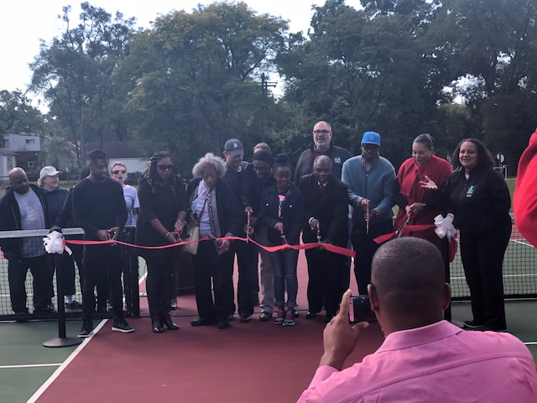
PUBLIC AFFAIRS: Good News
This month, the team garnered 1 positive news story. The story was about the GSI investment in and ribbon cutting of Viola Liuzzo Park.
PLEASE NOTE: For this metric, news stories are only counted once per topic, not by the number of media outlets picking up the story.

Slide 25
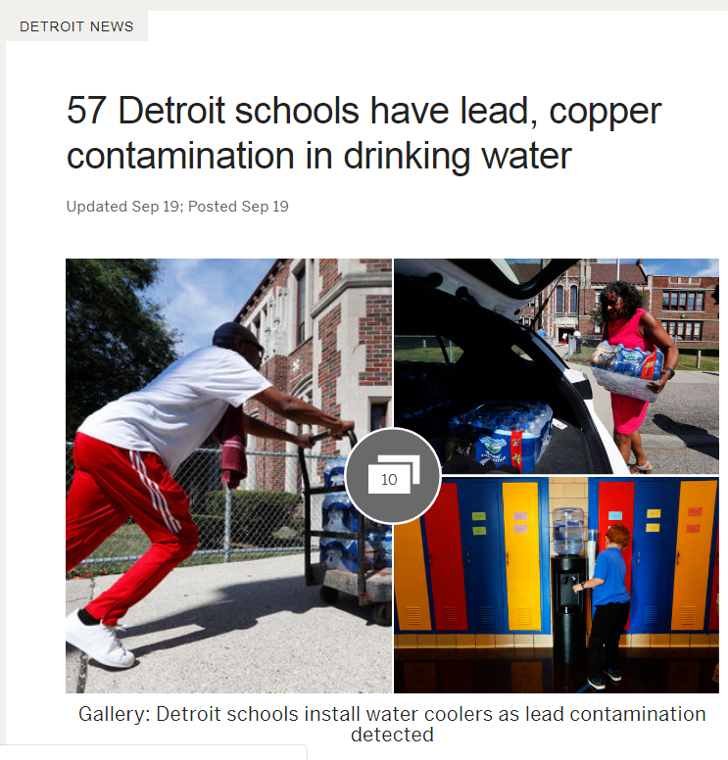
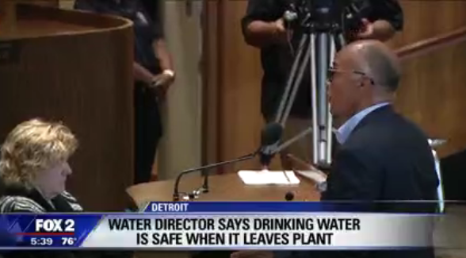
PUBLIC AFFAIRS: Positive vs. Negative News Stories
DWSD News Coverage: September 1 – September 30, 2018
This month the DWSD Public Affairs team saw a total of 245 media stories. The majority of the coverage was regarding the water shutoff at all Detroit Public School Community District schools. Many of the stories were counted as neutral because they noted the water treated by GLWA and delivered by DWSD was safe and that the issue was because of aging plumbing in the schools. Of the 245 stories, 15 were broadcast, 219 were print/online and 11 were radio.
PLEASE NOTE: For this metric, each story/interview published or aired is counted.

Slide 26
PUBLIC AFFAIRS: Social Media Activity
95
New Facebook Followers
7,413
Total Followers on Facebook
4,485
Engagement on Facebook
28
New Twitter Followers
1,340
Total Followers on Twitter
506
Engagement on Twitter
8
New Instagram Followers
1,010
Total Followers on Instagram
13
Engagement on Instagram
The DWSD Public Affairs team gained 131 new followers on social media in September 2018, bringing the total number of followers to 9,763. In addition to the metrics above, Facebook saw a total of 712,400 impressions and 3,699 link clicks. The top performing post on Facebook was on September 5 about DWSD’s efforts to replace broken fire hydrants. On this post alone, there were 13,600 impressions, 52 comments and 559 reactions. The top performing Twitter post was on September 12 was about DWSD’s Board of Water Commissioners meeting (45,600 impressions, 23 responses and 23 retweets.).

Slide 27
Information Technology

Slide 28
IT: Customer Service, Field Services and Finance Software Availability
In August, there were 206 outage hours mostly related to pay-by-phone (IVR) being unavailable, and a billing data pull glitch causing an auto-pay error. IT has been working with Public Affairs to communicate with the impacted customers.

