Slide 1
DIRECTOR’S REPORT
September 16, 2020
detroitmi.gov/dwsd

Slide 2
CONTENTS*
Metrics by Function:
• Director’s Message 3
• Customer Care 4
• Field Services 7
• Finance 12
• Legal Services 16
• Investigations 18
• Human Resources 20
• Public Affairs 23
• Information Technology 26

Slide 3
DIRECTOR’S MESSAGE TO THE BOARD
The Detroit Water and Sewerage Department (DWSD), through several funding sources and in partnership with Wayne Metropolitan Community Action Agency, has assisted Detroiters with water restoration, plumbing repairs and bill payment during the COVID-19 Pandemic.
This chart displays the spent or committed dollars and how the funds were utilized.
DWSD and Wayne Metro are collaborating on additional programs using state resources, including Michigan Public Act 123 of 2020.
DWSD is producing a series of videos updating the public on construction projects and the Green Stormwater Infrastructure (GSI) Program.
Three videos have been produced on the Oakman Boulevard GSI and water main replacement project.
An update on neighborhood-wide water and sewer upgrades in Cornerstone Village and North Rosedale Park is in production.
An update on the completed and in-progress DWSD projects, and the collaborative, integrative approach to project design.
A virtual GSI tour of the public and private GSI projects on the Detroit Stormwater Hub is in production.
Visit the DWSD YouTube Channel at: youtube.com/c/DWSDwater.
Leveraging Federal and State Funds to Assist Detroit Households
Funding Source | Amount | Purpose | Outcome
EGLE & Kresge Foundation | $650,000 | COVID-19 Water Restart | Contracted plumbing services to restore water in occupied houses with plumbing issues; DWSD restored services to 1,275 occupied houses; 400 houses needed significant repairs
CARES Act | $500,000 | Plumbing repairs | Plumbing repairs to households identified by Wayne Metro
CARES Act | $2,500,000 | Bill assistance | $250 credit to approximately 10,000 income-eligible DWSD customers, including 3,000 currently enrolled in WRAP, to help households economically impacted by COVID-19

Slide 4
Customer Care

Slide 5
CUSTOMER CARE: Number of Active Accounts
Active Residential Accounts Active Non-Residential Accounts
Vacant parcels, parking lots and other properties with no need for water service, receive stormwater charges only (drainage).

Slide 6
CUSTOMER CARE: Transactions
Number of Transactions
Millions of Dollars
DWSD continues to adapt during the COVID-19 Pandemic and is offering more services remotely, including contact via email at mydwsd@detroitmi.gov. DWSD is also communicating the convenient, safe ways to pay and how customers can access their account(s).

Slide 7
Field Services

Slide 8
FIELD SERVICES: Fire Hydrant Maintenance
n Operating Fire Hydrants n Operating Hydrants with Issues n Non-Operating Hydrants
DWSD prioritizes fire hydrant maintenance as a key component of providing essential and exceptional service delivery led by the Maintenance & Repair Service Line in our Operations Group.

Slide 9
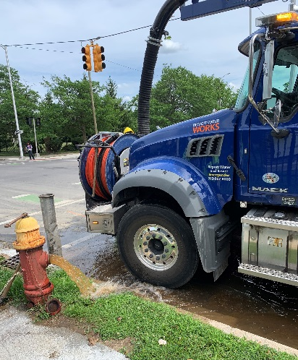
FIELD SERVICES: Running Water
n Reported by Customers n Resolved within Two Days
Complaint volume in this category has decreased over the summer. DWSD Operations continues to prioritize work orders based on level of impact, with water main repairs, street flooding and water-in-basement complaints taking priority.

Slide 10
FIELD SERVICES: Water Main Breaks
n Reported by Customers n Resolved within Four Days
The number of water main breaks significantly rose in June and July and began to decline in August. The early to mid-summer weeks had several days of above 90-degree weather. When there is dramatic change in temperature --- hot or cold --- the ground can shift and cause tension on the pipes potentially resulting in water main breaks.

Slide 11
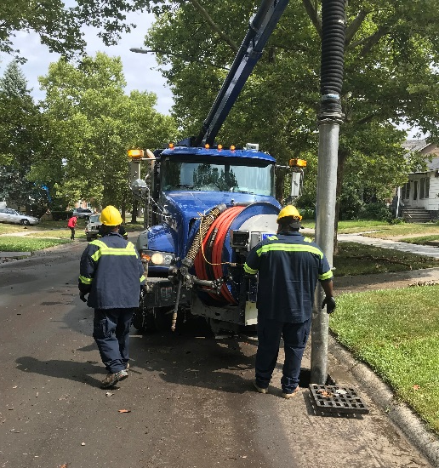
FIELD SERVICES: Catch Basin Inspection & Cleaning
The catch basin inspection and cleaning program launched in 2017. DWSD crews have touched more than 29,000 of the estimated 90,000 catch basins. The goal was 30,000 by August 2020, which is expected to be achieved this calendar year (delayed due to pandemic stay-at-home orders in March-May and the pandemic furloughs).

Slide 12
Finance

Slide 13
FINANCE: Bill Collection Rate
Until completion of the audit, the Finance Group is not providing updated data for this report. This same data shown here was shared in the July 2020 Director’s Metrics.

Slide 14
FINANCE: Bill Collection Rate
3-Month Rolling Average Collection Rate for All Accounts
Until completion of the audit, the Finance Group is not providing updated data for this report. This same data shown here was shared in the July 2020 Director’s Metrics.

Slide 15
FINANCE: Cash Balance
$179,969,412
Water cash balance as of May 31, 2020
$124,664,088
Sewer cash balance as of May 31, 2020
The operating cash days-on-hand as of May 31, 2020 is 143 days. The target is 120 days.
Until completion of the audit, the Finance Group is not providing updated data for this report. This same data shown here was shared in the July 2020 Director’s Metrics.

Slide 16
Legal Services

Slide 17
LEGAL: Claims, Hearings and Cases
22
Cases handled by in-house staff
10
Cases handled by outside counsel
0
Lawsuits dismissed
5
Lawsuits dismissed in FY2020
Postponed
Dispute hearings
Postponed
Number of cases DWSD prevailed
0
Property damage claims
$0
Amount in property damage claims
$0
Amount of total claims recommended to be paid
Postponed
Amount in dispute
Postponed
Credited to customers based on hearing outcomes
Postponed
Owed to DWSD after hearings
DWSD uses a mix of in-house and contracted legal counsel to handle damage claims, civil action for commercial delinquencies and lawsuits filed against the department.
Due to the COVID-19 Pandemic and Governor Gretchen Whitmer’s emergency orders, the legal proceedings have been postponed.

Slide 18
Investigations

Slide 19
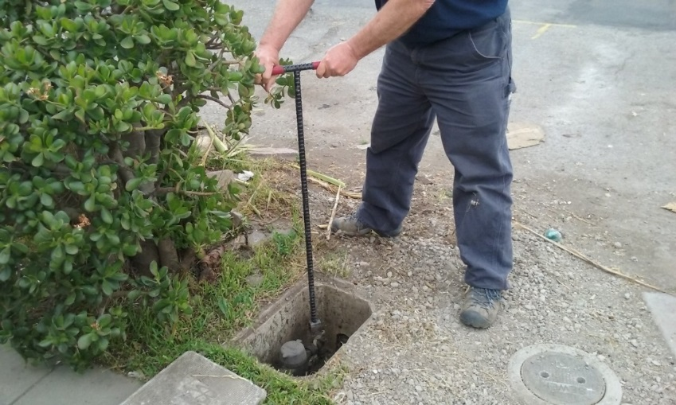
INVESTIGATIONS: Results
Money Owed to DWSD identified by Investigators
$514,994
Total since July 1, 2020
$40,892
Back billed
$141,952
Future owed in 12 months
$332,150
Water loss
115
Parcels investigated for delinquency, possible meter tampering and no meter since July 1, 2020
Revenue Identified Since Investigation Unit Began
$13,648,013
Total since August 14, 2017
Since August 2017, the unit, in collaboration with customer service/billing, has identified nearly $13 million in services owed by primarily commercial customers. They uncover severe delinquencies, non-working meters, unauthorized use of fire hydrants, meter tampering, or connected to the city’s water main without a meter and/or permit. The unit works closely with the Finance/Collections and Legal Groups.

Slide 20
Human Resources

Slide 21
HUMAN RESOURCES: Detroit Residents and Hiring
Fifty-six percent of the DWSD workforce lives in Detroit.*
*DWSD and the City of Detroit do not require residency to be employed, per Michigan law.

Slide 22
HUMAN RESOURCES: Retirement Eligible
Retirement Criteria | Total
30 YOS/Any Age (Legacy and Hybrid) | 59
10 YOS/60 years old (Legacy) | 46
10 YOS/62 years old (Hybrid) | 0
8 YOS/65 years old (Legacy) | 2
TOTAL | 107
LEGACY = HIRED BEFORE 2014
HYBRID = HIRED AFTER JANUARY 1, 2014
With a current population of 552 employees, there are 107 DWSD employees eligible for retirement.

Slide 23
Public Affairs

Slide 24
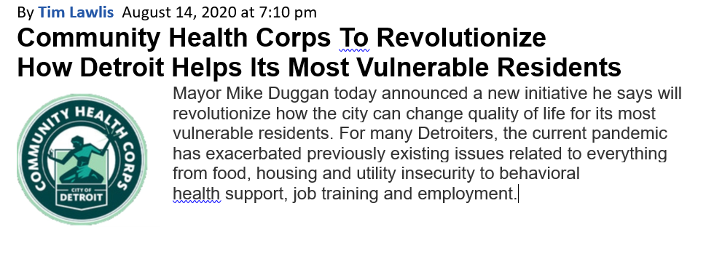
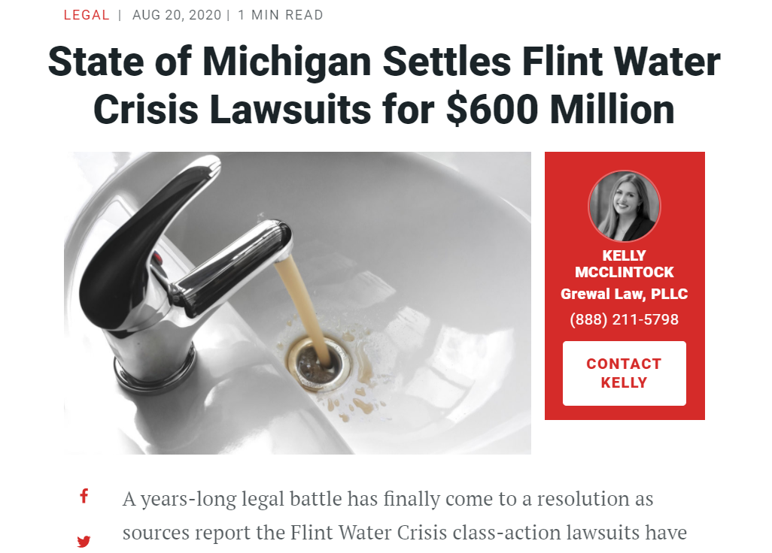
PUBLIC AFFAIRS: Positive vs. Negative News Stories
DWSD News Coverage: August 1 – August 31, 2020
In August, the DWSD Public Affairs team saw a total of 45 media stories. Majority of all the stories were neutral and were about Flint’s $600 million water settlement. DWSD was only mentioned by name as the original water provider. The other neutral story was about DWSD’s COVID-19 Restart Water Plan. There was 1 negative water shut-off story. The positive stories focused on the City’s new Community Health Corps. DWSD was mentioned as a partner of the new Corps.
PLEASE NOTE: For this metric, each story/interview published or aired is counted.

Slide 25
PUBLIC AFFAIRS: Social Media Activity
20
New Facebook Followers
8,562
Total Followers on Facebook
5,846
Engagement on Facebook
1
New Twitter Followers
1,698
Total Followers on Twitter
308
Engagement on Twitter
10
New Instagram Followers
1,473
Total Followers on Instagram
25
Engagement on Instagram
The DWSD Public Affairs team gained 31 new followers on social media in August 2020, bringing the total number of followers to 11,733. In addition to the metrics above, Facebook saw a total of 504.8K impressions and 3,887 link clicks for the month. The top performing post on Facebook was on August 3 when DWSD posted about all the convenient ways to pay while the Customer Care Centers remain closed due to COVID-19. The top performing post on Twitter was on August 4 regarding DWSD’s restorations progress. The post had 66 total engagements. The top Instagram post was on August 27, highlighting a water saving tip.

Slide 26
Information Technology

Slide 27
TECHNOLOGY: Top Ten Projects Scorecard
Exec. Priority Score | Sorted by Adjusted Priority Score | PM | Total Investment | Start Date | Target Date | Status/ Issues | Current Phase
1 | Customer Service-7:enQuestaLink (ServiceLink Replacement) | C. Penoza | $ 500,000 | 3/1/2020 | 10/31/2020 | PM Back. Moving back on track. | Procurement
2 | Customer Service-2:enQuesta 6.0 Upgrade | E Taiariol | $ 1,400,000 | 3/1/2020 | 5/1/2022 | Re-working the plan with S&S to reflect COVID-19 and remote resource constraints | Active Design
3 | Operations (M&R, MTR OPS,Fleet)-1:CityWorks | C. Penoza | $ 970,000 | 7/1/2018 | 10/31/2020 | PM Back. Moving back on track. | Active Implementation
4 | Administrative and Compliance-1:GLWA Separation - Network (Not WiFi) | R Burke | $ 1,000,000 | 7/1/2018 | 3/31/2021 | Hardware 95% complete, deployment delayed due to COVID-19 | Active Implementation
5 | Administrative and Compliance-2:GLWA Separation - Computers / Active Directory | R Burke | $ 300,000 | 7/1/2018 | 3/31/2021 | Currently testing applications on the new network, deployment delayed due to COVID-19 impacts on schedule | Active Design
6 | Customer Service-1:IVR / Call Center Replacement | G Burrell | $ 800,000 | 6/1/2020 | 3/31/2021 | Reviewing results from call center demos. Should have decision by October. | Procurement
7 | Contactless Customer Service Transformation | C. Penoza | $ 300,000 | 6/1/2020 | 6/30/2021 | Mapping out critical business processes; selected CityInsight to move forward with design and implementation on Customer Portal | Active Design
8 | Administrative and Compliance-3:GLWA Separation - Phones & WiFi | R Burke | $ 250,000 | 10/1/2020 | 6/30/2021 | Architectural design, complete. Requisition in progress for hardware. COVID-19 related delays. | Active Design
9 | eSignature Standard for Contracts and Forms | G Burrell | $ 300,000 | 7/1/2020 | 6/30/2021 | On track. Working on developing workflows for first set of documents | Active Kick-Off
10 | Operations (M&R, MTR OPS,Fleet)-3:GPS/AVL For Vehicles | C. Penoza | $ 90,000 | 1/7/2019 | 10/31/2020 | PM Back. Moving back on track. | Procurement
A+

Slide 28
TECHNOLOGY: Application Availability
99.91% SYSTEMS AVAILABILITY
99.9% = TARGET
Systems Availability
Last 90 Days
Tickets Created 586 | Tickets Closed 523 | Backlog 63 | SLA Compliance 80%
Service Desk Performance
A+

