Slide 1
DIRECTOR’S REPORT
July 18, 2018
detroitmi.gov/dwsd

Slide 2
CONTENTS*
Director’s Message for June 2018 3
Metrics by Function:
• Customer Care 4
• Field Services 7
• Finance 12
• Legal Services 15
• Investigations 17
• Human Resources 19
• Public Affairs 23
• Information Technology 27

Slide 3
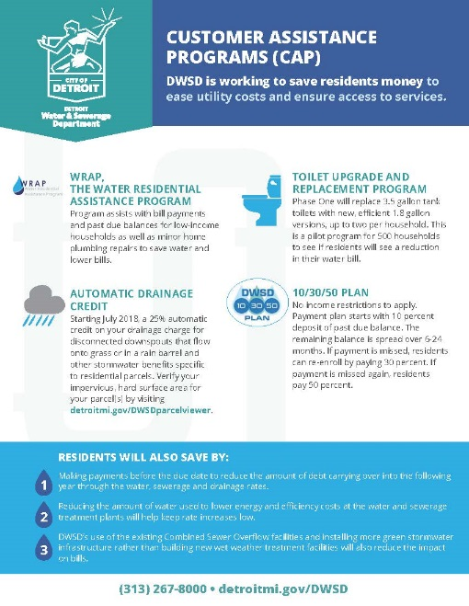
DIRECTOR’S MESSAGE TO THE BOARD
The Detroit Water and Sewerage Department (DWSD) is conducting preventative maintenance pilots in specific areas of the city.
The purpose is to identify potential water main breaks and blind leaks, including scheduling the repairs if an issue is uncovered in the pilot area.
Work is conducted during 12 a.m. to 6 a.m. to limit disruption to customers.
The first pilot area was Seven Mile to Eight Mile between Five Points and Lahser.
Residents and businesses were notified in advance with a flier placed on their front door.
Several construction projects will occur this summer and are currently in progress to replace water mains and renew the sewer system.
Twenty-three projects scheduled this year, including on West Outer Drive.
Customers notified in advance with a mailed letter as well as a door hanger.
Residents are provided filtered water pitchers as a precautionary measure.
The WS-698 contract includes the opportunity for homes with lead service lines to have the full line replaced at DWSD’s cost as part of a pilot program, with property owner permission.
The Capital Improvement Program Management Office will begin water and sewer assessments in July in Brightmoor, Miller Grove, Minock Park, Riverdale and Rosedale Park.
DWSD continues to partner with organizations in the community to reach residents who face difficulty in maintaining their water service.
Since January, 2,756 residents have received one-on-one help during assistance fairs at places of worship and community centers.
The catch basin inspection and cleaning program that launched last year, and is one of the ten points in Mayor Mike Duggan’s neighborhood plan, is full steam ahead after a late spring launch due to weather conditions.
As of May 31, 9.454 catch basins have been inspected and cleaned since the launch last year.
This is a component of the sewer rehabilitation program.

Slide 4
Customer Care

Slide 5
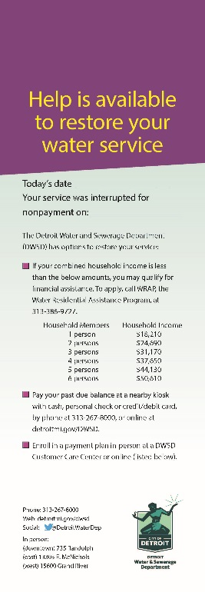
CUSTOMER CARE: Account Status
All Customers
Residential Only
Non-Residential Only
n Active customer accounts in good standing n Delinquent accounts
DWSD has created an additional customer communication. Residential households that have their service interrupted for nonpayment – after receiving three previous notices including the seven-day door hanger – are now receiving a door hanger that lists programs available to help them restore their water service.
The advertising program to let residents know about the assistance available, through billboards and DDOT bus posters, that began in April will continue through August. The week of June 18, DWSD’s new radio commercial informs Detroiters about the change to the drainage charge and this summer’s construction projects to rehabilitate the water and sewer system.

Slide 6
CUSTOMER CARE: Transactions
Number of Transactions
Millions of Dollars
Payment Transactions by Type
Total Customer Visits for May 2018
4,370
Main Office
4,727
Eastside
10,289
Westside
Revenue Collected by Type

Slide 7
Field Services

Slide 8
FIELD SERVICES: Fire Hydrant Maintenance
n Operating Fire Hydrants n Operating Hydrants with Issues n Non-Operating Hydrants
The Detroit Fire Department uses a mobile collector app whereby firefighters report on the status of each hydrant. This data integrates into DWSD’s work order system.

Slide 9
FIELD SERVICES: Running Water
n Reported by Customers n Resolved within Two Days
Running water reports include water flowing on a street, issues at vacant properties and calls by residents who see gushing or flowing water that is out of the ordinary.

Slide 10
FIELD SERVICES: Water Main Breaks
n Reported by Customers n Resolved within Four Days
DWSD has a service level agreement with contractors to have reported water main breaks repaired within four days.

Slide 11
FIELD SERVICES: Catch Basin Inspection & Cleaning
The catch basin inspections and cleaning had a late start in 2018 due to weather, equipment maintenance and two large rainstorms which had DWSD crews re-assigned to water-in-the-basement complaints for two weeks at a time.

Slide 12
Finance

Slide 13
FINANCE: Bill Collection Rate
Water Service Collection Rate Sewer Service Collection Rate
Every percentage increase in the collection rate above 80 percent is an additional $4 million which can be applied to the maintenance and rehabilitation of the water and sewer infrastructure.
The data in the chart is based upon the 330-360 day collection rate.

Slide 14
FINANCE: Cash Balance
$99,676,554
Water cash balance as of April 30, 2018
$59,900,548
Sewer cash balance as of April 30, 2018
As of April 30, 2018, DWSD had 134.23 days of cash on hand. The target is 100 days.

Slide 15
Legal Services

Slide 16
LEGAL: Claims, Hearings and Cases
16
Property damage claims
0
Basement backup damage claims appeals
16
Dispute hearings
8
Number of cases DWSD prevailed
17
Cases handled by in-house staff
5
Cases handled by outside counsel
$102,358
Amount in property damage claims
$0
Basement backup damage claim appeals
$102,358 Total claims in April 2018
$14,889
Amount in dispute
$4,157
Credited to customers based on hearing outcomes
$10,732
Owed to DWSD after hearings
DWSD uses a mix of in-house and contracted legal counsel to handle damage claims, civil action for commercial delinquencies and lawsuits filed against the department.
Customers who have disputes for their bill may request a hearing at the City of Detroit Department of Appeals and Hearings. The cases are heard by an administrative hearing officer.

Slide 17
Investigations

Slide 18
INVESTIGATIONS: Results
822
(74 per month, on average]
Property addresses investigated for delinquency, possible meter tampering and no meter.
$4,331,204
Money owed to DWSD
Water theft
Unauthorized fire hydrant usage
The DWSD Revenue Recovery Unit, in collaboration with customer service/billing, has identified more than $4 million in services owed by primarily commercial customers. They uncovered severe delinquencies, non-working meters, unauthorized use of fire hydrants, tampering with the meters, or connected to the city’s water main without a meter or permit. The team works closely with the DWSD collections and legal staff.

Slide 19
Human Resources

Slide 20
HUMAN RESOURCES: Detroit Residents and Hiring
Fifty-eight percent of the total DWSD workforce lives in Detroit. Eight new hires in May 2018.
Leadership development training was conducted for all managers and supervisors. There were a total of 39 participants in new training courses that included workplace sensitivity.

Slide 21
HUMAN RESOURCES: Retirement Eligible
DWSD
Employees
Total Eligible
for
Retirement
25+ Years of
Service
60+ Years Old
60+ Years Old &
10 or More Years of Service

Slide 22
HUMAN RESOURCES: Family Medical Leave Act
Applications
Timeframe Request

Slide 23
Public Affairs

Slide 24
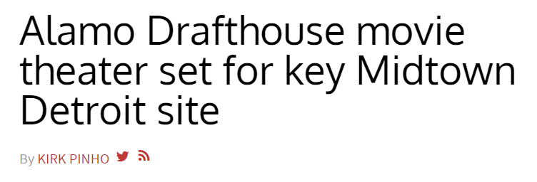
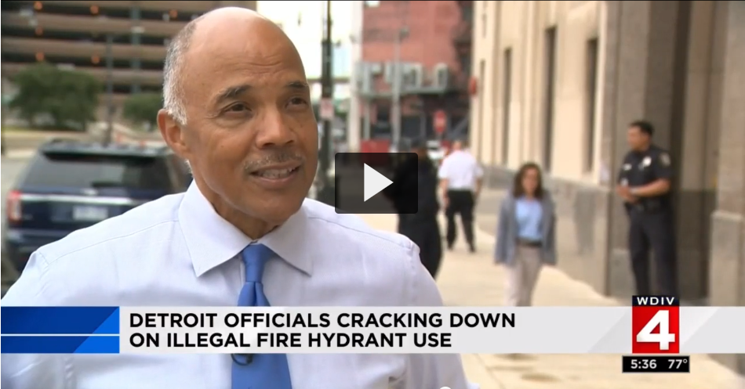
PUBLIC AFFAIRS: Good News
This month, the team garnered 3 positive news stories – and met the fiscal year 2018 goal! The stories included plans to open a Midtown movie theater, due to the selling of DWSD’s property, illegal usage of fire hydrants and lead service lines replacements.
PLEASE NOTE: For this metric, news stories are only counted once per topic, not by the number of media outlets picking up the story.

Slide 25
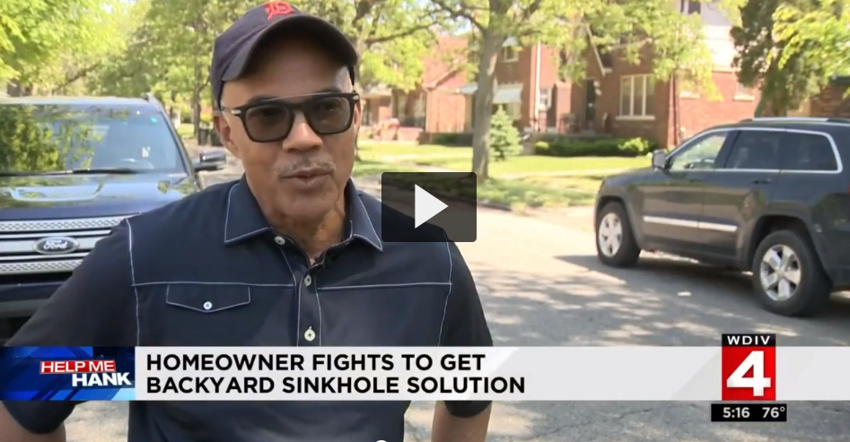
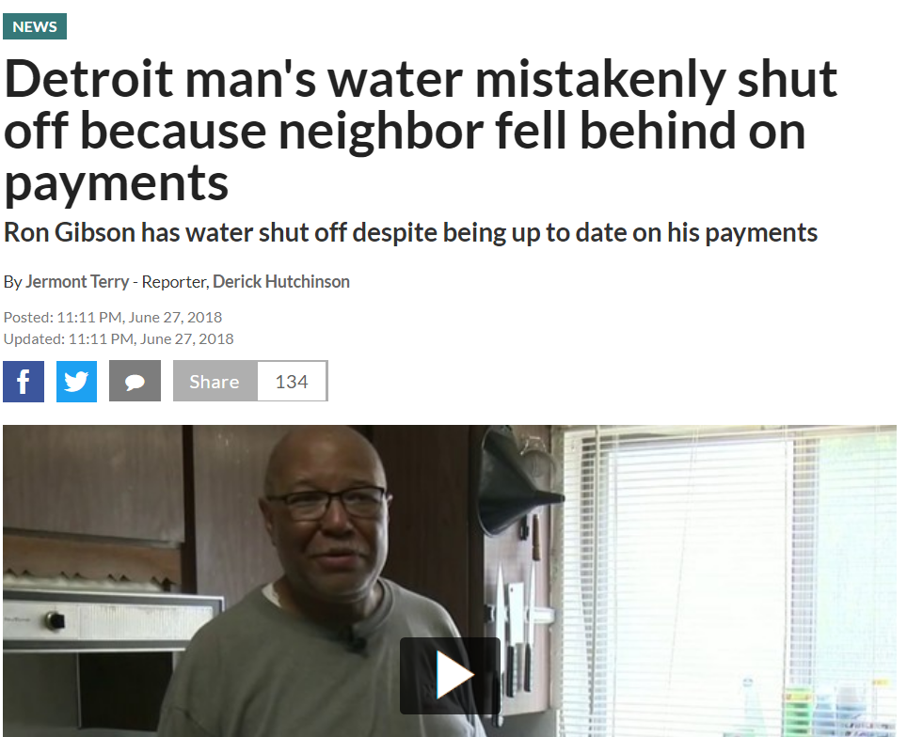
PUBLIC AFFAIRS: Positive vs. Negative News Stories
DWSD News Coverage: June 1 – June 30, 2018
This month the DWSD Public Affairs team saw a total of 49 media stories. The majority of the coverage was on DWSD’s service interruptions. Please note that even though the story was about service interruptions, it may have been counted as a neutral story if DWSD was able to provide a quote and factual information. Of the 49 stories, 7 were broadcast, 36 were print/online and 6 were radio.
PLEASE NOTE: For this metric, each story/interview published or aired is counted.

Slide 26
PUBLIC AFFAIRS: Social Media Activity
164
New Facebook Followers
6,834
Total Followers on Facebook
4,255
Engagement on Facebook
17
New Twitter Followers
1,306
Total Followers on Twitter
294
Engagement on Twitter
8
New Instagram Followers
991
Total Followers on Instagram
N/A
Engagement on Instagram
The DWSD Public Affairs team gained 189 new followers on social media in June 2018, bringing the total number of followers to 9,131. In addition to the metrics above, Facebook saw a total of 652,000 impressions and 5,955 link clicks. The top performing post on Facebook was on June 13 about the Alamo Drafthouse movie theater coming to Detroit, through the sell of DWSD’s property. On this post alone, there were 37,100 impressions, 110 comments and 875 reactions. The top performing Twitter post was the most recent Water Quality report (56,100 impressions, 39 responses and 36 retweets.).

Slide 27
Information Technology

Slide 28
IT: Customer Service, Field Services and Finance Software Availability
In May, outages temporarily for a short period of time impacted access to customer data. This did not affect billing, and customer transactions attempted during the outage were able to be processed by the customer shortly thereafter.

