Slide 1
DIRECTOR’S REPORT
June 16, 2021

Slide 2
CONTENTS*
Metrics by Function:
• Director’s Message 3
• Customer Care 4
• Field Services 7
• Finance 12
• Legal Services 15
• Investigations 17
• Human Resources 19
• Public Affairs 21
• Information Technology 25

Slide 3
DIRECTOR’S MESSAGE TO THE BOARD
This year, Detroit Water and Sewerage Department (DWSD) Operations started a new preventative maintenance program to clean sewers, with 186 miles of city sewer cleaned so far this calendar year, expanding on the Catch Basin Inspection and Cleaning Program.
As preventative maintenance, property owners are advised to contact a licensed plumber to clean their sewer service line at least once a year, especially if they have trees surrounding their property, and to make sure their plumber snakes all the way to connection to the City sewer pipe, which is at least 75-feet in most neighborhoods.
If the backups continue after the licensed plumber inspects and cleans the private sewer service line, the resident should call DWSD at 313-267-8000 to report “water in basement.”

Slide 4
Customer Care

Slide 5
CUSTOMER CARE: Number of Active Accounts
Active Residential Accounts Active Non-Residential Accounts
Vacant parcels, parking lots and other properties with no need for water service, receive stormwater charges only (drainage).

Slide 6
CUSTOMER CARE: Transactions
Number of Transactions
Millions of Dollars
DWSD continues to adapt during the COVID-19 Pandemic and is offering more services remotely, including contact via email at mydwsd@detroitmi.gov. DWSD is also communicating the convenient, safe ways to pay and how customers can access their account(s).

Slide 7
Field Services

Slide 8
FIELD SERVICES: Fire Hydrant Maintenance
n Operating Fire Hydrants n Operating Hydrants with Issues n Non-Operating Hydrants
DWSD prioritizes fire hydrant maintenance as a key component of providing essential and exceptional service delivery led by the Maintenance & Repair Service Line in our Operations Group. During the Fall season, Detroit Fire Department staff conduct inspections and share the data through a dashboard with DWSD if hydrants need to be repaired or replaced. The community can report hydrant issues via the Improve Detroit mobile app.

Slide 9
FIELD SERVICES: Running Water
n Reported by Customers n Resolved within Two Days
DWSD Operations continues to prioritize these work orders based on level of severity, including number of customers affected, to determine priority.

Slide 10
FIELD SERVICES: Water Main Breaks
n Reported by Customers n Resolved within Four Days
DWSD Operations continues to prioritize these work orders based on level of severity, including number of customers affected, to determine priority.

Slide 11
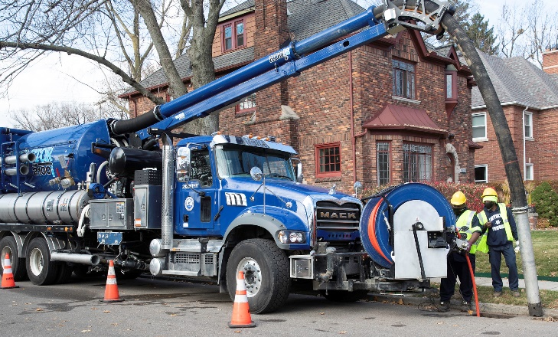
FIELD SERVICES: Catch Basin Inspection & Cleaning
DWSD is expanding sewer cleaning for preventative maintenance to help reduce street flooding and basement backups. As of this report, crews have cleaned 186 miles of city sewer pipe compared with 59 miles in calendar year 2020.
This program launched in 2017. DWSD crews have touched more than 30,000 of the estimated 90,000 catch basins, including tracking them through a mapping app for asset inventory. The 30,000 goal was achieved in the three-year commitment as announced by DWSD and Mayor Duggan in 2017.

Slide 12
Finance

Slide 13
FINANCE: Bill Collection Rate
October November December
3-Month Rolling Average Collection Rate
n Water Revenue n Sewer Revenue
The Finance data is provided based on the most recent month reported to the Finance Committee of the Board of Water Commissioners.

Slide 14
FINANCE: Cash Balance
The Finance data is provided based on the most recent month reported to the Finance Committee of the Board of Water Commissioners.

Slide 15
Legal Services

Slide 16
LEGAL: Claims, Hearings and Cases
27
Cases handled by in-house staff
8
Cases handled by outside counsel
0
Lawsuits dismissed
6
Lawsuits dismissed in calendar year 2021
39
Property damage claims
1
Damage claims approved
0
Dispute hearings*
0
Number of cases DWSD prevailed*
0
Number of accounts given adjustments*
*No hearings were held in January 2021
$127,177
Amount in property damage claims
$99
Amount of total claims recommended to be paid
DWSD uses a mix of in-house and contracted legal counsel to handle damage claims, civil action for commercial delinquencies and lawsuits filed against the department.

Slide 17
Investigations

Slide 18
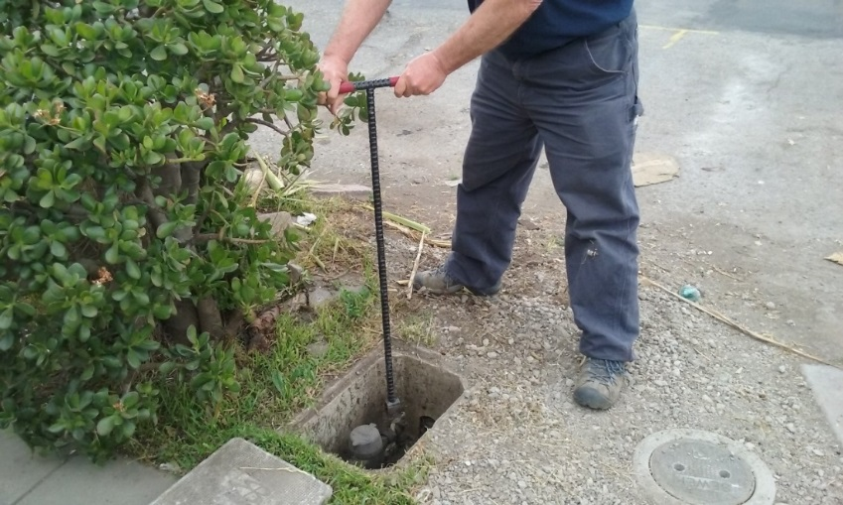
INVESTIGATIONS: Results
Money Owed to DWSD identified by Investigators
$5,900,996
Total since July 1, 2020
$380,505
Back billed
$1,177,056
Future owed in 12 months
$4,343,435
Water loss
986
Parcels investigated for delinquency, possible meter tampering and no meter since July 1, 2020
Revenue Identified Since Investigation Unit Began
$19,033,945
Total since August 14, 2017
Since August 2017, the unit, in collaboration with customer service/billing, has identified more than $17 million in services owed by primarily commercial customers. They uncover severe delinquencies, non-working meters, unauthorized use of fire hydrants, meter tampering, or connected to the city’s water main without a meter and/or permit. The unit works closely with the Finance/Collections and Legal Groups.

Slide 19
Human Resources

Slide 20
HUMAN RESOURCES: Detroit Residents and Hiring
Fifty-four percent of the DWSD workforce lives in Detroit.*
*DWSD and the City of Detroit do not require residency to be employed, per Michigan law.

Slide 21
Public Affairs

Slide 22
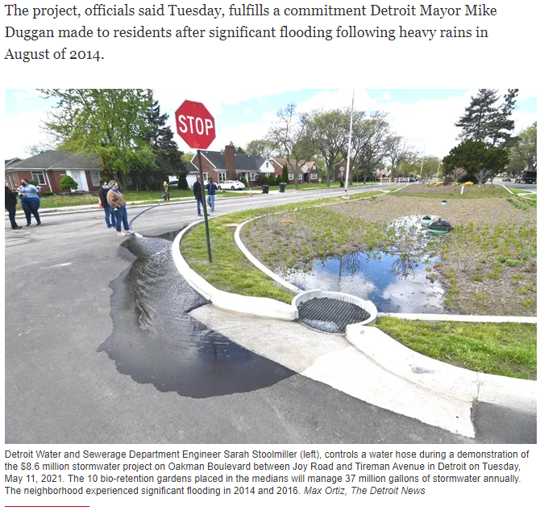
PUBLIC AFFAIRS: Good News
This month, the team garnered 2 positive pitched news stories. The first story was highlighting the completion of the Oakman Boulevard Green Stormwater Infrastructure project. The second story was regarding DWSD’s continuation of its Capitol Improvement Program, announcing another $204M investment over the next two years.
PLEASE NOTE: For this metric, news stories are only counted once per topic, not by the number of media outlets picking up the story.

Slide 23
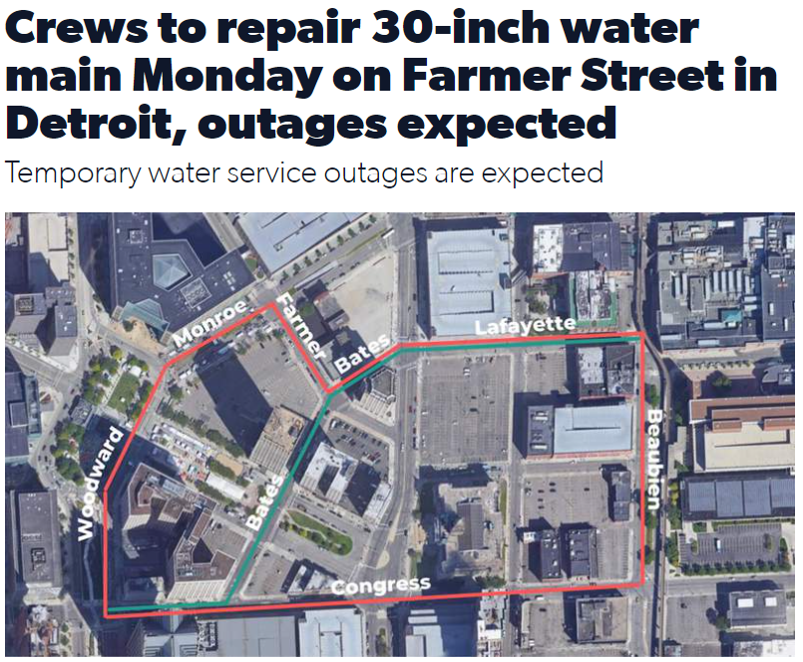
PUBLIC AFFAIRS: Positive vs. Negative News Stories
DWSD News Coverage: May 1 – May 31, 2021
In May, there was a total of 89 media stories. Most of the neutral stories were on the City of Saginaw resuming water shutoffs halted by the pandemic. DWSD’s moratorium extension on residential water shutoffs through 2022 was mentioned. Another series of neutral stories were about the 30-inch water main repair in downtown Detroit, which Public Affairs and Field Services proactively communicated to the media and impacted customers.
PLEASE NOTE: For this metric, each story/interview published or aired is counted.

Slide 24
PUBLIC AFFAIRS: Social Media Activity
8
New Facebook Followers
8,620
Total Followers on Facebook
6,345
Engagement on Facebook
3
New Twitter Followers
1,763
Total Followers on Twitter
211
Engagement on Twitter
3
New Instagram Followers
1,541
Total Followers on Instagram
58
Engagement on Instagram
The DWSD Public Affairs team gained 14 new followers on social media in May 2021, bringing the total number of followers to 11,924. In addition to the metrics above, Facebook saw a total of 536,058 impressions and 3,373 link clicks for the month. The top performing Facebook post was on May 26 when DWSD highlighted Engineer Richard Winfrey, a lifelong Detroiter and Wayne State University engineering graduate who chose to stay in Detroit and join DWSD in 2017. The post had 1,308 total engagements and 770 reactions. May 17 was the top performing Twitter post about the 30-inch water main repair on Farmer Street in downtown Detroit. The top performing Instagram post was on May 7 stating DWSD is currently accepting applications for various positions.

Slide 25
Information Technology

Slide 26
TECHNOLOGY: Top Ten Projects Scorecard
Exec. Priority Score | Sorted by Adjusted Priority Score | PM | Total Investment | Revised Target Date | Status/ Issues | Current Phase
1 | Customer Service-2:enQuesta 6.0 Upgrade | E Taiariol | $ 1,400,000 | 5/1/2022 | Test Case review and step development begins June 8th. Training Plan development is in progress. | Active Design
2 | Customer Service-7:enQuestaLink (Service Link Replacement) | C Penoza | $ 619,500 | 6/30/2021 | Phase 1 Complete. Project planning has begun for upgrade from v4 to v6. This priority will change for June BOWC Report | COMPLETE
3 | Operations (M&R, MTR OPS, Fleet)-2:Itron Meter Replacement | C Penoza | $ 1,000,000 | 12/31/2022 | Development of work force management integration is in progress with testing to begin in June and July of 2021. | Active Design
4 | Engineering-2:GIS Maintenance/As-Builts into Box | R Burke | $ 2500,000 | 6/30/21 | Data is actively copying to BOX. | Active Implementation
5 | Customer Service-3: Customer Service Portal v2.0 | C Penoza | $ 455,000 | 5/31/2021 | Demo of new UI changes has been reviewed and approved. Go live and new features being planned for August/September due to delays in development. | Active Implementation
6 | Administrative and Comliance-2:GLWA Separation - Computers | R Burke | $ 300,000 | 5/31/2021 | All onsite systems have been migrated at WBB, ECS, WSCS & West Yard. CSF to be complete 6/17/21. Remote Staff computers currently being upgraded. | Active Implementation
7 | eSignature Standard for Contracts and Forms | G Burrell | $ 300,000 | 4/30/2021 | Training is currently in progress for additional business units. | Active Implementation
8 | Engineering-1:eBuilder | C. Penoza | $ 300,000 | 5/01/21 | Resolved technical issues allowing the project to move forward with data exchange and dashboard development. | Active Implementation
9 | Office of CFO-1: Oracle Supply Chain | C. Penoza | $ 1,000,000 | TBD | Working to resolve issues with City contract. City states that contract issues will be resolved week of 6/14/21. | Procurement
10 | Customer Service-1:IVR Call Center Replacement | G Burrell | $ 800,000 | 6/30/2021 | Phase 1 complete. DWSD received audit report and SOW for Outbound calling for appointment reminders will be ready June 30th. Work Force Management is progressing through design phases with training of Customer Service & IT staff | Active Implementation
A+

Slide 27
TECHNOLOGY: Application Availability
100% SYSTEMS AVAILABILITY
99.9% = TARGET
Systems Availability
Last 90 Days
May 2021 Cherwell Stats | Totals
Total Tickets | 721
New Tickets Received | 541
Total Tickets Resolved | 478
Average Time to Resolve in Days | 5
Total Tickets Resolved within SLA | 413
Total Tickets Resolved not in SLA | 65

