Slide 1
DIRECTOR’S REPORT
May 19, 2021
detroitmi.gov/dwsd

Slide 2
CONTENTS*
Metrics by Function:
• Director’s Message 3
• Customer Care 4
• Field Services 7
• Finance 12
• Legal Services 15
• Investigations 17
• Human Resources 19
• Public Affairs 21
• Information Technology 25

Slide 3
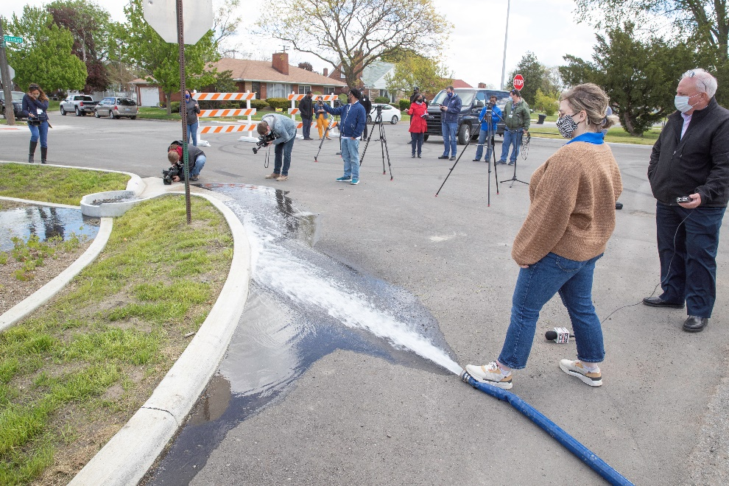
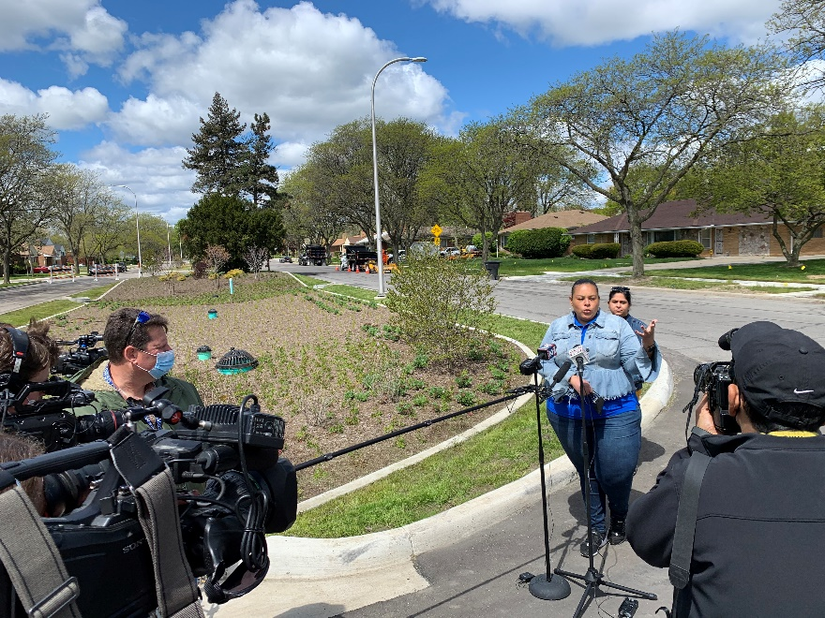
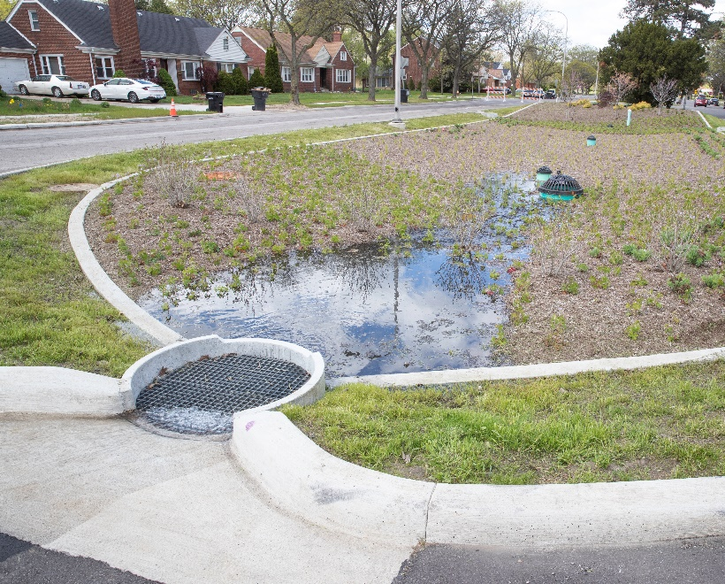
DIRECTOR’S MESSAGE TO THE BOARD
More than five years in the making and following a commitment made by Mayor Mike Duggan following the August 2014 flooding, Detroit Water and Sewerage Department’s (DWSD) largest single investment in Green Stormwater Infrastructure was completed with a media event and demonstration on May 11, 2021 on Oakman Boulevard.
Ten medians were transformed with bioretention gardens with most of them including underground boxed storage tanks to manage 37 million gallons of stormwater annually.
See FOX 2 story and The Detroit News article.
DWSD will begin its next GSI project at the Charles Wright Academy this month, and will be announcing a massive project in the Far West Detroit neighborhood to start later this year.

Slide 4
Customer Care

Slide 5
CUSTOMER CARE: Number of Active Accounts
Active Residential Accounts Active Non-Residential Accounts
Vacant parcels, parking lots and other properties with no need for water service, receive stormwater charges only (drainage).

Slide 6
CUSTOMER CARE: Transactions
Number of Transactions
Millions of Dollars
DWSD continues to adapt during the COVID-19 Pandemic and is offering more services remotely, including contact via email at mydwsd@detroitmi.gov. DWSD is also communicating the convenient, safe ways to pay and how customers can access their account(s).

Slide 7
Field Services

Slide 8
FIELD SERVICES: Fire Hydrant Maintenance
n Operating Fire Hydrants n Operating Hydrants with Issues n Non-Operating Hydrants
DWSD prioritizes fire hydrant maintenance as a key component of providing essential and exceptional service delivery led by the Maintenance & Repair Service Line in our Operations Group. During the Fall season, Detroit Fire Department staff conduct inspections and share the data through a dashboard with DWSD if hydrants need to be repaired or replaced. The community can report hydrant issues via the Improve Detroit mobile app.

Slide 9
FIELD SERVICES: Running Water
n Reported by Customers n Resolved within Two Days
DWSD Operations continues to prioritize work orders based on level of impact, including number of customers affected, with water main repairs, street flooding and water-in-basement complaints taking priority.

Slide 10
FIELD SERVICES: Water Main Breaks
n Reported by Customers n Resolved within Four Days
DWSD Operations continues to prioritize work orders based on level of impact, including number of customers affected, with water main repairs, street flooding and water-in-basement complaints taking priority.

Slide 11
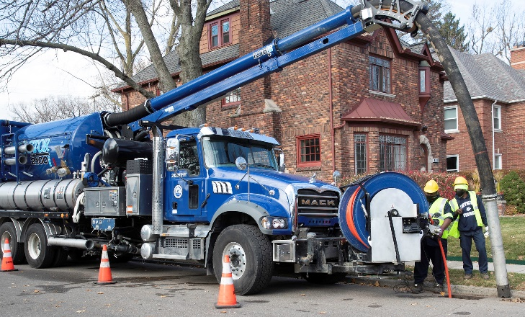
FIELD SERVICES: Catch Basin Inspection & Cleaning
DWSD is expanding sewer cleaning for preventative maintenance to help reduce street flooding and basement backups. As of this report, crews have cleaned 120 miles of city sewer pipe compared with 59 miles in calendar year 2020.
This program launched in 2017. DWSD crews have touched more than 30,000 of the estimated 90,000 catch basins, including tracking them through a mapping app for asset inventory. The 30,000 goal was achieved in the three-year commitment as announced by DWSD and Mayor Duggan in 2017.

Slide 12
Finance

Slide 13
FINANCE: Bill Collection Rate
October November December
3-Month Rolling Average Collection Rate
n Water Revenue n Sewer Revenue
The Finance data is provided based on the most recent month reported to the Finance Committee of the Board of Water Commissioners.

Slide 14
FINANCE: Cash Balance
The Finance data is provided based on the most recent month reported to the Finance Committee of the Board of Water Commissioners.

Slide 15
Legal Services

Slide 16
LEGAL: Claims, Hearings and Cases
26
Cases handled by in-house staff
8
Cases handled by outside counsel
2
Lawsuits dismissed
6
Lawsuits dismissed in calendar year 2021
43
Property damage claims
2
Damage claims approved
0
Dispute hearings*
0
Number of cases DWSD prevailed*
0
Number of accounts given adjustments*
*No hearings were held in January 2021
$200,038
Amount in property damage claims
$0
Amount of total claims recommended to be paid
DWSD uses a mix of in-house and contracted legal counsel to handle damage claims, civil action for commercial delinquencies and lawsuits filed against the department.

Slide 17
Investigations

Slide 18
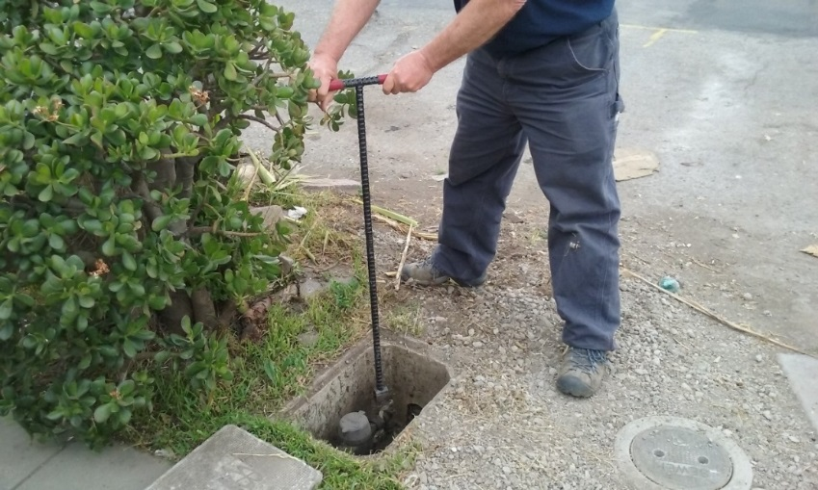
INVESTIGATIONS: Results
Money Owed to DWSD identified by Investigators
$5,585,887
Total since July 1, 2020
$264,899
Back billed
$977,553
Future owed in 12 months
$4,343,435
Water loss
924
Parcels investigated for delinquency, possible meter tampering and no meter since July 1, 2020
Revenue Identified Since Investigation Unit Began
$18,718,836
Total since August 14, 2017
Since August 2017, the unit, in collaboration with customer service/billing, has identified more than $17 million in services owed by primarily commercial customers. They uncover severe delinquencies, non-working meters, unauthorized use of fire hydrants, meter tampering, or connected to the city’s water main without a meter and/or permit. The unit works closely with the Finance/Collections and Legal Groups.

Slide 19
Human Resources

Slide 20
HUMAN RESOURCES: Detroit Residents and Hiring
Fifty-five percent of the DWSD workforce lives in Detroit.*
*DWSD and the City of Detroit do not require residency to be employed, per Michigan law.

Slide 21
HUMAN RESOURCES: Retirement Eligible
With a current population of 546 employees, there are 103 DWSD employees eligible for retirement.

Slide 22
Public Affairs

Slide 23
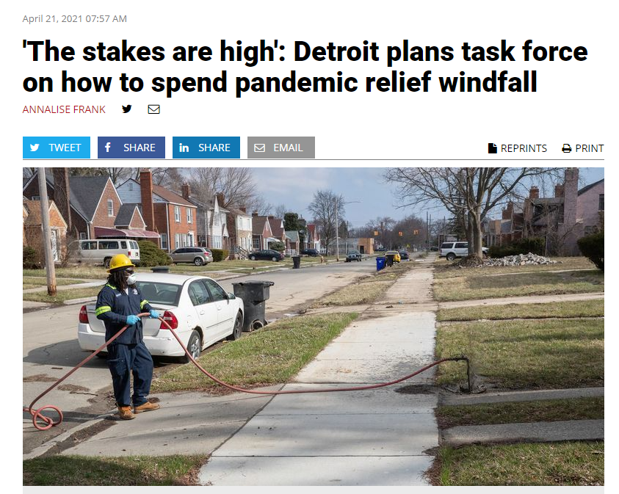
PUBLIC AFFAIRS: Positive vs. Negative News Stories
DWSD News Coverage: April 1 – April 30, 2021
In April, the DWSD Public Affairs team saw a total of 106 media stories. The majority of the neutral stories were regarding Bobby Ferguson being released from prison and having to pay back DWSD, DTE’s Energy Efficiency Assistance Program where they work with partners, such as DWSD, to assist customers who were negatively impacted by the COVID-19 pandemic, and stories about ways Detroit should spend the federal relief funds (infrastructure). The positive story was regarding DWSD’s Stormwater Management and the Far West Project where DWSD is partnering with the Great Lakes Water Authority (GLWA) and the Oakland County Water Resources Commissioner.
PLEASE NOTE: For this metric, each story/interview published or aired is counted.

Slide 24
PUBLIC AFFAIRS: Social Media Activity
6
New Facebook Followers
8,615
Total Followers on Facebook
3,619
Engagement on Facebook
2
New Twitter Followers
1,760
Total Followers on Twitter
141
Engagement on Twitter
27
New Instagram Followers
1,538
Total Followers on Instagram
39
Engagement on Instagram
The DWSD Public Affairs team gained 35 new followers on social media in April 2021, bringing the total number of followers to 11,913. In addition to the metrics above, Facebook saw a total of 297,627 impressions and 2,232 link clicks for the month. The top performing Facebook post was on April 8 and was DWSD’s job announcement for Field Services Technicians. The post had a total engagement of 78 and 16 reactions. April 6 was the top performing Twitter post about the City of Detroit’s neighborhood vaccination sites. The top performing Instagram post was on April 21 highlighting a water saving tip on washing fruits and vegetables.

Slide 25
Information Technology

Slide 26
TECHNOLOGY: Top Ten Projects Scorecard
Exec. Priority Score | Sorted by Adjusted Priority Score | PM | Total Investment | Revised Target Date | Status/ Issues | Current Phase
1 | Customer Service-2:enQuesta 6.0 Upgrade | E Taiariol | $ 1,400,000 | 5/1/2022 | Initial Test List Development is complete. Moving towards detailed review of Test List and Test Case development. Training Plan development has begun. | Active Design
2 | Customer Service-7:enQuestaLink (Service Link Replacement) | C Penoza | $ 619,500 | 6/30/2021 | Development Environment complete. Pre-Prod build currently on going. Preparing for Go Live 5/15-5/17. | Active Implementation
3 | Operations (M&R, MTR OPS,Fleet)-2:Itron Meter Replacement | C Penoza | $ 1,000,000 | 12/31/2022 | Development of work force management has begun in preparation for rollout tentatively scheduled for early 2022. | Active Design
4 | Engineering-2:GIS Maintenance/As-Builts into Box | R Burke | $ 2500,000 | 6/30/21 | Moved to Top 10. Project scoped modified and stakeholder meeting set for 5/12/21. | Active Implementation
5 | Customer Service-3: Customer Service Portal v2.0 | C Penoza | $ 455,000 | 5/31/2021 | Demo of new UI changes has been reviewed and approved. Tentative go live for late May. Additional features planned for Late June Launch. | Active Implementation
6 | Administrative and Comliance-2:GLWA Separation - Computers | R Burke | $ 300,000 | 5/31/2021 | DWSD IT is actively rolling out new images and cutting over staff to the new network. All buildings except West Yard and CSF have been cut over. Beginning rollout to At Home Staff | Active Implementation
7 | eSignature Standard for Contracts and Forms | G Burrell | $ 300,000 | 4/30/2021 | Training is currently in progress for additional business units including IT and Legal. | Active Implementation
8 | Engineering-1:eBuilder | C. Penoza | $ 300,000 | 5/01/21 | Resolved technical issues allowing the project to move forward with data exchange and dashboard development. | Active Implementation
9 | Office of CFO-1: Oracle Supply Chain | C. Penoza | $ 1,000,000 | TBD | Working to resolve issues with City contract. | Procurement
10 | Customer Service-1:IVR Call Center Replacement | G Burrell | $ 800,000 | 6/30/2021 | Phase 1 complete. Outbound calling for appointment reminders and Work Force Management is progressing through design phases. | Active Implementation
A+

Slide 27
TECHNOLOGY: Application Availability
100% SYSTEMS AVAILABILITY
99.9% = TARGET
Systems Availability
Last 90 Days
April 2021 Cherwell Stats | Totals
Total Tickets | 716
New Tickets Received | 506
Total Tickets Resolved | 533
Average Time to Resolve in Days | 10
Total Tickets Resolved within SLA | 487
Total Tickets Resolved not in SLA | 98

