Slide 1
DIRECTOR’S REPORT
May 16, 2018
detroitmi.gov/dwsd

Slide 2
CONTENTS*
Director’s Message for May 2018 3
Metrics by Function:
• Customer Care 4
• Field Services 7
• Finance 11
• Legal Services 14
• Investigations 16
• Human Resources 18
• Public Affairs 22
• Information Technology 26

Slide 3
DIRECTOR’S MESSAGE TO THE BOARD
The Detroit Water and Sewerage Department (DWSD) will mail an informative brochure to residential customers on the change from meter-based charge to an impervious (hard surface) acreage charge for drainage.
The mailer will be sent to 180,000 residential customers beginning May 21, followed by a letter in June that outlines their expected revised fee beginning in July 2018.
On May 11, Deputy Director Palencia Mobley, P.E., presented at a drainage roundtable to better inform the news media about the what, why and how of stormwater and the drainage fee.
DWSD is continuing its water and sewer infrastructure assessments with additional pilot neighborhoods starting in June to include Brightmoor, Miller Grove, Minock Park, Riverdale, and Rosedale Park as part of the capital improvement program.
The first two pilot assessments were in North Rosedale Park and Cornerstone Village.
This work is in addition to the 23 completed, in- progress and scheduled water and sewer construction projects for 2018.
More than 175 low-volume toilets have been installed at Detroit homes to help them conserve water and lower utility bills as part of pilot customer assistance program.
Detroit-based Benkari will install 550 toilets by June 30 and then DWSD will evaluate the data prior to recommending a citywide program.
DivDat is moving the kiosks from the Rite Aid stores to nearby grocery stores and other retail establishments which have equal or more traffic.
Rite Aid was recently purchased by Albertsons and did not renew the contract with DivDat.
Posters are placed in the Rite Aid stores with information on the new kiosk locations
As of May 16, there are 44 payment kiosks at 37 locations in and around the city of Detroit.

Slide 4
Customer Care

Slide 5
CUSTOMER CARE: Account Status
All Customers
Residential Only
Non-Residential Only
n Active customer accounts n Delinquent accounts
DWSD has a strategic effort underway to better inform customers about assistance for water bills through communication to include advertising, direct customer notifications and reaching customers where they are such as at churches and community centers.
WRAP, the Water Residential Assistance Program, is the most robust and compassionate program among any utility in America. Since March 2016, 9,800 Detroit households have been served through an investment of $7.8 million for bill credit, arrearage payments and water conservation minor home plumbing repairs.

Slide 6
CUSTOMER CARE: Transactions
Number of Transactions
Millions of Dollars
Payment Transactions by Type
Total Customer Visits for April 2018
5,292
Main Office
8,162
Eastside
11,462
Westside
Revenue Collected by Type

Slide 7
Field Services

Slide 8
FIELD SERVICES: Fire Hydrant Maintenance
n Operating Fire Hydrants n Operating Hydrants with Issues n Non-Operating Hydrants
The Detroit Fire Department uses a mobile collector app whereby firefighters report on the status of each hydrant. This data integrates into DWSD’s work order system.

Slide 9
FIELD SERVICES: Running Water
n Reported by Customers n Resolved
Running water reports include water flowing on a street, issues at vacant properties and calls by residents who see gushing or flowing water that is out of the ordinary.

Slide 10
FIELD SERVICES: Water Main Breaks
n Reported by Customers n Resolved
DWSD has a service level agreement with contractors to have reported water main breaks repaired within four days.

Slide 11
Finance

Slide 12
FINANCE: Bill Collection Rate
Water Service Collection Rate Sewer Service Collection Rate
Every percentage increase in the collection rate above 80 percent is an additional $4 million which can be applied to the maintenance and rehabilitation of the water and sewer infrastructure.
The data in the chart is based upon the 330-360 day collection rate.

Slide 13
FINANCE: Cash Balance
$96,903,959
Water cash balance as of March 31, 2018
$58,009,752
Sewer cash balance as of March 31, 2018
As of March 31, 2018, DWSD had 116.81 days of cash on hand. The target is 100 days.

Slide 14
Legal Services

Slide 15
LEGAL: Claims, Hearings and Cases
29
Property damage claims
0
Basement backup damage claims appeals
18
Dispute hearings
6
Number of cases DWSD prevailed
19
Cases handled by in-house staff
6
Cases handled by outside counsel
$108,715
Amount in property damage claims
$19,984
Basement backup damage claim appeals
$128,699 Total claims in March 2018
$8,131
Amount in dispute
$1,646
Credited to customers based on hearing outcomes
$6,485
Owed to DWSD after hearings
DWSD uses a mix of in-house and contracted legal counsel to handle damage claims, civil action for commercial delinquencies and lawsuits filed against the department.
Customers who have disputes for their bill may request a hearing at the City of Detroit Department of Appeals and Hearings. The cases are heard by an administrative hearing officer.

Slide 16
Investigations

Slide 17
INVESTIGATIONS: Results
637
(71 per month, on average]
Property addresses investigated for delinquency, possible meter tampering and no meter.
$3,435,688
Money owed to DWSD
Illegal usage investigation
The DWSD Revenue Recovery Unit, in collaboration with customer service/billing, has identified more than $3 million in services owed by commercial customers. They uncovered severe delinquencies, non-working meters, tampering with the meters, or connected to the city’s water main without a meter or permit. The team works closely with the DWSD collections and legal staff.

Slide 18
Human Resources

Slide 19
HUMAN RESOURCES: Detroit Residents and Hiring
Sixty-one percent of the total DWSD workforce lives in Detroit.
Nine new hires in April 2018 including one in Field Engineering, one in Information Technology, three in Maintenance and Repair, two in Finance/Procurement, one in Security, and one in the Stormwater Management Group.

Slide 20
HUMAN RESOURCES: Retirement Eligible
DWSD
Employees
Total Eligible
for
Retirement
25+ Years of
Service
60+ Years Old
60+ Years Old &
10 or More Years of Service

Slide 21
HUMAN RESOURCES: Family Medical Leave Act
Applications
Timeframe Request
DWSD Unit

Slide 22
Public Affairs

Slide 23
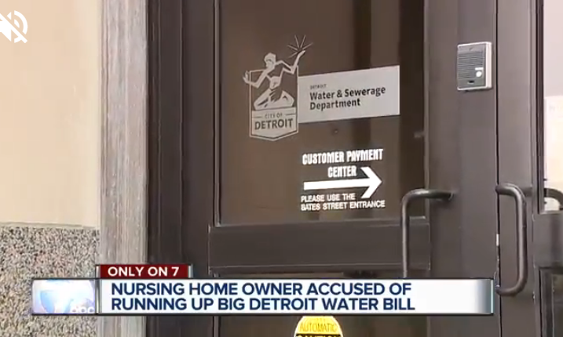
PUBLIC AFFAIRS: Good News
This month, the team garnered 3 positive news stories. The stories included an investigative report on a nursing home owner not paying his water bill, an interview with Paul W. Smith on WJR to discuss upcoming projects and the City of Detroit exiting active state financial oversight.
PLEASE NOTE: For this metric, news stories are only counted once per topic, not by the number of media outlets picking up the story.

Slide 24
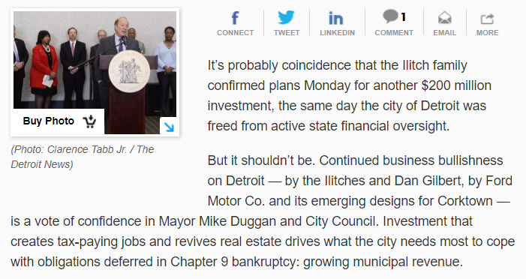
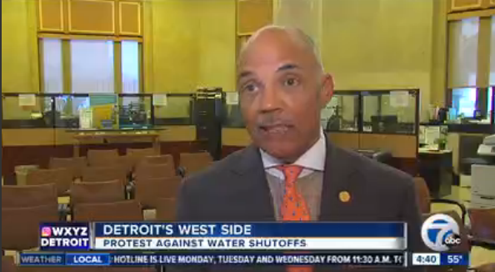
PUBLIC AFFAIRS: Positive vs. Negative News Stories
DWSD News Coverage: April 5 – May 2, 2018
This month the DWSD Public Affairs team saw a total of 75 media stories. The majority of the coverage were stories on Flint’s Water Crisis. The stories just mentioned DWSD as Flint’s original water supplier. The positive stories were mostly about the City’s financial oversight ending. The negative stories still focused on service interruptions. Of the 75 stories, 8 were broadcast, 60 were print/online and 7 were radio.
PLEASE NOTE: For this metric, each story/interview published or aired is counted.

Slide 25
PUBLIC AFFAIRS: Social Media Activity
51
New Facebook Followers
6,295
Total Followers on Facebook
1,110
Engagement on Facebook
12
New Twitter Followers
1,278
Total Followers on Twitter
172
Engagement on Twitter
6
New Instagram Followers
981
Total Followers on Instagram
26
Engagement on Instagram
The DWSD Public Affairs team gained 69 followers on social media in April 2018, bringing the total number of fans to 8,554. In addition to the metrics above, Facebook saw a total of 113,000 impressions, 689 link clicks and 17,100 video views. For the second month in a row, the top performing video was the Returning Citizens video, followed by the Toilet Upgrade pilot program video.

Slide 26
Information Technology

Slide 27
IT: Customer Service, Field Services and Finance Software Availability
In April, DWSD migrated the billing system, enQuesta, to Oracle's cloud environment. The issues with the cashiering system, Inovah, are being investigated and may be related to the new hardware configuration for enQuesta.

