Slide 1



DIRECTOR’S REPORT
March 18, 2020
detroitmi.gov/dwsd

Slide 2
CONTENTS*
Metrics by Function:
• Director’s Message 3
• Customer Care 4
• Field Services 7
• Finance 12
• Legal Services 16
• Investigations 18
• Human Resources 20
• Public Affairs 23
• Information Technology 27

Slide 3
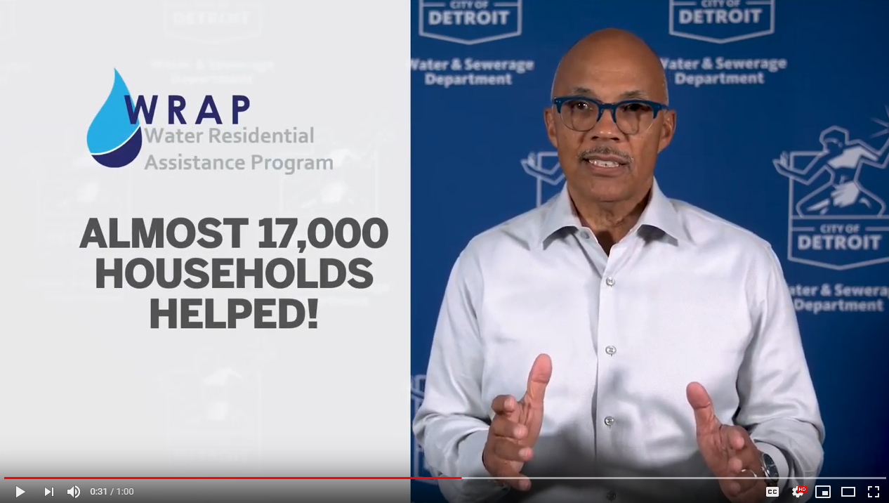
DIRECTOR’S MESSAGE TO THE BOARD
The Detroit Water & Sewerage Department (DWSD) announced key leadership changes to further improve operations under its new business model created in 2016 after the bifurcation with the Great lakes Water Authority.
  Robert Presnell transitioned to a newly created role, Chief Innovation and Transformation Officer, and will be responsible for enhancing the customer experience and improving business process through key initiatives.
  Timothy Cavitt has been hired as the Chief Operating Officer and will oversee several operating groups.
Recognizing the success of WRAP (Water Residential Assistance Program) while there remains ongoing needs in the community, DWSD will ask Detroit City Council and the GLWA board to approve a revision to the lease agreement between the City of Detroit and GLWA to expand WRAP, which includes the following:
  Open eligibility to more residential households by
  expanding the qualifications from 150% of poverty
  level to 200% of poverty level; therefore, a
  four-member household with a $50,000 annual
  income will now be eligible;
  Double annual funding for Detroit from $2.4 million
  to $5 million;
  Increase the minor home plumbing repairs from
  $1,000 maximum to $1,500. on average to replace
  inefficient fixture and fix leaks which cause high
  water and sewer bills; and
  Benefit an estimated 5,000 more households
  annually in Detroit to maintain their water service.
DWSD will produce with its agency of record, MCCI, a video series that educates customers about the water and sewer systems and their responsibility and clear up misinformation.
  The image at the right is screenshot of the first “DWSD Director Shares the Facts” video.

Slide 4


Customer Care

Slide 5
CUSTOMER CARE: Number of Active Accounts
Active Residential Accounts Active Non-Residential Accounts
Vacant parcels, parking lots and other properties with no need for water service, receive stormwater charges only (drainage).

Slide 6
CUSTOMER CARE: Transactions
Number of Transactions
Millions of Dollars
DWSD changed back-end processing to further improve business practices long term. As a result, the short-term impact reduced in-person transactions during the month of November and December. We expect an increase in transactions in January to catch up to the shortfall.

Slide 7
Field Services

Slide 8
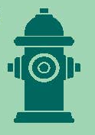
FIELD SERVICES: Fire Hydrant Maintenance
n Operating Fire Hydrants n Operating Hydrants with Issues n Non-Operating Hydrants
Firefighters are inspecting hydrants, which they do annually during the fall and early winter months. The data transfers to DWSD in order to create work orders, when necessary, to repair or replace hydrants. These inspections result in an increase in work orders for the next few months while firefighters are inspecting and DWSD crews are making repairs.
*Due to a data update, there is a change in the three categories in October versus previous months which is shown here.

Slide 9
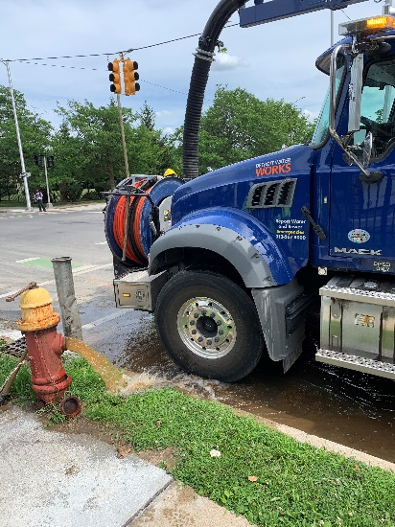
FIELD SERVICES: Running Water
n Reported by Customers n Resolved within Two Days
The running water reports have decreased from prior comparable years due to the preventative maintenance programs and the several unseasonably warm days this winter.

Slide 10
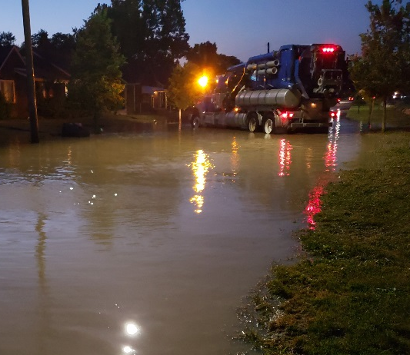
FIELD SERVICES: Water Main Breaks
n Reported by Customers n Resolved within Four Days
When there is dramatic change in temperature --- hot or cold --- the ground can shift and cause tension on the pipes potentially resulting in water main breaks. Fortunately this year’s winter has been historically warm.

Slide 11
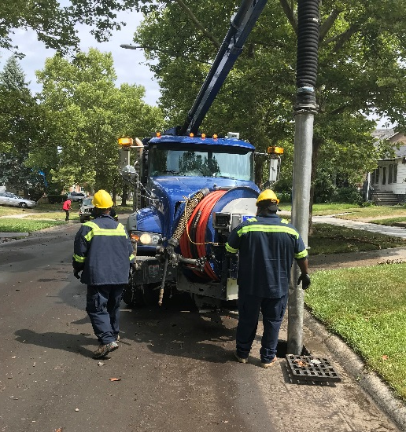
FIELD SERVICES: Catch Basin Inspection & Cleaning
Since the catch basin inspection and cleaning program launched in 2017, crews have touched nearly 27,000 of the estimated 90,000 catch basins. The goal is 30,000
by August 2020 and DWSD is expected to exceed this objective.

Slide 12
Finance

Slide 13
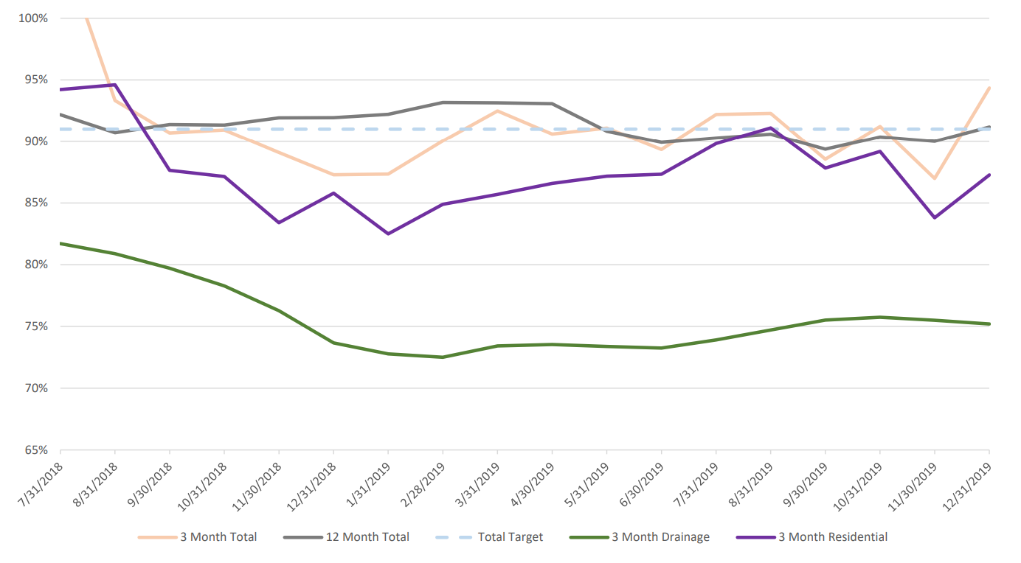
FINANCE: Bill Collection Rate
During the winter months, the collection rate historically decreases as households choose to pay their heating bills and catch up later with water bills in the spring, even moreso this past winter due to the temperatures falling well below zero for several days. Every percentage increase in the collection rate above 80 percent is an additional $3.5 million which can be applied to the maintenance of and upgrades to the water and sewer systems.

Slide 14
FINANCE: Bill Collection Rate
3-Month Rolling Average Collection Rate for All Accounts
Prior to 2016 and the bifurcation with the Great Lakes Water Authority, the bill collection rate was 77 percent. Since
the current leadership began at DWSD – changing the business practices, improving technology, customer service and outreach – the collection rate has remained above 90 percent the last three years.

Slide 15
FINANCE: Cash Balance
$67,344,016
Water cash balance as of
December 31, 2019
$142,042,297
Sewer cash balance as of
December 31, 2019
The operating cash days-on-hand as of December 31, 2019 is 128 days. The target is 120 days.
Due to when the books close after each month and following the reconciliation, the Finance Group data in this section is from two months prior to this report.

Slide 16

Legal Services

Slide 17
LEGAL: Claims, Hearings and Cases
23
Cases handled by
in-house staff
10
Cases handled by
outside counsel
1
Lawsuits dismissed
10
Lawsuits dismissed in FY2020
12
Dispute hearings
2
Number of cases
DWSD prevailed
0
Property damage claims
$0
Amount in property
damage claims
$0
Amount of total claims recommended to be paid
$8,503
Amount in dispute
$2,505
Credited to customers based on hearing outcomes
$5,998
Owed to DWSD after hearings
DWSD uses a mix of in-house and contracted legal counsel to handle damage claims, civil action for commercial delinquencies and lawsuits filed against the department.
Customers who have bill disputes may request a hearing at the City of Detroit Department of Appeals and Hearings.

Slide 18
Investigations

Slide 19
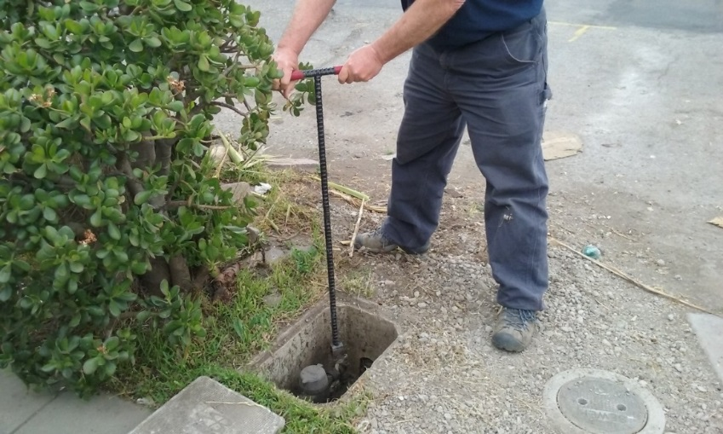
INVESTIGATIONS: Results
Money Owed to DWSD identified by Investigators
$3,555,473
Total since July 1, 2019
$777,059
Back billed
$2,607,066
Future owed in 12 months
$171,348
Water loss
606
[87 per month, on average]
Parcels investigated for delinquency, possible meter tampering and no meter since July 1, 2019
The DWSD Revenue Recovery Unit, in collaboration with customer service/billing, has identified more than $12 million in services owed by primarily commercial customers since its creation in August 2017. They uncovered severe delinquencies, non-working meters, unauthorized use of fire hydrants, tampering with the meters, or connected to the city’s water main without a meter and/or permit. The team works closely with the DWSD collections and legal staff.

Slide 20
Human Resources

Slide 21
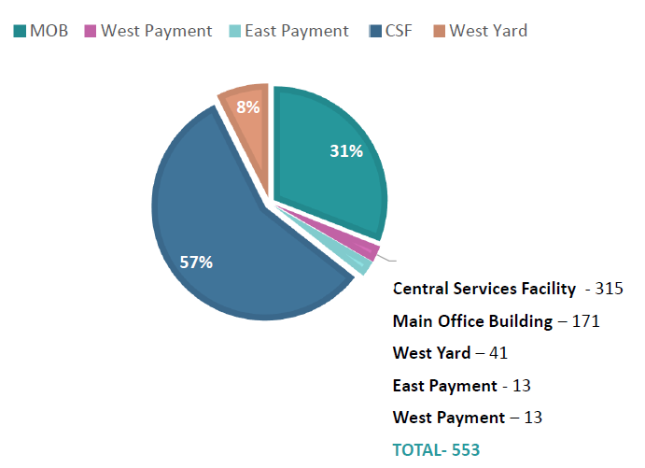
HUMAN RESOURCES: Detroit Residents and Hiring
Fifty-six percent of the DWSD workforce lives in Detroit.*
*DWSD and the City of Detroit do not require residency to be employed, per Michigan law.

Slide 22
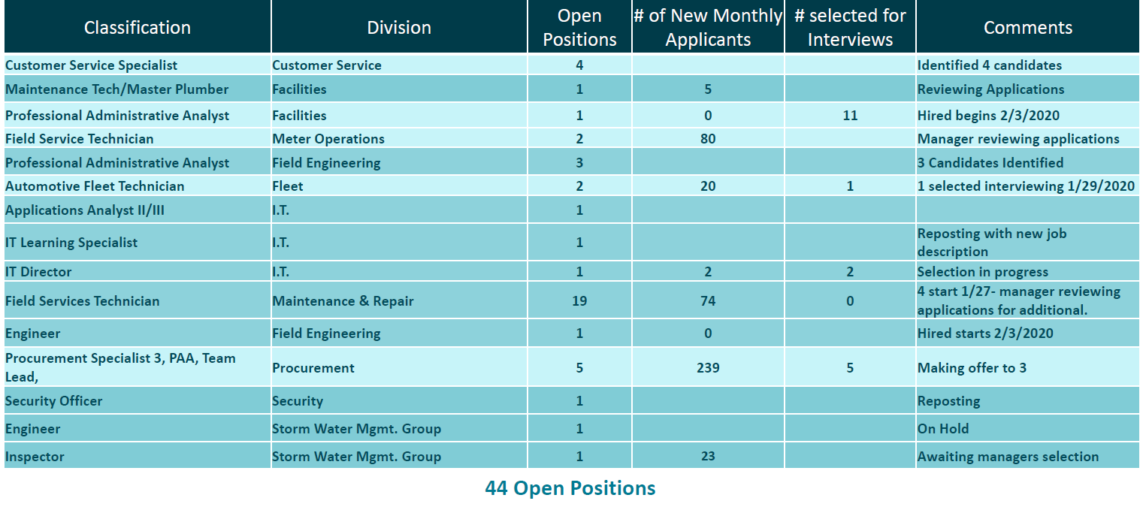
HUMAN RESOURCES: Recruitment

Slide 23
Public Affairs

Slide 24
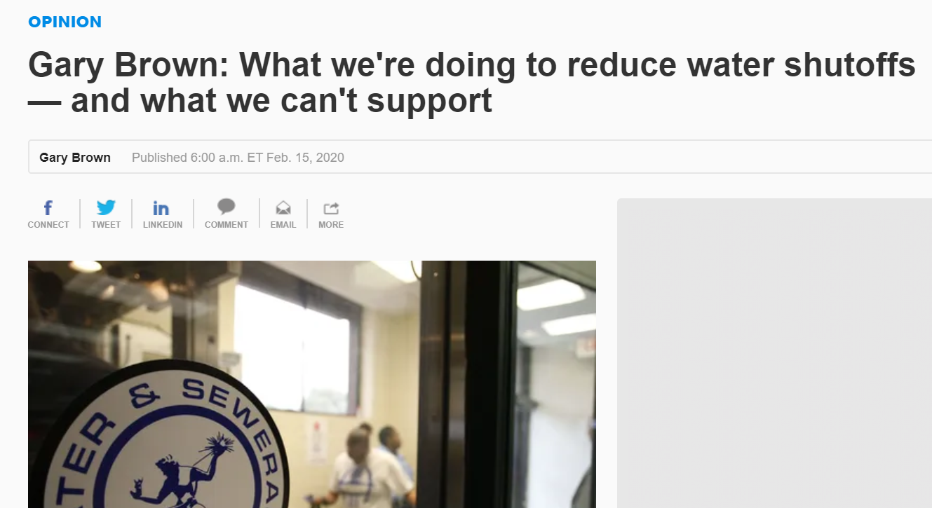

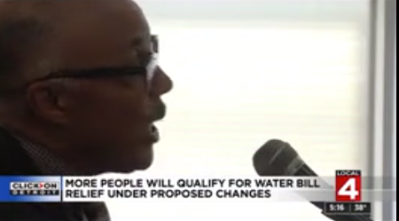
PUBLIC AFFAIRS: Good News
This month, the team garnered 2 positive pitched news stories. Both stories were about the proposal to expand WRAP (Water Residential Assistance Program). The proposed plan would double the budget, increase the income qualification from 150% to 200% of the federal poverty level and raise the plumbing budget from $1,000 to $1,500. One of the stories was an Op-Ed by Director Gary Brown in the Detroit Free Press on February 15.
PLEASE NOTE: For this metric, news stories are only counted once per topic, not by the number of media outlets picking up the story.

Slide 25

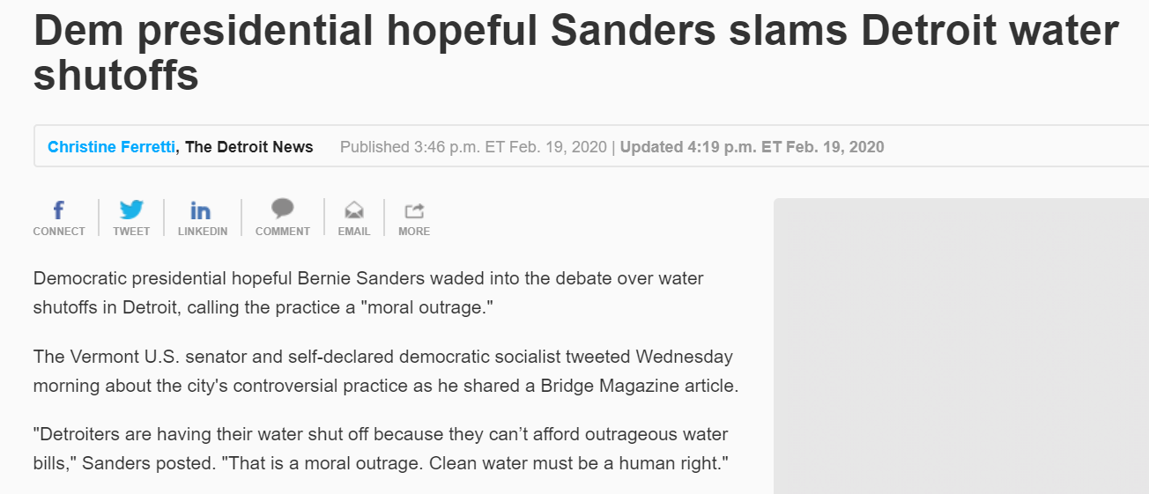
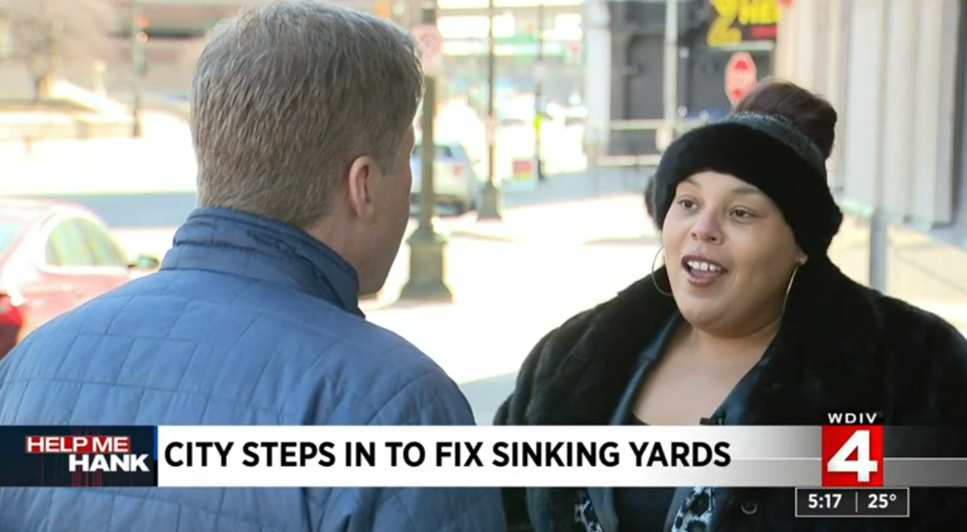
PUBLIC AFFAIRS: Positive vs. Negative News Stories
DWSD News Coverage: February 1 – February 29, 2020
In February, the DWSD Public Affairs team saw a total of 41 media stories. The majority of the stories were regarding DWSD’s shut off policy. Most of the stories were counted as neutral if they presented both sides and provided information on the customer assistance programs, including WRAP. The story was counted negative if no comment or statement was provided. Other stories were about the Bulk Storage Site on the riverfront and sinking yards caused by water main projects. Of the stories, 7 were broadcast, 31 were print/online and 3 were radio.
PLEASE NOTE: For this metric, each story/interview published or aired is counted.

Slide 26



PUBLIC AFFAIRS: Social Media Activity
9
New Facebook Followers
8,132
Total Followers on Facebook
8,682
Engagement on Facebook
2
New Twitter Followers
1,649
Total Followers on Twitter
300
Engagement on Twitter
12
New Instagram Followers
1,390
Total Followers on Instagram
54
Engagement on Instagram
The DWSD Public Affairs team gained 23 new followers on social media in February 2020, bringing the total number of followers to 11,171. In addition to the metrics above, Facebook saw a total of 360,583 impressions and 1,536 link clicks for the month. The top performing Facebook post was on February 26 when DWSD congratulated Deputy Director and Chief Engineer Palencia Mobley on being named Alternatives for Girls 2020 Role Model of the Year. The post had 1,162 reactions, 183 comments and 43 shares. The top performing post on Twitter was on February 18 about DWSD’s and Charles H. Wright Museum’s Green Stormwater Infrastructure (GSI) project.

Slide 27
Information Technology

Slide 28
Information Technology: Application Availability
Systems Availability
Last 90 Days
In the Informational Technology (IT) Group, the major projects underway are the transition from Great Lakes Water Authority (GLWA) IT shared services which includes new network, active director, BOX.com, print/fax services, IVR upgrade to the cloud, and GIS (Geographic Information System) to City of Detroit migration; launch of fleet management programs AssetWorks, FleetFocus and FuelFocus; CityWorks to replace WAM work order system; and Customer Care Web Portal phase two.

