Slide 1
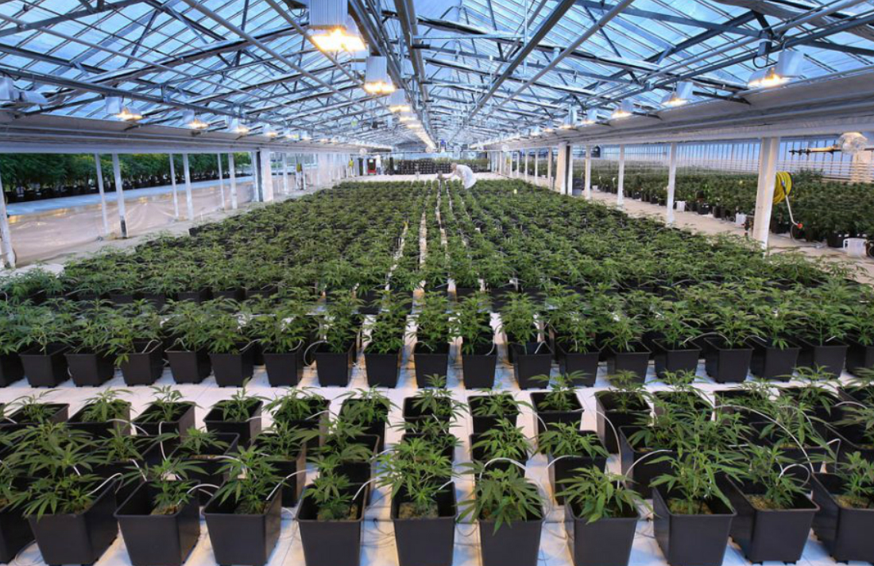
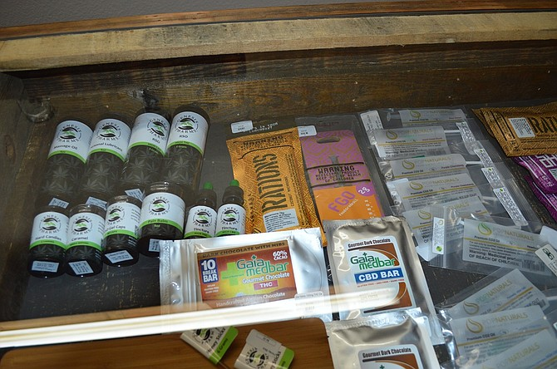
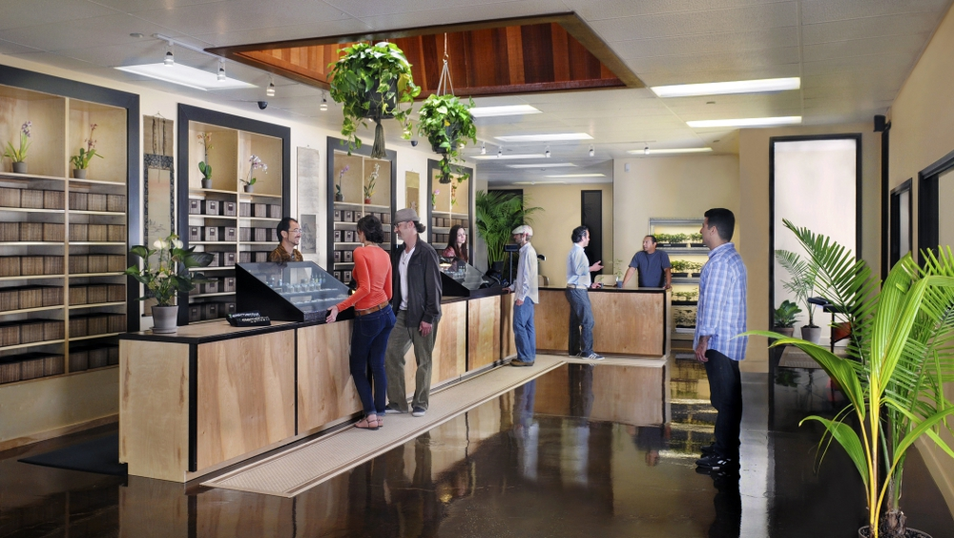
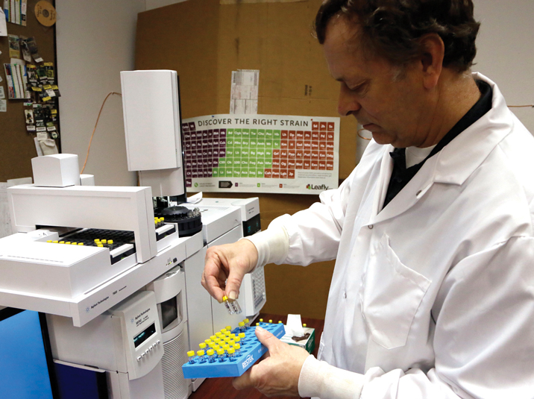
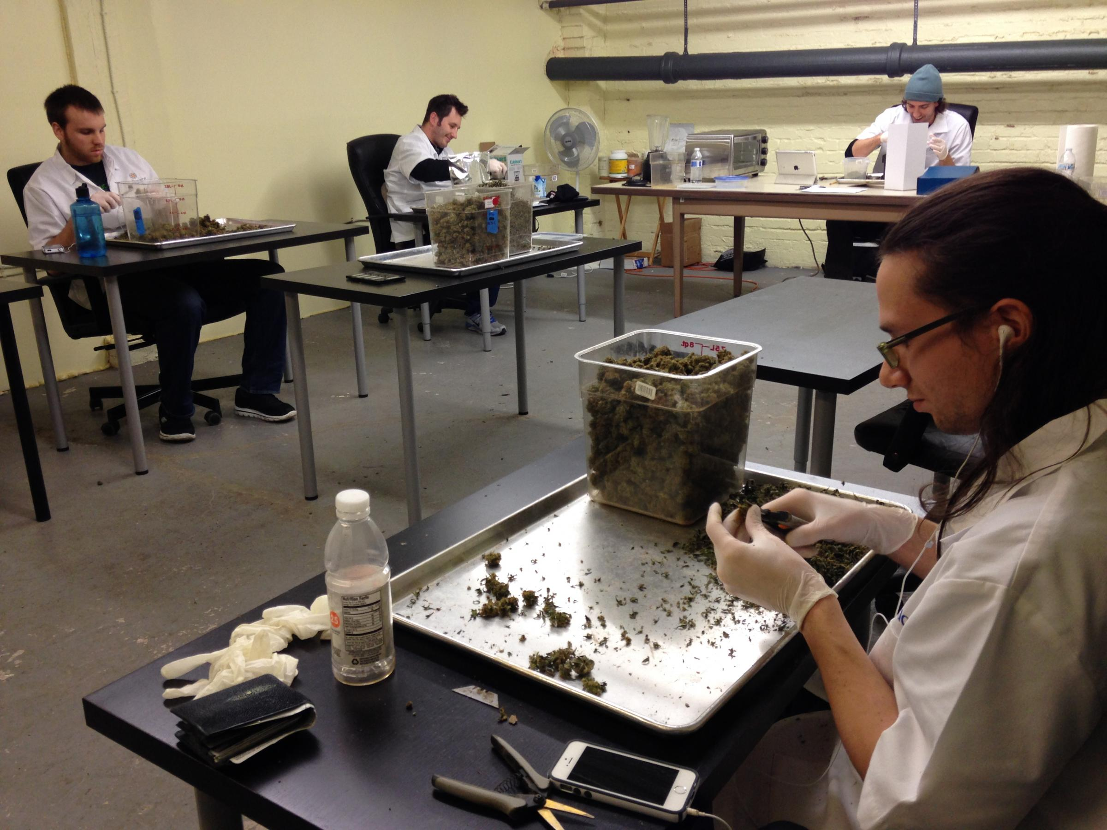
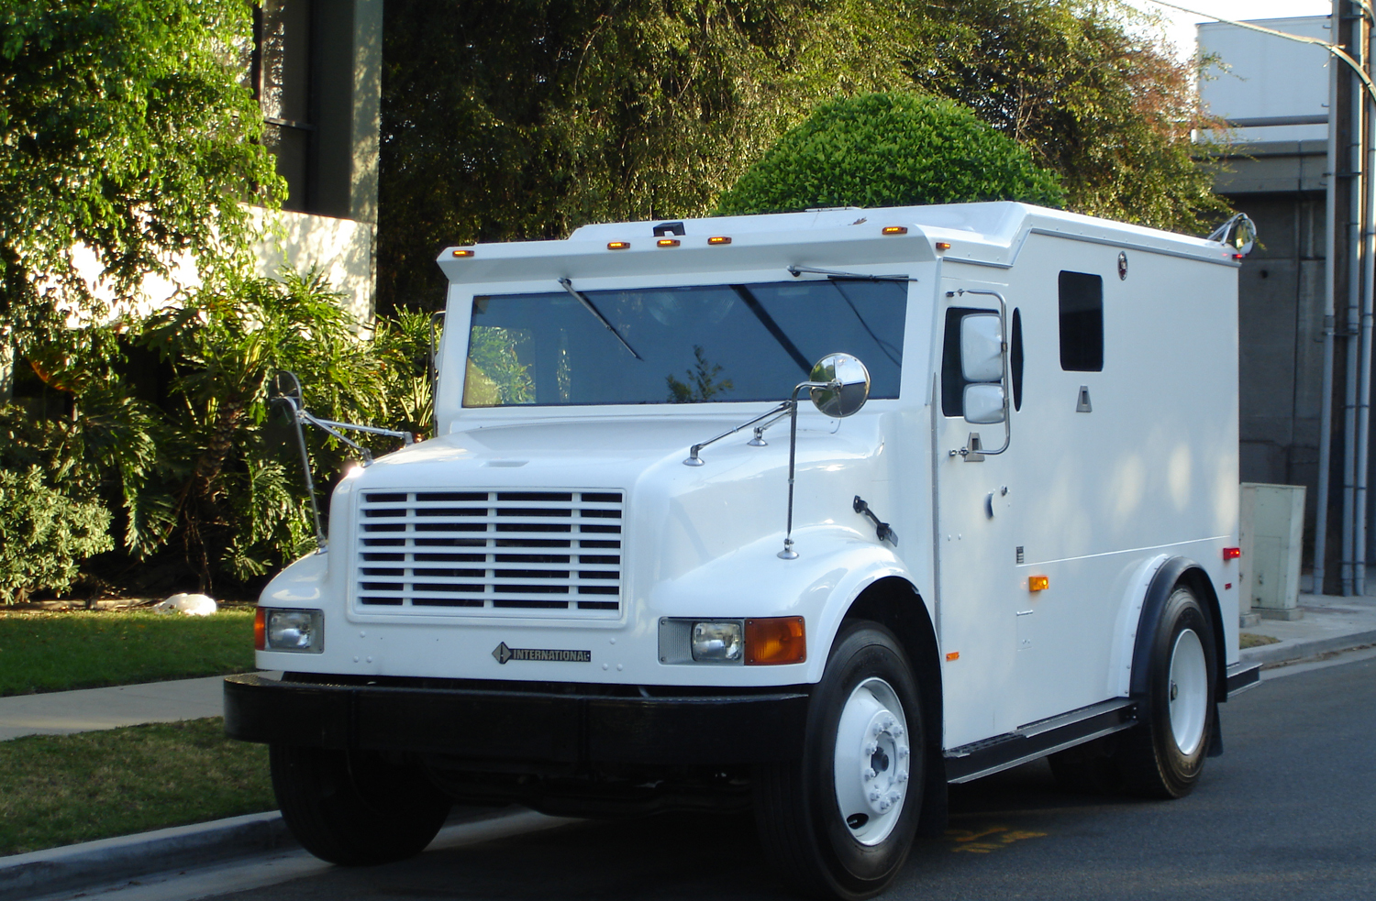
Medical Marijuana Facilities & Adult-Use Marijuana Establishments
CPC Presentation February 4, 2021

Slide 2
Proposed Text Amendments to Chapter 50 pertaining to Medical Marijuana Facilities and Adult-Use Marijuana Establishments

Slide 3
HISTORY
Medical Marihuana Act Initiated Law 1 of 2008
2012 Citizen Voter Legal Possession and Consumption (only Detroit)
2015 Medical Marihuana Caregiver Center provisions (only Detroit)
2016 Medical Marihuana Facilities Licensing Act (MMFLA)
May 2018 – Medical Marihuana Facilities Ordinance (only Detroit)
2018 Michigan Regulation and Taxation of Marijuana Act (MRTMA)
Notes:
In November 2008, Michigan voters passed a ballot initiative allowing the lawful sale and use of marihuana for medical purposes referred to as the Medical Marihuana Act Initiated Law 1 of 2008. This ballot initiative had widespread support amongst voters with a 63% approval of Michigan voters statewide and 75.6% of Detroit voters.
The passage of this act resulted in the proliferation of unlicensed and unregulated medical marihuana dispensaries and facilities throughout the city of Detroit, largely due to the lack of statutory regulation and oversight by the state, county and local government.
In November 2012, the electorate of the City of Detroit voted to enact a citizen-initiated ballot initiative which would allow for the legal possession and consumption of one ounce of marijuana or less on private property by an adult, aged 21 or older. This initiative passed with 65% voting yes.
In 2015 the Detroit City Council voted on the “Medical Marihuana Caregiver Center” ordinance (Ord. No. 31-15, effective 3/1/2016), which was enacted to amend the text of Chapter 61 of the 1984 Detroit City Code, “Zoning,” by defining “Medical Marihuana Caregiver Center” and creating regulations to stem the proliferation of and otherwise regulate such establishments in the City of Detroit. At the time of enactment, approximately 214 unlicensed and unregulated medical marihuana facilities had been established within the boundaries of the City of Detroit.
In 2016, the Michigan legislature enacted Public Acts, 281, 282, and 283 which allowed for the licensure of five Medical Marihuana Facility types, the production and sale of marihuana infused products, and the creation of a tracking system to monitor the products from “seed to sale.” This series of legislation has collectively been referred to as the Medical Marihuana Facilities Licensing Act (MMFLA).
In accordance with Public Act 281 (MMFLA), in order for a resident to obtain a state license, the municipality in which they wish to operate must opt into the state’s licensing scheme. The opt-in provisions have been implemented through what was previously Chapter 24 (now Chapter 20-Licensing), of the Detroit City Code, as a result of the November 7, 2017 ballot initiative – Proposal A. Proposal B was a citizen lead ballot initiative which sought to regulate the various land uses allowed through the MMFLA through zoning regulation, was ultimately struck down by Chief Judge Colombo of the 3rd Circuit Court and found to be in violation of the Michigan Zoning Enabling Act.
At the request of City Planning Commissioner Gregory Pawlowski (Feb. 2017- Feb. 2020), CPC staff convened two working group meetings including members of City Council staff, City department representatives, as well as members of the medical marihuana industry regarding developing the regulatory scheme for medical marihuana within the City of Detroit. Ordinance No. 20-18 was enacted on October 14, 2018 to regulate medical marijuana facilities in the City of Detroit.
In November 2018, the Michigan electorate enacted Proposal 1 – The Michigan Regulation and Taxation of Marijuana Act to legalize recreational marijuana possession, cultivation, and consumption by adults 21 years of age or older in the State of Michigan. The initiative was approved with 56% of the statewide vote, and was approved by the electorate of the City of Detroit with 69% voting yes.

Slide 4
SOCIAL EQUITY &
ADULT-USE MARIHUANA ORDINANCE
Lived in Detroit for 15 of the last 30 years, or
Lived in Detroit for 13 of the last 30 years and are low income, or
Lived in Detroit for ten of the last 30 years and have a marihuana conviction or have a parent with a marihuana conviction.
Notes:
After the passage of Proposal 1, the Office of Councilmember James Tate convened a working group to develop an ordinance specific to social equity to ensure that Detroiters, Detroit being one of the communities identified by the State as having been disproportionately impacted in terms of drug enforcement, benefit directly from the legalization of the adult-use cannabis industry. The product of the working group resulted in the adult-use marijuana provisions of the Detroit Business Licensing Ordinance under Chapter 20 of the 2019 Detroit City Code, Health Article VI – Medical Marihuana Facilities (Ord. No. 2020-44 effective 1/11/21). Under the provisions of the ordinance, Detroit residents who would like to participate in the recreational cannabis industry have the option to become certified as a Detroit Legacy applicant by CRIO (Civil Rights Inclusion & Opportunity Department) beginning January 19, 2021. To qualify as a Detroit Legacy applicant, individuals must currently reside in the city of Detroit, and be able to document that they:
Lived in Detroit for 15 of the last 30 years, or
Lived in Detroit for 13 of the last 30 years and are low income, or
Lived in Detroit for ten of the last 30 years and have a marihuana conviction or have a parent with a marihuana conviction.
On Tuesday, November 24, 2020, the Detroit City Council passed the Medical Marijuana Facilities and Adult-Use Marijuana Establishments ordinance authorizing the Buildings, Safety Engineering, and Environmental Department (BSEED) to issue business licenses for co-location, and adult-use marijuana establishments including grower, processor, retailer, secure transporter, safety compliance facility, microbusiness, marihuana event organizer, temporary marijuana event, and designated consumption establishments.

Slide 5
SOCIAL EQUITY &
ADULT-USE MARIHUANA ORDINANCE
The ordinance also requires that:
Detroit Legacy applicants get a minimum of 50% of all newly created adult-use marijuana business licenses for retailers, growers, processors, microbusinesses, designated consumption, and marijuana event organizers issued in Detroit.
There will be a six-week exclusive early licensing period for Detroit Legacy applicants.
Detroit Legacy applicants be able to purchase city-owned land at 25% of fair market value; and
The City work with philanthropy and private lenders to develop sources of funding and expertise to back Detroit-owned marijuana business start-ups.
Notes:
The ordinance also requires that:
Detroit Legacy applicants get a minimum of 50% of all newly created adult-use marijuana business licenses for retailers, growers, processors, microbusinesses, designated consumption, and marijuana event organizers issued in Detroit.
There will be a six-week exclusive early licensing period for Detroit Legacy applicants.
Detroit Legacy applicants be able to purchase city-owned land at 25% of fair market value; and
The City work with philanthropy and private lenders to develop sources of funding and expertise to back Detroit-owned marijuana business start-ups.

Slide 6
PROPOSED ZONING PROVISIONS
Article II, Division 6 – Review and Decision-Making Bodies
Article III, Division 12 – Medical and Adult-Use Provisions
Article IX, Business District Amendments
Article X, Industrial District Amendments
Article XI, Special Development District and Overlay Areas Amendments
Article XII, Use Table
Article XII, General Use Standards & Specific Use Standards
Article XIV, Parking
Article XVI, Words and Terms
Notes:
PROPOSED ZONING PROVISIONS
In order to fully effectuate adult-use marijuana facilities and accommodate the newly passed licensing provisions, new terms are being added to Chapter 50 to delineate adult-use facilities from medical marijuana facilities, as well as adding terms and permissibility for new adult-uses.
Below is an analysis and summary of the provisions of the proposed text amendments to Chapter 50, which will be the subject of your February 4th public hearing.

Slide 7
Article II, Division 6 –
Review and Decision-Making Bodies
Medical Marihuana Facility Review Committee
Chaired by Law
BSEED, Health, Detroit Police Department (DPD), Law, CPC, Planning and Development Department (PDD), and the Office of the Assessor.
Marihuana License Review Committee
Chaired by CRIO
Office of the Chief Financial Officer; the Office of the Assessor; BSEED; Office of the Chief Financial Officer, Treasury; Health Department; Law Department; Police Department; and any such departments, agencies, or individuals as deemed appropriate by the chairperson, on a case by case basis.
Notes:
The passage of the 2018 Medical Marihuana Facilities zoning provisions allowed the City of Detroit to expand the number of Review and Decision-Making Bodies to include the Medical Marihuana Facility Review Committee. The review committee served in the capacity of making comprehensive, multi-departmental recommendations prior to the statutorily required public hearing for conditional land uses. The committee was comprised of representatives from BSEED, Health, Detroit Police Department (DPD), Law, CPC, Planning and Development Department (PDD), and the Office of the Assessor. The rationale behind the creation of the committee was to avoid procedural errors and omissions which might result in litigation against the city. The final reviews of the Medical Marihuana Facility Review Committee in its current iteration took place on January 7, 2021.
With the passage of the Adult Use Marijuana Business Licensing provisions of Chapter 20 (Ord. No. 2020-44 effective 1/11/21), the Business Licensing the Medical Marihuana Facility Review Committee and its responsibilities as codified in the Zoning Ordinance Secs. 50-2-242 through 50-2-246 are being recommended to be stricken. The review for such facilities has shifted to Licensing under the Detroit City Code. The review of these facilities will be conducted by the Marihuana License Review Committee overseen by the CRIO rather than the Law Department. Additionally, the composition of the Marihuana License Review Committee differs from that of the Medical Marihuana Facility Review Committee and includes the Office of the Chief Financial Officer; the Office of the Assessor; BSEED; Office of the Chief Financial Officer, Treasury; Health Department; Law Department; Police Department; and any such departments, agencies, or individuals as deemed appropriate by the chairperson, on a case by case basis.
Staff will note that under the previous iteration of the Medical Marihuana Facilities Review Committee, the scope and utility of that review and decision-making body extended beyond reviewing an entity’s financial capability, and focused partially on an organization’s compliance with land use, zoning, setbacks, screening, and community benefits. The two agencies previously tasked with these elements of the review were the PDD, and CPC. In staff’s summation, these two departments provided a check to the interpretations offered by BSEED on issues which would often be discussed at either the special land use hearings or before the Board of Zoning Appeals. Staff believes that the inclusion of both PDD and CPC on the Marijuana License Review Committee would be beneficial by these departments continuing to review components of each application appropriate to their expertise.

Slide 8
Article III, Division 12 –
Medical and Adult-Use Provisions
Medical Marihuana Caregiver Centers (2015)
Medical Marihuana Facilities (2018)
Adult-Use Marijuana Establishments (2021)
Notes:
The ordinance as proposed amends Article III, Division 12 - Medical Marihuana Caregiver Centers and Medical Marihuana Facilities. The title of the division shall be changed to Medical Marijuana Facilities and Adult-Use Marijuana Establishments. With the passage of the 2020 Licensing Ordinance provisions, the land use of Medical Marihuana Caregiver Center has become a non-conforming use. Upon approval of the 2017 Medical Marihuana Facilities licensing provisions, the Buildings, Safety Engineering, and Environmental Department no longer accepts applications for Medical Marihuana Caregiver Centers nor issue renewals for such facilities. The intent is to phase out the land use in support of State-regulated Medical Marijuana establishments.
The general purpose of the revision of Article III is to regulate both medical marijuana facilities and adult-use marijuana establishments, to prevent concentration of these uses in order to better ensure the diversification of commercial and retail offerings along major and secondary corridors.
Additionally, references to the Michigan Medical Marihuana Facilities Licensing Act (Public Act 281 of 2016, MCL 333.27101 et seq.) and, the Michigan Regulation and Taxation of Marijuana Act (Initiated Law 1 of 2018, MCL 333.27951 et seq.) have been added to this section.
With the drafting of this ordinance a uniformed spelling of “Marijuana” has been adopted for utilization in all future ordinances and correspondence.
In regards to Sec. 50-3-531(c)(2)(d), the language requiring the Buildings, Safety Engineering and Environmental Department to maintain a list of locations of medical marihuana facilities that are licensed by the State of Michigan on the City of Detroit website is recommended to be stricken.

Slide 9
Sec. 50-3-532 – “Medical Marihuana Caregiver Centers and medical marihuana facilities subject to this division”
Notes:
In Sec. 50-3-532 – “Medical Marihuana Caregiver Centers and medical marihuana facilities subject to this division,” the language has been revised to strike the references to “Marihuana Caregiver Centers and medical marijuana” and replace the language with the terms “marijuana,” and “adult-use marijuana establishments.”

Slide 10
Sec. 50-3-533 – “Definitions.”
Notes:
In Sec. 50-3-533 – “Definitions.” The meaning of terms has been expanded and several definitions added to this section related to newly permissible business uses. Below is a summary of the revisions and/or additions proposed for this section:

Slide 11
Sec. 50-3-533 – “Definitions.”
The definition of Adult-use marijuana establishment has been newly added; as a location where a licensee operates one of the following commercial entities or activities under the authority of the MRTMA: grower, processor, retailer, secure transporter, safety compliance facility, marijuana microbusiness, excess marijuana grower, marijuana event organizer, temporary marijuana event, or designated marijuana consumption establishment, or any other type of marijuana-related business licensed to operate in accordance with the MRTMA.

Slide 12
Sec. 50-3-533 – “Definitions.”
The definition of Co-location has been revised to 1) include adult-use marijuana establishment in addition to medical marijuana facility where more than one licensee is authorized by the State of Michigan to operate; and, 2) specify that co-location applies to one building, and not multiple buildings on a single parcel.

Slide 13
Sec. 50-3-533 – “Definitions.”
The definition of Cultivation or cultivate has been revised to change the spelling of “marihuana” to “marijuana.”

Slide 14
Sec. 50-3-533 – “Definitions.”
The definition of a Designated marijuana consumption establishment has been newly added; as a location where a licensee that is licensed as a designated marijuana consumption establishment under the MRTMA and Chapter 20, Article VI of this Code operates a commercial entity that allows adults 21 years of age and older to consume marijuana products at a commercial location designated by the state operating license.

Slide 15
Sec. 50-3-533 – “Definitions.”
The definition of an Adult-use designated marijuana consumption establishment has been newly added; as a location where a business that is licensed under the Michigan Regulation and Taxation of Marihuana Act (MRTMA) and Chapter 20 of this Code is operated which permits adults 21 years of age and older to consume marijuana products at a commercial location designated on the state operating license, and approved in accordance with Chapter 50.

Slide 16
Sec. 50-3-533 – “Definitions.”
The definition of Drug-free zone in Sec. 50-3-533(d)(4) has been revised to reference “outdoor recreation facilities as defined in Sec. 50-16-324 of this Code, other than parkways and parklots.”

Slide 17
Sec. 50-3-533 – “Definitions.”
The definition of Equivalent licenses has been newly added, meaning any of the following held by a single licensee:
A marijuana grower license, of any class, issued under the MRTMA and a
grower license, of any class, issued under the MMFLA;
(2) A marijuana processor license issued under the MRTMA and a processor license under the MMFLA;
(3) A marijuana retailer license issued under the MRTMA and a provisioning center license issued under the MMFLA;
A secure transporter license issued under the MRTMA and a secure transporter
license issued under the MMFLA; or
A safety compliance facility license issued under the MRTMA and a safety
compliance facility license issued under the MMFLA.

Slide 18
Sec. 50-3-533 – “Definitions.”
The definition of Licensee has been revised by striking “marihuana” and adding “marijuana facility or a marijuana establishment.”

Slide 19
Sec. 50-3-533 – “Definitions.”
The definition of Medical marijuana grower facility has been revised to state Marijuana grower facility, meaning a location where a licensee that is licensed as a marijuana grower under the MRTMA or a grower under the MMFLA, and as a grower under Chapter 20, Article VI of this Code, operates a commercial entity located in this state that cultivates, dries, trims, or cures and packages marijuana for sale or transfer to a medical marijuana facility or adult-use marijuana establishment.

Slide 20
Sec. 50-3-533 – “Definitions.”
The definition of Marijuana microbusiness has been newly added meaning, a location where a licensee that is licensed as a marijuana microbusiness under the MRTMA and Chapter 20, Article VI of this Code operates a commercial entity that cultivates not more than 150 marijuana plants, or more as allowed by the State of Michigan, processes and packages marijuana, and sells or otherwise transfers marijuana to individuals who are 21 years of age or older or to a marijuana safety compliance facility, but not to other adult-use marijuana establishments or medical marijuana facilities.

Slide 21
Sec. 50-3-533 – “Definitions.”
The definition of Medical marihuana processor facility has been revised to state Marijuana processor facility, meaning a location where a licensee that is licensed as a marijuana processer under the MRTMA or a processer under the MMFLA, as well as under Chapter 20, Article VI of this Code, operates a commercial entity located in the state of Michigan that obtains marijuana from a medical marijuana facility or adult-use marijuana establishment and processes marijuana for sale and transfer in packaged form to a medical marijuana facility or adult-use marijuana establishment.

Slide 22
Sec. 50-3-533 – “Definitions.”
The definition of Marijuana retailer establishment has been newly added meaning, a location where a licensee that is licensed as a marijuana retailer under the MRTMA and Chapter 20, Article VI of this Code operates a commercial entity that obtains marijuana from adult-use marijuana establishments and sells or transfers marijuana to individuals who are 21 years of age or older and to other adult-use marijuana establishments.

Slide 23
Sec. 50-3-533 – “Definitions.”
The definition of Marijuana retail/provisioning facility has been newly added meaning, a marijuana retailer establishment or a medical marijuana provisioning center facility.

Slide 24
Sec. 50-3-533 – “Definitions.”
The definition of Medical marihuana safety compliance facility has been revised to state “Marijuana safety compliance facility” meaning, a location where a licensee that is licensed as a safety compliance facility under the MRTMA or the MMFLA, as well as under Chapter 20, Article VI of this Code, operates a commercial entity located in the state of Michigan that tests marijuana for contaminants and potency or as required by the MRTMA or the MMFLA for a primary caregiver, medical marijuana facility, or adult-use marijuana establishment.

Slide 25
Sec. 50-3-533 – “Definitions.”
The definition of Medical marihuana secure transporter facility has been revised to state “Marijuana secure transporter facility” meaning, a location where a licensee that is licensed as a secure transporter facility under the MRTMA or the MMFLA, as well as under Chapter 20, Article VI of this Code, operates a commercial entity located in the state of Michigan that stores marijuana, and transports marijuana between medical marijuana facilities or adult-use marijuana establishments for a fee.

Slide 26
Sec. 50-3-533 – “Definitions.”
The definition of Medical marihuana has been revised to state “Medical marijuana.”

Slide 27
Sec. 50-3-533 – “Definitions.”
The definition of Medical marihuana caregiver center has been stricken.

Slide 28
Sec. 50-3-533 – “Definitions.”
The definition of Medical marihuana facility has been revised to “Medical marijuana facility.”

Slide 29
Sec. 50-3-533 – “Definitions.”
The definition of Medical marihuana provisioning center facility has been revised to state “Medical marijuana provisioning center facility” meaning, a location where a licensee that is licensed as a provisioning center under the MMFLA and Chapter 20, Article VI of this Code operates a commercial entity located in the state of Michigan that purchases marijuana from a grower or processor and sells, supplies, or provides marijuana to qualifying patients, directly or through the registered primary caregivers of patients. Medical marijuana provisioning center facility includes any commercial property where medical marijuana is sold at retail to qualifying patients or primary caregivers. A medical marijuana caregiver center is not a medical marijuana provisioning center facility for purposes of this chapter.

Slide 30
Sec. 50-3-533 – “Definitions.”
The definition of Michigan Regulation and Taxation of Marihuana Act or “the MRTMA” has been newly added meaning, the Initiated Law 1 of 2018, MCL 333.27951, et seq.

Slide 31
Sec. 50-3-534 – “Medical marijuana caregiver center” procedures
Notes:
Sec. 50-3-534 – “Medical marijuana caregiver center procedures,” has been revised to reiterate that applications for medical marijuana caregiver centers will not be accepted after the effective date of the revised ordinance. Language pertaining to procedures for processing medical marijuana caregiver center applications have been stricken from this section.

Slide 32
Sec. 50-3-535 – “Permitted districts for medical marijuana facilities and adult-use marijuana establishments; Conditional use; Restrictions,”
“Notwithstanding anything to the contrary in this Code, all of the below uses may be located in PD zoning districts, excluding residential PD districts, with the appropriate approvals under this Code:”

Slide 33
Sec. 50-3-535 – “Permitted districts for medical marijuana facilities and adult-use marijuana establishments; Conditional use; Restrictions,”
Notes:
Newly added to Subsection (a) of this section are the land uses of Designated marijuana consumption establishment which may be permitted on a conditional basis in B2, B4, B5, B6, M1, M2, M3, M4, and SD2 zoning districts, and Marijuana microbusinesses which may be permitted on a conditional basis in the B2, B4, B5, B6, M1, M2, M3, M4, and SD2 zoning districts. The land use of Medical marijuana provisioning center has been replaced with Marijuana retail/provisioning facilties. Additionally the language which limits the number of provisioning center facilitity licenses to 75 has been stricken from this section, noting that the licensing limitation is now included in Chapter 20, Article VI of the City Code.

Slide 34
Designated marijuana consumption establishments
Notes:
Designated marijuana consumption establishments were created to give cannabis consumers places to legally consume cannabis other than on private property. They are commercial spaces where adults can legally consume marijuana products-sometimes being referred to as cannabis cafes or cannabis lounges.

Slide 35
Marijuana microbusinesses
Notes:
The intent of Marijuana microbusinesses is to give an opportunity to more entrepreneurs to be able to enter the marijuana industry on a small scale, in a vertically-integrated facility, by allowing growing of up to 150 cannabis plants, processing, and retail, all in the same facility. These businesses cannot acquire marijuana or marijuana products from other growers, processors or retailers, and, may not sell to other retailers.

Slide 36
Locational Prohibition
(1) within a drug-free zone,
(2) within a Gateway Radial Thoroughfare overlay area or Traditional Main Street overlay area, or
(3) on a zoning lot that is located less than “1,000 radial feet from a zoning lot occupied by any religious institution identified as exempt by the City Assessor,” any zoning lot “with an unexpired conditional land use approval, building permit, or certificate of occupancy for medical marijuana provisioning center facility, an adult-use marijuana retailer establishment, or a marijuana microbusiness,” or within “1,000 feet of any zoning lot occupied by a Controlled Use,”
Notes:
Also in Subsection (b) of this section, the three-part prohibition against locating (1) within a drug-free zone, (2) within a Gateway Radial Thoroughfare overlay area or Traditional Main Street overlay area, or (3) on a zoning lot that is located less than “1,000 radial feet from a zoning lot occupied by any religious institution identified as exempt by the City Assessor,” any zoning lot “with an unexpired conditional land use approval, building permit, or certificate of occupancy for a marijuana retail/provisioning facility or a marijuana microbusiness,” or within “1,000 feet of any zoning lot occupied by a Controlled Use,” has been extended to designated consumption establishments, marijuana retail/provisioning facilities and marijuana microbusinesses.

Slide 37
Drug Free Zone
Newly added to this section are subsections “e” and “f” which read:
(e) If a property has previously received zoning approval for a medical marijuana facility or adult-use marijuana establishment, no further approval is required under this chapter to operate a business under an equivalent license, as defined in Section 50-3- 533 of this Code, at the property, although a new business license under Chapter 20, Article VI of this Code and state operating license are required prior to commencing operation.
(f) If the Department establishes that a use posing a restriction under this section has been abandoned or has ceased all operations for at least one year, the Department may disregard the locational specifications of subsections (b)(1), (b)(2), (b)(3), or (c) of this section, excluding uses that are closed due to the Covid-19 pandemic.
Notes:
The prohibition against locating within a drug-free zone is also extended to marijuana grower, marijuana processor, designated marijuana consumption establishment, and marijuana secure transporter facilities.

Slide 38
Sec. 50-3-536 – “Medical marihuana facility procedures”
Notes:
Sec. 50-3-536 – “Medical marihuana facility procedures” has been revised to state Medical marijuana facility and adult-use marijuana establishment procedures and to make reference to to medical marijuana facilities and adult-use marijuana establishements. This section has also been revised by stricking references to the Medical marihuana Facility Review Committee and application requirements.

Slide 39
Sec. 50-3-357 – “Accessory Uses; Public Nuisance”
Notes:
Sec. 50-3-357 – “Accessory Uses; Public Nuisance” - provides that marijuana establishments are not permitted as accessory uses, and must not include accessory uses. However, multiple types of medical marijuana facilities and adult-use marijuana establishments may co-locate in the same building as separate principal uses of the premises.

Slide 40
Article IX, Business District Amendments
Notes:
The proposed ordinance amends Article IX, Division’s 3, 5, 6 and 7, which comprise the use lists for the B2 – Local Business and Residential District, B4 – General Business District, B5 – Major Business District, and B6 General Services District zoning classifications by adding the new uses of Designated marijuana consumption establishment, Marijuana microbusiness, Marijuana retail/provisioning facility, and Marijuana safety compliance facility as provided for in Article III, Division 12 of this chapter. These divisions are also revised by striking “Medical marihuana,” and replacing the language with “Marijuana” where appropriate, and by adding “adult-use marijuana retailer establishment” where appropriate as reflected in Secs. 50-9-54, 50-9-114, 50-9-144, and 50-9-174.

Slide 41
Article X, Industrial District Amendments
Notes:
The proposed ordinance amends Article X, Division’s 2, 3, 4, 5, and 6, which comprise the use lists for the M1 – Limited Industrial District, M2 – Restricted Industrial District, M3- General Industrial District, M4 – Intensive Industrial District, and M5 – Special Industrial District zoning classifications by striking references to Medical marihuana caregiver centers as provided for in Article III, Division 12, of this chapter, and adding the new uses of Designated marijuana consumption establishment, Marijuana grower facility as provided for in Article III, Division 12 of this chapter, Marijuana microbusiness, Marijuana processor facility as provided for in Article III, Division 12 of this chapter, Marijuana retail/provisioning facility, Marijuana safety compliance facility as provided for in Article III, Division 12 of this chapter, and Marijuana secure transporter facility as provided for in Article III, Division 12 of this chapter.
Sec. 50-10-144 – Special Industrial District does not permit the two aforementioned new uses, however, it does revise the permissible land uses associated with processing, safety compliance, and secure transporter facilities.

Slide 42
Article XI, Special Development District and Overlay Areas Amendments
Notes:
Additionally, the proposed ordinance amends Article XI, Division’s II, and X which comprises the legislative intent of the PD - Planned Development District and the use lists for the SD2 – Special Development District zoning classifications by reiterating that Marijuana-related uses, as specified in Sec. 50-12-110 of this Code, are not permitted on land zoned PD established as a residential planned development.
Designated marijuana consumption establishment, Marijuana retail/provisioning facility, and Marijuana microbusiness are newly added to the conditional use list of the SD2 zoning classification under Sec. 50-11-244. Additionally, this section is also revised by striking “Medical marihuana,” and replacing the language with “Marijuana” where appropriate.
The proposed ordinance amends Article XI, Division 14 – Overlay Areas by newly adding Designated marijuana consumption establishment, Marijuana retail/provisioning facility, and Marijuana microbusiness as prohibited on any zoning lot zoned B2 or B4 abutting any Gateway Radial Thoroughfare.

Slide 43
Sec. 50-11-386 – “Traditional Main Street Overlay Areas.”
Notes:
Sec. 50-11-386 – “Traditional Main Street Overlay Areas.” This section prohibits designated marijuana consumption establishments, marijuana microbusinesses, or marijuana retail/provisioning facilities from locating within any Traditional Main Street Overlay Area.

Slide 44
Article XII, Use Table
Notes:
The proposed ordinance amends Article XII, Division 1, Use Table, by adding the newly revised and/or added land uses to their respective category of Medical Marijuana Facilities and Adult-Use Marijuana Establishments as denoted in Sec. 50-12-110.

Slide 45
Article XII, General Use Standards & Specific Use Standards
Notes:
The proposed amendments to Article XII, Division 2 – General Use Standards, amend Sec. 50-12-132 – Other uses – Spacing, by striking the section pertaining to Medical marihuana caregiver center and specifying the spacing requirements for the other associated marijuana related uses.
Additionally, Sections 50-12-135 – “Waiver of general spacing requirements,” and 50-12-136 – “Waiver of spacing from schools,” state explicitly that spacing requirements may not be waived.
The proposed amendments to Article XII, Division 3 – “Specific Use Standards,” amend the language reflecting “Medical marihuana caregiver center” to reflect “Marijuana” where appropriate and to incorporate “adult-use marijuana establishment” where appropriate.

Slide 46
Sec. 50-12-413 – “Medical marijuana facilities and adult-use marijuana establishments”
Notes:
Newly added to Sec. 50-12-413 – “Medical marijuana facilities and adult-use marijuana establishments” are subsections (3),(4), and (5).
Subsection 3 specifies that a marijuana grower facility may operate only in a commercial or industrial building that has a building footprint that does not exceed 30,000 square feet and that is located on a parcel no larger than three acres; a marijuana grower facility may operate in a multi-story building, subject to applicale height limitations. A marijuana grower facility may operate in a building that has a building footprint that exceeds 30,0000 square feet but does not exceed 50,000 square feet, regardless of height, and is located on a parcel no larger than five acres only if that marijuana grower facility is co-located with another medical marijuana facility or another adult-use marijauan establishment.
Subsection 4 states that marijuana grower facilities may not grow outdoors.
Subsection 5 states that marijuana microbusinesses and marijuana retail/provisioning facilities may include drive-thru or curbside pickup operation if such operations are in compliance with applicable rules set forth by the state of Michigan. This section is incorporated to ensure that social distancing safeguards to combat the Covid-19 pandemic are in place.

Slide 47
Article XII, Division 6 – “Temporary Uses and Structures,”
Notes:
Article XII, Division 6 – “Temporary Uses and Structures,” strikes the references to Medical marihuana caregiver centers and medical marihuana facilities and replaces them with Medical marijuana facilities and adult-use marijuana establishments.

Slide 48
Article XIV, Parking
Notes:
Article XIV, Subdivision B – Off-Street Parking Schedule A, is revised as follows:

Slide 49
Article XVI, Words and Terms
Marijuana retailer establishment,
Marijuana retail/provisioning facility,
Marijuana safety compliance facility,
Marijuana secure transporter facility,
Medical marijuana facility,
Medical marijuana Provisioning Center Facility,
Michigan Medical Marihuana Facilities Licensing Act or “MMFLA,” and
Michigan Regulation and Taxation of Marijuana Act or “MRTMA”
Adult-use marijuana establishment,
Co-location (marijuana),
Cultivatoin or cultivate (marijuana),
Designated marijuana consumption establishment,
Drug-free zone, Equivalent licenses (marijuana),
Licensee (marijuana),
Marijuana grower facility,
Marijuana microbusiness,
Marijuana processor facility,
Notes:
Finally, Article XVI, Division 2 – “Words and Terms Defined,” is proposed to be revised by amending and adding several definitions. The existing terms, including the word “Marihuana,” have been revised to read “Marijuana,” and Adult-use marijuana establishment, Co-location (marijuana), Cultivatoin or cultivate (marijuana), Designated marijuana consumption establishment, Drug-free zone, Equivalent licenses (marijuana), Licensee (marijuana), Marijuana grower facility, Marijuana microbusiness, Marijuana processor facility, Marijuana retailer establishment, Marijuana retail/provisioning facility, Marijuana safety compliance facility, Marijauana secure transporter facility, Medical marijuana facility, Medical marijuana Provisioning Center Facility, Michigan Medical Marihuana Facilities Licensing Act or “MMFLA,” and Michigan Regulation and Taxation of Marijuana Act or “MRTMA” definitions are newly added to this section.
The proposed revisions to the Zoning Ordinance are anticipated to move in tandem with an amendatory ordinance for the Chapter 20 – “Business Licensing” provision so the definitions of Adult-Use Marijuana Consumption Establishment coincide with one another.

Slide 50
COMMUNITY CONCERNS &
RECOMMENDATIONS
Greenacres Woodward Civic Association (GWCA)
Other Residents
Notes:
COMMUNITY CONCERNS AND RECOMMENDATIONS
Following earlier attempts in March 2020 the Greenacres/Woodward Civic Association (GWCA) submitted a detailed list of suggested changes to both the Business Licensing (Chapter 20) and Zoning Ordinance (Chapter 50) provisions pertaining to Adult-use Marijuana establishments. There were two specific recommendations related to zoning regulations that the GWCA requested the working group to consider.
First, the GWCA requested that, in an effort to stop the over-concentration of marijuana-related facilities along Eight Mile Road and Woodward Avenue, new regulations be drafted to prohibit the establishment of retail marijuana establishments, marijuana micro-businesses, adult-use marijuana designated consumption establishments, and temporary marijuana events along the “Major Corridor Overlay Area.” Designated “Major Corridor Overlay Areas” are defined in Sec. 50-11-402 as:
Woodward. All zoning lots abutting Woodward Avenue between the center line of West McNichols and the center line of West Wight Mile Road;
(2) Eight Mile Road. All zoning lots abutting Eight Mile Road.
The Detroit Zoning Ordinance only prohibits sexually oriented business in this manner along the Major Corridor Overlay Areas. Such a prohibition may, in fact, have the opposite effect sought by the GWCA, which would be the greater distribution of marijuana-related facilities throughout the City of Detroit. The current zoning and spacing regulations imposed upon existing medical marijuana establishments are the same regulations proposed for adult-use marijuana establishments. Presently spacing restrictions are in place throughout the City of Detroit which prohibit dispensary type facilities from locating within 1,000 radial feet of each other, drug free zones, schools, daycare centers, parks, regulated uses and the like. The city’s Business Licensing ordinance only permits a limited number of Retail and/or Medical marihuana provisioning center facility licenses, i.e., 75 each. At present, approximately 48 of the permissible 75 licenses for Medical marijuana provisioning center facilities have been issued by the city since the passage and enactment of the Medical Marihuana Facilities licensing provisions.
Under the state law regulating the operation and taxation of such establishments (MRTMA), facilities are permitted to co-locate on the same premises. It is fully expected that many of the existing establishments along Eight Mile Road and Woodward Avenue which currently hold state licenses for medical marijuana will likely be licensed for adult-use marijuana sales as well. Presently each of these establishment casts a 1,000-foot radial shadow prohibiting other such establishments from proliferating in an area. If the requested amendment were to be enacted, 1) the City of Detroit would be acting contrary to the spirit and intent of the statute which encourages co-location; 2) existing, as well as, future facility owners would have to seek out primary or secondary facilities throughout the city in closer proximity to historically residential neighborhoods and commercial corridors.
The second zoning request submitted by GWCA is to amend the current Traditional Main Street Overlay Area on Livernois Avenue by extending the boundaries from its current end point at St. Martin Avenue to West Eight Mile Road. This latter recommendation has already been undertaken by the Commission and acted on by City Council as a part of the most recent text amendments (Ord. No. 2020-21) to address needed changes to the Main Street Overlay areas involving off-parking allowances, and the expansion of area boundaries along West Grand River, Livernois Avenue, and Van Dyke Avenue. While the intent of this most recent text amendment was not to expressly prohibit marijuana related establishment from locating along the Livernois Avenue Traditional Mainstreet Overlay Area corridor, the resulting effect has yielded the petitioners’ desired outcome.
An additional recommendation was submitted by a member of the public requesting a spacing restriction of 500 radial feet from all land zoned residential. In conducting a cursory review of this recommendation it would appear that every major and secondary thoroughfare within the City of Detroit would be affected, nearly prohibiting any such facility from being established. It is ill-advised to pursue such a recommendation considering that any municipality, village or township, which lawfully allows a principal land use, must also allow conditions in which that land use may be established. If the petitioner’s recommendation were enacted the City of Detroit would find itself exceedingly vulnerable to litigation.
Among the many reasons a spacing restriction from land zoned residential, outside of the Residential PD, has not been pursued is the fact that under state law a resident in a single-family detached home, or any other residential domicile could theoretically legally possess up to 84 marijuana plants. A typical single-family detached home has a required side setback of as little as four-feet. The average required rear setback from commercial property along a major or secondary thoroughfare is 30 feet.

Slide 51

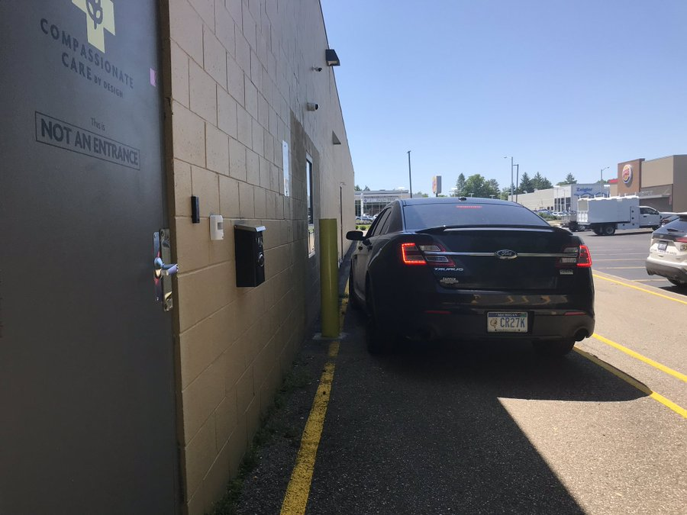
City Planning Commission Concerns
Notes:
In regards to the Commission’s concerns over the utilization of “curbside” and/or “drive-thru” operation, staff was able to find several examples of facilities in the State of Michigan which operated both “curbside” and/or “drive-thru” facilities. In speaking with law enforcement and licensing agencies in Ann Arbor, Michigan, Ypsilanti, Michigan, Kalamazoo, Michigan, and Grand Rapids, Michigan, staff received no negative reports regarding the “curbside” or “drive-thru” operations of these facilities associated with larceny, theft, or any other violent crime resulting in loss of property or life. Regardless, after further conversation with the sponsor of the ordinance, Councilmember Tate, it has been determined that the language regarding “drive-thru” and “curbside” sales be stricken from the ordinance.
In regards to the Commission’s request that a state issued list of licensed facilities be maintained on the City’s website, it is just that very list that is being recommended to be stricken from the ordinance. No rationale was given as to why the list is being removed.

Slide 52
Timeline & Council Consideration
City Planning Commission Public Hearing on February 4, 2021 @ 7 PM
Referred to the Planning and Economic Development Standing Committee for Introduction and the Setting of a Public Hearing
Public Hearing at the Planning and Economic Development Standing Committee after a 15 notice period
Vote by the Detroit City Council following the PED Public Hearing
Publication in the Legal News
Eight days after publication the Text Amendments take effect
April 1, 2021 applications for Adult-Use Marijuana establishments will be accepted by certified Detroit Legacy applicants
Notes:
The provisions of the Licensing Ordinance for Adult Use Marijuana are scheduled to go into effect on April 1, 2021 to accommodate the receipt of application for residents certified as Legacy Detroiters.

Slide 53
Recommendation

