Slide 1
CITY OF DETROIT
Police Department FY 2022 Budget Presentation
Nevrus P. Nazarko, Agency CFO
January 14, 2021

Slide 2
Outline
FY 2022 Budget Overview
Budget Timeline
New Initiatives
Revenues & Expenditures
Capital
Positions
Grants

Slide 3
FY 2022 Budget Baseline Factors
All departments were asked to support a balanced budget and long-term fiscal sustainability based on revenues streams.
Departments should working with their Agency CFO and Office of Department Financial Services (ODFS) to prepare budget submissions by the required timelines.
Departments should continue to plan for workforce efficiency, overtime management and other savings opportunities.
For FY2021 new Outcome budgeting appropriations will be in place to track:
Safer Neighborhoods
Vibrant and Beautiful City
Economic Equity and Opportunity
Efficient and Innovative Operations
Effective Governance
Budget submission should not exceed the Office of Budget allocation. Any funding requested over the Budget Allocation must be submitted with required forms and justifications.

Slide 4
Budget Timeline 1

Slide 5
Budget Timeline 2

Slide 6
Budget New Initiatives
Request to add 20 Police Officer positions and 5 HR Consultants for a total cost of $1,177,030
Shot Spotter initiative, to add detection sensors at the 8th and 9th districts to improve police response to shootings. It is a 4 year contract with an annual cost of $371,000.
Leadership Academy, program with Wayne State University for a cost of $220,000
More details on these initiatives are in the attached document provided separately

Slide 7
Overview of Budget Request 2022
 | FY 2021 Budget | FY 2022 Request | Variance
General Fund Revenue | $59,800,500 | $57,848,666 | ($1,951,834)
Special Revenue | $7,530,735 | $7,665,100 | $134,365
Narcotics Forfeiture Revenue | $1,229,053 | $1,253,064 | $24,011
Grant Revenue | $6,064,832 | $6,182,340 | $117,508
Total Revenue | $74,625,120 | $72,949,170 | ($1,675,950)
General Fund Expenditures | $314,662,142 | $354,702,949 | $40,192,987
Grant Expenditures | $6,064,832 | $6,281,041 | $214,029
Forfeiture Expenditures | $1,229,053 | $1,164,430 | ($64,623)
Special Fund Expenditures | $6,775,000 | $7,143,114 | $368,114
Total Expenditures | $328,731,027 | $369,291,534 | $40,560,507

Slide 8
Expenditures
 | FY 2021 Budget | FY 2022 Request | Variance
Total Expenditures | $328,731,027 | $369,291,534 | $40,560,507
Increase $40.7 million over FY 2021 Budget
$24M due to increase in positions, new titles, and wage increases for both civilian and uniform employees.
$9M due to increase in benefits
$1.3M due to increase in Professional and Contractual Services for IT Contracts, Clinical Psychologist, Fleet Analyst, and New Cadet Training Program
$5.6M due to increase in Operating Services for increase in utilities, private security (Lyndon (911 Backup), Oakman, & Tow Lots), IT Services (Voice Com, Purchased Services, Office Equip, & Telecom)
$0.6M in Special Revenue Fund (E 911 and Towing)

Slide 9
Capital Expenditures Request FY 2022

Slide 10
Capital Expenditures
 | FY 2021 Budget | FY 2022 Request | Variance
Total Capital Request | $0.00 | $23,625,000 | $23,625,000
$23M in capital requests focused on repairing, replacing, and rebuilding equipment and facilities that are well beyond their useful life. Prior fiscal year capital expenditures included in the UTGO Bond Fund.
This request is not part of the general fund budget request. The request is to have unused UTGO Bond Funds re-appropriated for Police Capital Projects.

Slide 11
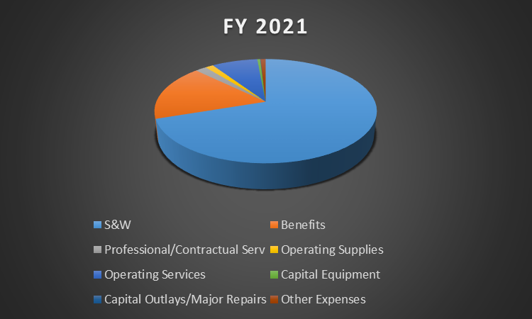
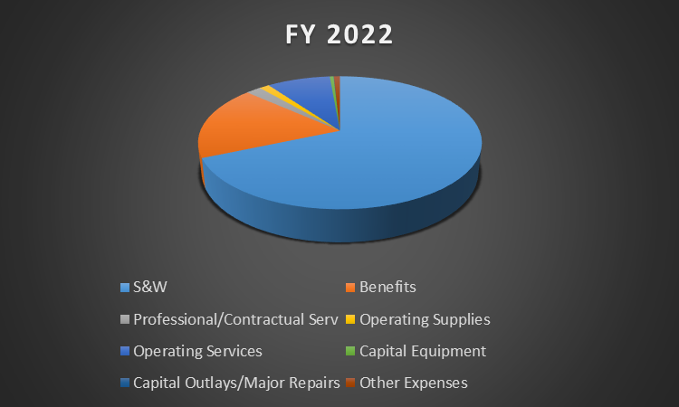
Expenditure Charts

Slide 12
Positions
 | FY 2021 Budget | FY 2022 Request | Variance | Major Changes
Civilian | 742 | 748 | 6 | Added Employee Services Consultants Added Project Manager & Analytics Specialist
Uniform | 2,671 | 2,691 | 20 | Added Police Officers
Total Positions | 3,413 | 3,439 | 26
Salary Benefits Total | $229,528,337 57,434,719 $286,963,056 | $253,184,764 66,820,127 $320,004,891 | $23.7M 9.4M $33.1M

Slide 13
Grants – FY 22 Budget Request

Slide 14
Questions?

