Slide 1
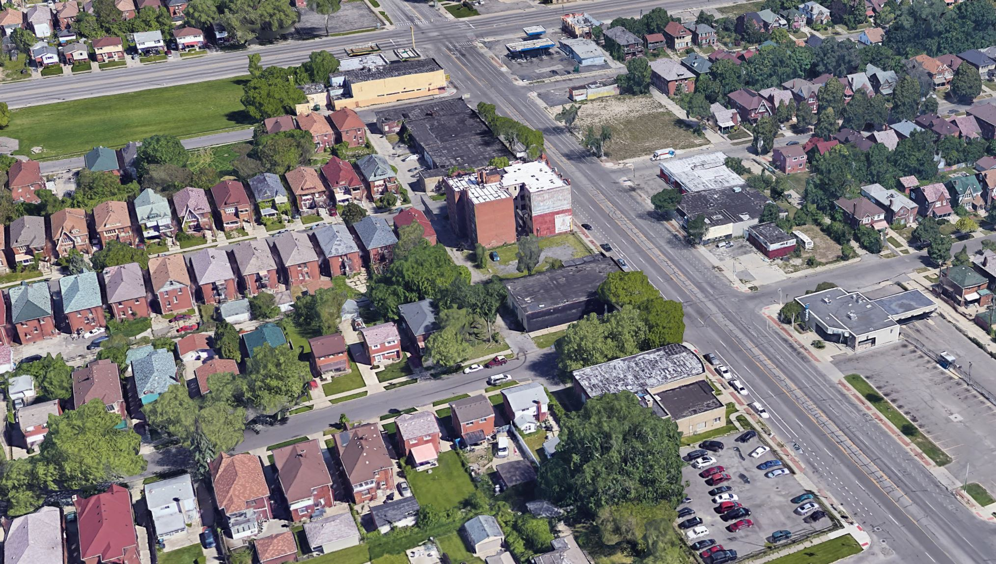

DEXTER
AVENUE

Slide 2
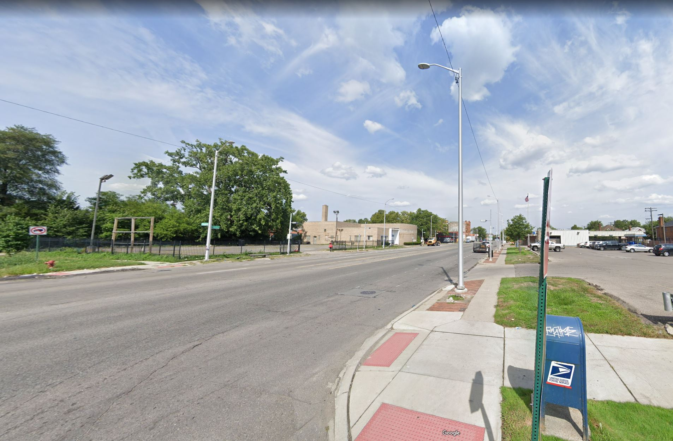
Agenda
Introduction & Overview
Streetscape Elements
Street Section Options
Gateways
Q & A
Open House Review

Slide 3



Project Team
City of Detroit
  Department of Public Works
    Planning & Development Department
    Department of Neighborhoods
Consultant Team
www. detroitmi.gov/streetscapes

Slide 4
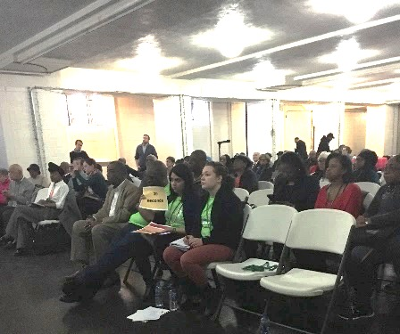
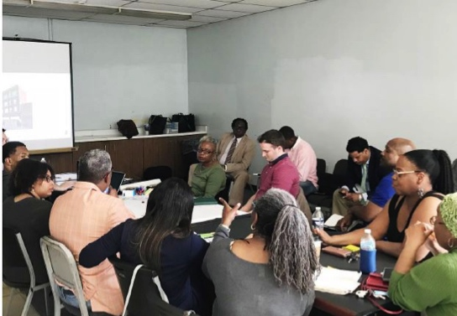
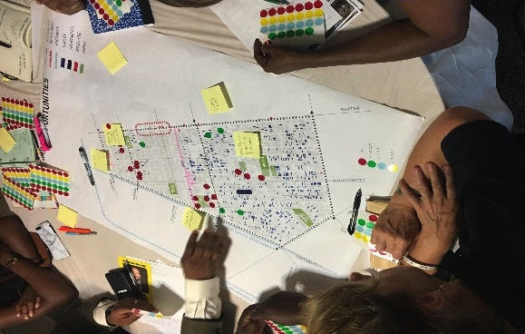
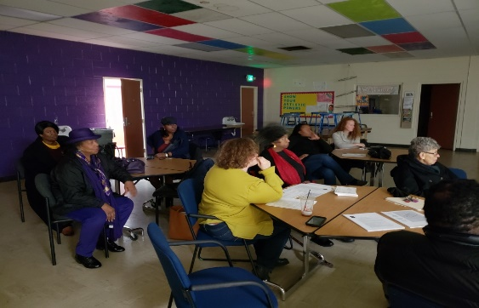
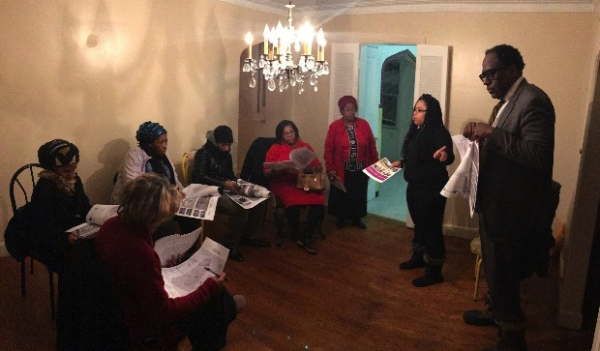
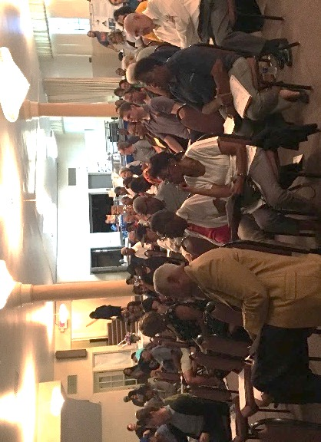
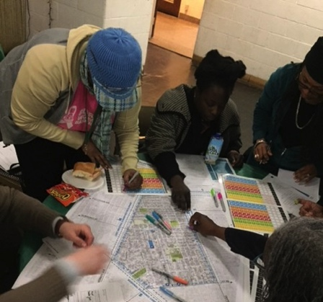
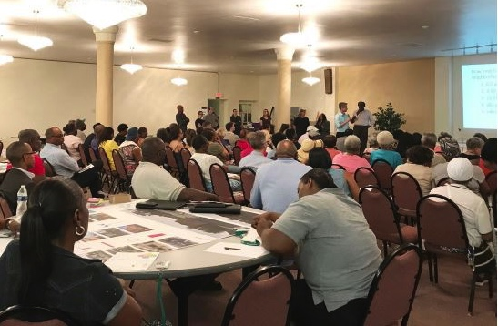
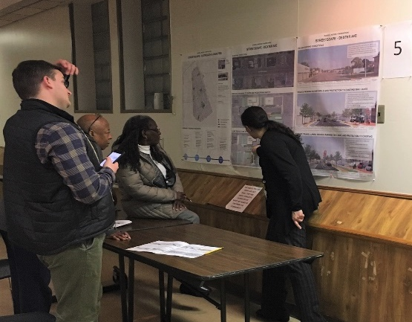
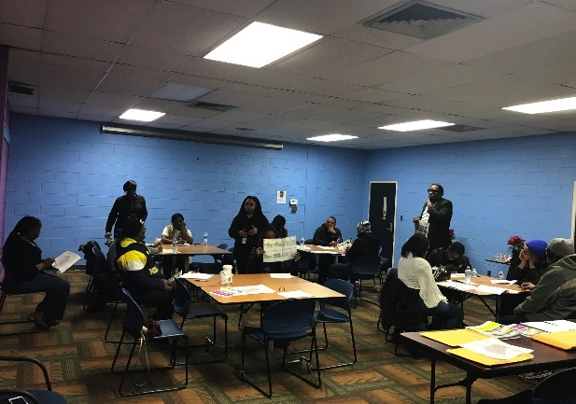
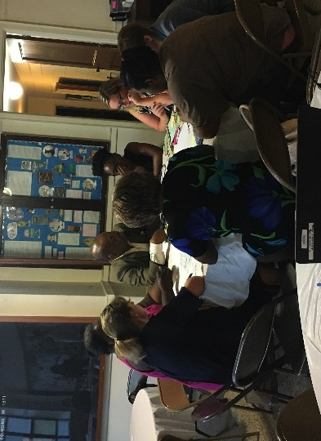
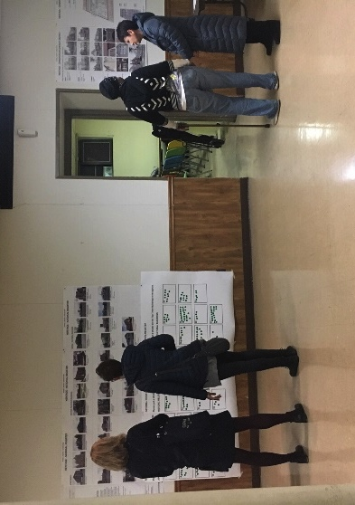
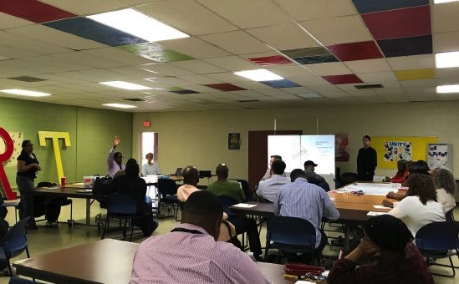
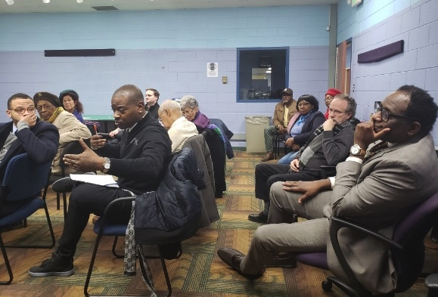
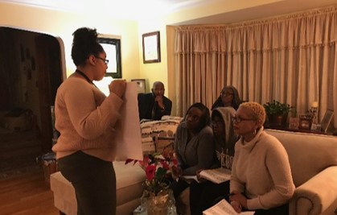
Neighborhood Framework Plan
APR 2018
MAY 2018
AUG 2018
NOV 2018
JAN 2019
APR 2018
JUL 2018
SEPT 2018
DEC 2018
JAN 2019
MAY 2018
AUG 2018
NOV 2018
DEC 2018
FEB 2019

Slide 5
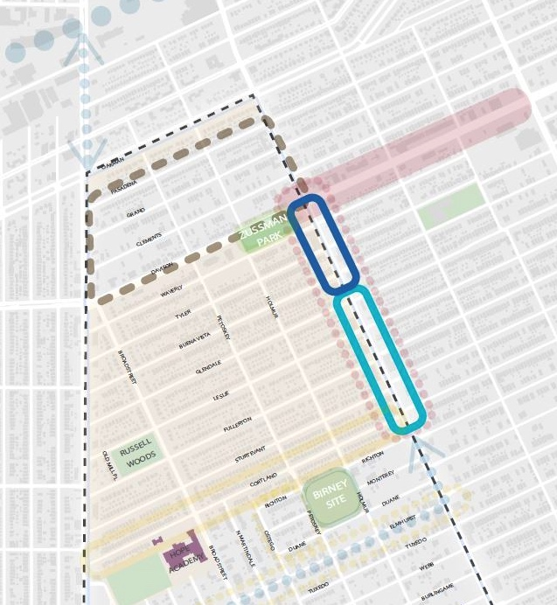
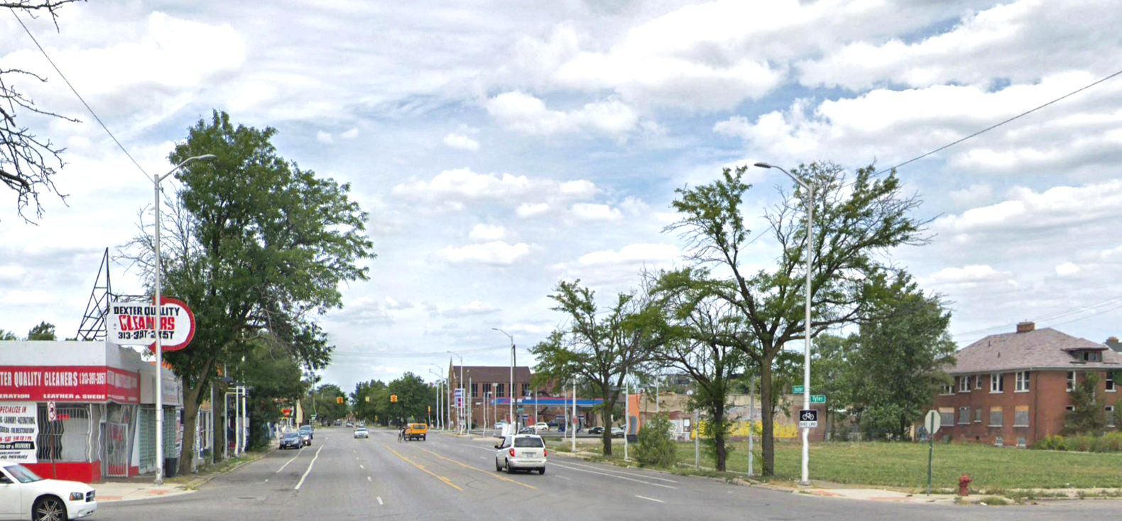
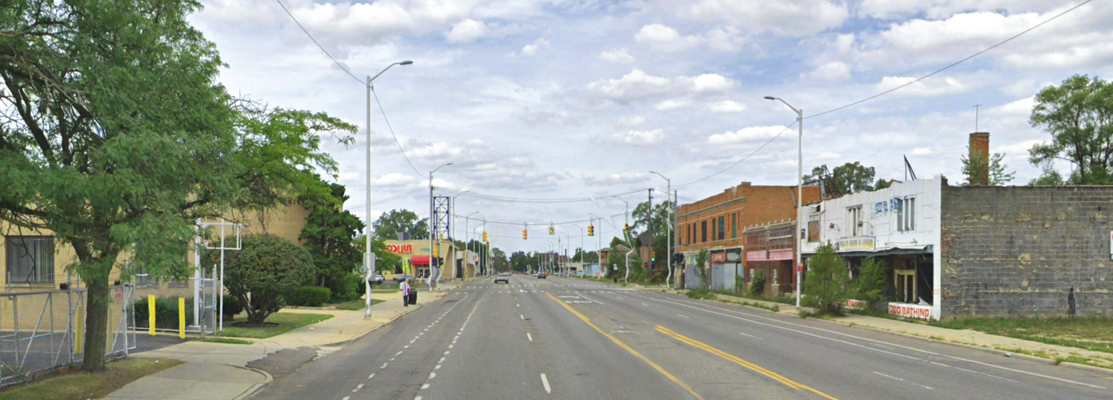
Dexter Streetscape
OAKMAN BLVD
STREET
NODE 1
RUSSELL WOODS
HISTORIC DISTRICT
LIVERNOIS AVE
STREET
NODE 2
DEXTER AVE

Slide 6
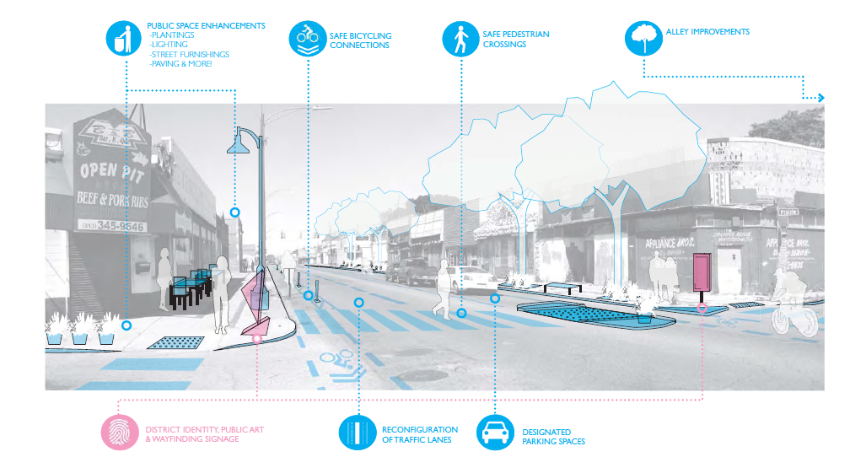
What is a “streetscape”?

Slide 7
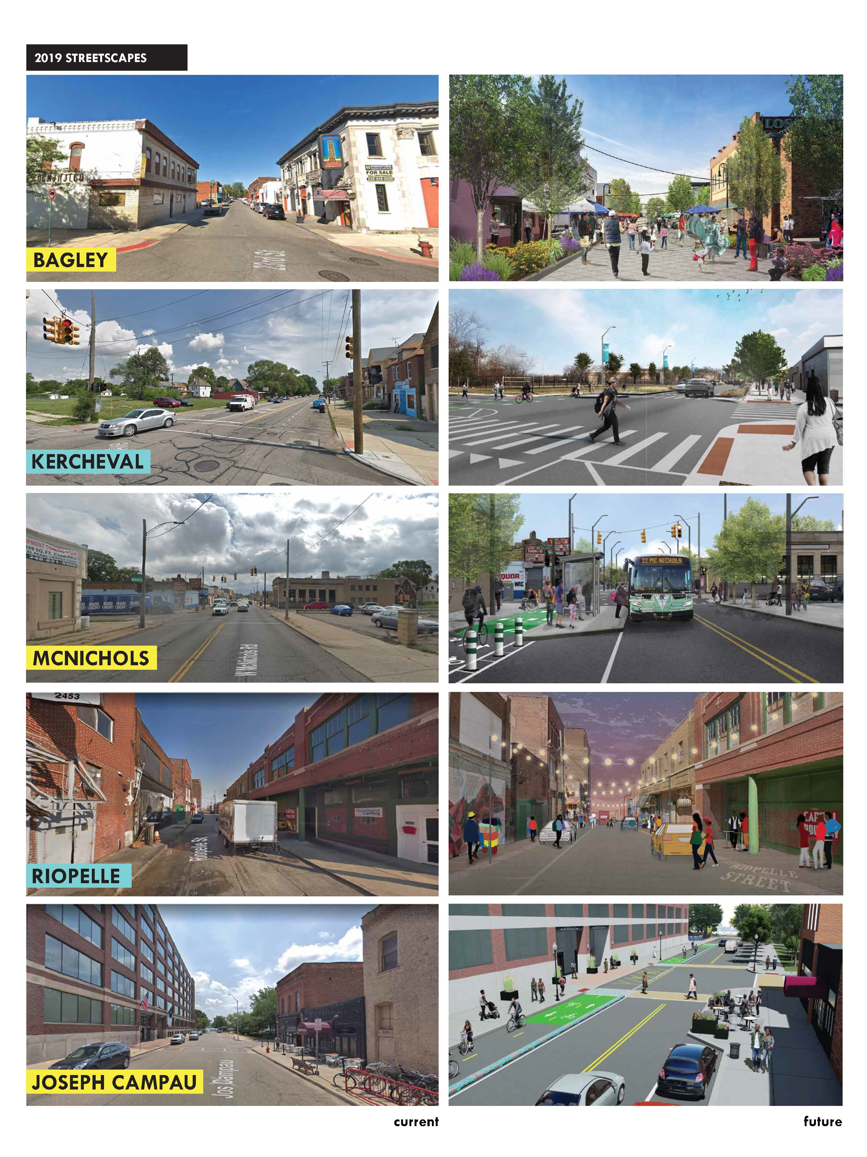
Detroit Bond Program
5-Years
26 projects
$80 million

Slide 8
Detroit Bond Program
Funding to support transformative streetscape projects
Revitalizing retail corridors
Tied to Neighborhood Framework Plans

Slide 9
Schedule
2019
2020
AUG | SEPT | OCT | NOV | DEC | JAN | FEB | MAR | APR | MAY | JUNE | JULY
PROJECT START
CONCEPT DESIGN
ENGINEERING & DESIGN
BIDDING
1
2
3
4
5
COMMUNITY
ENGAGEMENT
CONSTRUCTION – 2020
COMMUNITY
ENGAGEMENT
COMMUNITY
ENGAGEMENT
COMMUNITY
ENGAGEMENT
COMMUNITY
ENGAGEMENT

Slide 10
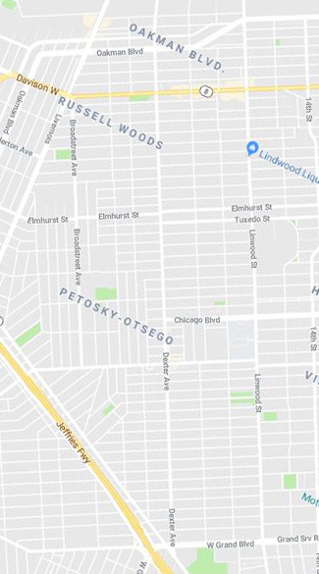
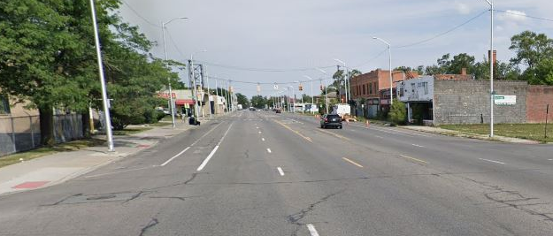
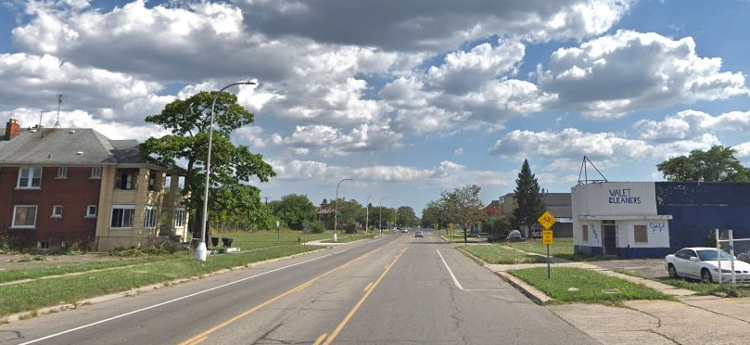
3
LANES
Dexter
Road
Lanes
DAVIDSON
5 LANES
DEXTER
5
LANES
CHICAGO
3
LANES
3 LANES

Slide 11
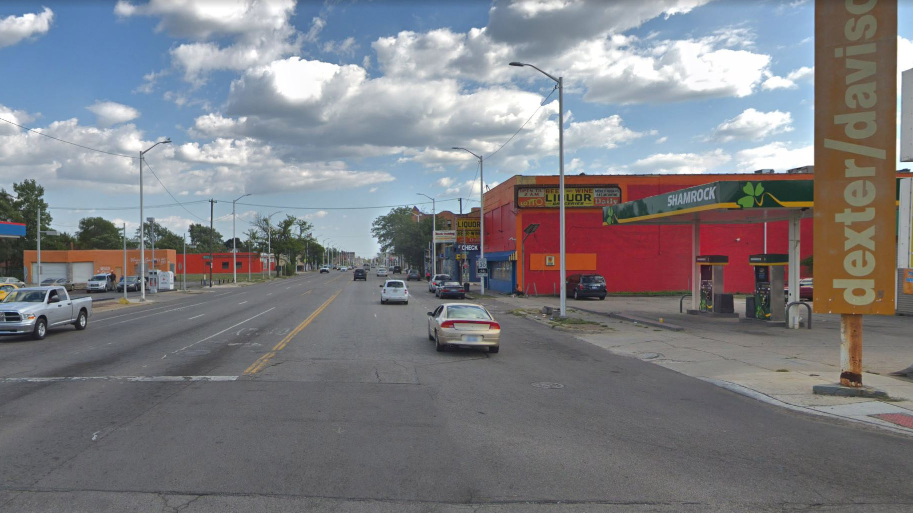
Road Capacity: Avg. Number of Cars per Day
Sept. 24-25, 2019: MIOVISION CAMERAS
Davison St. to Fullerton Ave.
Northbound 4,900 Cars
Southbound 5,600 Cars
TOTAL 10,500 Cars
Fullerton Ave. to Sturtevant St.
Northbound 5,400 Cars
Southbound 5,400 Cars
TOTAL 10,800 Cars
2039: ESTIMATED FUTURE
Davison St. to Fullerton Ave.
Northbound 5,300 Cars
Southbound 6,100 Cars
TOTAL 11,400 Cars
Fullerton Ave. to Sturtevant St.
Northbound 5,800 Cars
Southbound 5,800 Cars
TOTAL 11,600 Cars

Slide 12
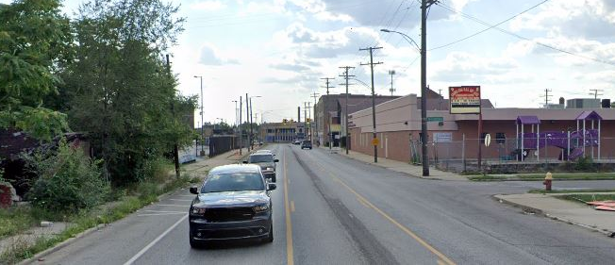
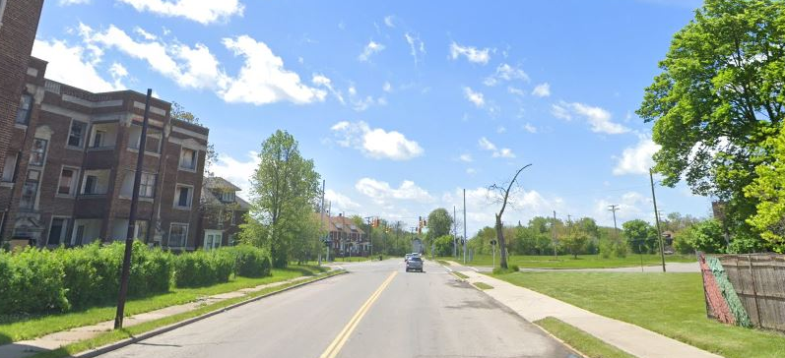
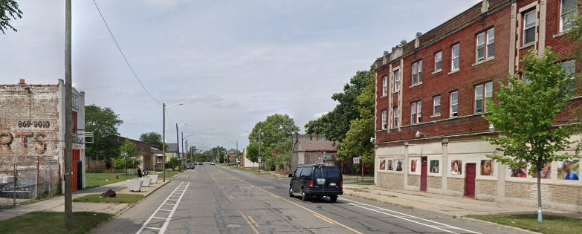
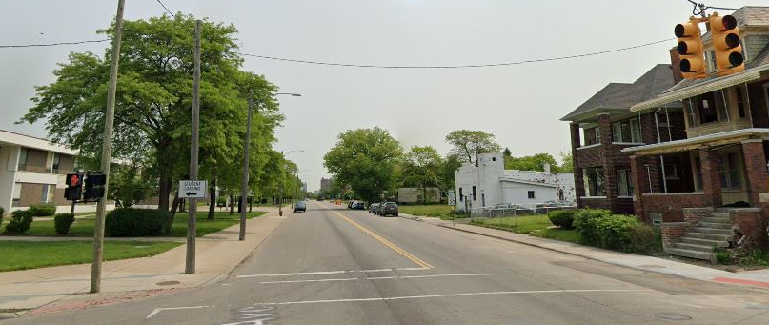
Similar Road Capacity: 1 Lane in Each Direction
Joy Rd:
11,400 Cars/Day
McGraw Ave:
11,200 Cars/Day
Linwood St:
8,200 Cars/Day
Tireman Ave:
6,300 Cars/Day

Slide 13
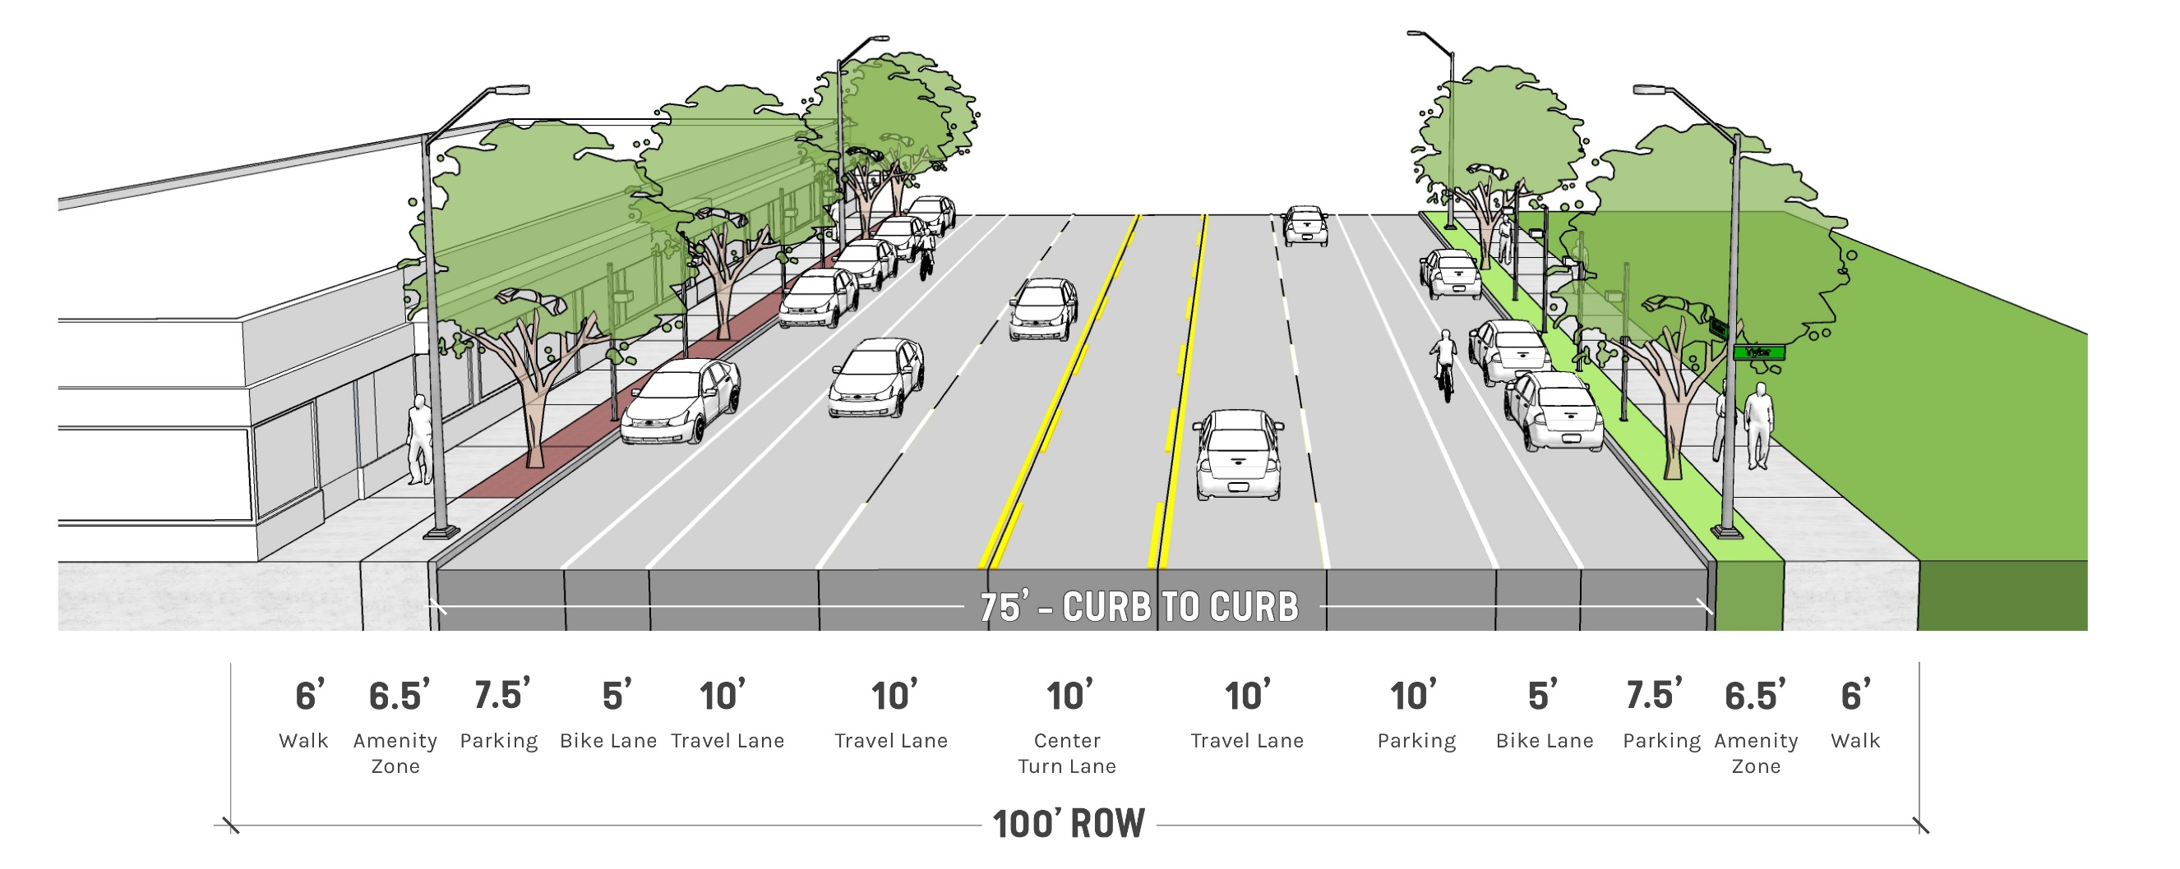
Existing Street
PROPOSED SECTIONS
Bike lanes not protected
Not reflective of neighborhood character
Streetscape not supportive of business corridor
Street wide & open
Encourages higher traffic speeds
Wide pedestrian crossings

Slide 14
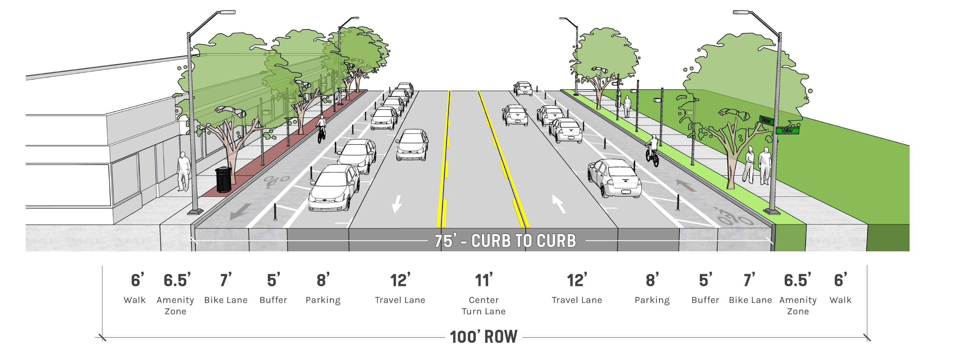
3 Lane Road Option with Protected Bike Lanes
Curb bump-outs at intersections
Traffic calming reducing vehicular speeds
Parking on both sides
Protected bike lanes

Slide 15
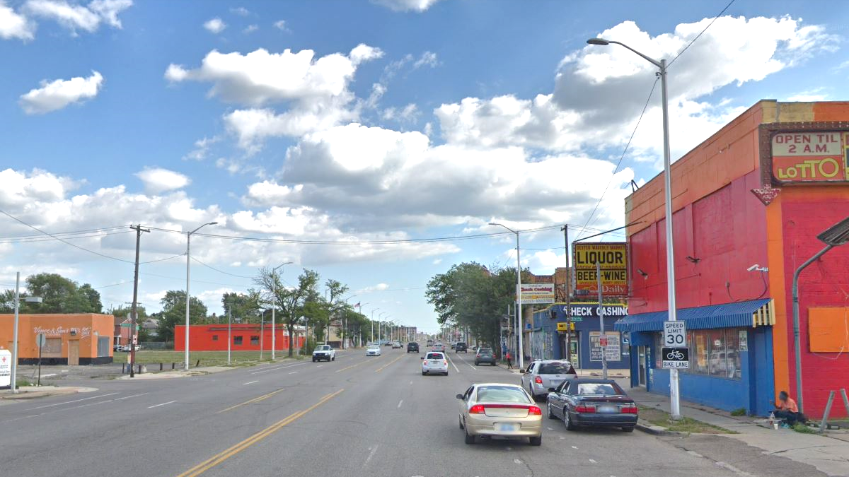
SPEED
Sept. 25-26, 2019
POSTED SPEED LIMIT
30
MPH
SOUTHBOUND CARS
NORTHBOUND CARS
85% SPEED 42.7 MPH
85% SPEED 37.4 MPH
40-45 MPH 938 Cars
40-45 MPH 422 Cars
45-65 MPH 295 Cars
45-65 MPH 98 Cars
>65 MPH 29 Cars
>65 MPH 1 Cars

Slide 16
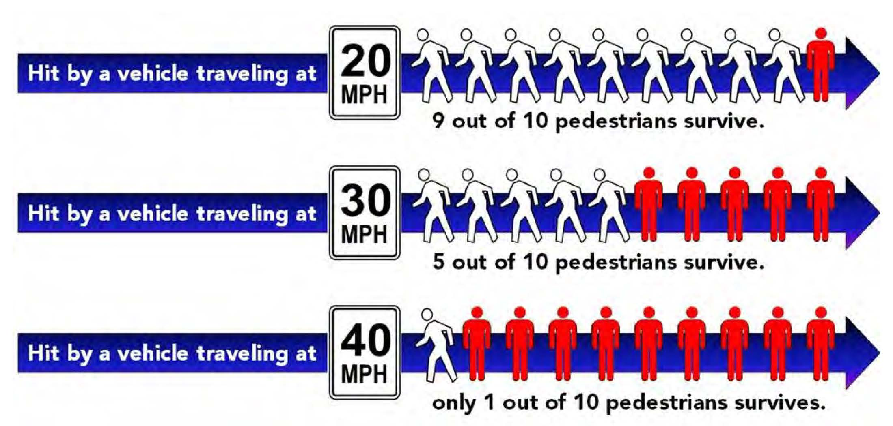
SAFETY

Slide 17



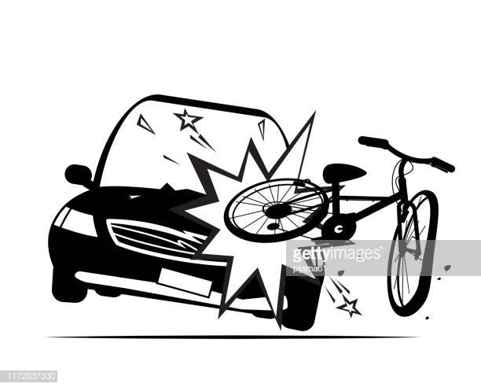
MTCF
(Michigan Traffic Crash Facts – Univ. of Mich.)
DETROIT CRASH STATISTICS
24,276
2018
520
CRASH DEATHS
101
183
TOTAL
24,979

Slide 18

MTCF
(Michigan Traffic Crash Facts – Univ. of Mich.)
DEXTER CRASH STATISTICS
Injury Crashes
132
2
19
4

Slide 19
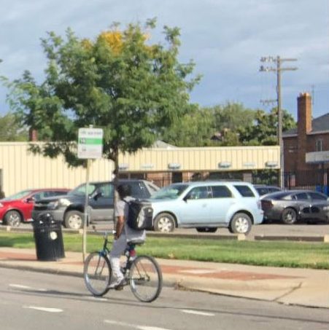
DEXTER BIKE COUNTS
Sept. 24, 2019
Bike
Riders on
Dexter
88
Bikes
(24 Hr. Period)

Slide 20
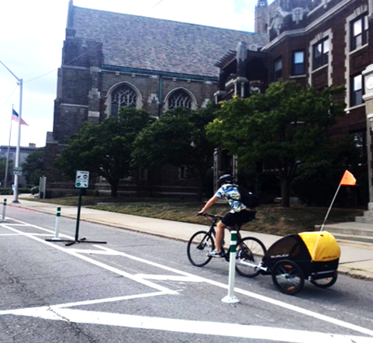
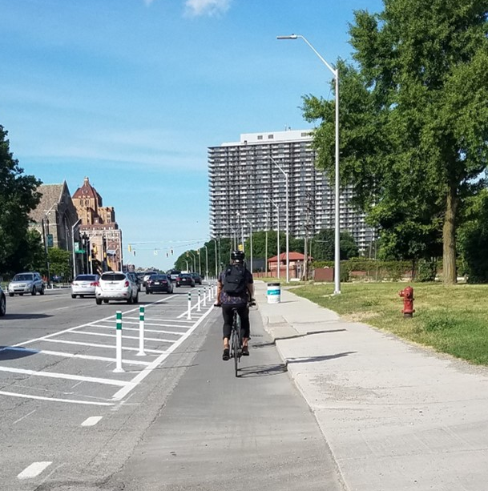
BIKE COUNTS – East Jefferson
AVG. DAILY RIDERSHIP
June 2018 160
July 2018 373
Weekdays: 340
Weekends: 449
Busiest Day: 721 (Sunday July 15)

Slide 21
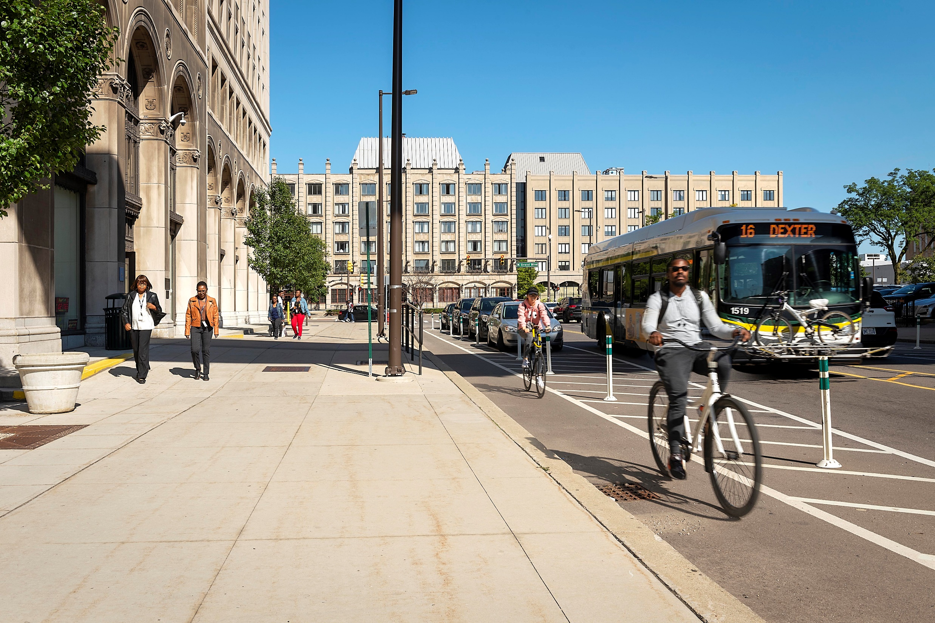
BIKE COUNTS – Cass Avenue
TUES. SEPT. 15, 2015
Cass at Alexandrine (Northbound) 196
Cass at Willis (Southbound) 190
24-Hour Period 386
TUES. June 11, 2019
Cass at Canfield (Northbound) 276
Cass at Canfield(Southbound) 288
24-Hour Period 564

Slide 22
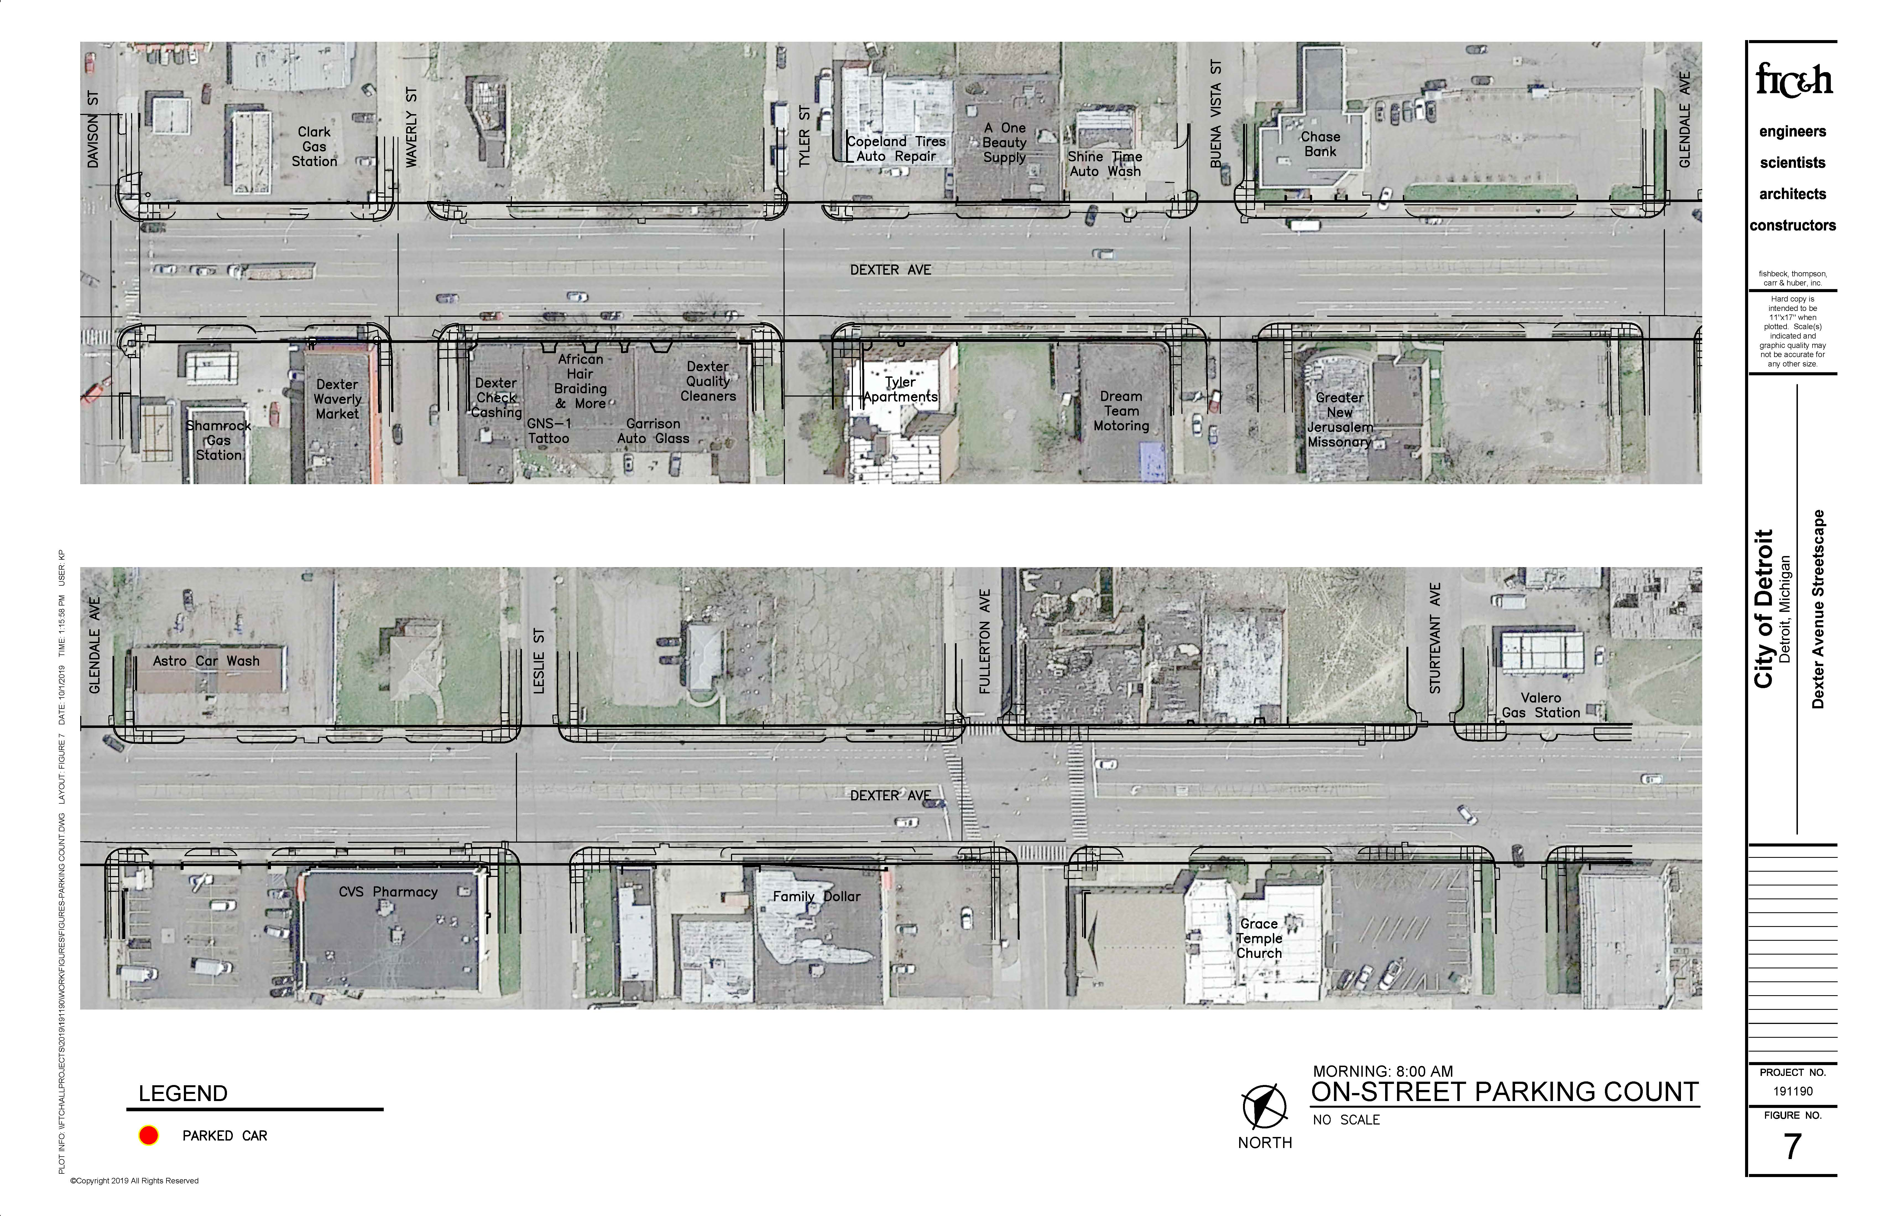
On-Street Parking: Sept. 25, 2019
8:00 AM 0 CARS
PARKED CAR

Slide 23
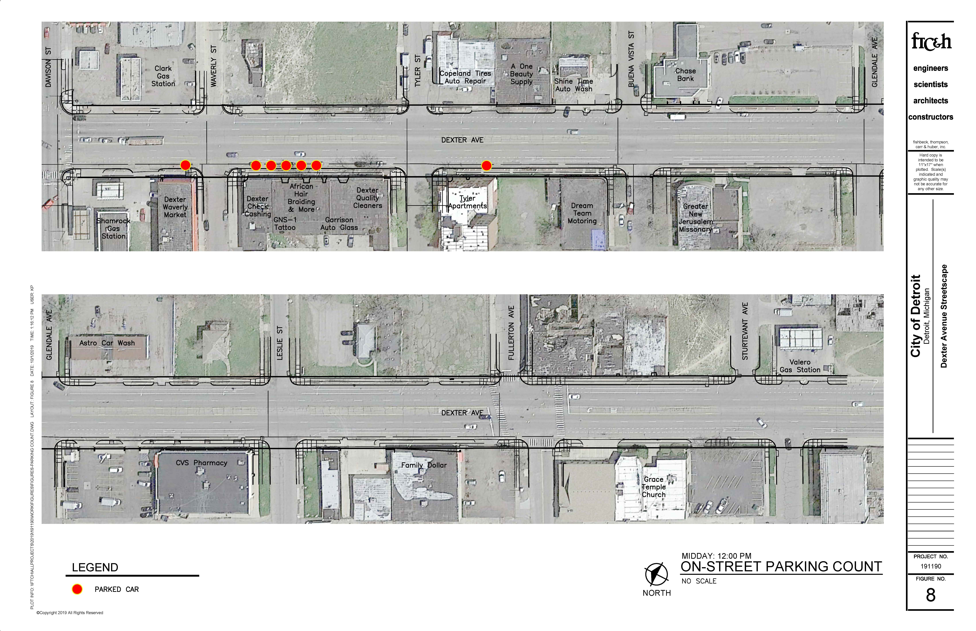
On-Street Parking: Sept. 25, 2019
12:00 NOON 7 CARS
PARKED CAR

Slide 24
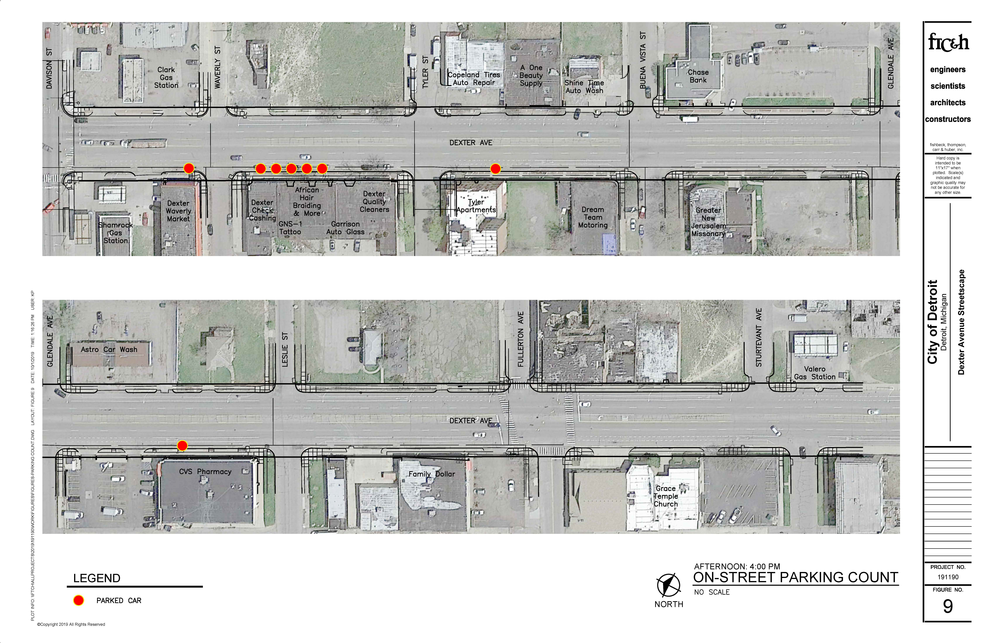
On-Street Parking: Sept. 25, 2019
4:00 PM 8 CARS
PARKED CAR

Slide 25
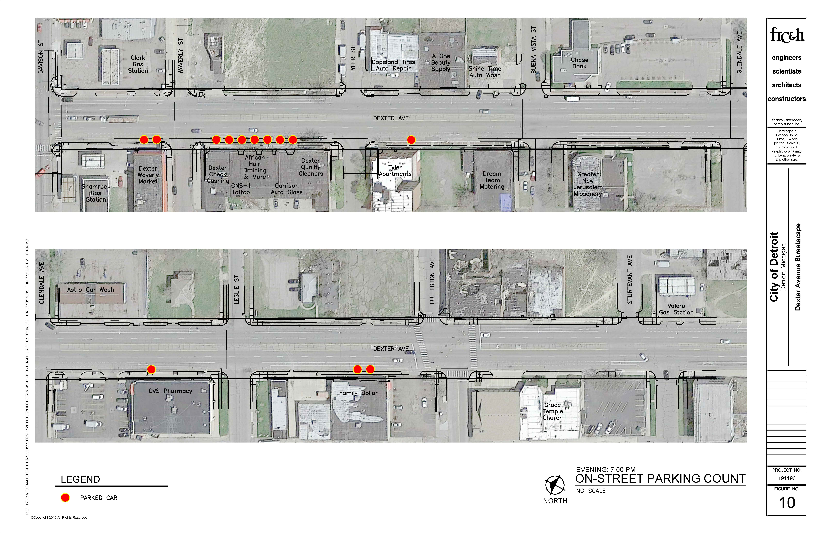
On-Street Parking: Sept. 25, 2019
7:00 PM 13 CARS
PARKED CAR

Slide 26
Cross Section Options

Slide 27
Existing Street
PROPOSED SECTIONS
Bike lanes not protected
Not reflective of neighborhood character
Streetscape not supportive of business corridor
Street wide & open
Encourages higher traffic speeds
Wide pedestrian crossings

Slide 28
3 Lane Road Option with Protected Bike Lanes
Curb bump-outs at intersections
Traffic calming reducing vehicular speeds
Parking on both sides
Protected bike lanes

Slide 29
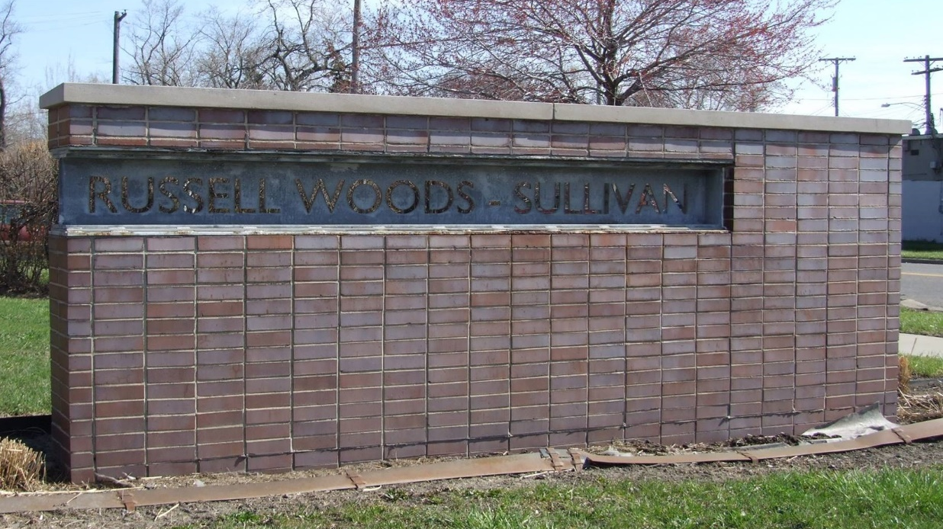
Gateways
Honoring historic district
Key neighborhood entrances
2 to 3 Locations: selected by the community
Conceptual designs for the gateways are being developed and community input will be sought at a future community meetings.

Slide 30
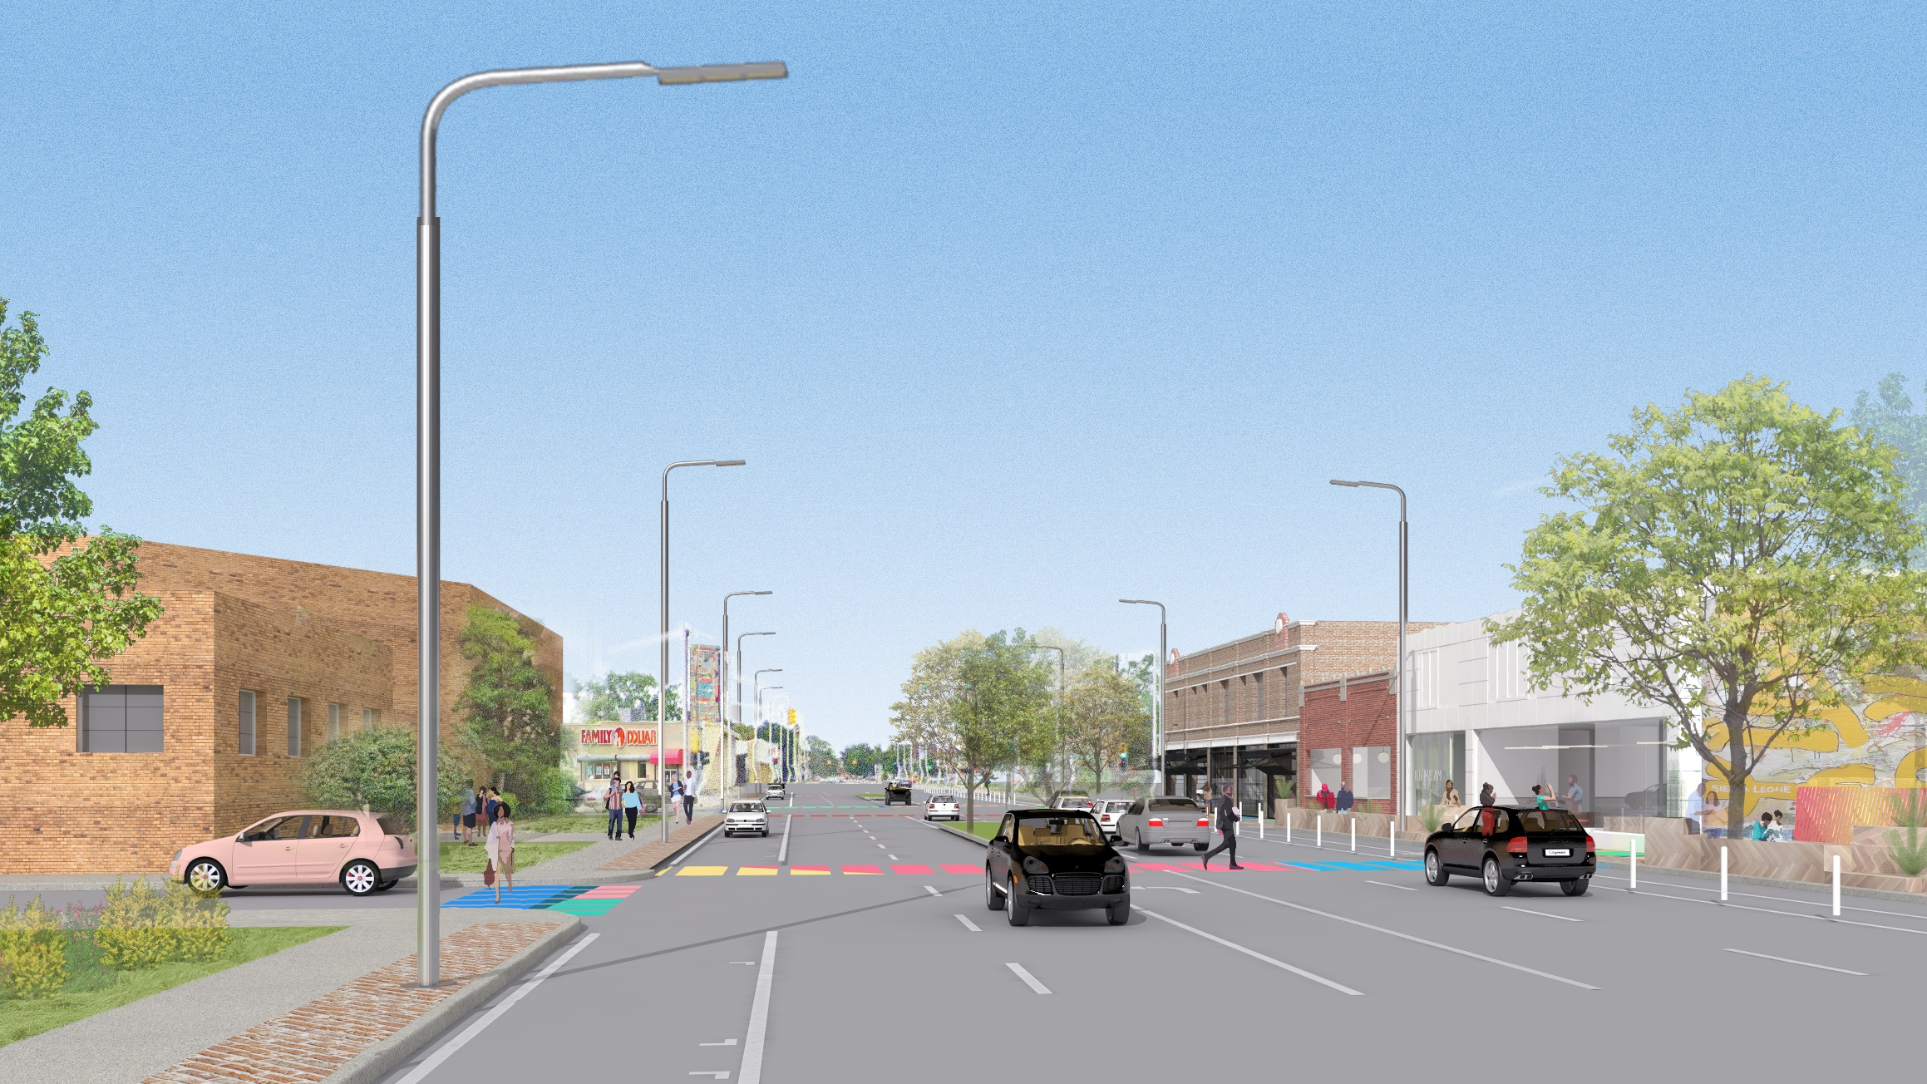
NEXT STEPS:
Continued Development of Streetscape Design
Gateway Design Concepts
Streetscape Enhancements and Amenities

Slide 31

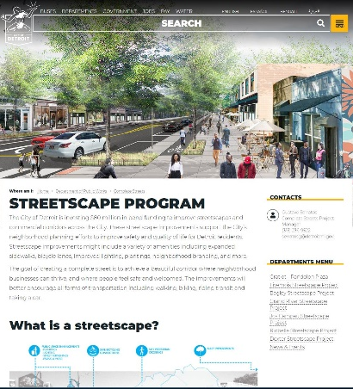

Stay Connected
Questions & Answers
Sign-In Sheet
Future Project Announcements
Visit the Website
www.detroitmi.gov/streetscapes
Gustavo Serratos
Complete Streets Project Manager
(313) 236 9522
serratosg@detroitmi.gov
THANK YOU!

Slide 32


OPEN HOUSE REVIEW
Select Preferred Street Section
Select Gateway Locations
THANK YOU!
Gustavo Serratos
Complete Streets Project Manager
(313) 236 9522
serratosg@detroitmi.gov

