Slide 1
Funding that’s making a difference.
Update to Detroit City Council, Budget, Finance & Audit Subcommittee
June 7, 2023
Notes:
To the chair, thank you for the opportunity to speak before you as well as any residents who may be listening from outside of the chamber

Slide 2
How Much Has Been Spent?
$826,675,290 TOTAL APPROPRIATED
APPROPRIATED Total funds issued to the City of Detroit from the $1.2 trillion American Rescue Plan Act (ARPA). City Council appropriated 15 uses for these funds in June 2021.
PROGRAMMED Total funds allocated to initiatives that have project plans and budgets, identified City-stakeholders, and clear outputs and outcomes
OBLIGATED Combined total of Council-approved contracts, subrecipient agreements and funds budgeted for personnel
SPENT Total funds expended - ex, vendor invoices, personnel costs, subrecipient payments, issued grants, etc.
Funds must be obligated by December 31, 2024; and spent by December 31, 2026.
Funds cannot be used directly for pensions, debts, settlements, judgments, or rainy-day funds.
Funds cannot be used for expenses incurred prior to March 3, 2021
As of June 6, 2023
$776,737,037 TOTAL PROGRAMMED
$347,614,545 TOTAL OBLIGATED
$95,370,302 TOTAL SPENT
For a breakdown on spending, visit the Spending Dashboard at detroitmi.gov
Notes:
I want to start by talking about our current spend and obligations first. I have included here the definitions on the right hand side but won't walk through those, but want to focus on where we are to date. Then I will give more specifics about internal targets and goals we are working on overall and this year specifically.
Read through the spend list
As a note, all remaining dollars ($49.9M) that you could read as not being programmed, do have a specified use via council appropriation and program design, but we don't classify them as programmed until they have undergone our project plan and budget compliance review process. The great majority of these programs are part of the reappropriated dollars that this body approved in April away from projects with slower spend and towards areas of greater need ($9M is capital contingency for cost overuns)

Slide 3
ARPA Obligation and Spend: Goals & Deadlines
Action | City Target | US Treasury Deadline
Obligate | $600M - December 2023 $826M - June 2024 | $826M - December 2024
Spend | $826M - June 2025 | $826M - December 2026
Notes:
As we all know, Treasury has set a deadline for full obligation by Dec 2024 and full spend by Dec 2026. We have a more pressing timeline because we don't want to come in under the buzzer. So every City department utilizing ARPA dollars knows that our expectation is to have all funds obligated by June of next year, and fully spent by June of the following year.
This is important both to accelerate the deployment strategy with teams but also gives us time after those deadlines to make critical decisions, namely of where to re-deploy or to consider a revenue replacement strategy at that time for the same program.

Slide 4
2023 ARPA Obligations & Targets
$621,553,357 | Cumulative Projected ARPA Obligations by December 2023
$347,614,545 | Total Obligated as 6/5/23
$97,056,991 | Total in OCP pipeline – Expected Obligation By Summer 2023 Recess*
$148,364,820 | Total in OCP pipeline – Expected obligation By Winter 2023 Recess*
*Includes PRFs and Pending Development Agreements
Notes:
Now to what we are doing this year

Slide 5
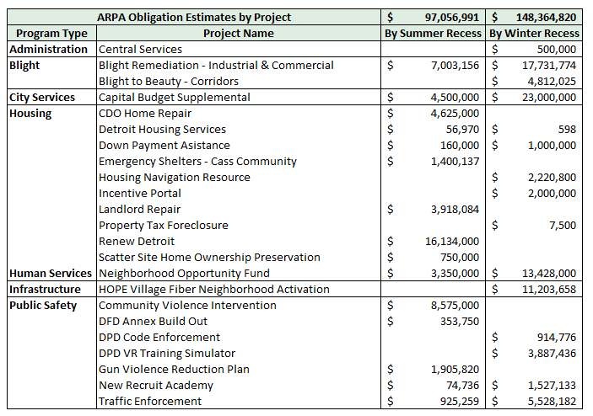
Current ARPA Obligation Projections (By Project)

Slide 6
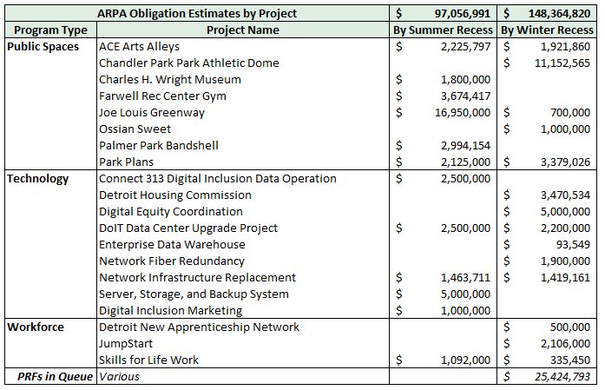
Current ARPA Obligation Projections (By Project) - cont'd

Slide 7
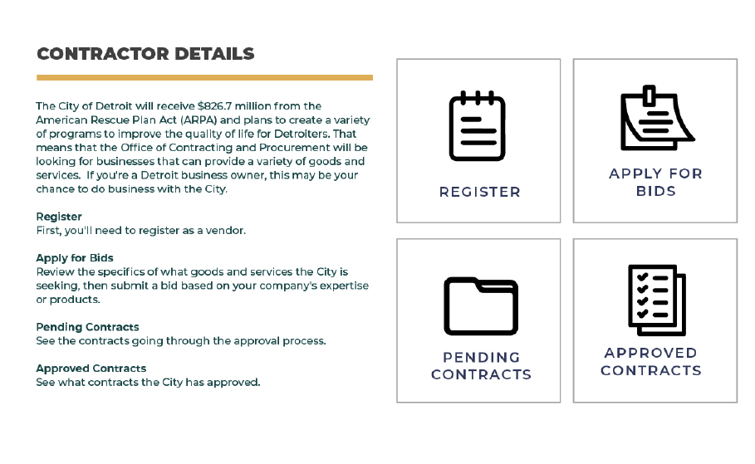
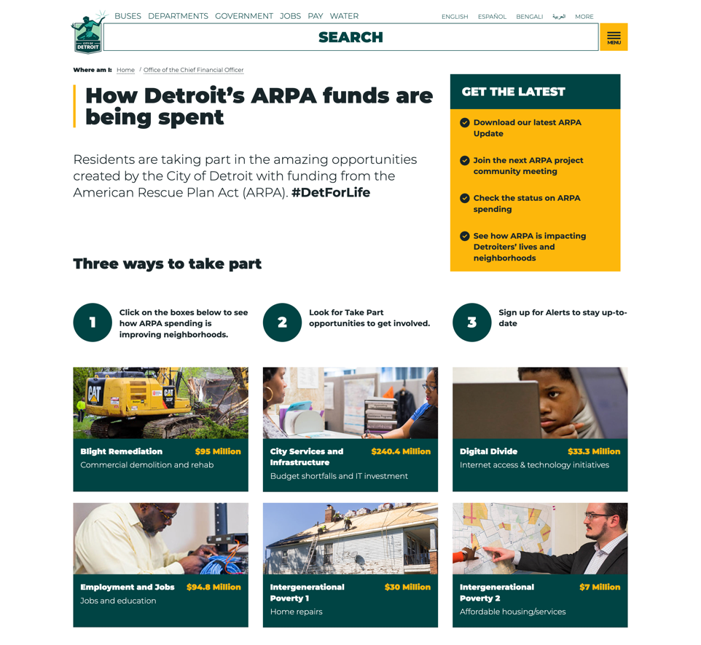
Access and Transparency
Learn more at detroitmi.gov/arpa
Send questions about ARPA to arpacommunity@detroitmi.gov.

Slide 8
Thank You
Q&A Time

